Slide 1
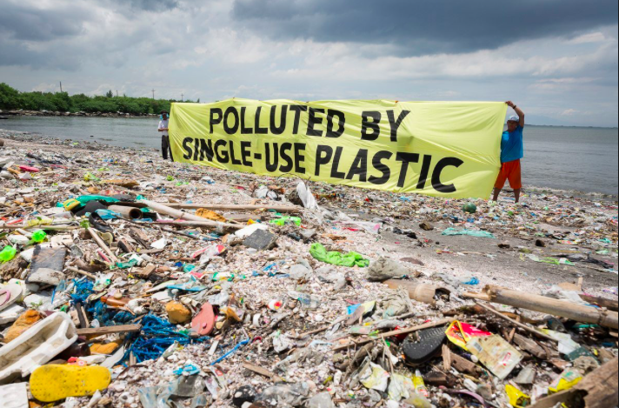
6.2 Environmental risks

Slide 3
Local environmental impacts of global flows
Bangladesh textiles
E-waste in Ghana
Apple- mining DRC
Machu Picchu
Maldives
New Zealand
China waste recycling
E-waste Ghana

Slide 4
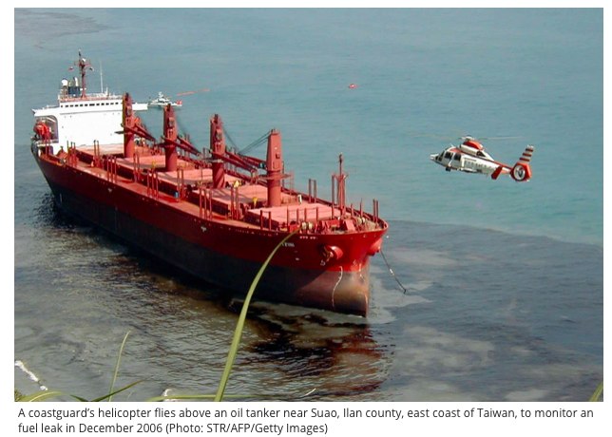
Shipping flows- why are container ships so bad for the environment?
https://www.youtube.com/watch?time_continue=798&v=u5JkRtMTEdI
It has been estimated that just one of these container ships, the length of around six football pitches, can produce the same amount of pollution as 50 million cars. The emissions from 15 of these mega-ships match those from all the cars in the world. And if the shipping industry were a country, it would be ranked between Germany and Japan as the sixth-largest contributor to global CO2 emissions.
- Shipping isn’t covered by the Paris Agreement on climate change because of the international nature of the industry.
_Today, most ships burn bunker fuel. Typically, it’s the dregs left over at the end of the refinery process.
-Provide invasive species with a means of international travel
Read more at: https://inews.co.uk/news/long-reads/cargo-container-shipping-carbon-pollution/

Slide 5
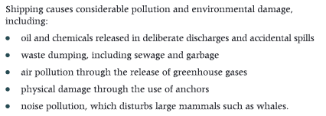
Civil society: Marine Issues in Shipping
http://wwf.panda.org/our_work/oceans/problems/shipping/
90% of the World’s trade is carried out by container ships

Slide 6
This photograph was taken in a remote wilderness area, 1000s of km from any major populated area.
Can you list or draw the chain of events that led to this bird’s death?

Slide 7
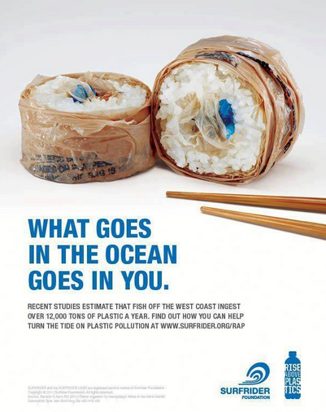
The plastics issue reduce/ reuse/ recycle

Slide 8
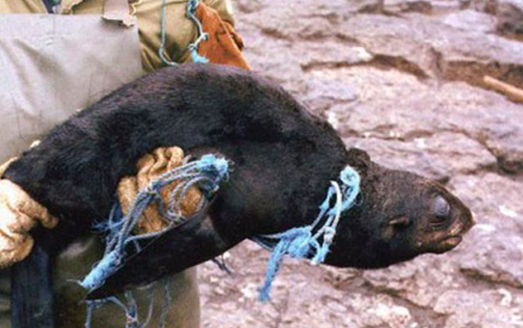
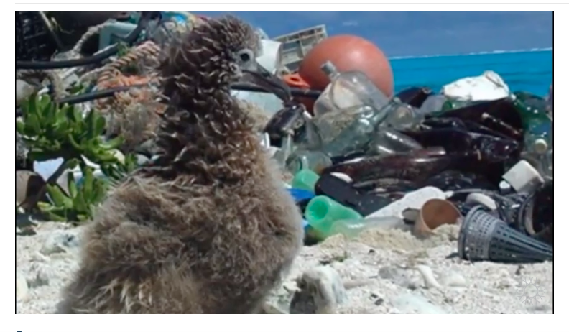
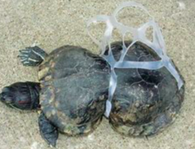
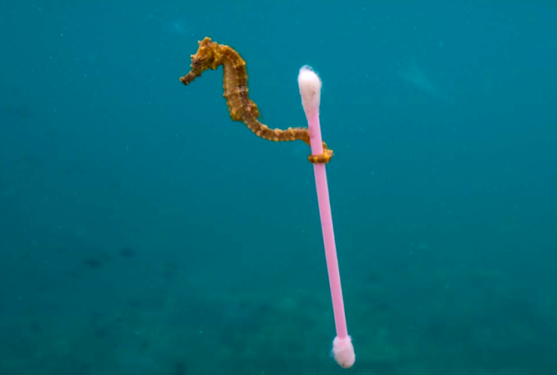
Watch:

Slide 9
Link to E waste in Ghana

Slide 10
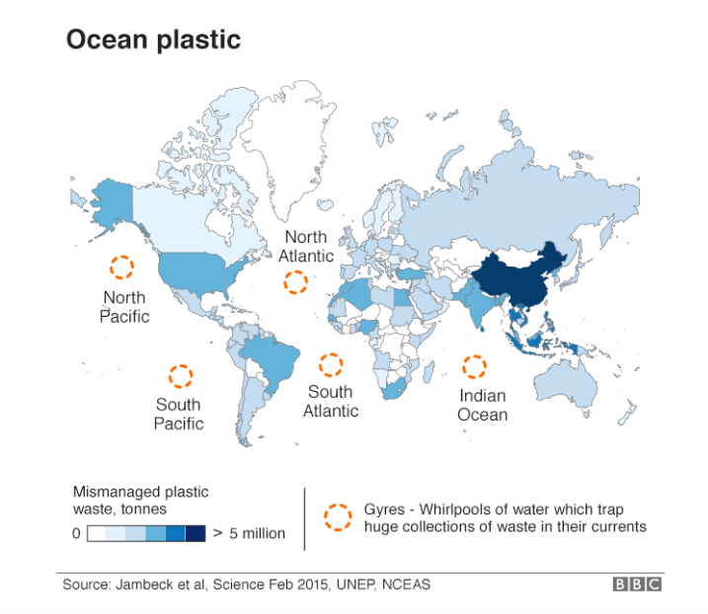

Slide 11
Plastic pollution
Plastic pollution is a problem that has truly ‘gone global’.
Fragments of plastics have been carried by planetary-scale ocean currents to the remotest corners of the world, including both Arctic and Antarctic wilderness areas.

Slide 12
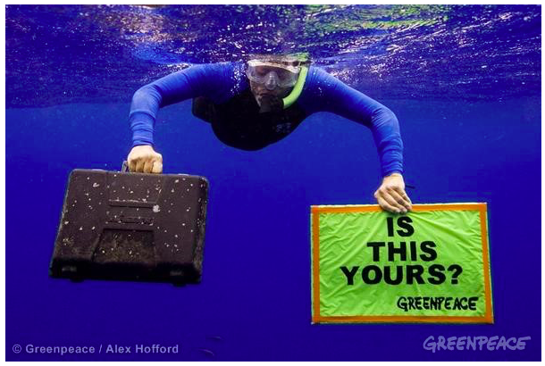
Trash vortex
The Trash Vortex
The trash vortex is an area the size of Texas in the North Pacific in which an estimated six kilos of plastic for every kilo of natural plankton, along with other slow degrading garbage, swirls slowly around like a clock, choked with dead fish, marine mammals, and birds who get snared. Some plastics in the gyre will not break down in the lifetimes of the grandchildren of the people who threw them away.
https://www.greenpeace.org/archive-international/en/campaigns/oceans/fit-for-the-future/pollution/trash-vortex/

Slide 13
Why is the world's biggest landfill in the Pacific Ocean?

Slide 15
Why has global plastic use increased?

Slide 16
Read: The plastic global challenge
_What are the causes of increased plastic?
_ Where is it impacting and why?
_What impacts?
_ What are the solutions to the issue?

Slide 17
Additional reading: What is the issue with Plastic?
https://www.youtube.com/watch?v=bQCReet5oyA
Seven charts that explain the plastic pollution problem
A million bottles a minute: world's plastic binge 'as dangerous as climate change'
How plastic pollution is hurting the Gulf of Mexico
Coca-Cola increased its production of plastic bottles by a billion last year, says Greenpeace

Slide 18
Maldives: Trashing an Island
Link to:
Environmental impacts of tourism
Global shift in industry
Local impacts of global flows
Thilafushi, the trash island of Maldives, collects trash from many residential islands in Kaafu Atoll and resorts across the country. Trash is sorted and materials such as plastic and metal are recycled, house-hold waste is mostly incinerated. Construction waste is dumped to the sea to extend the land area.

Slide 19
Managing global risks and wicked problems
Read the embedded sheet on the Weebly: Taking action to tackle plastic pollution in the oceans

Slide 20
Building local and global resilience
Read: The embedded sheet on the Weebly about the WWF

Slide 21
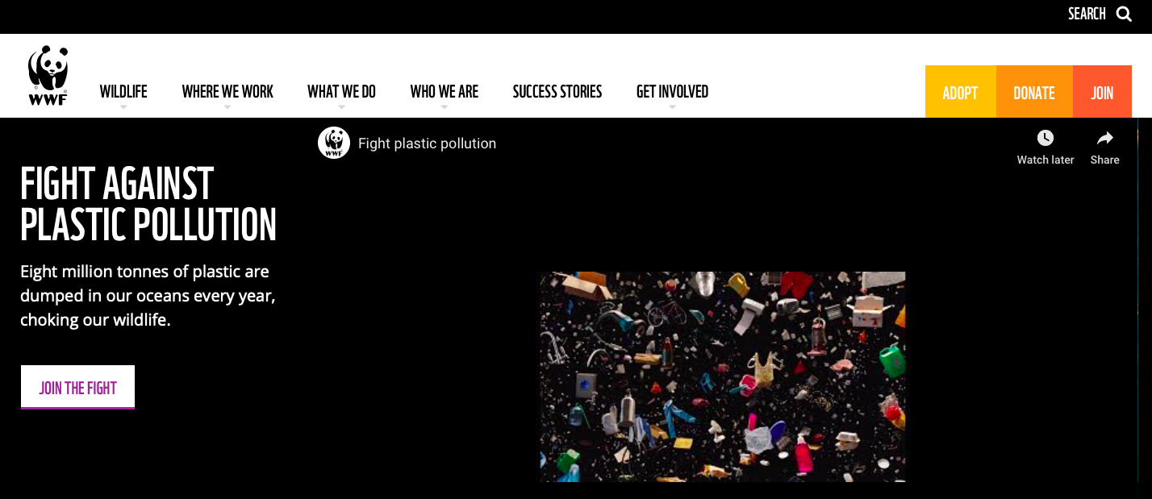
What are the solutions? Civil society action- WWF
https://www.wwf.org.uk/fight-plastic-pollution

Slide 22
How are the WWF encouraging people to reduce plastic pollution?

Slide 23
Links to circular economy
http://oohowater.com
It’s a spherical packaging made of seaweed, entirely natural and biodegradable. Our goal is to create a waste-free alternative to plastic bottles and cups.
https://www.youtube.com/watch?v=VpXvIuQEbJM

Slide 24
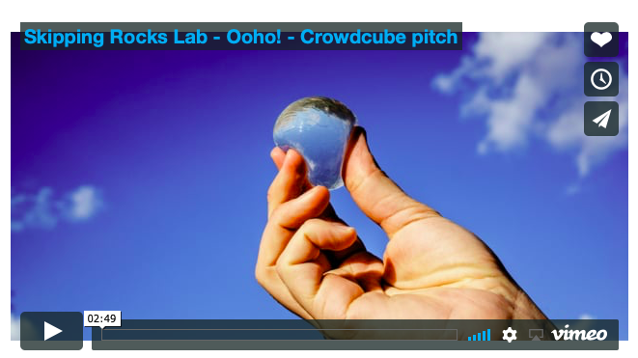
Crowdfunding the Ooho
https://phys.org/news/2017-04-crowdfunding-consumable-spherical-bottlethe-ooho.html
https://startacus.net/culture/edible-water-bottle-ooho-receives-a-flood-of-crowdfunding-support#.XDUTYafMw6g
- How does the Ooho bottle work?
How could this help with the plastics problem?
How did the Ooho team attact investors through their crowdfunding?

Slide 25
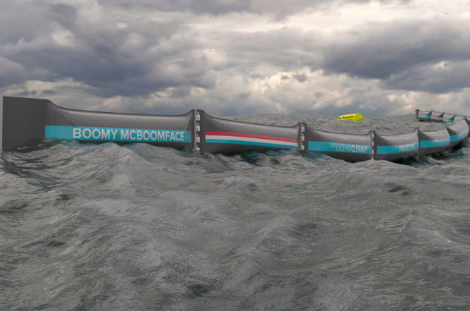
Crowdfunding: Boomy McBoomface
https://www.youtube.com/watch?time_continue=1&v=_vRU51BeprM
Read: Can Boomy McBoomface save the oceans?

Slide 26
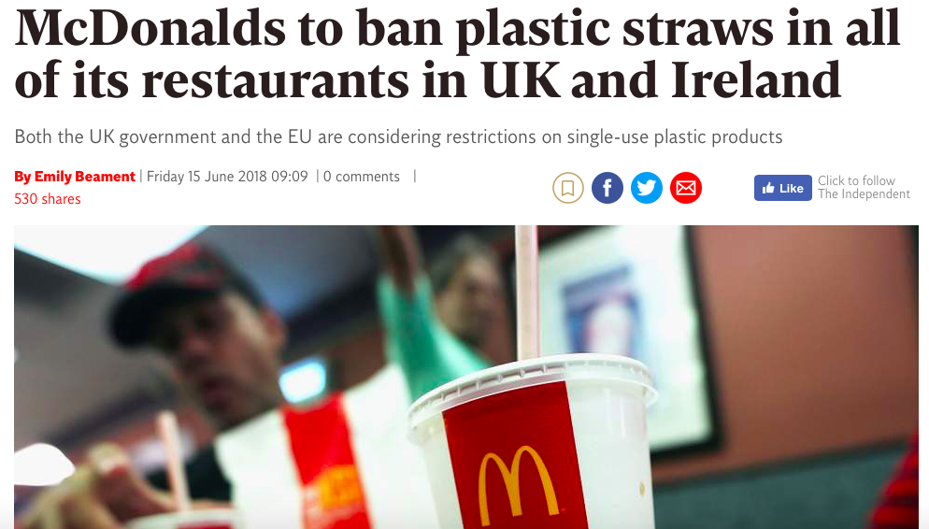
Corporate social responsibility
https://www.independent.co.uk/news/business/news/mcdonalds-plastic-straws-ban-uk-ireland-pollution-environment-eu-rules-a8399841.html
https://www.bbc.com/news/world-us-canada-44774762

Slide 27
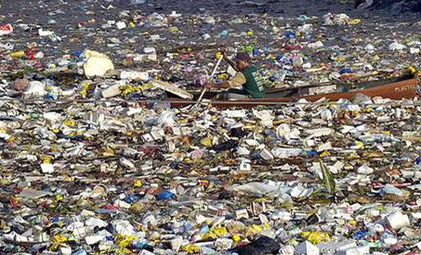
Government actions- Rwanda: complete ban on plastic bags
https://www.youtube.com/watch?v=58aBoXJARNQ
https://www.theguardian.com/commentisfree/2014/feb/15/rwanda-banned-plastic-bags-so-can-we

Slide 28
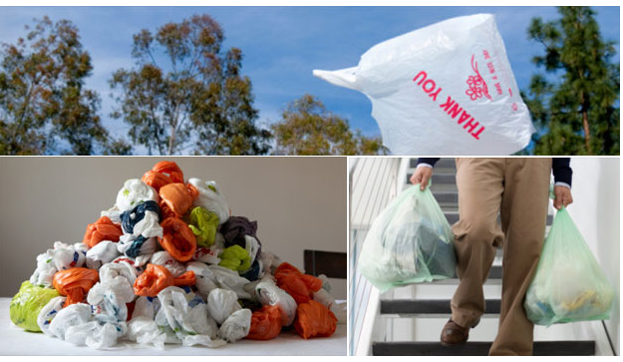
Different levels of control for plastic bags
http://www.bbc.com/news/magazine-17027990
Make notes on each of the three schemes highlighted: 1. Complete Ban (reduce) 2. Bag Tax (reduce) 3. Long Life Bags - Pay particular attention to the interactive comparison section. (reuse)

Slide 29
Examine how different kinds of global interactions can affect the physical environment. (16 marks)

