Slide 3
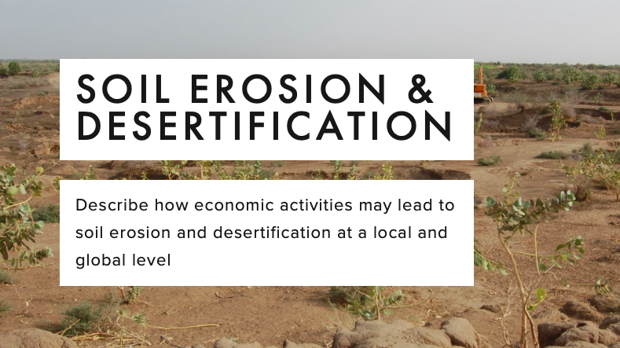
Environmental risks of economic development

Slide 4
SOIL DEGRADATION
Soil degradation is the decline in quantity and quality of soil.

Slide 5
What is desertification?
"Desertification" is the process whereby productive land becomes so seriously eroded that any remaining soil loses nutrients essential to plant growth.

Slide 6
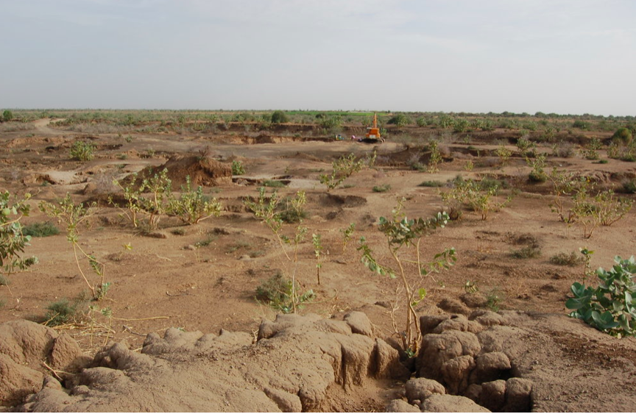
What are the causes?
https://www.youtube.com/watch?v=w9RxnuBiFbg&t=1s

Slide 7
What are the main causes? Human
Overgrazing: Allowing too much livestock to graze on a piece of land which means all the vegetation is eaten making the ground susceptible to wind and water erosion. (Lesotho starves in rich SA's shadow - BBC article)
Overcultivation: If you farm land to intensively and don't have fallow (periods of not growing anything) periods then all the nutrients in the soil get used.
Deforestation: Cutting down trees which not only means the land will be receiving less nutrients, but it also means it is more vulnerable to erosion because there is no interception and less stability because the root systems have been removed.
Overpopulation: As the world population continues to grow (now nearly 7 billion) the demand for agricultural products (crops and meat) is increasing causing more land to be deforested, overcultivated and overgrazed.
Fertiliser and Pesticide Use: By using fertilisers and pesticides you can artificially increase yields of crops. However, the process is unnatural and prolonged periods of use can all naturally produced nutrients to be used and local water sources to become polluted reducing the ability of land to cultivate crops and therefore making it vulnerable to chemical degradation as well as wind and water erosion.
HYV and GM Crops: Like with fertilisers and pesticides, it is argued that HYV and GM crops have encouraged overcultivation, diminishing natural nutrients in the soil.
Industrial Pollution: Chemicals, metals and other pollutants leaked from industrial processes can chemical degrade soil making it useless or dangerous for farming. Acid rain caused by pollution can also cause soil degradation.
Unsustainable Water Use (aquifer depletion, unsustainable irrigation): If aquifers or rivers are used unsustainably then areas can become increasingly arid as water resources are used up. A classic example of unsustainable irrigation happened in the Aral Sea (Irrigation and agriculture).
Toyotarisation: This is basically the increased use of 4x4s to travel across grasslands, deserts, etc. damaging topsoil and increasing wind and water erosion.
Conflict: During times of war biological and chemical weapons can be used which degrade the quality of the soil. During the Vietnam war large quantities of agent orange were used to defoliate forests. Much of the land in Vietnam is still degraded because of this 40 years on.

Slide 8
What are the main causes? Physical
Rising Temperatures: As global temperatures increase it is becoming increasingly hard for vegetation to grow thus reducing vegetation cover and increasing the risk of wind and water erosion.
Falling Rainfall: As the amount of rainfall reduces in some areas like the Sahel, then it is increasingly hard for vegetation to grow again making the ground more vulnerable to wind and water erosion.
Flash floods: Intense periods of rainfall can also cause erosion of topsoil which leads to land degradation.
Wind: If a region is particularly windy then the amount of wind erosion is likely to increase.
Topography: If land is relatively flat then it is much less vulnerable to water erosion, but maybe vulnerable to wind erosion. Alternatively hilly land is vulnerable to water erosion, but maybe protected more from wind erosion.

Slide 10
Pollution

Slide 11
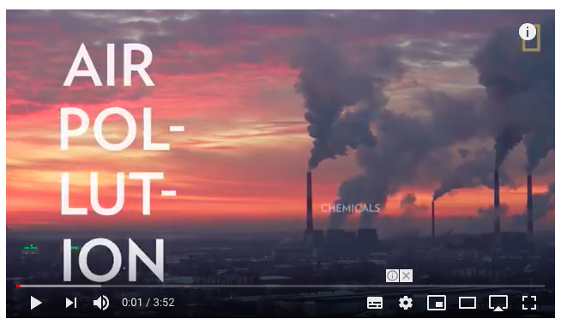
AIR pollution
Air pollution is the contamination of air by smoke and harmful gases, mainly oxides of carbon, sulfur, and nitrogen. Some examples of air pollution include:
Exhaust fumes from vehicles
The burning of fossil fuels, such as coal, oil, or gas
Harmful off-gasing from things such as paint, plastic production, and so on
Radiation spills or nuclear accidents

Slide 12
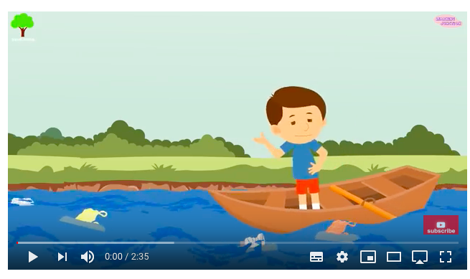
WATER pollution
Water pollution is the contamination of any body of water (lakes, groundwater, oceans, etc). Some examples of water pollution: Raw sewage running into lake or streams
Industrial waste spills contaminating groundwater
Radiation spills or nuclear accidents
Illegal dumping of substances or items within bodies of water
Biological contamination, such as bacteria growth
Farm runoff into nearby bodies of water

Slide 13
Water pollution example: Textiles in Banglaesh

Slide 14
Water pollution in Bangladesh
https://www.nytimes.com/2013/07/15/world/asia/bangladesh-pollution-told-in-colors-and-smells.html
Bangladesh’s garment and textile industries have contributed heavily to what experts describe as a water pollution disaster, especially in the large industrial areas of Dhaka, the capital. Many rice paddies are now inundated with toxic wastewater. Fish stocks are dying. And many smaller waterways are being filled with sand and garbage, as developers sell off plots for factories or housing.
Some factories treat their wastewater, but many do not have treatment plants or chose not to operate them to save on utility costs.
Task: Use the interactive ‘water pollution in Bangladesh’ and make notes on the causes and issues of water pollution

Slide 15
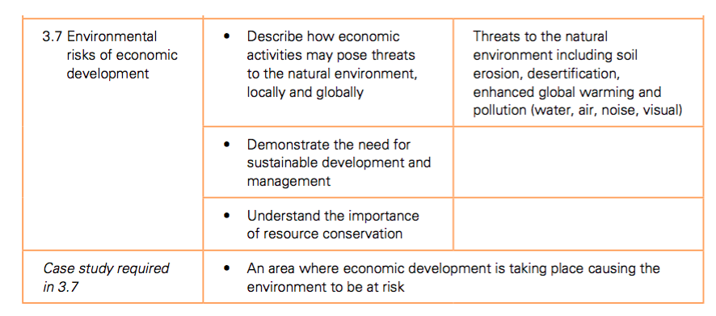
PROJECT WORK: Environmental risks of Economic development
In groups of 2-3 create a revision resource to explain the link between human activity and environmental damage.
Success criteria:
Based on one of the following case studies: Tourism in Kenya, the threat to the Great Barrier reef , textile manufacturing in Bangladesh or Deforestation in the Amazon
Explain the economic activity
Explain the threats to the local environment (soil erosion, air pollution, water pollution etc…)
Include specific case study detail (place names, figures etc)
What is being done to manage the risk?

Slide 16
7 mark questions
Name an area which you have studied and state an economic activity which is causing the environment to be at risk and explain the risks it is causing
For an example of an economic activity in a named area you have studied, describe how the threats to the natural environment are being managed.
Name an area which you have studied and state an economic activity which is causing the environment to be at risk. Explain how it is being managed so that it is more sustainable.

