Slide 1
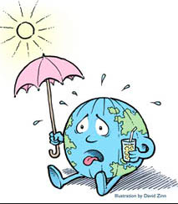
The Enhanced Greenhouse effect
​LO: The enhanced greenhouse effect and international variations in greenhouse gas sources and emissions, in relation to economic development, globalization and trade.

Slide 3
The enhanced greenhouse effect
Watch the video. Draw an annotated diagram which explains the Enhanced Greenhouse Effect

Slide 4
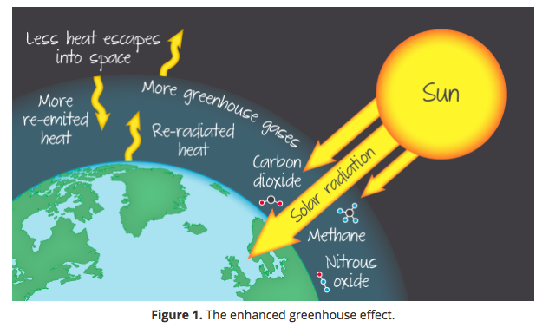
The enhanced greenhouse effect
The enhanced greenhouse effect is simply the natural greenhouse effect out of balance. Human activity has increased the proportion of GHGs in the atmosphere and (over the short-term) there is no longer a balance between the incoming and outgoing energy (Figure 1). The additional GHGs trap extra heat in the atmosphere, causing temperatures to rise.

Slide 5
Key question: Discuss in small groups
”What is causing the increase in GHGs?'

Slide 6
The greenhouse gases:
Water vapor, carbon dioxide nitrous oxide, methane , tropospheric ozone, CFCs
Kognity has more detail about each of these gases and the factors that may increase them.

Slide 9
Enquiry question: What are the international variations in Greenhouse Gases and emissions?
​Enquiry question: What are the international variations in Greenhouse Gases and emissions? Read the information on kognity and complete all of the tasks on the weebly. Use your notes and conclusions to create an analysis that describes and explains international variations in greenhouse gas sources and emissions based on variations in emissions, emissions per capita and the link between emissions and globalization and trade . Success criteria: Use the 4P's approach to structure your response: 1. Place - What are the global patterns of greenhouse emissions? How are these linked to economic development? What are the similarities and differences between cumulative emissions, annual emissions and emissions per capita? 2. Processes - What are the sources of these emissions? Do the emissions just affect the emitting countries or are there processes in place that disperse the problem? How do atmospheric processes mean that emissions are an international concern? How are the emissions connected to processes of globalisation and trade? 3. Possibility - What steps could be taken to reduce emissions? How will this need to be connected to trade and globalization? What are the targets (SDG's) to reduce emissions and reduce impacts on MIC's & LIC's. ​4. Power - Who will be the key decision makers in the future patterns of emissions? Think about national and international politics, the SDGs as well as big business and ground roots environmental activists as well as those governments who are promoting economic growth through industrialisation and processes of globalization. Your analysis can take any form that you judge to be appropriate: a written analysis, slide show, infographic or video could all work. You must include place specific data and graphics.

Slide 10
Variations in emissions

Slide 11
Describe and explain the pattern shown in this graph (3+3)
Which country has seen the biggest increase in CO2 since 1970?
Comment on US Co2 emissions since 1970.
How many billion tonnes of Co2 is Asia Pacific producing in 2015?

Slide 12
Emissions and globalisation and trade
A country’s carbon emissions are generally measured as the emissions that occur within its border. This is sometimes referred to as “territorial-based” emissions. This method takes no account of emissions which may be imported or exported in the form of traded goods. “Consumption-based” accounting adjusts CO2 emissions for this trade of emissions and more accurately reflects the emissions necessary to support a given country’s way of living.
https://www.youtube.com/watch?time_continue=53&v=XZX3QhmPj8I https://www.youtube.com/watch?time_continue=53&v=XZX3QhmPj8I

Slide 15
Assessment: 10 mark exam questions
Example essay 1:
‘The causes of climate change are mainly natural in origin.’ To what extent do you agree with this statement? (10 marks)

Slide 16
‘The causes of climate change are mainly natural in origin.’ To what extent do you agree with this statement? (10 marks)
For each of the statements to the left decide if the support or challenge the statement.
Tick the support or challenge box and use your notes to write a detailed summary of why you have made your choice.

Slide 17
Assessment: 10 mark exam questions
Example essay 2:
‘Population growth is the main reason why climate change is unavoidable in the 21st century.’ To what extent do you agree with this statement? (10 marks)

Slide 18
‘Population growth is the main reason why climate change is unavoidable in the 21st century.’ To what extent do you agree with this statement? (10 marks)
To the left are a range of general points which could be used to answer the above essay.
Make a judgement of how important these points are to answer the question.
Arrange the in order of importance along a spectrum.
Having done the write a brief justification of your placements, explaining why some factors are more important than others.

