Slide 1
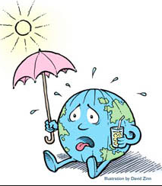
The Enhanced Greenhouse effect
​Why: To understand how humans are having adding greenhouse gases to enhance the greenhouse effect
How: To explain the difference between the greenhouse effect and the enhanced greenhouse effect

Slide 2
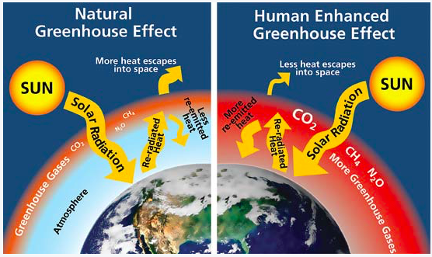
Spot the difference
What is the difference between these diagrams?

Slide 3
The difference between the greenhouse effect and the enhanced greenhouse effect
The greenhouse effect refers to the retention of heat in the atmosphere by greenhouse gases, including water vapor, carbon dioxide, methane and nitrous oxide. These gases create the natural greenhouse layer and naturally warm the planet to make it the right temperature to support life
The Human enhanced greenhouse effect Due to increasing levels of greenhouse gases in the atmosphere, partially as a result of human industrial activity, there is a thickening of the greenhouse layer and progressively more heat is being trapped. This results in a phenomenon commonly referred to as global warming.

Slide 4
Carbon dioxide is a naturally occurring greenhouse gas. But changes in human activity since the industrial revolution have increased the amount of carbon in our atmosphere= enhanced greenhouse effect

Slide 6
Global Warming What’s the Evidence?
Increasing growth of human population.
Higher demands of energy and fuel combustion.
More land becoming desert and barren.
Increasing growth of human population.
Increased rates of deforestation./Increased areas of land used for agriculture.
Increased level of greenhouse gas emissions from human activity.
Increased rates of deforestation.
The average temperature is increasing.
The area of snow cover on higher land is decreasing./The size of the glaciers is decreasing.
The sea levels are rising/shore lines are receding.
Increasing growth of human population.
Increased level of greenhouse gas emissions from human activity.
The humidity of the atmosphere is increasing.
Stronger hurricanes and cyclones./Spring is occurring earlier in the year.

Slide 7
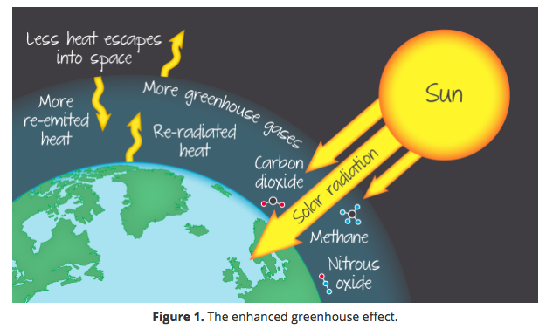
The enhanced greenhouse effect
The enhanced greenhouse effect is simply the natural greenhouse effect out of balance. Human activity has increased the proportion of GHGs in the atmosphere and (over the short-term) there is no longer a balance between the incoming and outgoing energy (Figure 1). The additional GHGs trap extra heat in the atmosphere, causing temperatures to rise.

Slide 8
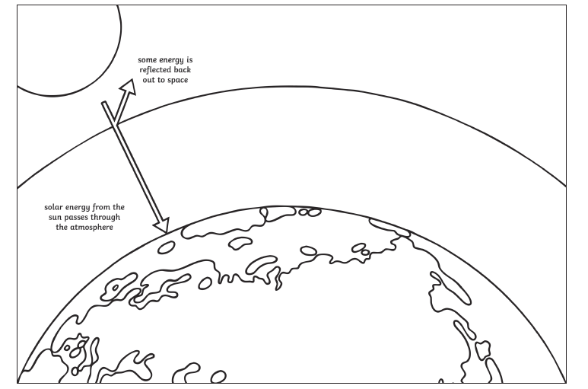
The enhanced greenhouse effect
Watch the video on the weebly. Draw an annotated diagram which explains the Enhanced Greenhouse Effect- you could use the outline below as a starting point

