Slide 1
​Subject Guide ​An overview of global patterns and trends in the availability and consumption of energy, including the relative and changing importance of hydrocarbons, nuclear power, renewables, new sources of modern energy.

Slide 2
Examine the changing importance of three energy alternatives to oil [10 Marks].

Slide 3
PATTERNS & TRENDS IN ENERGY - CHANGING IMPORTANCE OF HYDROCARBONS... ​
https://www.labs.timogrossenbacher.ch/worldoil/

Slide 4
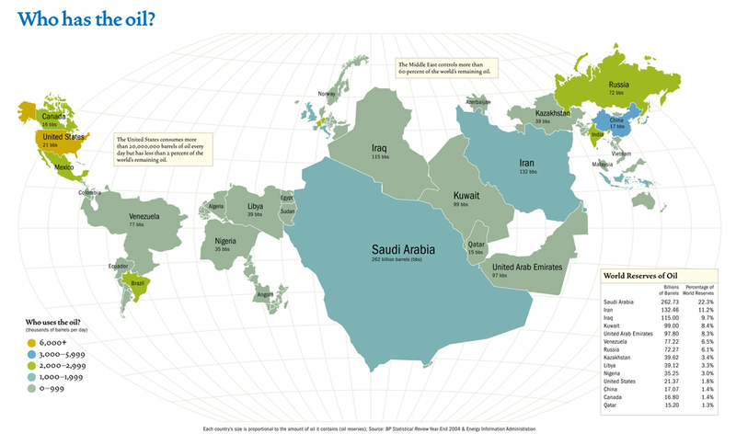

Slide 5
Using the resources on the previous 2 slides answer the question:
How has this changed?
Why has this changed?
Use p 479 of the core textbook to add detail to your answers- are there anymore recent examples you could add to the ones explained in the book

Slide 6
Key terms
Energy surplus: A country that has more than enough energy for its needs (e.g. Russia)
Energy deficit: A country that does not have enough energy reserves to meet its needs (e.g. USA)
Energy security: access to reliable and affordable sources of energy. Areas with a surplus are said to be energy secure, areas with a deficit suffer energy insecurity.
Geopolitics: The study in the ways in which political decisions and processes affect the way space and resources are used. It is the relationship between geography, economics and politics.

Slide 7
Key term: Peak oil
Peak oil refers to the hypothetical point at which global crude oil production will hit its maximum rate, after which production will start to decline.

Slide 9
Peak oil
Make notes from the videos on the weebly... ​i. How Much Oil Is Left on Earth? - Where does our oil come from now? ii. Oil Production Has Peaked - How have the patterns and trends of global oil consumption changed in recent years? **3.00 - Make a sketch of the Hubbert's Peak graph on your sheet and annotate with data from the video** "The better you do the job of exploiting oil and gas, the sooner that it is gone" Task 2 - 2017 Update - Watch the last video on the recent Trump ordered shrinking of two National Parks possibly with the view to drill for oil in these once protected areas.

Slide 11
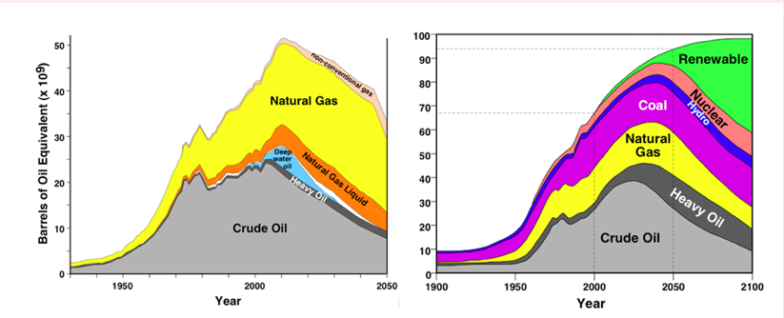
Synthesis: Optimism or Pessimism?
Study the two graphs below, which show both an optimistic outlook and a pessimistic outlook on future energy production.
Identify the key differences in the graphs
Discuss why you think these contrasting views exist?
Discuss the relative importance of hydrocarbon, nuclear and renewables.

Slide 12
Study the data in the table below and suggest reasons for the differences between the top 10 producers and top 10 consumers

Slide 13
Energy security in USA and Iceland
Make notes from kognity 3.2.6 Energy security

Slide 14
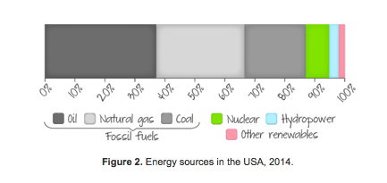
Using the sources below decide which country is the most energy secure
Make notes from Kognity 3.2.8

Slide 15
Examine the changing importance of three energy alternatives to oil [10 Marks].

Slide 16
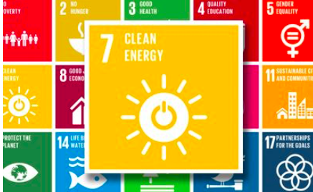
Research into renewables
Three case study energy sources will be Nuclear, and a choice of Wind, Solar Power, Geothermal or HEP. Use your internet research skills, the videos on Weebly and page 483-484 of the IB DP Geography textbook and kognity (section 3.2.6-3.2.8) to help you to research the following: Task 1 - Create a revision resource case study of your chosen energy sources with the following information included: i. Location map to show suitable places to generate this type of energy (e.g. wind/solar power suitability map, security issues concerning the siting of nuclear power plants (think of Chernobyl & Fukushima) ii. Details of how this form of energy can be harnessed (the production and mechanisms). Add images. iii. Case study of domestic & industrial use in MEDC's (name and details scheme) iv. Case study of practical uses in LEDC's (name and detail scheme) v. Drawbacks and criticisms vi. Evaluation of suitability for future mass use. Can this improve energy security for certain countries?

Slide 17
CHANGING IMPORTANCE OF RENEWABLES & NEW SOURCES OF MODERN ENERGY...

Slide 18
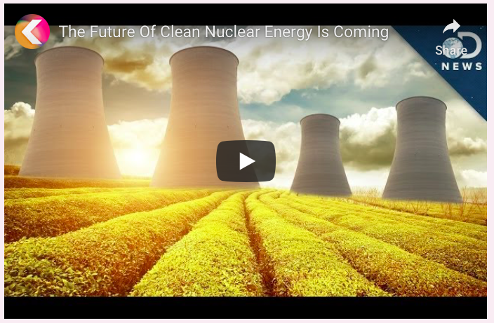
Possibilities: Nuclear power
Watch the following D News clip and make notes on the opportunities and challenges of Nuclear Power

Slide 19
Solar lighting Tanzania

Slide 20
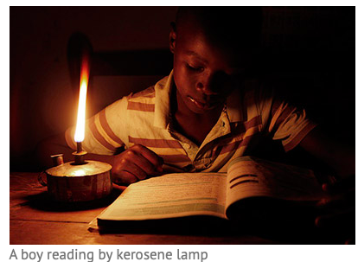
Solar power: Tanzania
With 64% of the population living off-grid, the use of polluting, hazardous kerosene lamps is extremely wide-spread. According to the National Bureau of Statistics, 58.4% of households in mainland Tanzania rely on these lamps as a lighting source. In rural areas this figure rises to 66% of households, and even in urban areas as many as 42.8% of households use this kerosene as a lighting source.
Many rural and peri-urban Tanzanians use toxic and dangerous fuel-based lighting like kerosene lanterns and must purchase fuel daily, which is the second highest expense in the average Tanzanian household budget.

Slide 21
Solar power: Tanzania
The case for off-grid energy solutions in Tanzania is particularly compelling. The widely dispersed population means grid expansion is not economically feasible in many rural areas.
https://www.theguardian.com/environment/2015/oct/29/how-tanzania-plans-to-light-up-a-million-homes-with-solar-power
https://solar-aid.org/kerosene-paraffin-lamps-africa/
https://littlesun.com

Slide 22
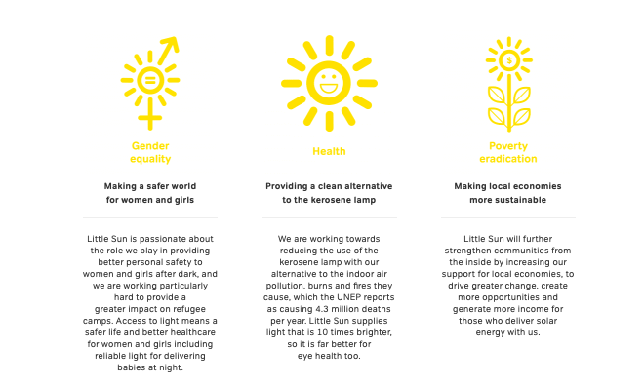

Slide 23
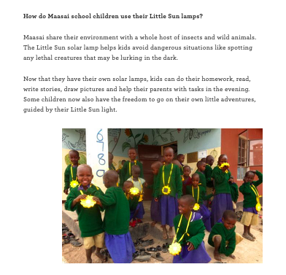

Slide 24
Solar lights Tanzania
What are the issues with supplying energy in Tanzania?
How do Solar lights work?
What are the benefits?
https://www.theguardian.com/environment/2015/oct/29/how-tanzania-plans-to-light-up-a-million-homes-with-solar-power
https://solar-aid.org/kerosene-paraffin-lamps-africa/
https://littlesun.com

Slide 25
Research into renewables
Three case study energy sources will be Nuclear, and a choice of Wind, Solar Power, Geothermal or HEP. Use your internet research skills, the videos on Weebly and page 483-484 of the IB DP Geography textbook and kognity (section 3.2.6-3.2.8) to help you to research the following: Task 1 - Create a revision resource case study of your chosen energy sources with the following information included: i. Location map to show suitable places to generate this type of energy (e.g. wind/solar power suitability map, security issues concerning the siting of nuclear power plants (think of Chernobyl & Fukushima) ii. Details of how this form of energy can be harnessed (the production and mechanisms). Add images. iii. Case study of domestic & industrial use in MEDC's (name and details scheme) iv. Case study of practical uses in LEDC's (name and detail scheme) v. Drawbacks and criticisms vi. Evaluation of suitability for future mass use. Can this improve energy security for certain countries?

Slide 26
Essay
Examine the changing importance of three energy alternatives to oil [10 Marks]. Your teacher will write the introduction to this piece of work (see below) and you will be responsible for using your research to formulate your middle section and conclusion (as per the IB essay planner). Introduction to IB Essay. In 2018, oil continues to fuel the modern world. No other substance on earth can equal the enormous impact which the use of oil has had on so many people, so rapidly, in so many ways, and in so many places around the world. Oil in its various refined forms, such as petrol, kerosene, and diesel, has a unique combination of many desirable and useful characteristics including current availability in (decreasing) abundance, ease of transportation and storage and great versatility in end use. Oil is also useful as more than an energy source. It is the basis for the manufacture of petrochemical products including plastics, medicines, paints, and a huge number of other useful materials. Alternative energy sources must be compared with oil in all these various attributes when their substitution for oil is considered. To the untrained geographer, none appears to completely equal oil. This essay will explore the extent to which nuclear, wind and solar power could be considered as a long term replacement for oil and their changing importance in countries at different levels of development. ​

Slide 27
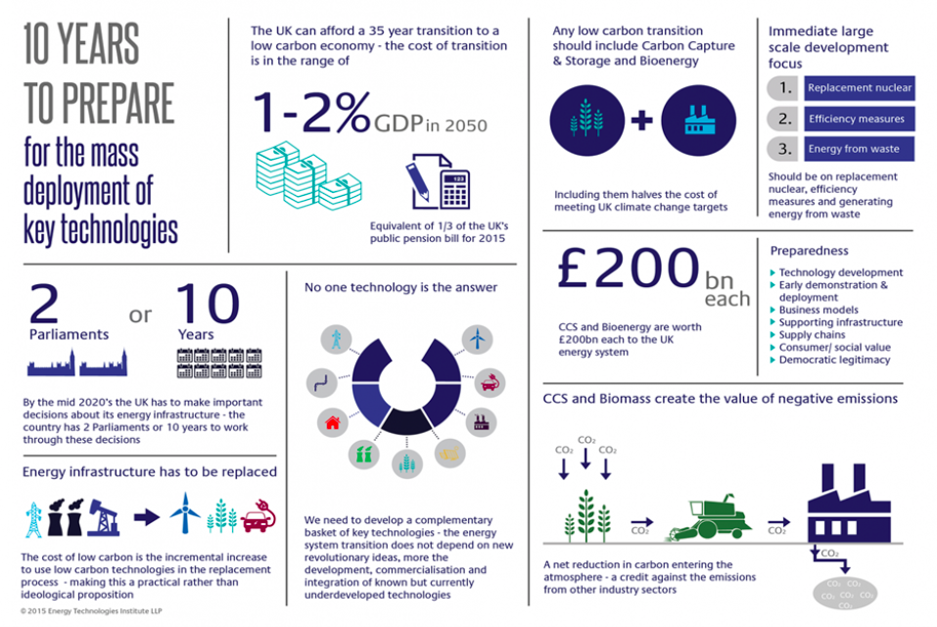
Infographic practice
https://www.eti.co.uk/insights/development-insight/

Slide 28
Study the Infographic and answer the following questions
Identify the main purpose of the infographic
Discuss who consider to be the main target audience for the infographics
Identify the main ways the UK will reach a low carbon economy

