Slide 1
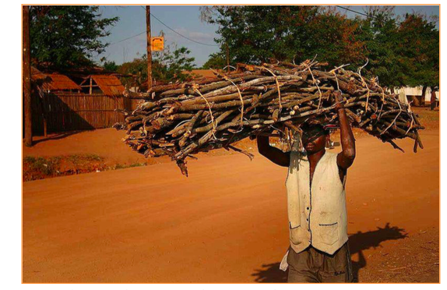
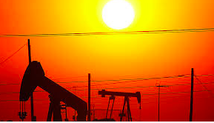
Energy

Slide 3
Starter
Can you name twelve energy sources?

Slide 4
Coal
Natural gas
Crude oil
Nuclear
Biogas
Wind
Tidal
Wave
Solar
HEP
Geothermal
Fuelwood

Slide 5
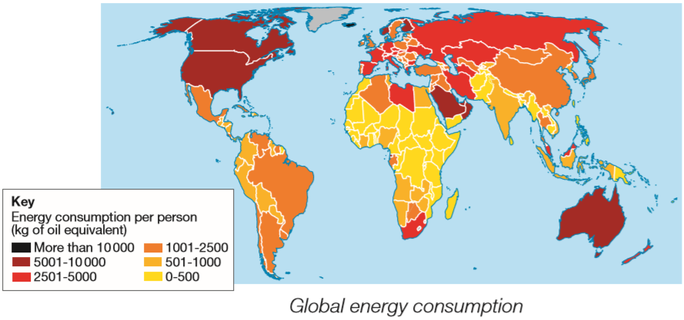
TASK: Global energy consumption
ACTIVATE:
Study the map above on global energy consumption.
Describe the pattern of global energy consumption.
Which countries/regions are high? Which countries/regions are low?

Slide 6
TASK: Global energy consumption
ACTIVATE:
Energy consumption per person is very high in countries like USA, Canada, Australia, most of Europe and parts of the Middle East. It is low across most of Africa and parts of south east Asia.
In regions of high energy consumption there is a growing demands for industry, transport and domestic use.

Slide 7
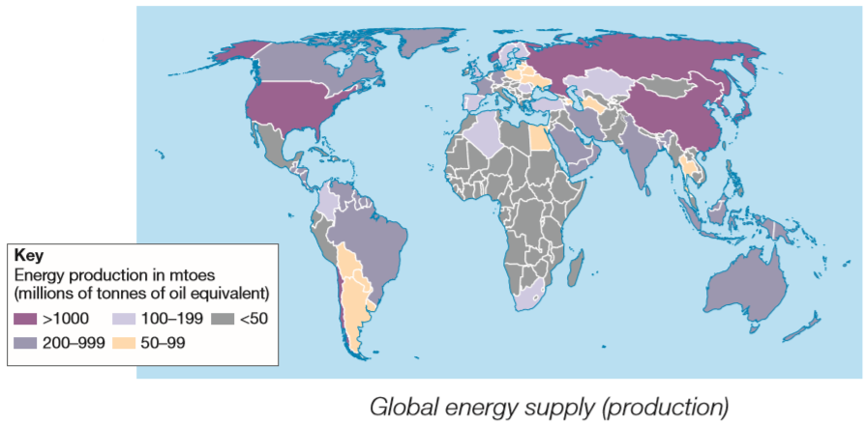
TASK: Global energy consumption and supply
ACTIVATE:
Study map 1 and map 2. Compare global energy supply with global energy demand.
What are the similarities and differences?
Do any countries/regions have both high consumption and supply?
Do any countries/regions have both low consumption and supply?
Do any countries/regions have high consumption and low supply?
Do any countries have low consumption and high supply?

Slide 8
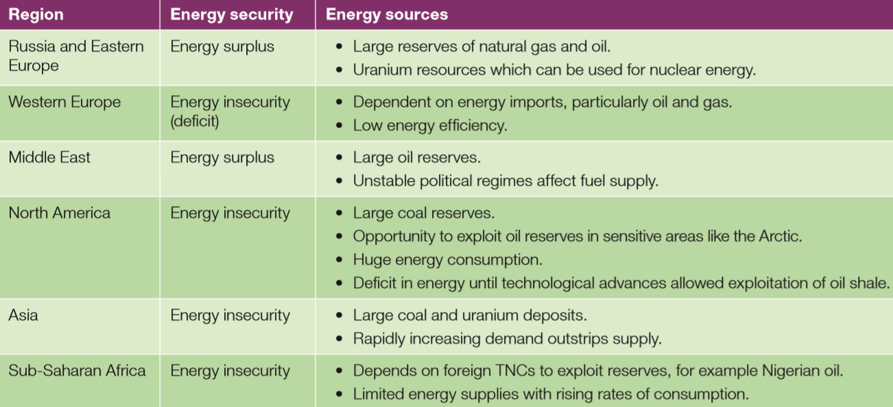
Energy security status by region
ACTIVATE:
If supply exceeds demand then the country has an energy surplus. If demand exceeds supply then the country has a deficit. If there is a deficit then the country suffers from energy insecurity.
The balance between energy supply (production) and demand (consumption) determines the energy security.

Slide 9
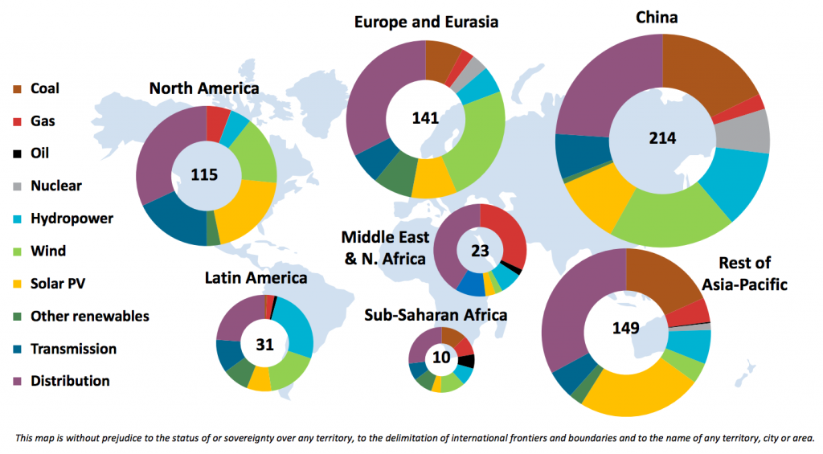
What energy sources make up regional energy mixes?
ACTIVATE:

Slide 10
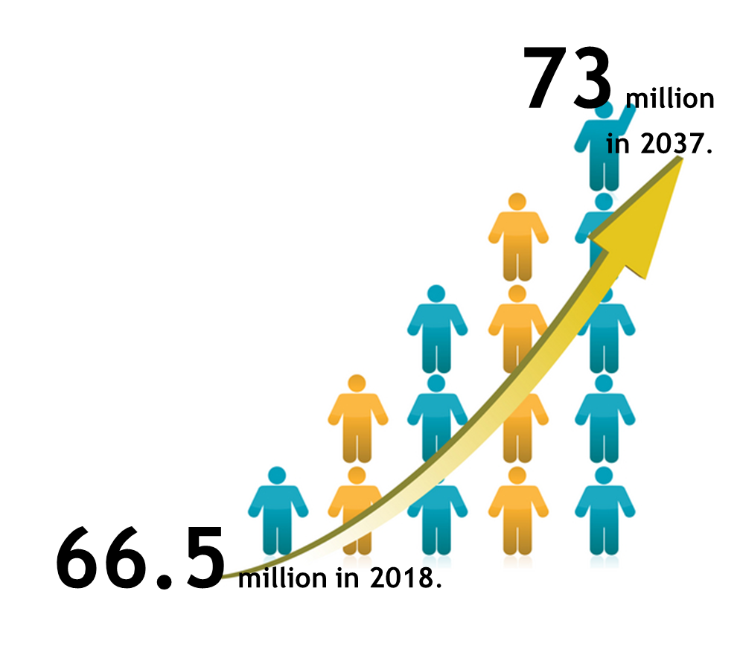
How is energy demand changing in the UK?
ACTIVATE:
Even though the population is increasing, the energy consumption has fallen.

Slide 11
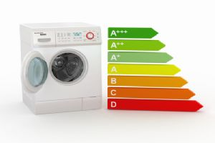
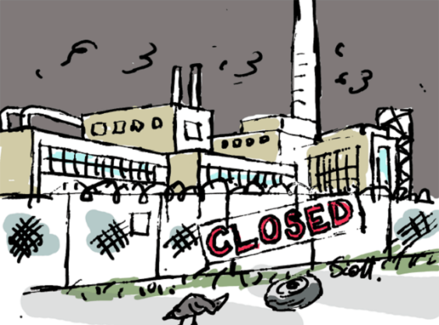
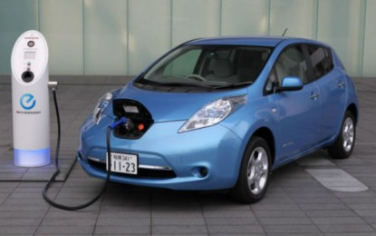
How is energy demand changing in the UK?
ACTIVATE:
Even though the population is increasing, the energy consumption has fallen.
Low Energy Appliances
Better Insulation
Deindustrialisation
Energy Efficient Cars

Slide 12
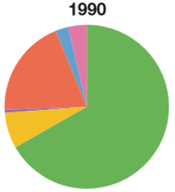
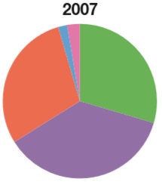
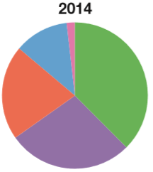
Fossil Fuels VS Renewables
ACTIVATE:
The UKs energy mix – the range and proportions of different energy sources has changed in the last 25 years.
By 2020, the UK aims to have 15% of its energy produced by renewable sources.

Slide 13
How and why has the UKs energy mix changed?
ACTIVATE:
The UK does not have enough energy to supply the demand.
The UK has used up around 75% of its known oil and gas reserves.
By 2020, the UK is likely to import 75% of its energy.
This affects the UKs energy security.
A major change has been the decline of coal.

Slide 14
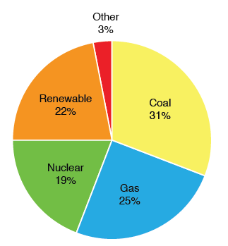
How and why has the UKs energy mix changed?
ACTIVATE:
However fossil fuels (coal, oil and gas) will remain important in the future because:
we have enough reserves to provide energy for several decades,
coal imports are cheap
fracking will increase.

Slide 15
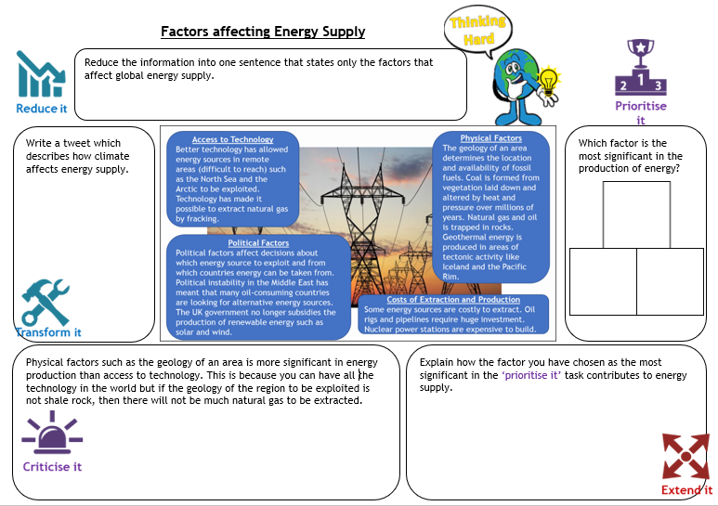
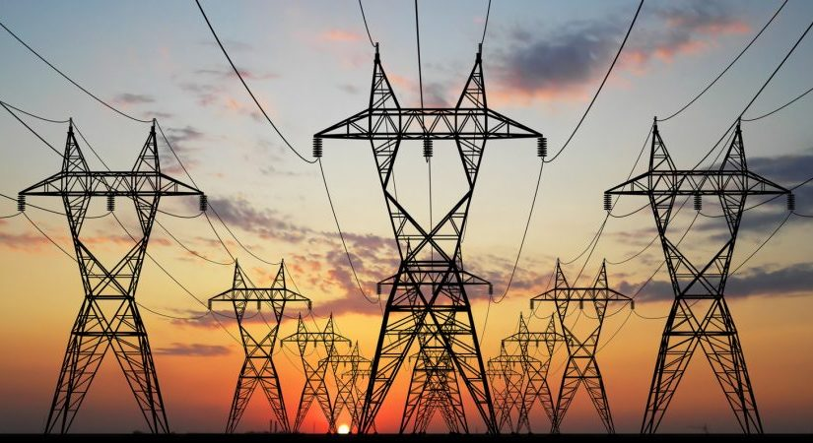
What factors affect energy supply?
Climate
The amount of sunshine and wind influence the amount of solar and wind energy produced.
ACTIVATE:
Access to Technology
Better technology has allowed energy sources in remote areas (difficult to reach) such as the North Sea and the Arctic to be exploited. Technology has made it possible to extract natural gas by fracking.
Physical Factors
The geology of an area determines the location and availability of fossil fuels. Coal is formed from vegetation laid down and altered by heat and pressure over millions of years. Natural gas and oil is trapped in rocks. Geothermal energy is produced in areas of tectonic activity like Iceland and the Pacific Rim.
Political Factors
Political factors affect decisions about which energy source to exploit and from which countries energy can be taken from.
Political instability in the Middle East has meant that many oil-consuming countries are looking for alternative energy sources.
The UK government no longer subsidies the production of renewable energy such as solar and wind.
Costs of Extraction and Production
Some energy sources are costly to extract. Oil rigs and pipelines require huge investment. Nuclear power stations are expensive to build.

Slide 16
Why is energy consumption increasing?
ACTIVATE:
As countries develop, their demand for energy supplies increases. Recent growth in China’s energy demand has been led by China but this has now started to slow down. India is expected to be next. This is due to industrialisation and greater wealth.
An increasing population means lots of extra people needing and using more energy. Many will grow up in an energy starved world.
The increasing use of technology like computers and other electrical equipment means a greater demand for energy. As quality of life increases so does the demand for vehicles, lighting and heating.

Slide 17
Explain why many countries will experience energy insecurity in the future.
DEMONSTRATE:
It is asking about energy insecurity. What will cause the demand to exceed the supply?
Increasing population
Economic development
Use key words/phrases such as:
Energy security
Energy insecurity
Energy surplus
Energy deficit
Population
Economic development
Supply
Demand

Slide 18
Coal, oil and gas
Task: Non- renewable energy
Using the textbook page 286-291 and the video embedded on the wiki make notes on:
Type of energy | How is it produced? | What are the issues with the use? | What are the advantages?
Coal
Oil
Gas

Slide 19
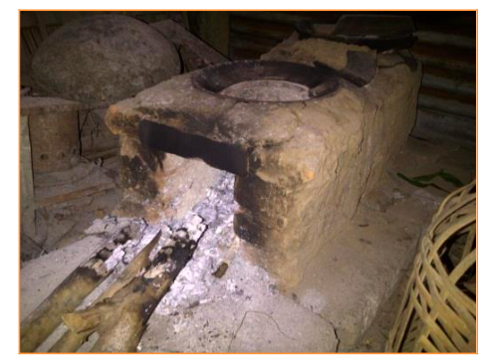
Fuelwood- Case study Democratic Republic of the Congo
Task: Non- renewable energy- fuelwood

Slide 20
Fuelwood- Case study Democratic Republic of the Congo
Task: Non- renewable energy- fuelwood
Also use p291 to add to your notes

Slide 22
Exam question
Identify a form of energy and describe how its use threatens the natural environment. You may refer to named areas which you have studied. [7 Marks]

Slide 23
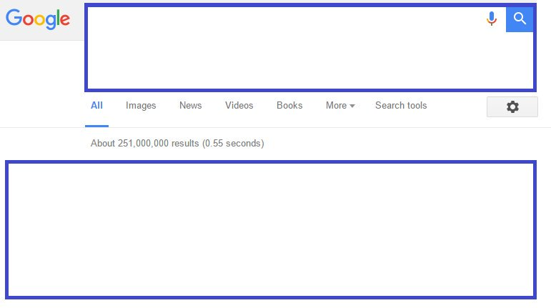
Google it
REVIEW
Write a question that your peer should be able to answer based on todays lesson.
Give it to your peer to glue into their books and answer.

Slide 25
Task: Renewable energy
Using the textbook page 291-301 and the videos embedded on the wiki make notes on:
Renewable energy source | Example of location | How it works | Advantages | Disadvantages
Wind
Solar
HEP
Biomass
Biogas
Geothermal
Tidal

Slide 26
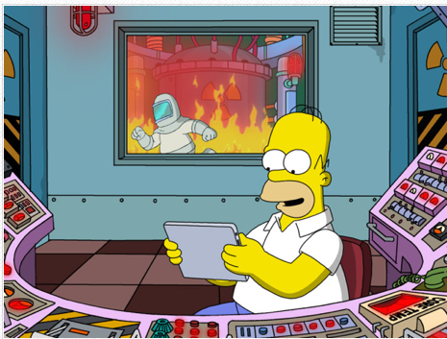
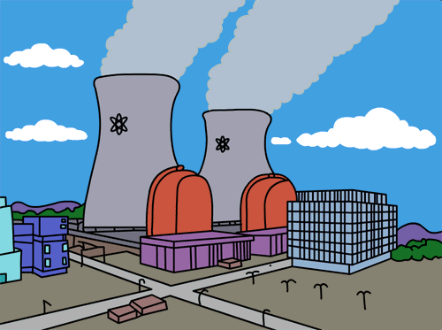
Nuclear Power Meeting Future energy needs
Nuclear Power.
Not purely renewable but grouped with renewables as the amount of raw material (plutonium) needed is very small.
You need to be able to explain the advantages and disadvantages of nuclear power.

Slide 27
Nuclear power is not a renewable energy source because it uses uranium which is finite. However, the estimated supply of uranium is much greater than fossil fuels and when used to produced energy, creates a lot less greenhouse gases. At the moment France and Lithuania are the biggest users of energy, accounting for nearly 80% of their energy mix.

Slide 28
The advantages and disadvantages of Nuclear Power
Also read textbook page 300-301

Slide 29
Exam questions
2011: For a named country or area which you have studied, describe the ways in which energy supplies are being developed. [7]
2012: For a named country or area which you have studied, describe one way in which energy is produced. [7]
2012: For a named example which you have studied, describe how renewable energy is being developed. [7]

