Slide 1
Create a timeline of electoral support

Slide 2
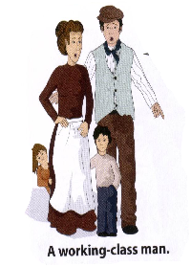
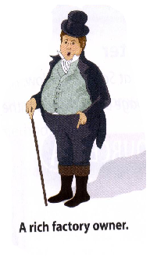


How satisfied were these people with the Reform Acts?

Slide 3
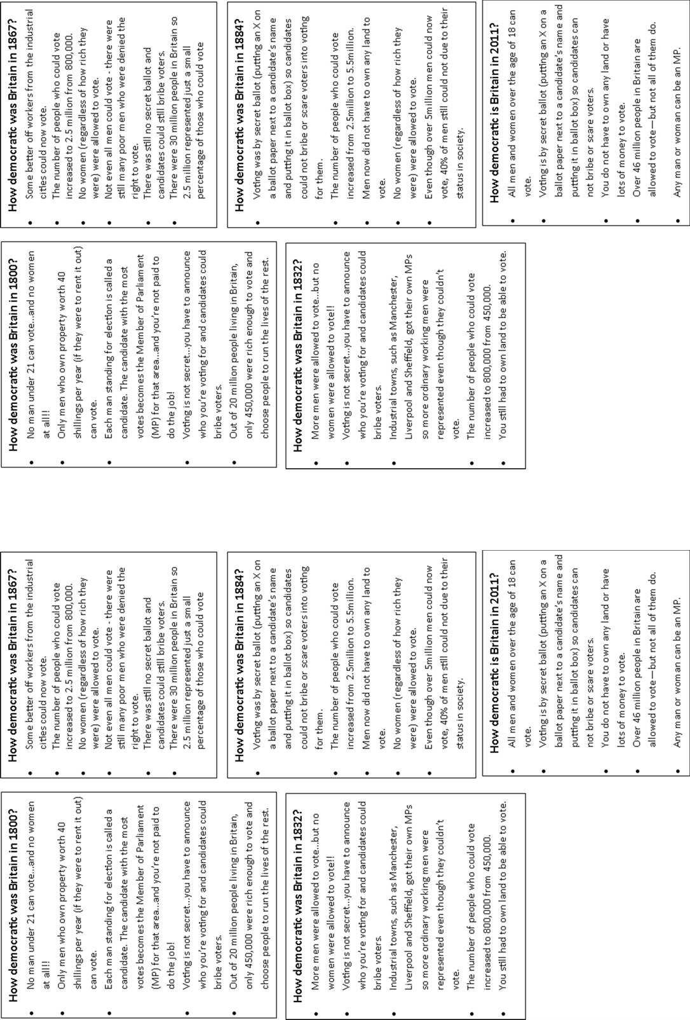
Secret Ballot Act, 1872.
Landlords and employers could no longer intimidate or bribe workers to vote for a certain person.
Elections had to be carried out in private.
Third Reform Act, 1884-5
In most areas, all men could now vote.
Voters increased by two million.
Women still could not vote.
Great Reform Act, 1832
Middle class men given the vote.
56 Rotten Boroughs abolished.
Voters in industrial towns able to elect 142 MPs.
One in five men could vote.
Second Reform Act, 1867
All male property owners were given the vote.
45 extra MPs elected from industrial towns.
Over one million more people could now vote.

Slide 4
1800
1850
1900

