Slide 2
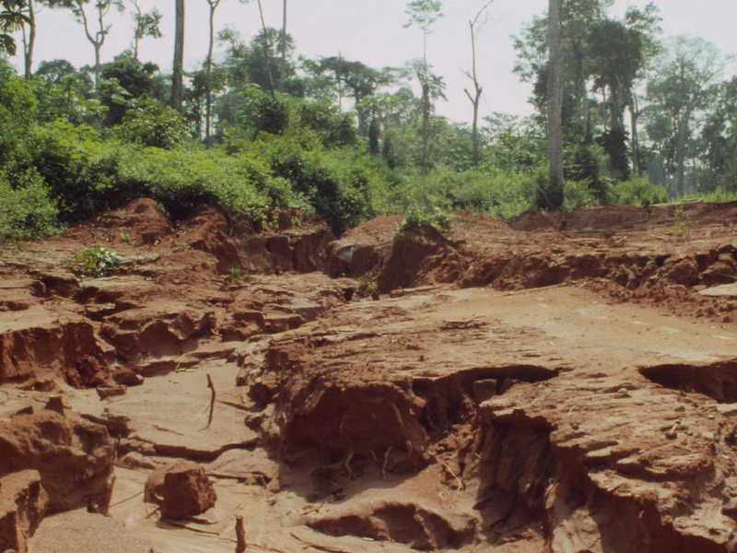
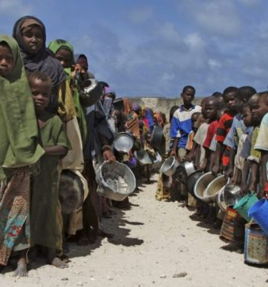
What might the impacts of desertification be?
Write down as many as you can think of in your books.

Slide 3
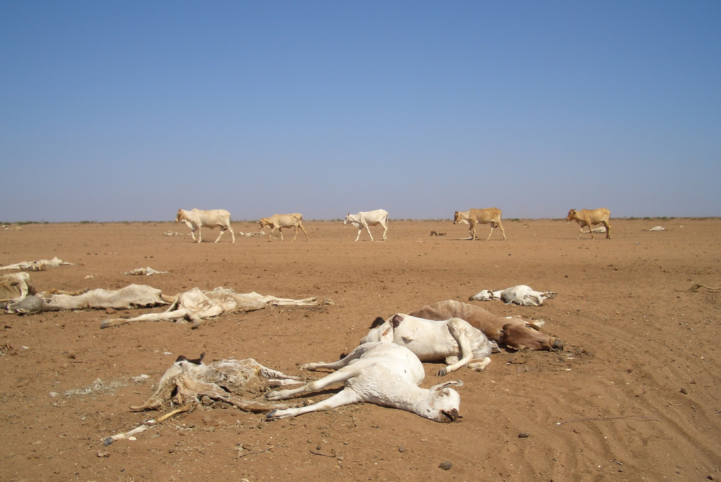
The impacts of desertification
Outcomes:
All will be able to describe and explain some of the impacts of desertification
All will be able to classify the impacts as social, economic and environmental
All will be able to consider what the biggest impact of desertification is.

Slide 4
Challenge 1 – How can desertification lead to conflict?
Complete a piece of work to explain how the first impact of desertification, soil degradation, can eventually lead to conflict. Use the information cards to help. You could either:
Complete a flow diagram using the cards
Write a paragraph describing the links
Complete a quick sketch storyboard with annotations
Any other method that you check with your teacher
Extra Challenge – Link the steps to a real life example using the QR code linked to information on the Darfur crisis in Sudan
https://www.theguardian.com/environment/2007/jun/23/sudan.climatechange

Slide 6
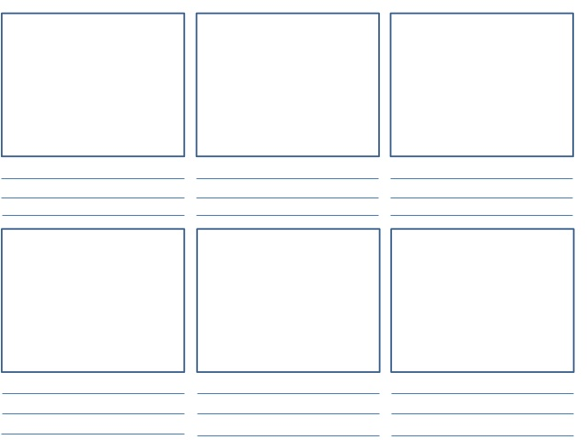

Slide 7
Soil Degradation - as the plant cover gradually disappears, soils no longer receive nutrients from decomposing plants. Soil becomes even less fertile as people keep trying to grow plants and raise animals. The exhausted soil dries out and soon starts to erode. Eventually, the soil becomes dust and is blown away by the wind.
Malnutrition, famine and starvation – the decline in agricultural productivity leads to food shortages and a poor diet. People can survive famine for some time, but eventually the lack of food and poor diet leads to starvation and even death. The young and old and particularly badly affected. This is usually a symptom of overpopulation.
Migration – Eventually the situation becomes so bad that people face a difficult choice – either die where you are or migrate in the hope of finding somewhere where you can raise enough food to survive.
Reduced agricultural output – the decline in the condition of the soil, plus the increasing shortage of water, means that less crops are able to be grown. Crops fail and livestock die.
Conflict- a problem with migration is that it sometimes leads to conflict. Migrants arriving and settling in a place where other people are only just surviving are not going to very welcome.
Soil Degradation - as the plant cover gradually disappears, soils no longer receive nutrients from decomposing plants. Soil becomes even less fertile as people keep trying to grow plants and raise animals. The exhausted soil dries out and soon starts to erode. Eventually, the soil becomes dust and is blown away by the wind.
Malnutrition, famine and starvation – the decline in agricultural productivity leads to food shortages and a poor diet. People can survive famine for some time, but eventually the lack of food and poor diet leads to starvation and even death. The young and old and particularly badly affected. This is usually a symptom of overpopulation.
Migration – Eventually the situation becomes so bad that people face a difficult choice – either die where you are or migrate in the hope of finding somewhere where you can raise enough food to survive.
Reduced agricultural output – the decline in the condition of the soil, plus the increasing shortage of water, means that less crops are able to be grown. Crops fail and livestock die.
Conflict- a problem with migration is that it sometimes leads to conflict. Migrants arriving and settling in a place where other people are only just surviving are not going to very welcome.
Soil Degradation - as the plant cover gradually disappears, soils no longer receive nutrients from decomposing plants. Soil becomes even less fertile as people keep trying to grow plants and raise animals. The exhausted soil dries out and soon starts to erode. Eventually, the soil becomes dust and is blown away by the wind.
Malnutrition, famine and starvation – the decline in agricultural productivity leads to food shortages and a poor diet. People can survive famine for some time, but eventually the lack of food and poor diet leads to starvation and even death. The young and old and particularly badly affected. This is usually a symptom of overpopulation.
Migration – Eventually the situation becomes so bad that people face a difficult choice – either die where you are or migrate in the hope of finding somewhere where you can raise enough food to survive.
Reduced agricultural output – the decline in the condition of the soil, plus the increasing shortage of water, means that less crops are able to be grown. Crops fail and livestock die.
Conflict- a problem with migration is that it sometimes leads to conflict. Migrants arriving and settling in a place where other people are only just surviving are not going to very welcome.

Slide 8
Soil Degradation
Conflict
Reduced agricultural productivity
Malnutrition, famine and starvation
Migration
Soil Degradation
Conflict
Reduced agricultural productivity
Malnutrition, famine and starvation
Migration
Soil Degradation
Conflict
Reduced agricultural productivity
Malnutrition, famine and starvation
Migration
Soil Degradation
Conflict
Reduced agricultural productivity
Malnutrition, famine and starvation
Migration
Soil Degradation
Conflict
Reduced agricultural productivity
Malnutrition, famine and starvation
Migration
Soil Degradation
Conflict
Reduced agricultural productivity
Malnutrition, famine and starvation
Migration
Soil Degradation
Conflict
Reduced agricultural productivity
Malnutrition, famine and starvation
Migration
Soil Degradation
Conflict
Reduced agricultural productivity
Malnutrition, famine and starvation
Migration
Soil Degradation
Conflict
Reduced agricultural productivity
Malnutrition, famine and starvation
Migration
Soil Degradation
Conflict
Reduced agricultural productivity
Malnutrition, famine and starvation
Migration
Soil Degradation
Conflict
Reduced agricultural productivity
Malnutrition, famine and starvation
Migration
Soil Degradation
Conflict
Reduced agricultural productivity
Malnutrition, famine and starvation
Migration

Slide 9
Challenge 2- Impact Classification
Classify the 5 impacts you have looked at as either, social, economic or environmental.
Extra challenge – Watch the video and identify any other impacts that we have not covered, making sure to classify them as either social, economic, or environmental.
https://www.youtube.com/watch?v=D8ADeT9RAH8

Slide 10
Challenge 3 – Impact Evaluation
Complete a piece of work that enables you to evaluate what the biggest / smallest impact of desertification is – you could:
Complete the provided triangle, putting the biggest impact at the top, and then work down to the smallest impacts. You must then justify your ranking.
Write a paragraph explaining what you think the biggest / smallest impacts are and why.
Rank the impacts from 1 to 5, then justify the ranking underneath.
Create a short personal video, describing your opinions and justifying them.
All options should include the 5 main impacts we have looked at today.

Slide 11
To finish – Solutions
What do you think might be some of the solutions to desertification?

