Slide 1
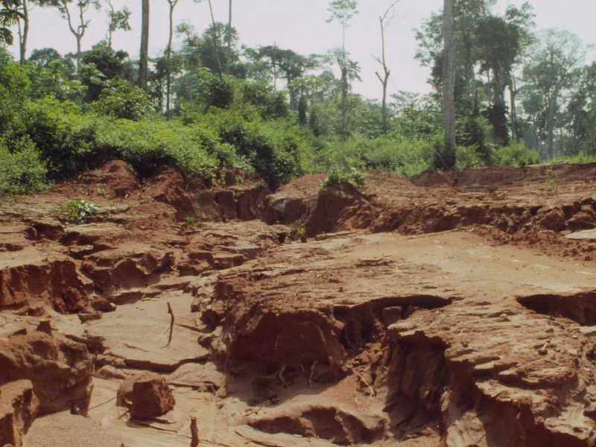
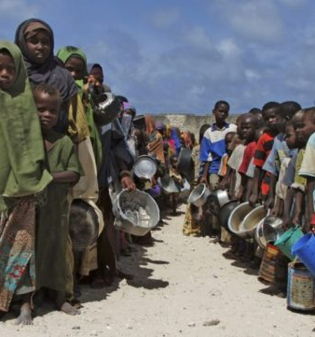
What might the impacts of deforestation be?
Discuss with the person next to you.

Slide 2
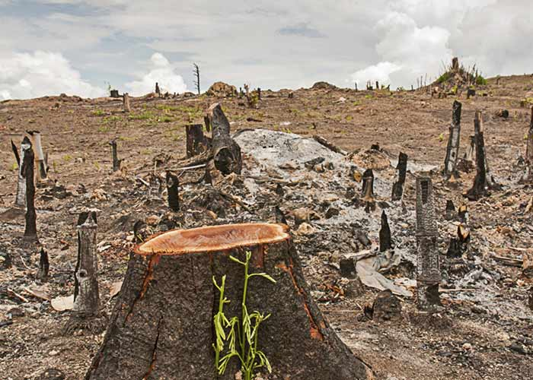
The impacts of deforestation
Outcomes:
All will be able to describe and explain some of the impacts of deforestation
All will be able to classify the impacts as social, economic and environmental
All will use numeracy skills to appreciate the extent of deforestation worldwide

Slide 3
Challenge 1 – Describe what has been happening to rates of deforestation around the world. Remember to use examples and statistics
Extra challenge – Why are the green
bars not necessarily good news?

Slide 5
Challenge 2 – Effects of deforestation
First, colour code the effects of deforestation as either social, economic or environmental. Second, show whether they are positive or negative. Finally, either:
Sum-up each effect in less than 5 words
Draw a quick sketch under the effect to present what
is happening
Turn each effect into a Haiku
Extra Challenge – access the resource and see if you can find any other effects of deforestation – then do the same as above for them
https://www.livescience.com/27692-deforestation.html

Slide 6
Loss of biodiversity – Biodiversity is a natural resource and a vital part of the Earth’s life support system. Humans rely on a biodiverse world for a variety of goods and services. Without biodiversity, humans would soon perish.
Contribution to climate change – deforestation contributes to the build-up of greenhouse gases. Deforestation means that levels of carbon dioxide build up in the atmosphere, leading to increased climate change.
Economic development – For a number of developing countries, deforestation can stimulate much-needed economic development. Many countries in South American and South Asian countries have been benefiting from deforestation.
Soil Erosion– as vegetation is removed, the soil is left exposed and open to erosion by wind or rain, this degrades the soil and makes it become infertile

Slide 7
Challenge 3 – Startling Percentages
Calculate the percentage loss for each country
Write a brief summary of what you find.
Numeracy Reminder
Take the original number and minus the present to find the total loss.
Divide the total loss by the original number
Multiply by 100 to get the total percentage loss

Slide 9
To finish – Solutions
What do you think might be some of the solutions to deforestation?

