Slide 1
Edexcel IGCSE History P2: Breadth Study B1
Changes in Medicine,
1848-1948

Slide 2
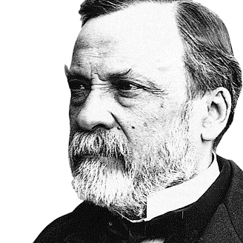

Slide 3
Edexcel IGCSE History P2: Breadth Study B2
Changes in Medicine,
1848-1948
5. Advances in Medicine, Surgery
& Public Health, 1920-1948

Slide 4
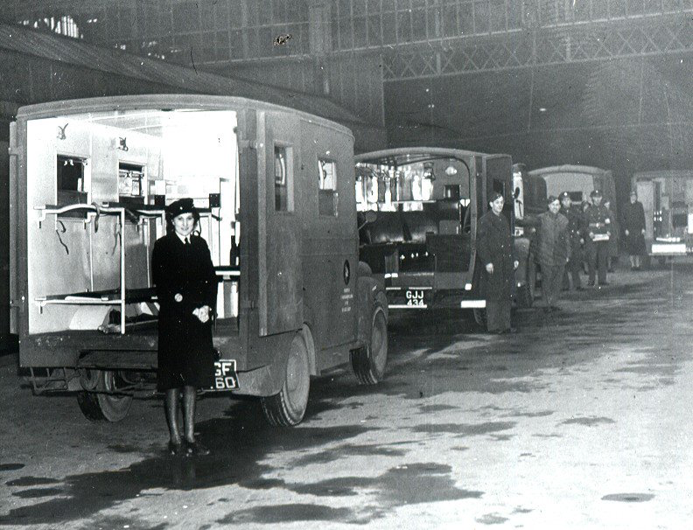
(c) The Development of the N.H.S.
During WW2, the role of Government in Health expanded once more. In the 19th Century the Government had taken responsibility for general public health & hygiene – focusing on living conditions. In the 20th Century the Government had passed laws to keep individuals healthy & campaigned to persuade parents to have children vaccinated. In 1939 the Emergency Medical Service had been created to co-ordinate hospitals & health care.

Slide 5
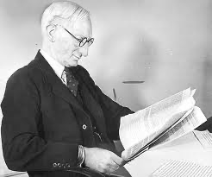
(c) The Development of the N.H.S.
When WW2 was nearing its end, it was only natural for the Government to plan how to rebuild the UK after the war. WILLIAM BEVERIDGE, a lawyer who advised Lloyd George on Pensions & Nat Ins in 1911 and the Director of London School of Economics, was asked to produce a report outlining ideas for the future. Initially, Beveridge didn’t want to take on this role – he wanted a more direct role like he had during WW1 – but it soon became clear that the Beveridge Report was to be of major significance.

Slide 6
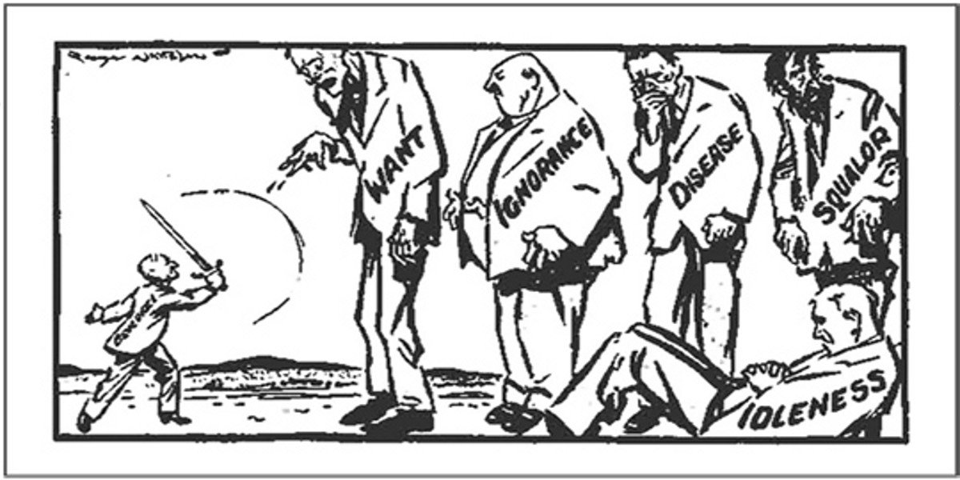
(c) The Development of the N.H.S.
The Beveridge Report, 1942, identified 5 key problems that he called ‘Giant Evils’:
WANT – Poverty & not having enough money/food
DISEASE
IGNORANCE – Lack of education preventing jobs
SQUALOR – Dirty living
IDLENESS – Unemployment leading to alcoholism & crime

Slide 7
(c) The Development of the N.H.S.
Beveridge felt the State had a duty to help and protect the people from the ‘Evil Giants’, but he also believed that the people had a responsibility to help themselves.
The Beveridge Report was a best-seller; 95% of the population had heard of it and there was huge support for the brighter future it promised for Britain. People felt the proposals made in the Beveridge Report would help Britain recover from WW2 after 1945.

Slide 8
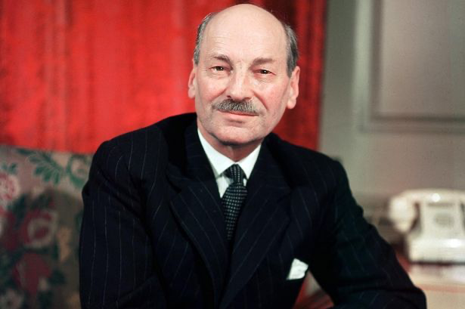
(c) The Development of the N.H.S.
The Labour Government elected in 1945 was led by the new Prime Minister, Clement Attlee. He proudly announced that a Welfare State would be set up to protect the people “from the cradle to the grave”. This guaranteed an acceptable standard of living for all. This new Welfare System would be paid for through National Insurance contributions from employees & employers (exactly like the system set up by Lloyd George). The National Insurance Act, 1946 provided pensions, maternity benefits & payments to the sick & unemployed.

Slide 9
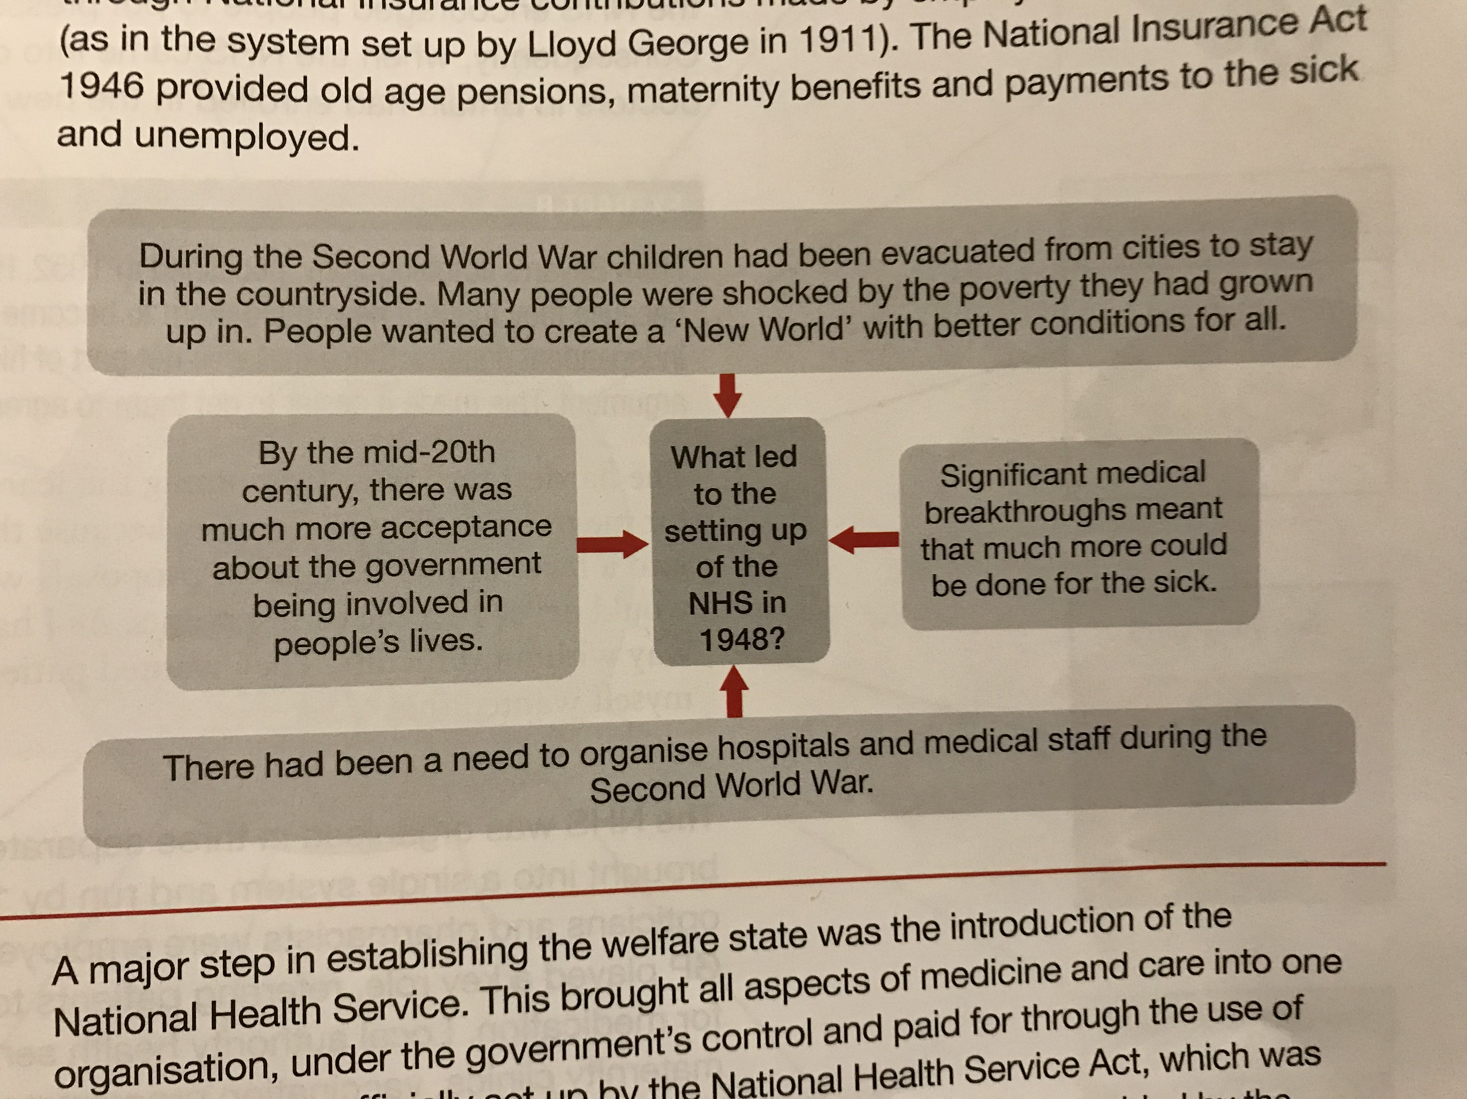

Slide 10
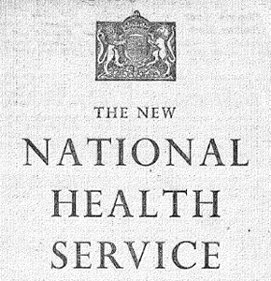
(c) The Development of the N.H.S.
The National Health Service (N.H.S.) was a vital step in establishing the Welfare State. It brought all aspects of Medicine and Care under one organization, which was under Government control and paid for through taxation. The N.H.S. began care during pregnancy & at birth to continue throughout a person’s life. This included medical diagnosis & treatment, access to a GP & Hospital specialists, access to a Dentist & Opthalmologist, emergency care & long-term illness care or care during old age.

Slide 11
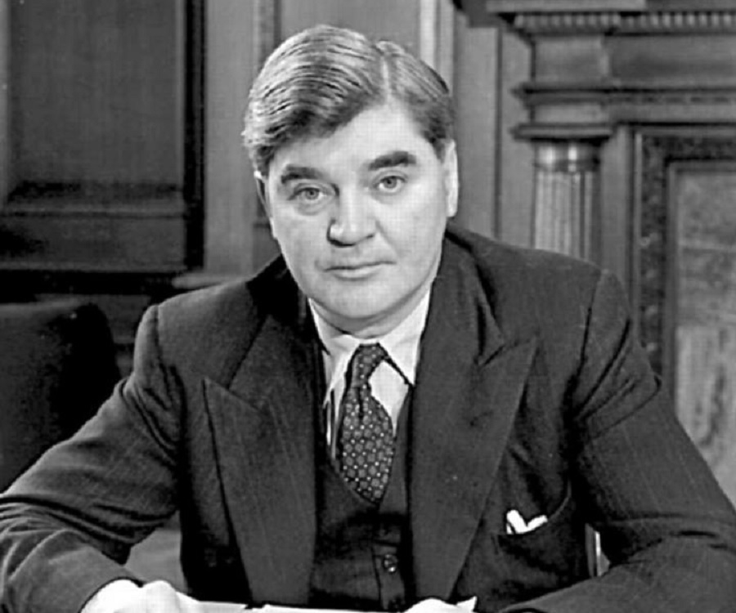
(c) The Development of the N.H.S.
While William Beveridge’s Report from 1942 established the idea of the N.H.S. the work of setting up the N.H.S. was carried out by Labour’s Minister for Health, Aneurin Bevan. Bevan was from a poor background in Wales and had left school at 13 to work in a Coal Mine. He knew all about the problems of poverty and poor health first hand. He won a scholarship to study in London and, in 1929, he became a Member of Parliament. As M.P. for Ebbw Vale, he worked tirelessly to improve the lives of the poor

Slide 12
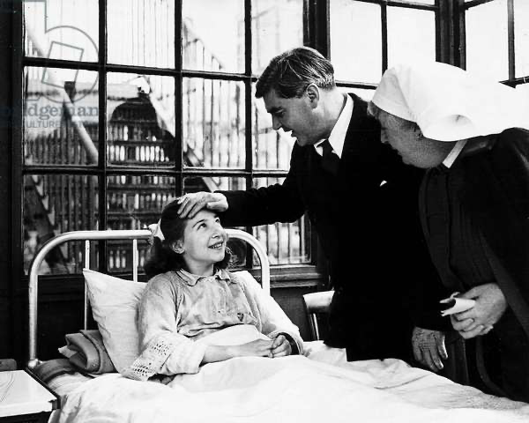
(c) The Development of the N.H.S.
When Bevan tried to set up the N.H.S. he faced a great deal of opposition from doctors – who objected to the idea of being employed by the N.H.S. rather than running their own private practices. Many doctors relied on private patient fees to top up meagre pay for Hospital work. A British Medical Association survey on the new N.H.S. Act found:
40,000 Medical Practitioners disapproved
5,000 Medical Practitioners approved

Slide 13
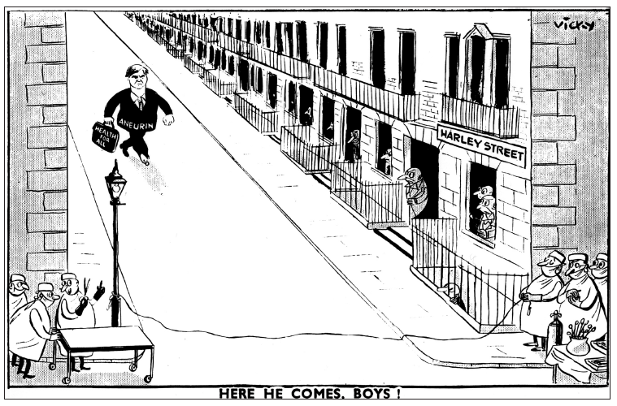

Slide 14
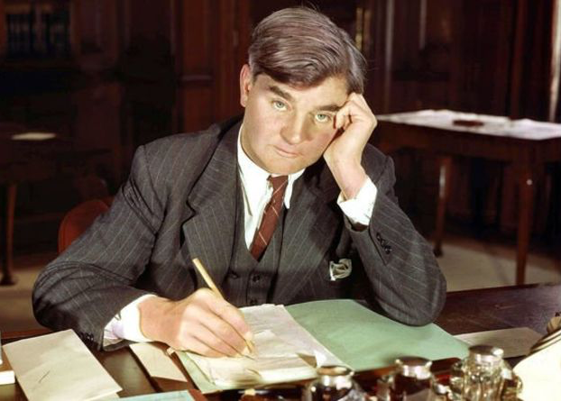
(c) The Development of the N.H.S.
Eventually, Bevan agreed to pay GPs according to the number of patients they saw. He also agreed that they could run their own private practices alongside N.H.S. work. A campaign to inform the British public about the N.H.S. encouraged people to put pressure on their doctors to join the N.H.S. As a result, when the N.H.S. came into operartion in 1948, 90% of British doctors were enrolled in the new N.H.S. system.

Slide 15
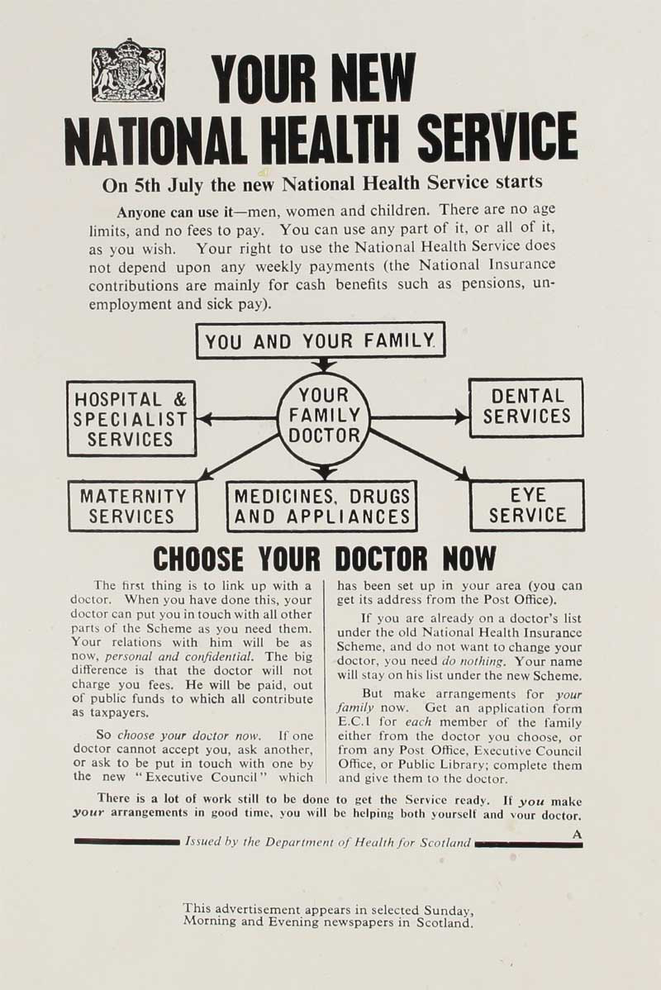
(c) The Development of the N.H.S.
The N.H.S. was organized in 3 parts:
HOSPITAL SERVICES were brought under one system run by 14 Regional Boards.
DOCTORS, DENTISTS, OPTICIANS + PHARMACISTS were employed through individual contracts – GPs were key, as they referred patients to Hospital & wrote prescriptions for medications.
LOCAL HEALTH SERVICES, led by a Medical Officer, ran Maternity Clinics, Vaccination Programmes & School Dental Services.
Everything was “FREE AT THE POINT OF DELIVERY”.

Slide 16
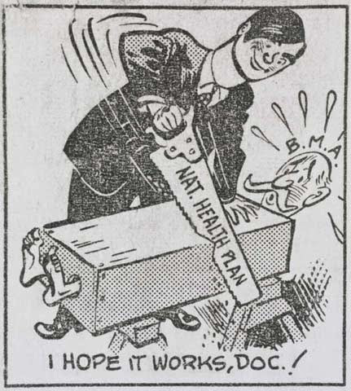

Slide 17
(c) The Development of the N.H.S.
NHS DATA JULY 1948 TO OCTOBER 1949
No. of Prescriptions | 187,000,000
Spectacles supplied | 8,250,000
Dental Treatment patients | 8,500,000
The N.H.S. made a massive difference to people’s lives – most women & children had not been protected by the 1911 National Insurance system, so they did not seek Medical treatment when it was needed. The 1946 National Insurance Act & the 1948 National Health Service met the Labour Government’s objective to offer support at every stage of life. The overall impact of the N.H.S. was shared by Aneurin Bevan in a press conference in October 1949.
LIFE EXPECTANCY 1901 COMPARED TO 1950 | ME
 | MEN | WOMEN
1901 | 51 | 55
1930 | 58 | 62
1950 | 66 | 70

Slide 18
Exam-Style Question
Explain two ways in
which health care in 1905 was different from health care in 1949. (6 marks)

Slide 20
Activity 51 – Recall Quiz
Who discovered Penicillin as a result of his untidy laboratory habits?
Give one reason why it was difficult to use Penicillin as a treatment?
Give 2 ways in which War affected the production of Penicillin.
Who received the Nobel Prize for their Penicillin work?
Name one of the groups of nurses who worked in the Armed Forces during WW2.

Slide 22
Activity 51 – Recall Quiz
What was the Guinea Pig Club?
Give one way in which McIndoe improved plastic surgery for burned pilots.
Give one way that blood transfusions improved during WW2.
Name the 5 ‘Evil Giants’ in the Beveridge Report.
Name 5 services the NHS provided from 1948.

Slide 24
Activity 52 – Explaining
Explain why the mass production of Penicillin was important.
Explain why advances in plastic surgery were important during WW2.
Explain the ways in which the NHS improved medical care for most people.

Slide 26
Activity 53 – Challenge
How important was Fleming’s discovery of Penicillin in 1928?
How much did WW2 lead to improvements in surgery?
Why did many doctors oppose the introduction of the NHS?

