Slide 1
Edexcel IGCSE History P2: Breadth Study B1
Changes in Medicine,
1848-1948

Slide 2
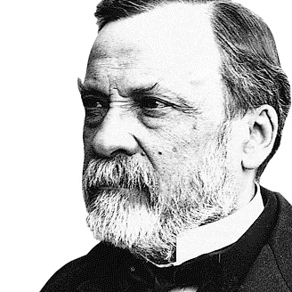

Slide 3
Edexcel IGCSE History P2: Breadth Study B2
Changes in Medicine,
1848-1948
5. Advances in Medicine, Surgery
& Public Health, 1920-1948

Slide 4
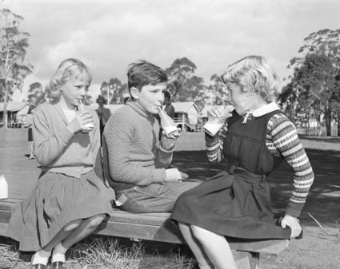
(b) The Impact of WW2
Immediately after WW1, important developments in Medicine occurred:
PRONTOSIL, the second “Magic Bullet”, was developed.
THE MINISTRY OF HEALTH was created in 1919.
ISOLATION HOSPITALS were set up for TUBERCULOSIS PATIENTS.
DIPTHERIA VACCINATIONS were encouraged.
FREE MILK at School helped try to improve children’s health.

Slide 5
Activity 49
RESEARCH SPARKED BY WW1 CONTINUED 1919-1939.
Can you recall which new areas of Medicine Harold Gillies & Harvey Cushing worked in?

Slide 7
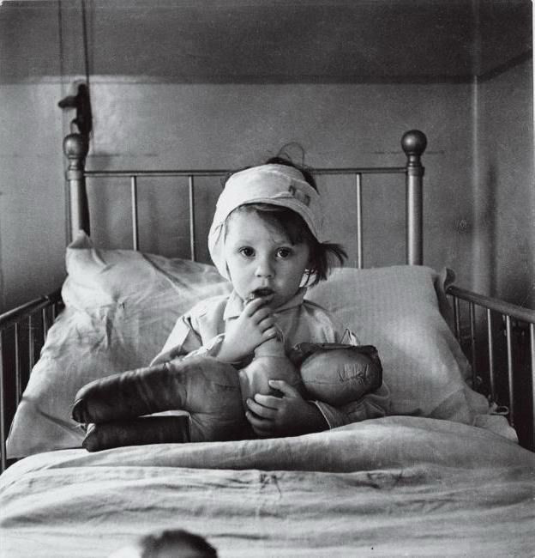
(b) The Impact of WW2
After a period of less urgency, 1919-1939, the Second World War suddenly forced Britain to have to deal with large numbers of injuries. Unlike in the First World War, however, in addition to British soldiers getting wounded British civilians were hurt too. The Blitz brought injuries caused by EXPLOSIONS, DAMAGED BUILDINGS & FIRE. Coordinating voluntary & charity hospitals became vital for success in WW2, so the EMERGENCY MEDICAL SERVICE was created in 1939 to ensure enough ambulances & doctors in bombed out areas or expected Luftwaffe targets.

Slide 8
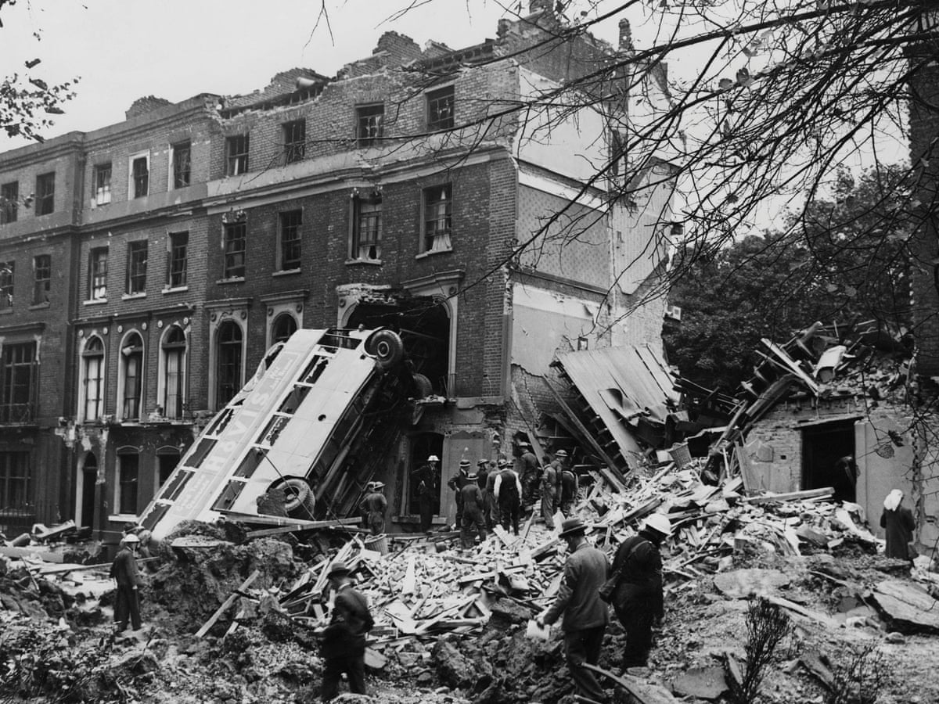
(b) The Impact of WW2
As England’s capital city, London was an obvious target for Nazi bombing raids 1940-1945. Before war broke out on 1st Sept. 1939, plans had been drawn up to divide London into 10 sections – to establish First Aid & Casualty Sorting Centres near danger zones.
First Aid Centres would provide basic treatment, before patients got moved to better-equipped hospitals in safer areas;
Casualty Sorting Centres were usually set up in Teaching Hospitals, so doctors & nurses gained invaluable experience treating a variety of injuries with the vast numbers of wounded.

Slide 9
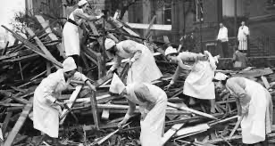
(b) The Impact of WW2
WW2 casualties from bombing put pressure on Hospitals, but these were targeted by Nazi bombs:
In South London, a nurse wrote in her diary ‘Medical staff were carrying buckets of sand & water to put out flares ahead of Nazi bombers.’
In Sutton in 1940, a bomb fell on an Emergency Hospital & killed 30 mothers & babies who had been evacuated from Guy’s Hospital.
In 1944, a South London Hospital saw several direct hits – 2 wards destroyed, 70 patients & staff injured, 3 died.

Slide 10
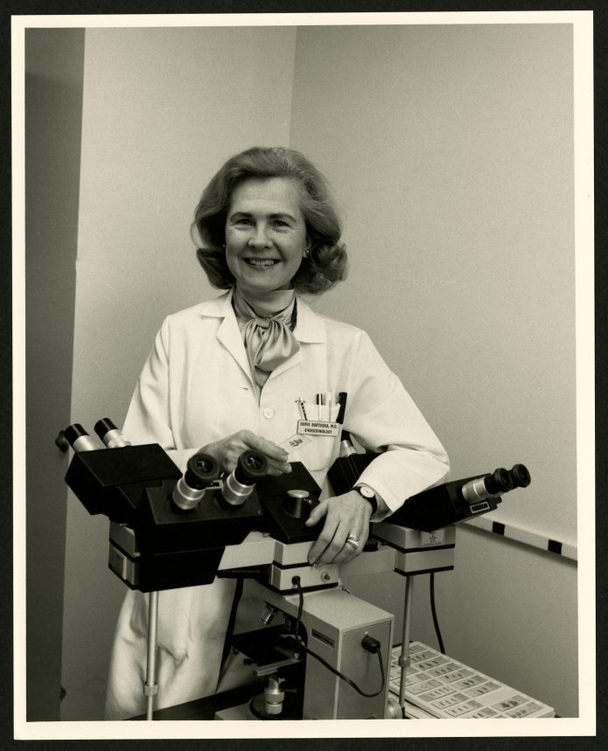
(b) The Impact of WW2
Between the World Wars, 1919-1939, the role of women didn’t change very much at all. Female doctors were still restricted to working as GPs or in Hospitals for Women & Children. Large General Hospitals did not accept females, so they could not develop specialists skills or gain promotions to Professorships. By 1931, only 10% of the 30,000 UK doctors were women. As male doctors had returned from WW1, they took the places they had left and all the temporary positions that female doctors had held were reverted back to males.

Slide 11
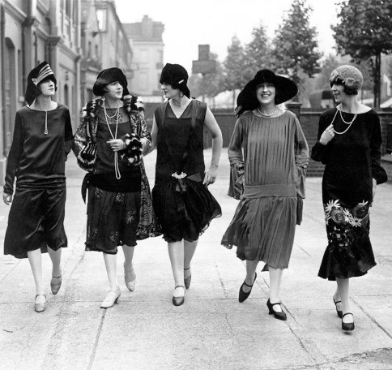
(b) The Impact of WW2
During the 1920s, many Medical Schools discouraged women from undertaking medical training. Some even stopped admitting women altogether! Their reasons for doing so were threefold:
They thought training was a waste, as women would leave the profession to start a family.
Some males thought medical training ruined the “delicate nature” of women.
Some male students didn’t want to train alongside female students.

Slide 12
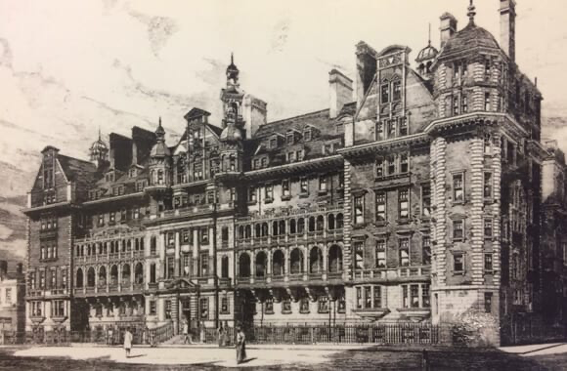
(b) The Impact of WW2
Despite the misogyny & patronization, women remained determined to train as doctors and stay in the profession.
A survey of 230 women who trained at St. Mary’s Hospital Medical School (1914-1924) showed that only 17% were NOT working in Medicine in 1936 … and ¼ were married with children & still working full-time. Nevertheless, many female doctors found themselves dismissed from Hospitals when they married … forcing them into GP roles, rather than seeking Hospital promotion.

Slide 13
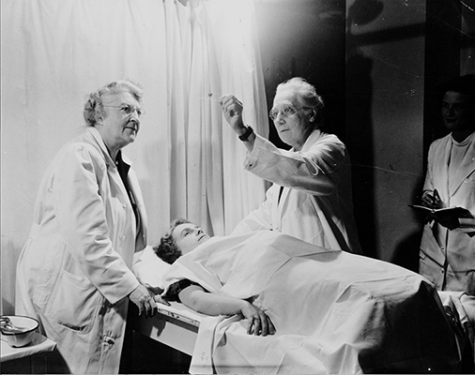
(b) The Impact of WW2
The fact that women doctors were paid less than male doctors became an issue in the 1920s and 1930s. Some men feared that if women were cheaper to employ, they may be appointed ahead of more expensive men. This led to a number of Hospitals agreeing that salaries could be the same for men & women … not for the sake of gender equality … but to protect men’s positions!

Slide 14
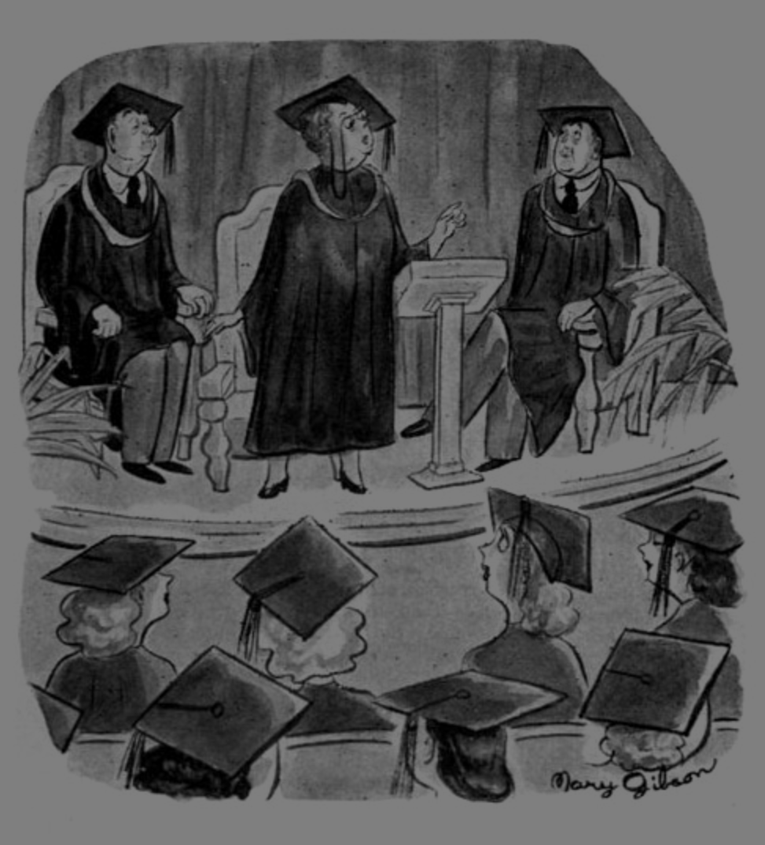
(b) The Impact of WW2
WW2 opened up opportunities for women to take on new roles & responsibilities; the number of female medical students rose from 2,000 in 1938 to 2,900 in 1946. Conversely, the impact of WW2 on the Medical Profession was less than in WW1 because fewer male doctors were called up. Many women doctors worked within the Emergency Medical Service (rather than on the front lines) yet they were sent to small hospitals … not working in the centre of cities, where the need was greatest … reduced to second-class status as ever.

Slide 15
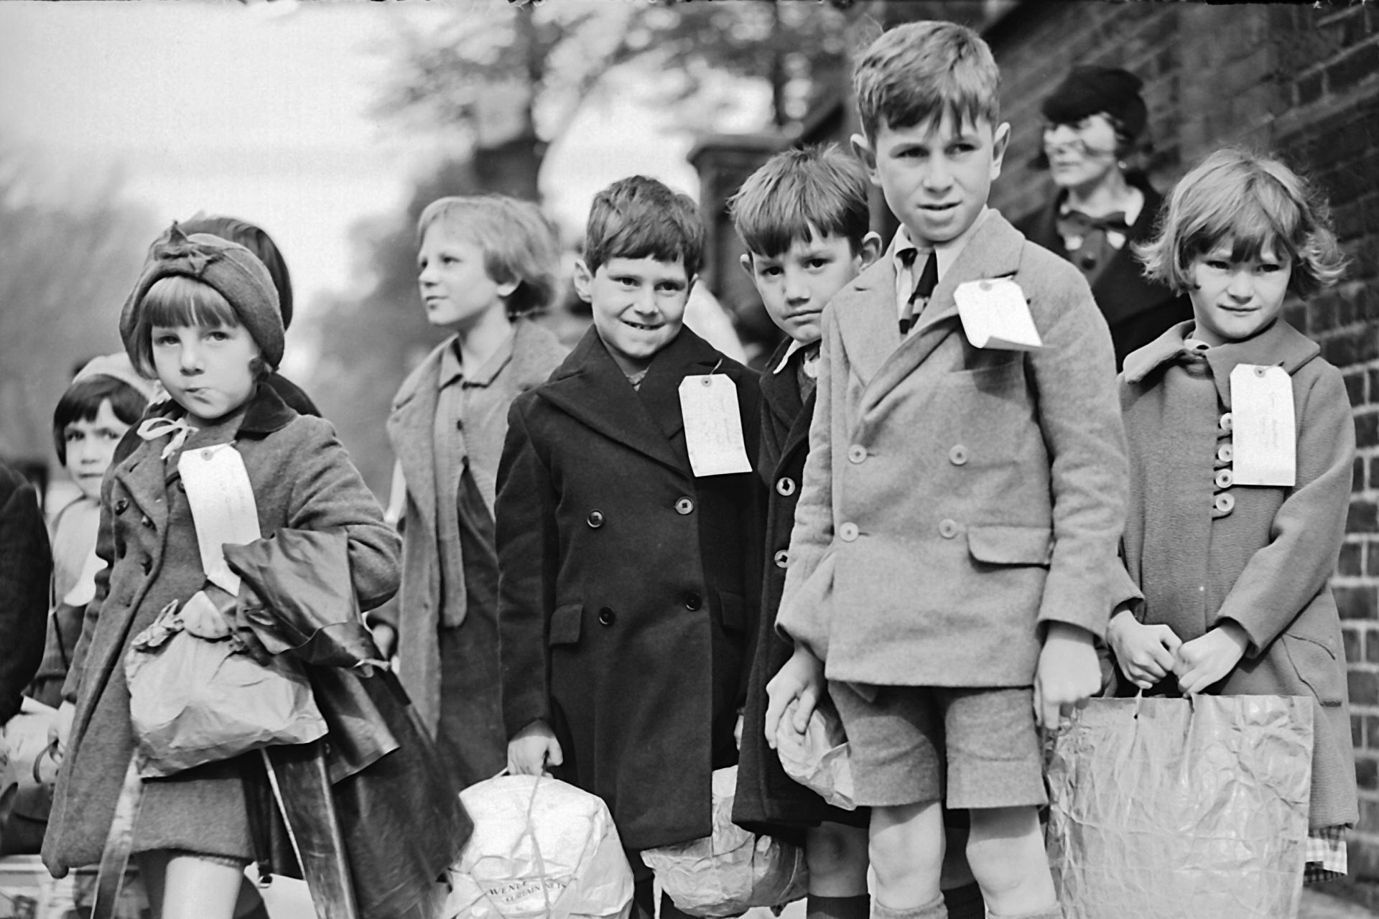
(b) The Impact of WW2
Evacuation (from the cities to the countryside) also put pressure on the overstretched Medical Services. Children were moved away from areas with plenty of doctors & resources, to areas with fewer doctors & far fewer facilities. District nurses had checked all evacuated children before moving them, but poorer children carried health issues to the countryside, especially skin infections.

Slide 16
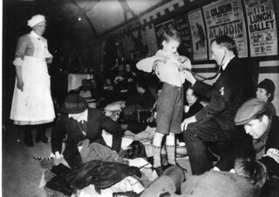
(b) The Impact of WW2
WW2 Medical Services were helped by volunteers. The Red Cross set up First Aid Posts & Mobile First Aid Units. This freed up Ambulances for immediately urgent cases. Volunteers acted as stretcher-bearers and gave treatment to people pulled from rubble. The Red Cross even set up a First Aid Unit in Picadilly Tube Station on the London Underground, amid the many taking shelter from the Blitz.

Slide 17
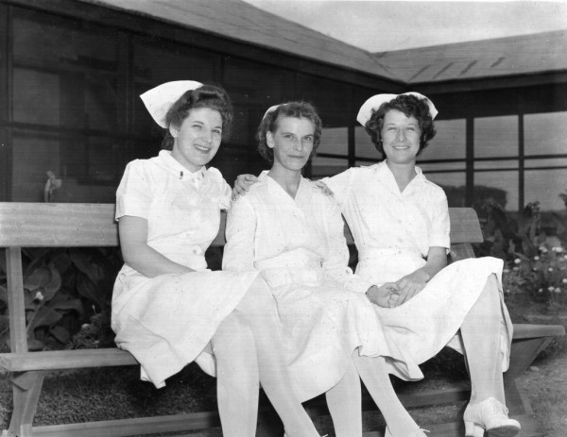
(b) The Impact of WW2
Many WW2 Nurses also served abroad with the Army, 1939-1945:
First Aid Nursing Yeomanry (FANY)
Voluntary Aid Detatchments (VAD)
Territorial Army Nursing Service (TANS)
Queen Alexandra’s Imperial Military Nursing Service (QAIMNS)

Slide 18
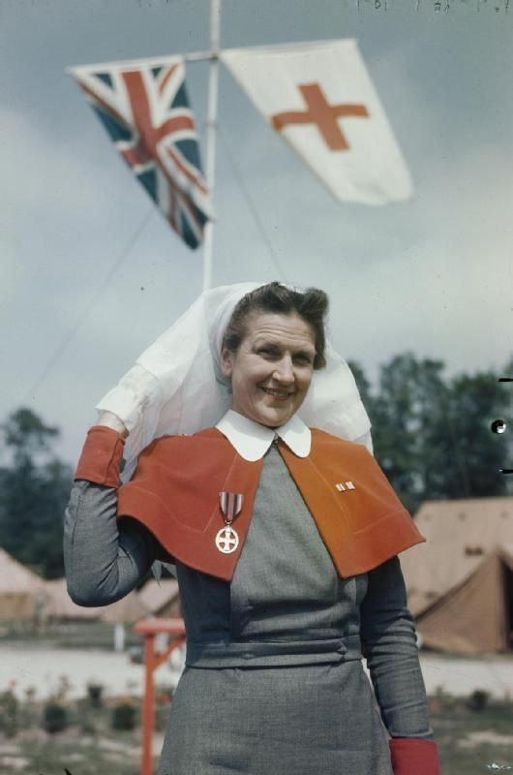
(b) The Impact of WW2
In 1938, there were about 500 QAIMNS working in Military Hospitals abroad. As war seemed increasingly likely, Matrons ‘requested’ suitably trained nurses join the QAIMNS. These nurses were all interviewed at the War Office & given an enveloped marked “Only open in the event of War.” In 1944, the British & American forces provided QAIMNS with physical & military training – including self-defence, rope-ladder climbing, how to jump from ship to boat & how to move across barbed-wire.

Slide 19
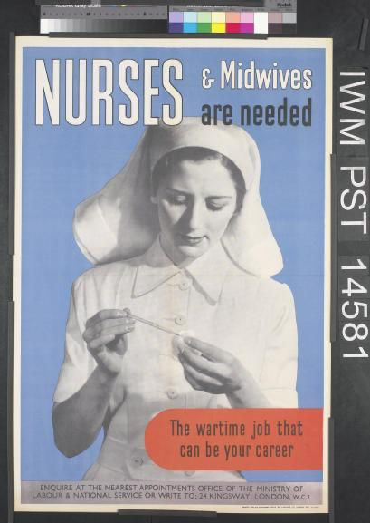
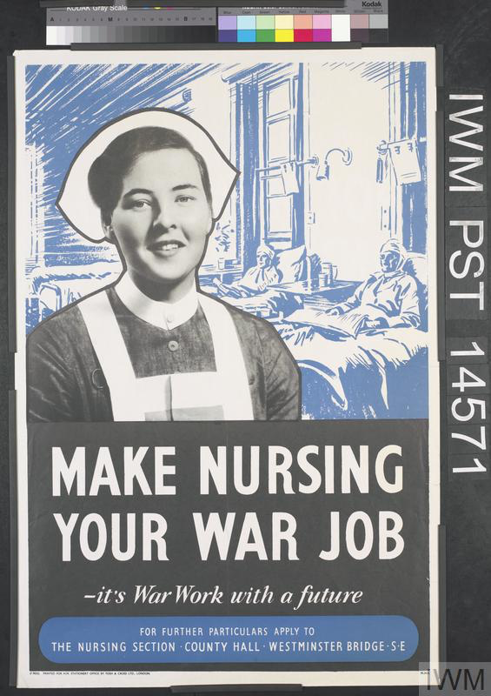
(b) The Impact of WW2
By 1945, QAIMNS had served in China, Egypt, Iceland & Italy. WW2 Recruitment of Army Nurses for work in overseas war zones was so successful that, in 1943, it was decided that only NEWLY QUALIFIED NURSES could join. This was done to ensure that there were enough experienced nurses left in Britain to treat the victims of civilian air raids by the German Luftwaffe.

Slide 20
Activity 50
IN 2012, THE ROYAL COLLEGE OF NURSES BEGAN TO PUT UP MEMORIALS FOR NURSES.
How many Nurses died upon active service in WW1+WW2?

Slide 22
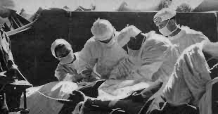
(b) The Impact of WW2
During WW1, doctors had realized it was essential to clean & treat wounds to avoid gangrene. The average time-gap between injury and operation, however, was 14 hours. PENICILLIN was particularly effective in preventing gangrene, so new mass-production of Penicillin after 1943 made it a key factor in increased Soldier survival rates.

Slide 23
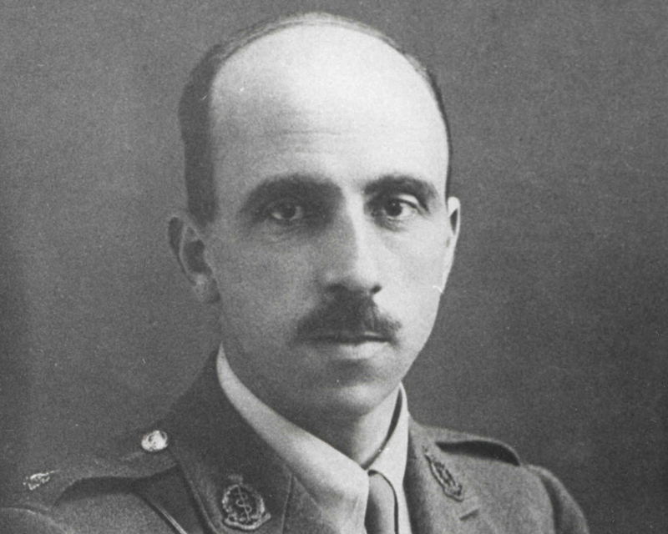
(b) The Impact of WW2
The biggest advance in surgical techniques was in the development of plastic surgery. In their 1920 book, PLASTIC SURGERY OF THE FACE, Harold Gillies & T.P. Kilner wrote about their WW1 experiences; Gillies was insistent that facial reconstruction of features should be undertaken with dental & other medical experts. His lectures on new techniques of plastic surgery saw Harold Gillies recognized with a knighthood in 1930. The same year, his NZ relative, Archibald McIndoe, moved to Britain to specialize in plastic surgery; becoming RAF Consultant Surgeon, 1938.

Slide 24
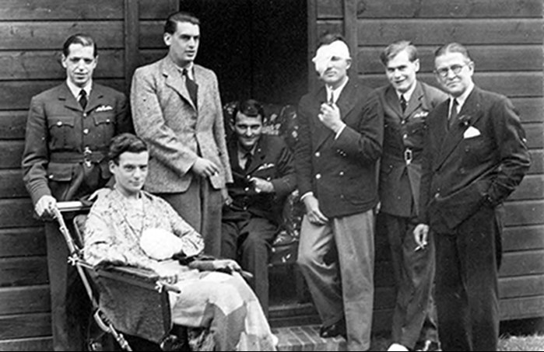
(b) The Impact of WW2
When WW2 broke out (1st Sept. 1939) there were only 4 fully experienced Plastic Surgeons in Britain. These were each asked to head up 4 separate Plastic Surgery Units – McIndoe led a Research Centre based at the Queen Victoria Hospital, East Grinstead, West Sussex. His work became famous in 1940, when he dealt with RAF pilots injured in the Battle of Britain.

Slide 25
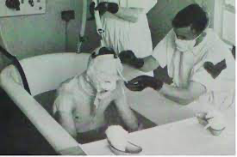
(b) The Impact of WW2
Planes that caught on fire caused deep burns:
Damaged Muscles & Nerves restricted feeling in burned areas and movement
Disfigurement led to psychological problems
Treatment for burns developed during WW2:
A chemical coating protected burns, but the chemical shrank tissue around the burns
McIndoe noticed burned pilots who crashed in the sea healed better, so McIndoe banned the chemical treatment & used Saline Baths instead

Slide 26
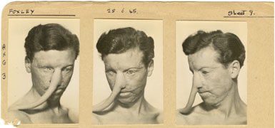
(b) The Impact of WW2
Skin Grafts were in their infancy during WW1. Transplanted tissues need a good blood supply otherwise the grafts will not be successful.
In WW1, Ukranian surgeon VLADIMIR FILATOV developed PEDICLE SKIN GRAFTS; growing flaps of skin for grafting.
In WW2, HAROLD GILLIES developed PEDICLE TUBES and VLADIMIR FILATOV developed EYE TRANSPLANTS.
Scientist LEONARD COLEBROOK discovered ways of dealing with infections in burns.

Slide 27
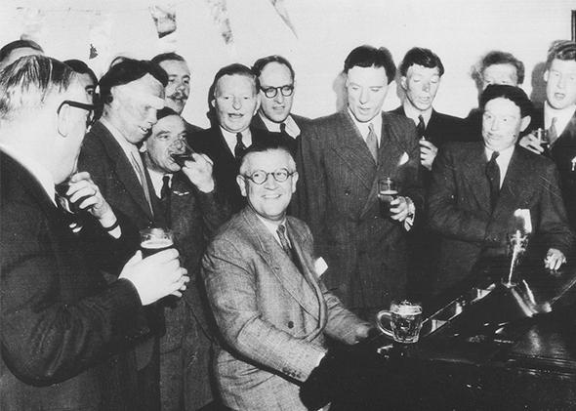
(b) The Impact of WW2
Patients of Archibald McIndoe called themselves the “GUINEA PIG CLUB” – the new techniques were trial & error, treatments were untested & some patients endured over 30 operations each. Positivity was promoted in patients:
They wore their Army uniforms & walked about
A barrel of beer was kept on the Ward
Even smoking was permitted!
“Guinea Pig Club” Patients were accepted in areas around the Hospital & East Grinstead was hailed as “The Village where No One stared.” In 1947, McIndoe was knighted, just like Gillies.

Slide 28
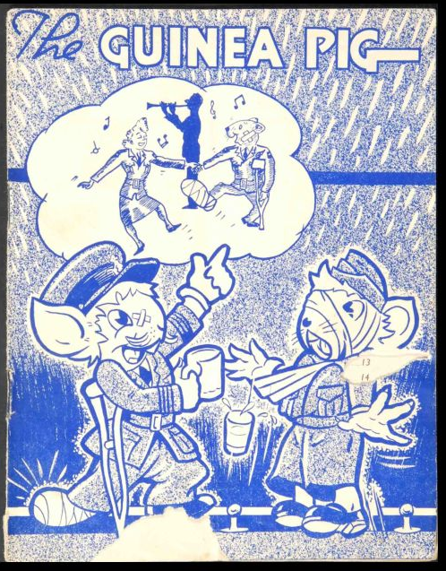
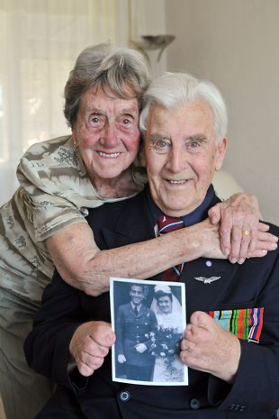

Slide 29
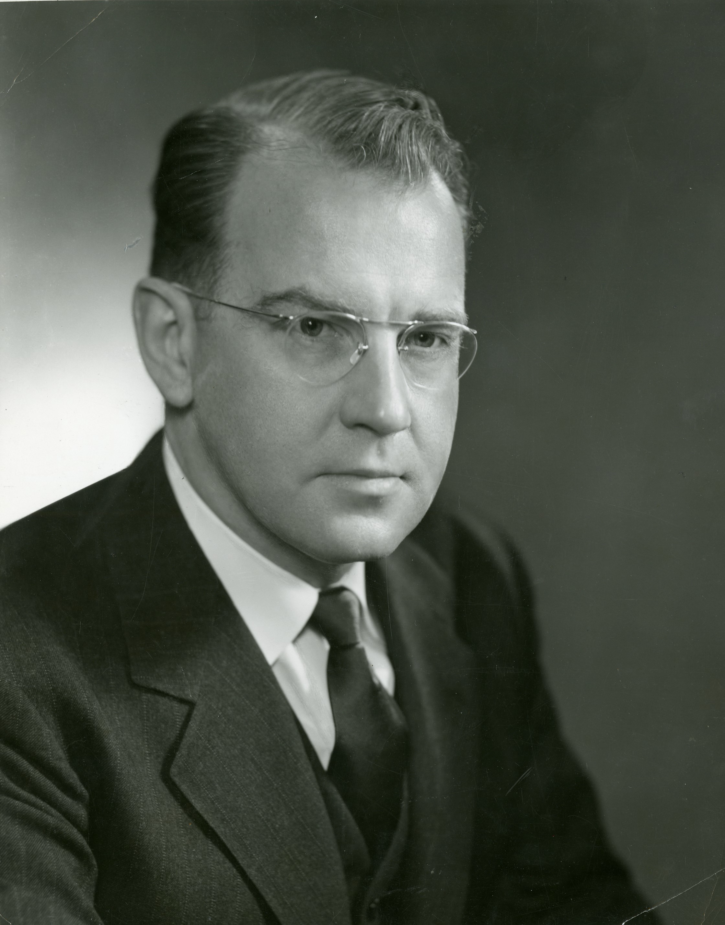
(b) The Impact of WW2
After US surgeon, Harvey Cushing, had began neurosurgery during WW1, a British surgeon, Wylie McKissock followed up in the 1930s. After researching in Sweden & America, he developed new techniques in neurosurgery & set up a vital Neurosurgical Unit during WW2.
Another US surgeon, Dwight Harken, made a huge step forward when he developed a new technique to remove bullets & shrapnel from the heart. He carried out 130 successful operations without a single death occurring. Without Dwight Harken’s work, modern heart surgery would not be possible today.

Slide 30
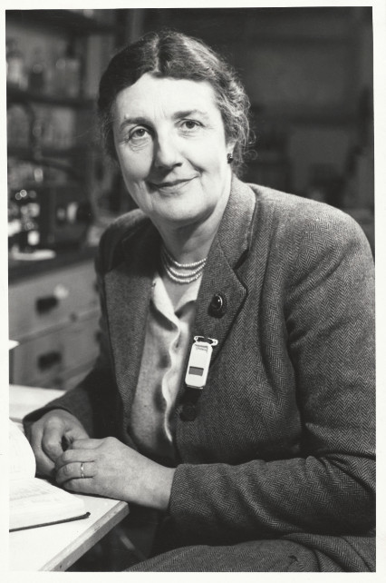
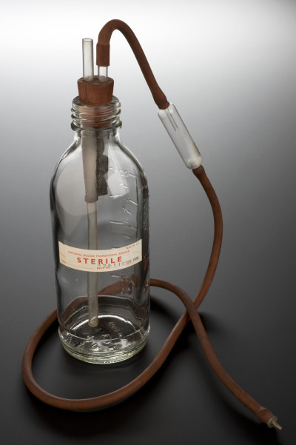
(b) The Impact of WW2
Blood Transfusions also developed throughout WW2, into an efficient organization – storing & delivering blood wherever it was needed. In 1938, with war looming, DR. JANET VAUGHAN collected 50 bottles of blood from volunteer donors – the largest stock of stored blood in London at the time. An Army Blood Supply Depot was set up in Bristol & 4 large civilian blood banks were created across London; in 1940, 8 regional blood centres were set up.

Slide 31
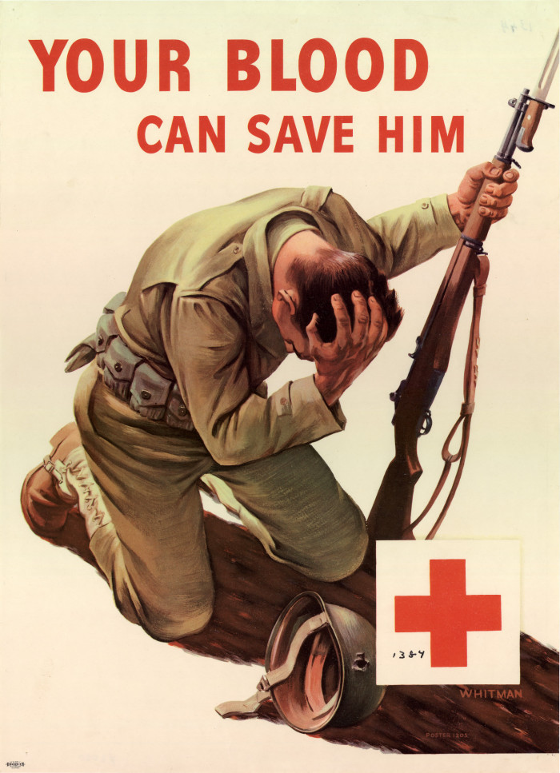
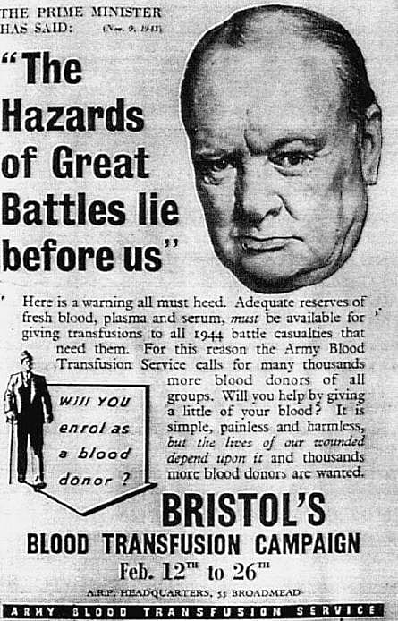
(b) The Impact of WW2
In total, over 700,000 donors gave blood during WW2. Doctors also started using BLOOD PLASMA as a substitute for whole blood and even a dried plasma package was developed. This innovation made the transportation & storage of blood much simpler. When the RHESUS blood group system was discovered in 1939, blood transfusions became even safer.

Slide 32
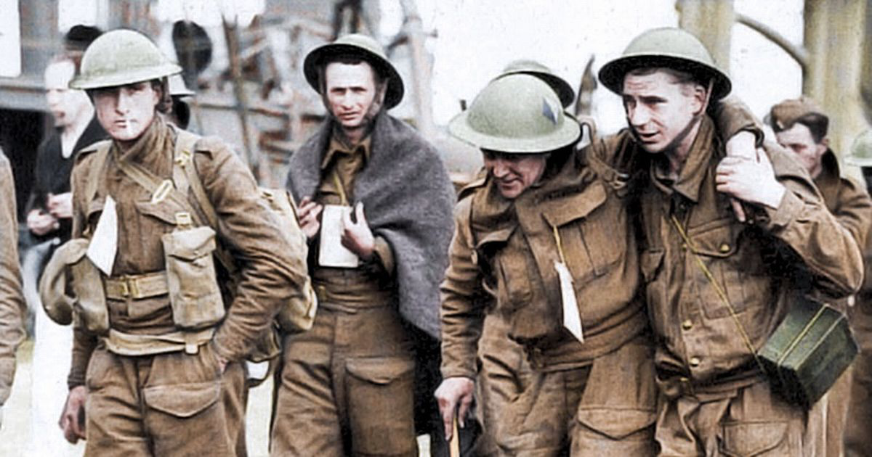
(b) The Impact of WW2
Tetanus is a disease caused when microorganisms enter a wound and get into the bloodstream. It causes muscle spasms, high temperature & rapid heartbeat – often ending in death. Bacteriologists had been developing a Tetanus vaccine in 1939, just as WW2 was starting. At the Battle of Dunkirk, over 17,000 vaccinated soldiers were wounded. Not a single one of the vaccinated soldiers developed Tetanus.

Slide 33
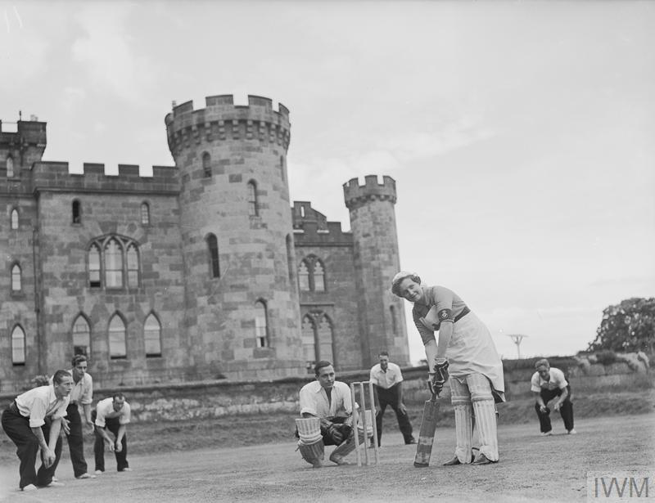
(b) The Impact of WW2
Post-Traumatic Stress Disorder (PTSD) had been evident in WW1, known as “Shell Shock”, but attitudes towards sufferers veered between disbelief it existed to putting it on in cowardice. Treatment for “Shell Shock” was limited to receiving Electric Shocks or being locked away in Mental Asylums. By WW2, however, 18 Psychiatric Hospitals had been set up for Service Men with mental health problems. Stately homes, like Cholmondeley Castle, provided pleasant, peaceful convalescence conditions to help PTSD patients recover.

Slide 34
Exam-Style Question
How far were developments in Science & Technology responsible for changes in medicine 1905-48?
You may use the following in your answer:
Magic Bullets
Plastic Surgery
You must also use information of your own.
(16 marks)

