Slide 1
Edexcel IGCSE History P2: Breadth Study B1
Changes in Medicine,
1848-1948

Slide 2
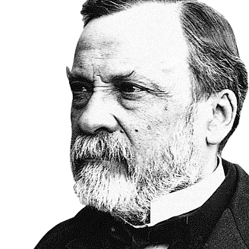

Slide 3
Edexcel IGCSE History P2: Breadth Study B2
Changes in Medicine,
1848-1948
5. Advances in Medicine, Surgery
& Public Health, 1920-1948

Slide 4
Activity 47
THE NEXT CHANGE TO MEDICINE WAS BY ALEXANDER FLEMING.
How was Fleming involved in WW1 & how did it influence his work after returning from war?

Slide 6
(a) Alexander Fleming’s Discovery
Alexander Fleming’s first-hand work with septicaemia & gangrene in WW1 wounds only emphasized the fact that antiseptics were ineffective. He soon realized that new treatments, like the “magic bullet” SALVARSAN 606, were needed to fight microorganisms that caused infections. In 1922, he found that lysosome (an enzyme in tears) killed microorganisms – but only the harmless ones, not the ones causing infections. Fleming did not pursue this lysosome work any further, however, as the laboratory he worked at was focused on vaccines, not bacteria.

Slide 7
(a) Alexander Fleming’s Discovery
In 1928, Fleming became Professor of Bacteriology. He was well-known for his research … and his untidy methods & his untidy desk! He had been studying staphylococcus cultures and, when he went away on holiday, he left a pile of cultures in the corner of his messy laboratory. When he returned from holiday, he saw one of the cultures had been contaminated by mould – but then noticed the staphylococcus culture had been destroyed in the area around the mould. This was the breakthrough that led Fleming to grow mould in a pure culture & use it to kill various microorganisms that cause disease – this was PENICILLIN and, not based on chemicals, it was instead an example of an ANTIBIOTIC – where one bacteria attacked & killed another bacteria.

Slide 8
(a) Alexander Fleming’s Discovery
Penicillin was not really a new discovery – in the Medieval period, people discovered that mouldy bread was sometimes effective against infection if spread into a wound. But they could not explain why, of course, as microscopes were not around to see the bacteria. In 1871, Joseph Lister had used penicillin to treat a nurse at King’s College Hospital after her wounds were unresponsive to antiseptic. Louis Pasteur & Ernest Duchesne had also noticed how types of penicillium were effective against infection … so Fleming’s “discovery” wasn’t all that exciting or significant in the Medical World.

Slide 9
(a) Alexander Fleming’s Discovery
In 1929, Fleming published his Penicillin research in the BRITISH JOURNAL OF EXPERIMENTAL PATHOLOGY. He was pretty much ignored, however, as few people realized how important pencillin was to treatment. It has 2 major drawbacks:
It was only possible to produce Penicillin in small quantities.
Laboratory tests suggested it was slow to act & ineffective when mixed with blood.
Fleming himself only saw it as an external cream, not as an internal drug … so his funding failed and he returned to investigating staphylococcus cultures.

Slide 10
(a) Alexander Fleming’s Discovery
Since the discovery of SALVARSAN 606, Scientists had been desperately trying to develop another “magic bullet” to treat other diseases.
In 1932, German Scientist GERHARD DOMAGK tested a bright red chemical compound (PRONTOSIL) used to dye wool & leather. Domagk found that Prontosil killed streptococcus bacteria infections in mice.
In 1935, when 6-year-old HILDEGARD DOMAGK was ill after an embroidery needle infected her arm, her father refused an amputation – ignoring the Doctor, Domagk gave Hidegard Prontosil + she was cured.
A desperate dad had risked his daughter’s life, but saved it in the process and proved Prontosil worked!

Slide 11
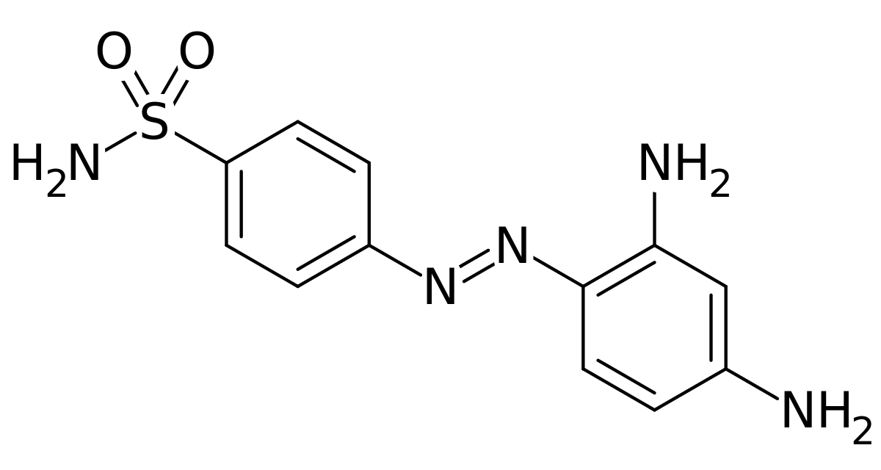
(a) Alexander Fleming’s Discovery
Domagk published his Prontosil laboratory results and a British Hospital tested the use of Prontosil as a cure for PUERPERAL FEVER – a bacterial infection associated with childbirth. The key ingredient of Prontosil was SULPHONAMIDE and, soon after the puerperal fever discovery, other sulphonamide drugs were developed which could cure PNEUMONIA, SCARLET FEVER and MENINGITIS.

Slide 12
(a) Alexander Fleming’s Discovery
In his 1945 Nobel Prize for Medicine speech, Fleming said “I had a clue that here was something good but I could not possibly know how good it was and I had not the team, especially the chemical team, necessary to concentrate and stabilize the penicillin.” This shows how little to no progress had been made because a chemist was needed to purify the mould.
In 1939, however, a team at an Oxford Hospital – led by HOWARD FLOREY & ERNST CHAIN – followed up on Fleming’s abandoned research. Despite limited funds, but with vital biochemist support from NORMAN HEATLEY, they constructed equipment to purify Penicillin cheaply. Experiments could begin.

Slide 13
(a) Alexander Fleming’s Discovery
In 1940, the Oxford Team had purified enough Penicillin to test its effects on mice:
8 mice were given sufficient streptococci to kill them
4 of the 8 mice were given Penicillin
Within 16 hours, the 4 mice not given Penicillin had died.
The remaining 4 mice given Penicillin survived for various amounts of time.

Slide 14
MICE NOT TREATED WITH PENICILLIN
MOUSE 1 | Very sick 7 hours after infection | Survived for 12 hours
MOUSE 2 | Very sick 7 hours after infection | Survived for 14 hours
MOUSE 3 | Very sick 7 hours after infection | Survived for 14 hours
MOUSE 4 | Very sick 7 hours after infection | Survived for 16 hours
MICE TREATED WITH PENICILLIN
MOUSE 5 | Given 10mg after 2 hours | Survived for 4 days
MOUSE 6 | Given 10mg after 2 hours | Survived for 6 days
MOUSE 7 | Given 5mg after 2,4,6,8,10 hours | Survived for 13 days
MOUSE 8 | Given 5mg after 2,4,6,8,10 hours | Survived for 6+ weeks

Slide 15
(a) Alexander Fleming’s Discovery
The Penicillin mice results were a real breakthrough. To have enough Penicillin mould to purify it for a test treatment on a human, however, 500 litres of mould was needed. Norman Heatley experimented with the best containers to produce large amounts – he even employed 6 “Penicillin Girls” to be responsible for the culture.
By 1941, the Oxford Team thought they had purified enough Penicillin for their first human test.

Slide 16
Activity 48
NORMAN HEATLEY TRIED TO FIND CONTAINERS TO GROW PENICILLIN CULTURE – PIE TINS, BISCUIT TINS + PETROL CANS.
What finally proved to be best?

Slide 18
(a) Alexander Fleming’s Discovery
In 1941, Albert Alexander, was the first ever Penicillin patient. A policeman from Oxford, he had developed septicaemia after getting a scratch from a rose bush; his face, eyes & scalp were badly swollen. Doctors removed one eye & drained Albert’s abscesses, but his remaining eye was still badly swollen & very painful.
Albert Alexander was given Penicillin and swiftly started to recover … but, on the fifth day, the Oxford Team ran out of penicillin! Desperate to deliver the doses, they collected Albert’s urine each day to extract Penicillin passed through his body. But, unfortunately, they could not produce enough Penicillin to complete his course of treatment & he died on 15th March, 1941.

Slide 19
(a) Alexander Fleming’s Discovery
The treatment of Albert Alexander had clearly shown the potential that Penicillin had to save peoples’ lives. It had also highlighted how important it was to manufacture large quantities of Penicillin. The Oxford Team agreed that their drug should only be used on children – as they would require smaller doses of Penicillin. Like many breakthrough scientists before him, Florey refused to patent Penicillin as he firmly believed it should be available to everybody once it could be mass-produced.

Slide 20
(a) Alexander Fleming’s Discovery
Howard Florey knew the Oxford Team needed funding & a large-scale factory to grow & purify Penicillin in life-saving large quantities. With Britain at war, however, funding was unavailable. British factories were either fully engaged on the war effort, producing existing drugs, or had been bombed by the Blitz. Florey got pharmaceutical companies in the USA, not involved in WW2 yet, to fund him. Penicillin impressed US Scientists & 35 institutions wanted in on the action – these included University Chemistry Departments, Government Agencies, Research Foundations & Drug Companies. When Roosevelt declared war in December 1941, even more funds came to Florey.

Slide 21
(a) Alexander Fleming’s Discovery
By 1943, Howard Florey had purified enough Penicillin to test on a large scale – in WW2. He flew to North Africa to treat wounded Allied soldiers – where the hot & humid conditions meant wounds became infected. To prevent so many limbs ending up amputated, Florey suggested fresh wounds be cleaned and the injured soldiers given Penicillin. This real-life test on live subjects proved extremely effective and provided further proof that Penicillin was not only a massive step forward in treating war wounds, but a useful everyday treatment.

Slide 22
(a) Alexander Fleming’s Discovery
Florey’s North African results were convincing & techniques for mass production were improving as the war went on. By 1944, there was enough Penicillin to treat all the Allied casualties in the D-Day landings. This new ANTIBIOTIC was used for military patients who had undergone major operations (including amputations) or had sustained extensive wounds. Penicillin was given to patients by injection, but it took time to prepare the wonder drug – Penicillin powder had to be mixed with sterile saline before it could be injected & syringes had to be sterilized before being reused.

Slide 23
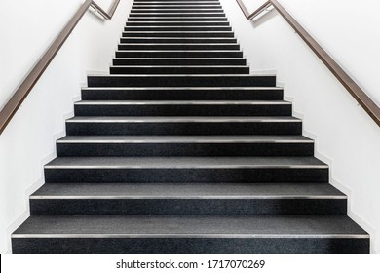
MAIN FACTORS IN THE DEVELOPMENT OF PENICILLIN
Science – Ability to observe bacteria attack bacteria
Technology – Availability with methods of mass production
Attitudes in Society – New treatments had urgency in WW2
Individuals – Florey & Chain build upon the work of Fleming
Research – US government & US institutions funded Florey for 5 years

Slide 24
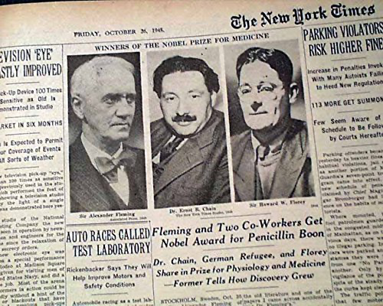
(a) Alexander Fleming’s Discovery
In 1942, Sir Almroth Wright (Head of Fleming’s Department at St. Mary’s Hospital, London) wrote to The Times newspaper complaining that Fleming had been “overlooked” in the discovery of Penicillin. This, in turn, upset the Oxford Team of Chain & Florey, who felt that their role in developing mass production was equally overlooked too.
In 1945, the Nobel Prize for Medicine was jointly awarded to Fleming, Florey & Chain. (Norman Heatley had died by this point & posthumous awards are not made). It has been estimated that at least 200 million lives have been saved by Penicillin since 1942.

Slide 25
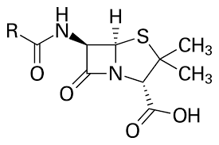
(a) Alexander Fleming’s Discovery
Further research using Penicillin demonstrated that one bacteria could be used to attack another bacteria – originally Streptococcus. Soon after, Scientists found that another mould could be used to make STREPTOMYCIN which could be used to treat the 19th Century TUBERCULOSIS. Some people are allergic to naturally purified Penicillin, but after 1,000 US & UK Scientists worked in 39 laboaratories (at a research cost of $20,000,000) a synthetic version of Penicillin was developed & produced in 1955.

Slide 26
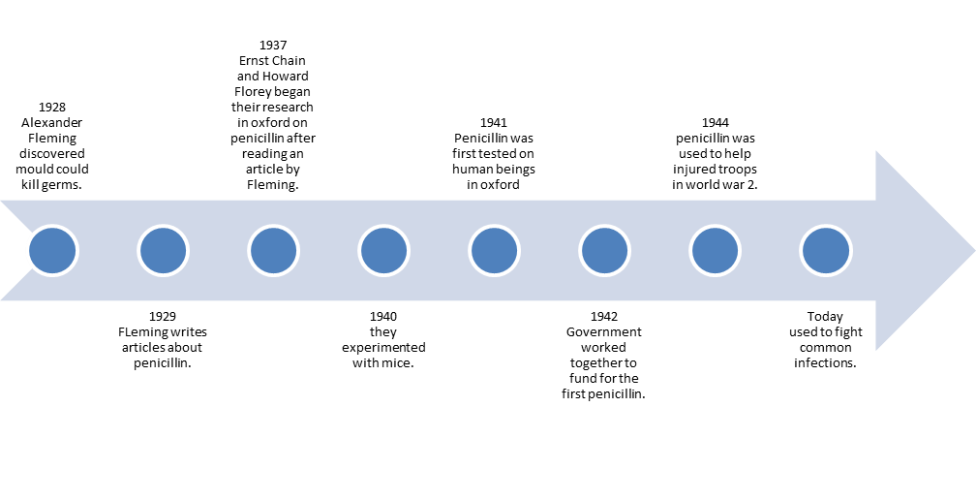

Slide 28
Exam-Style Question
Explain two causes of improvement in treatment from 1905 to 1948. (8 marks)

