Slide 1
Edexcel IGCSE History P2: Breadth Study B1
Changes in Medicine,
1848-1948

Slide 2
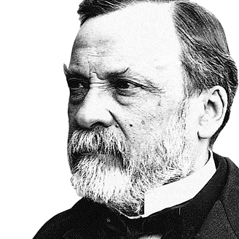

Slide 3
Edexcel IGCSE History P2: Breadth Study B2
Changes in Medicine,
1848-1948
4. Government Action & War, 1905-1920

Slide 4
Activity 42
Weaponry was the most damaging ever during WW1.
What sort of injuries were surgeons having to deal with?

Slide 6
(c) The First World War improves Surgery
X-rays proved essential for precise surgery during WW1. Base Hospitals & Casualty Clearing Stations had X-ray machines & Marie Curie’s French X-ray Units were soon mirrored by 6 British X-ray Units. By taking 2 X-rays from different angles, surgeons could locate metal in wounds very precisely & surgery was less haphazard as a result.

Slide 7
(c) The First World War improves Surgery
There were some issues, however, that stopped X-rays being used to their full potential:
X-rays could not identify fragments of clothing, likely to cause infection.
Wounded soldiers had to stay still for X-rays, even in writhing agony & pain.
Glass tubes in X-ray machines often overheated after just 1 hour, so continuous use was impossible.
High doses of radiation during X-rays was harmful & could cause burns.

Slide 8
(c) The First World War improves Surgery
Blood loss was a major problem during WW1, as many soldiers ‘bled out’ from injuries that would not have been fatal in peace time. Blood transfusions, however, had developed before the war began. As the blood donor had to be present during the transfusion, though, this made them impractical on the Front. Scientists were forced by WW1, then, to experiment with better ways to prevent blood clotting to increase the time that blood could be stored for Front Line transfusions.

Slide 10
(c) The First World War improves Surgery
Delays in surgery were known to increase the chances of infection, especially with GAS GANGRENE in the wound. It was impossible, however, to recreate the aseptic conditions of a London Hospital in a Dressing Station or Casualty Clearing Station. There were so many casualties, for example, that wounded men would be left on the floor (in the dirt or in the mud) because there were not enough beds for them.

Slide 11
(c) The First World War improves Surgery
WW1 surgeons knew that infected tissue needed to be removed as soon as possible and the wound thoroughly cleansed of microbes. New techniques were developed:
EXCISION / DEBRIDGEMENT to cut away infected tissue & reduce the risk of gangrene.
STERILISED SALT SOLUTION fed through the wound was also effective for cleaning wounds. This was the Carrel-Dakin method, first successful in 1917.
Both of these were time-consuming, however, so AMPUTATION remained the safest option to guarantee infection was avoided. By 1918, over 240,000 men had lost limbs … many to avoid infection.

Slide 12
(c) The First World War improves Surgery
A major problem of broken bones in WW1 was they could break through the skin to create an open wound. Keeping broken limbs as still & straight as possible before operating was made difficult by carrying men on stretchers from the Front Line to a Casualty Clearing Station. By the time most soldiers had been moved, amputation was the best option. Otherwise, the wounded soldier would be likely to die of infection, bleeding or gas gangrene.

Slide 13
(c) The First World War improves Surgery
Robert Jones worked in a London Hospital and he developed a method to keep a wounded soldier’s leg still. He named the device after his uncle, Hugh Thomas, who had originally developed the idea. This ‘Thomas Splint’ was first introduced on the Western Front in the winter of 1915. It proved incredibly effective.
As a result of the ‘Thomas Splint’ the survival rate for broken limbs in WW1 improved from 20% to 82%.

Slide 14
(c) The First World War improves Surgery
Due to the fact 240,000 men lost a limb, there was a massive need for prosthetic replacements. As a result of WW1, protheses became much more advanced:
LIGHTER METAL ALLOYS were used to construct the prosthetic limbs.
MECHANISMS for movement improved to allow those with protheses a better quality of life.
Waiting lists, however, were long as prosthetics took so long to make, plus it was necessary to train those with protheses how to use them.

Slide 15
(c) The First World War improves Surgery
Soldiers soft cloth caps from 1914 were soon replaced by steel helmets in 1915. Nevertheless, many soldiers still suffered serious head injuries. Before WW1, there was little or no brain surgery or operations on the central nervous system. During WW1, surgeons had to deal with these new challenges. On top of bleeding and infection, soldiers with head wounds were confused or unconscious. US neurosurgeon HARVEY CUSHING experimented with magnets to draw out metallic shards; he also found local anaesthetic was better than general, as the latter caused the brain to swell.

Slide 16
(c) The First World War improves Surgery
Head injuries caused terrible non-fatal wounds; facial bones were often smashed, eyes lost, jaw bones knocked clean off, or be left with gaping holes in their faces. New Zealand doctor, HAROLD GILLIES, experimented with new techniques – using pieces of bone or cartilage for new facial features, rather than injured soldiers simply wearing a mask to hide any injuries.

Slide 17
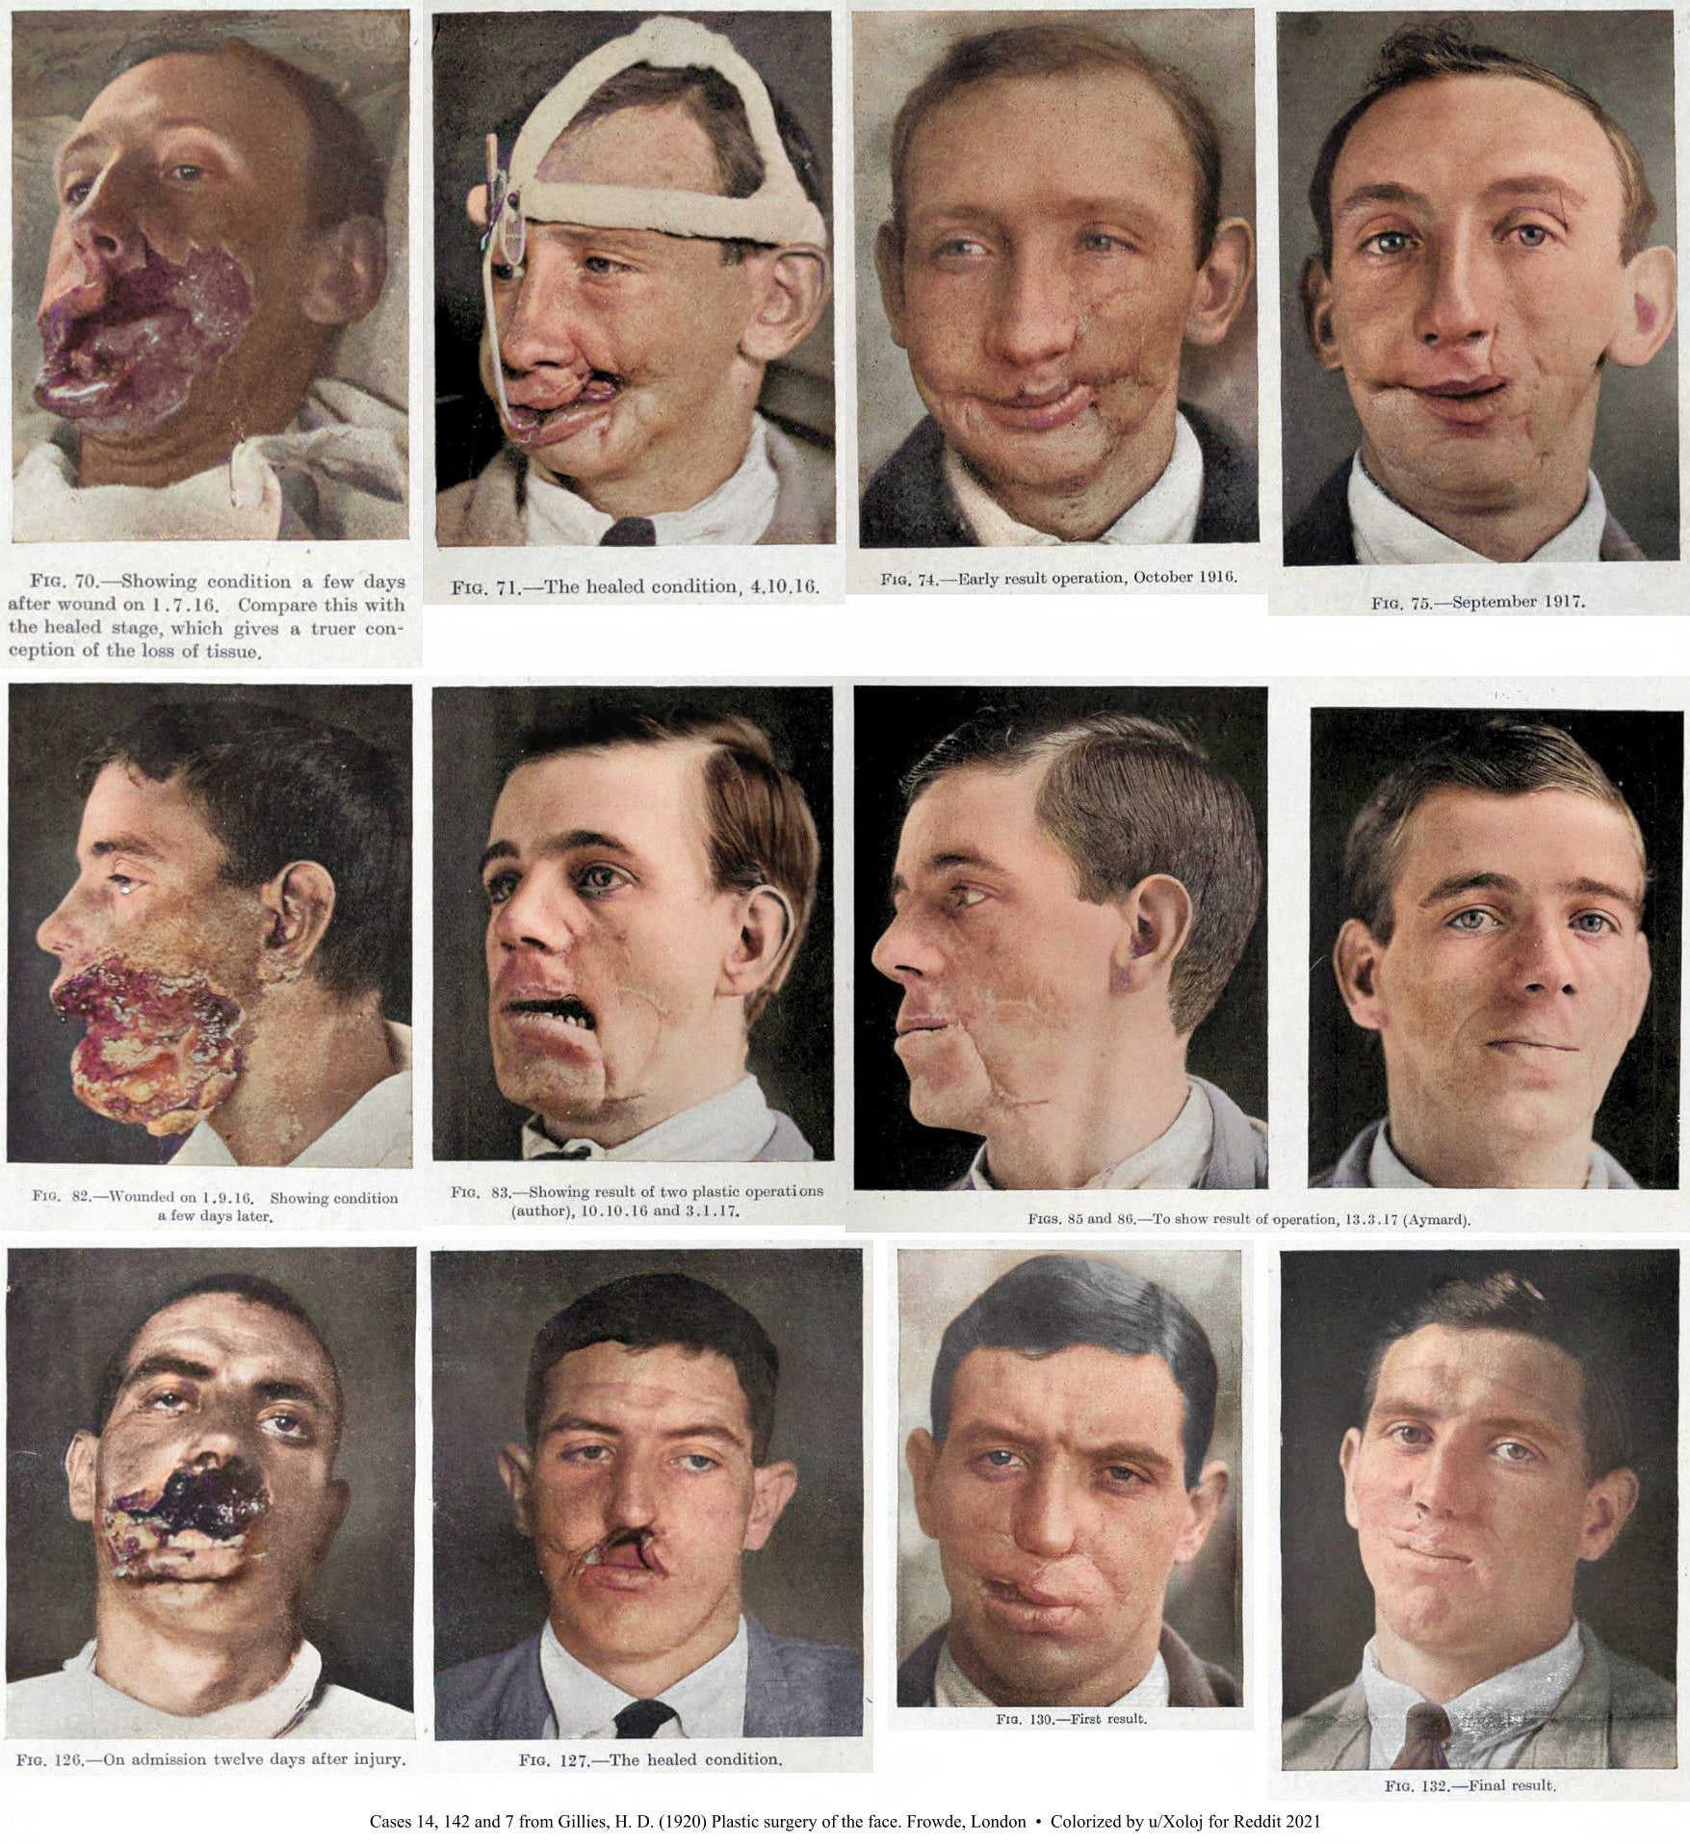
(c) The First World War improves Surgery
Before WW1, surgeons developed skin grafts – taking tissue from one part of the body to repair another part – but these grafts were often rejected & unsuccessful. HAROLD GILLIES felt that skin grafts could be improved if blood flow to the grafted tissue was maintained. He developed the PEDICLE TUBE technique – where a flap of skin was ‘grown’ until it could be attached to the new part of the body. In 1917, Harold Gillies set up a Plastic Surgery Unit at the Queen’s Hospital, Sidcup, Kent. Nearly 12,000 operations were carried out by the end of 1918.

Slide 18
Activity 43
Create a Timeline for
WW1 developments.
Scientific Knowledge; Technology; New Surgical Techniques; Blood Transfusions; X-rays; Prostheses.

Slide 20
Exam-Style Question
Explain two causes of improvements in surgery from 1905-1920.
(8 marks)

Slide 22
Activity 44 – Recall Quiz
Name one act passed by the Liberal Government to help children become healthier.
Why was there opposition to Lloyd George’s introduction of pensions?
Who was helped by the National Insurance Act, 1911?
Who didn’t benefit from the National Insurance Act, 1911?
What was the RAMC?

Slide 24
Activity 44 – Recall Quiz
Name 3 medical conditions that affected soldiers during WW1.
What was the role of VADs and FANYs in WW1?
Why did WW1 lead to an increase of female doctors?
State 2 ways in which technology improved surgery during WW1.
Give 2 examples of areas of surgery where progress was stimulated by WW1.

Slide 26
Activity 45 – Explaining
Explain why the Government wanted to improve the health of the nation.
Explain why the Liberal Government reforms aimed to create a healthier nation.
Explain the types of injury that soldiers suffered during the First World War.

Slide 28
Activity 46 – Challenge
How much impact did the Liberal Government reforms have on public health?
How much did the position of women in medicine change from 1905 to 1920?
In what area of surgery did the First World War lead to most progress?

