Slide 1
Edexcel IGCSE History P2: Breadth Study B1
Changes in Medicine,
1848-1948

Slide 2
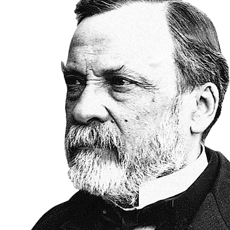

Slide 3
Edexcel IGCSE History P2: Breadth Study B2
Changes in Medicine,
1848-1948
4. Government Action & War, 1905-1920

Slide 4
Activity 38
People expected war to be over by Christmas, 1914.
Why did the war actually last until 1918 instead?

Slide 6
(b) The First World War, 1914-1918
Unlike all the wars that had gone before, World War One saw soldiers fighting a new style of warfare. The development of new weapons & new tactics meant worse injuries that needed medical treatment. It was very dangerous to be out in the open, so trenches were dug on “The Western Front” across Belgium & France. This was of attrition meant the only way to gain an advantage was to attack using huge numbers of soldiers in Battles; resulting in massive numbers of casualties, putting enormous strain on existing Army Medical services.

Slide 7
(b) The First World War, 1914-1918
The First World War led to far more casualties than any previous war. Most injuries were caused by bullets or shrapnel and many wounds became infected as bits of muddy clothing were carried into wounds. Gangrene in WW1 was a particular problem – when the blood supply cannot reach a part of the body, so it begins to rots.
The microorganisms causing gangrene produce foul smelling gas and, in trenches, gangrene usually proved fatal.

Slide 8
(b) The First World War, 1914-1918
For the first time, too, medical treatment had to be provided to those suffering the effects of poison gas attack. Chlorine and Phosgene gases killed few soldiers, but they needed to be given oxygen & hospitalized for up to 2 months. Mustard gas, however, saw soldiers need to bathe with hot soapy water to remove the chemical from their skin – making portable showers a requirement of Medical Units. 186,000 soldiers were injured by gas, 80% of these by Mustard gas, but only 2.6% died after gas attack.

Slide 9
Activity 39
Phosgene, Chlorine & Mustard Gas were used extensively on The Western Front.
Find out when these 3 gases were first used in attacks?

Slide 11
(b) The First World War, 1914-1918
Living conditions in the trenches were extremely unhealthy, so soldiers had to deal with disease as well as awful injuries. Rats grew as big as cats feeding on the dead. Body lice thrived in dirty, muddy clothes that never got changed. Rain made trenches water-logged, so soldiers developed Trench Foot after being constantly ankle-deep all day. The dirt & mud, moreover, made infection of wounds easier.

Slide 12
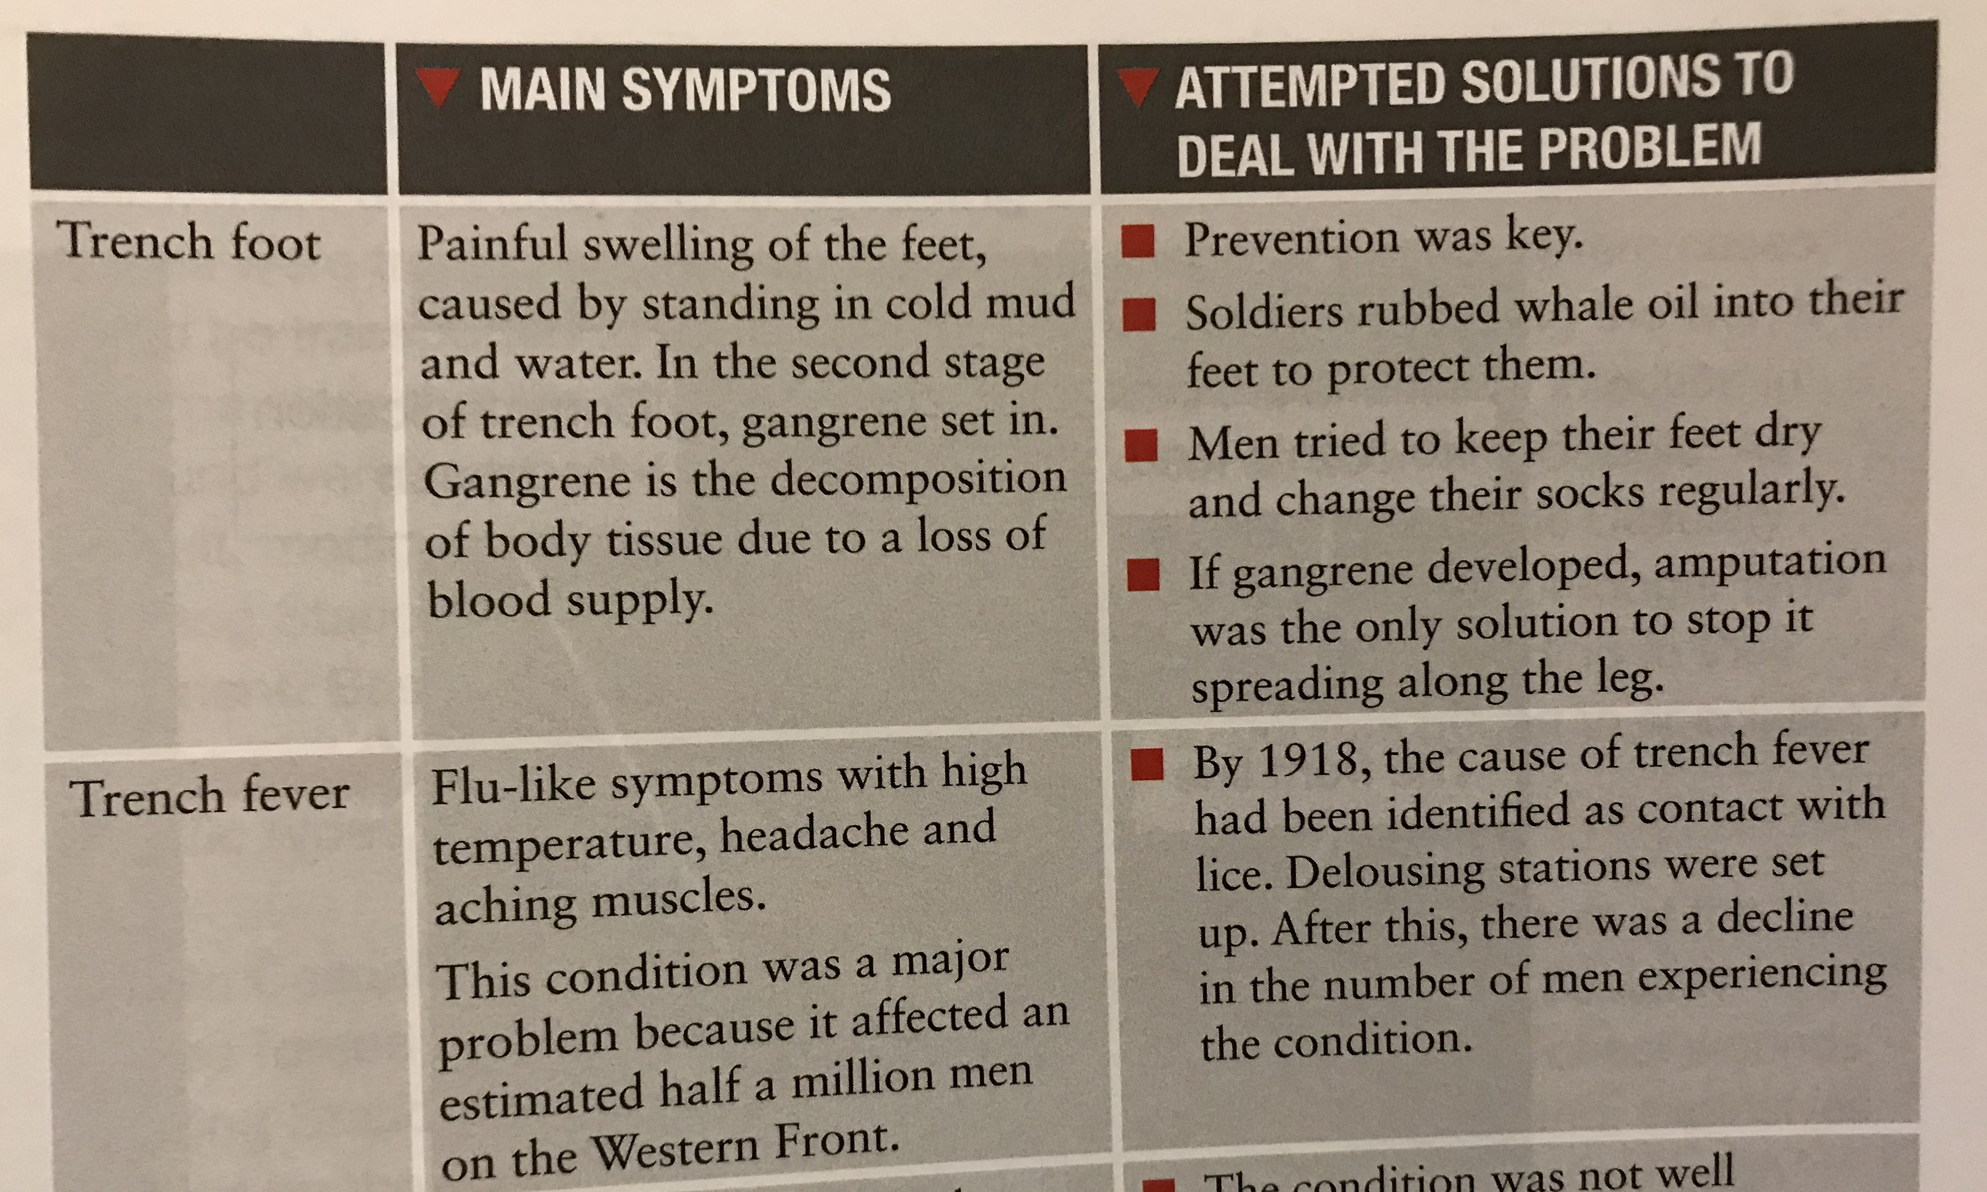

Slide 13
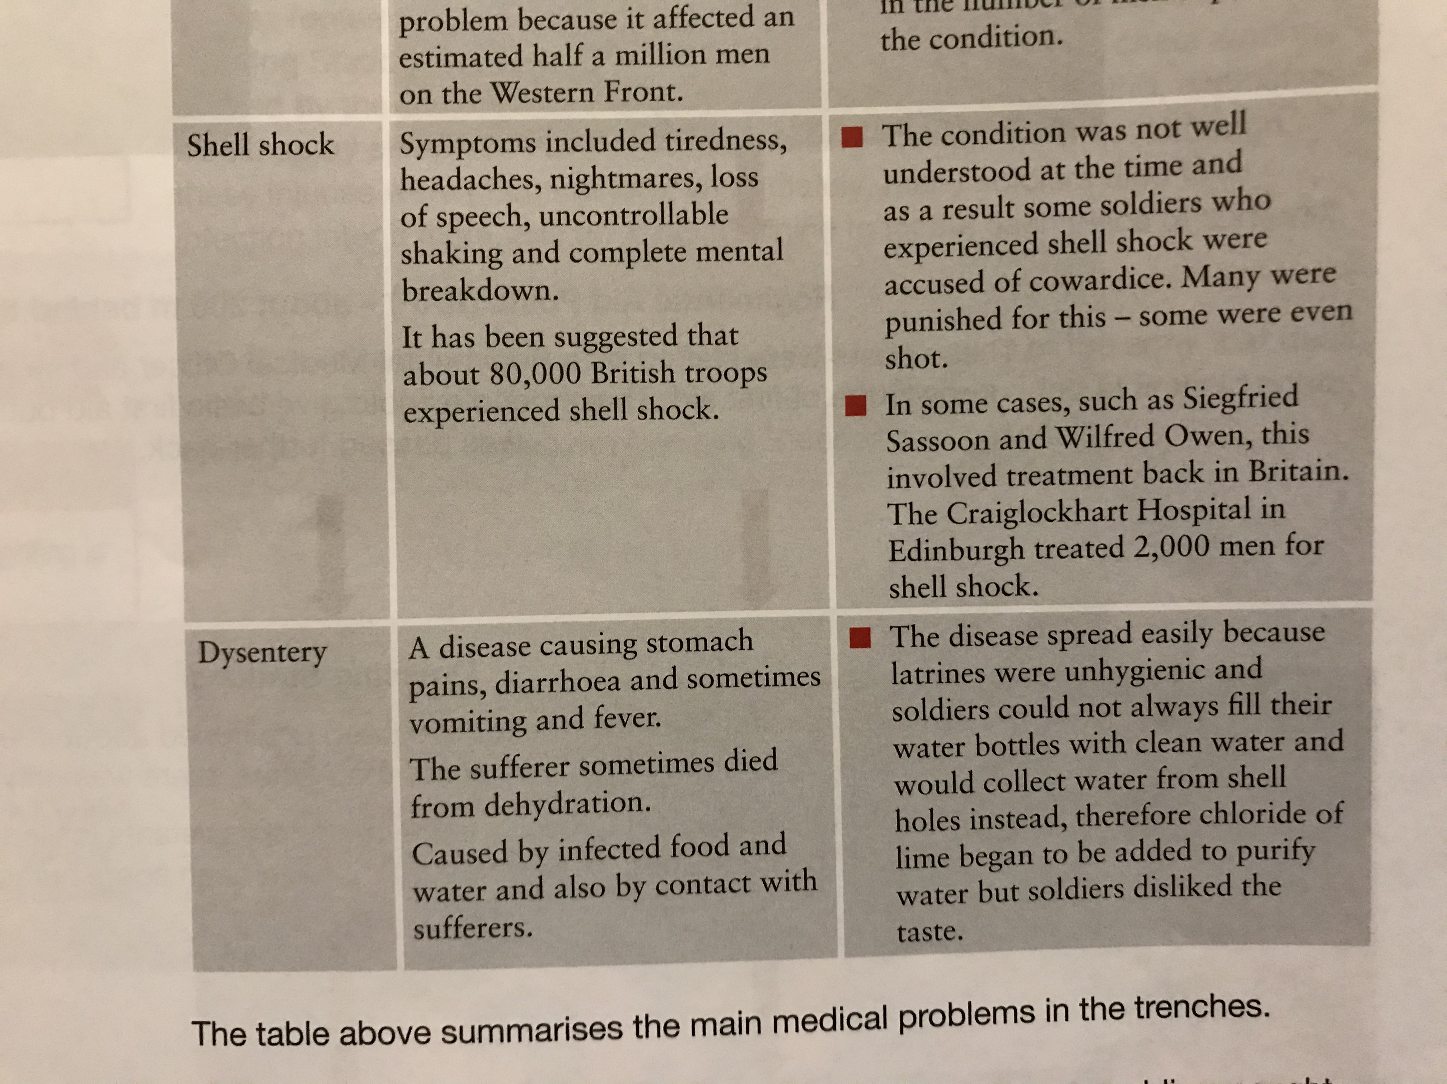

Slide 14
(b) The First World War, 1914-1918
Alongside the Trench-based illnesses, INFLUENZA was a common killer in World War One. Some soldiers also caught SEXUALLY TRANSMITTED DISEASES visiting prostitutes on Leave. For all of the medical issues of WW1, there was little that could be done to treat the illnesses – rest, good food & clean conditions helped, of course, but there had been too little progress in the treatment of illnesses 1905-1914. The ”Magic Bullet” of Salvarsan 606 was only effective against Syphilis & there was no Penicillin to treat infection yet.

Slide 15
‘Gassed’ by John Singer Sargent, March 1919.

Slide 16
(b) The First World War, 1914-1918
The British set up a system of treatment centres to help casualties on front-lines:
Regimental Aid Posts (RAPs) gave immediate aid to wounded soldiers.
Dressing Stations provided more advanced help for the wounded next.
Casualty Clearing Stations treated soldiers with critical injuries next.
Base Hospitals gave longer term care & grouped patients in specific wards with specialized doctors for specific injuries.
Back to Britain for better care was last.

Slide 17
(b) The First World War, 1914-1918
Due to the new nature of injuries, both Casualty Clearing Stations & Base Hospitals began to experiment with new techniques of treatment. Instead of the usual single bullet wounds surgeons were used to dealing with, Casualty Clearing Station staff had to treat horrific head wounds & chest wounds caused by extensive use of explosives. Pieces of shrapnel would spray in all directions, causing multiple wounds instead of just one. Although not fatal in the short term, infected shrapnel could kill in the long term without X-ray machines to locate all bits of shrapnel.

Slide 18
(b) The First World War, 1914-1918
The Royal Army Medical Corps (RAMC) was the section of the Army that dealt with injured soldiers. It organized all treatment for the wounded at First Aid posts close to The Front. The Royal Army Medical Corps also ran Dressing Stations and Base Hospitals.

Slide 19
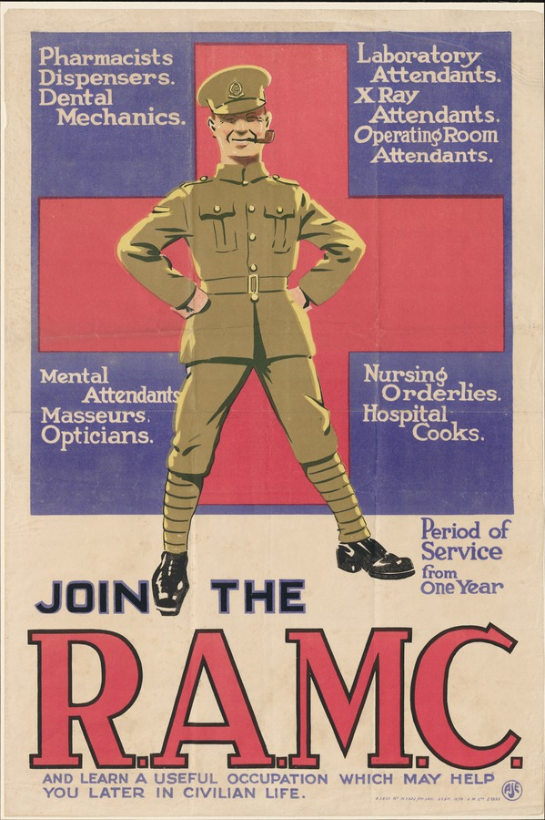

Slide 20
(b) The First World War, 1914-1918
The main group of trained nurses working with the British Army was Queen Alexandra’s Imperial Military Nursing Service (QAIMNS). This had been founded in 1902 and there were fewer than 300 nurses in 1914. By 1918, however, there were over 10,000 trained nurses.
Another group of nurses who worked with the RAMC was the First Aid Nursing Yeomanry (FANY) founded in 1907. FANY members were trained in specialist treatment, signalling & camping out in Military Tents.

Slide 21
(b) The First World War, 1914-1918
The high number of casualties during WW1 meant the RAMC needed additional help. While Marie Curie drove an ambulance for the French Army on the Western Front, British women volunteered to help and do their bit for the war effort. Many women joined the Women’s Army Auxiliary Corps, set up in 1917.
These women, unable to fight as soldiers, acted as ambulance drivers, as chauffeurs for the Military Top Brass and even as mechanics repairing Army vehicles.

Slide 23
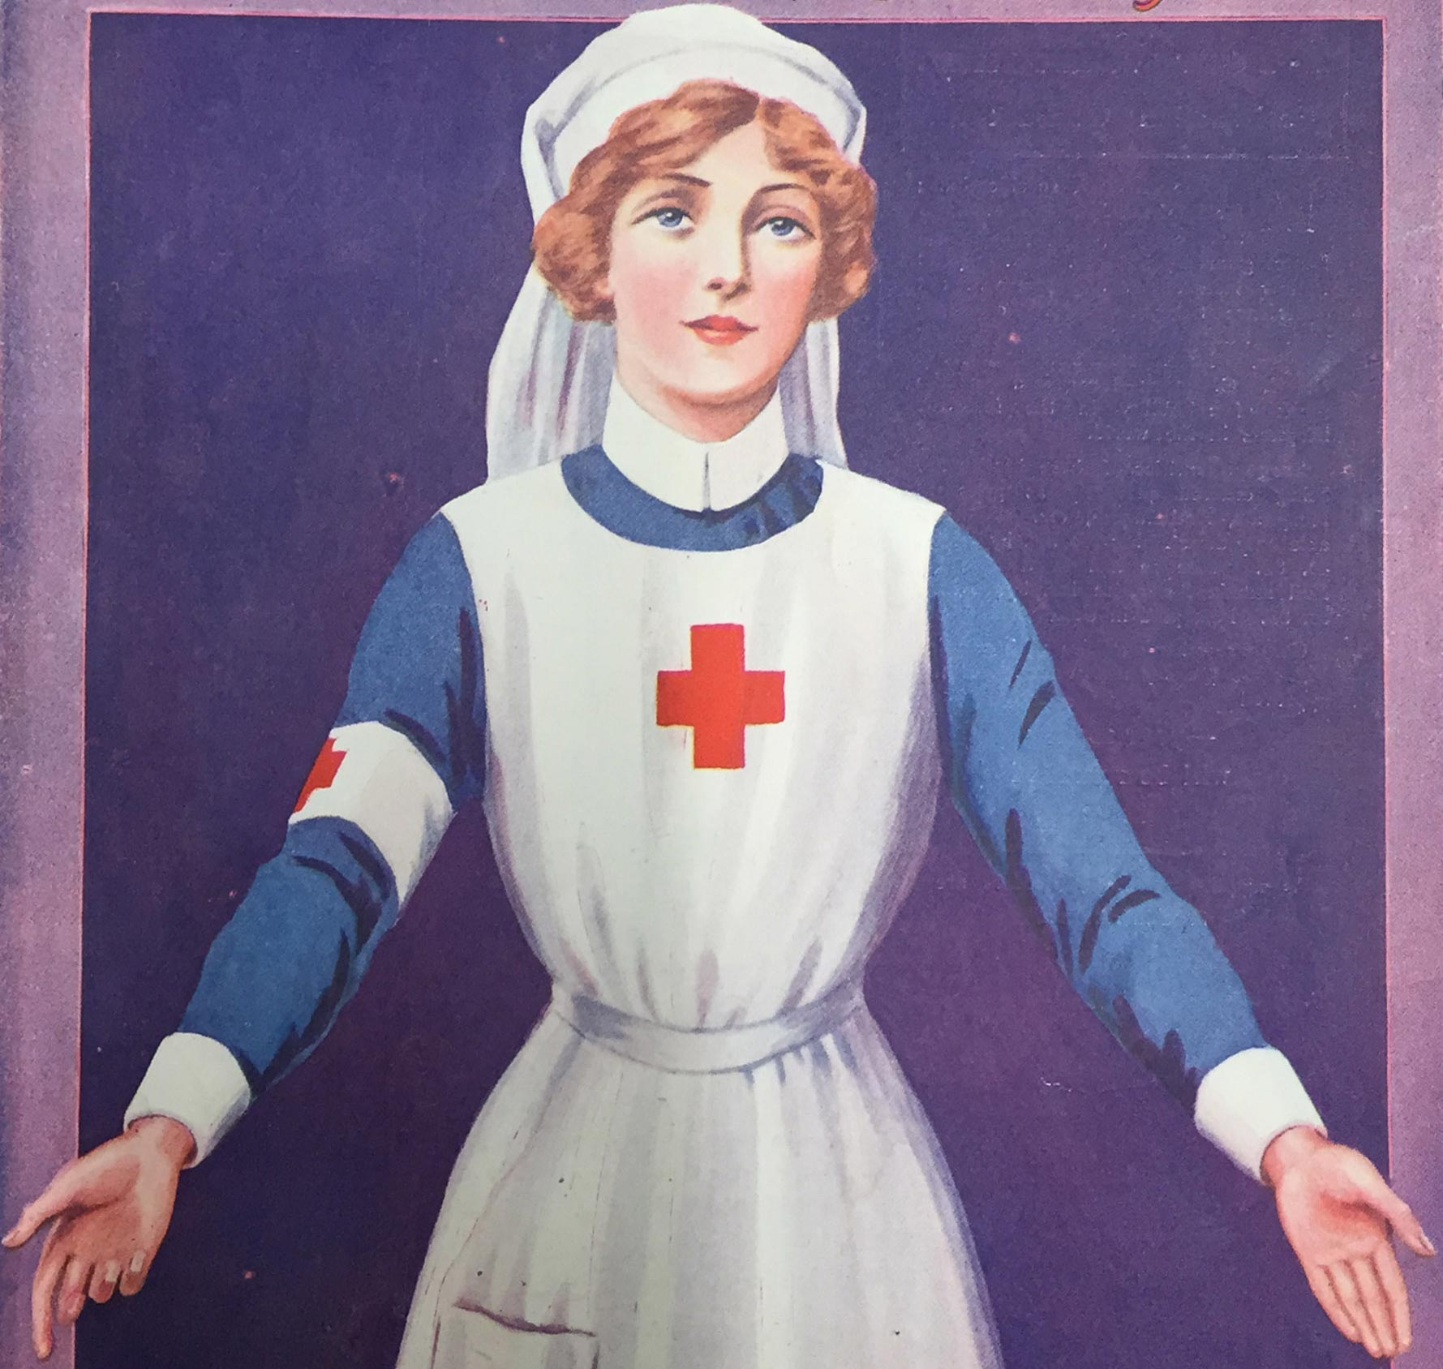
(b) The First World War, 1914-1918
The Red Cross organized Voluntary Aid Detachments (VADs) who drove ambulances and acted as nurses in RAMC Hospitals. These nurses were often middle-class single women, with little relevant experience, but vital for completing basic tasks like cleaning floors, changing beds and emptying bedpans. No official register of nurses was kept until 1919, but VADs often annoyed properly trained nurses – they felt that volunteers undermined respect for qualified nurses … but volunteers were vital.

Slide 25
Activity 40
The Duchess of Sutherland was nicknamed “Meddlesome Millie”
before WW1 broke out in 1914.
How did she win a French Croix de Guerre, a Belgian Red Cross Medal
& a British Red Cross Medal?

Slide 27
(b) The First World War, 1914-1918
Despite the achievements of women like Dr. Elizabeth Garrett & 1876 Medical Act (that allowed women Medical Degrees) female doctors who volunteered to help on the Western Front were not welcomed at all. Dr. Elsie Inglis offered to take women’s medical units to create a 100-bed Hospital, but she was impolitely informed “hysterical women were the last people wanted at the Front!” Her persistence was met by the War Office telling her “My good lady, go home and sit still!” But the French Government finally took up Dr. Inglis on her offer and she opened a 600-bed Hospital at the Abbey of Royaumont … which proved essential in treating British soldiers wounded at The Battle of the Somme!

Slide 28
(b) The First World War, 1914-1918
Dr. Flora Murray & Dr. Louisa Garrett (daughter of Dr. Elizabeth Garrett) founded the Women’s Hospital Corps in 1914, staffed entirely by Suffragists, but were not granted permission to open a Military Hospital in London! Instead, they were forced to open their Military Hospitals in Paris & Boulgne. Similarly, Mabel Stobart successfully founded a Military Hospital staffed only by women by 1915 … but it was in Belgium, not Britain!

Slide 29
Activity 41
Dr. Hector Munro set up an Ambulance Corps in Belgium to move wounded soldiers.
Who were the ‘Angels of Pervyse’ who moved their First Aid post
just 100m from the Front Line?

Slide 31
(b) The First World War, 1914-1918
The largest Voluntary Hospital was in France and one of the Hospitals closest to the Front Line was run by Dr. Frances Ivens – a surgeon & gynaecologist who led Liverpool’s Stanley Hospital & led Liverpool’s Women’s Suffrage movement. It had over 600 beds and an excellent X-ray unit – vital for locating bullets & shrapnel before surgery was performed. Between January 1915 and February 1919, the surgeons under Dr. Ivens’ direction performed 7,204 operations on wounded soldiers.

Slide 32
(b) The First World War, 1914-1918
At the start of WW1, in 1914, less than 1% of doctors were female and most general hospitals did not accept women doctors. As a result, their medical experience was limited to being General Practitioners or working in hospitals for women & children. Although nurses & VADs became more welcome during WW1, the War Office instructed female doctors to stay in Britain to plug the gaps left by male doctors off to The Front. In 1916, however, the RAMC in Malta requested medical women & 80 female doctors were working in Malta by 1917. Unfortunately, while male RAMC doctors automatically became temporary Army Officers … women were denied such promotion!

Slide 33
(b) The First World War, 1914-1918
The Home Front in Britain lost over half of its male doctors when they joined the Army, 1914-1918. Hospitals needed to replace these males who had either volunteered in 1914 & 1915 (or had been conscripted in 1916) plus new Military Hospitals also needed staffing – to help severely wounded soldiers. Dr. Louisa Garrett & Dr. Flora Murray were finally put in charge of Endell St. Military Hospital, London, in 1915, which had 573 beds & was staffed only by women: 15 doctors, surgeons, ophthalmic surgeons, dental surgeons, an anaesthetist, bacteriologists, 7 assistant doctors and a full staff of women medical assistants. Over 24,000 soldiers were treated at Endell St, 1915-1919.

Slide 34
(b) The First World War, 1914-1918
The shortage of male doctors during WW1 saw attitudes change towards female doctors … but this positive shift was only temporary. Although around 1/5 of women doctors were engaged in vital war work (often abroad, for other Armies) they were simply expected to return to GP roles after November 1918. In London, however, 12 Hospital Schools began to accept women during WW1 and the London School of Medicine for Women became the largest trainer of doctors in the country. In 1911, there were 610 qualified women doctors, but by 1921 there were 1,500. After 1918, however, the Royal Free Hospital was the only teaching hospital accepting females.

Slide 35
(b) The First World War, 1914-1918
The British Government encouraged women to volunteer their help for the war effort during WW1, but it was not on an equal footing with men. Tens of thousands of untrained women worked as midwives or nurses on the Home Front, but their lack of qualifications saw them regarded as mere ‘servants’ rather than in the Military Service.

Slide 36
Exam-Style Question
How far was WW1 responsible for changes in the role of Women in Medicine 1875-1920?
You may use the following in your answer:
Medical Act, 1876
VADs during WW1
You must also use information of your own.
(16 marks)

