Slide 1
Edexcel IGCSE History P2: Breadth Study B1
Changes in Medicine,
1848-1948

Slide 2
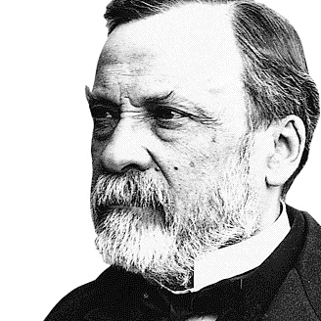

Slide 3
Edexcel IGCSE History P2: Breadth Study B2
Changes in Medicine,
1848-1948
4. Government Action & War, 1905-1920

Slide 4
Activity 35
Wealthy Victorian Factory Owners in the 19th Century were often ‘philanthropists’.
What is a ‘philanthropist’?

Slide 6
Activity 36
William Lever (soap), Richard & George Cadbury (chocolate) & Joseph Rowntree (sweets) all cared for their workers. What villages did they build?

Slide 8
(a) The Liberal Govt Public Health Measures, 1906-11
Although there were improvements in hygiene & housing during the late 19th Century, the general standard of health remained poor. Between 1891 and 1903, surveys by philanthropists Seebohm Rowntree & Charles Booth categorically proved that very large numbers of people lived below the poverty line – existing in dirty, poor conditions, where disease spread easily, with poor nutrition making health recovery unlikely. Death during childhood was common.

Slide 9
(a) The Liberal Govt Public Health Measures, 1906-11
Politicians were motivated to try to improve the health of the nation when it was found that over 1/3 of Army volunteers for the Boer Wars (1899-1902) were unfit for service. This shocked the people in power. In some parts of the UK, like the slums of Manchester, the number of unfit volunteers was nearer 90%. As Britain ruled a large Empire, an effective, well-trained Army & Navy was essential – so an unhealthy & unfit nation of men weakened the whole British Empire overall.

Slide 10
(a) The Liberal Govt Public Health Measures, 1906-11
When the Liberal Party won a landslide victory in the 1906 General Election, there was hope that their huge majority would allow the introduction of reforms. The Liberals seemed sympathetic to ordinary people, so the voters who had elected them expected improvements. The Liberals did not let their voters down and began passing measures to deal with the problems associated with poverty; many see this as the beginnings of the modern Welfare State in the UK today.

Slide 11
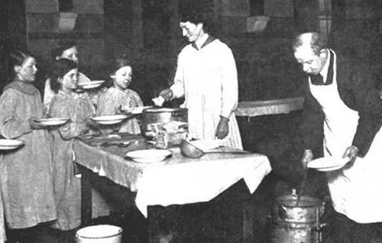
(a) The Liberal Govt Public Health Measures, 1906-11
IMPROVING THE HEALTH OF CHILDREN
In 1906, free school meals were introduced for children from poor families. Local Authorities received a Government Grant to cover half the cost of these meals.
Compared to the 3,000,000 free meals provided in 1906, this figure had risen to 14,000,000 free meals by 1914.
Having one proper meal each day hugely improved children’s health & growth.

Slide 12
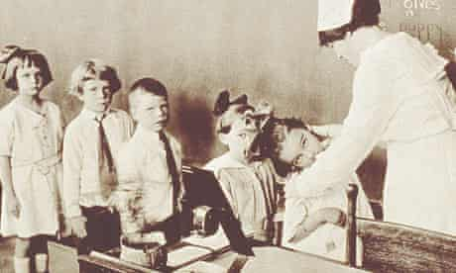
(a) The Liberal Govt Public Health Measures, 1906-11
IMPROVING THE HEALTH OF CHILDREN
Also in 1906, the Board of Health produced a booklet for Schools, instructing that all children should be taught about hygiene to help reduce the spread of disease.
In 1907, the School Medical Service was set up. It ensured that children were checked for illnesses & conditions like ringworm, lice or nits. Health Visitors would visit homes, too, to check the health of youngsters – even though many families could not afford treatment.

Slide 13
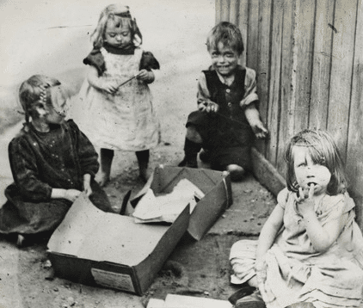
(a) The Liberal Govt Public Health Measures, 1906-11
IMPROVING THE HEALTH OF CHILDREN
The Children & Young Persons Act, 1908 protected children by making it illegal to sell them alcohol, tobacco and fireworks; Juvenile Courts & Borstals were set up for children who committed crimes too.
The Children & Young Persons Act, 1908 also protected children by making it a crime to send a child out on the streets begging and a crime to neglect children; Working hours for children were limited too.

Slide 14
(a) The Liberal Govt Public Health Measures, 1906-11
IMPROVING THE LIVES OF THE OLD
In 1908, old age pensions were introduced for people over 70 who earned less than £31.50 per year. They received 25p per week (about 1/6 of a working man’s weekly wage) but pension payments could be withheld for alcoholics or any people imprisoned within the previous 10 years.
Only 600,000 pensions were granted in 1908, but they certainly helped the elderly afford housing, heating & food to stay healthy & combat disease.

Slide 15
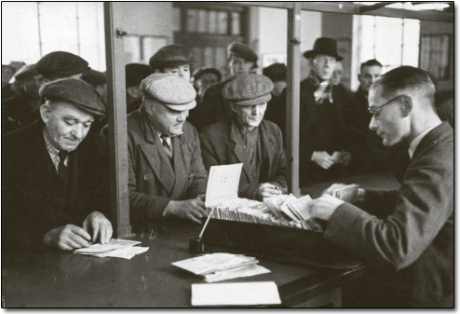
(a) The Liberal Govt Public Health Measures, 1906-11
IMPROVING THE LIVES OF THE UNEMPLOYED
In 1909, Labour Exchanges were set up as a result of The Labour Exchange Act. These were places where unemployed people could go to look for work. Employers could advertise vacant positions at the Labour Exchange. Potential employees could apply for these jobs, then, rather than end up in Workhouses or begging on the streets. A regular wage meant a worker’s family would be more likely to eat properly, live in decent accommodation & fight diseases.

Slide 16
(a) The Liberal Govt Public Health Measures, 1906-11
NOT IMPROVING THE LIVES OF THE ILL
Every visit to the doctor had to be paid for & prescribed medicines had to be paid for, too, so people close to the poverty line often avoided seeing a doctor until it was too late. Town & City Hospitals had free dispensaries for those who queued, but ready-made medicines & pills from a pharmacist were only affordable to the rich. Traditional folk remedies (like ‘vinegar & brown paper’ for headaches) were utterly ineffective, but all the poor could afford.

Slide 17
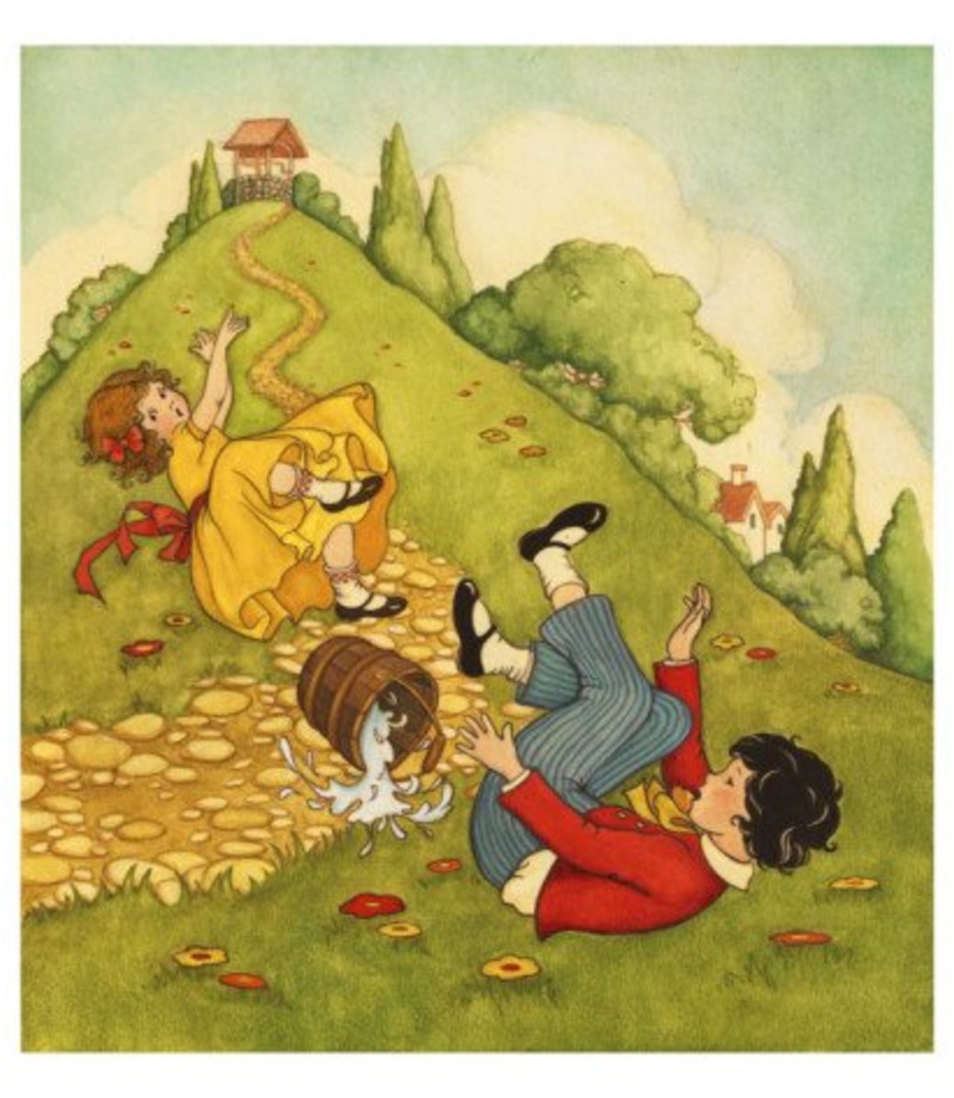
Jack and Jill went up the hill to fetch a pail of water. Jack fell down and broke his crown and Jill came tumbling after.
Up Jack got and home did trot, as fast as he could caper; he went to bed to mend his head with vinegar and brown paper.
Jill came in and she did grin to see his paper plaster; Mother, vex’d, did whip her next for causing Jack's disaster.

Slide 18
Activity 37
Some of the traditional folk remedies are still used today. What are MILKWEED, WILLOW, SNOWDROPS and COW’S STOMACH JUICE used to treat?

Slide 20
(a) The Liberal Govt Public Health Measures, 1906-11
THE NATIONAL INSURANCE ACT, 1911
Under the terms of the Act, money was paid into the National Insurance Scheme by workers & their employers. Any worker who became ill could receive free medical care from a doctor linked to the Scheme; they could also claim sickness benefit payments. Maternity Grants were given to mothers to help with buying baby essentials. Workers could also pay into a fund (if they opted to) that would provide unemployment benefit payments if they lost their jobs.

Slide 21
(a) The Liberal Govt Public Health Measures, 1906-11
THE NATIONAL INSURANCE ACT, 1911
Unfortunately, the Act only applied to workers; members of their family who became ill could not receive treatment.
Furthermore, any people who were unemployed or self-employed were not covered by the National Insurance Act.
A third criticism of the Act’s limitations was the fact that women did not benefit from the Liberal Reforms – mothers still struggle, especially if their husbands were the only ones who worked.

Slide 22
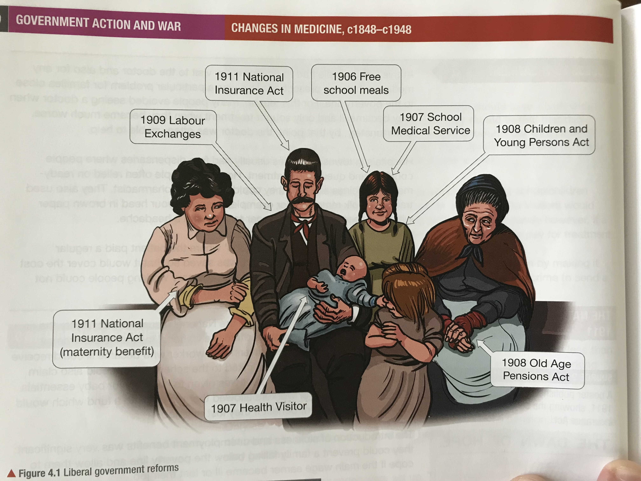

Slide 23
Exam-Style Question
Explain two ways in which public health provision in Britain 1905-1920 was different from public health provision from 1875-1905. (6 marks)

