Slide 1
Edexcel IGCSE History P2: Breadth Study B1
Changes in Medicine,
1848-1948

Slide 2
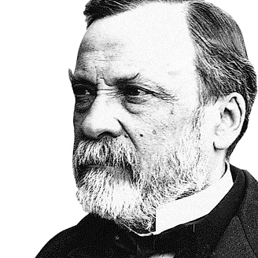

Slide 3
Edexcel IGCSE History P2: Breadth Study B2
Changes in Medicine,
1848-1948
3. Accelerating Change, 1875-1905

Slide 4
(e) Radioactivity & Marie Curie
Miss Marie Sklodowska was a Polish Chemist who came to Paris in 1891. In Paris she met and married a French Physicist named Pierre Curie.
In 1896 Henri Becquerel discovered radioactivity and Marie & Pierre Curie began to investigate radioactive material together.
In 1898, the Curies discovered 2 new scientific elements: POLONIUM and RADIUM. This earned Bequerel and the Curies the 1903 Nobel Prize for Physics in recognition of their work on radiation & X-rays in surgery.

Slide 5
Activity 30
Marie Curie was the first ever woman to win a Nobel Prize; one of only 2 people to win a Prize in 2 different fields.
Who was the other + what for?

Slide 7
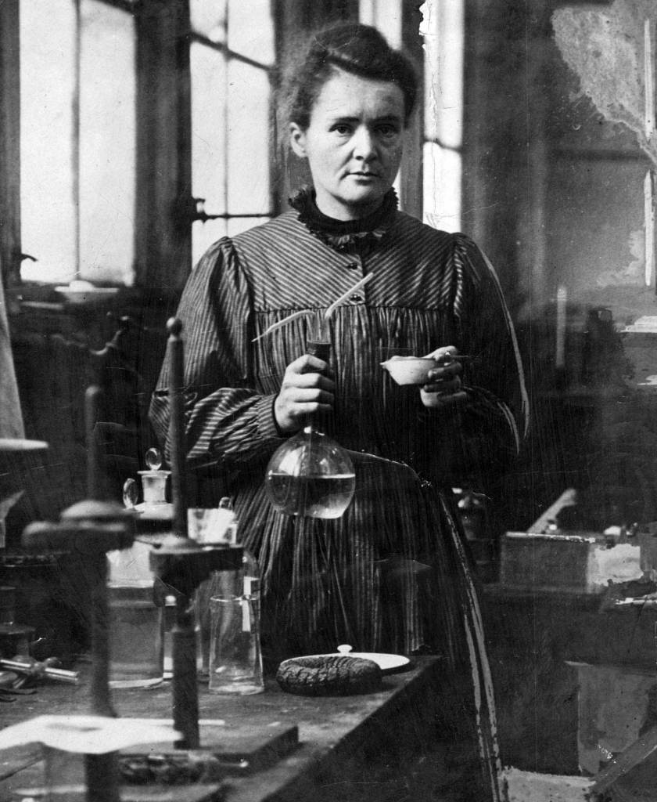
(e) Radioactivity & Marie Curie
Pierre Curie died in 1906, but Marie took over his position in a research laboratory in the University of Paris.
In 1910, a brand new Radium Institute was created for Marie Curie so that she could continue her research on radium. She was trying to shrink or kill tumours using radioactivity. She tried putting radium as close as possible to the tumour; she even inserted radium into the tumour itself. This became the basis of radiotherapy – Curie’s technique is still used to fight against modern cancers today.

Slide 8
(e) Radioactivity & Marie Curie
Like Wilhelm Rontgen did with this X-ray machine, Marie Curie did not patent her radioactivity work. This meant that other people could use it freely. Doctors across Europe began to experiment with radiation in the early 1900s – testing it as a treatment for epilepsy and acne. They found it had very dangerous side-effects, but its benefits in treating cancer cases were clear enough. The importance of Marie Curie’s work was recognized with a second Nobel Prize in 1911 for Chemistry. Curie died aged 67, from Leukaemia – caused by her radiation.

Slide 9
(e) Radioactivity & Marie Curie
During the First World War (1914-1918) Marie Curie used her own money to help supply ambulances with X-ray equipment; she even drove X-ray ambulances to the Front Lines herself!
These X-ray units became known as “Les petites Curies” and they allowed injured soldiers to be X-rayed and operated on as soon as possible. The International Red Cross made Marie Curie head of their Radiological Service. She ran courses to teach & train medical assistants & doctors how to use her new techniques.

Slide 10
Activity 31 – Recall Quiz
Why has Koch been called the “Father of Bacteriology”?
What is a vaccination?
Name 3 techniques of aseptic surgery.
What is a ligature?
Give 3 examples of changes made by the Public Health Act, 1875?

Slide 11
Activity 31 – Recall Quiz
Why was the discovery of blood groups important?
What was a “magic bullet”?
What are X-rays?
How are X-rays used in medicine?
Why was the study of radiation important in medicine?

Slide 12
Activity 32 – Explaining
Explain why Koch’s work on identifying microorganisms was important for medicine.
Explain why the Public Health Act, 1875 was important in improving the overall health of the nation.
Explain why Marie Curie’s work in physics & chemistry had an impact on medicine.

Slide 13
Activity 33 – Challenge
Why did it take so long after the work of Pasteur & Koch for new treatments to be developed?
Was science or technology more important in improving medicine from 1870-1905?
Were the greatest advances of 1870-1905 in medicine, surgery or public health?

