Slide 1
Edexcel IGCSE History P2: Breadth Study B1
Changes in Medicine,
1848-1948

Slide 2
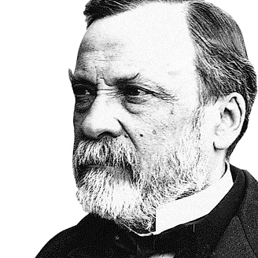

Slide 3
Edexcel IGCSE History P2: Breadth Study B2
Changes in Medicine,
1848-1948
3. Accelerating Change, 1875-1905

Slide 4
(d) Science & Rapid Change in Medicine
Victorian blood transfusion attempts had often caused the death of the patients and nobody understood why. In 1901, however, Austrian Dr. Karl Landsteiner discovered there were different blood groups – A, B + O. A year later, in 1902, he identified a fourth blood group – AB. Doctors soon realized that patients given a different blood group to their own would die. In 1907, Doctors discovered that type O blood could be given safely to anyone whatever their blood group.

Slide 5
(d) Science & Rapid Change in Medicine
With the understanding of different blood groups, Doctors could carry out blood transfusions safely … as long as the blood given was from the right blood group. Surgery, at last, felt the huge impact of increased safety – the problem of blood loss had been solved, so patient death rates could lower as surgeons were no longer racing to complete operations. People with common blood disorders, too, could be given help to cope with them, rather than being left to die from them.

Slide 6
Activity 29
Anaemia, Hemophilia, Leukemia & Jaundice are common blood disorders.
Can you define them all after doing a bit of research?

Slide 8
(d) Science & Rapid Change in Medicine
Blood transfusions were not without their problems, however:
Blood donors had to be present during the operation.
It was not always possible to find a donor from the right blood group.
Blood starts to clot as soon as it leaves the body, blocking transfusion tubes.
Scientific knowledge still needed to progress to develop methods to prevent blood clotting & to develop technology to store blood properly.

Slide 9
(d) Science & Rapid Change in Medicine
Pasteur & Koch were key to rapid changes in scientific knowledge. Koch’s use of agar jelly to grow bacteria and use of dyes to stain bacteria made the study of many microorganisms much easier. Koch found that certain dyes were taken up by specific microorganisms, so they could be seen more clearly under a microscope. Although this helped the understanding of many diseases, it did not really help develop treatments for diseases.

Slide 10
(d) Science & Rapid Change in Medicine
Other European Scientists were all inspired by Pasteur & Koch. Diphtheria, a disease caused my microorganisms in milk, killed around 8,000 children per year in the 19th Century. A Russian Scientist, named Elie Metchnikoff, showed that the Diphtheria microorganism generated a poison in the body. This poison then created a membrane in the throat that stopped patients breathing. In 1890, Emil von Behring identified the antitoxins produced in the body to fight Diphtheria and, when these antitoxins were injected into patients they fought the disease effectively. Emil von Behring had found a cure that could finally be used as a treatment for Diphtheria!

Slide 11
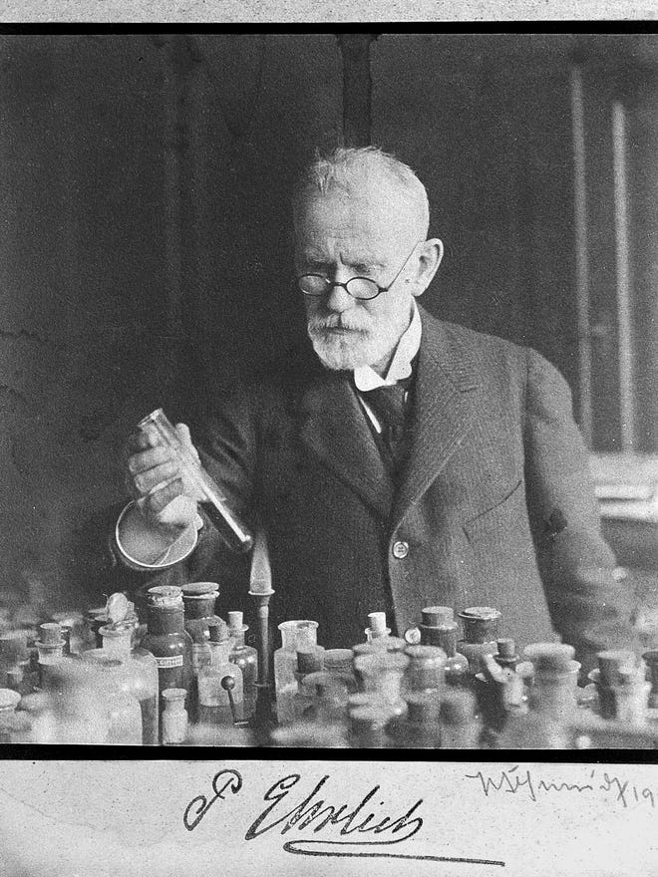
(d) Science & Rapid Change in Medicine
Paul Ehrlich was on Koch’s research team and had also worked with Emil von Behring. In 1896, he led a team working on possible treatments. He tried to combine Koch’s dye work with Behring’s antitoxin work – to develop a chemical that could kill the microorganism of a specific disease. This became known as the “magic bullet” as it would kill the disease but do no other harm to the body. It became Ehrlich’s work’s focus for developing treatments for diseases.

Slide 12
(d) Science & Rapid Change in Medicine
If left untreated, the disease sexually transmitted disease syphilis affects the brain and can lead to a stroke, dementia, vision issues & heart problems. As a result, most Victorians really feared syphilis. The usual remedy used, however, was just as dangerous as syphilis itself – mercury – a poisonous metal that can cause kidney failure & lead to death. In 1905, Ehrlich experimented to find a “magic bullet” that could treat syphilis without damaging other cells in the body. He tried various compounds of poisonous arsenic and, four years later, his first “magic bullet” was found in 1909 – it was the first ever chemical cure for a disease & named Salvarsan 606 (after 605 earlier failed compounds before it).

Slide 13
(d) Science & Rapid Change in Medicine
As new areas of Science developed, supported by technology, the discovery of X-rays had a major impact on medicine. In 1895, a German physicist, Wilhelm Rontgen was investigating cathode rays and happened upon the fact that normal rays of light could not pass through black paper but unknown rays could … so he called them X-rays. When Mrs Rontgen put her hand between a cathode ray tube & a photographic plate, an image showed the bones in her hand clearly and even her wedding ring too.

Slide 14
(d) Science & Rapid Change in Medicine
When Wilhelm Rontgen published his X-ray findings in 1895, however, he did not take out a patent (giving him full legal rights over his new discover) – he did this so that other people could use it freely. As early as 1896, therefore, many hospitals had an X-ray machine installed – including the London Royal Hospital.
X-rays could be used to show details of broken bones so that they could be set properly. This new accuracy prevented reduced movement or limps after bones weren’t set right. More importantly, the real value of X-rays came to the fore during war – locating bullets. This sped up surgery and reduced chances of infection. Every piece of shrapnel, too, was definitely removed.

Slide 15
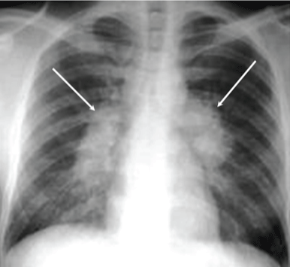
(d) Science & Rapid Change in Medicine
Doctors also found X-rays useful for diagnosing other medical problems:
Tuberculosis, for example, shows up as a shadow on the lungs of an X-rayed patient.
Bone tumours could also be seen in X-rayed patients too.
Exploration of internal organ function was possible too – a drink given to patients would show up on the X-ray as it travelled through the body.

Slide 16
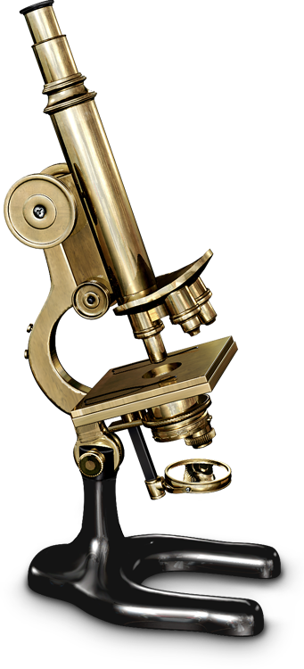
(d) Science & Rapid Change in Medicine
Pasteur & Koch led a breakthrough in understanding of disease. They gave others the basis for prevention and treatment. It was a long time before Doctors & Scientists fully accepted their ideas. Research & Government Funding, however, drove large-scale testing and new technologies:
More powerful Microscopes were developed – leading to the science of Bacteriology, helped by the developments in chemistry.
Hypodermic needles were made, to inject medicines into the body.

Slide 17
Exam-Style Question
How far did scientific
knowledge lead to changes
in medicine 1860-1905?
You may use the following in your answer:
Pasteur’s Germ Theory
Blood Groups
You must also use information of your own.
(16 marks)

