Slide 1
Edexcel IGCSE History P2: Breadth Study B1
Changes in Medicine,
1848-1948

Slide 2
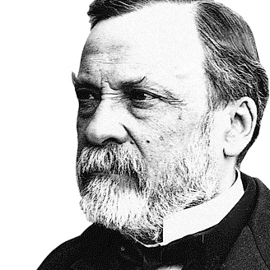

Slide 3
Edexcel IGCSE History P2: Breadth Study B2
Changes in Medicine,
1848-1948
3. Accelerating Change, 1875-1905

Slide 4
(c) Impact of Public Health Act, 1875
IMPACT OF THE PUBLIC HEALTH ACT, 1875
Sewage properly treated could not contaminate water supplies, so diseases risk was reduced
Factories dumping waste in Rivers made illegal
Clean water supply reduced cholera & typhoid cases
Street Lighting meant rubbish & dirt could be avoided
Medical Officer appointed to oversee Public Health
House Inspections for new houses ensured that they had sufficient light & ventilation. Slums demolished
Food Quality Inspectors reduced illnesses caused by eating poor quality goods or infected goods
The 1866 Sanitary Act had made local authorities responsible for sewers, clean water & street cleaning.
But the Public Health Act, 1875 went even further – now Councils were responsible for a range of public health measures designed to tackle issues in health, hygiene and housing.
The Public Health Act, 1875 was to have a huge impact on the UK.

Slide 5
(c) Impact of Public Health Act, 1875
Local Councils could charge taxes to pay for the improvements to be carried out. The task of doing the improvements was daunting, however, as sewer tunnels needed to be dug by a large workforce with appropriate technology.
Bazalgette’s sewer-system in London had 21,000km of sewers feeding 6 interceptor sewers and just digging out these 6 interceptors involved moving 2.7 million cubic metres of earth & laying 300 million bricks with 670,000 cubic metres of concrete & Portland cement.

Slide 6
(c) Impact of Public Health Act, 1875
The technological advances that went alongside improvements in public health were:
Use of pipes for water supplies.
Use of pipes for gas lighting.
Use of Steam-powered engines in Bazalgette’s sewage-system pumping stations.

Slide 7
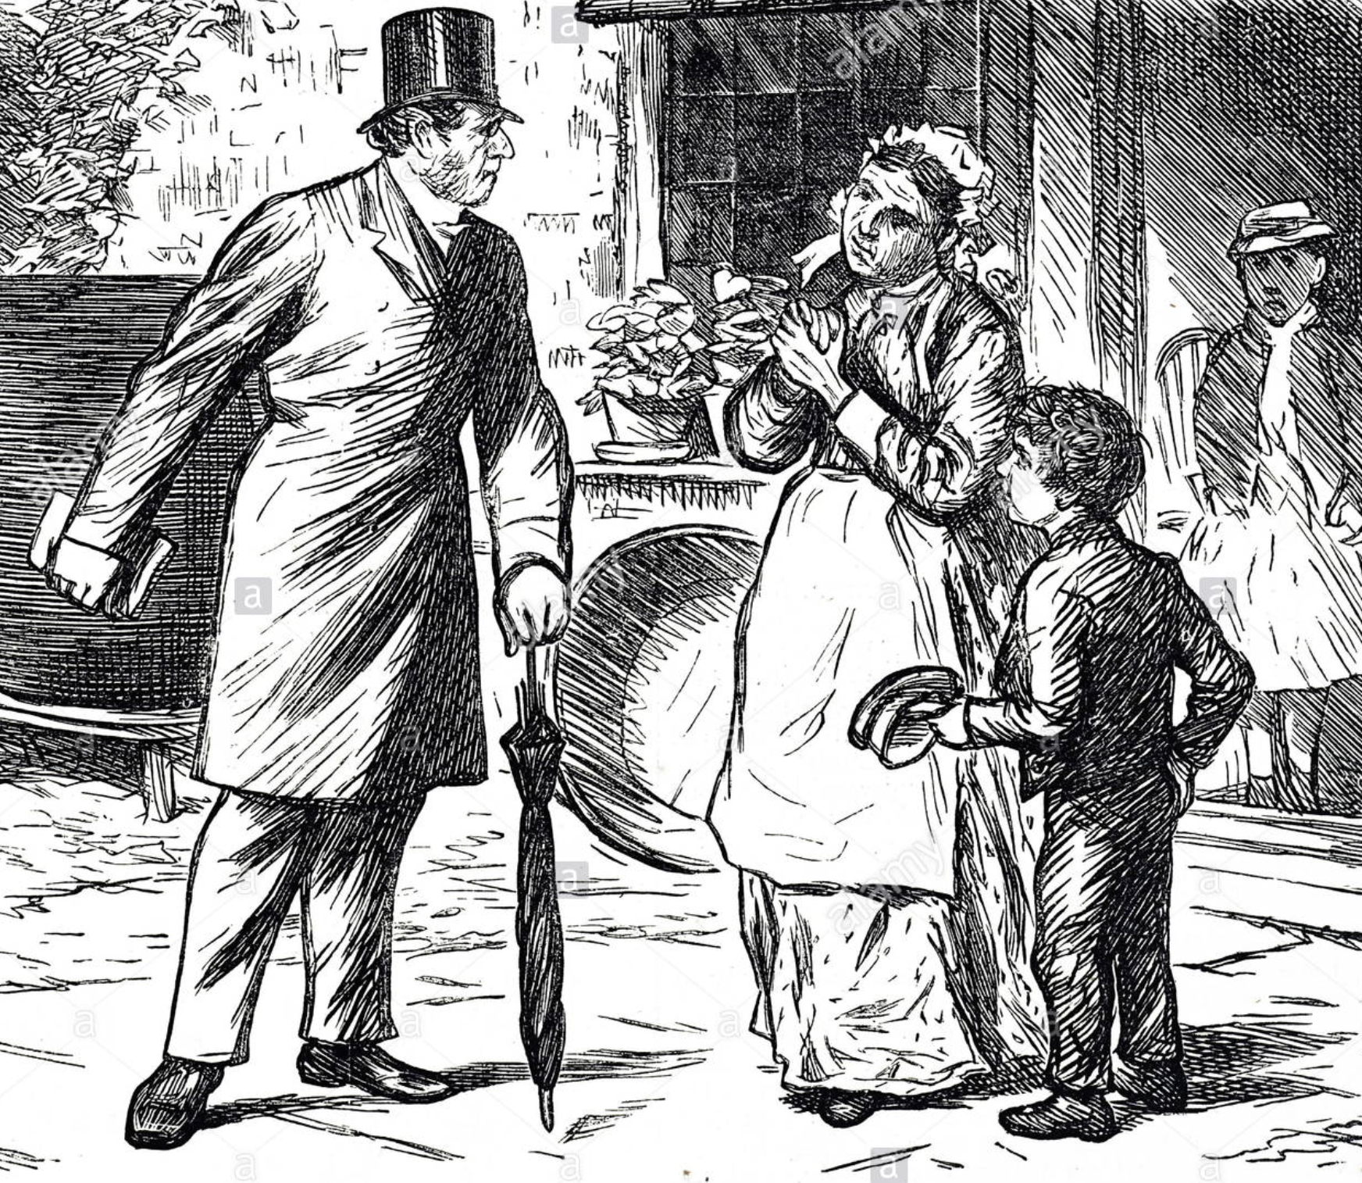
(c) Impact of Public Health Act, 1875
Other Acts of Parliament also improved Public Health:
Artisan Dwellings Act, 1875 gave councils power to demolish slum housing.
Food & Drugs Act, 1875 tried to improve food standards; butchers painted meat red & sand was mixed into flour!
River Pollution Prevention Act, 1876 made it illegal to dump waste, including chemicals, into rivers.
Infectious Disease (Notification) Act, 1889 ordered householders or doctors in London to report any infectious disease cases to the Medical Officer. This was extended to the rest of the UK in 1899.

Slide 8
(c) Impact of Public Health Act, 1875
The Infectious Disease (Notification) Act 1889 led to building of Isolation Hospitals. In London, Park Hospital was opened in 1897; one of 5 infectious disease hospitals. It had 48 wards for up to 368 Scarlet Fever patients & 24 wards for up to 120 Diphtheria patients. A larger space between all patients allowed isolation.

Slide 9
Activity 28
There were 7 other UK Fever Hospitals alongside Park.
Can you name them all after doing a bit of research?

Slide 11
(c) Impact of Public Health Act, 1875
The years 1875-1905 mark a significant shift in the Government approach to making changes in health, hygiene & living standards legislation. While Government attitudes towards the role of Government, away from “Laissez-Faire” and towards leading changes, helping the newly enfranchised ordinary people to win votes was equally important too. A third important factor was the role of Science & Technology. The new understanding of microorganisms and how diseases spread allowed emphasis on improving hygiene. Piped water and sewer systems were only possible due to new Victorian technology.

Slide 12
Exam-Style Question
How far did public health provision change 1848-1905?
You may use the following in your answer:
Cholera Epidemics
Public Health Act, 1875
You must also use information of your own.
(16 marks)

