Slide 1
Edexcel IGCSE History P2: Breadth Study B1
Changes in Medicine,
1848-1948

Slide 2
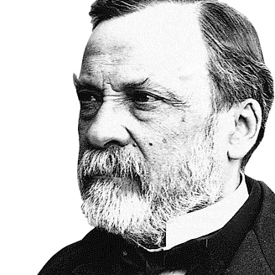

Slide 3
Edexcel IGCSE History P2: Breadth Study B2
Changes in Medicine,
1848-1948
3. Accelerating Change, 1875-1905

Slide 4
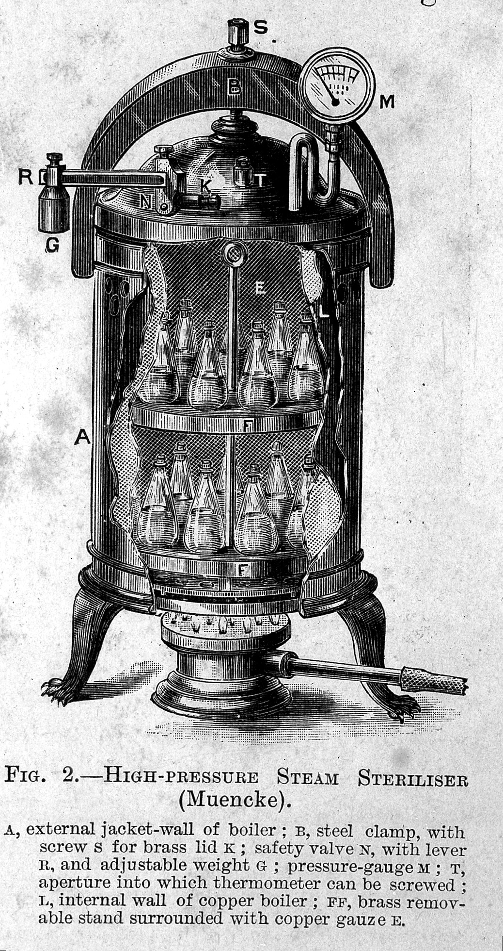
(b) Aseptic Surgery
In 1877, Joseph Lister became Professor of Surgery at King’s College Hospital, London. Pasteur’s germ theory & Lister’s antiseptic techniques were slowly & becoming accepted, especially after Robert Koch identified the microorganisms causing blood poisoning in 1878, but there was still resistance to Lister’s Carbolic Spray making operations difficult. Robert Koch, however, also developed a steam sterilizer in 1878 for equipment & dressings. This was a huge improvement for aseptic surgery.

Slide 5
(b) Aseptic Surgery
As the understanding of microorganisms increased, new techniques were gradually introduced. These achieved 4 aims:
Surgeons tried to fight infections via antiseptic surgery.
Surgeons tried to prevent microbes getting near open wounds to infect them via aseptic surgery.
Surgeons operated in clean theatres without spectators.
Surgeons wore clean clothes, masks & rubber gloves to stop any microbes entering wounds during surgery.

Slide 6
Activity 26
Nurse Caroline Hampton had eczema on her hands in 1890. How did Goodyear Rubber Company help Nurse Hampton & improve surgery forever?

Slide 8
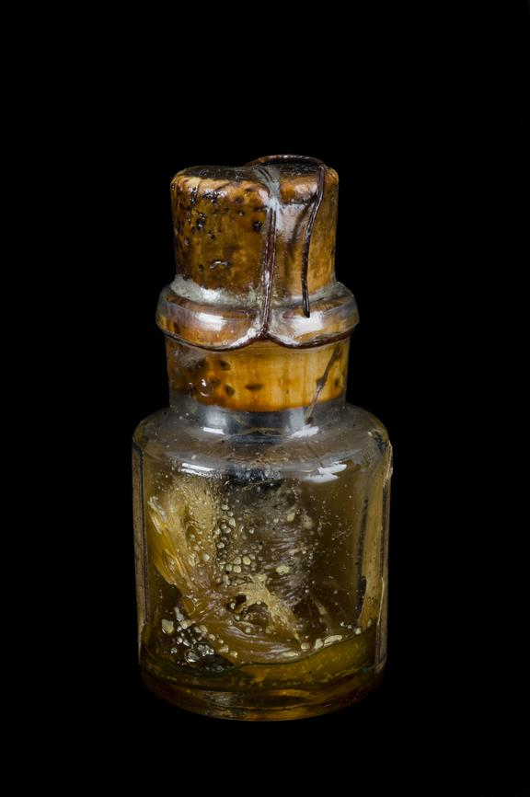
(b) Aseptic Surgery
Despite pain & infection during surgery being pretty much solved, blood loss still meant that operations needed to be completed quickly. As well as investigating antiseptic techniques, Joseph Lister had experimented with methods of reducing blood loss too. [Pressure was usually applied to stem the flow of blood during an operation & any blood vessels cut were sealed via cauterization – placing hot iron on the end.] Lister tried & failed using silk ligatures soaked in carbolic acid, but then, in 1881, found that catgut ligatures (made from sheep intestines) soaked in carbolic acid both avoided infection & dissolved in the body after 2 to 3 weeks.

Slide 9
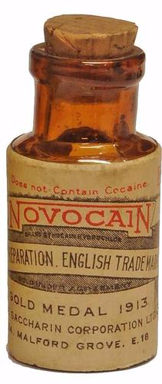
(b) Aseptic Surgery
While chloroform had proved a much better anaesthetic than ether gas, a spate of sudden deaths during operations using cholorform saw Scientists search for an alternative source of pain relief. Cocaine was used but, as it was very addictive, it was not very suitable. In 1884, however, it was discovered that Cocaine could be used as a local anaesthetic (numbing & causing loss of feeling) rather than a general anaesthetic (causing unconsciousness). By 1905, a safer & more suitable version of the drug had been developed called Novocaine.

Slide 10
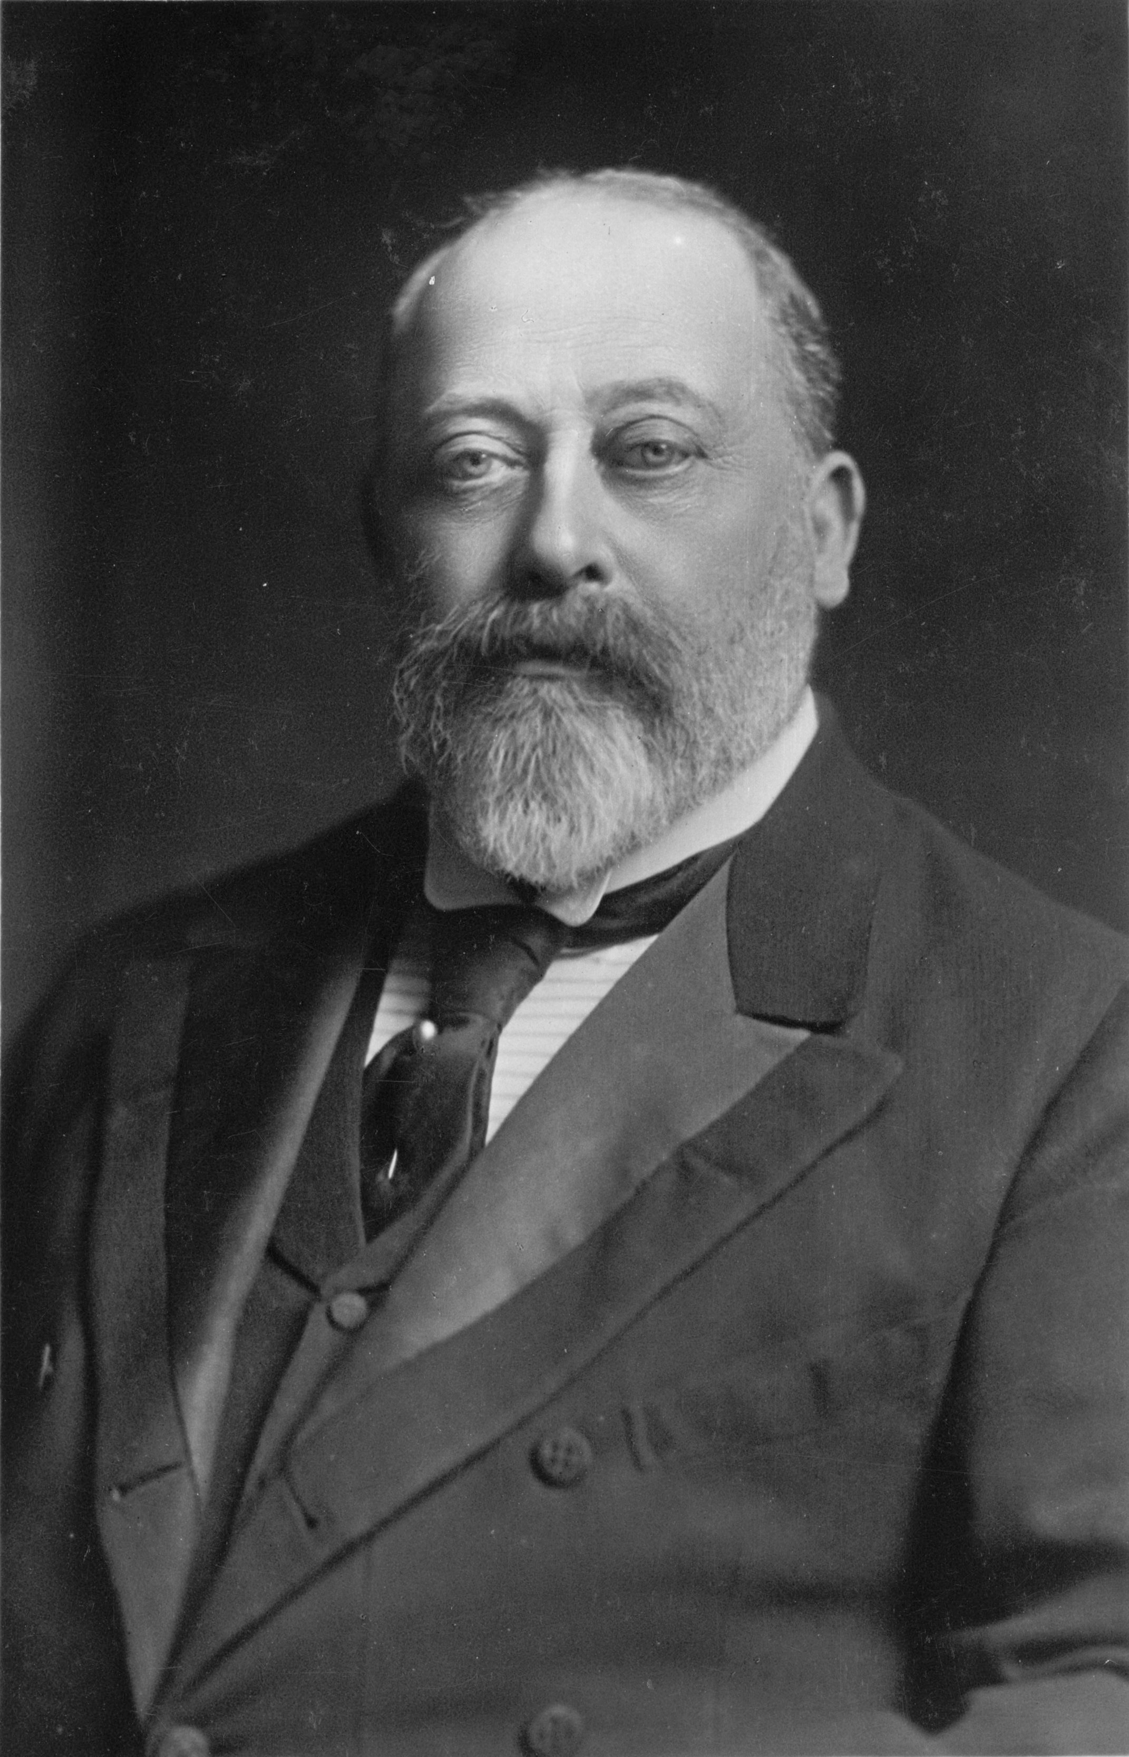
(b) Aseptic Surgery
The improvements in surgical conditions & techniques during Queen Victoria’s reign had made surgery safer for patients and allowed surgeons to carry out more complex operations. When Queen Victoria’s son, Edward VII, was supposed to be at his coronation, he was on the operating table with appendicitis! The huge celebration had to be cancelled at short notice. Fortunately, the Royal Surgeon had carried out the operation over 1,000 times before, so the coronation of Edward VII was only postponed from 26 June to 2 August 1902.

Slide 11
Activity 27
In 1883, Joseph Lister was the first doctor to be knighted. Why was his contribution
to surgery so important?

Slide 13
Exam-Style Question
Explain two causes of improvements in surgery
in the years 1848-1905.
(8 marks)

