Slide 1
Edexcel IGCSE History P2: Breadth Study B1
Changes in Medicine,
1848-1948

Slide 2
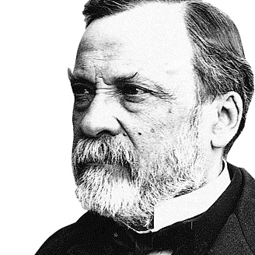

Slide 3
Edexcel IGCSE History P2: Breadth Study B2
Changes in Medicine,
1848-1948
3. Accelerating Change, 1875-1905

Slide 4
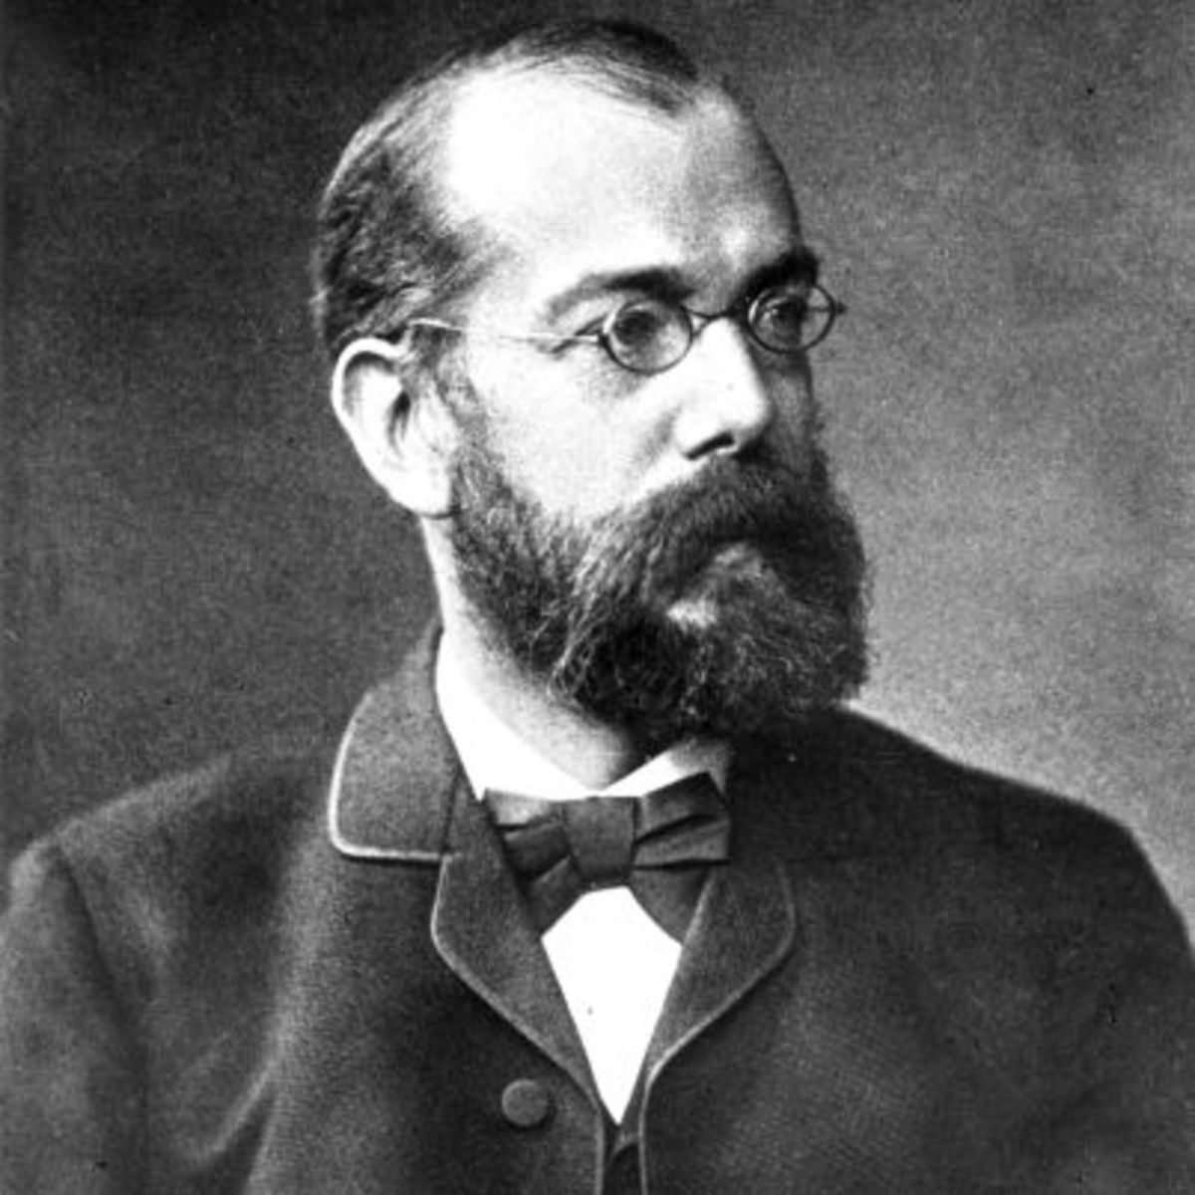
(a) The Fight Against Germs
Pasteur’s theories about microorganisms causing decay were broadly accepted by 1875, but this had little impact on Medicine. Joseph Lister had shown that antiseptic techniques reduced deaths from infection, too, yet the ideas of Pasteur & Lister had not come together to link microorganisms to disease. So, without this link being made, treatment & prevention of disease remained as unclear as ever. A German doctor, named Robert Koch, whose wife bought him a microscope in 1872, was the next key player.

Slide 5
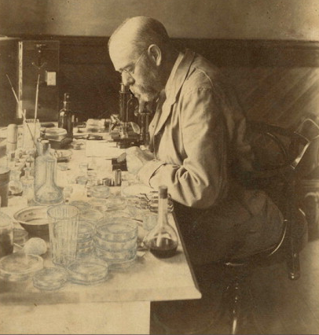
(a) The Fight Against Germs
Robert Koch was investigating Anthrax in farm animals using Pasteur’s ideas. He knew the disease spread through the blood being infected, but he wanted to scientifically prove that the Anthrax Microorganism was causing the disease in the first place. His research was conducted at his home and, after 4 years of investigating, 1872-1876, he published his work in 1876. Further research saw Koch develop methods of staining & photographing microorganisms – so others could see the support for his theories. In 1878, Koch published work on bacteria in wounds causing infection. The link was made.

Slide 6
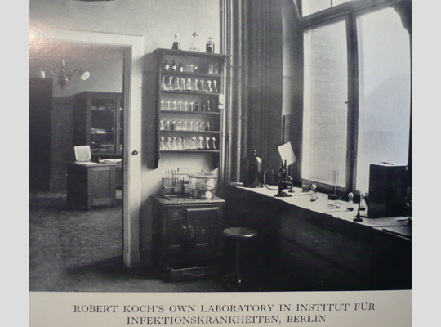
(a) The Fight Against Germs
Robert Koch’s work was important for 3 reasons:
He was not focused on disease in humans; instead he focused on microorganisms in laboratory tests.
Techniques he developed, such as staining & photographing microorganisms, could be used to investigate many diseases; not just 1.
Invited to move to move to Berlin, Germany’s capital, the German Government funded his microorganism research + he developed a team of researchers.

Slide 7
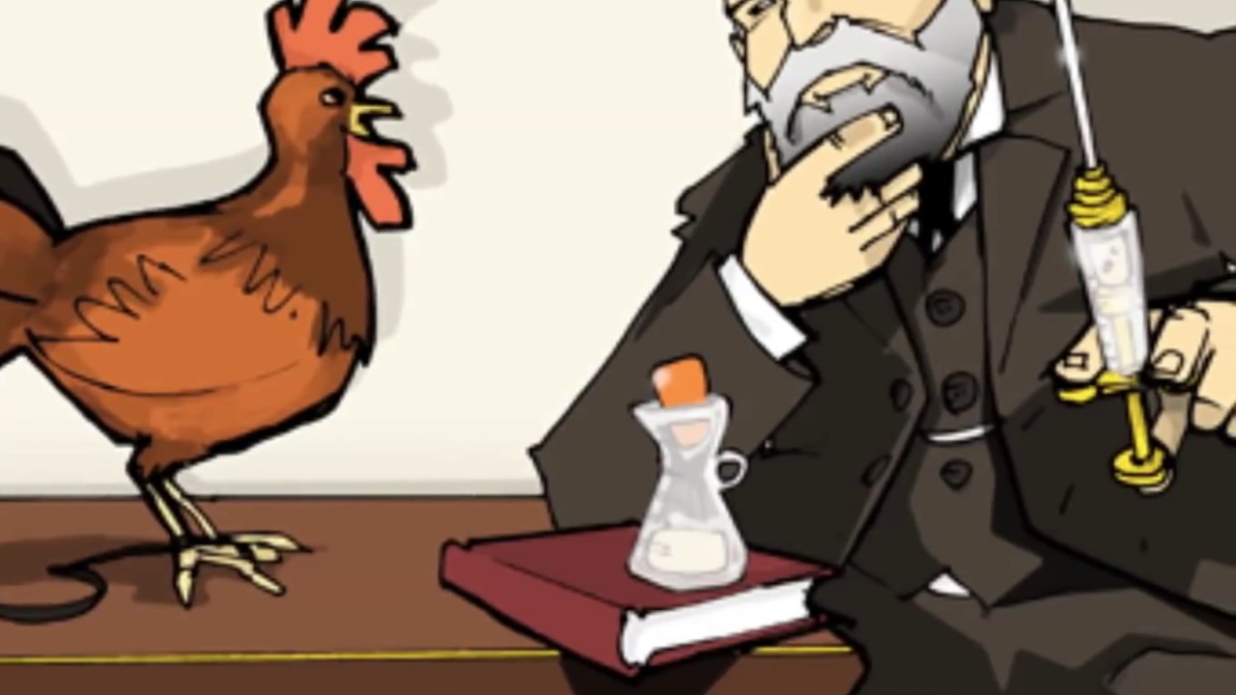
(a) The Fight Against Germs
Louis Pasteur had continued his research too. At the same time as Koch published his work on bacterial infection of wounds, Pasteur published his Germ Theory of Infection in 1878. Pasteur next focused on studying Chicken Cholera – injecting poultry with a culture of bacteria. One of the Lab Assistants went on holiday, so a culture was left to one side for a couple of weeks. When chickens were injected with this ‘old’ culture, they did not develop Chicken Cholera … even after being infected with a ‘fresh’ culture! Injecting the ‘old’ weakened culture had stimulated the chicken’s natural defences to be able to fight the ‘fresh’ culture. Vaccinations had finally begun.

Slide 8
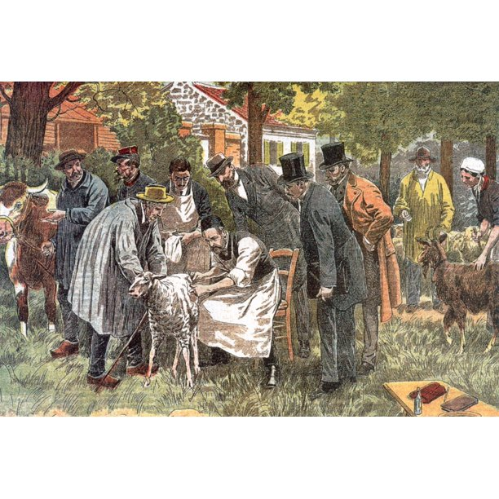
(a) The Fight Against Germs
In 1881, combining his work with Koch’s, Pasteur proved an Anthrax vaccination could be used to protect cows & sheep. He publicly vaccinated 24 sheep, 4 cows and 1 goat; a control group of the exact same animals were left unvaccinated. On 31 May all 58 animals were inoculated with Anthrax bacilli – two days later, all 29 of the vaccinated animals were alive; the control group, however, saw that all 24 sheep & the goat were dead, while the 4 cows were swollen & feverish. This was public proof that Vaccinations worked.

Slide 9
Activity 25
Pasteur’s ‘Vaccinations’ were named after Edward Jenner’s work on smallpox in 1796. Why did Jenner call his new discovery a ‘vaccination’?

Slide 10
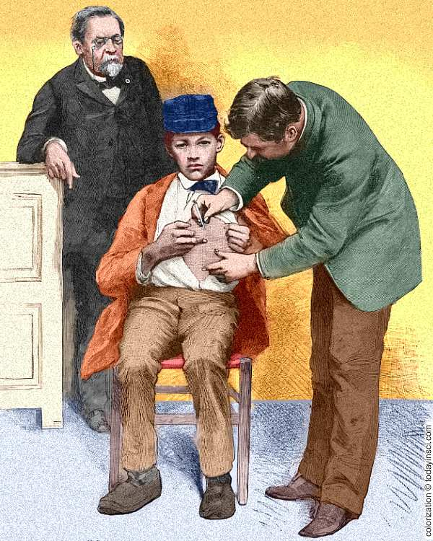
(a) The Fight Against Germs
In 1885, Pasteur’s vaccinations for human diseases were at an experimental level. He developed a Rabies vaccine (against a disease that affects humans & animals) when a 9-year-old boy, Joseph Meister, was brought to him after being bitten by a rabid dog. [Vaccines cannot protect a person already affected by a disease, but Rabies only develops once microbes reach the brain] Aware that the boy would die if nothing was done, Pasteur agreed to use his vaccine in this instance and young Joseph Meister’s life was saved.

Slide 11
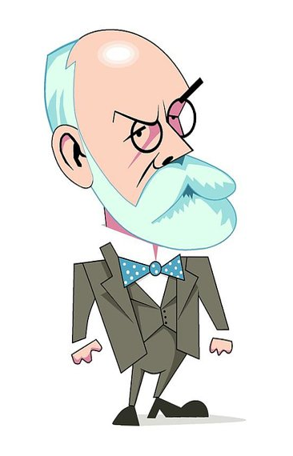
(a) The Fight Against Germs
Robert Koch began to investigate different diseases effecting humans, to see if he could identify specific microorganisms to make cultures. When he had created a new culture, he injected it into test animals to see if they would develop the diseases. Thus, Koch identified the microorganism that caused TB in 1882 + Cholera in 1883. Koch used agar jelly to grow cultures in a Petri dish and experimented with dyes to stain microorganisms different colours so that people could study them under the microscope. Bacteriology was born (Koch is known as “The Father of Bacteriology”) so tetanus, pneumonia, meningitis, diptheria & dysentery microorganisms were all identified in the 1880s & 1890s.

Slide 12
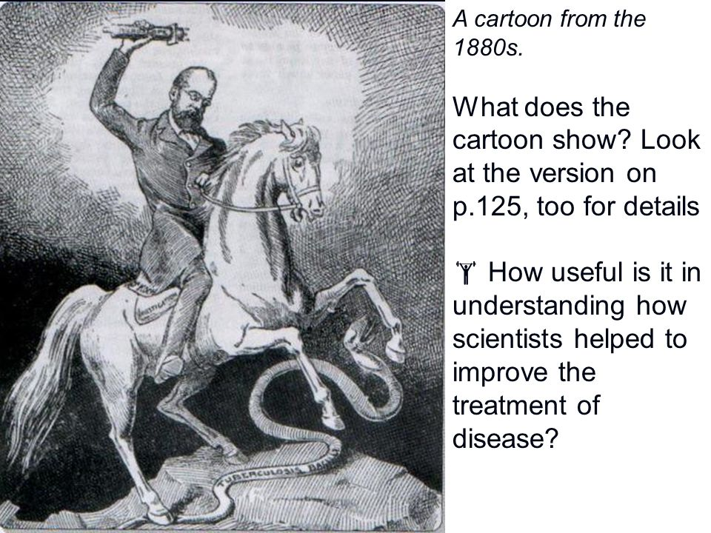
(a) The Fight Against Germs
Louis Pasteur & Robert Koch were scientific rivals. This rivalry was heightened in 1870-1871, when France & Germany were at war. Both Governments were keen to outdo the other, so the French & the Germans provided plenty of funding for research teams & equipment. While Pasteur & Koch never worked together, they were well-aware of each other’s work through reading their research after being published in science journals & at conferences. The public, however, knew nothing of the pair’s work and their new developments were not accepted into Medicine by doubtful doctors & skeptical scientists.

Slide 13
Exam-Style Question
How far did understanding of disease change 1848-1890?
You may use the following in your answer:
Four Humours
Pastuer’s Germ Theory of Infection
You must also use information of your own.
(16 marks)

Slide 15
Exam-Style Advice
How far did understanding of disease change 1848-1890?
You may use the following in your answer:
Four Humours
Pasteur’s Germ Theory of Infection
You must also use information of your own.
(16 marks)
This question wants you to explain what people thought caused disease in 1848 and compare it with what was thought by 1890. The “how far” part means look for continuity as well – then weigh up both sides of the issue.

