Slide 1
Edexcel IGCSE History P2: Breadth Study B1
Changes in Medicine,
1848-1948

Slide 2
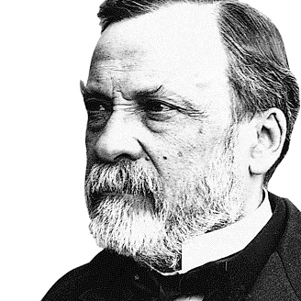

Slide 3
Edexcel IGCSE History P2: Breadth Study B2
Changes in Medicine,
1848-1948
2. Discovery & Development, 1860-1875

Slide 4
(e) Elizabeth Garrett & Progress of Women in Medicine
The Society attitude towards women throughout 19th Century was that they were the daily carers of the sick at home. Few women became doctors, as they were not given the same educational opportunities as men. Women were seen to be inferior in intellect compared to men, so higher education was seen as unnecessary. Wealthy girls were educated at home and trained to be good wives for future husbands; they were not expected to go to University or gain a higher education in the Arts, Science or even embark on Medical Training.

Slide 5
(e) Elizabeth Garrett & Progress of Women in Medicine
Florence Nightingale, however, had made it quite acceptable for women to train as nurses and it fitted in with the traditional Victorian view of women as carers for the sick. Women were the nurses and men were the doctors, mostly because Medical Training was seen as too unpleasant for women to endure – expecting a woman to sit through a dissection was subjecting her to something ‘unladylike’ and, if a woman wished to become a doctor, it was ‘unnatural’. Some women started to challenge Victorian attitudes, however, demanding the vote, an education & employment.

Slide 6
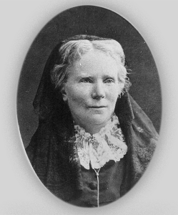
(e) Elizabeth Garrett & Progress of Women in Medicine
There were a number of barriers preventing women from becoming doctors. An essential qualification was a Medical Degree from a University or a Teaching Hospital so, as long as women were not attending Universities, no women could become qualified. The Medical Act, 1858, also stated that doctors needed to be officially registered with the General Medical Council. Again, as no women had registered, no women could be doctors in an official capacity. It was a woman named Elizabeth Blackwell who changed this and became the first female to qualify as a doctor … in the United States.

Slide 7
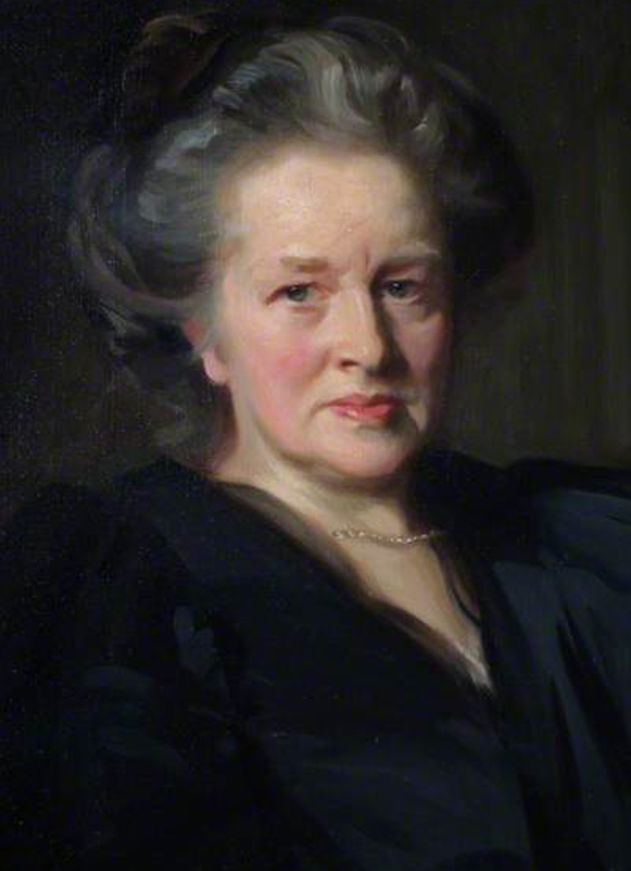
(e) Elizabeth Garrett & Progress of Women in Medicine
Dr. Elizabeth Blackwell returned to England from America for a year and spent those 12 months giving lectures on Medicine. At one of her 1859 lectures, Dr. Elizabeth Blackwell met & inspired Elizabeth Garrett – a daughter from a wealthy family, horrified at the idea of Garret training to become a doctor.
Elizabeth Garrett became a nurse at Middlesex Hospital and, in her free time, attended lectures for young male doctors (who complained about her presence as “an outrage on our natural instincts and feelings”) before being barred from them.

Slide 8
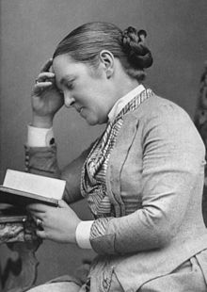
(e) Elizabeth Garrett & Progress of Women in Medicine
Garrett put in applications to several Medical Schools, but not a single institution accepted her. Undeterred, she paid for private lessons and was even forced to dissect corpses in her own bedroom as she was not permitted access to dissecting rooms.
Garrett had completed her Medical Training, but could not be licensed as none of the 3 societies that license doctors would accept her membership – the College of Surgeons & College of Physicians had long-standing regulations against admitting women, but the Society of Apothecaries had no such regulation. When her father threatened to sue, the Apothecaries let her in and Garrett officially qualified as a doctor in 1865 … The Society immediately put in a no-women regulation.

Slide 9
Activity 21
Frances Hoggan, a Welsh woman, passed the Society of Apothecaries Exam in 1867. Why did it take her 10 years to be licensed in Britain, 1877?

Slide 11
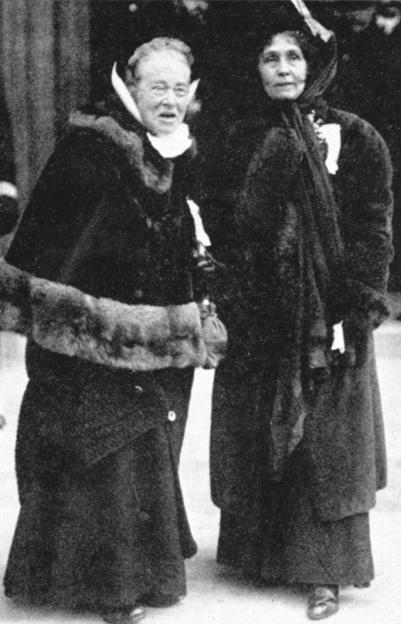
(e) Elizabeth Garrett & Progress of Women in Medicine
Dr. Garrett’s father rescued her again, when he helped fund the opening of St. Mary’s Dispensary, London, 1866. Dr. Garrett then taught herself French, so that she could go to Paris to study for a full Medical Degree. When she returned to England in 1872, she expanded the Dispensary to have a 10-bed ward staffed entirely by women. In 1873, Dr. Garrett became a member of the BMA – the first & last for 19 years, due to another hasty rule change! In two further expansions, her Dispensary became the New Hospital for Women and then the London School of Medicine for Women. In 1908, she was the first female Mayor of Aldeburgh & first ever female mayor in England too! Shortly after her death in 1918, the Dispensary was rightly renamed the Elizabeth Garrett Anderson Hospital.

Slide 12
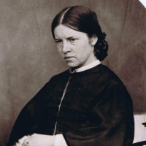
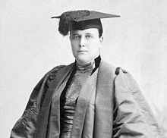
(e) Elizabeth Garrett & Progress of Women in Medicine
Elizabeth Garrett & Frances Hoggan were not alone in trying to pursue a career as a female doctor. Sophia Jex-Blake led 4 women who successfully persuaded Edinburgh University to let them study Medicine there. They had to pay additional fees (to cover the cost of being taught separately from male students) and faced opposition & harassment there.
When Edith Pechey won an Edinburgh University first prize in Chemistry, it was awarded to the second place male student! In 1874, the University forced all female students to leave Medical courses (just 5 years after they were first accepted to Edinburgh in 1869).

Slide 13
(e) Elizabeth Garrett & Progress of Women in Medicine
Like Elizabeth Blackwell, Frances Hoggan & Elizabeth Garrett before them, Sophia Jex-Blake & Edith Pechey eventually gained their Medical Degrees abroad. Attitudes were slow to change, but Parliament heard from one MP, on 3rd March 1875, who highlighted “You cannot rub out the stain which will be on the House if it refuses to do justice for women and if it prevents them from using their own intelligence in a fair, honest & upright manner for their own good.” In 1876, an Act of Parliament stated that Universities & Medical Societies should accept women who wish to become doctors. The number of female doctors was increasing.
 | 1861 | 1871 | 1881 | 1891
Female Doctors | 0 | 2 | 25 | 65
Male Doctors | 2,385 | -- | 15,091 | --
Female Students | 1 | 5 | 64 | --
Male Students | 3,566 | -- | 5,991 | --

Slide 14
Exam-Style Question
How far did the role of women in Medicine change 1848-75?
You may use the following in your answer:
Florence Nightingale and nursing
Elizabeth Garrett
You must also use information of your own.
(16 marks)

Slide 16
Exam-Style Advice
How far did the role of Women in Medicine change 1848-1875?
You may use the following in your answer:
Florence Nightingale and nursing
Elizabeth Garrett
You must also use information of your own.
(16 marks)
This question is about change, but it also expects you to evaluate the extent of change. Examples of change & continuity are needed, plus a judgement of both sides too.

Slide 18
Activity 22 – Recall Quiz
Name 3 different liquids investigated by Louis Pasteur.
What did Pasteur say was the cause of decay?
Why did Lister think about using Carbolic Acid in surgery?
Why did many surgeons not use Lister’s Carbolic Spray?
What does ‘Laissez Faire’ mean?

Slide 19
Activity 22 – Recall Quiz
Why was Public Health in London improved by Bazalgette’s work on sewers?
What were the terms of the 1875 Public Health Act?
How did Elizabeth Garrett qualify as a doctor?
Why did Medical Schools & Universities not want to accept female Medical students?
How did Garrett, Hoggan, Jex-Blake & Pechey gain their Medical Degrees?

Slide 20
Activity 23 – Explaining
Explain how Pasteur’s work showed that the Theory of Spontaneous Generation was wrong.
Explain the importance of Lister’s use of antiseptic techniques.
Explain how the position of women changed in the years 1860-1875.

Slide 21
Activity 24 – Challenge
In which aspect of medicine had there been most improvement 1860-1875?
Why were surgeons slow to accept Lister’s antiseptic techniques?
How far did the position of women in medicine change in the years 1860-1875?

