Slide 1
Edexcel IGCSE History P2: Breadth Study B1
Changes in Medicine,
1848-1948

Slide 2
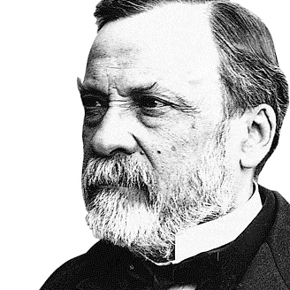

Slide 3
Edexcel IGCSE History P2: Breadth Study B2
Changes in Medicine,
1848-1948
2. Discovery & Development, 1860-1875

Slide 4
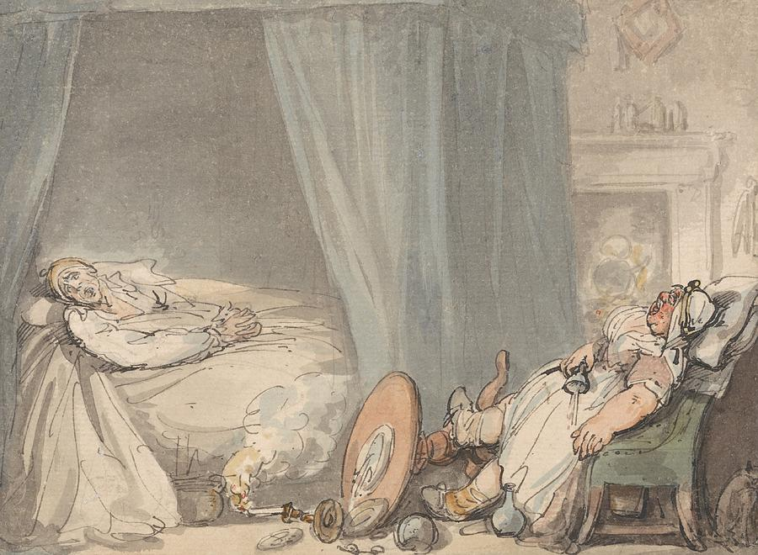
(d) Nightingale & Continuing Improvements
Hospitals were limited in the treatment they could provide while the causes of disease were misunderstood prior to Pasteur’s Germ Theory. Most people chose avoid hospitals and be cared for at home by a family member or, if they could afford it, a nurse would be employed. Doctors would visit patients at home and prescribe medicines, which family would then have to ensure got taken as per the doctor’s instructions. Home nurses rarely had any training & did not keep medical records of the patient’s condition at all.

Slide 5
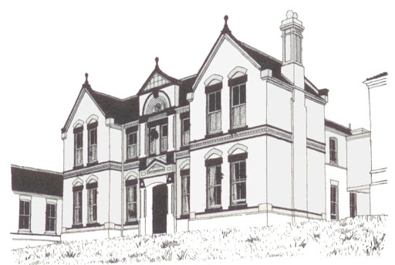
(d) Nightingale & Continuing Improvements
When people went to Hospital, however, they were small organizations that relied on charity for funding. Cottage Hospitals began in 1860, run by local GPs + had about 12 beds. Only able to handle a few patients at a time, admittance depended on a written letter of recommendation from a doctor or respected individuals (a local Clergyman, Businessman or Landowner). There were strict standards of behaviour expected of patients and, if rude or aggressive, patients could find themselves forced to leave.

Slide 6
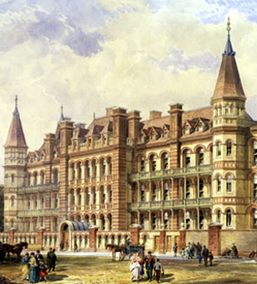
(d) Nightingale & Continuing Improvements
Larger towns & cities had some larger hospitals, known as Infirmaries. These had outpatient departments – where people could queue to be seen by a doctor, rather than invite a doctor to their home. The 3 most important London Infirmaries were:
The London Dispensary for Curing Diseases of the Eye & Ear, Moorsfields, 1805
The Royal Free Hospital, Camden, 1828
The Hospital for Sick Children, Great Ormond Street, 1852
The standard of care in Hospitals, however, was low & little progress had been made by 1860.

Slide 7
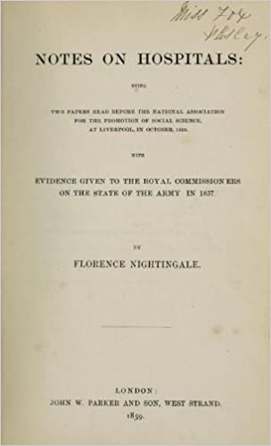
(d) Nightingale & Continuing Improvements
When Florence Nightingale returned from Scutari Military Hospital and the Crimean War in 1856, she was hailed as a hero and an expert on Nursing & Hospitals. In fact, she was less a nurse and more an excellent organizer & manager of nurses. Her 1859 book, ‘Notes on Hospitals’, set out recommendations for Hospitals about space, ventilation & cleanliness. Even though her ideas were based on ‘Miasma’ (so ultimately incorrect) her sensible suggestions – encouraging wards to be set out as “Nightingale Wards” with fresh air & space between patient beds – did make hospitals more hygienic & helped reduce infection rates in the end.

Slide 8
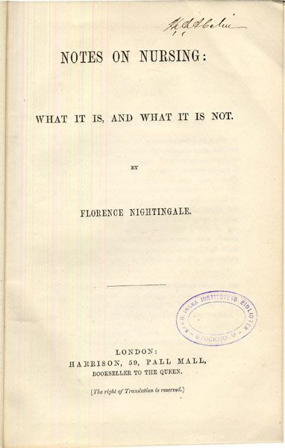
(d) Nightingale & Continuing Improvements
Nightingale also published ‘Notes on Nursing’ in 1859, giving advice on the importance of ventilation, light, bedding, cleanliness and quality food for the patient. She also emphasized the importance of personal cleanliness of the nurse and, furthermore, she highlighted the importance of the nurse as an observer of the patient to report to the doctor. ‘Notes on Nursing’ was translated into 11 languages & shows that training for nurses was a desperate need within & without the UK. In 1860, the Nightingale School was set up at St. Thomas’s Hospital, London & a Midwifery School was established by Nightingale herself at King’s Hospital, London, in 1861.

Slide 9
Activity 20
How much did Hospitals
and Nursing change in
the period 1860-1875?

