Slide 1
Edexcel IGCSE History P2: Breadth Study B1
Changes in Medicine,
1848-1948

Slide 2
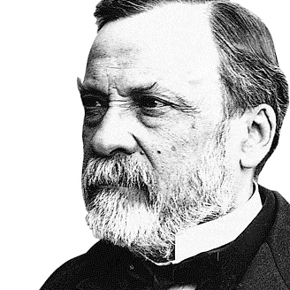

Slide 3
Edexcel IGCSE History P2: Breadth Study B2
Changes in Medicine,
1848-1948
2. Discovery & Development, 1860-1875

Slide 4
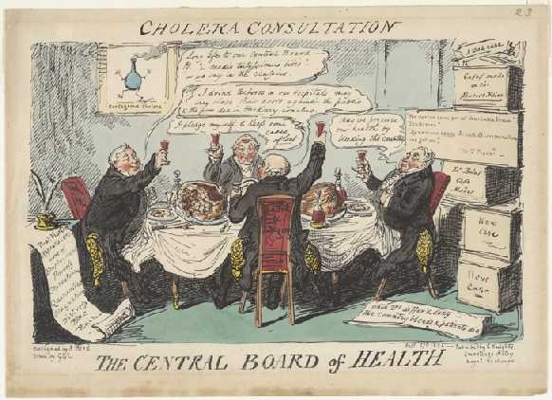
(c) Government Action on Public Health
Between 1848 and 1860, Chadwick & Snow had shown the link between hygiene & health was real. Government action, passing the 1848 Public Health Act, only permitted local authorities to act – it was not compulsory. Only one-third had bothered to created a Board of Health; even less employed a Medical Officer & the General Board of Health only lasted 5 years. As a result of the Government’s not forcing local authorities to act, there had been very little progress by 1860.

Slide 5
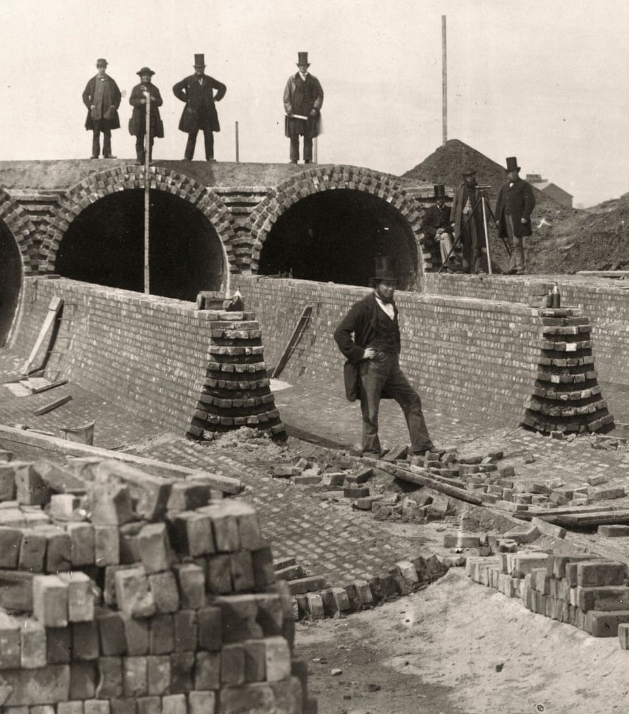
(c) Government Action on Public Health
Despite a lack of Government-led progress, John Snow’s work on cholera & the Great Stink of 1858 did convince the Government that London’s sewer system needed improvement. The London Metropolitan Board of Works was given £3,000,000 to build a better sewer system. Joseph Bazalgette was made Chief Engineer & his plan had 2 new key features:
Sewers should be very large, oval-shaped brick tunnels instead of narrow, round pipes.
Sewers would bring waste to lower Thames, where the River was tidal – taking it out to sea.

Slide 6
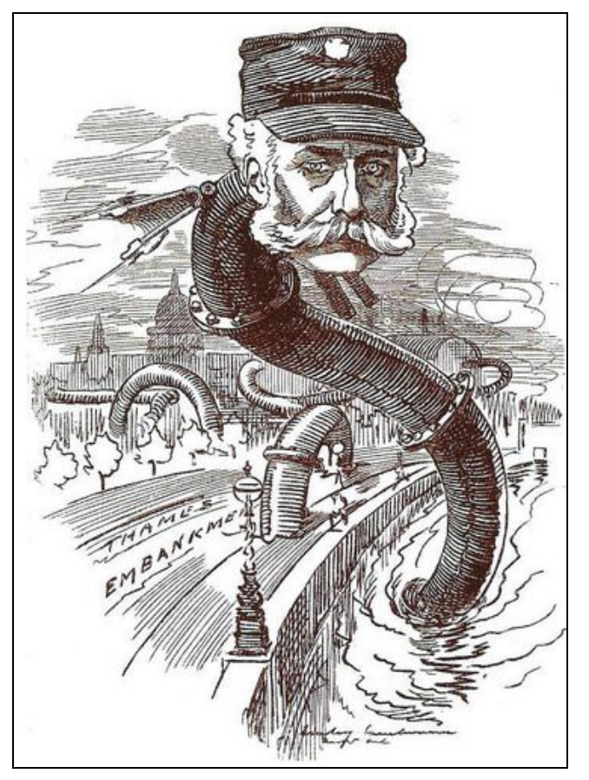
(c) Government Action on Public Health
Bazalgette’s sewer system was extremely expensive and too a long time to complete. The majority of the 2,000km of sewers had been built by 1865. Gravity was often used to keep sewerage flowing, but four pumping stations were built between 1864 and 1875, plus two treatment works to deal with waste not sent out to sea. By 1875, Bazalgette’s project was done; it had cost a total of £6,500,000 and London’s Embankment was created as a side-effect, from the earth dug out to create the sewer tunnels, which also narrowed the Thames to control the River. (A small railway was installed in the tunnels, too, so people could travel through them!)

Slide 7
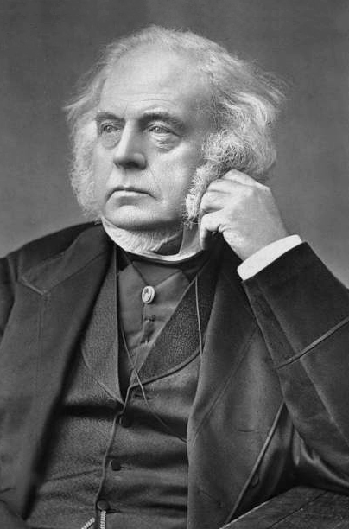
(c) Government Action on Public Health
In the 1870s, attitudes towards the role of Government were changing. Previously, the Government only took action in an emergency – like a cholera epidemic – but chose not to interfere in peoples’ lives or businesses; “Laissez Faire” or “Leave Alone”. An example of the “Laissez Faire” attitude can be seen in the way that not all laws were strictly enforced – despite a law making it compulsory to vaccinate children against Smallpox in 1852, the Government ignored those ignoring the law until a new Act of Parliament enforced vaccinations in 1871. Also, people did not want the Government to interfere if it meant an increase in taxes. Chadwick & Snow, however, highlighted the importance of access to clean water & the removal of sewerage. So, at last, the Government had to take action.

Slide 8
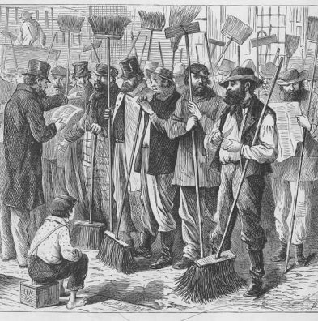
(c) Government Action on Public Health
The Sanitary Act, 1866 stated that all towns had to employ inspectors to check water supply & drainage. Local Authorities also took action to improve public health – a town council in Manchester made strict regulations about the size of rooms & size of windows in new homes, to ensure enough light & ventilation. Joseph Chamberlain, Mayor of Birmingham, improved the city’s water supplies and started to demolish slums across the city. Some Local Authorities were starting to tackle problems, but it was too ‘hit & miss’ across the United Kingdom to be effective.

Slide 9
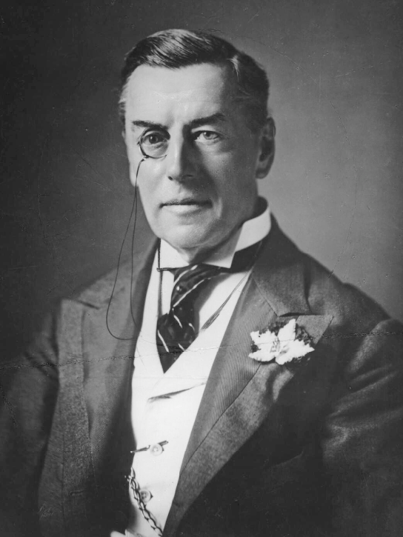
(c) Government Action on Public Health
Pasteur’s proof that disease could be traced back to polluted water soon made access to clean water, removal of rubbish & sewer systems a clear way to improve public health. After Joseph Chamberlain, Mayor of Birmingham, found popularity by dealing with Birmingham’s public health problems, it also became a clear way to win votes. Political Parties tried to appeal to the men newly able to vote – in 1848 only 1 million Middle Class men could vote but, after the 1867 Reform Act, 2 million Working Class men could now vote – so a Government that helped the newly enfranchised could stay in power.

Slide 10
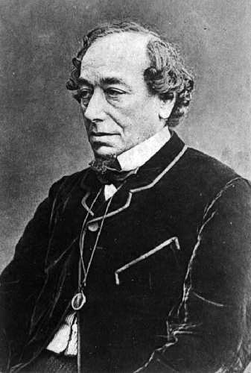
(c) Government Action on Public Health
Prime Minister, Benjamin Disraeli, knew exactly how to appeal to new Working Class voters and his Conservative Government passed the Public Health Act, 1875, making local authorities:
Have to supply clean water
Have to stop sewerage polluting drinking water
Have to build public toilets + install street lighting
Have to ensure new housing was good standard
Have to regularly inspect lodging houses’ conditions
Have to employ Health Inspectors + Sanitary Inspectors
Have to regularly check the quality of food on sale
Unlike earlier Acts, this was not optional or ‘Laissez Faire’; it enforced a national standard of public health in the UK.

Slide 11
Activity 18
Look at the terms of Disraeli’s Public Health Act, 1875.
Rewrite them in order of importance to show which
terms would have most impact.

Slide 13
Activity 19
Put these in Chronological Order:
Sanitary Act, 1866 The Great Stink, 1858
Bazalgette’s Sewers, 1858 Public Health Act, 1875
Chadwick’s Board of Health, 1848-1854
John Snow & the Broad Street pump, 1854
Pateur’s Germ Theory, 1861 Public Health Act, 1848

Slide 15
Exam-Style Question
How far was Govt responsible for changes in public health 1848-70?
You may use the following in your answer:
The 1848 Public Health Act
Joseph Bazalgette
You must also use information of your own.
(16 marks)

Slide 17
Exam-Style Advice
How far was Govt responsible for changes in public health 1848-70?
You may use the following in your answer:
The 1848 Public Health Act
Joseph Bazalgette
You must also use information of your own.
(16 marks)
This question asks you to evaluate whether changes in public health were due to Government action or some other factor – like the work of individuals or improved scientific understanding.

