Slide 1
Edexcel IGCSE History P2: Breadth Study B1
Changes in Medicine,
1848-1948

Slide 2
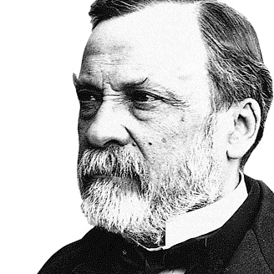

Slide 3
Edexcel IGCSE History P2: Breadth Study B2
Changes in Medicine,
1848-1948
2. Discovery & Developments, 1860-1875

Slide 4
Activity 16
Dr. Ignaz Semmelweiss
was sacked from Vienna
General Hospital in 1849.
Find out 2 reasons WHY.
Find out where he died in 1878.

Slide 5
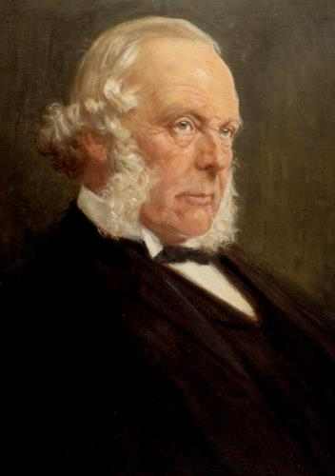
(b) Improvements in Surgery
In 1859, Joseph Lister became Professor of Surgery at Glasgow University. In 1861, he became Surgeon at Glasgow Royal Infirmary – one of the leading Scottish Hospitals. He was put in charge of a new building and made it his mission to reduce deaths after surgery by focusing on hygiene to reduce infections. Lister had read Pasteur’s work and, when he found out Carbolic Acid was used at the Carlisle Sewage Works to treat sewage, he realized Carbolic Acid could kill the microorganisms causing decay & smell. He noticed that the smell associated with infected wounds was similar to the smell of sewerage. Consequently, he wondered if Carbolic Acid could be used to prevent infection in surgery.

Slide 6
(b) Improvements in Surgery
During one of Lister’s cases, an 11-year-old boy was brought into Glasgow Royal Infirmary with a broken leg. As the bone was sticking out through the skin, which would usually lead to infection, amputation would have been the usual treatment – but Lister, instead, set the broken bone and covered the wound in bandages soaked in a Carbolic Acid solution. He was delighted to see the boy’s wound heal without any infection. Lister began to use his Carbolic Acid solution to clean wounds, equipment & bandages in all his operations & death rates dropped hugely. His method was called ‘Antiseptic’ because the technique was used to fight (ANTI) infection (SEPSIS).
 | 1864-1866 WITHOUT ANTISEPTICS | 1867-1870 WITH ANTISEPTICS
TOTAL CASES | 35 | 40
RECOVERED | 19 | 34
DIED | 16 | 6
DEATH RATE | 45.7% | 15.0%

Slide 7
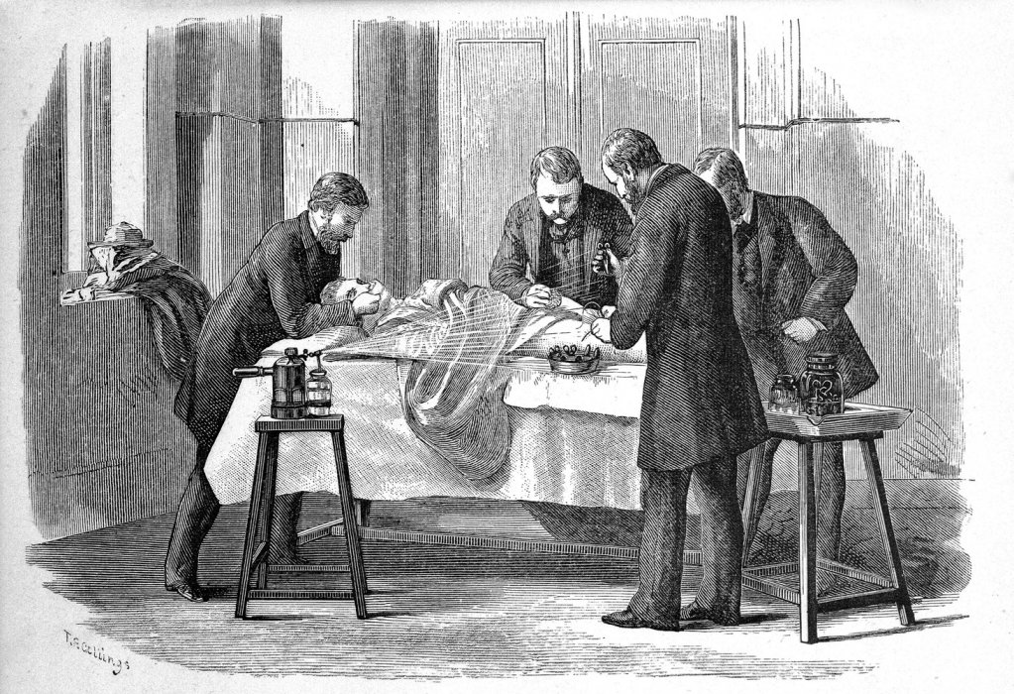
(b) Improvements in Surgery
Lister also developed a Carbolic Spray, that could be used during an operation. This spray ensured that no microorganisms were on the hands of the surgeon or on the equipment – thus stopping all of the microorganisms being able to enter the would to infect it.

Slide 8
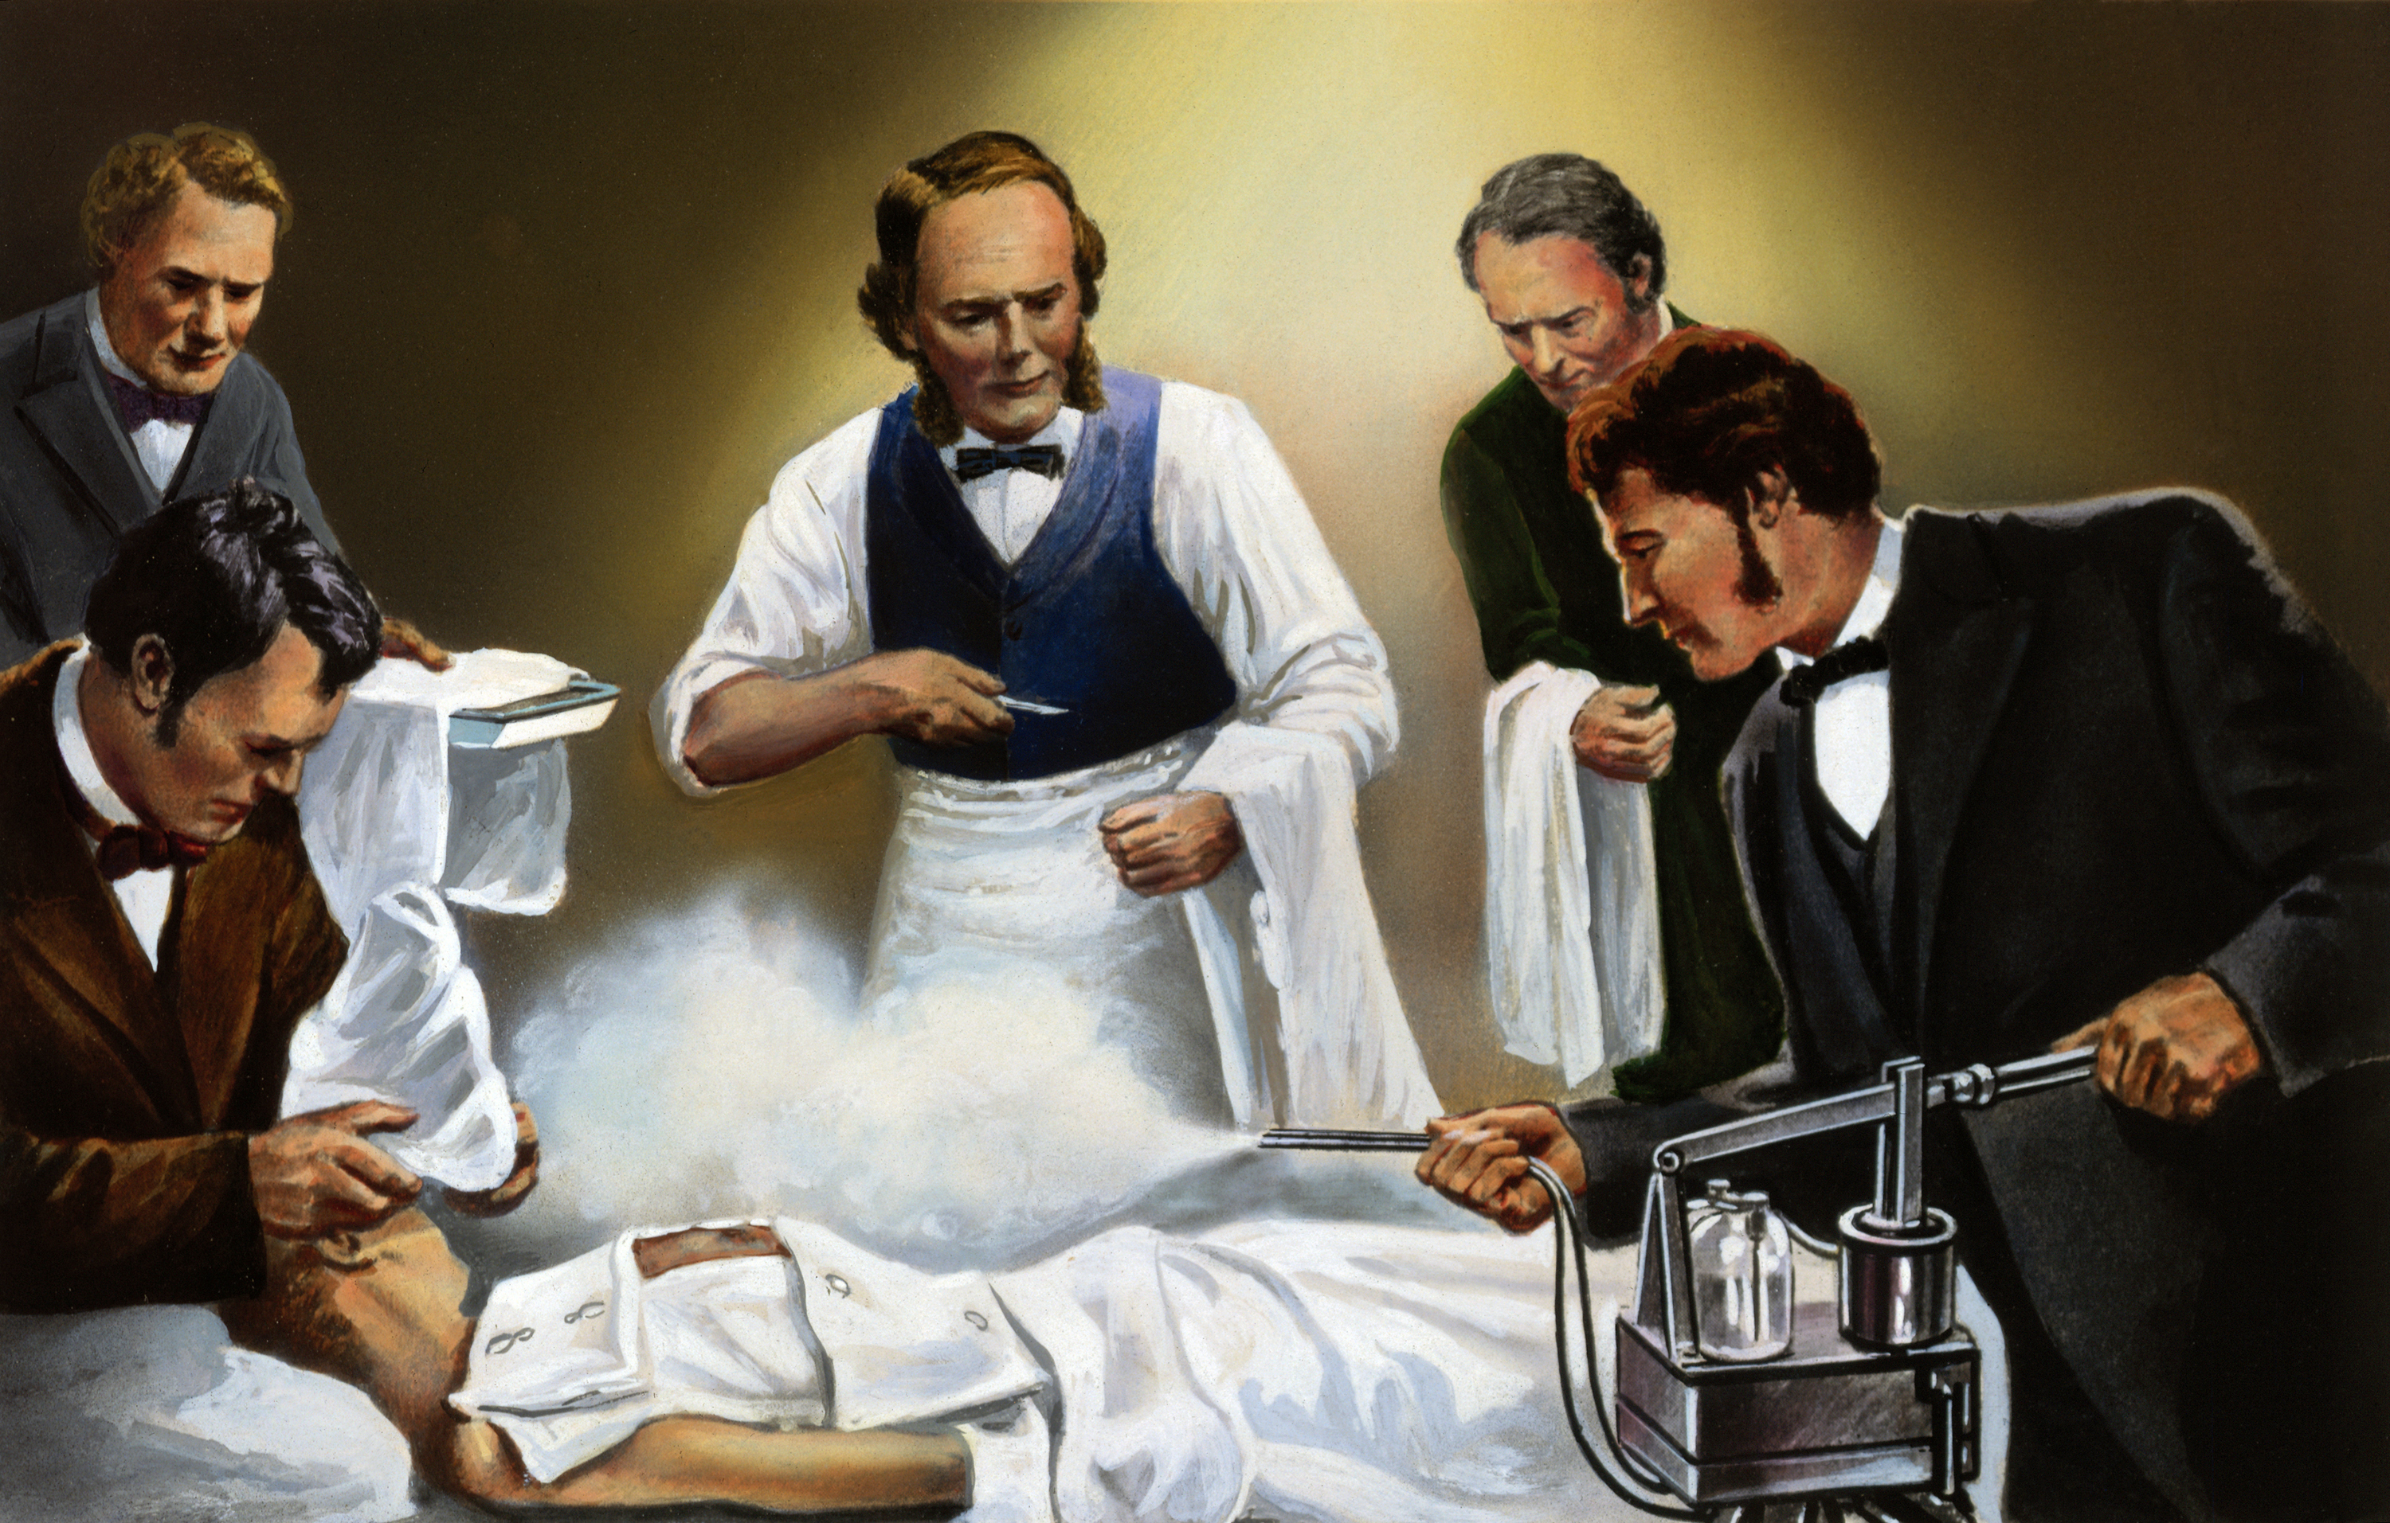
(b) Improvements in Surgery
Lister, however, faced a lot of opposition:
Carbolic Spray made surgical instruments slippery & difficult to grip – slowing surgeons down & blood loss was still a major issue during operations.
Surgeons’ hands were cracked & sore after Sprays.
Many doctors rejected Pasteur’s ‘Germ Theory’, so they also saw no need for Antiseptics.
Doctors didn’t use Lister’s methods correctly, so found them ineffective during operations.
Nurses found the extra time & extra work of dressing wounds irritating, so opposed the methods.
Soap & Water were working well, so many doctors didn’t feel the need for extra Antiseptic techniques.

Slide 9
Activity 17
Work in Pairs or Small Groups.
Model yourselves into a ‘freeze frame’ position showing a key development in the progress of Surgery. Can others guess it?

Slide 10
Exam-Style Question
How far were the problems of surgery solved 1848-1875?
You may use the following information to help:
Ether
Blood loss
You must also use information of your own.
(16 marks)

Slide 12
Exam-Style Advice
How far were the problems of surgery solved 1848-1875?
You may use the following information to help:
Ether
Blood loss
You must also use information of your own.
(16 marks)
This question is about the problems of surgery, so you need to identify several problems & explain what was done to solve them. This is an assessment of your knowledge, understanding + recall.

