Slide 1
Edexcel IGCSE History P2: Breadth Study B1
Changes in Medicine,
1848-1948

Slide 2
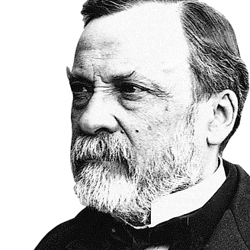

Slide 3
Edexcel IGCSE History P2: Breadth Study B2
Changes in Medicine,
1848-1948
2. Discovery & Development, 1860-1875

Slide 4
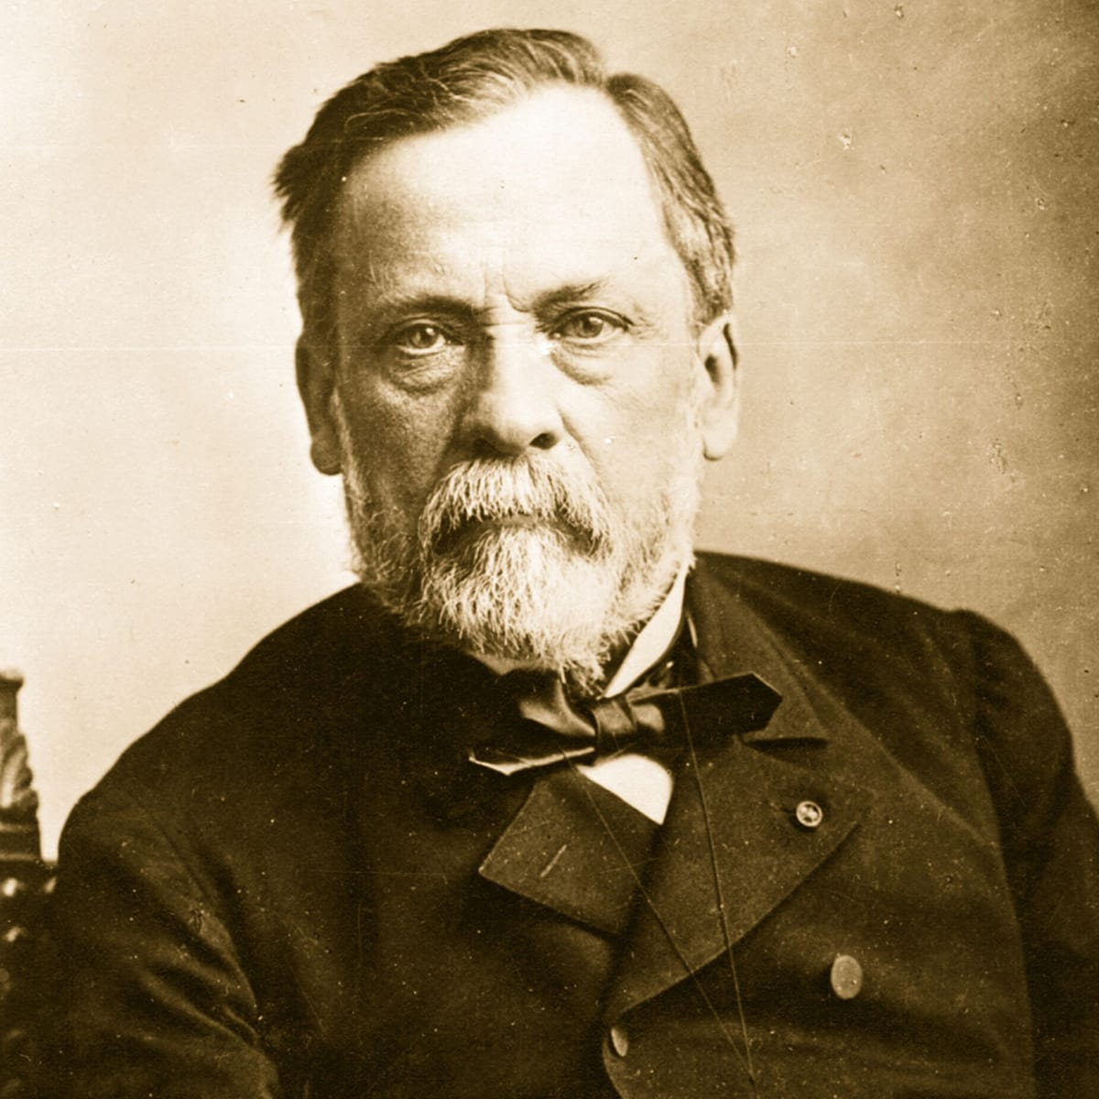
(a) Pasteur, Development of Germ Theory & its Effects
Louis Pasteur was a research Chemist from France. He was asked to investigate why vats of beer were turning sour in 1854 and, as microscopes were more available and more powerful, Pasteur discovered tiny microorganisms (or microbes) in the beer. According to the Theory of Spontaneous Generation, the microorganisms were created by the beer decaying – but Louis Pasteur disputed this. He suggested that microbes were affecting the beer and making it turn sour. To prove his new theory, Pasteur heated the liquid – to kill the microbes – which then stopped the beer going sour. Pasteur was right!

Slide 5
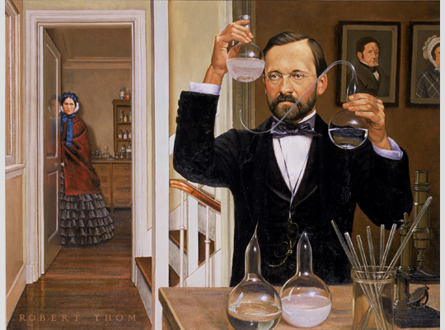
(a) Pasteur, Development of Germ Theory & its Effects
Louis Pasteur carried out experiments on milk, wine & vinegar and became convinced that the liquids were being contaminated with microbes that were floating in the air. In each case, when milk, wine & vinegar was heated it didn’t go sour. In 1860, the French Academy of Science set a challenge to scientists to prove the Theory of Spontaneous Generation. Pasteur’s earlier experiments disproving it were soon publicized. His results were clear – mixtures left in the open air went bad and, under a microscope, microorganisms were present in the mixture; mixtures that were kept from the air didn’t go bad and, after contaminated mixtures were heated, there were no microorganisms present.

Slide 6
(a) Pasteur, Development of Germ Theory & its Effects
Pasteur explained that the mircrobes were not spontaneously generating, but germinating. So his new ideas became known as ‘Germ Theory’. Pasteur also collected samples of air from different locations & found that mountain air was “cleaner” with less microbes than “dirty” city air full of microbes. The usual date for Pasteur’s Germ Theory is 1861, but his ideas were resisted & ridiculed. He published detailed experiments in Scientific Journals, so that others could check them + accept them.
The 4 Basic Principles of Germ Theory
1. Air contains living microorganisms.
2. Microorganisms are not evenly distributed in the air.
3. Microorganisms in the air cause decay.
4. Microorganisms can be killed by heating them

Slide 7
Activity 15
Make a Mind-Map showing how the work of individuals affected ideas about the cause of disease.
Start with 4 Humours, Miasma & Spontaneous Generation; then link these to Chadwick, Snow & Pasteur.

Slide 8
(a) Pasteur, Development of Germ Theory & its Effects
In 1865, Pasteur was asked to investigate a Silk Industry problem. Silk worms were dying from a disease, possibly caused by microorganisms, so Louis Pasteur began to make the vital link between microorganisms and disease. These findings were published in Germ Theory & Its Applications to Medicine, 1878. Scientists were not won over, however, as hundreds of microorganisms could be seen in the blood of healthy patients & they were not diseased. Why did some microorganisms cause disease why other microorganisms did not?

Slide 9
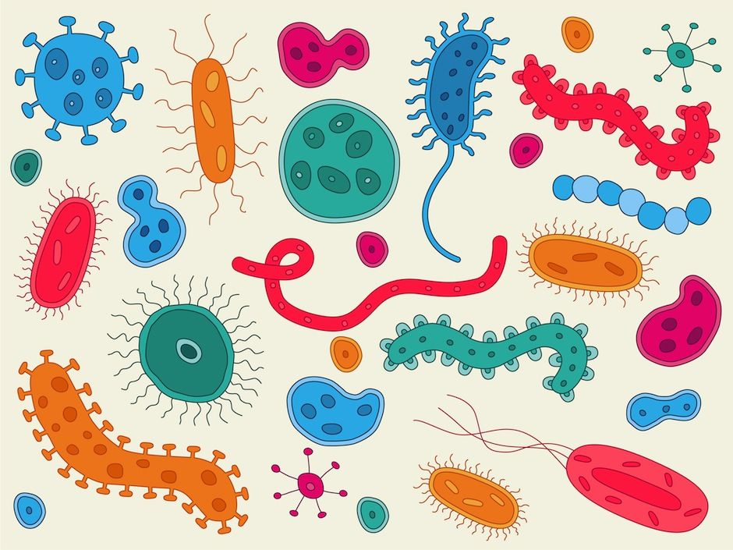
(a) Pasteur, Development of Germ Theory & its Effects
It wasn’t clear how Germ Theory could help medicine. Pasteur proved diseases spread by microorganisms, but this knowledge did not help explain how to cure diseases. One man influenced by Pasteur, was Joseph Lister – who then saw why infection often developed after operations, so he made antiseptic techniques for Surgery. Germ Theory impacted Public Health, too, as it helped explain the link between hygiene & healthiness. Without Pasteur influencing the identification of disease-causing microorganisms, there would be no vaccinations developed over the next 30 years + no treatments in the next 40 years.

Slide 10
Exam-Style Question
Explain two ways in which ideas about the cause of disease were different in 1850 from ideas in 1870. (6 marks)

Slide 12
Exam-Style Advice
Explain two ways in which ideas about the cause of disease were different in 1850 from ideas in 1870.
(6 marks)
As this is for 6m, it should not be a long answer – you cannot get more than 6 marks, even if you brilliantly explain 3 differences!
For each example you give, you should say WHAT was different and then provide SUPPORTING DETAIL to illustrate that difference.

