Slide 1
Edexcel IGCSE History P2: Breadth Study B1
Changes in Medicine,
1848-1948

Slide 2
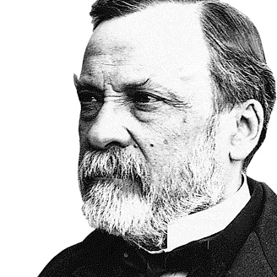

Slide 3
(d) Problems & Improvements in Public Health
Changes in farming and the rapid development of factories during the Industrial Revolution caused many workers to move to brand new industrial towns. These overcrowded industrial areas, however, had poor quality houses which were very basic. As factories paid low wages, rents were low, so Landlords kept rents low by refusing to repair damaged & dirty homes.
CITY | 1801 POPULATION | 1851 POPULATION
Glasgow | 77,000 | 329,000
Liverpool | 82,000 | 376,000
Birmingham | 71,000 | 233,000
Manchester | 70,000 | 303,000
Leeds | 53,000 | 172,000
London | 957,000 | 2,362,000

Slide 4
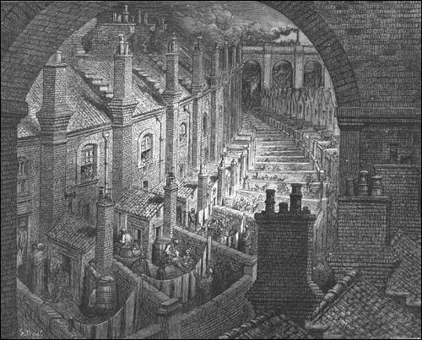
(d) Problems & Improvements in Public Health
Grouped houses in poor areas of industrial towns were arranged in narrow, dark streets called ‘Courts’. These courts housed hundreds of people. A whole family would live in one room and 50 people or more lived in one house. Living conditions were damp, dark & unventilated. In bad weather, cellars and ground floors would flood and a single ‘Privy’ may be used by 100 people, young & old. Water was collected from a pump shared by 20-30 families; and, worse, this water was taken from polluted rivers. This was ideal conditions for disease to spread rapidly.

Slide 5
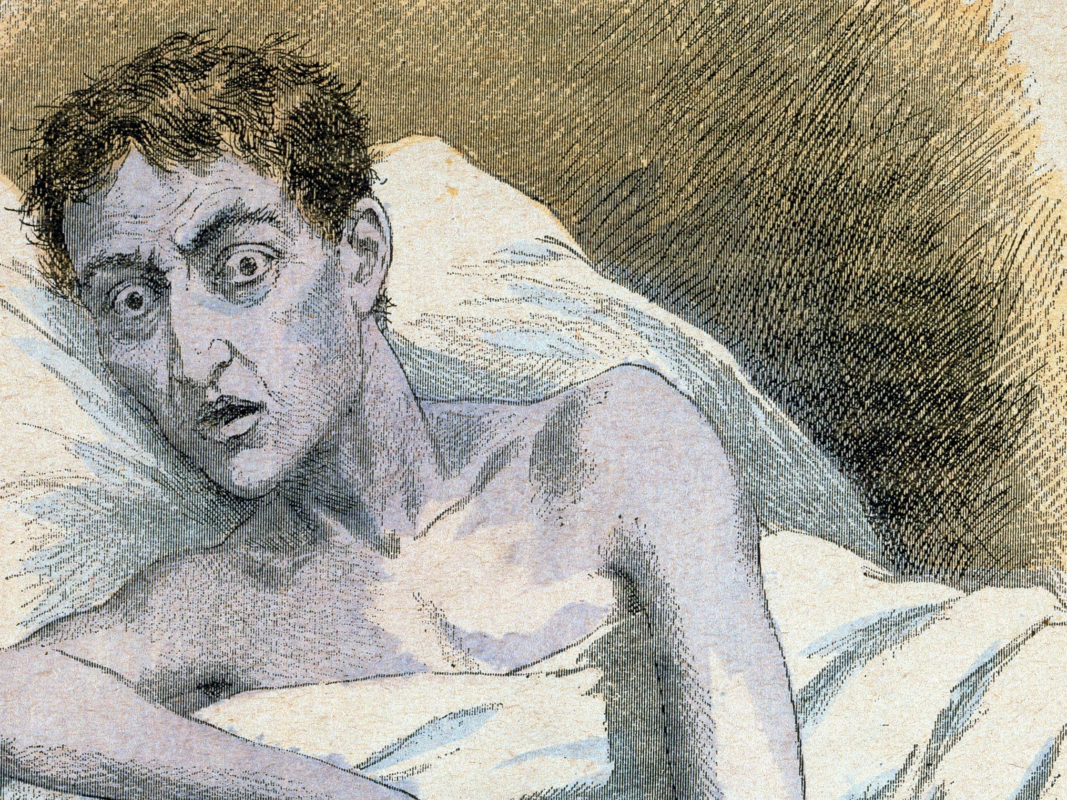
(d) Problems & Improvements in Public Health
Killer diseases were a major problem across Victorian Britain. Despite a vaccination being developed to prevent smallpox, few people had been vaccinated. There was no prevention or treatment for typhus, typhoid fever or influenza. Even if patients survived these diseases, they were so weak that they usually died from pneumonia or bronchitis. Perhaps the most feared and frightening disease was cholera – as it could kill in a single day – plus the symptoms were pain, muscle spasms, extreme vomiting & diarrhoea, until death resulted from dehydration. In the cholera epidemic, 1831-1832, 20,000 died.

Slide 6
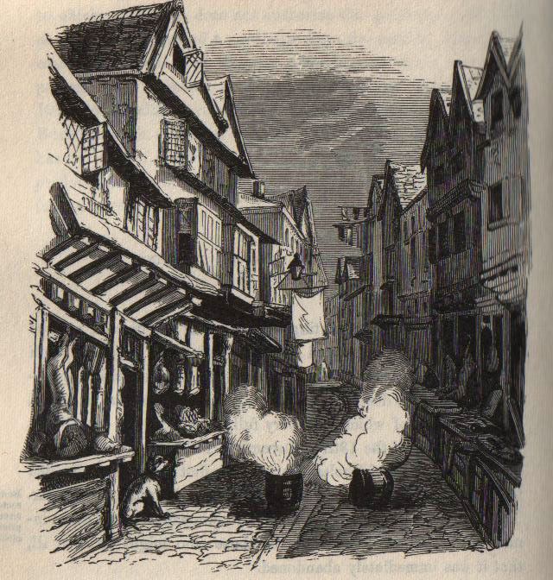
(d) Problems & Improvements in Public Health
The lack of understanding of disease is best demonstrated by the fact that MPs debated a day of prayer in response to another cholera epidemic in 1848. They eventually decided to against the day of prayer and, instead, told local authorities to deal with the problem. The local authorities acted swiftly, but their action was based on miasma; they burnt barrels of tar on street corners and advised people to stay warm & stay clean. Only one of these helped.

Slide 7
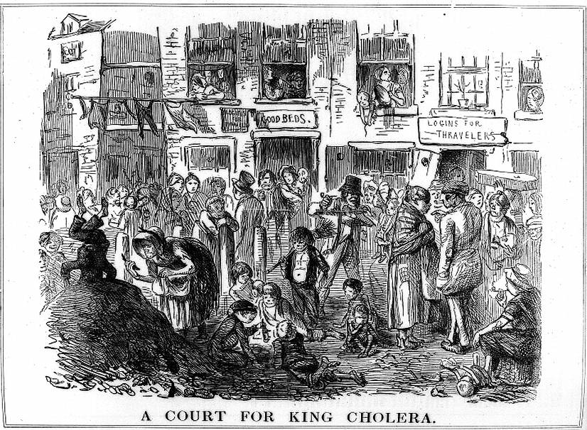

Slide 8
Activity 6
How many health hazards
can you see in ‘A Court
for King Cholera’?

Slide 10
Activity 7
Why would the conditions
in ‘A Court for King Cholera’ make the miasma explanation of local authorities seem true?

Slide 12
(d) Problems & Improvements in Public Health
A Government Report into the 1832 cholera epidemic in Leeds, carried out by Dr. Robert Baker, found a link between the disease & living standards in the poor parts of the city:
Streets were bare earth, so they became muddy & diseases collected in the mud.
19 streets did not have a sewer & another 10 streets only had a sewer for half-streets.
Stagnant water created offensive smells.
Human excrement was collected to sell to farmers and dung-heaps were often huge. One yard in Leeds held 75 cart-loads!

Slide 13
(d) Problems & Improvements in Public Health
Edwin Chadwick was originally involved with Workhouses (where poor people were sent when too old or too ill to support themselves) and was familiar with rate-payers’ complaints that the Workhouses were financed from tax. Chadwick published a Report in 1842 called ‘The Sanitary Conditions of the Labouring Classes’ which suggested that rate-payments would be better spent on improving housing & living conditions to keep the poor healthy. He argued that, rather than letting the poor die in dreadful conditions or end up in the Workhouse, the poor could enjoy better lives and drain the public purse less if they had access to clean water, had rubbish removed + sewers.

Slide 14
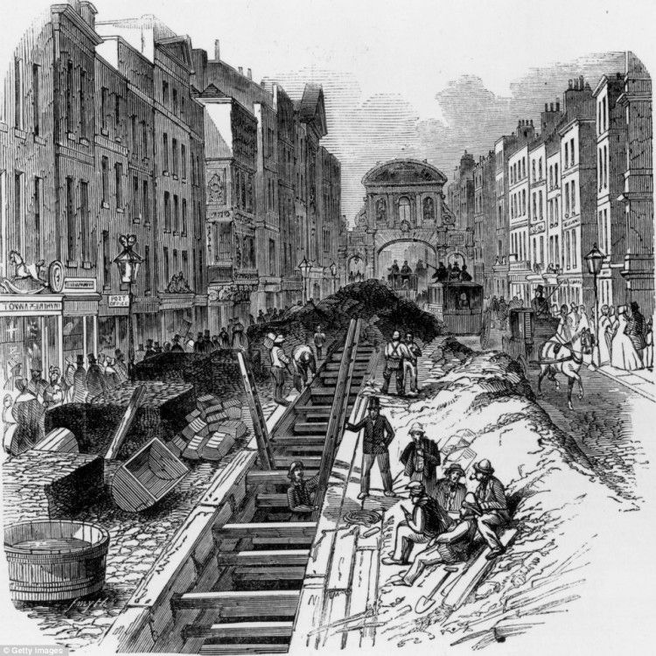
(d) Problems & Improvements in Public Health
Even though Chadwick’s ideas gained little support after 1842, further cholera epidemics (affecting the Middle & Upper classes) drew attention to the issue of hygiene. The Government finally responded to Chadwick’s Report with the 1848 Public Health Act:
A General Board of Health was set up
Towns also set up their own Boards of Health; employing a Medical Officer, organized rubbish removal & built a sewer system.
3 Commissioners were appointed to oversee each Town Board of Health and a London Metropolitan Commission of Sewers was appointed for 1848-49.

Slide 15
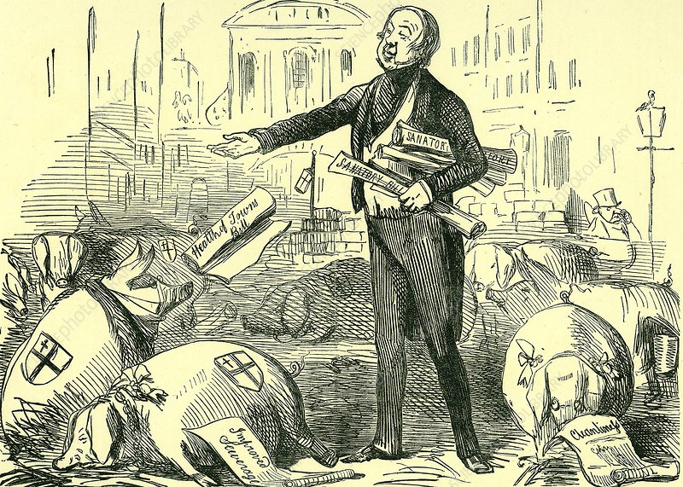
(d) Problems & Improvements in Public Health
The impact of the 1848 Public Health Act was limited. Firstly, the terms of the Act were temporary – the Board of Health was only to last 5 years, so ended in 1854. Next, more importantly, the Act allowed local authorities to improve conditions – but it was not compulsory, so many simply saved money + took no action at all. Chadwick, himself, was also a problem. He was arrogant and aggressive, so people were less likely to listen to him … even after over 50,000 people died during the cholera epidemic 1848-49 … the pace of change was painfully slow. The general public also opposed the increasing taxes to help the poor – especially with no ‘proof’ diseases linked to hygiene!

Slide 16
Activity 8
Edwin Chadwick was not a doctor & had no medical background. Why was he involved in such important medical issues in the 1840s?

Slide 18
Activity 9
Edwin Chadwick’s ideas were sensible solutions to the epidemics of the 1840s.
Why were these ideas only partially implemented?

Slide 20
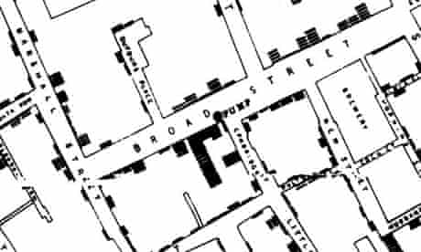
(d) Problems & Improvements in Public Health
Following another cholera epidemic in 1854, the British attitudes finally started to change. In 1849, Dr. John Snow was first to suggest that cholera was spread by polluted water. His research also proved this idea correct. Dr. Snow had investigated a cholera outbreak in London’s Soho, using scientific methods of observation and recordings. He made a street map showing all the cholera deaths in the area and noticed that the deaths all seemed to centre around a water pump in Broad Street, Soho.

Slide 21
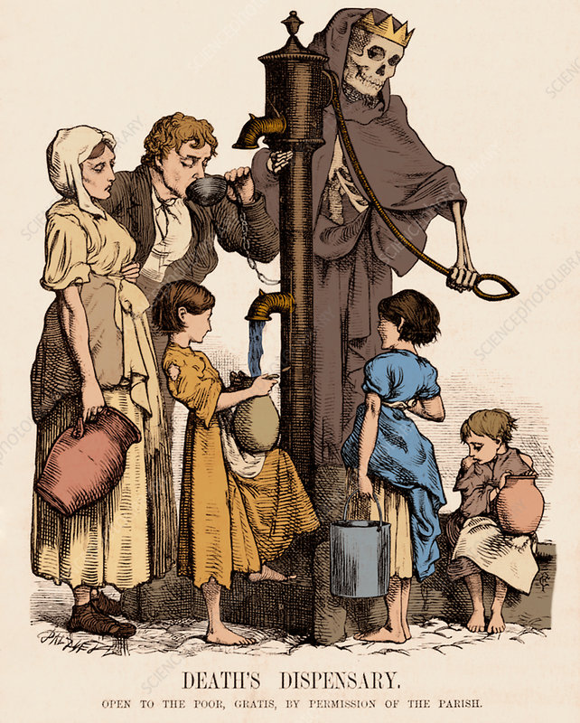
(d) Problems & Improvements in Public Health
Dr. Snow’s detailed findings in 1849 were:
Within 200m of the Broad Street pump, there had been 500 fatal cases.
In houses nearer to another pump, there were only 10 fatal cases; all of which had used the Broad Street pump.
18 workers in a factory near the Broad Street pump had died.
A Workhouse near Broad Street, which had its own water supply, recorded just 5 deaths out of 535 inhabitants.
Workers at a local brewery, who drank free beer as part of their wages, were not affected at all.
A woman in Hampstead, miles away from Soho, had died. It was discovered that she used to live on Golden Square, Soho, drinking a bottle of Broad Street pump water daily.

Slide 22
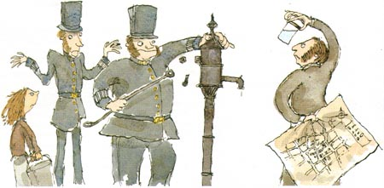
(d) Problems & Improvements in Public Health
Dr. Snow’s research was completely convincing. He could show why some did not catch cholera who lived near the Broad St. pump and could show why some living far away died after drinking from it. Conclusive evidence Snow was correct was provided when they removed the pump handle – cholera deaths stopped!

Slide 23
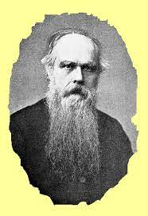
(d) Problems & Improvements in Public Health
Reverend Henry Whitehead worked with John Snow to investigate the origins of the cholera epidemic. They found the very first case was the baby daughter of Sarah Lewis, living at 40 Broad Street. The baby had suffered from diahorea and Sarah Lewis had washed the nappies with water that was emptied into a cesspool on Broad Street. Reverend Whitehead discovered that the cesspool’s brick lining was cracked and the cesspool had leaked into the Broad Street pump’s reservoir, just 1m away. The investigation had clearly demonstrated the link between cholera and infected water, putting pressure on water companies, local authorities & Parliament to improve water supplies. While this was positive, there was still no clear link between ‘invisible’ germs + disease!

Slide 24
Activity 10
Why do you think Parliament did not immediately pass
laws to improve the supply
of clean water?

Slide 26
(d) Problems & Improvements in Public Health
Although the link between cholera & polluted water was very clear by 1849, very little was done to improve public health until 1858. The hot summer of 1858 saw British rivers dry up and previous dumps of rubbish & excrement were exposed on river banks and caused “The Great Stink”. Even MPs debated whether to move meetings elsewhere, as Parliament was too near the stinking River Thames. After they were affected themselves, MPs passed an Act in just 18 days (most laws take months or years) to invest in new sewer systems to be designed by Joseph Bazalgette. This was a big step forward, but the most significant change in Pasteur’s Germ Theory was not until 1861.

Slide 27
Activity 11
Who played a more
important role in public
health – Edwin Chadwick
or Dr. John Snow?

Slide 28
Activity 12 – Recall Quiz
Explain 3 different ideas about the cause of disease in the mid-19th Century.
Name 3 problems Florence Nightingale found at the Army Hospital in Scutari
Give 3 examples of improvements made by Nightingale.
Explain 3 barriers to progress in surgery in 1848.
Why did people prefer to use chloroform rather than ether in operations?

Slide 30
Activity 12 – Recall Quiz
Why did the use of anaesthetics lead to the Black Period in surgery?
What was a ‘court’ in an industrial town?
What were the terms of of the 1848 Public Health Act?
How did John Snow prove there was a link between infected water and cholera?
How did the Great Stink push the Government into taking action on the issue of public health?

Slide 32
Activity 13 – Explaining
Explain why a lack of understanding of the causes of disease prevented progress in medicine.
Explain the importance of Simpson’s use of chloroform.
Explain why disease spread so quickly.

Slide 34
Activity 14 – Challenge
In which aspect of medicine had there been most improvement 1848 to 1860?
Why were Parliament & Local Authorities so slow to take action to improve public health?
What barriers to progress in medicine still existed in 1860?

Slide 36
Exam-Style Question
Explain two causes of improvements in surgery in Britain from 1848-1860. (8 marks)

Slide 37
Exam-Style Advice
Explain two causes of improvements in surgery 1848-60.
(8 marks)
A cause is something which leads directly to an outcome (in this case a change), not simply something that happened before change occurred. The focus is on improvements, so you need to use changes for the better. The focus is on surgery, too, so don’t drift off it.
1st Change / Why was it an improvement?/ Why did it happen?
2nd Change / Why was it an improvement?/ Why did it happen?
DON’T FORGET THE DETAILS ALONG THE WAY FOR EXTRA MARKS

