Slide 1
Edexcel IGCSE History P2: Breadth Study B2
Changes in Medicine,
1848-1948

Slide 2
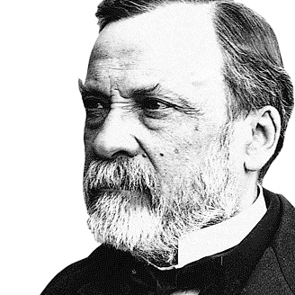

Slide 3
Edexcel IGCSE History P2: Breadth Study B2
Changes in Medicine,
1848-1948
1. Progress in the Mid-19th Century

Slide 4
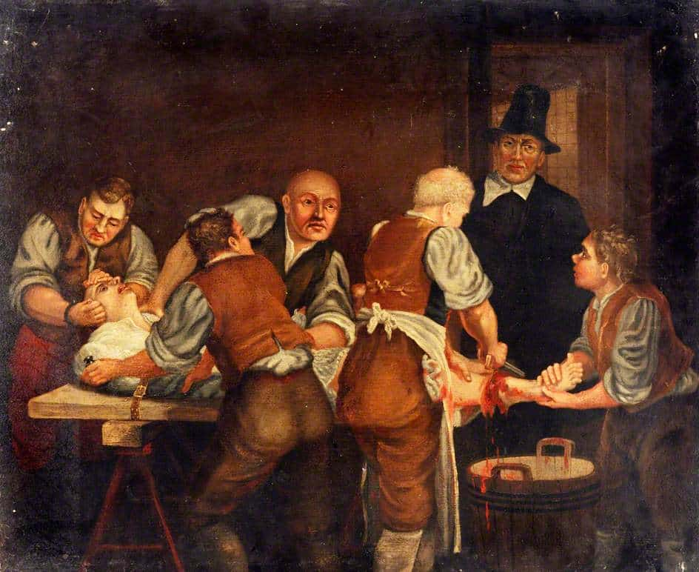
(c) Dangers in Surgery
In the mid-1840s, medical training for a doctor took 4 years. It included:
Lectures on illness and treatment
Practical experience in a hospital
Practical experience of midwifery
Practical experience of surgery
Operations, however, were very basic procedures – cutting open a boil, tumour removal or amputating a limb. Amputation was often necessary if a bone broke through skin + was infected.

Slide 5
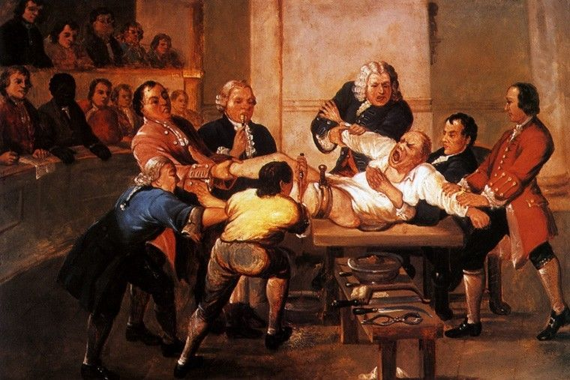
(c) Dangers in Surgery
Pain was a major problem in surgery. Before the 1840s, the only pain relief were alcohol, a form of opium or being knocked unconscious. Most operations saw the patient awake and screaming in pain – hence the surgeon required assistants or ‘dressers’ to hold the patient down. The ‘best’ 19th Century surgeons were not the ones who cut most skillfully, but the ones who cut the quickest.

Slide 6
Activity 5
Robert Liston was regarded as one of the ‘best’ surgeons.
Find out 2 reasons WHY.
Find out what happened during his operations that went wrong.

Slide 8
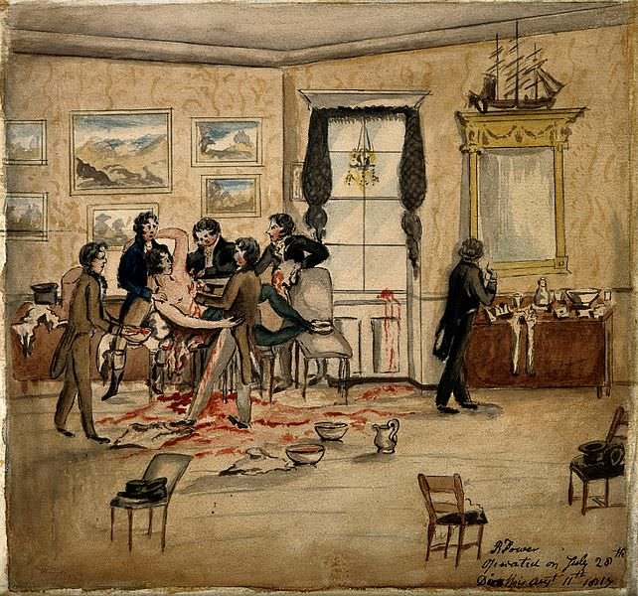
(c) Dangers in Surgery
Blood loss was another major issue, so a tourniquet would be used to reduce blood flow in an artery. Even if patients survived the surgery, a high percentage of them died afterwards from infection. Operations were carried out in the patient’s home, often in unhygienic conditions, but hospitals were far worse! Surgeons wore old clothes stained with blood & pus; they rarely washed their hands or sterilized equipment; bandages were washed & reused; medical students watched – all increasing infection risks.

Slide 9
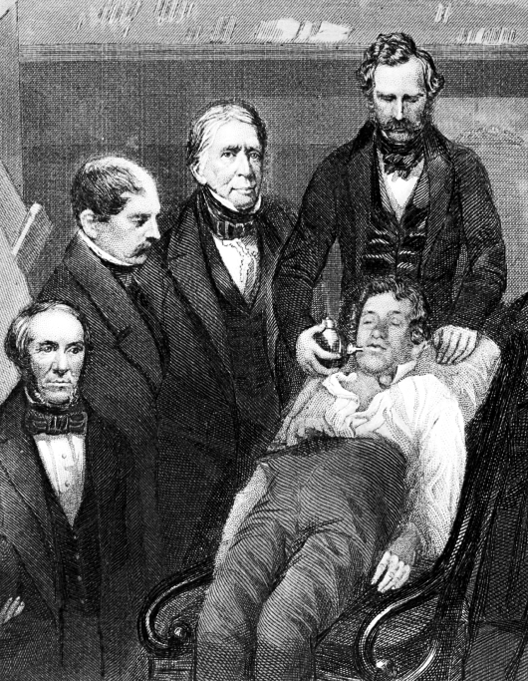
(c) Dangers in Surgery
Early 19th Century Scientists had investigated the chemical properties of various gases to limit pain during surgery. Nitrous Oxide (Laughing Gas) was known to make people unaware of pain, but was limited to dentistry and not considered suitable for surgery. William Morton, a US dentist, discovered that Ether gas was stronger than Nitrous Oxide. Robert Liston, a British surgeon, used Ether in 1846 during an amputation and those watching in the operation theatre were stunned the patient didn’t need to be held down at all & woke up completely unaware that any surgery had taken place.

Slide 10
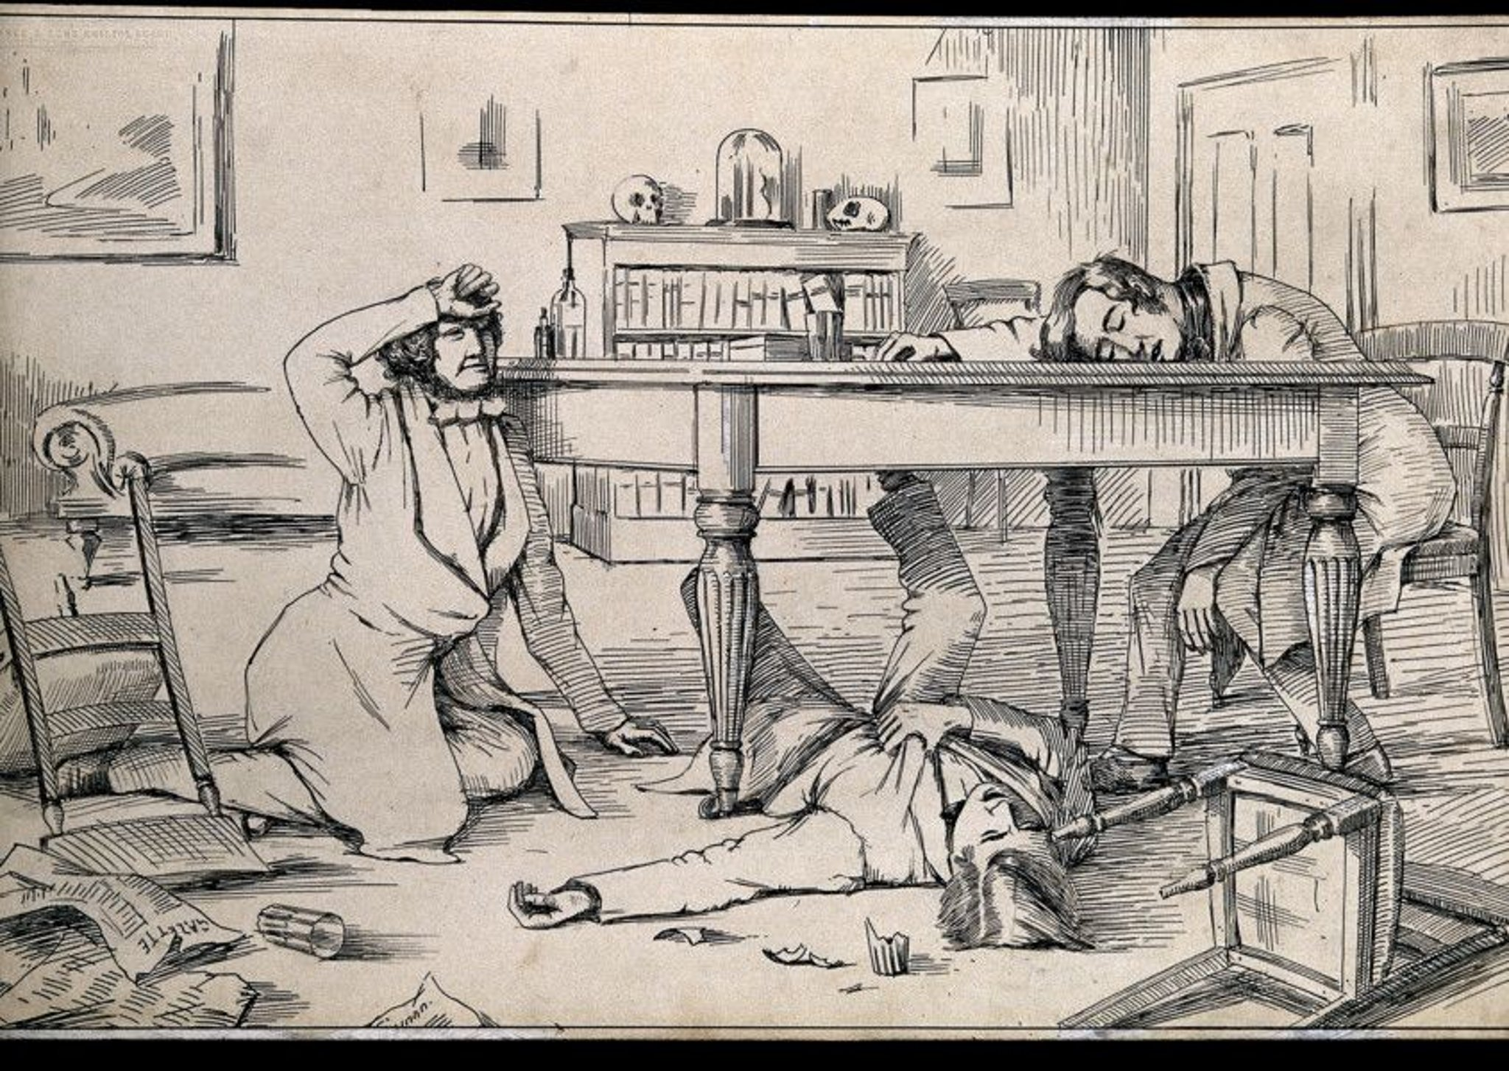
(c) Dangers in Surgery
Ether gas was not without its problems:
It sometimes caused vomiting
It irritated the lungs, causing coughing
It could leave patients asleep for hours … even days!
It was an extremely flammable gas being used in candle-lit operating theatres.
James Simpson, a Scottish professor, wanted to find a better anaesthetic. He recklessly tested various gases himself & with friends, rather than rabbits, discovering chloroform was best.

Slide 11
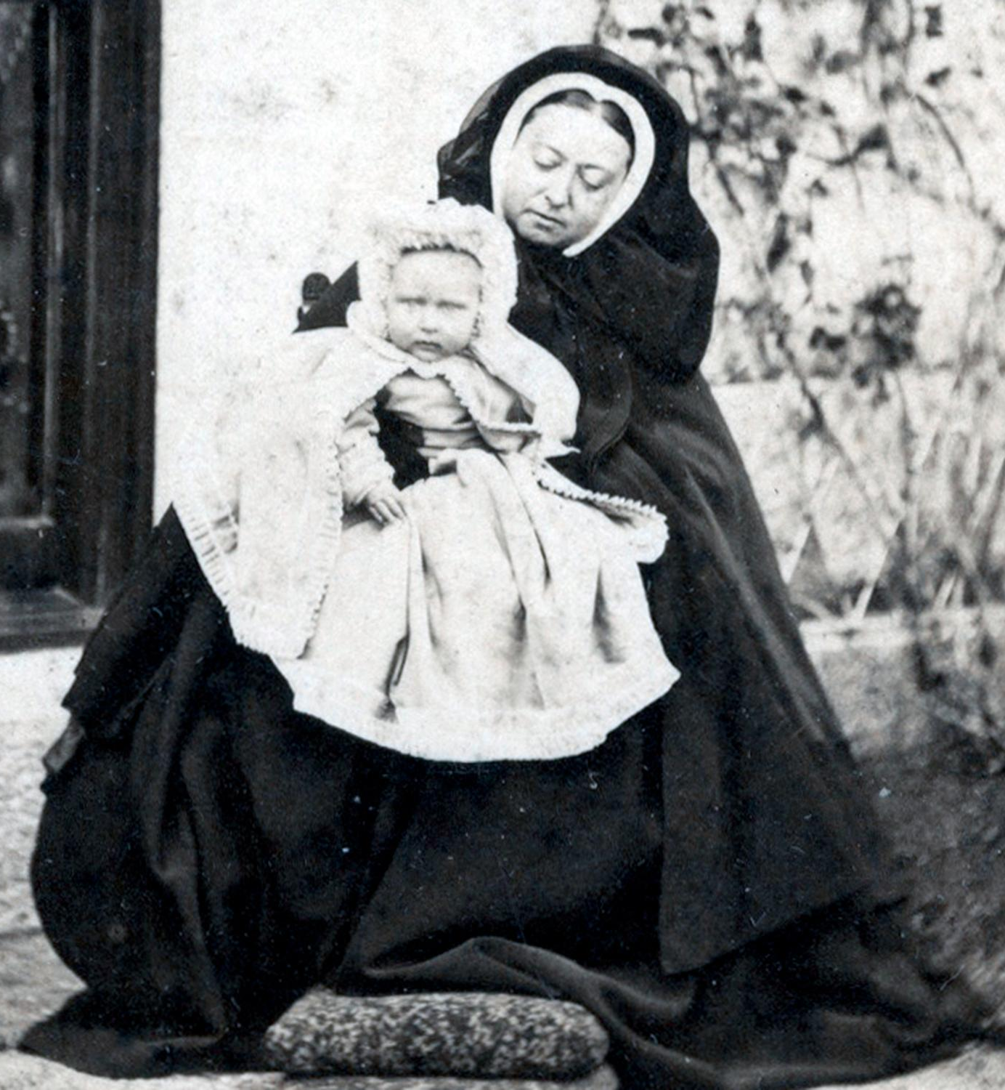
(c) Dangers in Surgery
Chloroform did not have the same side-effects as Ether. Simpson, Professor of Medicine & Midwifery at Edinburgh University, used for women in childbirth in 1847. That year, he became Queen Victoria’s Physician in Scotland and she gave birth to her 8th child in 1853 using chloroform as pain relief. This royal approval and newspaper publicity about the new “miracle pain relief” saw patients begin to ask for chloroform for operations & it was much more widely used. In 1870, the route of John Simpson’s funeral was lined by 50,000.

Slide 12
(c) Dangers in Surgery
Chloroform was not without its problems too:
Christianity was opposed to it, as the Bible recorded that Eve was told childbirth would be painful.
Doctors opposed its use in childbirth, as the effects upon the baby were unknown.
Dosing chloroform was difficult – some patients could die if given too high a dose.
Doctors believed an awake patient in pain was less likely to die than an unconscious one.
Surgeons attempted longer and more complex procedures, deeper inside the body.

Slide 13
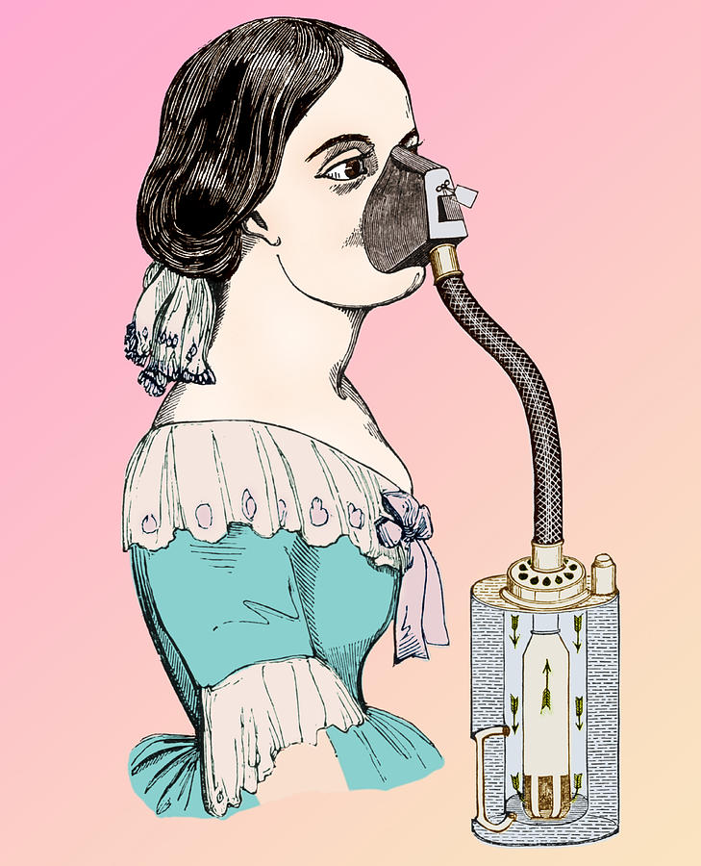
(c) Dangers in Surgery
John Snow solved the problem of incorrect dosages by inventing a chloroform inhaler in 1848. This controlled the dose of chloroform, but the problems of infection and blood loss remained. The death rate rose so much, in fact, that the years after 1848 have been known as the “Black Period” of Surgery. Failure to fully understand infection cost lives. Chloroform gave surgeons more time to work, but their medical equipment was still unhygienic and bloody hands inside the body took germs inside, spreading infection. Gangrene around wounds and Sepsis after operations killed many.

Slide 14
Exam-Style Question
Explain two causes of the Black Period in surgery. (8 marks)

Slide 16
Exam-Style Advice
Explain two causes of the Black Period in surgery.
(8 marks)
A cause is something which leads directly to an outcome (in this case a change), not simply something that happened before change occurred. You need to be able to show the link between the causes you identify and the changes in surgery.

