Slide 1
Edexcel IGCSE History P2: Breadth Study B2
Changes in Medicine,
1848-1948

Slide 2
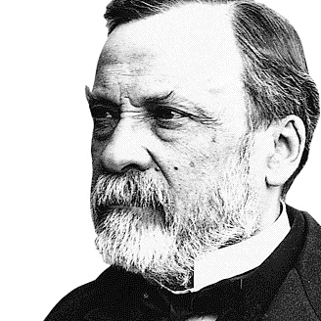

Slide 3
Edexcel IGCSE History P2: Breadth Study B2
Changes in Medicine,
1848-1948
1. Progress in the Mid-19th Century

Slide 4
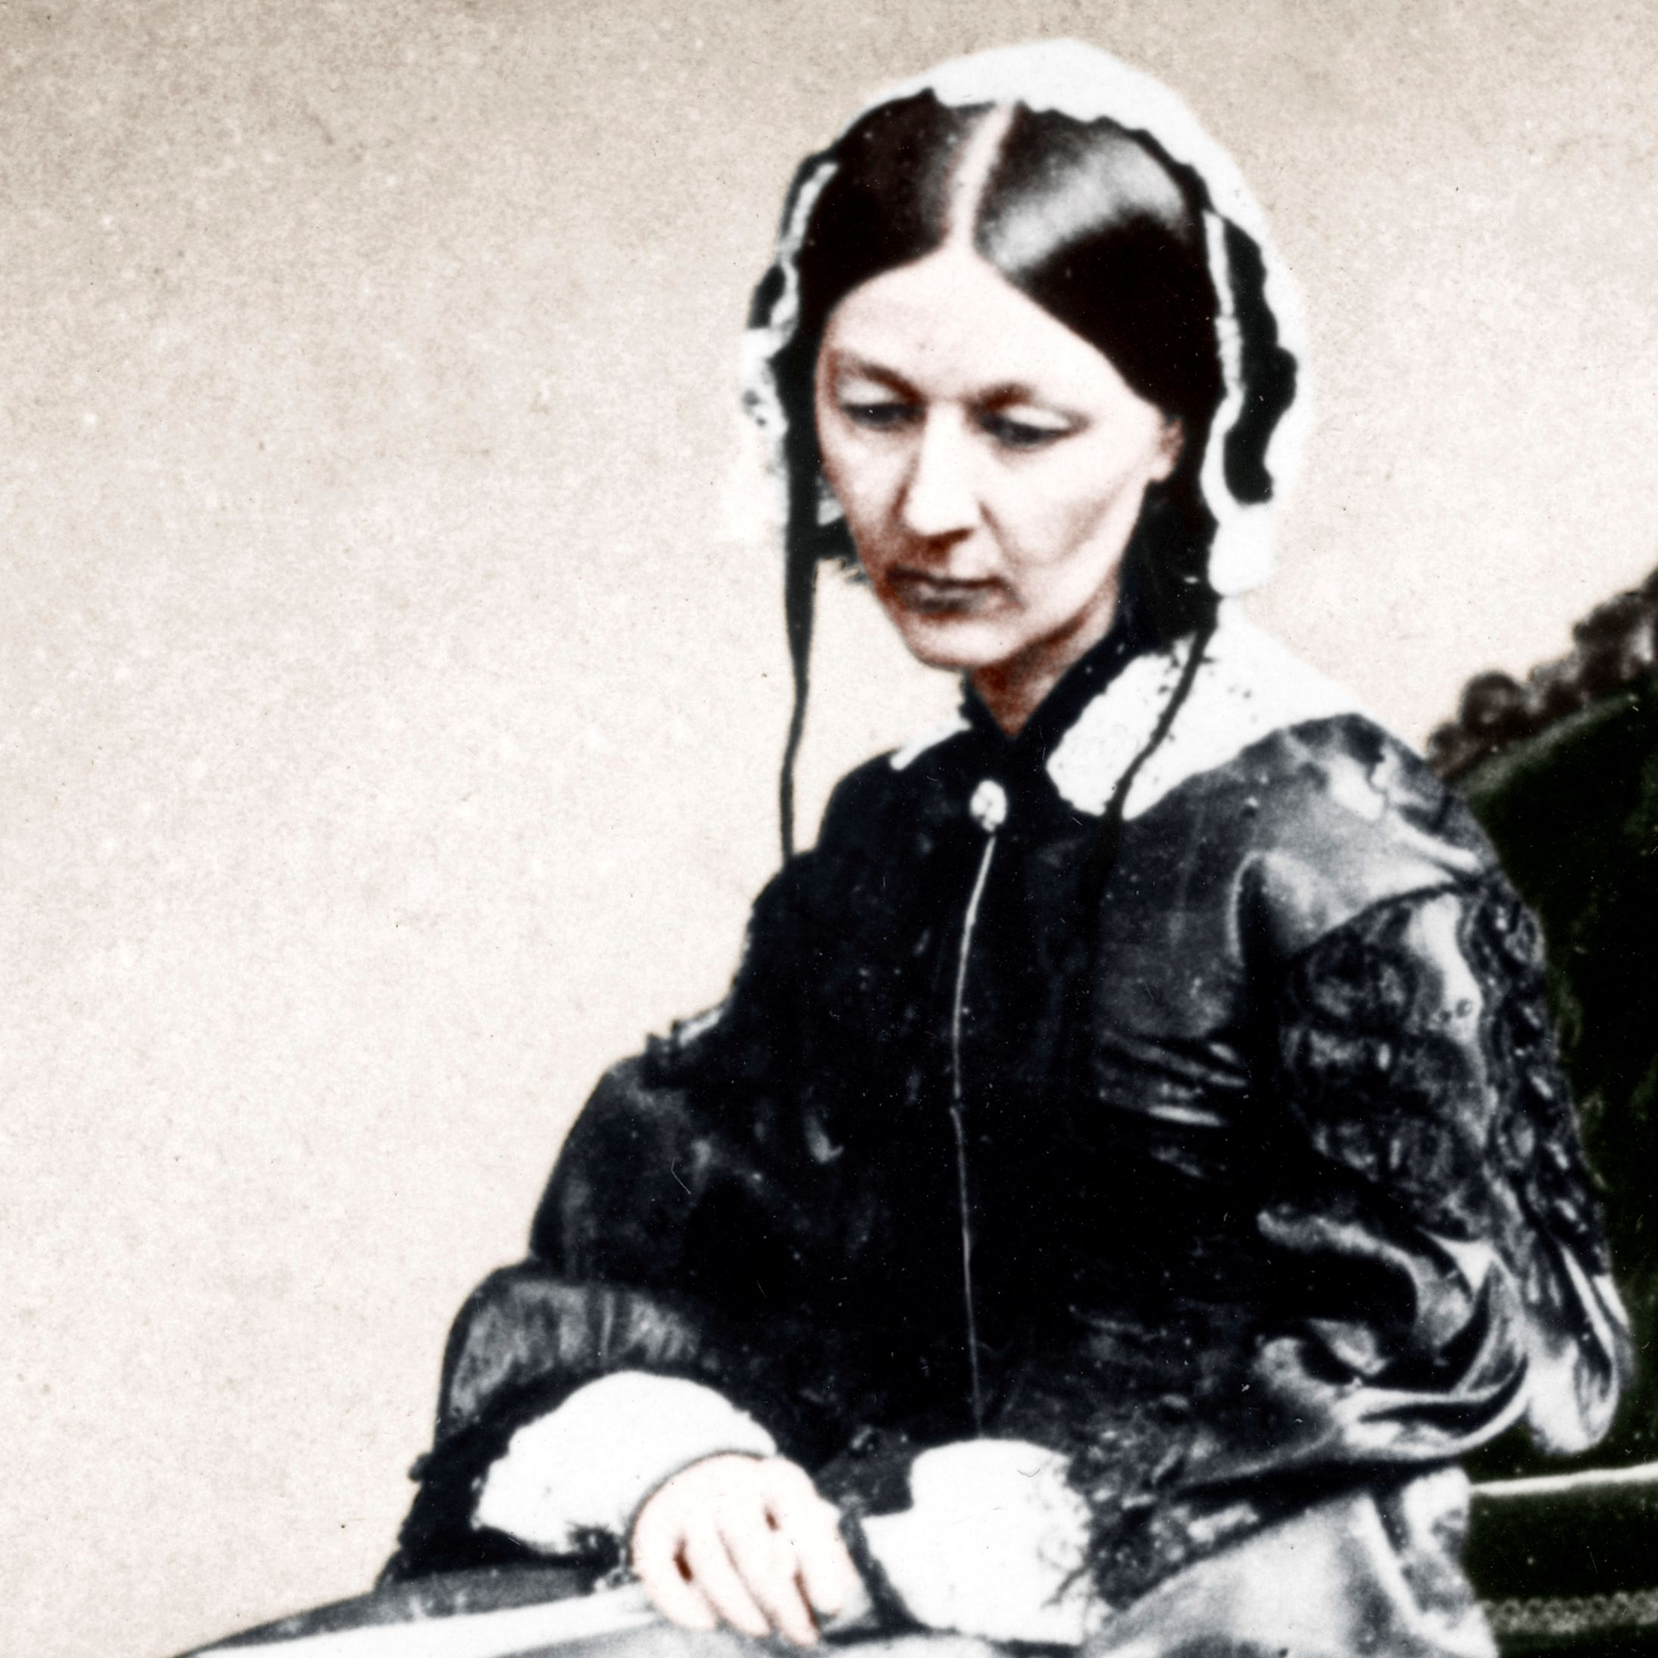
(b) Nightingale & Changes to Nursing & Hospitals
Florence Nightingale came from a wealthy middle-class family. Her family were shocked that she wanted to work and, worse still, she wanted to train as a nurse. There was no formal training for nurses in the 1840s, however, so Florence visited various British hospitals and spent 3 months in 1851 at Kaiserwerth, Germany, where training for nurses had been established in 1833.

Slide 5
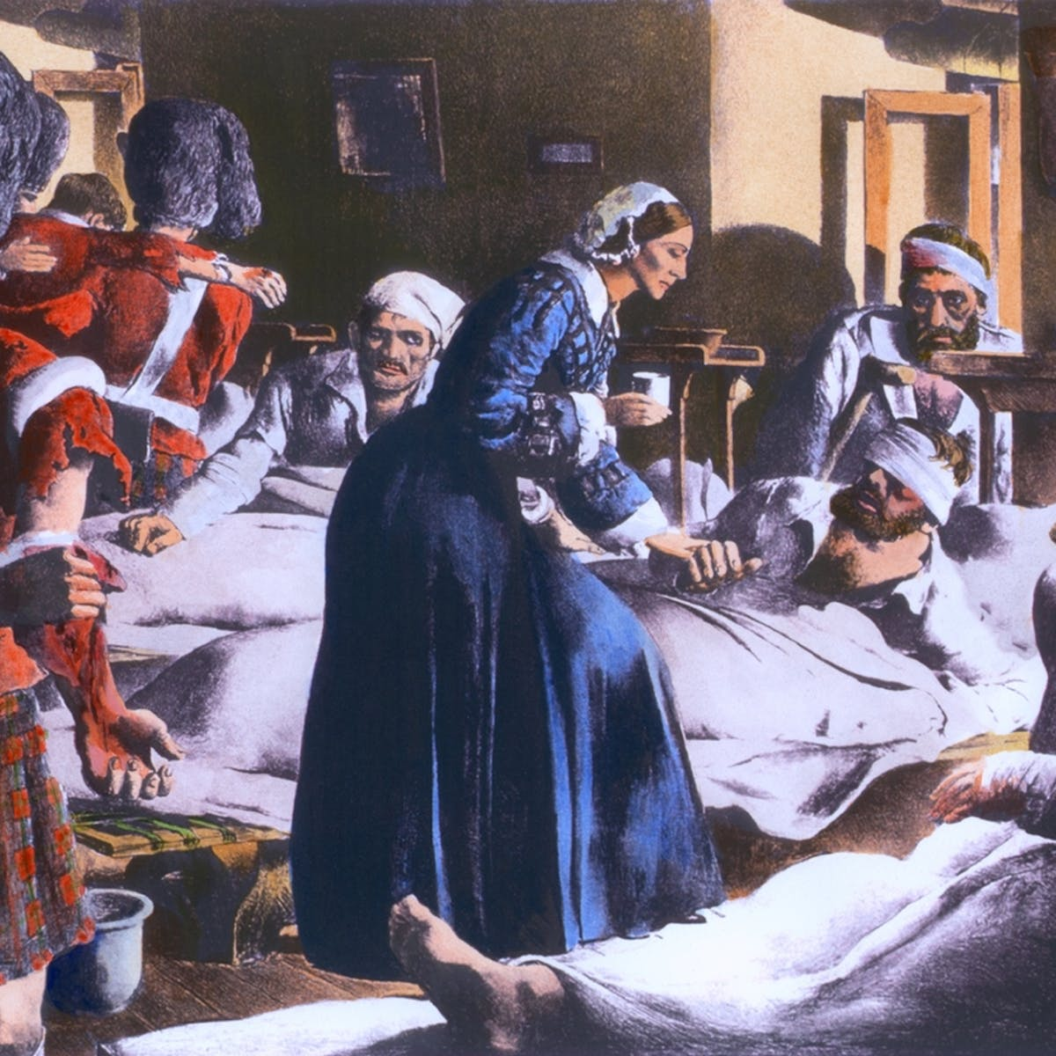
(b) Nightingale & Changes to Nursing & Hospitals
In 1853, Florence Nightingale became Superintendent of a small nursing home in London. Having earlier met Sidney Herbert, the Secretary for War, her name was top of the list to lead a team of 38 nurses to a military hospital in Scutari. Britain was fighting Russia in the Crimean War and was losing soldiers due to infection rather than their original injuries. Could Florence turn things around?

Slide 6
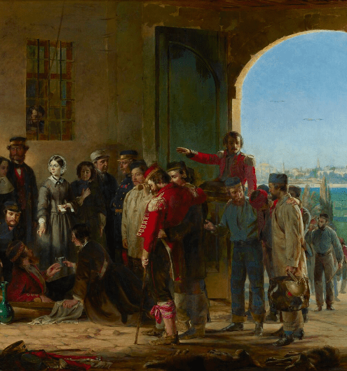
(b) Nightingale & Changes to Nursing & Hospitals
At Scutari Military Hospital, Florence found
10,000 injured soldiers over-crowded
Sharing beds, lying on floors + in corridors
Clothing infested with lice + fleas
Typhoid Fever + Cholera were common
Diarrhoea was effecting many soldiers
Medical supplies (bandages + drugs) low
Poor quality food supplies + little food
Leaky roof, dirty wards with rats + mice
Water + air supply polluted by a cesspool.

Slide 7
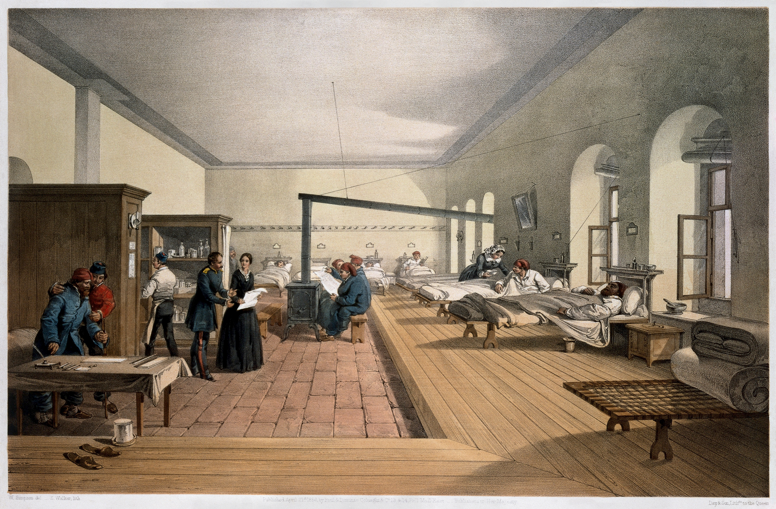
(b) Nightingale & Changes to Nursing & Hospitals
Nightingale and her nurses scrubbed the surfaces clean and washed all the sheets, towels, bandages & medical equipment. As she believed in miasma, she opened all windows to improve air flow at the military hospital. Her team of nurses also cleaned the kitchens and improved the quality of food for patients. The Times newspaper organized a fundraising campaign to provide new supplies – 200 towels, clean shirts, soap, plates & cutlery.

Slide 8
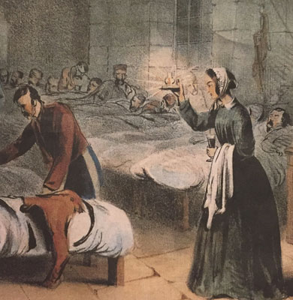
(b) Nightingale & Changes to Nursing & Hospitals
Army Medical staff had been resistant to the idea of nurses in the Crimean War because they felt that women would not cope there. Nightingale’s suggested changes were seen as a criticism of the Army medical staff and many resented her. Despite top brass opposition, Nightingale was incredibly popular with patients – she gained the nickname “The Lady with the Lamp” after checking on all patients nightly – so this popularity was soon reflected back in Britain as families were reassured that their relatives were being well cared for.

Slide 9
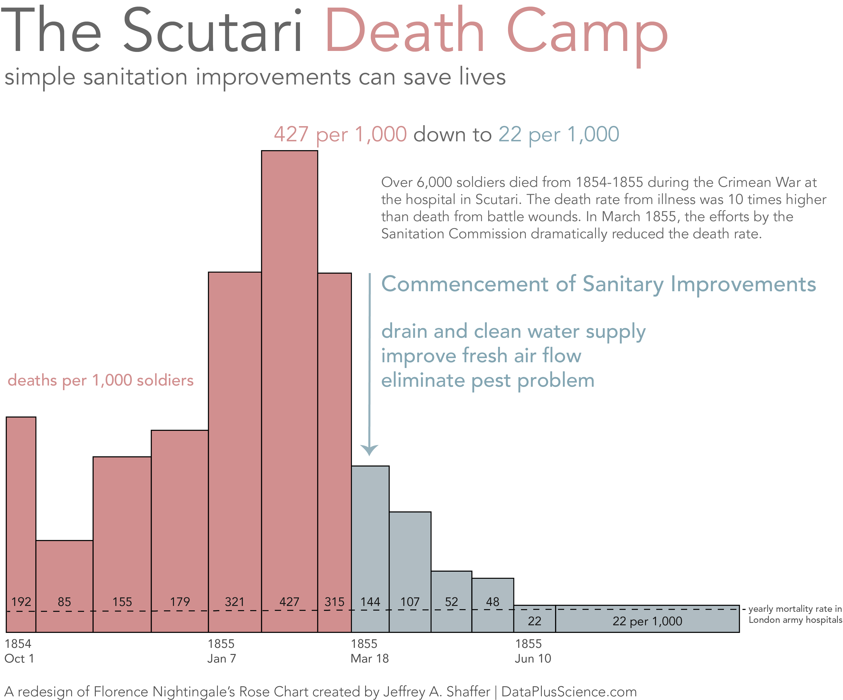
(b) Nightingale & Changes to Nursing & Hospitals
Nightingale could not solve all of Scutari’s problems overnight and it should not be forgotten death rates remained high even with all her improvements. It was not until 1855, when a Government Commission repaired drains at Nightingale’s hospital and also improved the drinking water supply, that the death rate dropped dramatically.

Slide 10
Activity 3
Make a list of all the barriers to progress that Nightingale faced at Scutari. Add a symbol after each barrier
that sums it up.

Slide 12
Activity 4
Florence Nightingale believed in miasma. How does this explain her actions in the Scutari Military Hospital?

Slide 14
Exam-Style Question
Explain two ways in which the situation at Scutari in 1856 was different from the situation when Nightingale arrived. (8 marks)

Slide 16
Exam-Style Advice
Explain two ways in which the situation at Scutari in 1856 was different from the situation when Nightingale arrived. (8 marks)
This question is testing KNOWLEDGE by asking you to give two examples of difference. Ensure that in each case that you identify the difference & support it with detail about
The situation when Nightingale arrived
How the situation changed as a result of her work

