Slide 1
Edexcel IGCSE History P2: Breadth Study B2
Changes in Medicine,
1848-1948

Slide 2
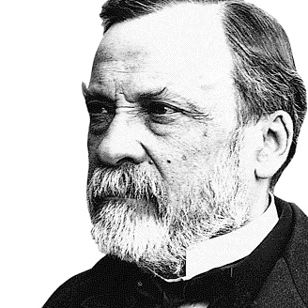

Slide 3
Edexcel IGCSE History P2: Breadth Study B2
Changes in Medicine,
1848-1948
1. Progress in the Mid-19th Century

Slide 4
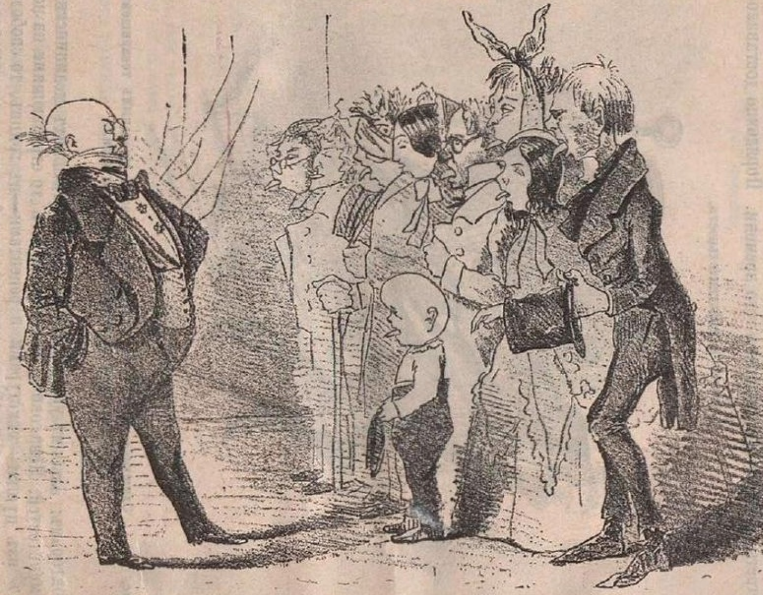
(a) Barriers to Progress
In the mid-19th Century, people did not know what caused disease and usually blamed either problems within the body or miasma (something bad in the air). This meant that most attempts to prevent or treat illnesses, whether at home or in hospitals, were unlikely to work. Medical understanding of what caused disease in 1848 was based on ideas that made sense at the time … but we now know these ideas were wrong.

Slide 5
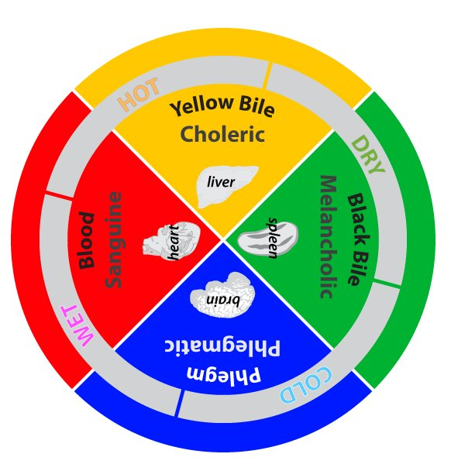
(a) Barriers to Progress
The idea of the Four Humours in the body was developed by the Ancient Greeks, but it lasted for a long time because it seemed so logical. People knew BLOOD was important and they could see BILE when people vomited. They could also see mucus and PHLEGM when people had a cold. Observations of patients showed that some were HOT and vomited; some were COLD and coughed & sneezed.

Slide 6
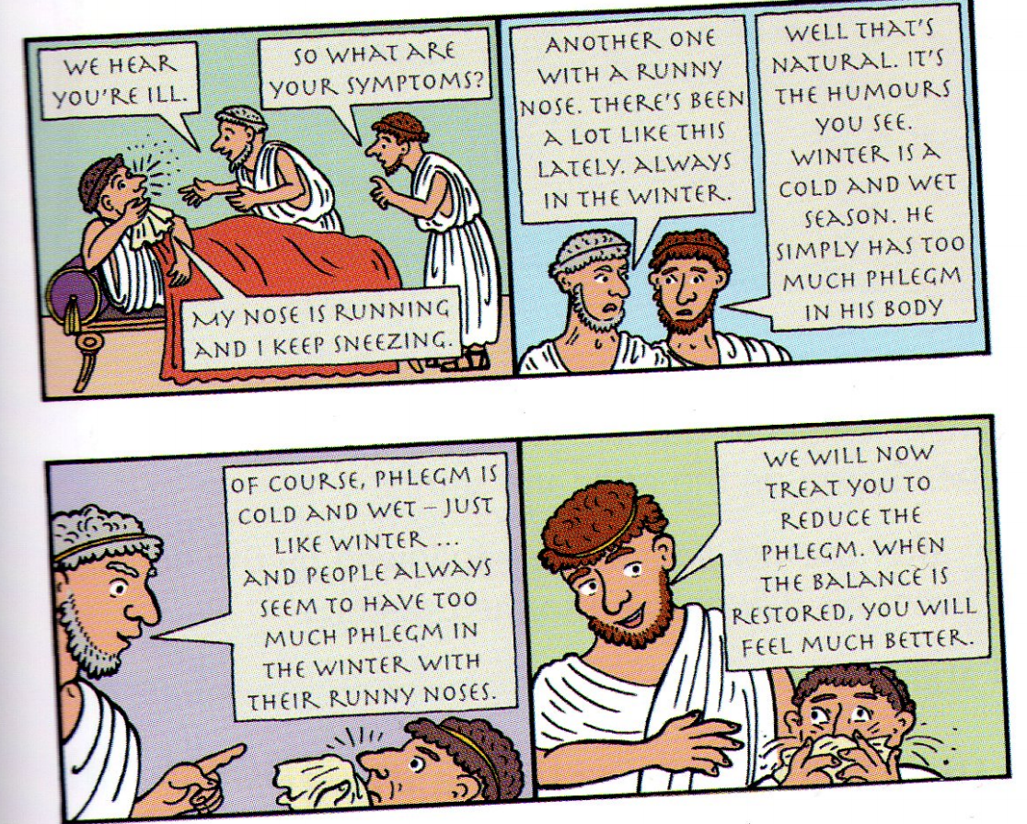
(a) Barriers to Progress
The imbalance of humours in the body made sense at the time, but prevented progress in prevention and treatment of disease. Medical treatments from Ancient Greece up to 1848 were based on the Theory of Opposites:
Phlegm (Cold & Wet) → Hot & Dry
Treatment – Hot Chillis in diet.
Blood (Hot & Dry) → Cold & Wet
Treatment – Cucumbers in diet.

Slide 7
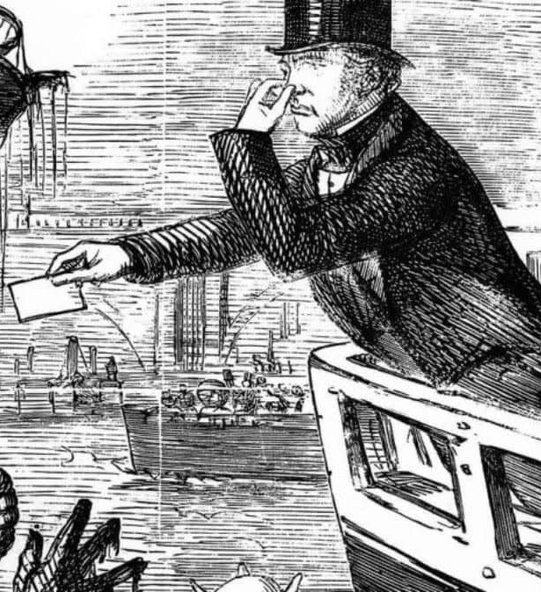
(a) Barriers to Progress
An alternative to the Four Humours was the idea of miasma – suggesting that disease was carried in unpleasant smells and harmful fumes in the air. Poor people lived in dirty, unhygienic areas where smells were overwhelming and diseases were at higher rates. Hot weather also spread these diseases far quicker, so the rising rate of infections in Summer were soon linked to the stronger bad smells in Summer.
This, of course, is incorrect … it is germs, not smells, that cause diseases & need killing.

Slide 8
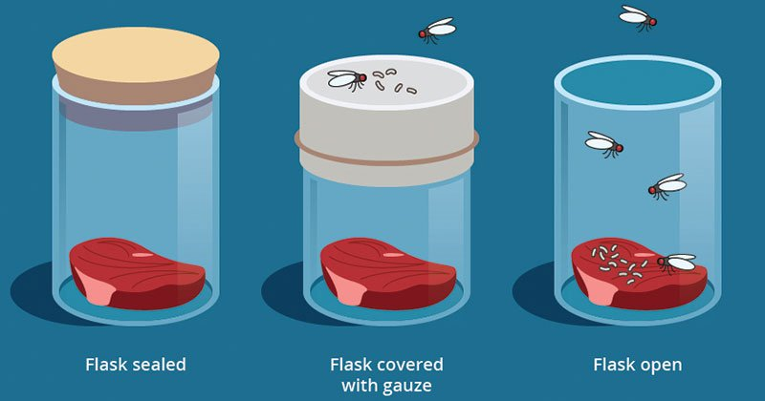
(a) Barriers to Progress
Disease is caused by microorganisms and different microorganisms cause different diseases. Before the microscope had been invented, however, people couldn’t actually see the microorganisms so couldn’t make the link between them and diseases. Instead, a Theory of Spontaneous Generation developed – stating that rotting material (food, excrement, dead animals & plants) created maggots, fleas and, thus, diseases.

Slide 9
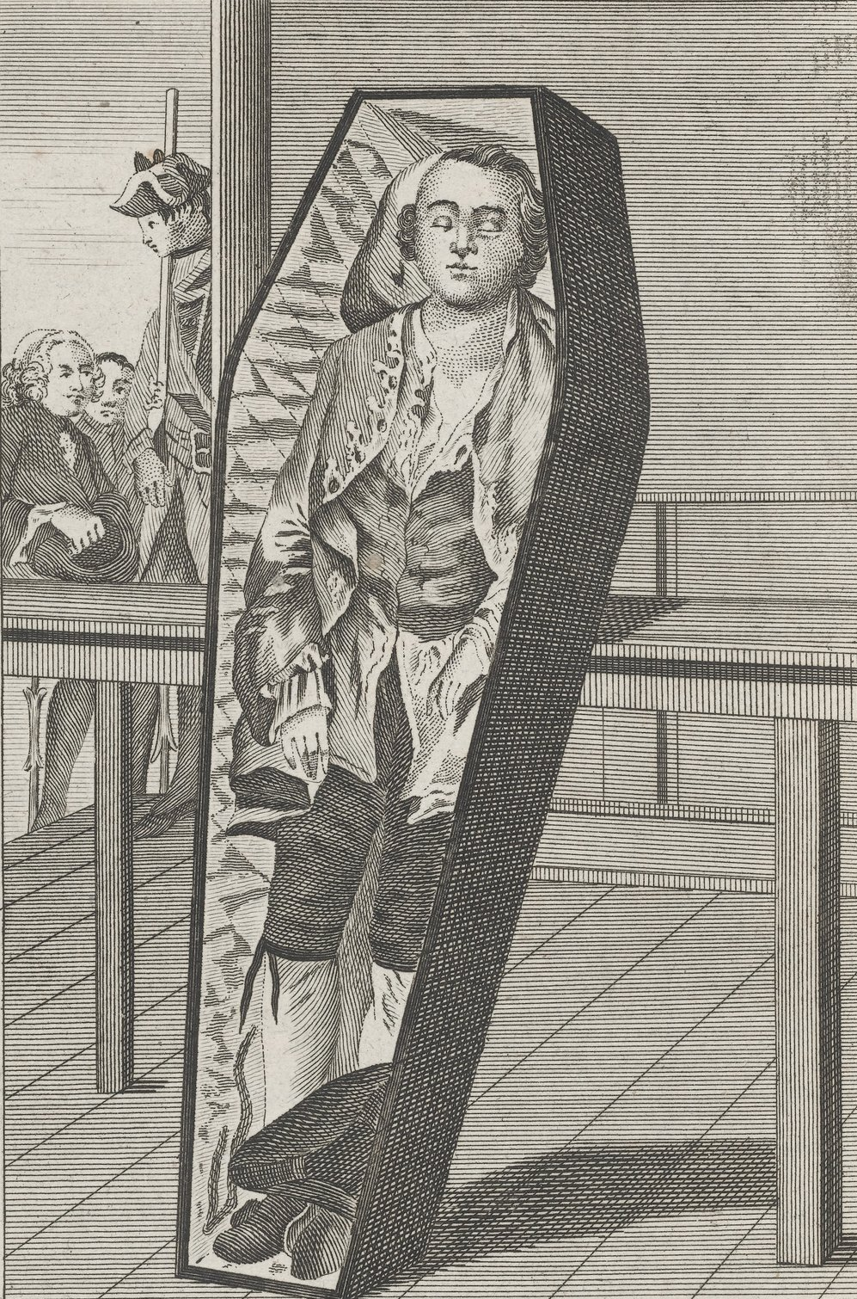
(a) Barriers to Progress
The general understanding of the human body was also very limited in 1848. Doctors would observe a few dissections during their medical training but, because most people believed in life after death, they wanted to be buried whole after death. The bodies available for medical dissection were mainly criminals who had been executed. Planning research on symptoms of diseases was, therefore, incredibly difficult and conditions like diabetes or arthritis could only be studied if recently killed criminals had them. In 1823, the crimes punishable by death was reduced, so there were less dead bodies available. Burke & Hare even took to murder to sell the bodies!

Slide 10
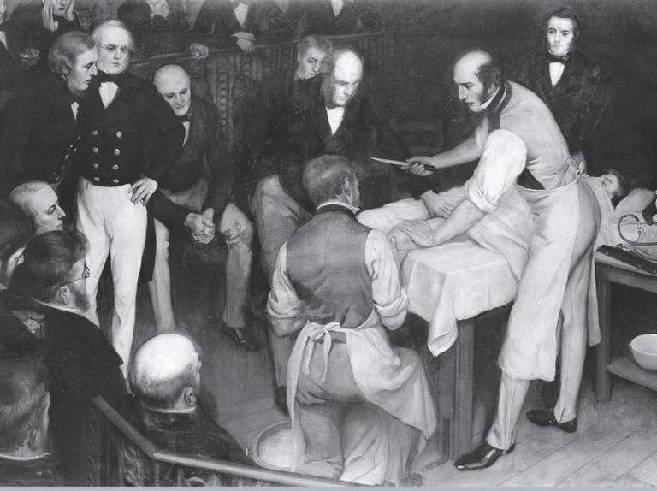
(a) Barriers to Progress
Lack of understanding of the causes of illnesses was a key reason for the limited progress in medicine up to 1848. Because understanding was faulty, the training of doctors was also faulty. Thus, ideas about prevention and treatment were likely to be ineffective. The lack of understanding was closely linked to the level of technology available before the 19th Century. If their microscopes had been stronger, scientists could have actually seen microorganisms to be more curious about them.

Slide 11
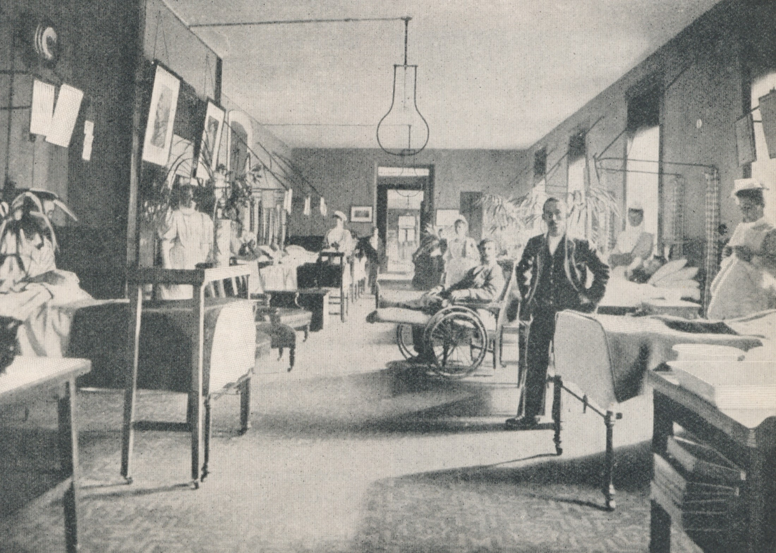
(a) Barriers to Progress
Funding for research and developing new ideas was a massive problem in 1848. The Government did not feel that they were responsible for issues like this and Hospitals were reliant on charity for their funding. By the time doctors had been paid, of course, there was little money left over for research. Attitudes in 1848 were also a major barrier to progress in the medical field. Doctors wanted to carry on what they had always done and had no appetite for learning new ways to treat patients. Besides, there was no proof that their old methods were wrong!

Slide 12
Activity 1
Make a list of all the barriers to progress in Medicine up
to 1848. Add a symbol after each barrier that sums it up.

Slide 14
Activity 2
Now rank your list of all the barriers to progress in Medicine up to 1848 from most to least important.

