Slide 1
Edexcel IGCSE History P2: Breadth Study A1
The Origins & Course of WW1,
1905-1918

Slide 2
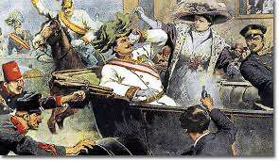
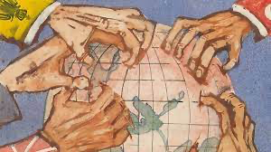
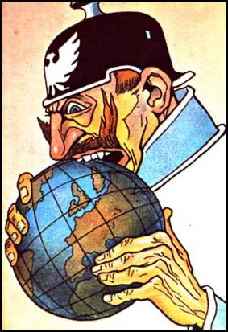
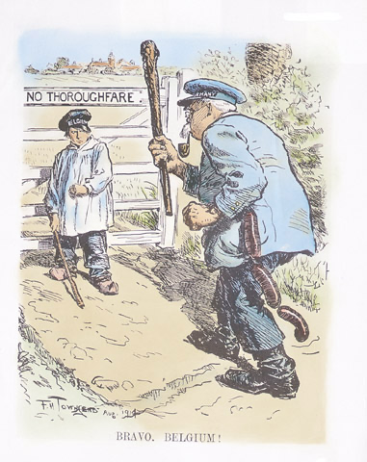
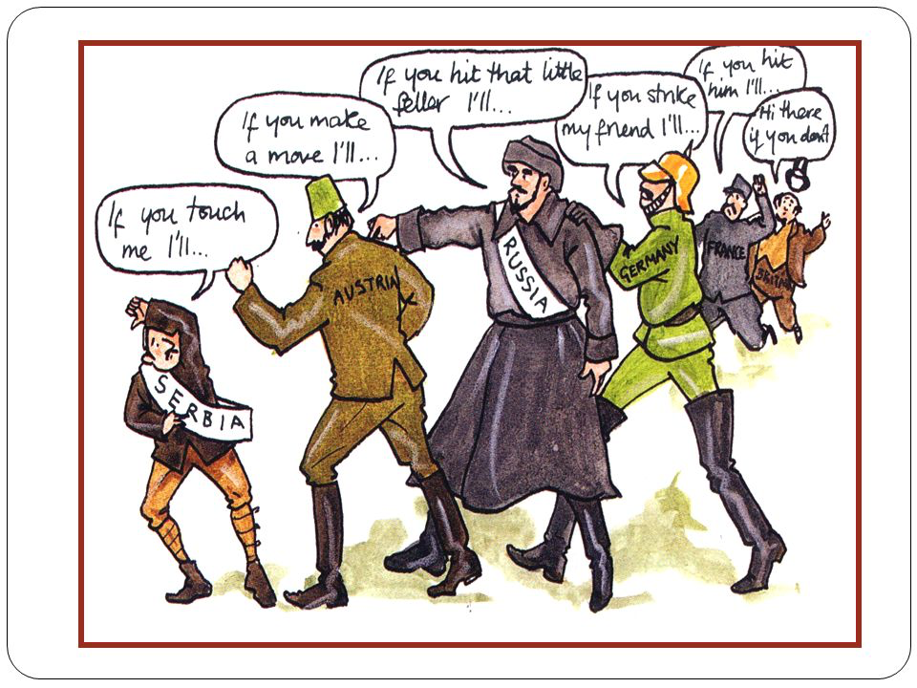

Slide 3
Edexcel IGCSE History P2: Breadth Study A1
The Origins & Course of WW1,
1905-1918
4.3 The Gallipoli Campaign

Slide 4
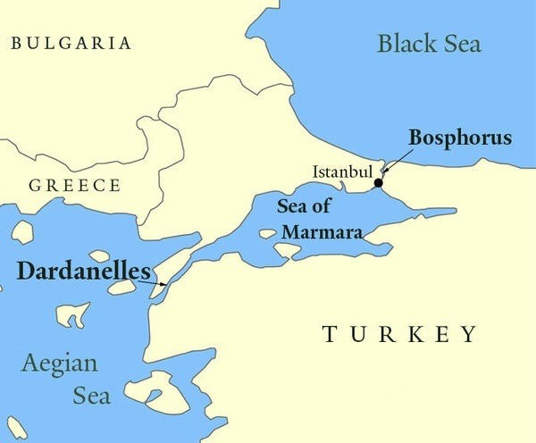
(c) The Gallipoli Campaign
In October 1914, the Ottoman Empire (TURKEY) joined the war on the side of Germany & Austria-Hungary. This meant a serious problem for the Allies. The Turks controlled the DARDANELLES – a narrow strait of water leading to the Black Sea. Food & Arms to Russia could be cut off by whoever controlled the Dardanelles and, worse still, Russian Ships moored in the Black Sea were trapped there. Desperate for help, Russia was being attacked by Germany & Austria-Hungary while Russia’s Allies (Britain & France) were at ‘Stalemate’ on the Western Front.

Slide 5
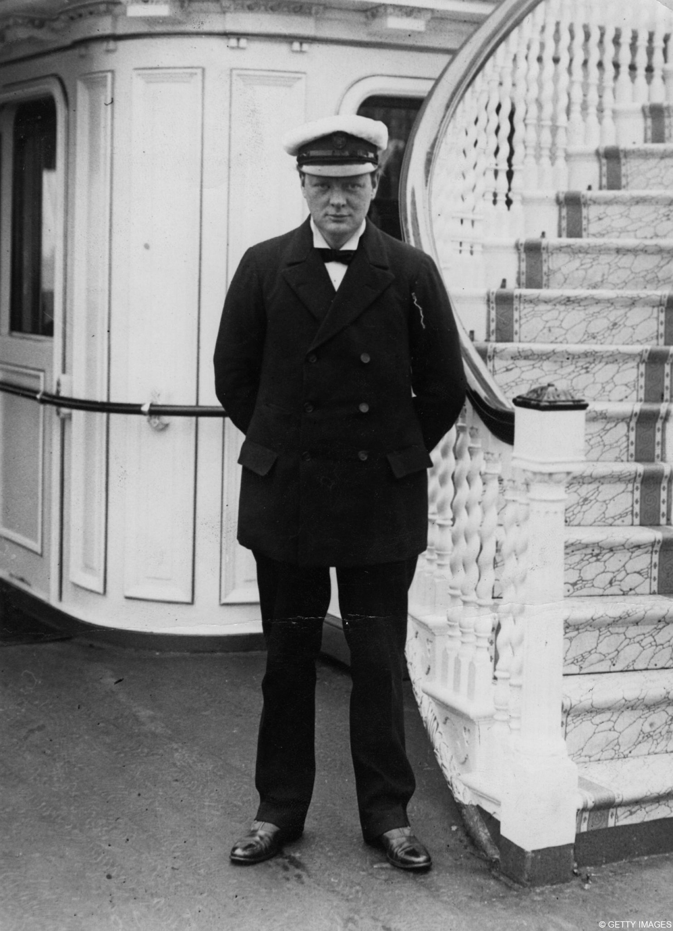
(c) The Gallipoli Campaign
WINSTON CHURCHILL, the British First Lord of the Admiralty, devised a plan that would move enemy forces away from Russia & open the Dardanelles to British & French shipping. Churchill’s Plan was straightforward – a huge naval bombardment would knock out the Turkish forts on the Gallipoli peninsula that were guarding the Dardanelles; this weakening up of defenses would enable ground troops to move in & clear the way for British & French shipping; thus, enabling Allied ships to provide much needed food & arms to Russia.

Slide 6
(c) The Gallipoli Campaign
CHURCHILL’S PLAN
Allied troops attack Turkey at the entrance to the Daranelles.
Allied invasion draws the German & Austro-Hungarian troops away from Russia to defend Turkey.
Allies win control of Gallipoli peninsula.
Allies clear the Dardanelles of mines & open the straits for Allied shipping.
Allied forces attack the Turkish capital, Constantinople.
Constantinople falls & Turkey leaves war.

Slide 7
(c) The Gallipoli Campaign
Churchill’s Plan was bold & simple.
If it succeeded, there was a very strong chance that neural countries, like BULGARIA + GREECE, would join the war on the Allied side. They would be attracted by the Allied military superiority & want to be on the winning side. The addition of Bulgaria & Greece would overwhelm Austria-Hungary and, possibly, force them out of the war so that Germany was left alone to fight + lose.
If it failed, however, thousands of Allied lives would be lost with nothing gained at all.

Slide 8
(c) The Gallipoli Campaign
CHURCHILL’S PLAN IN ACTION
19th February 1915 – An Anglo-French naval force bombarded Turkish guns on the coast, destroying some forts.
18th March 1915 – Main attack launched with 18 Battleships, supported by Cruisers & Destroyers, forcing their wat through the Dardanelles. 3 Battleships were blown up by mines, 300 sailors drowned & the rest of the Fleet rapidly retreated. The plan then evolved to be an Allied landing on the coast, to capture forts guarding the Dardanelles.

Slide 9
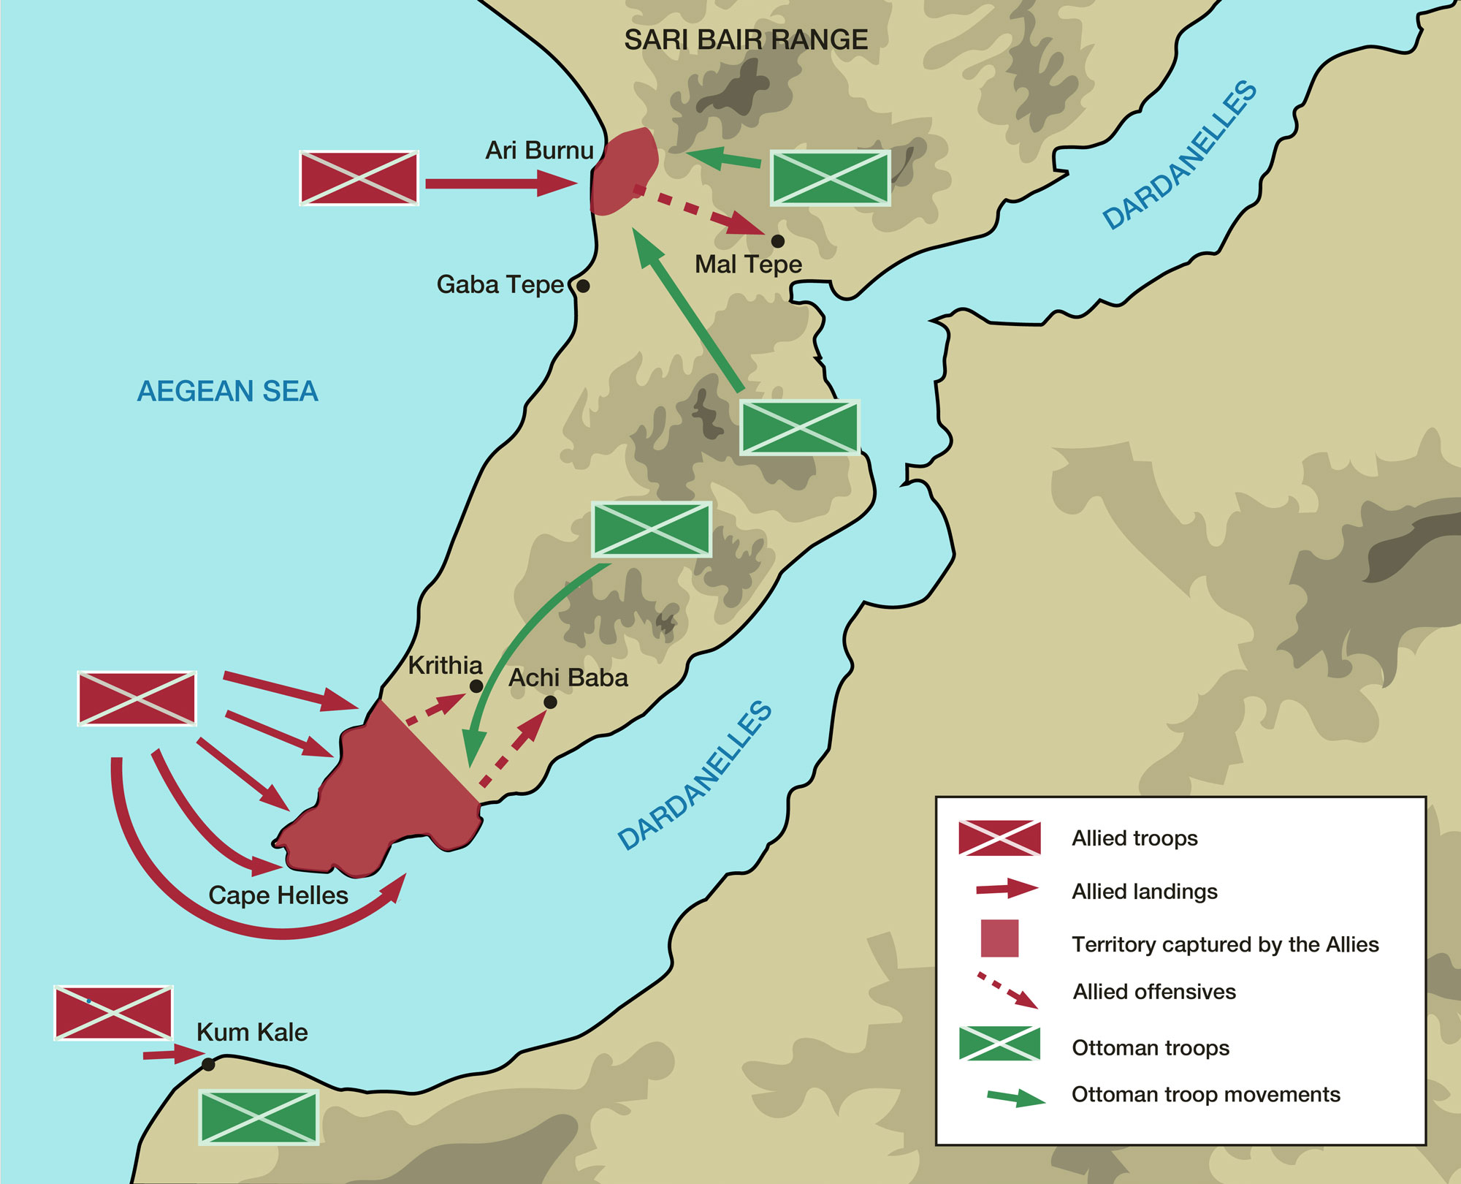
(c) The Gallipoli Campaign
CHURCHILL’S PLAN IN ACTION
25th April 1915 – Allied troops, mainly British & ANZAC (Australia & New Zealand Army Corps) commanded by General Ian Hamilton invaded the Gallipoli peninsula … despite:
Many troops had no experience of landing on enemy beaches
Most of the Turkish beaches had steep cliffs to climb up
Hamilton’s maps were out-of-date, so of little practical use to the landing troops
The plan had been leaked to the Turks, so they were expecting every action!

Slide 10
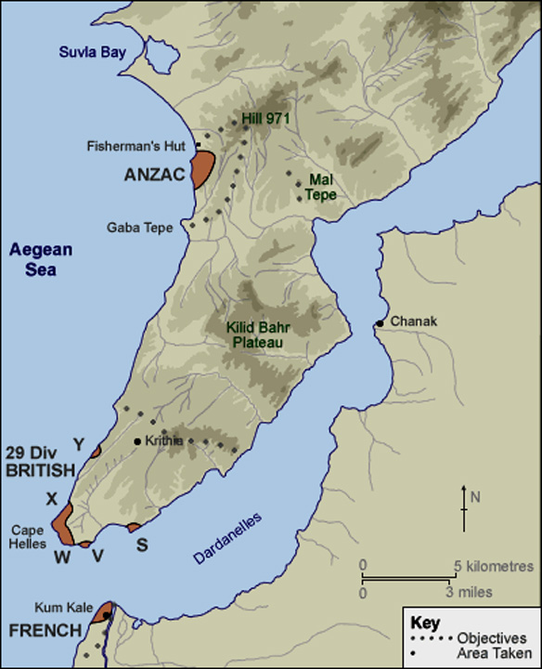
(c) The Gallipoli Campaign
CHURCHILL’S PLAN IN ACTION
25th April 1915 – French troops landed at Kum Kale & were defeated after just one day’s heavy fighting. The survivors were taken off by French ships.
26th April 1915 – British troops landed at Cape Helles, where the beaches soon became blood-baths. The troops did manage to secure a small piece of land on the shore, but the Turkish defenders met them in several battles & successfully prevented the British taking a single Turkish fort.

Slide 11
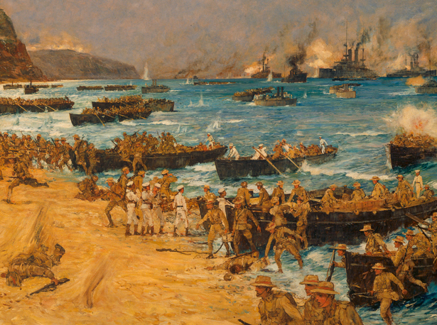

Slide 12
(c) The Gallipoli Campaign
CHURCHILL’S PLAN IN ACTION
26th April 1915 – ANZAC & British troops were forced to dig TRENCHES to protect themselves from fierce Turkish fire. This inevitably meant a STATIC WARFARE for the straits. Prevented from advancing & stopped from clearing all the enemy sea-mines in the Dardanelles, the very plan that was supposed to end the “stalemate” on the Western Front ended up with a similar “stalemate” in Gallipoli – same old trenches, same old suffering, casualties & death.

Slide 13
(c) The Gallipoli Campaign
CHURCHILL’S PLAN IN ACTION
25th April 1915 – ANZAC troops landed at the coastal area that was later named “Anzac Cove” & they were hit by machine-gun fire as they left their landing boats. They were able to get control of the Cove, but were never able to move any further inland.
6th August 1915 – ANZAC troops tried another landing at Sulva Bay. Although unopposed during the landing, Turks began fiercely firing at them & they could not advance inland yet again.

Slide 14
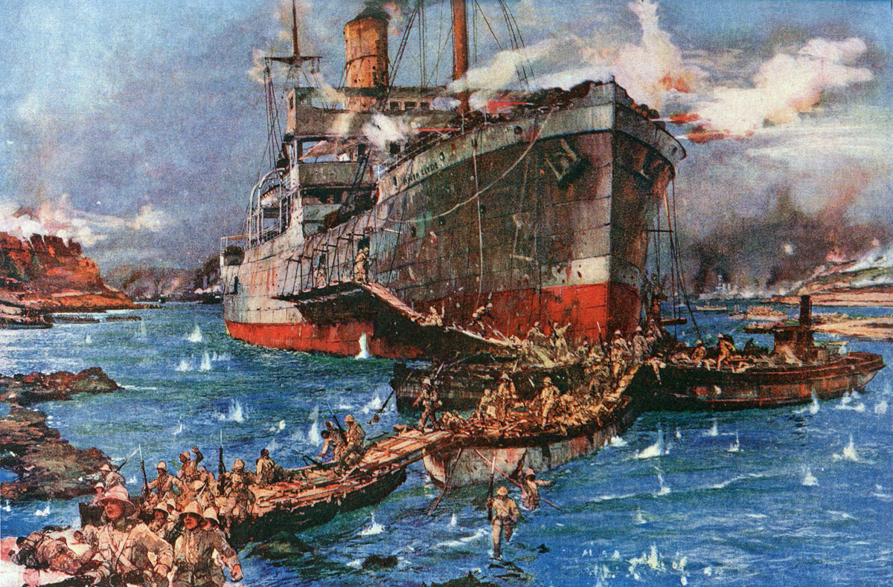

Slide 15
“The whole beach went up in flames
in front of us. Bullets hit us like a blizzard of lead. The boat next to us tore apart – bodies, blood, splinters of wood. Bodies jammed in so tight in other small boats they couldn’t even fall over.”
A New Zealand soldier describes the landing at Anzac Cove

Slide 16
“There was an awful tornado of shrapnel from the Turkish fort as the unmercifully shelled the seashore. We dared not fire because of our own men often being in front of us, and the nature of the ground making it impossible to get into a line and charge. When we got half way up, we thought we could have a bit of a rest. So we sat down for a bit and those lucky enough to find their pipe, cigarettes & tobacco dry, had a good smoke.”
An Australian soldier describes fighting inland at Anzac Cove

Slide 17
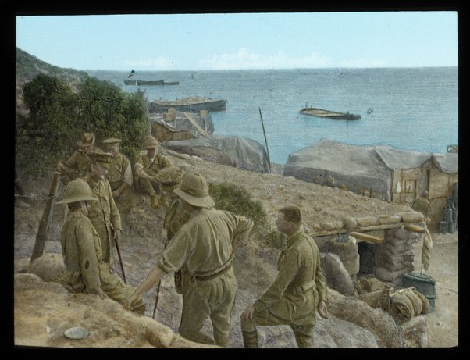

Slide 18
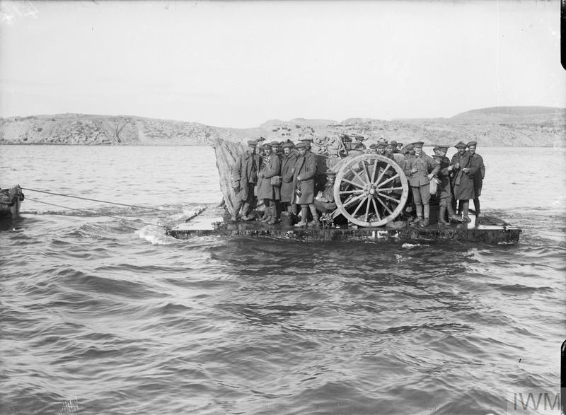
(c) The Gallipoli Campaign
EVACUATION FROM GALLIPOLI
By Autumn 1915, the campaign’s failure was obvious to everyone. General Hamilton was instructed to EVACUATE all troops, but he argued against this – stating that casualties could be 50% during the operation – so was removed as Commander-in-Chief. His replacement, General Monro, toured the beaches, saw the situation was impossible and he ordered immediate evacuation.

Slide 19
(c) The Gallipoli Campaign
EVACUATION FROM GALLIPOLI
10th Dec. 1915 to 9th Jan. 1916 over 135,000 troops & 300 guns were evacuated from Gallipoli & Hellas. Careful preparations had been made so that the Turks would not suspect such an evacuation was occurring – rifles fired on timers to fool the Turks. Indeed, THE EVACUATION WAS THE MOST SUCCESSFUL PART OF THE ENTIURE CAMPAIGN – only 3 casualties & 0 deaths recorded.

Slide 20
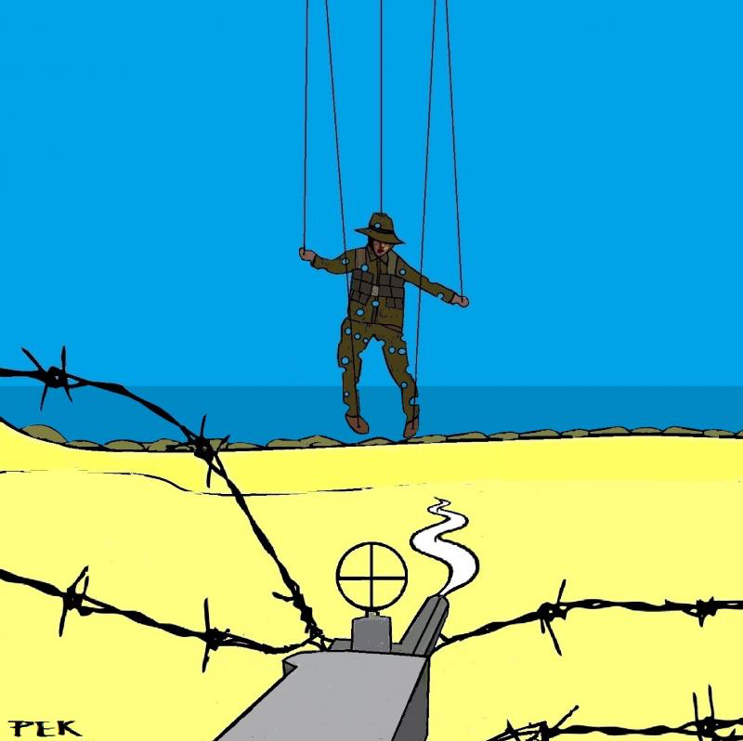
(c) The Gallipoli Campaign
EFFECTS OF THE GALLIPOLI CAMPAIGN
480,000 Allied troops took part; 48,000 killed + 204,000 wounded.
Dirty conditions made many sick; Typhoid, Dysentery & Diarrhoea were common – 145,000 British soldiers + 64,000 Turkish soldiers were affected.
The Dardanelles remained closed to Russian ships throughout 1915 + 1916.
Stalemate on Western Front wasn’t broken & troops had been moved away, so Germany was even stronger.

Slide 21
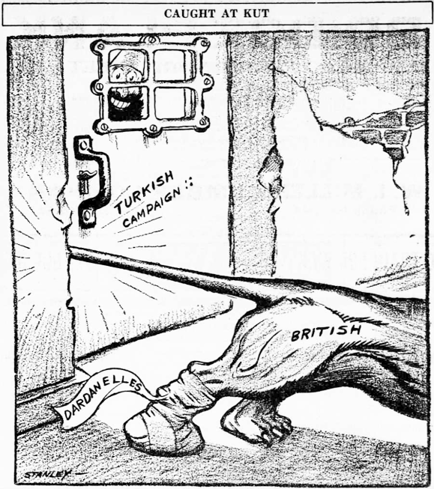
(c) The Gallipoli Campaign
EFFECTS OF THE GALLIPOLI CAMPAIGN
Turkish morale was sky high and its troops were more confident than ever after such a “victory” (?)
General Ian Hamilton’s career was in question and Winston Churchill cruelly commented “He came, he saw, he capitulated!”
Churchill, himself, was forced to resign as First Lord of the Admiralty and was often taunted “Remember the Dardanelles!” in Parliament for years afterwards.

Slide 22
‘Away from Europe,
the joint landings at
Gallipoli were well
thought out but poor
in operation.’
A modern historian sums up the Gallipoli campaign

Slide 23
Activity 24 – Recall Quiz
Name the Admiral leading the British Grand Fleet in 1914.
When was the Battle of Heligoland Bight?
Who was leading the German High Seas Fleet in 1914?
Name 2 British towns shelled from the sea by the German Navy.
Which Battle happened 31 May to 1 June 1916?

Slide 25
Activity 24 – Recall Quiz
What was “unrestricted submarine warfare”?
Where & when was the liner Lusitania sunk?
What does ANZAC stand for?
When did the invasion of the Gallipoli peninsula start and end?
Who was the British First Lord of the Admiralty during the Gallipoli campaign?

Slide 27
Activity 25 – Explaining
Give two examples of British naval successes in the First World War.
Why did a German U-boat sink the Lusitania?
Identify one reason for the Gallipoli campaign, one event & one consequence.

Slide 29
Activity 26 – Challenge
If both the Germans & the British thought they had such great navies, why was there only one major sea-battle in WW1?
Why were U-boats, in the end, unsuccessful in the battle of the Atlantic?
To what extent was the failure of the Gallipoli campaign due to poor planning or problems in carrying out the plans?

