Slide 1
Edexcel IGCSE History P2: Breadth Study A1
The Origins & Course of WW1,
1905-1918

Slide 2
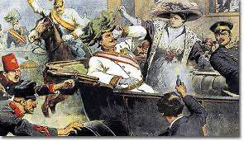
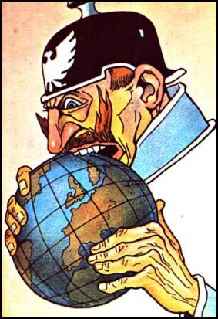
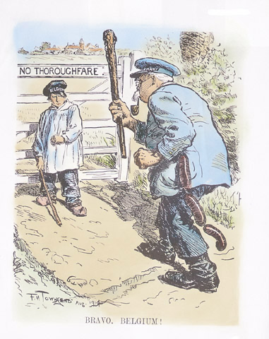
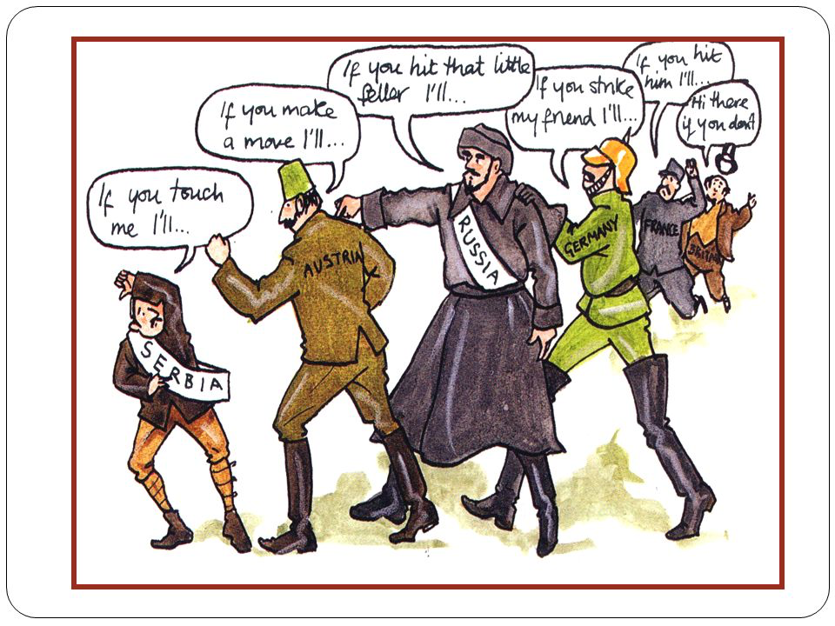

Slide 3
Edexcel IGCSE History P2: Breadth Study A1
The Origins & Course of WW1,
1905-1918
4.1 The German Threat from Under the Sea

Slide 4
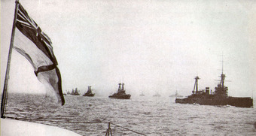
(b) German Threat from Under the Sea
The War at Sea was not just restricted to the North Sea, as German SUBMARINES operated in the Atlantic Ocean and very nearly brought Britain close to defeat. As an island nation, Britain depended on its MERCHANT NAVY to bring food & goods into its ports from abroad. Germany planned to use its U-BOATS to stop this supply chain to induce surrender.
Britain imposed a NAVAL BLOCKADE on Germany on 4th Feb. 1915 and the German Government announced a SUBMARINE BLOCKADE of Britain.

Slide 5
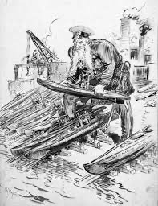
(b) German Threat from Under the Sea
SUBMARINE WARFARE
At the start of the War, Germany was not keen to engage the British Grand Fleet directly. Instead, Admiral Tirpitz advised the Kaiser to use UNRESTRICTED SUBMARINE WARFARE as a way of weakening the British war effort. On 4th February 1915, the Germans declared that all Merchant Ships entering or leaving British waters would be destroyed – an ambitious plan, as Germany only had 21 U-boats & there were 15,000 moves in & out of British ports each week! In fact, only 4% of these ships were sunk in 1915.

Slide 6
“All the waters surrounding Great Britain & Ireland, including the whole English Channel, are hereby declared a war zone. From 18 February onwards, every merchant vessel found withing this war zone will be destroyed.”
German Government declaration, 4th February 1915

Slide 7
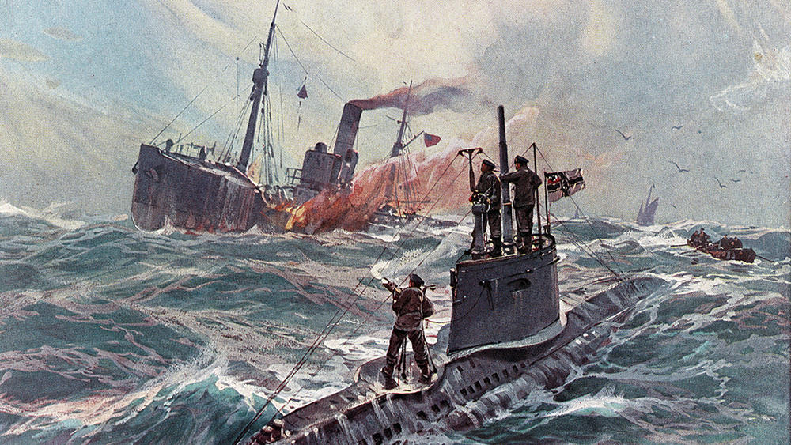
(b) German Threat from Under the Sea
The problem with unrestricted submarine warfare was that German U-boats might hit ships from a NEUTRAL NATION & bring them into the war on the Allies’ side. Bringing the USA into the War on the same side as Britain was a huge fear in Germany. This very nearly happened in May 1915, when a GermanU- boat sunk the US Passenger ship, Lusitania, but USA only protested against Germany without declaring war.
In Sept. 1915 & May 1916, Germany stated its U-boats would not attack neutral ships; reducing their U-boat effectiveness overall.

Slide 8
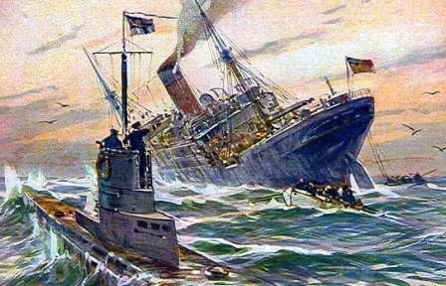
(b) German Threat from Under the Sea
By 1917, the German U-boat fleet had increased to almost 200 submarines. Germany firmly believed that Britain could be starved into submission, so restarted its campaign of UNRESTRICTED SUBMARINE WARFARE. It worked well, at first, sinking 841,114 tons of Allied ships. Merchant Navy captains expected 1 in 4 ships would not reach their destination. Rationing, however, saved GB.

Slide 9
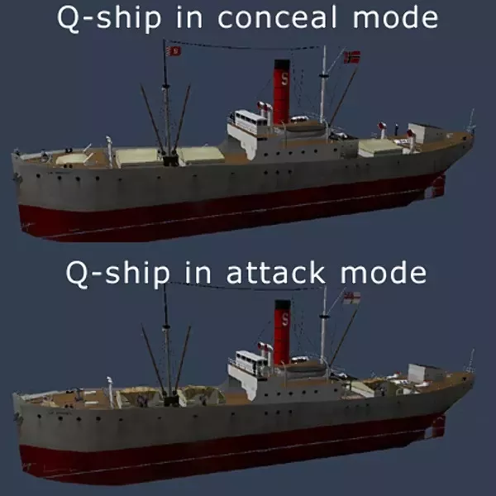
(b) German Threat from Under the Sea
Britain soon took Anti-U-boat measures:
MINEFIELDS were set in the English Channel.
DEPTH CHARGES were developed – dropped from ships onto submarines below, they exploded & destroyed U-boats beneath the waves.
British PM, David Lloyd George, persuaded the Royal Navy to use a CONVOY system to protect the Merchant Ships as ‘escorts’.
Q-SHIPS were introduced -- heavily armed ships, disguised as Merchant Ships, to give U-boats a nasty shock when surfacing.

Slide 10
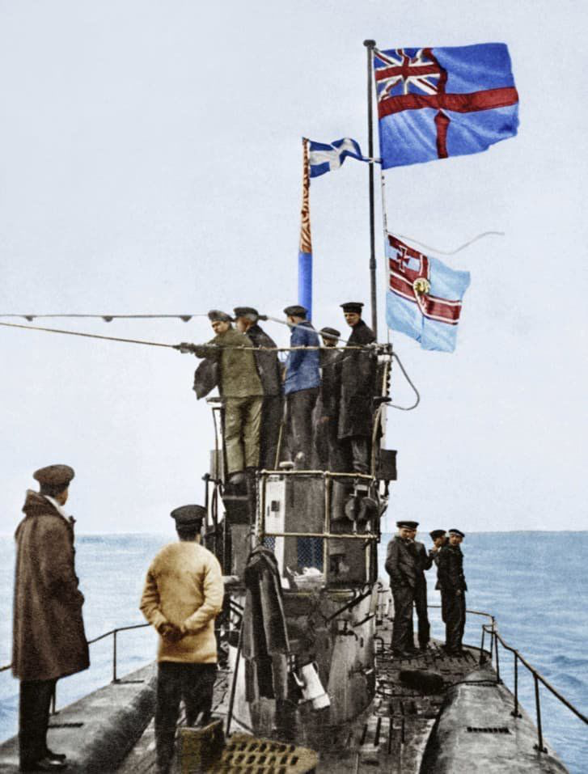
(b) German Threat from Under the Sea
Anti-U-boat measures were very successful:
MINES sunk large numbers of U-boats. 20/63 U-boats sunk in 1917 had hit a mine.
1915-1917 saw depth charges destroy only 5 U-boats. Improved designs in 1918 saw new depth charges destroy 22 U-boats.
The first British Navy convoy crossed the Atlantic on 10 May 1917. By 1918, only 1% of ships in convoys were sunk by U-boats.
Q-Ships were an unwelcome & unexpected surprise for submarines. Q-Ships were responsible for 10% of all U-boats sunk.

Slide 12
Activity 22
Lord Herbert Horatio Kitchener (1850-1916) was the British War Secretary in WW1 & is most famous as the face on the “Your Country Needs YOU” recruitment posters in WW1.
Tsar Nicholas II invited him to Russia in May 1916.
Find out what happened next.
Find out why Kitchener’s coffin was empty.

Slide 14
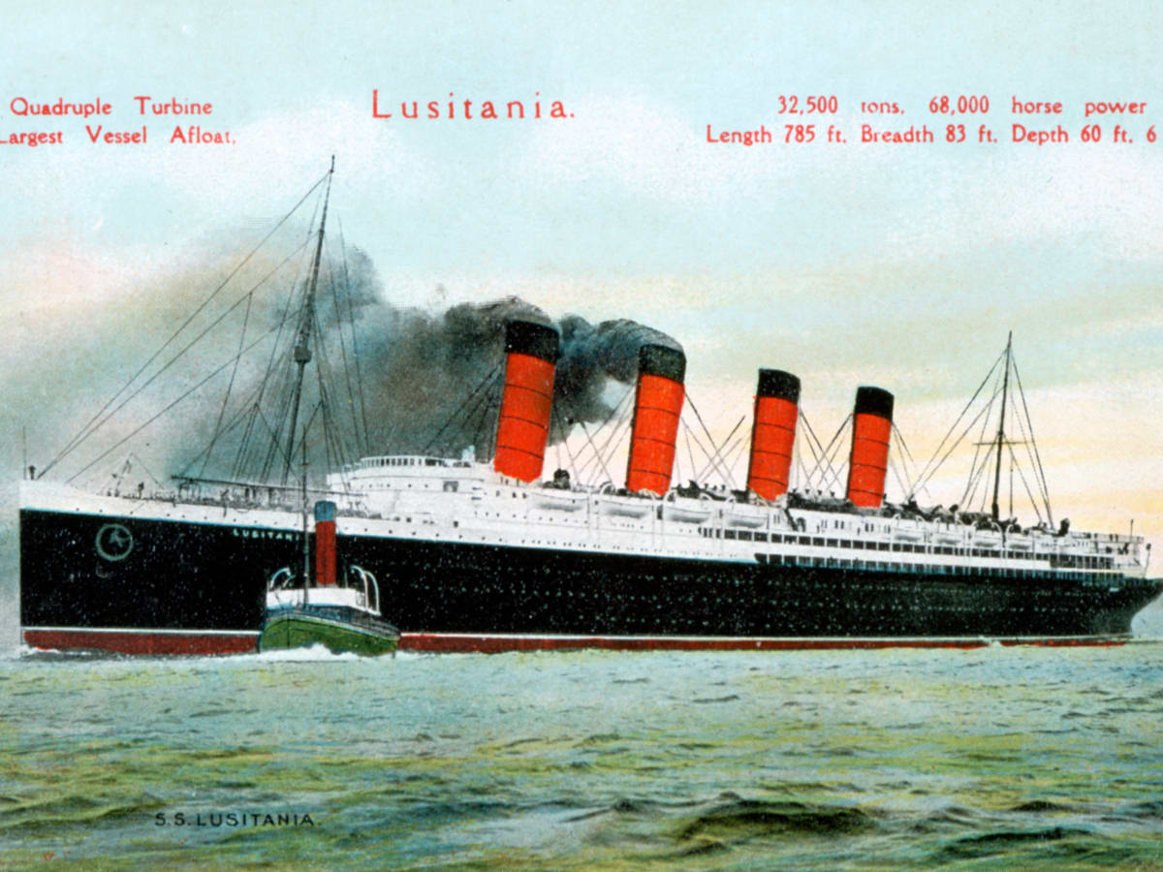
(b) German Threat from Under the Sea
On 1st May 1915, the huge British luxury liner, the LUSITANIA, set sail from New York to Liverpool. Despite a German Embassy warning, that appeared next to Cunard’s advert for the trip, many passengers felt “the fastest ship in the World” could sail faster than any submarine. These people did not consider U-boat TORPEDOES in their thought processes.

Slide 15
“Travellers intending to embark on the Atlantic voyage are reminded that a state of war exists between Germany & her allies and Great Britain & her allies; vessels flying the flag of Great Britain are liable to destruction in those waters and travellers sailing in the war zone do so at their own risk.”
German Embassy warning in US newspapers, May 1915

Slide 16
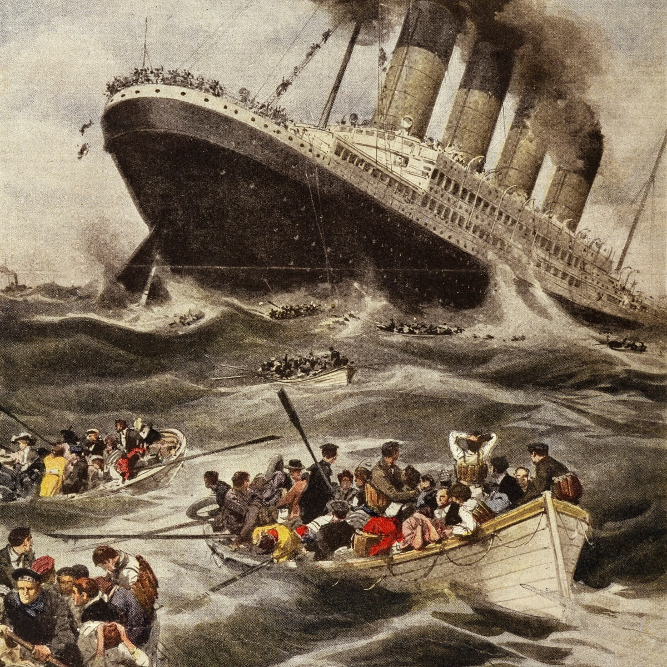
(b) German Threat from Under the Sea
On 7th May 1915, 13km off the coast of Ireland, the German submarine U20 torpedoed the Lusitania. A second huge (unexplained internal) explosion sank the ship in 18 mins, so most passengers didn’t stand a chance of survival. The tilt of the sinking ship was so steep that Lifeboats couldn’t be launched & they swung around, hitting passengers crowded on the decks or, worse, merely emptied their occupants into the Sea.
Of the 1,959 passengers aboard the Lusitania, 1198 people drowned – 128 of the dead were Americans.

Slide 17
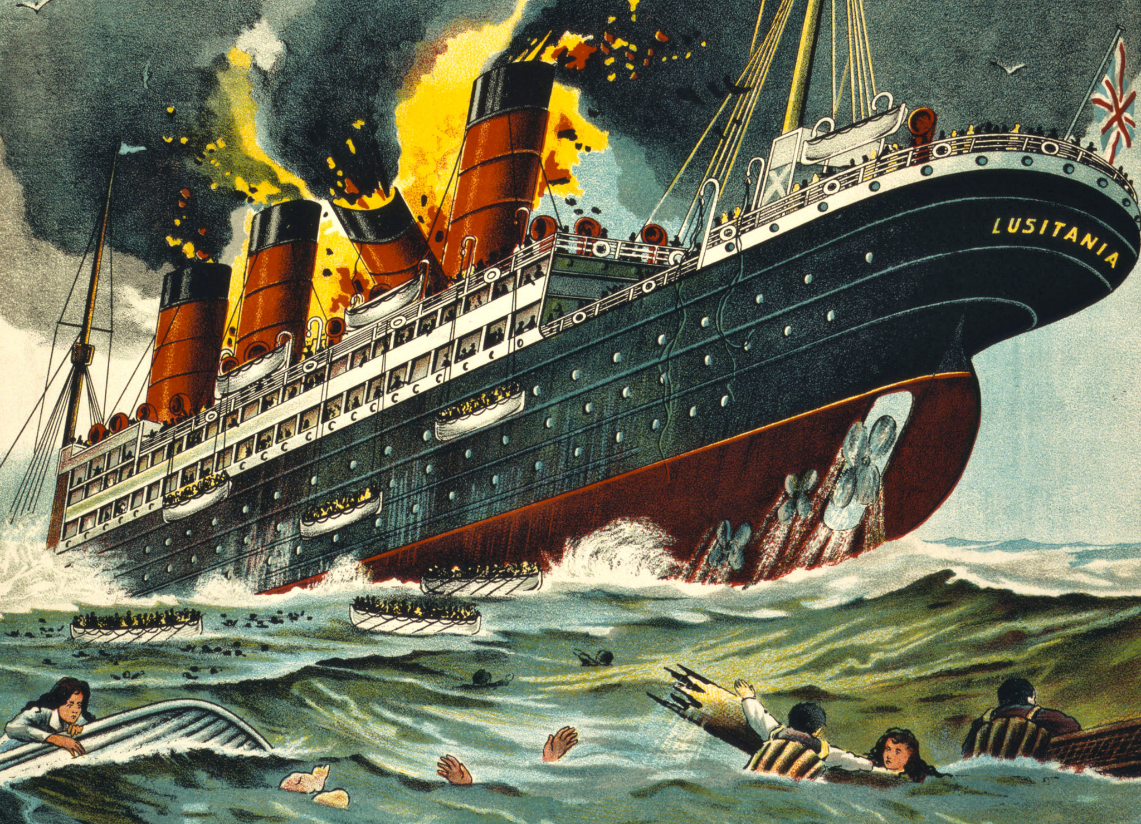

Slide 18
Activity 23
Arthur Vanderbilt, one of the richest men in the World, and Carl Frohman, a successful playwright, rushed to the Lusitania Nursery to save the babies when the ship began to sink.
Find out what rescue attempt they made.
Find out what happened in the end.

Slide 20
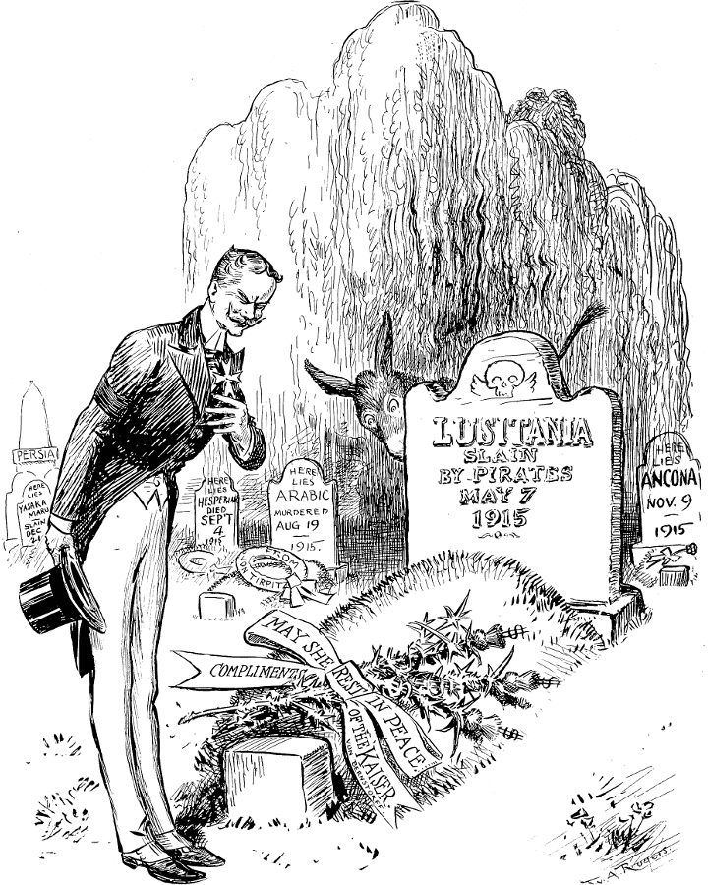
(b) German Threat from Under the Sea
The sinking of the Lusitania outraged the International press – in Britain, the Daily Express said ‘It is simply an act of piracy. Nothing more.’ There were calls for the USA to declare war on Germany, but Germany published a statement that claimed the Lusitania was sunk because it was carrying “war materials”, so had the right to sink it. Britain denied any such “war materials” were aboard. This denial has been disputed, however, as there were some irregularities about the Lusitania …

Slide 21
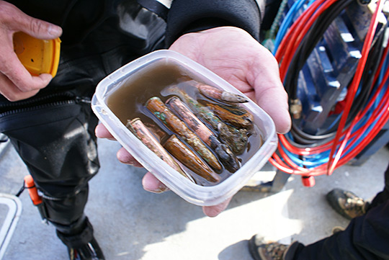
(b) German Threat from Under the Sea
ODDITIES ABOUT THE LUSITANIA:
In strict secrecy, on 12th May 1913, one of the Lusitania’s decks had been converted to a gun-deck with 6 guns on each side of the passenger liner.
The Lusitania’s cargo contained:
4,927 boxes of cartidges
1,248 cases of 3-inch shrapnel shells
18 cases of fuses for artillery shells
Large quantities of gun cotton, an explosive used in shell manufacture
2 consignments labelled “butter” + “cheese” unrefrigerated & weighing 90 tons together

Slide 22
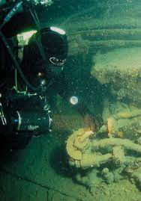
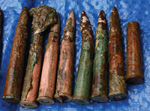

Slide 23
‘Whatever the facts regarding the Lusitania, the principal fact is that a great steamer, primarily & chiefly a conveyance for passengers, and carrying 1,000 souls who had no part or lot in the conduct of the war, was torpedoed & sunk without so much as challenge or warning. Men, women & children were sent to their death in circumstances unparalleled in modern warfare.’
Official note from US to Germany after the sinking, May 1915

Slide 24
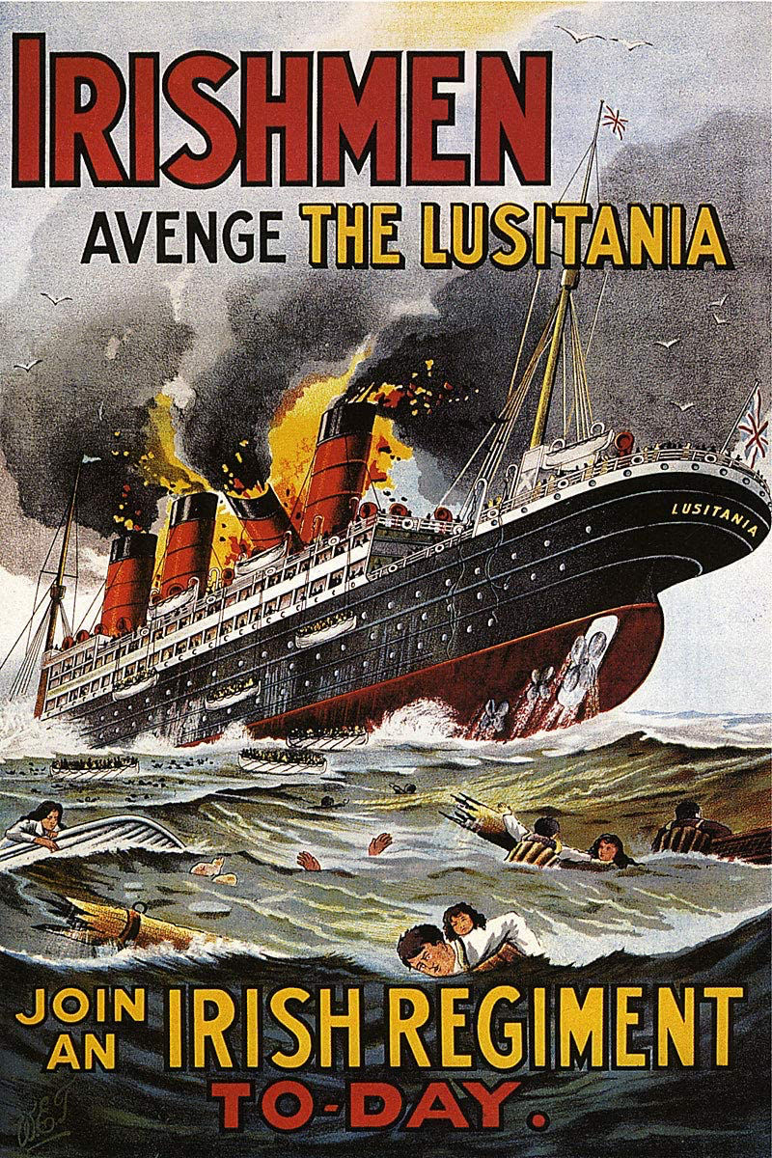
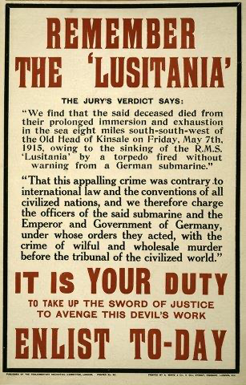
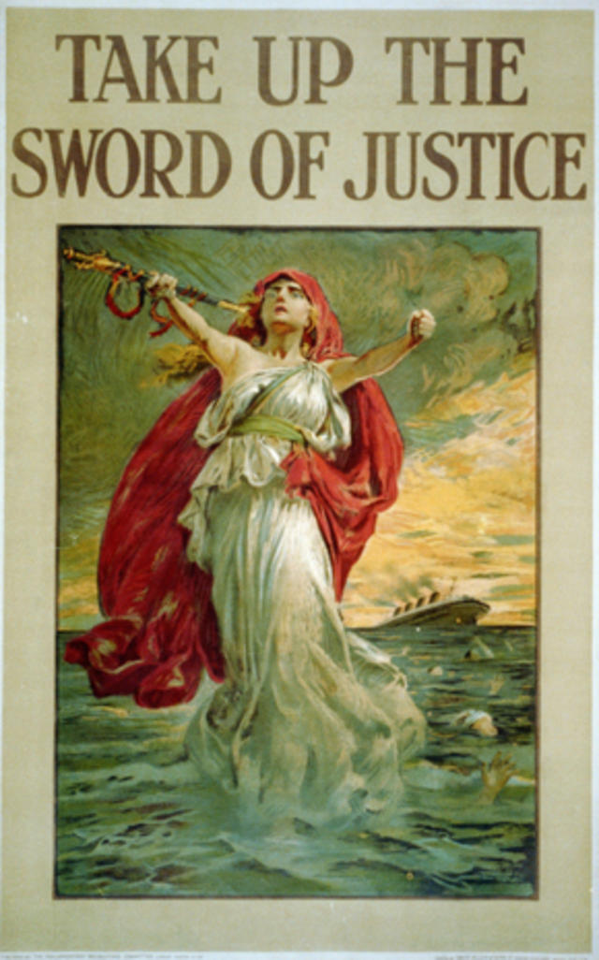

Slide 25
