Slide 1
Edexcel IGCSE History P2: Breadth Study A1
The Origins & Course of WW1,
1905-1918

Slide 2
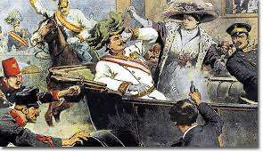
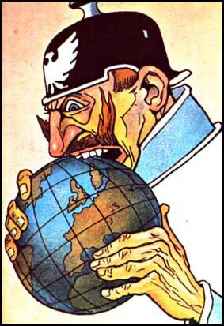
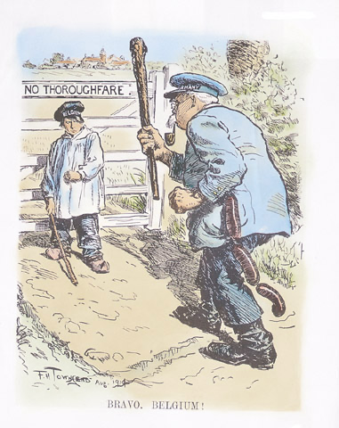
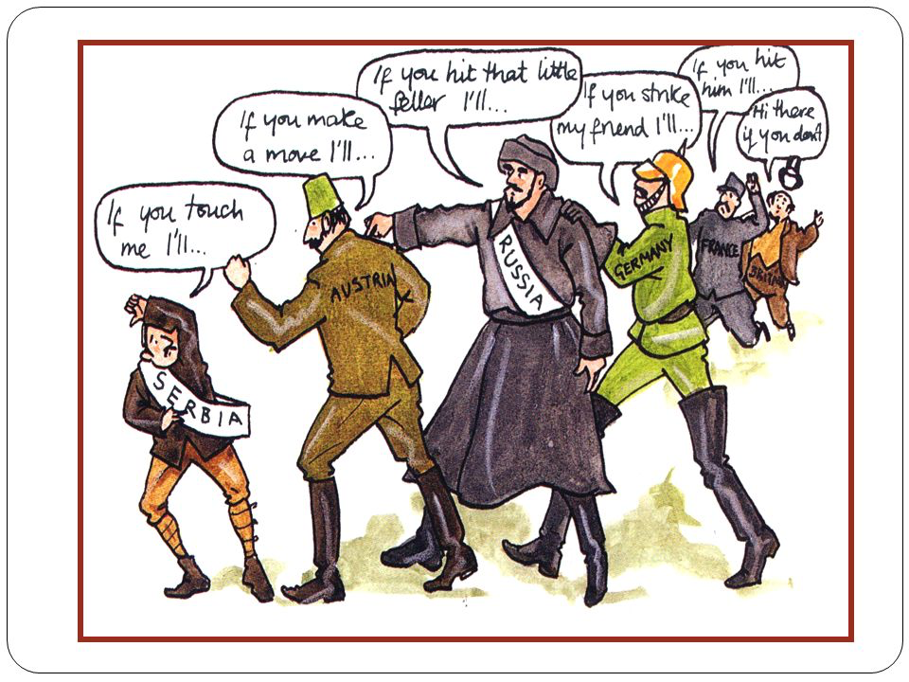

Slide 3
Edexcel IGCSE History P2: Breadth Study A1
The Origins & Course of WW1,
1905-1918
4.1 The German Threat from the North Sea

Slide 4
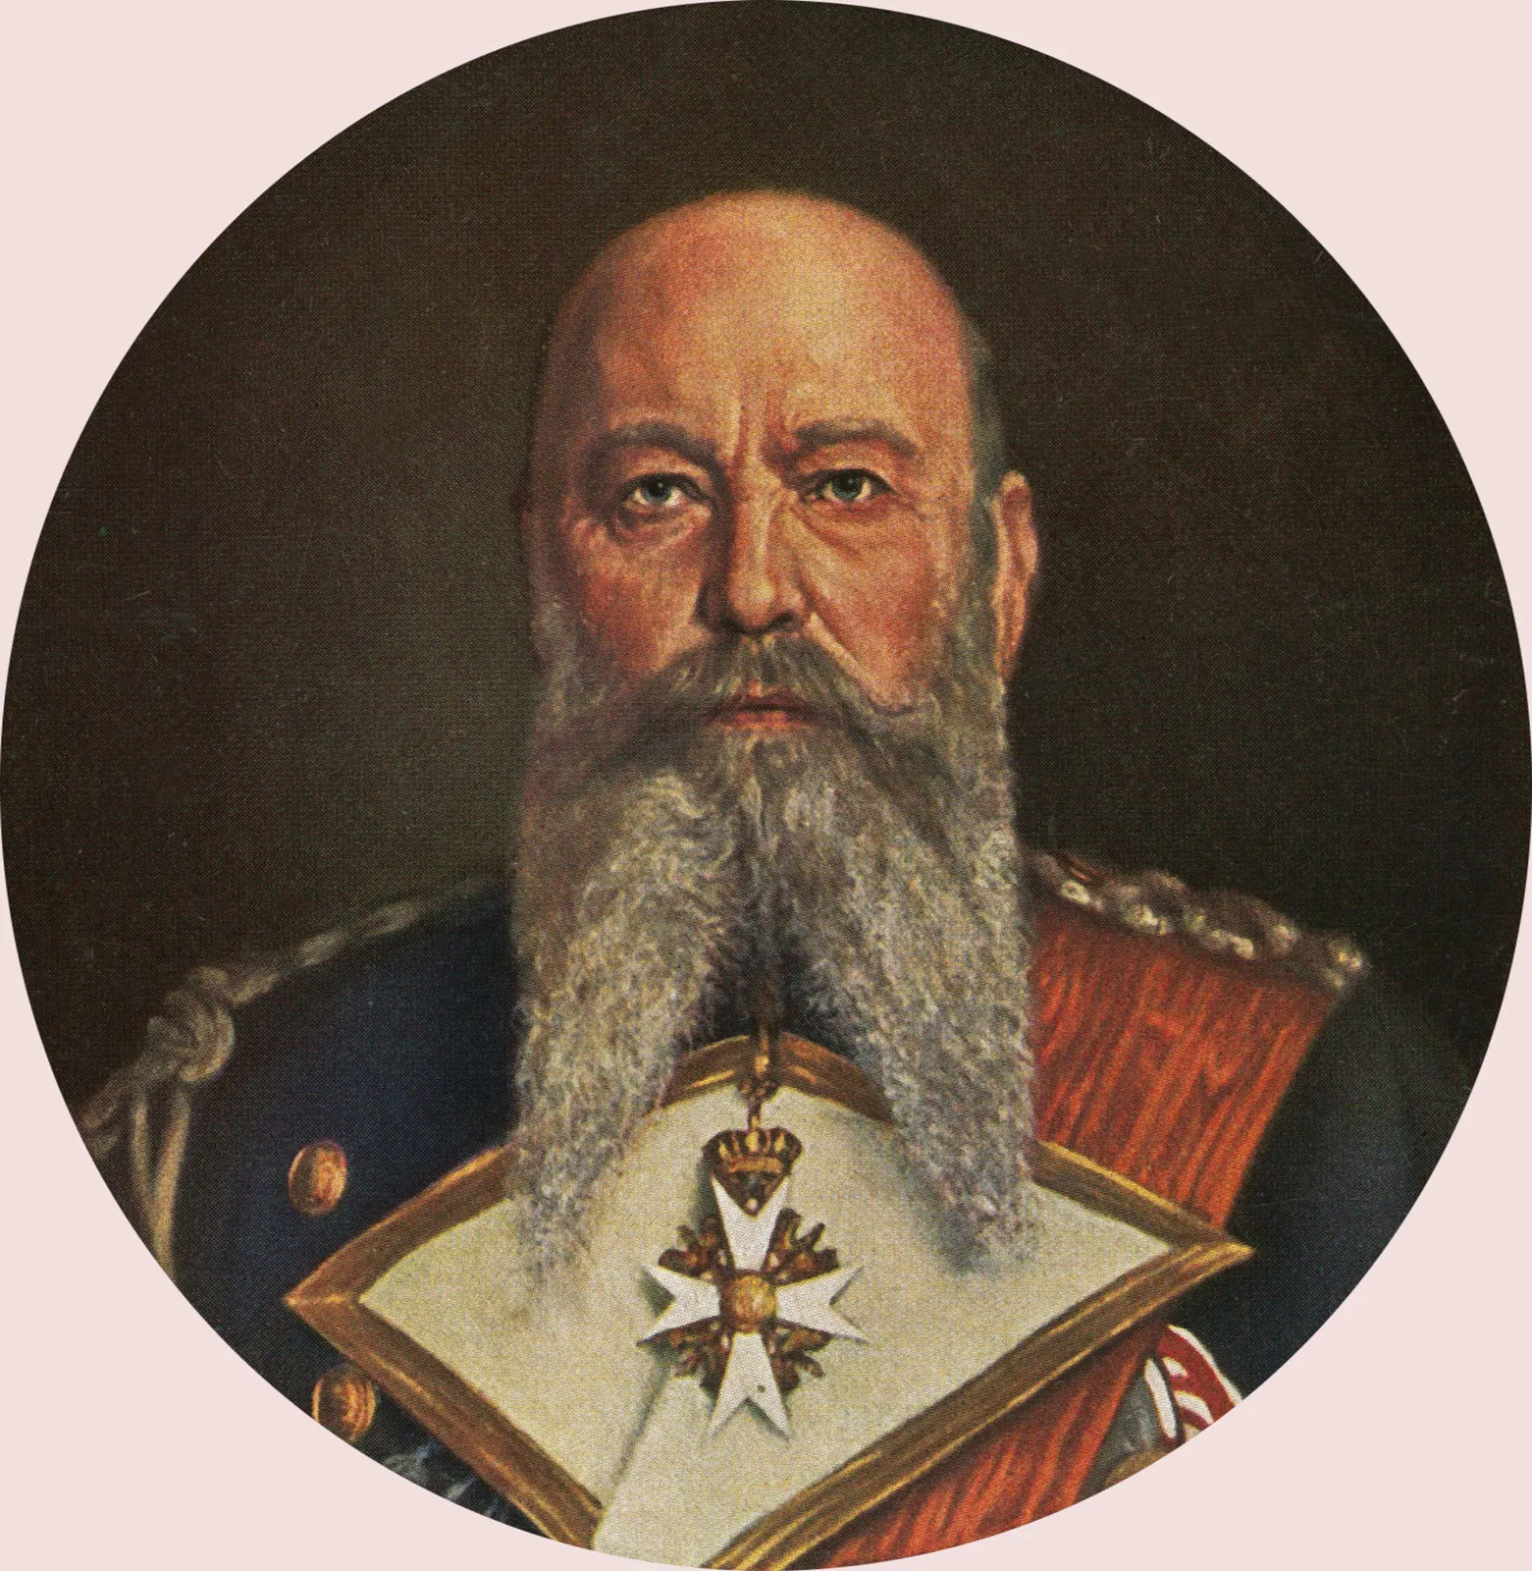
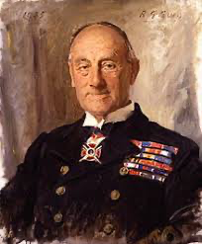
(a) German Threat from North Sea
In 1914, no other Navy rivaled the British Navy. Germany had tried to build up enough of a fleet to challenge British dominance but, in the end, both Navies were a DETERRENT to the other.
Admiral Alfred von Tirpitz led the German High Seas Fleet
Admiral John Jellicoe led the British Grand Fleet
As soon as war broke out, both men wanted to keep their fleets ‘in port’ as long as possible. A major sea battle lost could have meant the war was lost. The Germans remained anchored at Wilhelmshaven & the British Navy stayed at Scapa Flow, Orkney Islands.

Slide 5
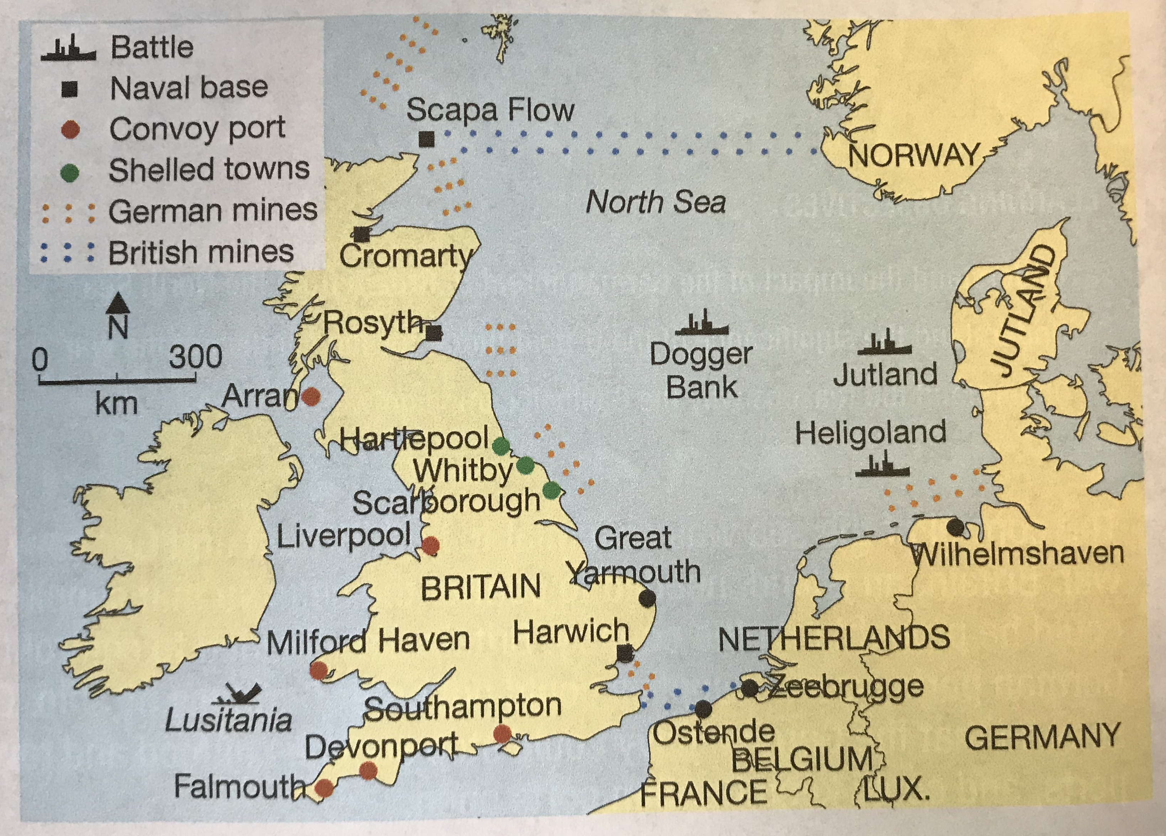

Slide 6
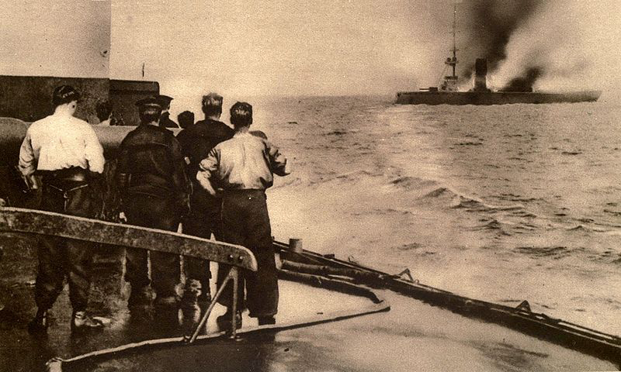
(a) German Threat from North Sea
BATTLE OF HELIGOLAND BIGHT
Although both fleets were anchored in August 1914, smaller Warships patrolled the North Sea & had minor clashes. On 28th August 1914, two British Officers had noticed German Destroyers & Cruisers making a regular pattern of patrols – both would move into the North Sea in the evening, look for British ships until morning, then return to port. The British plan was to catch the German destroyers on the return journey & sink them.

Slide 7
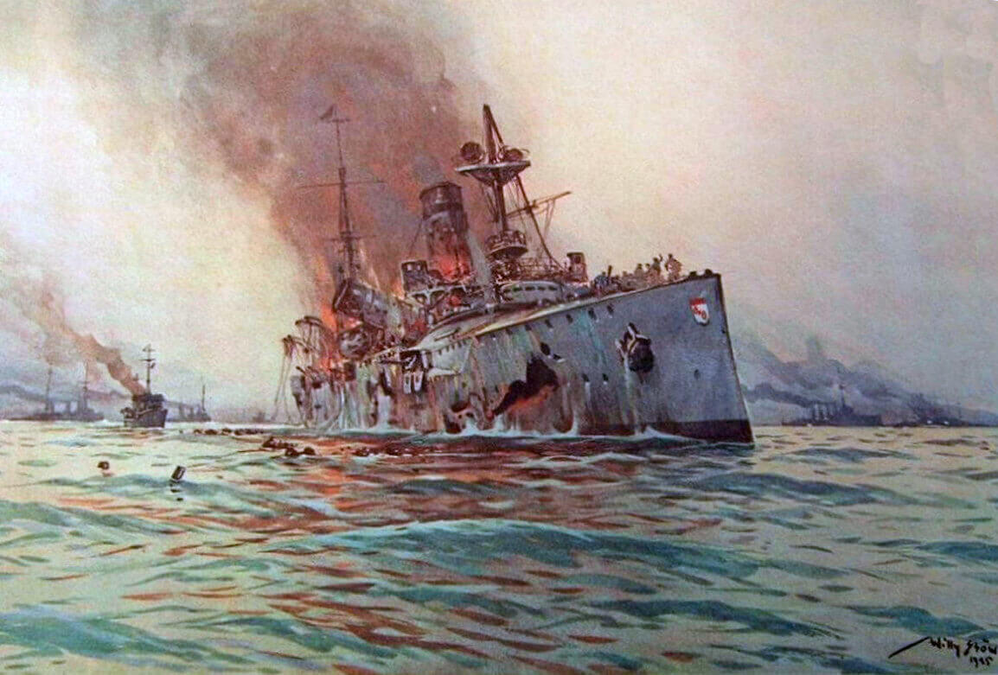
(a) German Threat from North Sea
BATTLE OF HELIGOLAND BIGHT
The British used 31 Destroyers, 2 light Cruisers + 8 Submarines in the attack. The plan worked perfectly & German losses included the sinking of 3 light Cruisers + 1 Destroyer, plus 3 more light Cruisers badly damaged. The British saw no ships sunk, 3 Destroyers + 1 light Cruiser damaged.
712 German sailors died, 530 injured & 336 taken prisoner.
35 British sailors died & 40 wounded.

Slide 8
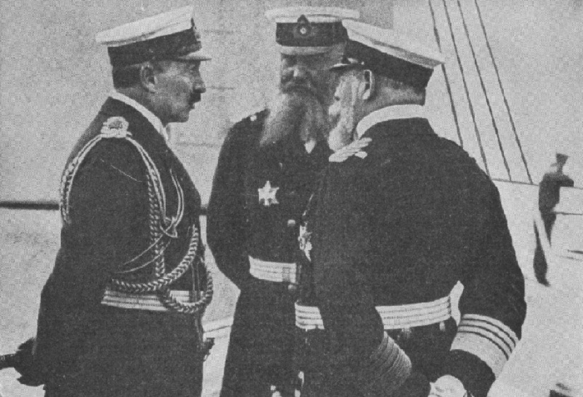
(a) German Threat from North Sea
BATTLE OF HELIGOLAND BIGHT
In Britain, cheering crowds declared the Battle of Heligoland Bight a glorious victory.
In Germany, however, the Kaiser was horrified at the sinking of German ships & ordered any future “decisive action” had to be personally approved by him. Alfred von Tirpitz was furious – as the Admiral of the German High Seas Fleet, he should have the final say on whether to engage the enemy or not … not the Kaiser. No fleet action as a result of this.

Slide 9
Activity 20
The British submarine, E4, fired
a torpedo at the German light
Cruiser, Stettin, but missed it.
Find out what happened next.
Find out why the E4 is famous.

Slide 11
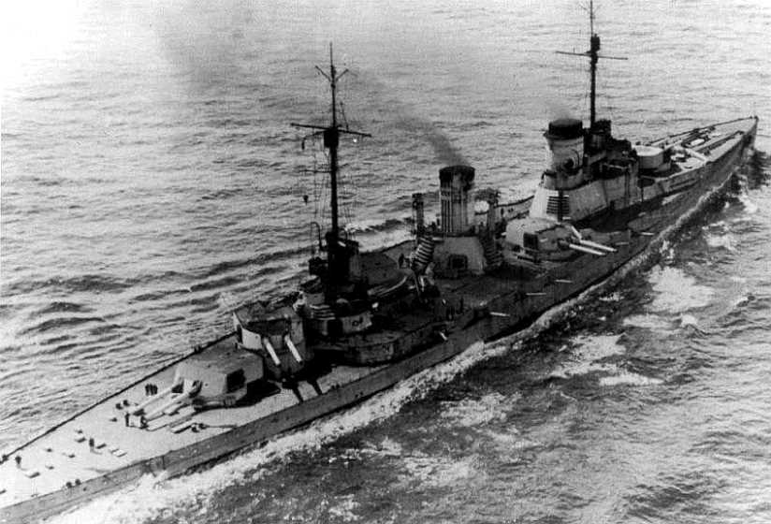
(a) German Threat from North Sea
Germany carried out RAIDS on the North Sea coast of Britain, with 3 main objectives:
To lay sea-mines to sink passing British ships
To force British ships to chase German raiders to the German coast for AMBUSHES
To force the British Grand Fleet to split up, to defend various coastal towns, giving Germany a better chance against isolated ships to reduce British strength

Slide 12
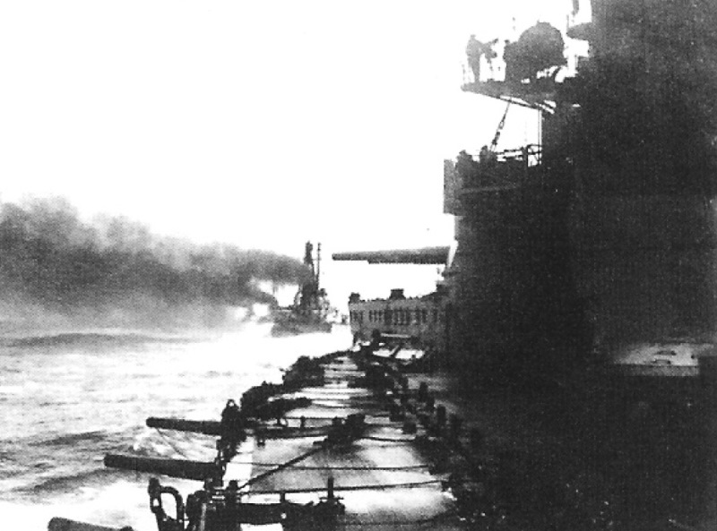
(a) German Threat from North Sea
RAID ON GREAT YARMOUTH, NOV. 1914
On 3rd November 1914, 8 Battle Cruisers set off across the North Sea to lay mines & to shell Great Yarmouth. The gunners’ aim was poor & most of the shells landed on the beach. A small fragment of a shell killed ONE British man, but that was it. Once the mines were laid, the German Battle Cruisers headed home; the trap set. When British ships saw them & gave chase, 1 German Battle Cruiser hit 2 of their own mines & sank, killing 235. The Germans saw how easy it was to reach the British coast & the British felt that bombarding a beach was no real threat at all.

Slide 13
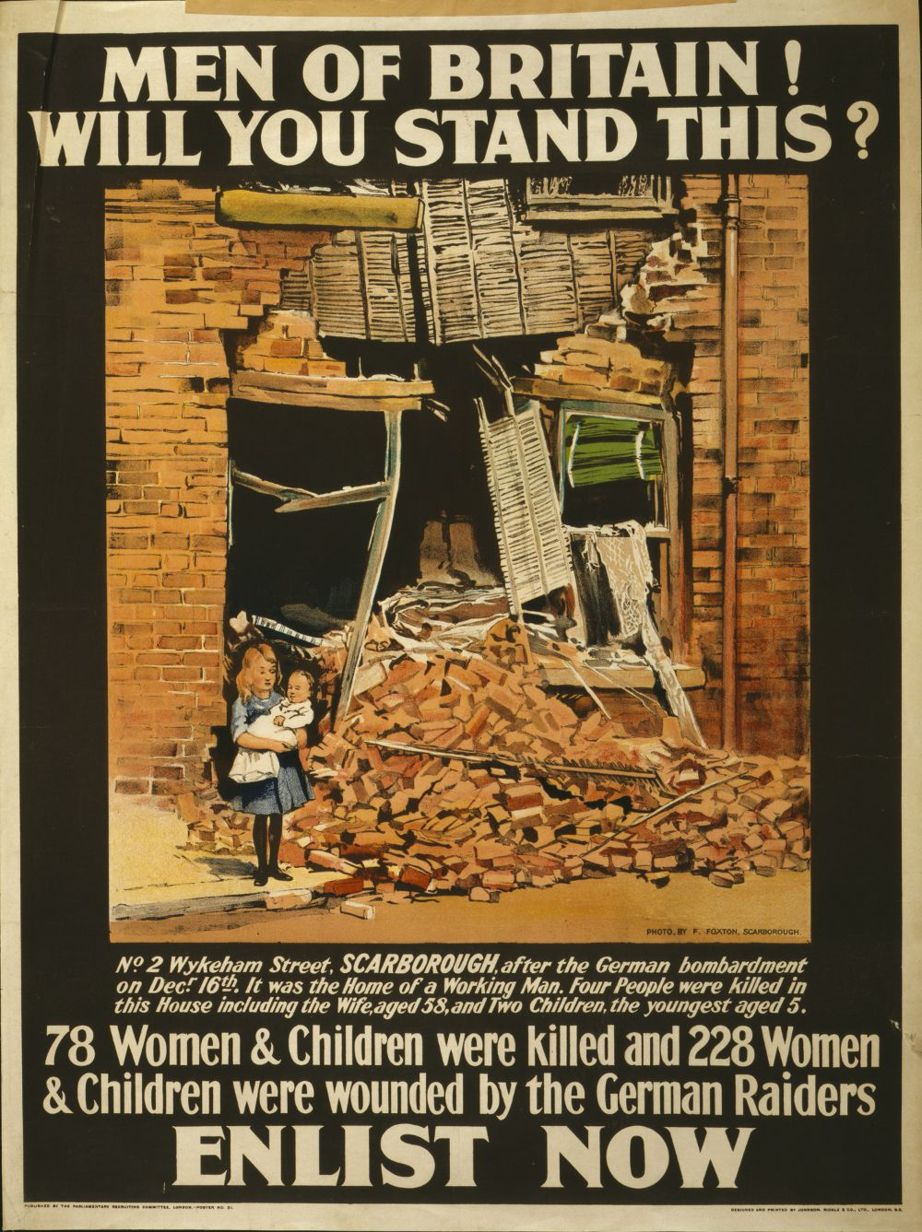
(a) German Threat from North Sea
RAID ON SCARBOROUGH, WHITBY & HARTLEPOOL
The relative ease of the Great Yarmouth raid made German Commanders hope that future raids could be successful. British code-breakers were now able to read messages sent between German ships. The British, therefore, knew about a German crew heading into the North Sea on 15th Dec. 1914. These ships began shelling Scarborough, moved along the coast to shell Whitby, before shelling Hartlepool for 50 mins; firing 1,000 shells, wrecking property & killing innocent civilians. The raids saw a public outcry the British Navy had done nothing & Admiral Jellicoe promised to deploy the whole fleet in defense of the coast from now on.

Slide 14
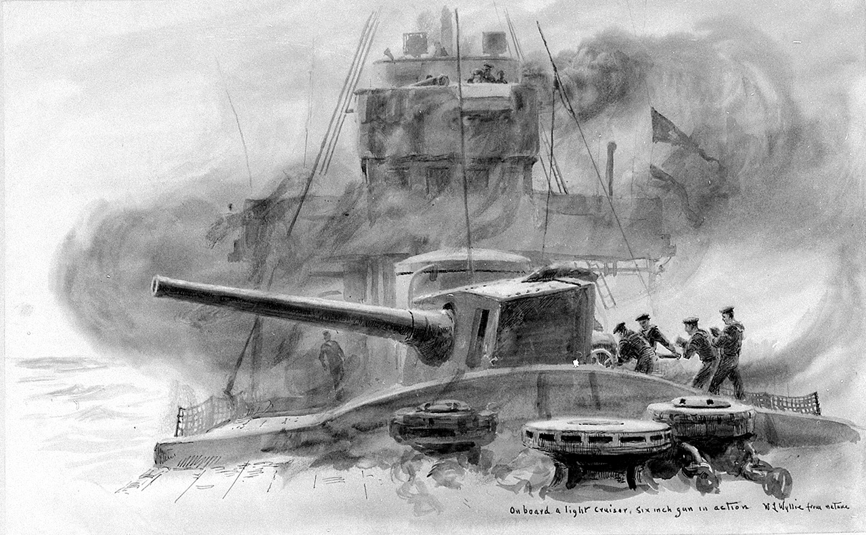
(a) German Threat from North Sea
BATTLE OF DOGGER BANK, JAN. 1915
On 24th January, 1915 British code-breakers knew that a German crew were heading into the North Sea and, this time, they would sail to meet them. Taken by surprise, the Germans turned around to head back home … but the British Grand fleet chased them & began firing on them … sinking the German Cruiser, Blucher. After confusing signals, suggesting to concentrate on sinking the Blucher, the rest of the German squadron of ships got clean away, but the victory was won:
Britain lost 0 ships + just 15 sailors.
Germany lost 1 Battle Cruiser + 954 sailors.

Slide 15
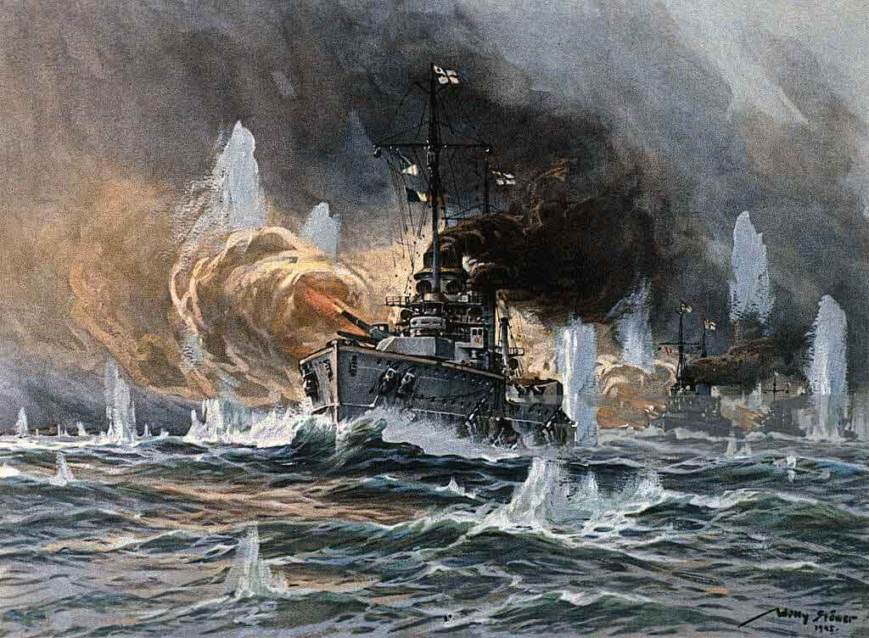

Slide 16
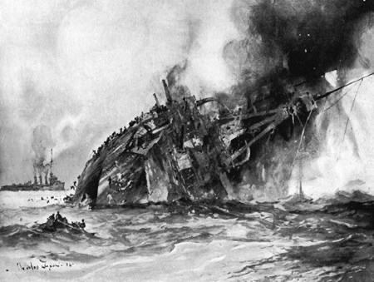

Slide 17
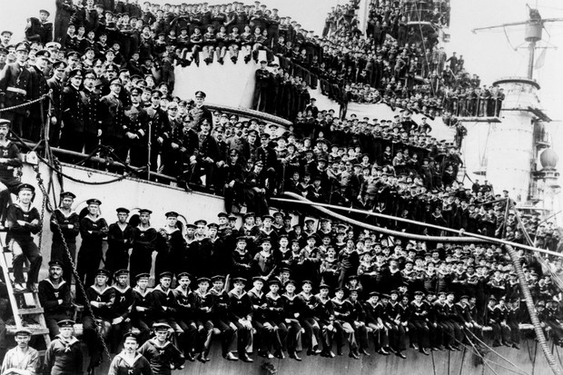
(a) German Threat from North Sea
BATTLE OF JUTLAND, MAY 31—JUNE 1, 1916
The almighty clash that both sides had been in fear of occurred on 31st May 1916. Admiral Tirpitz had been replaced by Admiral Scheer & he was keen for a confrontation. He sent an advance squadron to draw out the entire British Grand Fleet & intended to surprise them with the entire German High Seas Fleet. Having cracked German codes, however, the British knew that Scheer’s ships were coming & were ready & waiting. Thus, 2 Dreadnought fleets (259 warships carrying over 100,000 men) met off the Danish coast, near Jutland.

Slide 18
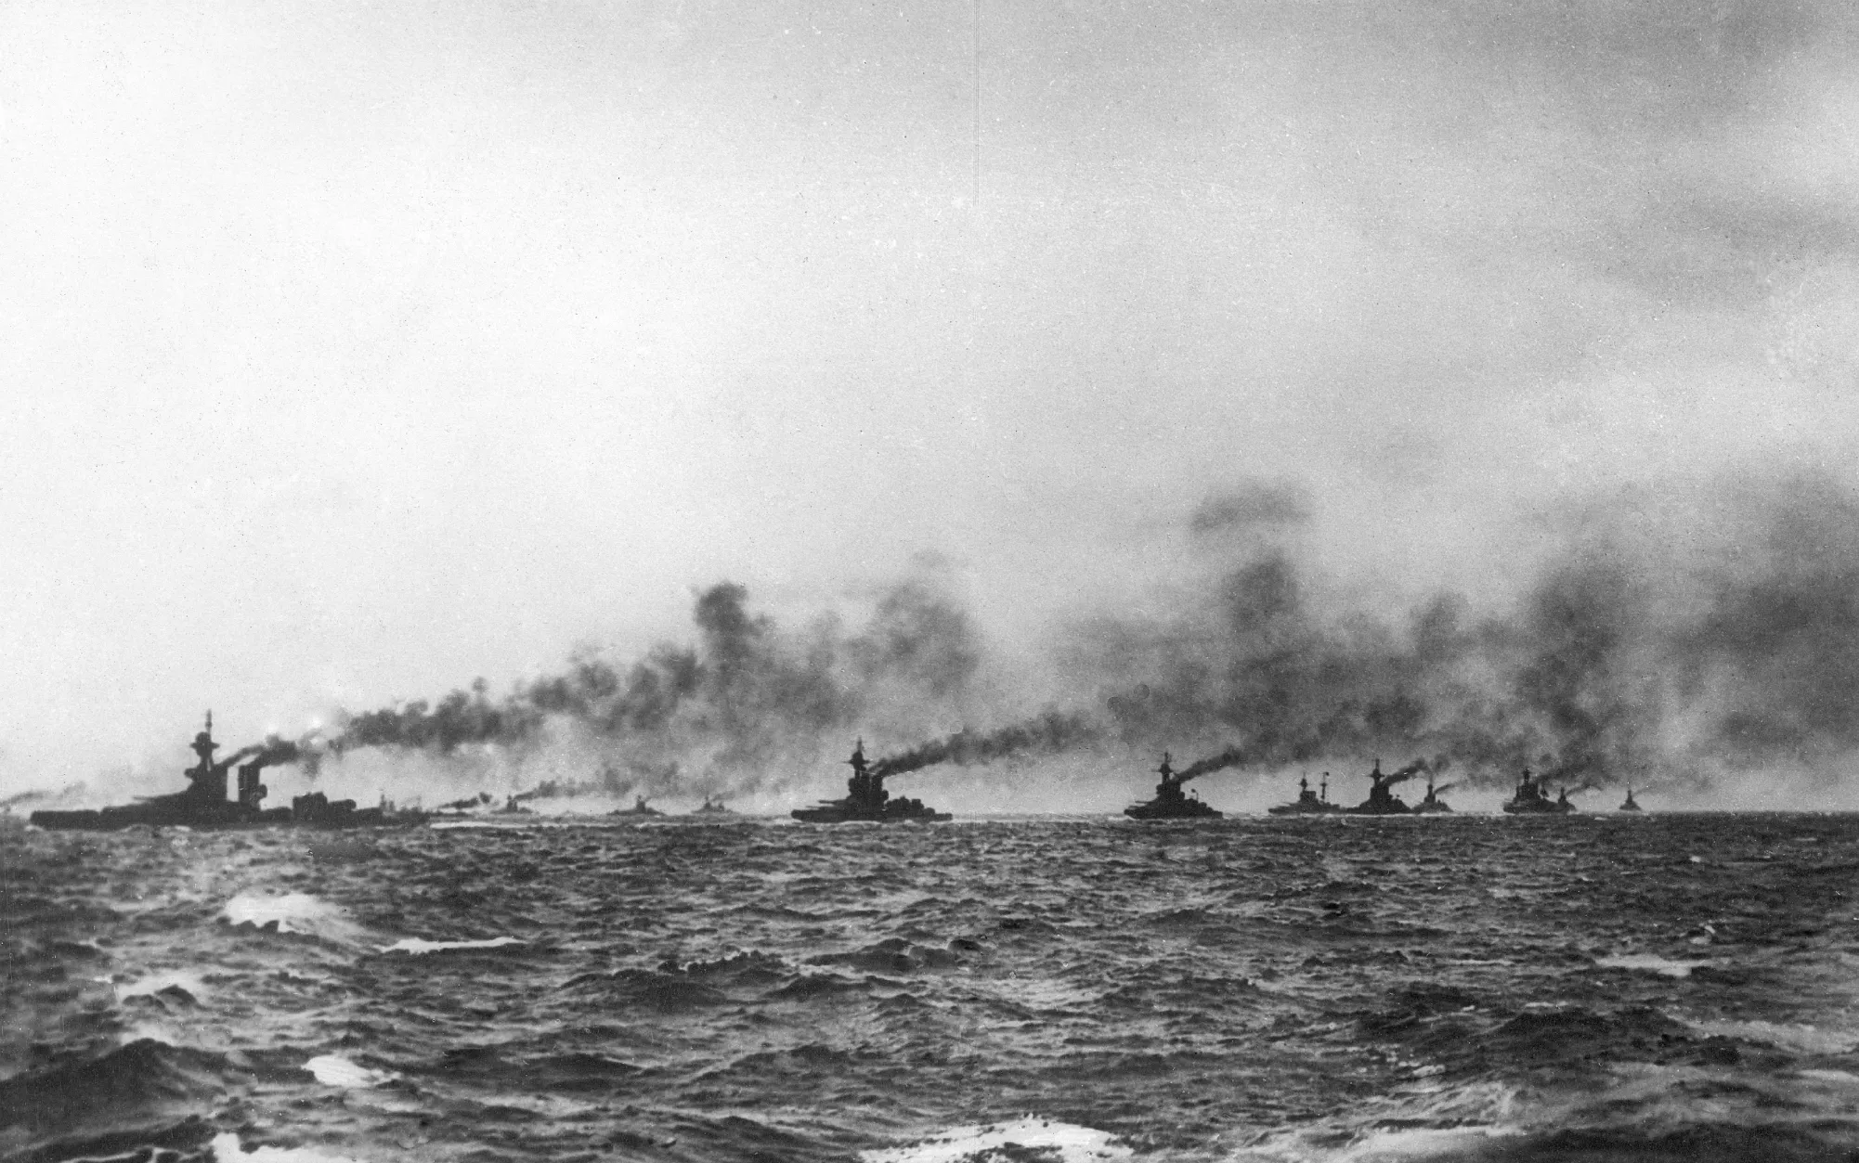

Slide 19
“Chatfield, there seems to be something wrong with our bloody ships today.”
Vice-Admiral David Beatty, speaking to one of his captains during the Battle of Jutland.

Slide 20
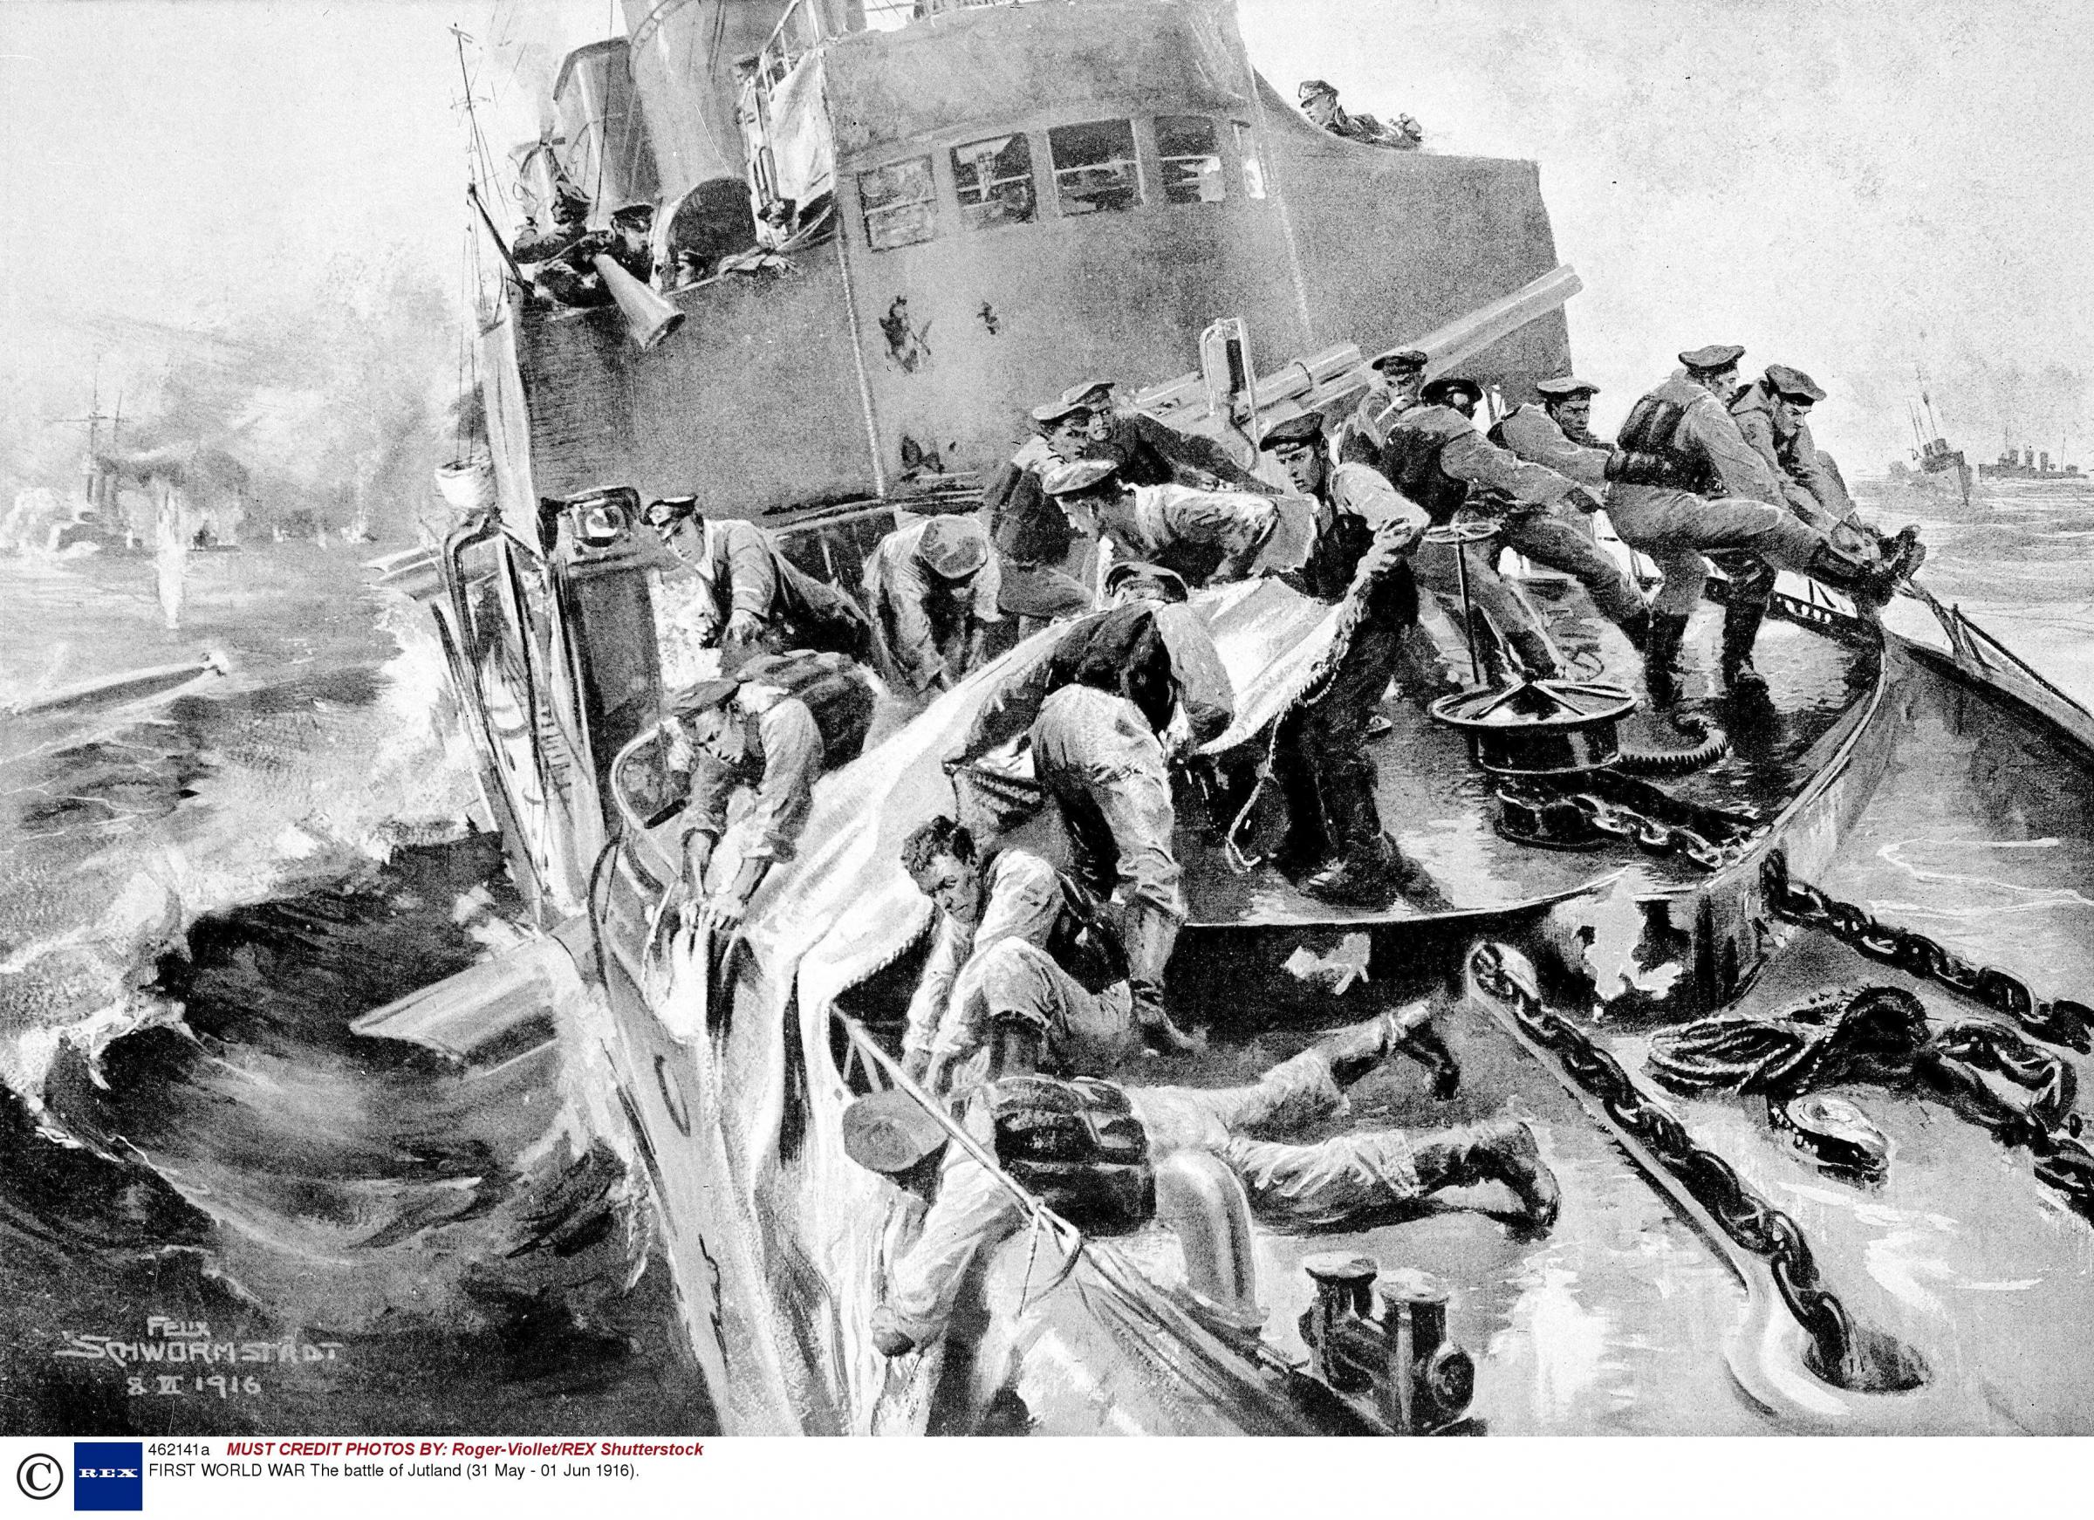
(a) German Threat from North Sea
BATTLE OF JUTLAND, MAY 31—JUNE 1, 1916
Fighting was fierce and, worrying for the British, German ships operated better & were less easily damaged. When night fell, German ships suddenly stopped fighting & sailed back to port. The British Grand Fleet had, by far, suffered most damage:
Britain lost 14 ships & over 6,000 lives
Germany lost 9 ships & over 2,500 lives
BUT BOTH SIDES CLAIMED JUTLAND A VICTORY! Germany had won, as they sank most ships; Britain had won, as they controlled the North Sea & the German High Seas Fleet stayed in port for the rest of the war – all of 1917 + 1918.

Slide 21
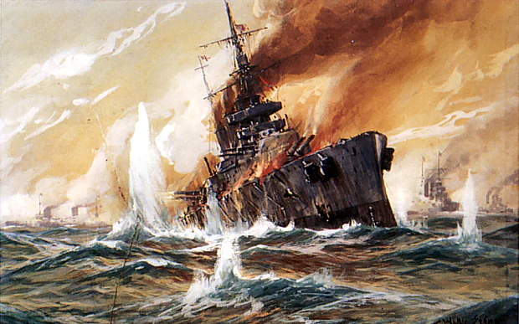

Slide 22
Activity 21
Jack Cornwell joined the Royal Navy
when he was 15 years old & he was
a member of the crew of H.M.S. Chester
at the Battle of Jutland on 31 May 1916.
Find out what happened to Jack.
Why was Jack’s story told + retold?

