Slide 1
Edexcel IGCSE History P2: Breadth Study A1
The Origins & Course of WW1,
1905-1918

Slide 2
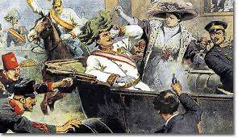
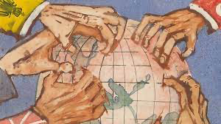
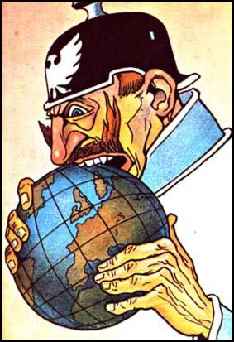
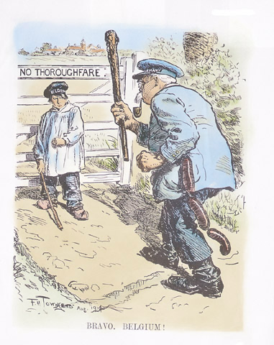
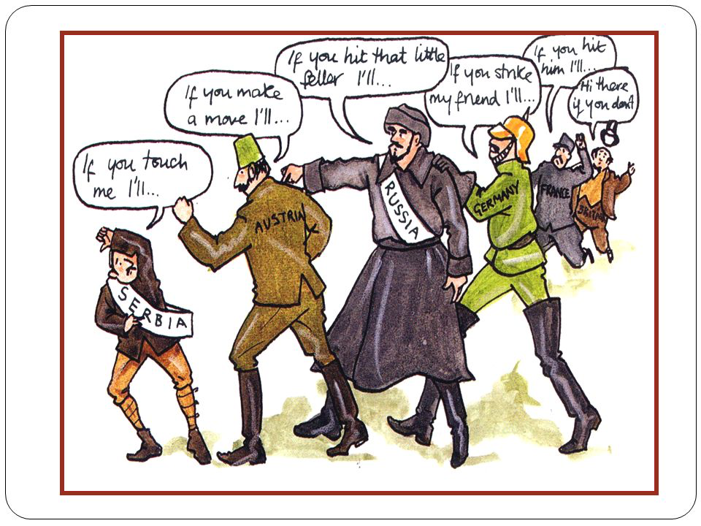

Slide 3
Edexcel IGCSE History P2: Breadth Study A1
The Origins & Course of WW1,
1905-1918
3.4 Successes & Failures: The Somme + Passchendaele

Slide 4
(d) Successes & Failures
By the end of 1915, General Joffre & General Haig agreed to a full-scale attack along the River Somme in the summer of 1916. This meant that the first 6 months of 1916 could be spent developing supplies of men & weapons. What the French & British military leaders didn’t know, however, was the German General Falkenhayn was also planning a major attack in 1916 … at Verdun … in February.

Slide 5
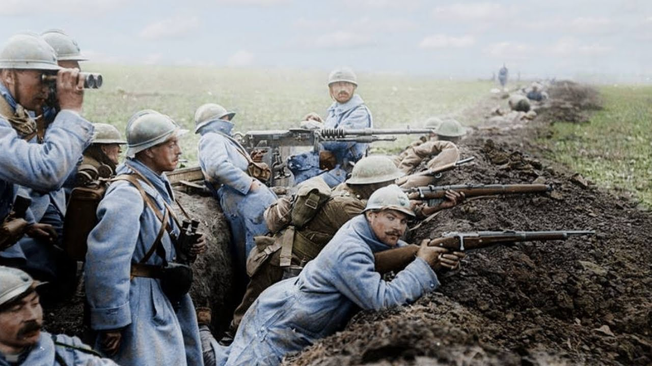
(d) Successes & Failures
The Battle of Verdun lasted from February to December 1916 – overlapping with the Battle of the Somme, July to November 1916. While the Germans had not captured Verdun by July, they had inflicted terrible casualties on the French – 542,000 were reported dead, wounded or missing. The Germans had not got off lightly, though, as their own casualties were 434,000.

Slide 6
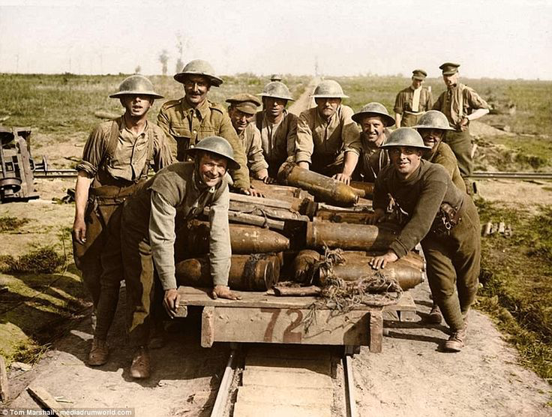
(d) Successes & Failures
As a result of Verdun casualties, the French were unable to assist the British at the Somme, as originally planned. This made the Somme offensive even more important:
As an attempt to break through German lines & to draw
As a distraction to draw German troops away from Verdun
One of General Haig’s major problems when launching the Somme offensive was the German reconnaissance had reported new roads & railways, plus supplies, arriving. Germans were not taken by surprise at all.

Slide 7
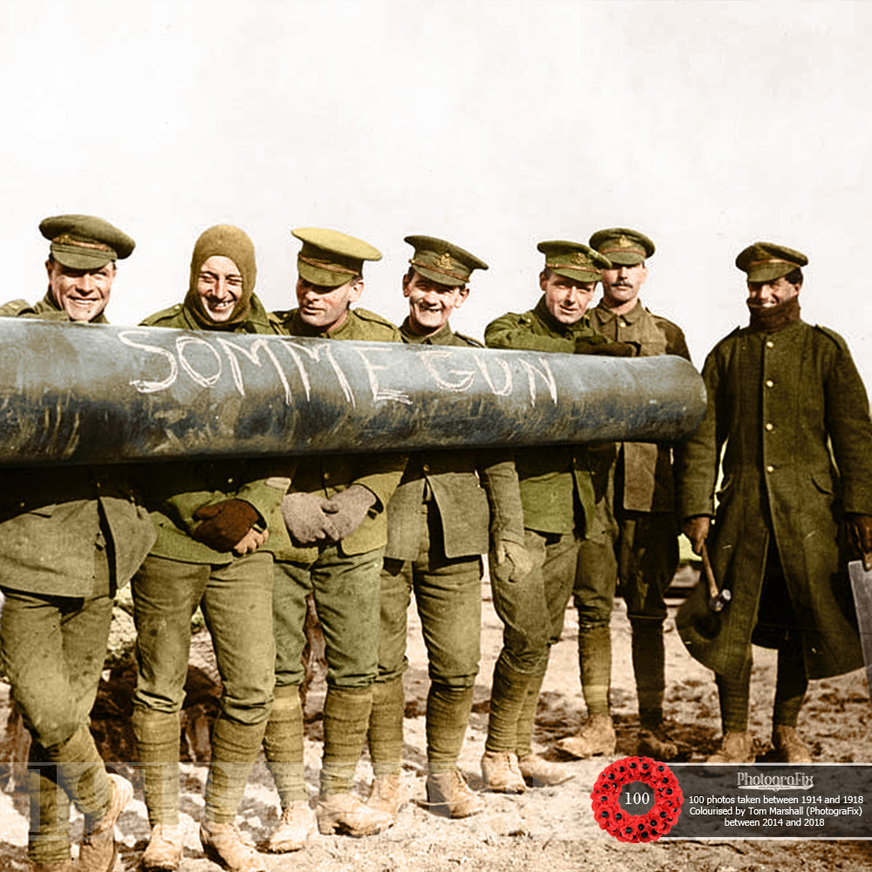
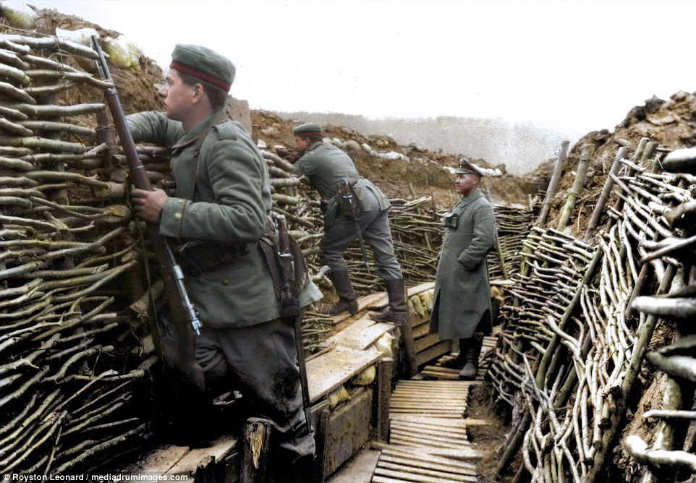

Slide 8
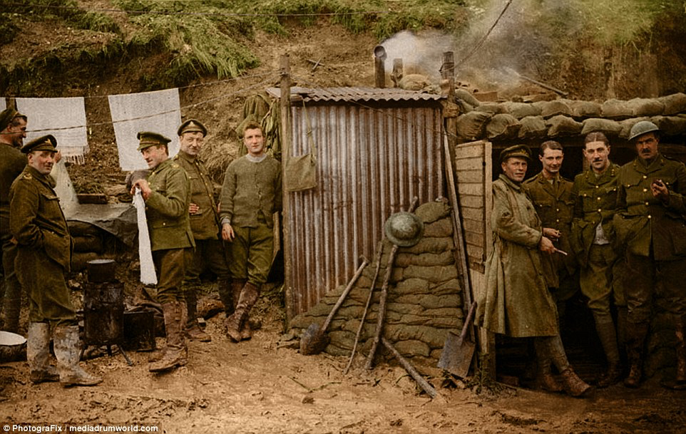

Slide 9
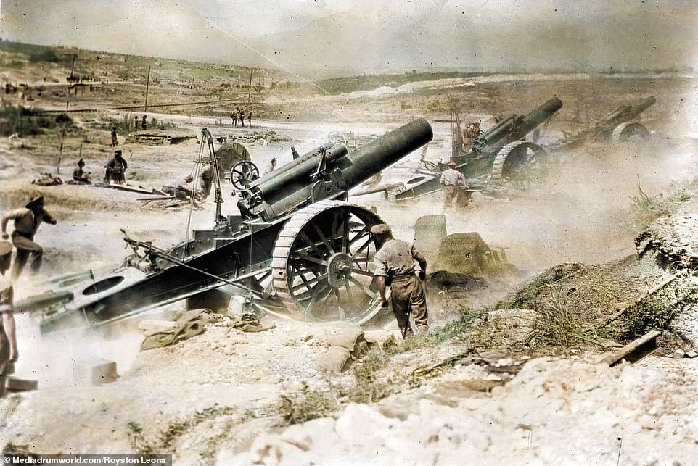
(d) Successes & Failures
The Battle of the Somme began with a massive artillery attack on 24 June, 1916, intended to bombard the German Front-Line for a week, ahead of a July advance. As this was expected by the Germans, they had moved troops away from the Front-Line to specially built, strengthened trenches 12m deep. 1.73 million shells were fired at empty German trenches & General Haig believed that most of the German forces had been wiped. He was completely wrong about this.

Slide 10
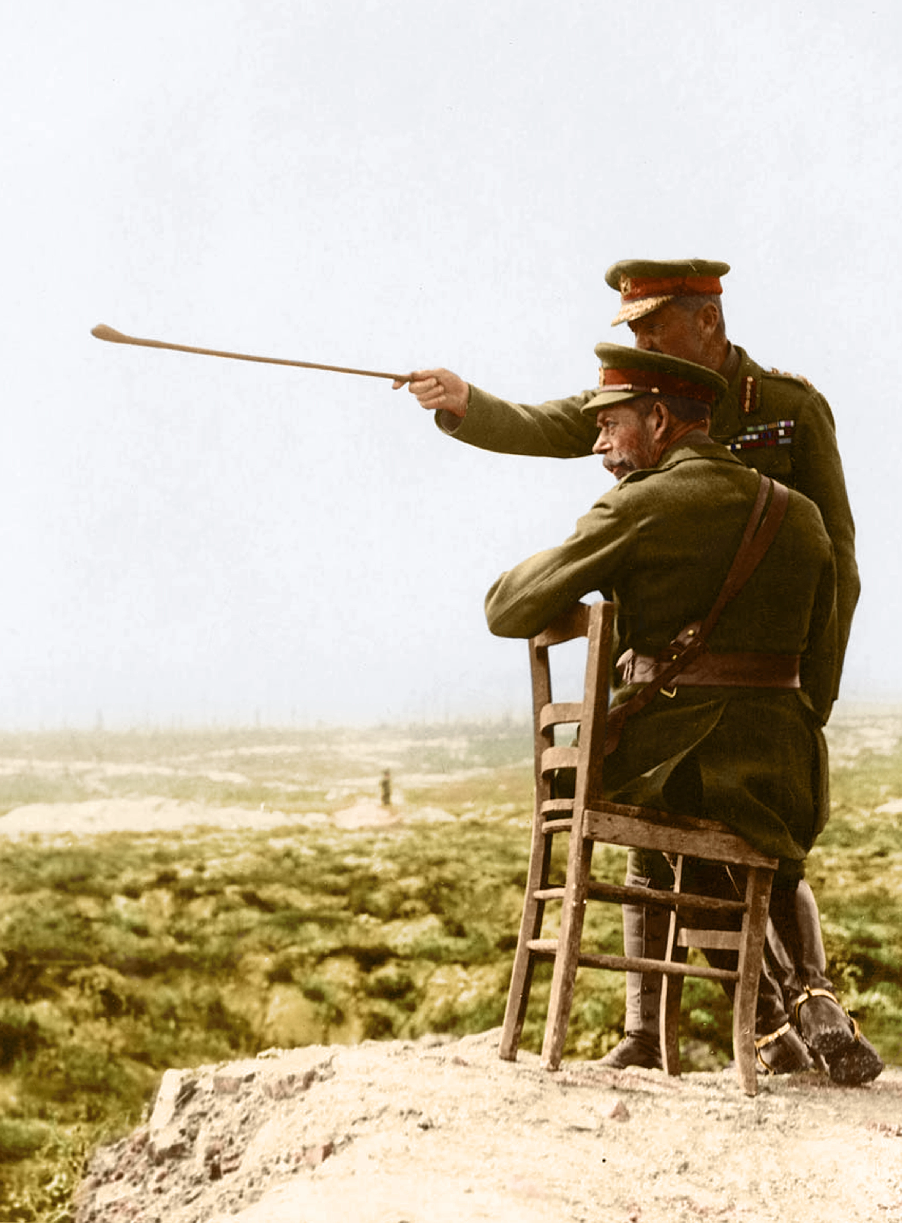
(d) Successes & Failures
The artillery bombardment ended on 1 July. It was the artillery falling silent, however, that signaled the German troops to race to their Front-Line machine-guns. Gen. Haig ordered 200,000 British troops to advance into “No Man’s Land” confident that they were approaching empty German trenches; they were even carrying 30kg of equipment & ordered to walk slowly, rather than run. Thousands of German machine-guns saw the first day of the Battle of the Somme a complete disaster for the British – by dusk on July 1, 57,570 Allied soldiers were dead or wounded, compared to 8,000 Germans.

Slide 11
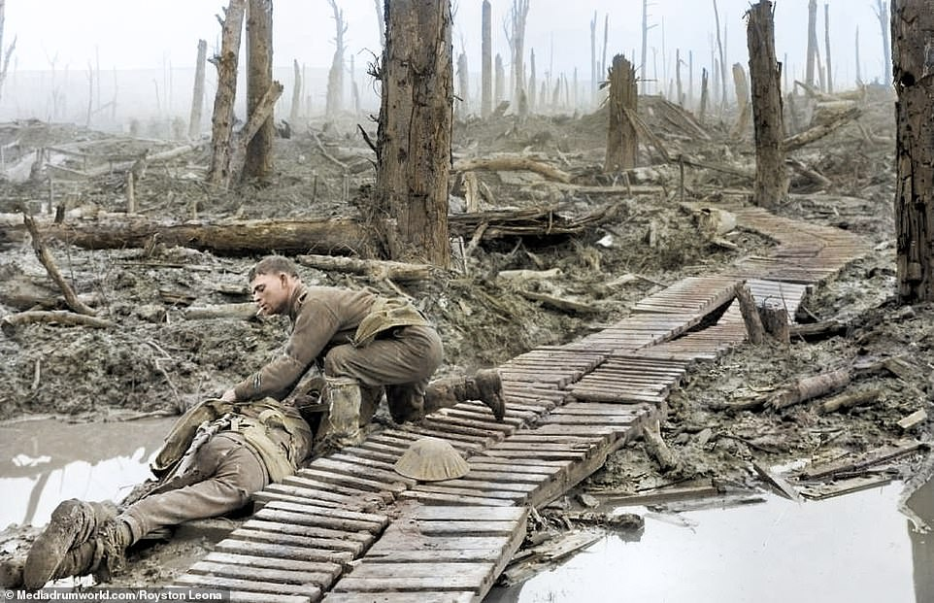

Slide 12
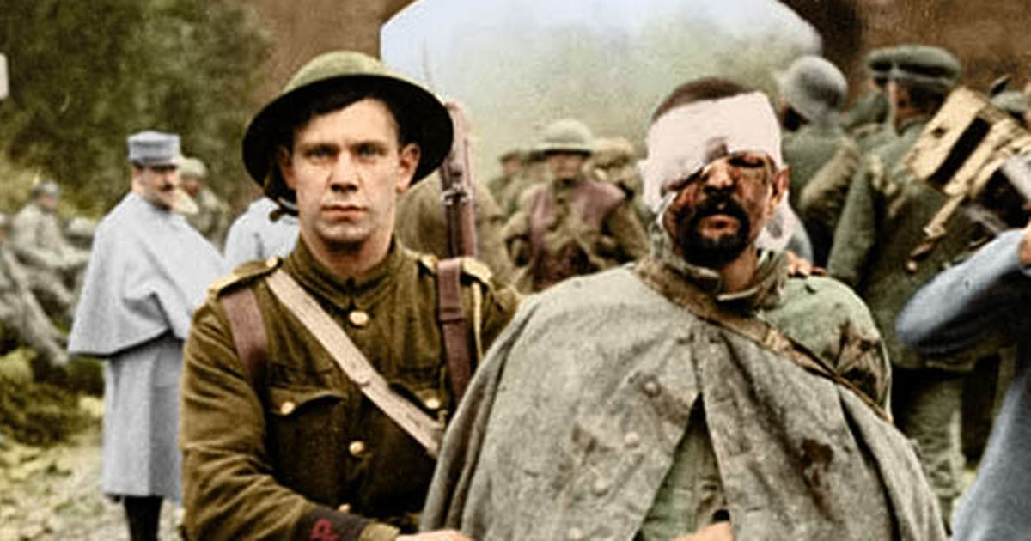
(d) Successes & Failures
General Haig, however, saw no reason to revise his tactics. From July to Nov, he ordered attack after attack with same devastating result. In Sept, 1916, he eventually ignored military experts & he ordered the use of a brand new weapon – the Tank. Only 50 tanks were ready for use … and 29 of these broke down before reaching the battlefield … then the rest got stuck in the mud. By November, both sides were exhausted. 620,000 Allied soldiers & 450,000 Germans were dead or wounded & only 15km of the Western Front was won.

Slide 13
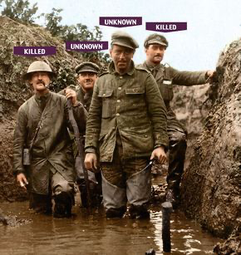
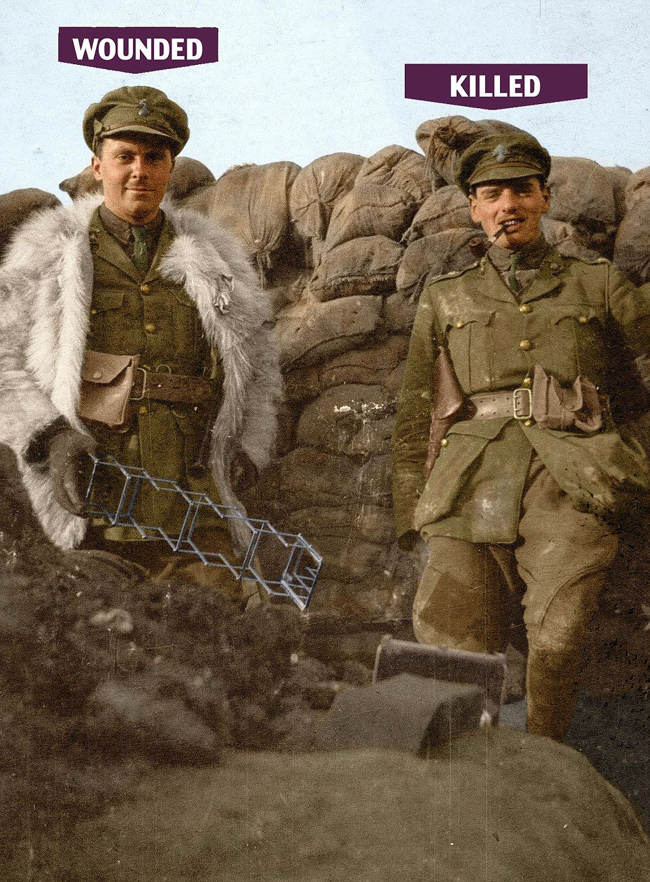

Slide 14
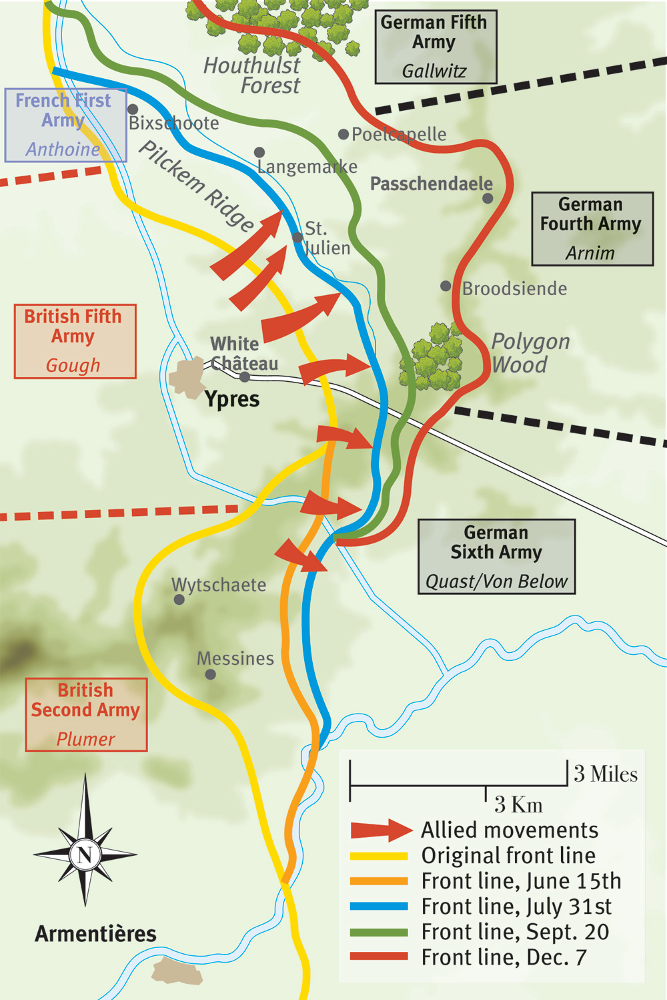
(d) Successes & Failures
One year after the disastrous first day at the Somme, General Haig believed that he could break through the German lines in Flanders & capture costal navy bases at Blankenberge & Ostend. This could end the U-Boat threat. When advised that the land en-route was likely to flood & the Germans were settled in strong, well-constructed trenches, Haig insisted he could win. On 22 July, 1917, Haig ordered an artillery bombardment of more than 400 million shells that last 10 days & turned the already wet terrain into a sea of sludgy mud. Haig ordered an advance … but men were up to their waist & slow-moving.

Slide 15
(d) Successes & Failures
General Haig, however, saw no reason to revise his tactics. From July to Nov, he ordered attack after attack with same devastating result. In Sept, 1916, he eventually ignored military experts & he ordered the use of a brand new weapon – the Tank. Only 50 tanks were ready for use … and 29 of these broke down before reaching the battlefield … then the rest got stuck in the mud. By November, both sides were exhausted. 620,000 Allied soldiers & 450,000 Germans were dead or wounded & only 15km of the Western Front was won.

Slide 16
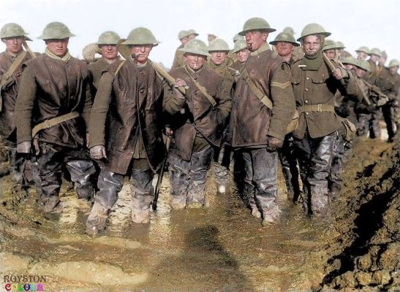

Slide 17
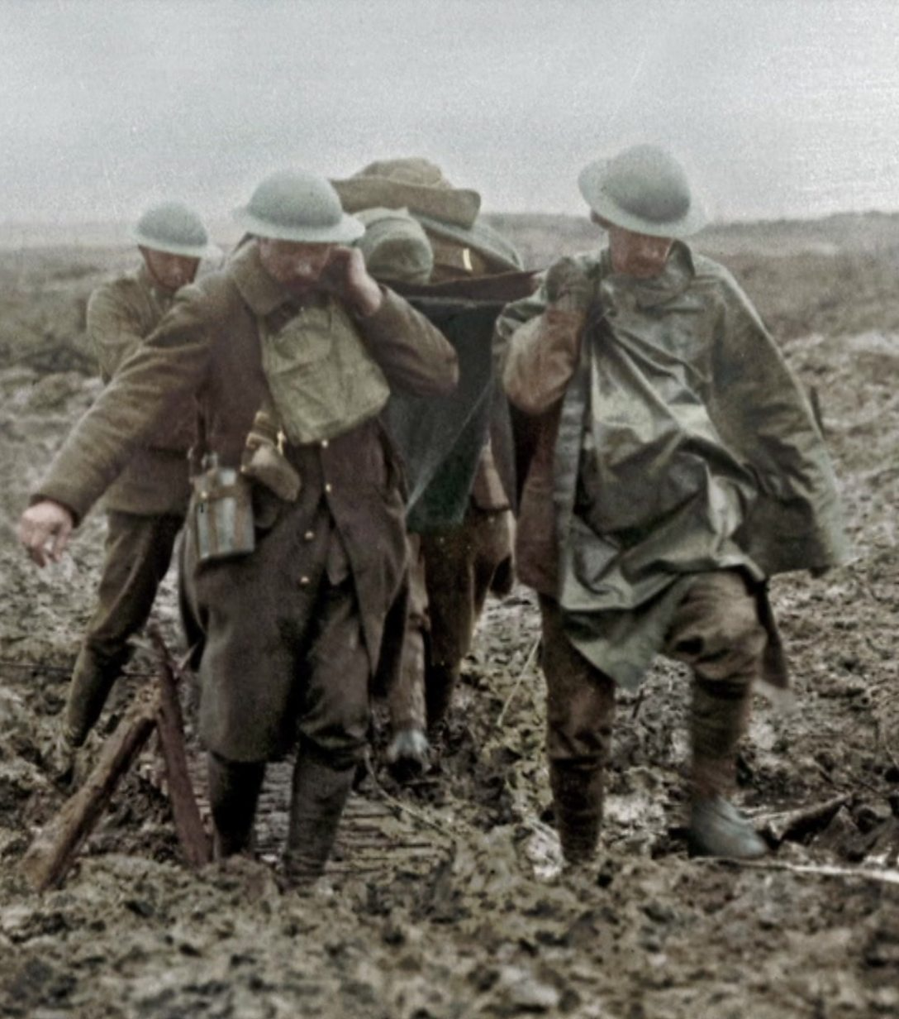

Slide 18
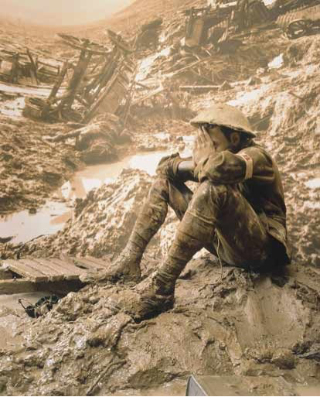
(d) Successes & Failures
The bodies of dead men & dead horses sank into the mud at Passchendaele. Indeed, the battlefield itself began to smell very bad. Generals in their Headquarters, 8km away from the Front-Line, could smell the putrid stench of rotting men & rotting horses. As the fighting continued for 3 months, conditions got worse; men, guns & horses sank into more & more mud. Finally, in Nov. 1917, the Allies captured Passchendaele village from Germany & Haig claimed victory; 240,000 British soldiers were dead or wounded & 220,000 Germans … for 800m of mire. A staff officer sent by Haig gasped “My God, did we send men to fight in that?”

Slide 19
(d) Successes & Failures
General Haig remains a controversial figure in WW1 history, as some see him as “BUTCHER OF THE SOMME” while others see him more heroic & “THE MAN WHO WON THE WAR.” While it is too easy to dismiss Haig due to the vast number of soldiers his policy of “attrition” cost, the new warfare 1914-1918 was always going to cost lives. Disasters in 1916 + 1917 saw Haig respond calmly to the 1918 offensive and, essentially ended the war early, as many expected war to drag on into 1919 or beyond.

Slide 20
Activity 16
http://www.ichistory.com/uploads/1/0/2/9/10290322/haighero__2015.pdf
https://www.birminghammail.co.uk/news/nostalgia/sir-douglas-haig-national-heroor-10619689
What evidence can you find to support
the 2 schools of thought on General
Douglas Haig – Hero or Villain?
Organize your arguments for both sides.
Be ready to argue if General Douglas Haig deserves to be remembered as “Butcher of the Somme” or “The Man who Won the War.”

Slide 21
Butcher of the Somme | The Man who Won the War

Slide 22
Exam-Style Question
The WW1 section of the Exam Paper contains additional EVIDENCE QUESTIONS!
Hint – Remember to ‘quote’ from the sources
& extracts in order to support your views
about the evidence using your knowledge.

Slide 23
1(a) Study sources K and L.
How far does Source K support the evidence of Source L about Haig’s lack of ability to plan a campaign? [8m]

Slide 25
1(b) Study Extract A.
Extract A suggests that Haig was a good general
How far do you agree with this interpretation?
Use sources K and L & your own knowledge to explain your answer.
[16m]

Slide 28
Activity 17 – Recall Quiz
What does B.E.F. stand for?
Which battle was fought close to France, and when?
What was a British field postcard?
What was the WW1 name + the modern name of the psychological condition that made soldiers shake & moan in fear?
Name any 3 types of gas used on the Western Front.

Slide 30
Activity 17 – Recall Quiz
What was a “barrage”?
Name the town that the French armies were determined to defend at all costs in 1916?
On what dates did the Battle of the Somme begin & end in 1916?
Who was David Lloyd George?
When did the Battle of Passchendaele begin & end in 1917?

Slide 32
Activity 18 – Explaining
Why was there stalemate on the Western Front by December 1914?
Give two examples of problems faced by soldiers living in the trenches.
What was the purpose of an artillery bombardment?

Slide 34
Activity 19 – Challenge
Explain how disease became a problem in the trenches during WW1.
How important were tanks as a weapon of war during WW1?
To what extent was Haig’s leadership responsible for huge casualties in (a) the Somme + (b) Passchendaele?

