Slide 1
Edexcel IGCSE History P2: Breadth Study A1
The Origins & Course of WW1,
1905-1918

Slide 2
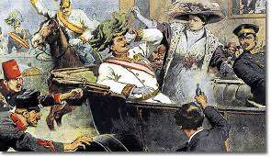
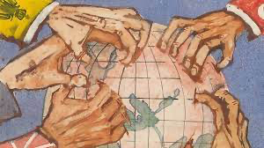
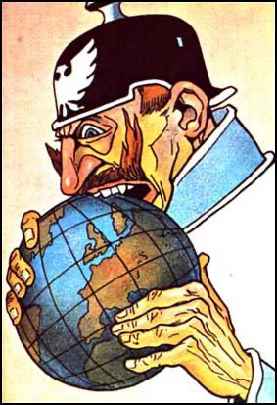
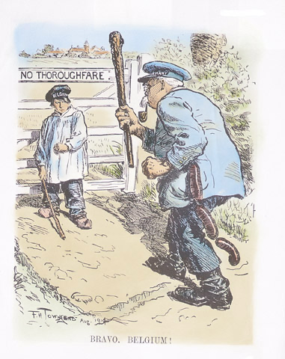
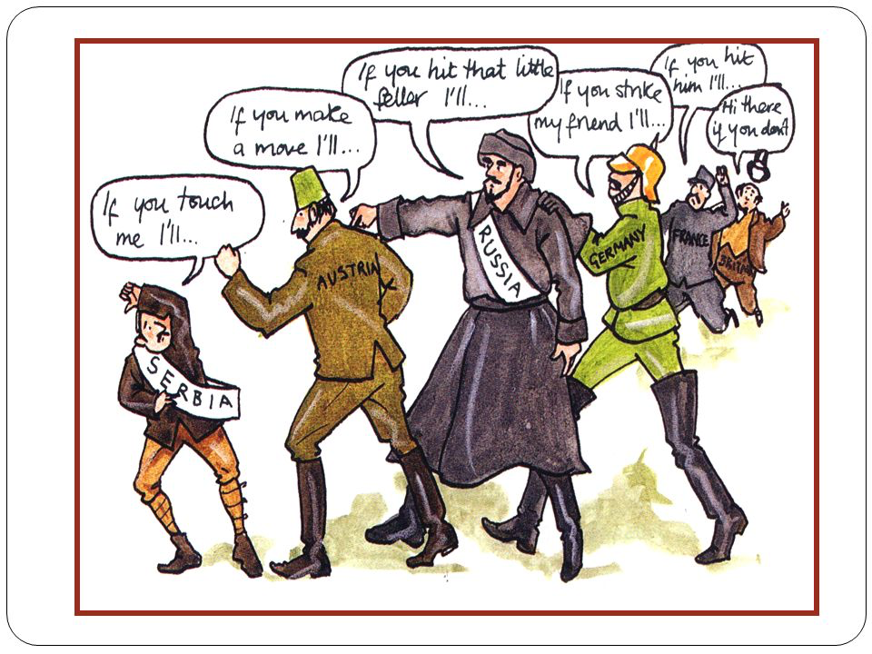

Slide 3
Edexcel IGCSE History P2: Breadth Study A1
The Origins & Course of WW1,
1905-1918
3.3 New Weapons & Methods

Slide 4
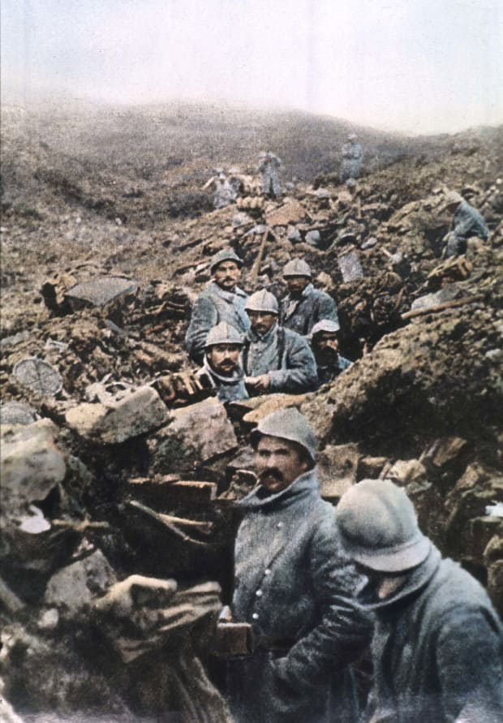
(c) New Weapons & Methods
In 1914, both sides’ generals were confident that the War could be won by quick-moving Armies. By the start of 1915, however, there were millions of men dug into trenches & facing each other across “No Man’s Land.” Many thought that TECHNOLOGY would be the key to breaking the stalemate; others disagreed & assumed ATTRITION was the only option left – continual attacks would weaken the enemy enough to see them surrender. Unfortunately, both technology & attrition would lead to huge numbers of dead & wounded on both sides.

Slide 5
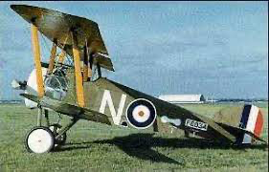
(c) New Weapons & Methods
AIRCRAFT
The first plane had flown just 11 years before WW1 began, so nobody knew if the 100 or so the ‘Great Powers’ had would be important. They were made of wood, cloth & piano-wire after all! Cockpits were open & pilots had to wear warm clothes, thick gloves, leather helmets & goggles to stop them freezing to death in the air. Engines were unreliable & there were no parachutes – courage was essential just to fly one, let alone fight in one.

Slide 6
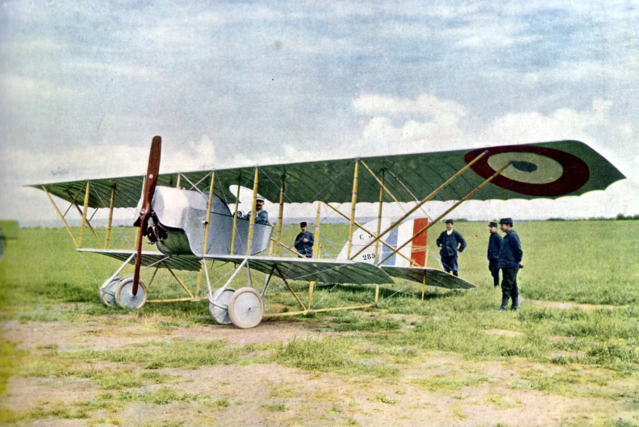
(c) New Weapons & Methods
AIRCRAFT
The British Royal Flying Corps & the German Flying Corps used planes as the “eyes of their armies.” Able to fly high above the enemy trenches and report back on troop movements & trench systems, planes were mostly used for reconnaissance. During a Battle, however, planes could advise on whether the enemy was advancing, attacking, regrouping or retreating.

Slide 7
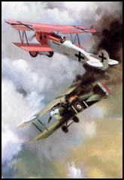
(c) New Weapons & Methods
DOG FIGHTS
The first airmen were armed with revolvers or machine-guns (or bombs) to use from their cockpits. Gradually, planes developed into fighting machines. Antony Fokker, a Dutch engineer working for the Germans, invented a mechanism to fire between the blades of a spinning propellor. Dog fights between fighter planes above the trenches were common and, by 1918, pilots were famous for shooting down the enemy – Baron von Richthoven (80) Rene Fonk (75) & Mick Mannock (73). By 1916, pilots could expect to live for just 3 weeks. By 1918, over 10,000 planes were used & over 50,000 airmen dead.

Slide 8
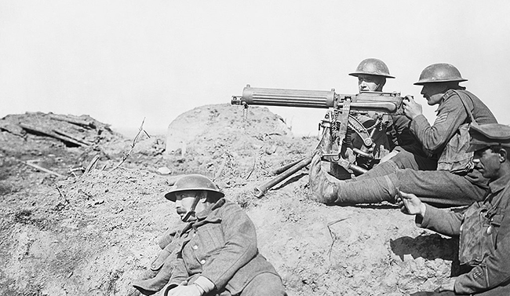
(c) New Weapons & Methods
MACHINE-GUNS
All soldiers were given rifles, bayonets & hand-grenades, but these were of little use until they had crossed “No Man’s Land” to use them directly. Being out in “No Man’s Land” was the problem – as machine-guns could effectively wipe out a whole battalion. At first, the British Army weren’t impressed by them – heavy, difficult to transport & frequently broke down or jammed – but then lighter versions proved more reliable. The British VICKERS machine-gun fired 450-600 rounds per minute over 2000m. When both sides started using them, however, stalemate.

Slide 9
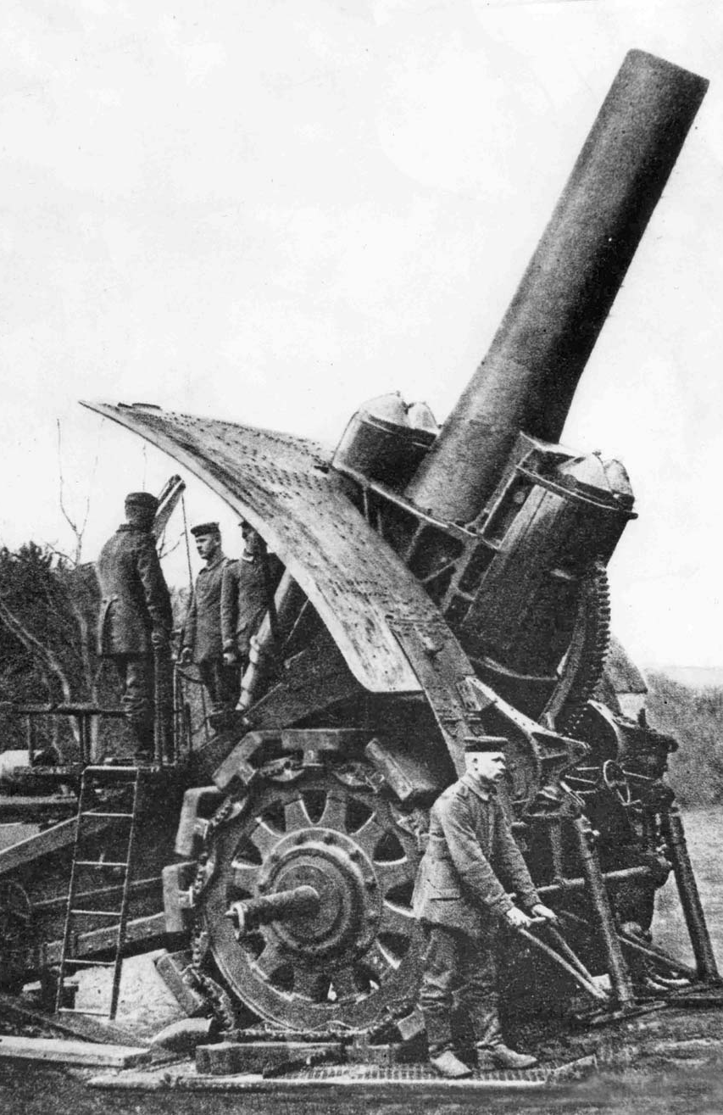
(c) New Weapons & Methods
ARTILLERY
The ‘Great Powers’ began the war using artillery (mobile field guns) that fired about 6 shells per minute & were fairly accurate. Once trenches were dug in December 1914, however, they were of little use. Larger & more powerful guns were developed to bombard from further & further away. Germany’s “Big Bertha” could fire a 108kg shell 132km. An artillery attack (or BARRAGE) on trench systems was not always effective – when aiming to destroy barbed-wire defenses, artillery fire merely left wire unbroken & churned up the mud. In 1916, the British FUSE 106 developed – causing shells to explode parallel to the ground & was more effective in destroying barbed wire; widely used on the Western Front by 1917.

Slide 10
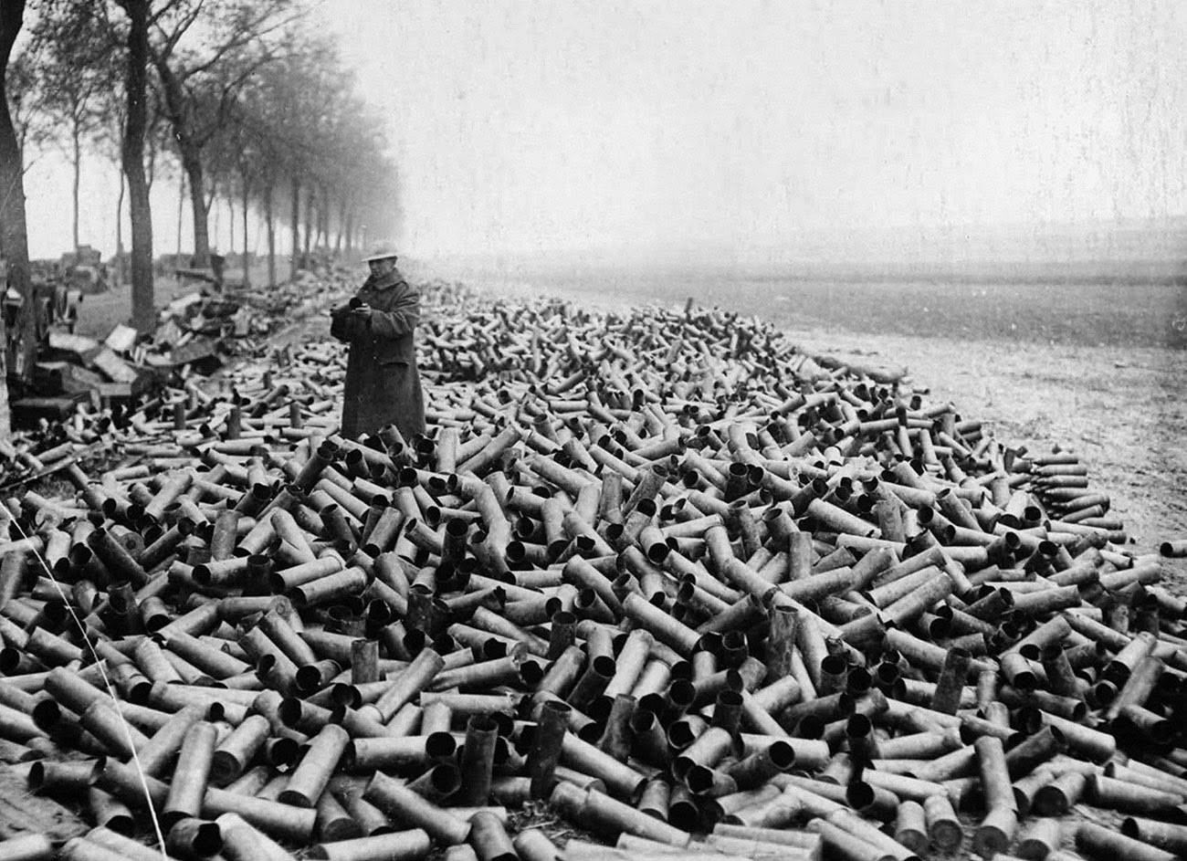

Slide 11
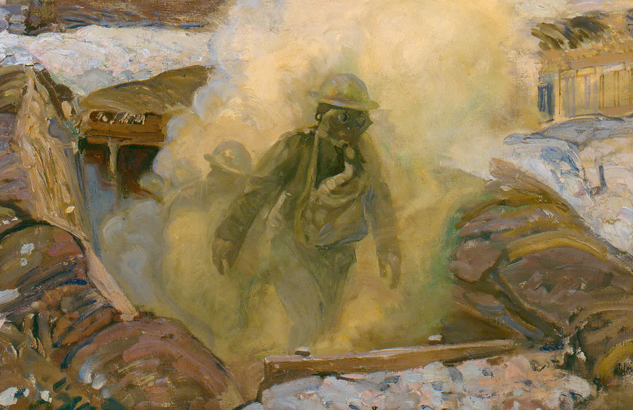
(c) New Weapons & Methods
GAS
Poison gas was useful as a weapon of war, more because of the fear & panic it created than the casualties it caused. Sir John French, B.E.F. Commander, said the use of gas was “a cynical & barbarous disregard for the well known usages of civilized war” but, soon, both sides were using gas. It was first used at 2nd Battle of Ypres, April 1915 – hundreds of French & Algerian troops suffocated in thick green clouds of chlorine gas; Canadians later that month; and British troops in May, 1915. After that, both sides used chlorine, phosgene & mustard gas to disorientate troops.

Slide 12
Activity 13
Clara Haber (1870-1915) was a
German Scientist, married to
fellow Scientist, Fritz Haber.
Find out what happened to Clara Haber.
What does this story tell you about
attitudes to First World War weapons?

Slide 13
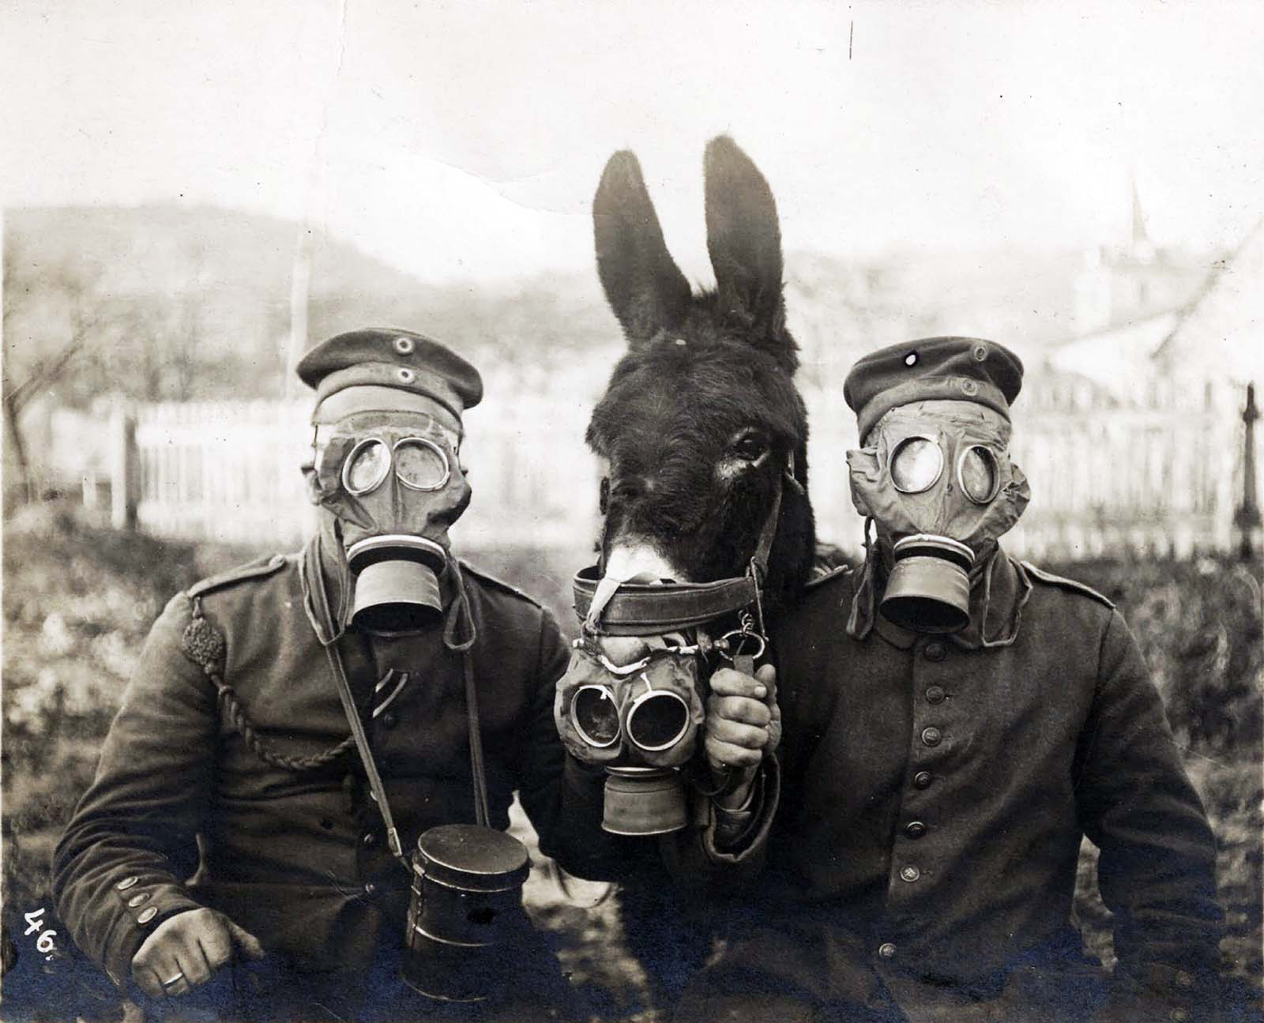
(c) New Weapons & Methods
GAS
Whilst it was quite terrifying to the enemy, gas was rather unreliable:
In damp weather. Gas clouds would move slowly towards the enemy at knee height.
If the wind changed direction, troops would gas their own comrades.
Gas alarms & Gas masks reduced the risk to troops, however, so gas was only ever a real distraction to aid snipers complete kills.
Early gas masks were cloths soaked in urine & soldiers often removed them … only to die.

Slide 14
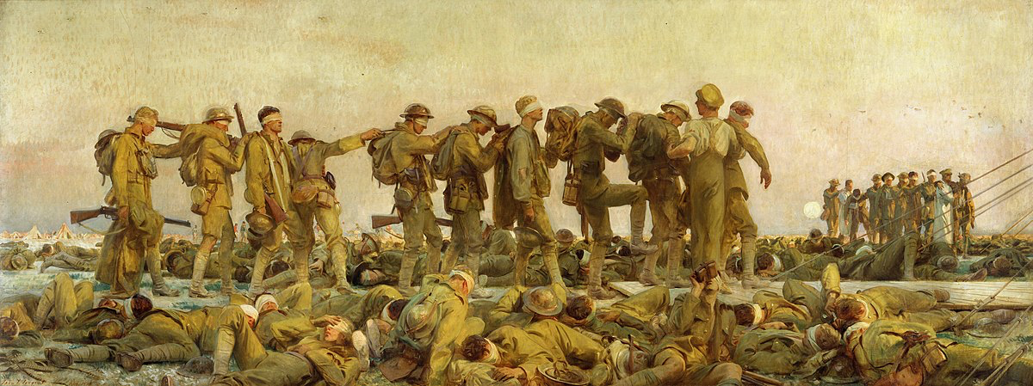

Slide 15
Activity 14
Gas! Gas! Quick, boys! – An ecstasy of fumbling,
Fitting the clumsy helmets just in time;
But someone still was yelling out and stumbling
And flound’ring like a man in fire or lime …
Dim, through misty panes and thick green light,
As under a green sea, I saw him drowning.
How does Wilfred Owen create panic & fear?

Slide 16
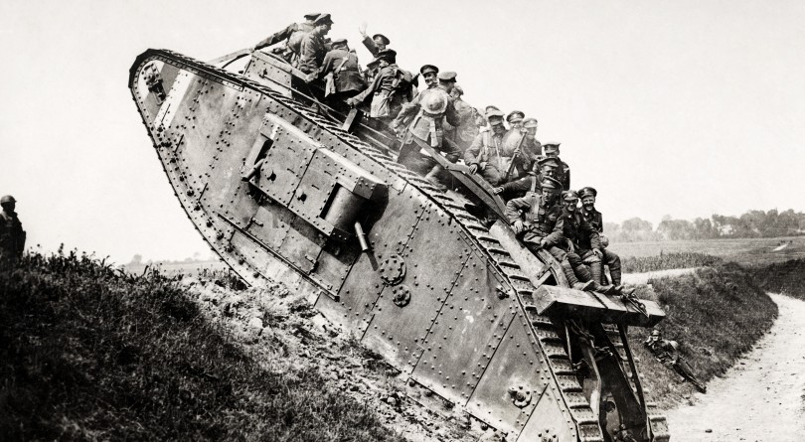
(c) New Weapons & Methods
TANKS
The most significant attempt to end stalemate of trench warfare was Lt.-Col. ERNEST SWINTON designing an armed vehicle that could cross difficult ground. They were called “Tanks” as they were disguised as water-tanks in transportation. 50 were used at the Battle of the Somme, July 1916, but they were a complete failure. At the Battle of Cambrai, Nov. 1917, more than 400 Mark IV tanks smashed through German trenches & pushed them back 8km. German Generals claimed the use of tanks “was to admit all proper military tactics had failed.” German tanks were used in March 1918, but it was almost too late.

Slide 17
Activity 15
List all the new weapons of WW1.
Next, number them in order of
most to least dangerous to soldiers.
Finally, explain which new weapon of WW1 was most significant and explain why.

