Slide 1
Edexcel IGCSE History P2: Breadth Study A1
The Origins & Course of WW1,
1905-1918

Slide 2
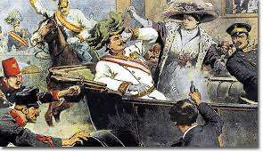
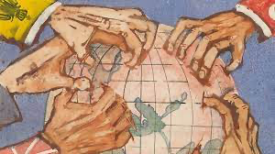
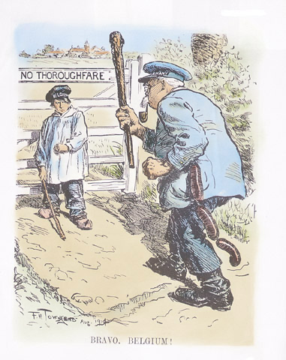
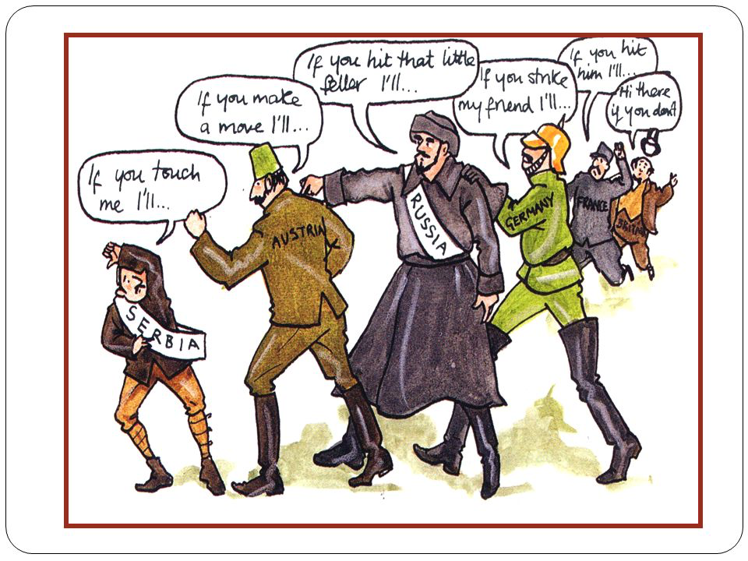

Slide 3
Edexcel IGCSE History P2: Breadth Study A1
The Origins & Course of WW1,
1905-1918
3.2 Living in the Trenches

Slide 4
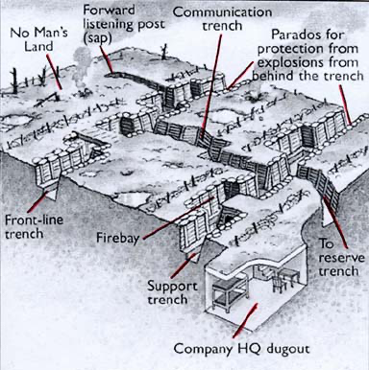
(b) Living in the Trenches
In the winter of 1914, both sides dug in along the Western Front and created a complicated system of trenches. British & French trenches were usually 2m deep + 1.8m wide, while German trenches were often deeper & wider.
Trench systems had a front-line, where most of the fighting took place; communication, reserve & support trenches behind front-lines, including kitchens, field hospitals & battalion headquarters or the Company HQ dugout.

Slide 5
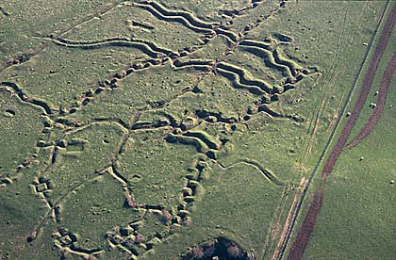

Slide 6
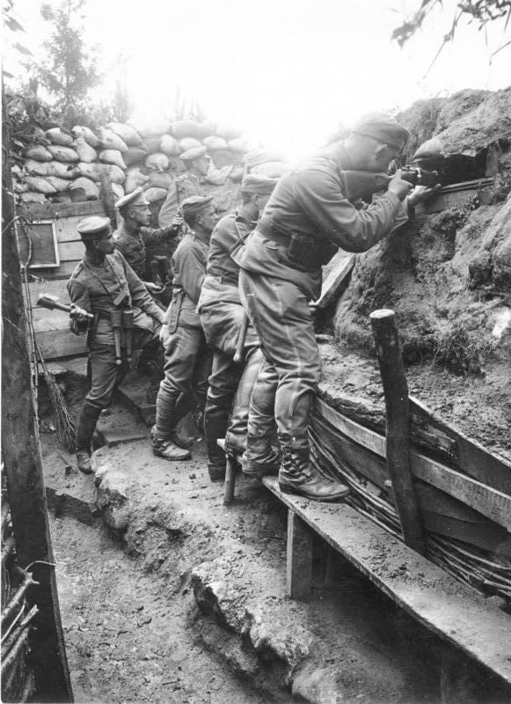
(b) Living in the Trenches
The top of a front-line trench was protected by sandbags, to absorb enemy bullets. In front of the sandbags was barbed-wire, to trap any soldiers who made it across “No Man’s Land” – the area between the German & Allied front-line trenches. In “No Man’s Land” there were “small posts”, for listening to the enemy, in the hope of gaining an advantage the next day. Rest for soldiers came from very brief moments in the dug-out. The whole trench system was dug in a ‘Z’ pattern, to prevent firing straight down a line if a trench was captured by the enemy.

Slide 8
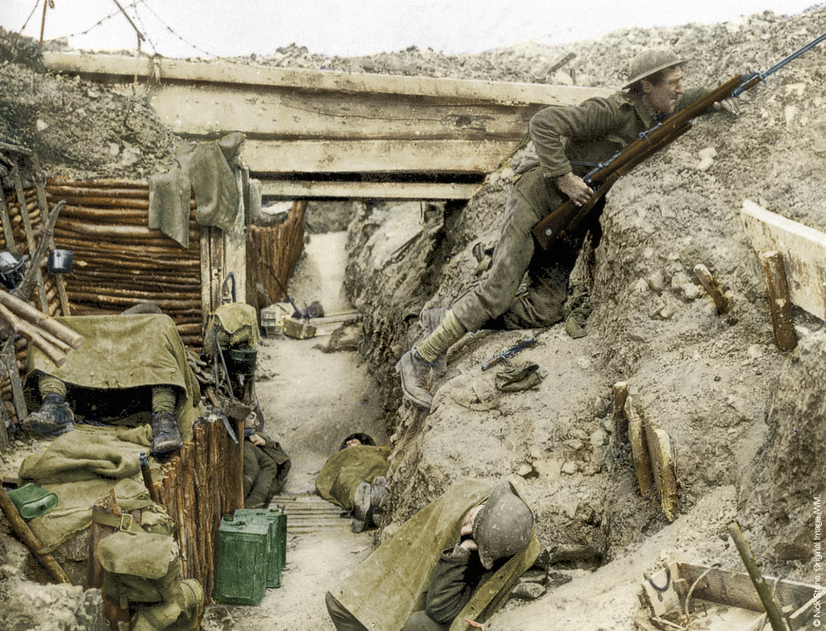
(b) Living in the Trenches
The trenches dug in December 1914 were a reaction to the DEADLOCK in the fighting on the Western Front:
After the failure of the Schlieffen Plan, neither side aimed to win the war – just consolidate, without losing territory.
Trench systems were very difficult to attack & troops crossing “No Man’s Land” were likely to die before reaching the enemy.
Attacking weapons in WW1 were not as effective as defensive weapons – the machine-gun proved a decisive defense.

Slide 9
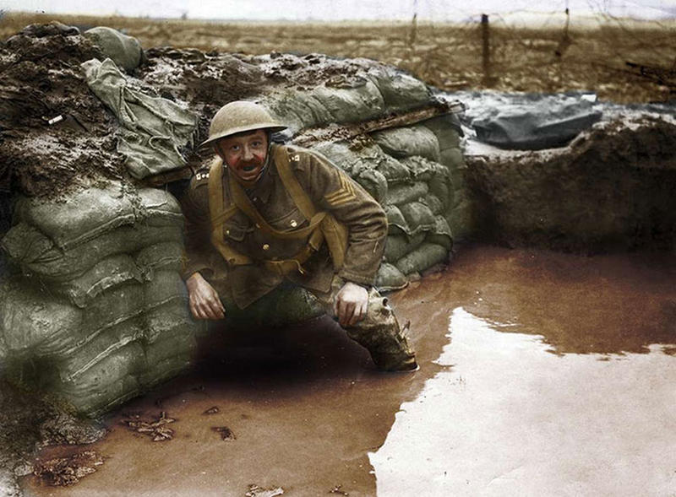
(b) Living in the Trenches
The trenches dug in December 1914 were a reaction to the DEADLOCK in the fighting on the Western Front:
The geography of the area between Belgium and France made advances very difficult – Flanders is particularly wet & the Germans had secured the “high ground” which left the boggy, muddy mire for the Allied forces to dug in & churn up.
Generals on both sides only understood “old” warfare (hand-to-hand combat & cavalry charges) so were ill-equipped to work out a way forward in trench warfare.

Slide 10
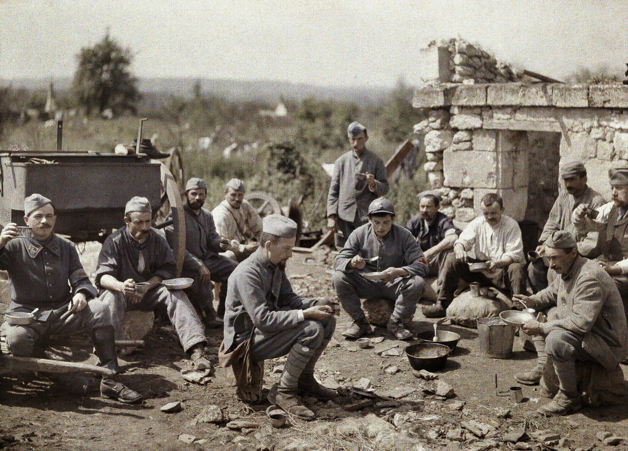
(b) Living in the Trenches
British Soldiers on the Western Front did not spend their entire time in the trenches:
4 days in Front-Line trenches
4 days in Support trenches
8 days in Reserve trenches
14 days resting
If a Battle was taking place, however, every soldier had to remain in the Front-Line trenches & fight. Although terrifying during a Battle, trenches saw very little happen on a daily basis.

Slide 11
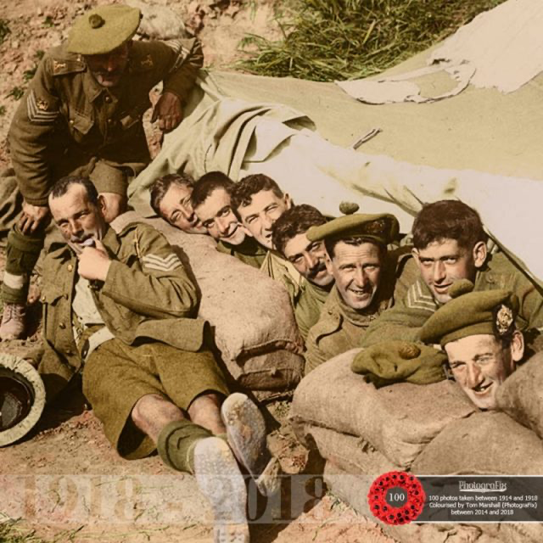
(b) Living in the Trenches
Boredom was one of the most difficult aspects of living in a trench for many soldiers. Routine work – like sentry duty, trench repair & moving supplies around soon became a monotonous regime. At night, the Front-Line trenches were full of silence & fear. Night Patrol consisted of selected groups crawling through mud, filth & shell-holes (past decaying bodies) to spot enemy activity. Night Attacks saw soldiers overwhelm enemy trenches, take prisoners & try to gain advantageous information to report back.

Slide 12
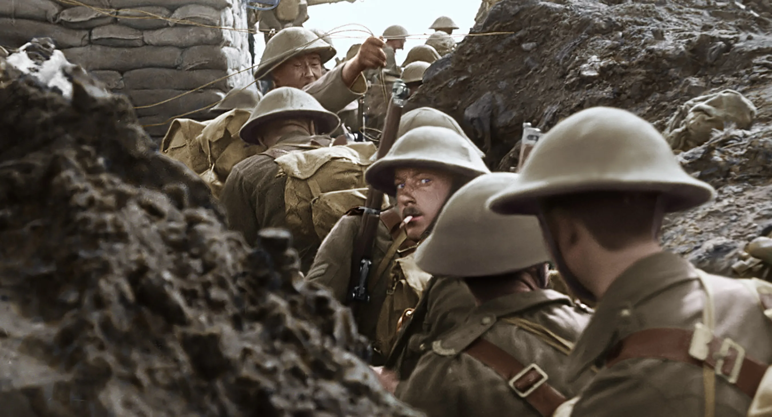

Slide 13
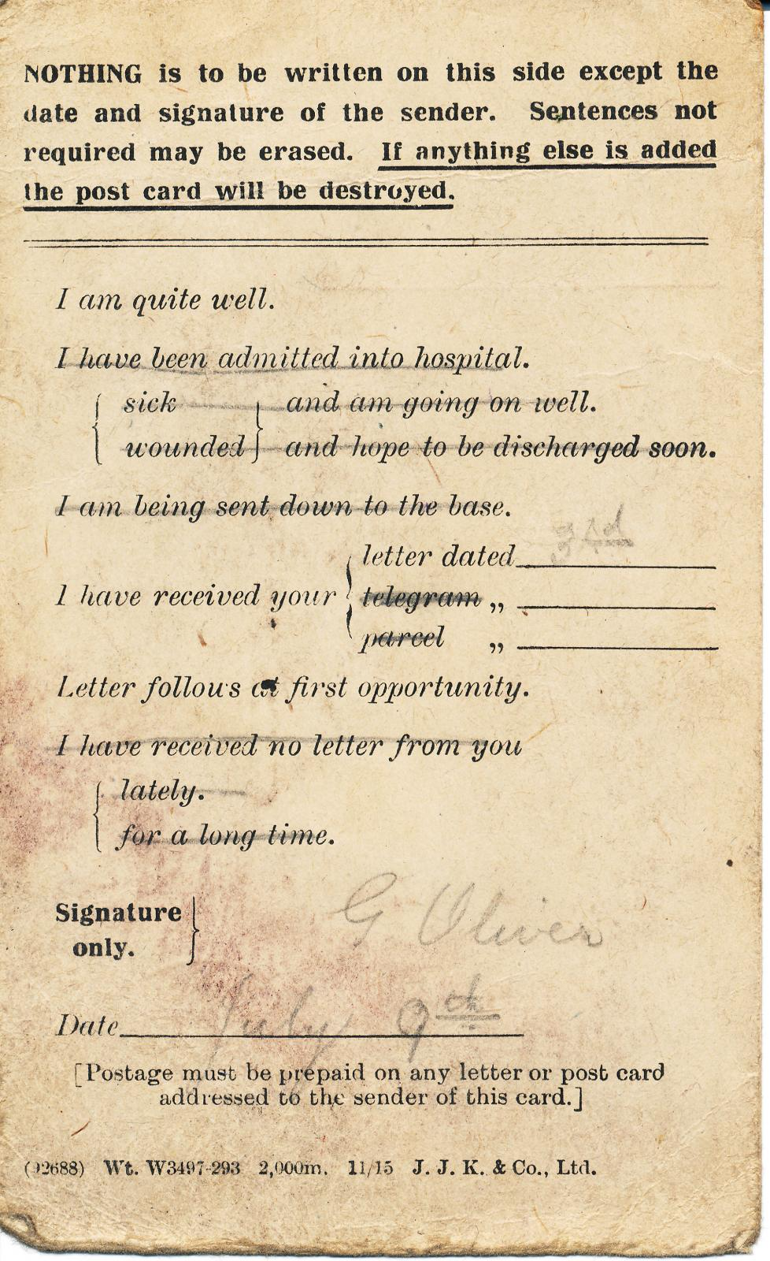
(b) Living in the Trenches
Soldiers never knew when they would get home to see their loved ones. From the Front-Lines, troops could only send field postcards, but those further back from the fighting could write letters home. Such letters were often CENSORED by the Authorities, to ensure that nothing that was useful to the enemy was accidentally given away. Families & Organizations, on both sides, sent parcels of “luxuries” to the troops. The British Red Cross & the German Deutsches Rotes Kreuz sent razor-blades, soap, cigarettes, chocolate, cake, hand-knitted socks & hand-knitted gloves. These really boosted morale on both sides.

Slide 14
Activity 11
Dear Ma & Pa, Here I am feeling the cold in a wooded area just outside Montreuil, where the friendly French soldiers are loading rifles with us ready to attack the German pigs at 10pm. This night attack should go well this time, as we know the enemy positions and have at least 4 battalions more than them. Hope that your dog is better after his amputation – our General Dobbs had his leg off, like the dog, after coming down with trench foot! Poor General Dobbs can’t run any more! Lots of Love to everyone at home, Bernard.
What needs to be censored above?

Slide 15
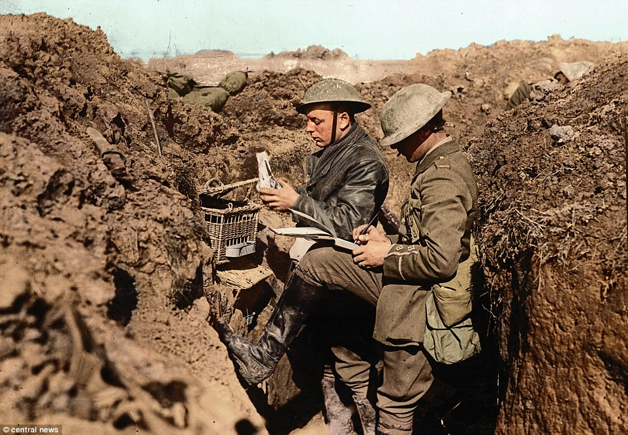

Slide 16
Activity 12
A group of British soldiers
produced “Wipers Times” to
give to their fellow troops.
Find out what the “Wipers Times” was.
How did it help boost British morale?

Slide 17
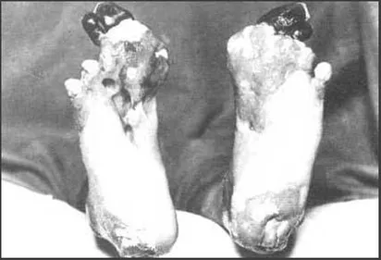
(b) Living in the Trenches
Trenches were not healthy places to live. Troops had face the cold, the mud & the side-effects of sleeping rough in dug-outs. The ground at Flanders was simply a sea of mud – men & horses drowned in it; boots, coats & socks became coated in it and could not be replaced or cleaned easily; and, worst of all, it caused TRENCH FOOT. Men who stood for hours in very wet trenches, unable to change their socks & boots ended up with feet that went numb, turned red & blue … and, if not treated, went gangrenous & amputation was necessary. In winter 1914-1915 over 20,000 men in the British Army suffered trench foot.

Slide 18
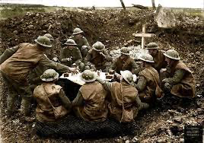
(b) Living in the Trenches
Soldiers often went without decent food to sustain themselves on the Western Front, too, due to difficulties moving supplies up communication trenches to the Front-Line trenches.
Standard fare was bully beef, hard biscuits, margarine & jam (plus some occasional bacon & cheese). Tea was drunk in vast quantities and sweetened with condensed milk.
Regular hot meals were only available from Army Field Kitchens away from Front-Line trenches.

Slide 19
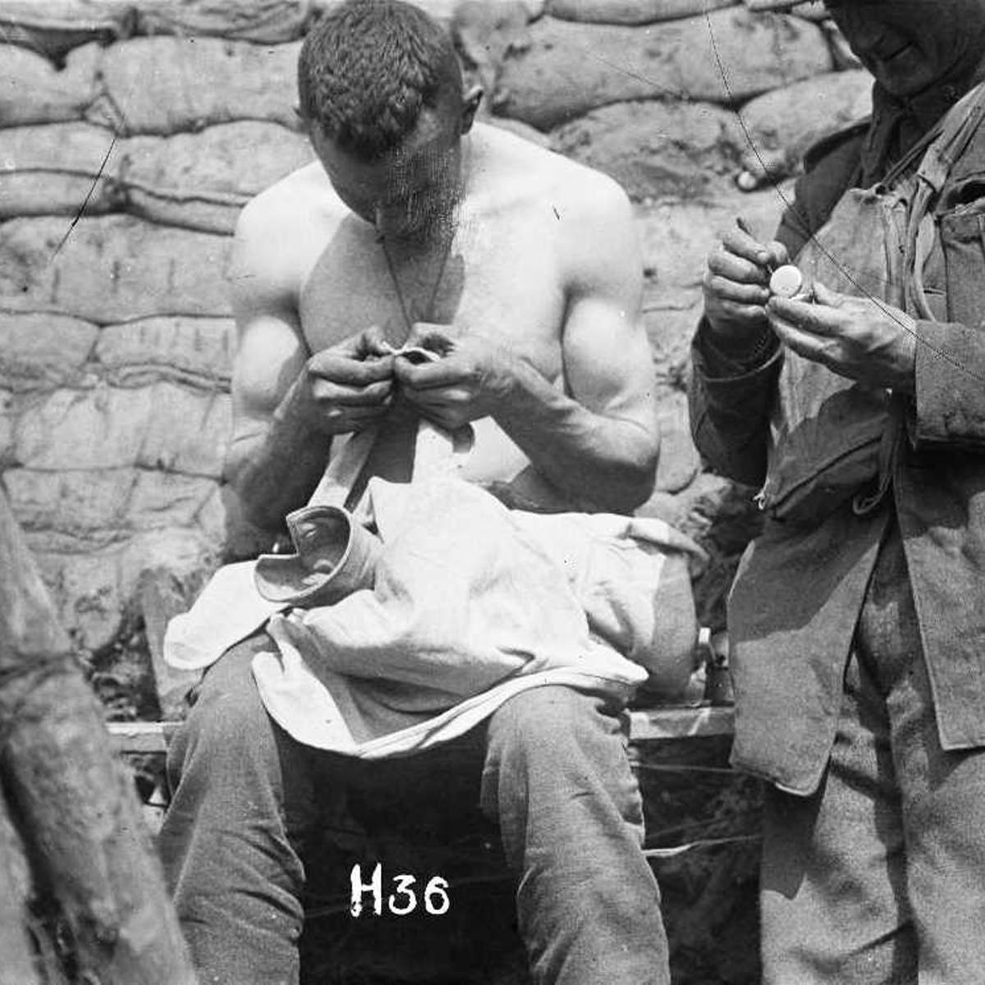
(b) Living in the Trenches
Keeping clean was pretty much impossible and most soldiers were infected with body lice that buried under the skin & sucked blood. Lice were found in warm places on a soldier’s body or in the seams of clothing. It was common for over 100 lice to be crawling about on a single soldier. There was only 2 ways to kill such a louse – to squash it or burn it (by candle/cigarette). Rats also ran rampant in trenches – grown fat on decaying body or by stealing scraps of food, they also increased diseases too. Finally, flies were everywhere too – horses created 40 tons of manure each day & flies were multiplying in the muck as quickly as maggots formed in the dead.

Slide 20
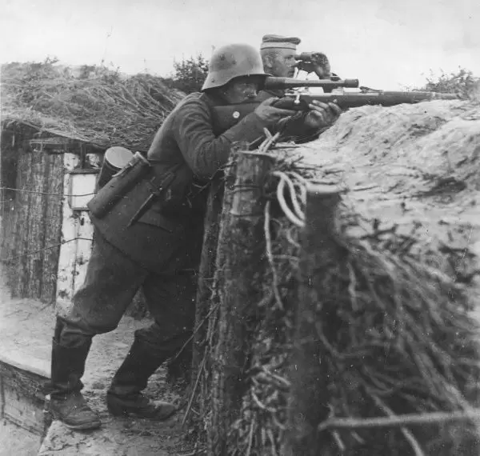
(b) Living in the Trenches
The threat of sudden death hung over ever soldier – either from planned enemy attack or from a sniper’s bullet. One of the most dangerous activities at night was smoking, as it gave a sniper a perfect glow to aim for! The thought of going “over-the-top” as part of a move across “No Man’s Land” terrified many soldiers, as they knew it could be their last move in the war. Men had to live with the sight, sound & smell of dead, dying & wounded soldiers every day. Treading on the dead was horrific.

Slide 21
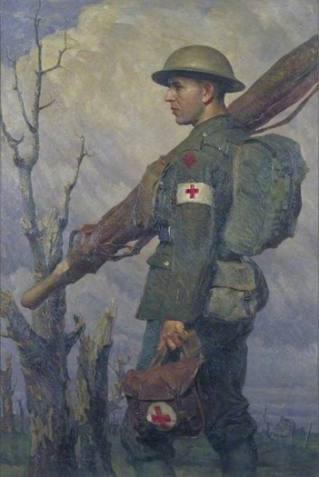
(b) Living in the Trenches
During a Battle, most casualties occurred in “No Man’s Land” and, at night, stretcher parties had to search for the wounded who were unable to return to their trenches. Those lucky enough to be rescued were taken back, through all the communication trenches, where Medical Officers assessed who needed further treatment & who could be given first aid & return to the Front-Line. Those seriously wounded were sent to Casualty Clearing Stations, several km away, but those who could be operated on at the CCS. The worst affected soldiers were transported by train to a Base Hospital to recover. Many, however, died from their wounds or from infection – without Antibiotics, dirt & filth killed.

Slide 22
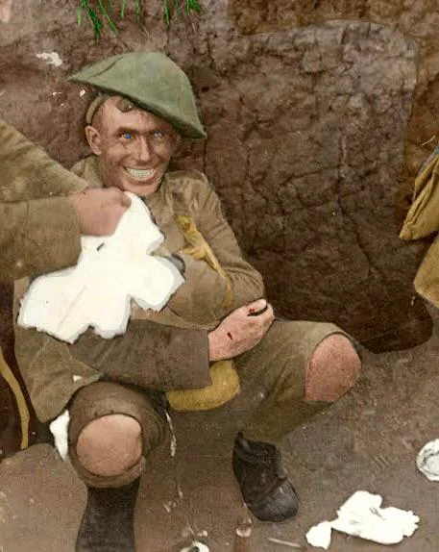
(b) Living in the Trenches
The fear of death & the death of friends were the worst things that soldiers had to live with. Many simply couldn’t cope: hands shook & eyes twitched; mouths fell dumb & ears fell deaf; rocking & moaning & shivering uncontrollably; reliving the horrors over & over again. This condition was SHELL-SHOCK. At first, sufferers were branded as cowards but, gradually, doctors accepted it as a psychological condition. Men suffering shell-shock were removed from the Front-Line for treatment, but some never recovered from this “P.T.S.D.”

Slide 23
(b) Living in the Trenches
Some soldiers simply couldn’t cope with the First World War & DESERTED due to:
Fear
Shell-shock
Problems at home
Utter exhaustion
Deserted were dealt with by Firing Squad. 1914-18, 346 British soldiers were shot for desertion.

