Slide 1
Edexcel IGCSE History P2: Breadth Study A1
The Origins & Course of WW1,
1905-1918

Slide 2
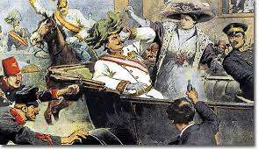
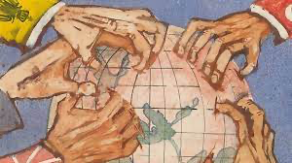
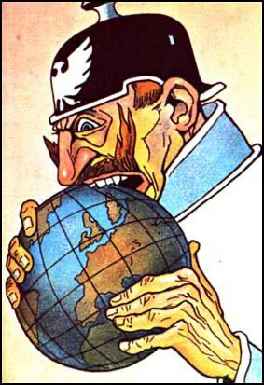
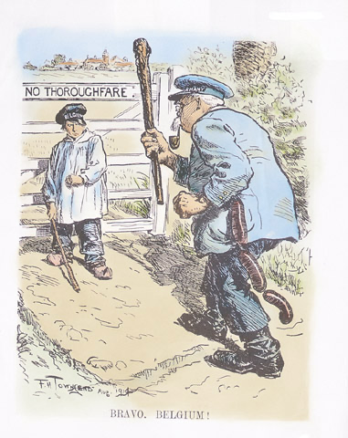
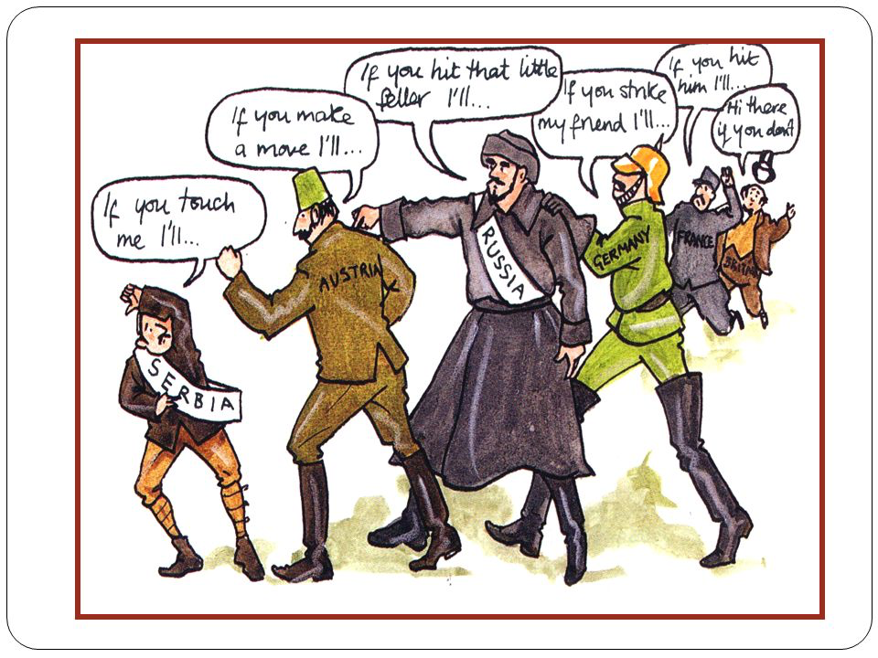

Slide 3
Edexcel IGCSE History P2: Breadth Study A1
The Origins & Course of WW1,
1905-1918
3.1 The Schlieffen Plan Fails

Slide 4
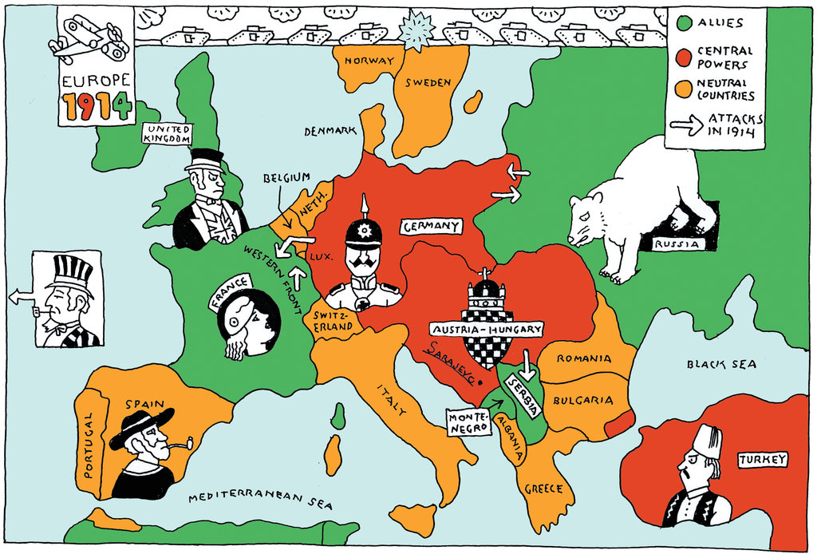
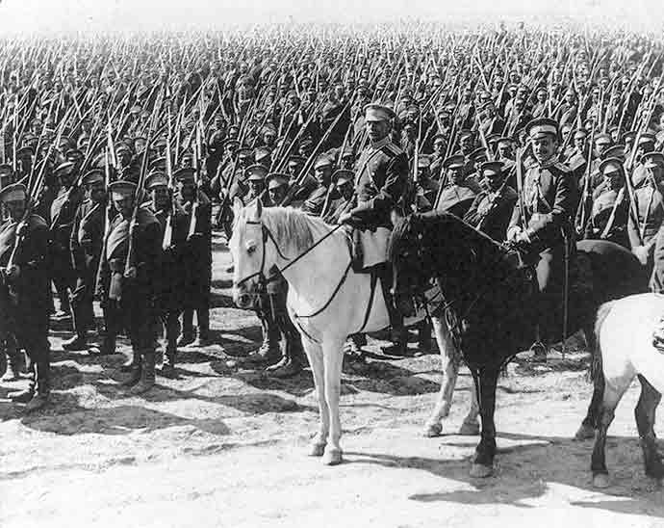
(a) The Schlieffen Plan fails
From the moment that war was declared, the Great Powers put their war-plans into operation. Thousands of men & MOBILISATION had begun.
Britain sent 4 Infantry divisions + 1 Cavalry division to France – this meant 80,000 men + 30,000 horses landed at French ports & headed for the border between France & Belgium.
France gathered 1,000,000 soldiers on the German border, ready for an invasion of Alsace-Lorraine.
Germany sent 3 enormous Armies through Belgium – 1 to meet the British + 2 heading towards the French forces.

Slide 5
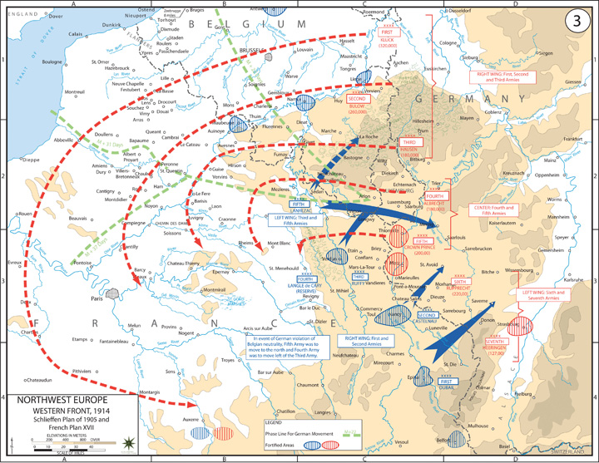

Slide 6
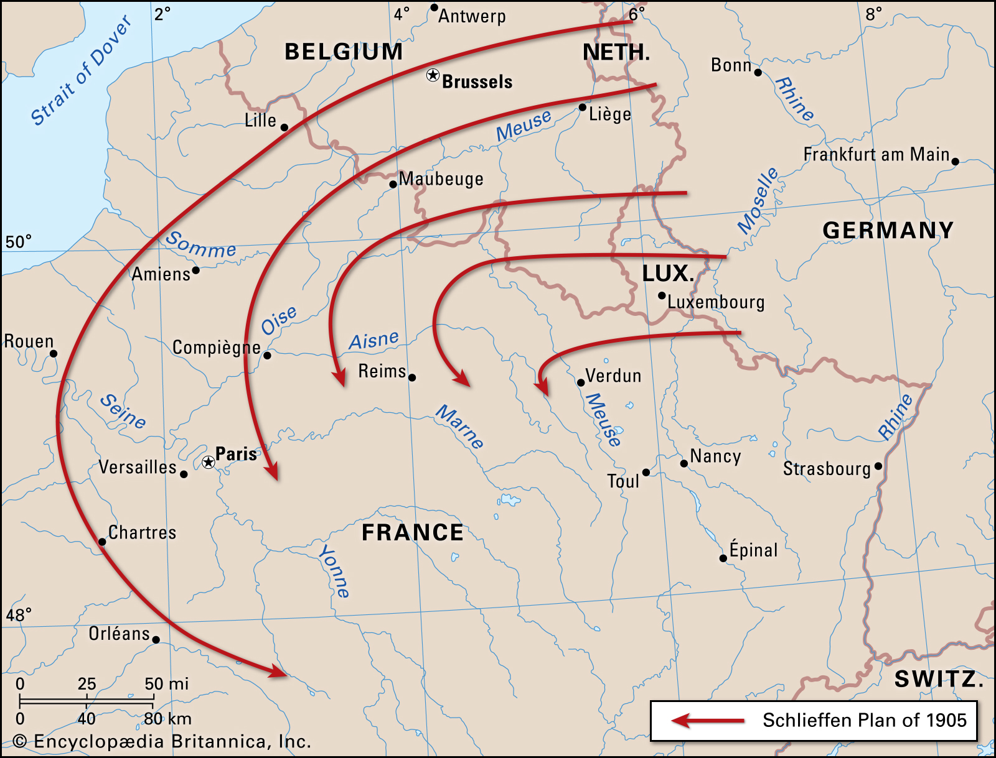
(a) The Schlieffen Plan fails
The success of the Schlieffen Plan depended on speed. France was to be invaded via a high-speed German advance through Belgium, so that once Paris fell, France would then surrender completely within 6 weeks; Germany could then turn eastwards to fight Russia – a huge nation that would be slow to mobilize (at least 6 weeks). Germany was so confident in their plan that they could not conceive of it going wrong. This was quite a massive mistake.

Slide 7
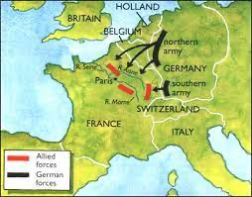
(a) The Schlieffen Plan fails
Gradually, the Schlieffen Plan (the only plan that Germany had made) began to fall apart:
The German advance through Belgium was slower than expected.
The BEF delayed the German advance at the Battle of Mons, 23-24 August 1914.
Russia mobilized its troops quicker than expected, so Germany had to withdraw their Western Front troops to fight in the East.
The delay in Belgium meant that German troops missed an opportunity to take Paris.
The Germans faced French & British troops at the Battle of the Marne, 5-11 September 1914.
After a week of fighting, the German advance was stopped, they retreated 60km and they took up defensive positions along the River Aisne.

Slide 9
Activity 9
The French Army used an
unusual form of military
transportation at the
Battle of the Marne at
the start of September 1914.
Find out what this was.
Find out why the French did this.

Slide 10
(a) The Schlieffen Plan fails
The Schlieffen Plan had clearly failed. Both sides dug trenches to defend themselves & to stop the other side advancing. By December 1914 (the original deadline British recruitment had reassured “War would be over by Xmas”) trenches stretched from the English Channel to Switzerland. For the next 4 years, two enormous armies would face each other across these trenches. Neither side would advance by a few km. A war of movement had turned to a static war. There was STALEMATE on the Western Front.

Slide 11
Activity 10
After the Battle of the Marne,
General von Moltke said to the
Kaiser “Sir, we have lost the war.”
Why do you think that General von
Moltke was so sure at such an early
stage as 11 September 1914?

