Slide 1
Edexcel IGCSE History P2: Breadth Study A1
The Origins & Course of WW1,
1905-1918

Slide 2
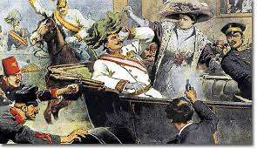
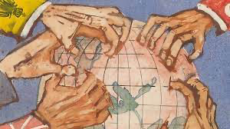
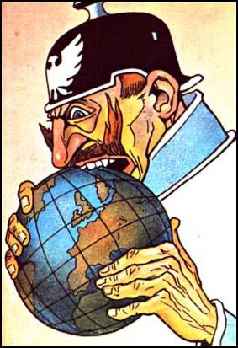
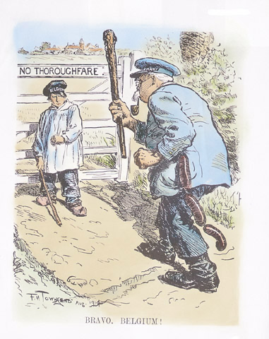
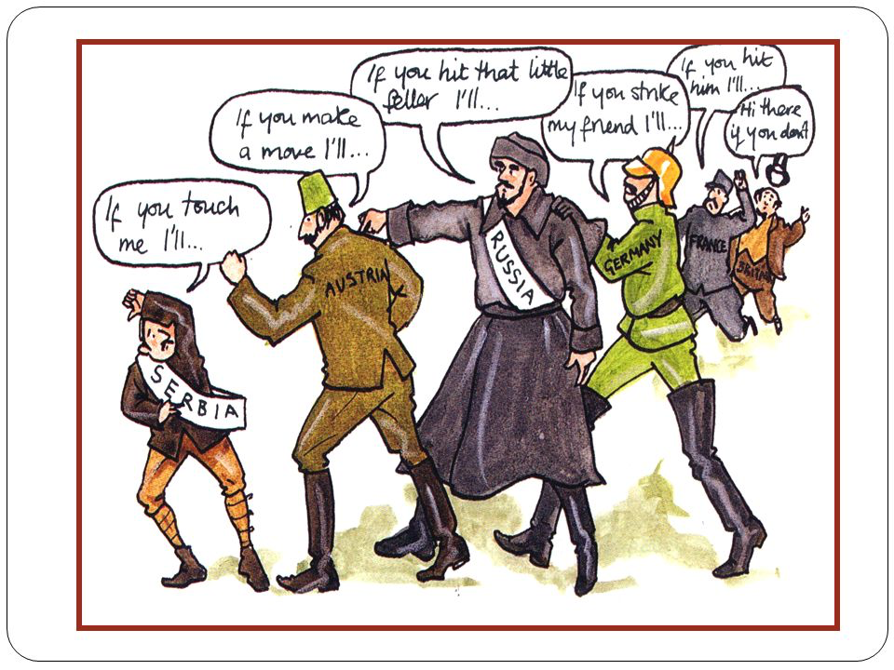

Slide 3
Edexcel IGCSE History P2: Breadth Study A1
The Origins & Course of WW1,
1905-1918
2.3 Murder at Sarajevo

Slide 4
(c) Murder at Sarajevo
The spark that ignited all-out war in Europe came on 28 June 1914 in Sarajevo, the capital city of Bosnia.
The Black Hand killed the heir to the Austrian throne; Archduke Franz Ferdinand & his pregnant wife, Sophie.
All of the building Balkan tensions suddenly exploded and led to the First World War in August 1914.

Slide 5
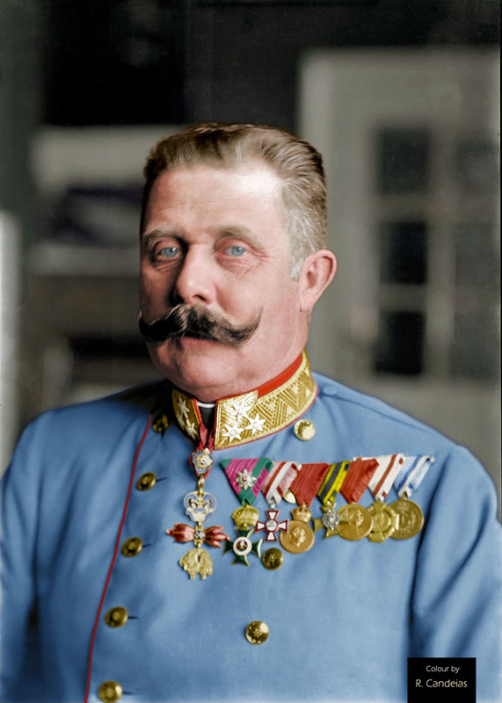
(c) Murder at Sarajevo
Franz Ferdinand was making an official visit to Bosnia as the Austro-Hungarian Government needed a show of strength to silence Serbian whispers of rebellion. As Head of the Army, Franz Ferdinand would watch some Army exercises, then go to the Bosnian capital to meet city officials. The date chosen, however, was 28th June – the national day of the Serbian people!
The Black Hand viewed this as the final insult and, after the Archduke’s route was published in the newspaper, they formulated a plan. An assassination to strike a blow at a hated Empire.

Slide 6
(c) Murder at Sarajevo
After inspecting the troops, the Archduke & Sophie were looking forward to their visit to the city. Aware that he could be a political target, the Archduke wore a specially woven tunic – supposedly bullet-proof.
An open-top car was used for the Royal couple.
Black Hand assassins mingled amid the cheering crowd.
Several assassins faltered & failed to kill the Archduke; a bomb was thrown at the Royal car but missed the pair.
Upset at such unpopularity, the Archduke cancelled the visit and ordered his chauffeur to go to the train-station.
Taking a wrong turn, as the chauffeur struggled with the reverse gear, GAVRILLO PRINCIP shot the Royal couple.

Slide 7
(c) Murder at Sarajevo
By midnight on 28th June 1914, Archduke Franz Ferdinand & his pregnant wife, Sophie, were dead.
GAVRILO PRINCIP tried to commit suicide by cyanide pills but, due to them being old, they just made him vomit. Raising his gun to his head to shoot himself, the Sarajevo Police wrestled him to the ground before he could kill himself. He was arrested and severely beaten during a brutal interrogation.
At trial, GAVRILO PRINCIP was sentenced to 20 years in Prison – at just 19 years old, he was too young to be executed by hanging. Princip knew he was dying of TB, so had nothing to lose in Prison. He died in April 1918, just months before the World War he sparked ended.

Slide 8
(c) Murder at Sarajevo
COUNTDOWN TO WAR
5 July Germany agrees to support Austria-Hungary
23 July Austria-Hungary sends demands to Serbia
25 July Serbia agrees to all demands, except one
26 July Russia promises to support Serbia
28 July Austria-Hungary declares war on Serbia; Serbia asks Russia for help
29 July Germany warns Russia not to intervene; Russia mobilizes
31 July Germany warns France not to intervene
1 August Germany declares war on Russia; France mobilizes
2 August Belgium refuses to permit German troops through to get to France
3 August Germany declares war on France; German troops enter Belgium
4 August Britain declares war on Germany; Triple Alliance & Triple Entente at War

Slide 9
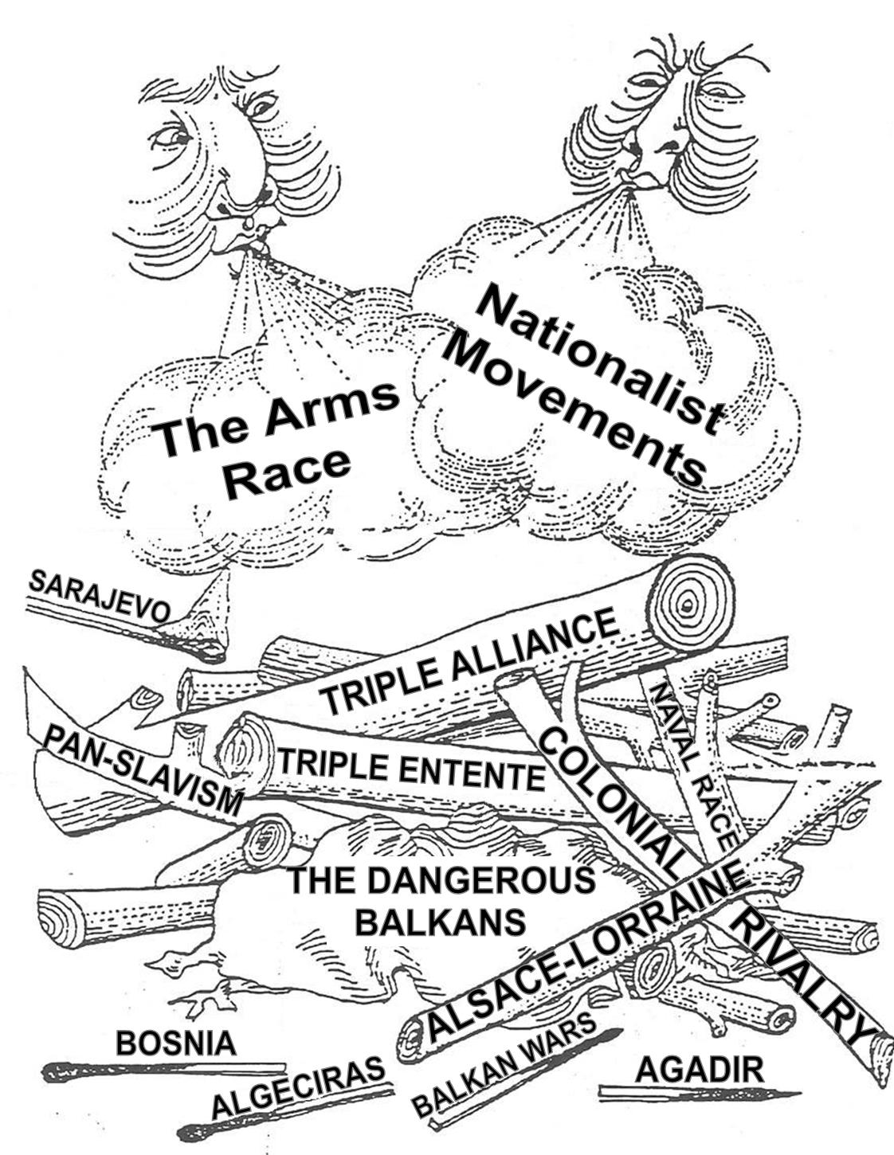
(c) Murder at Sarajevo
THE ROLE OF THE GREAT POWERS IN STARTING WAR
Rivalries between them had got so strong that war could get triggered easily after just one event.
Archduke Franz Ferdinand’s murder was serious, but not really a reason to plunge into 4 years of warfare.
IT WAS THE POLITICAL, ECONOMIC, COLONIAL + MILITARY RIVALRIES THAT CAUSED WAR TO BREAK OUT.

Slide 10
(c) Murder at Sarajevo
THE ROLE OF THE GREAT POWERS IN STARTING WAR
Britain feared Germany was a threat to its economic & colonial supremacy
France also felt threatened & wanted Alsace-Lorraine back
Germany wanted their “place in the sun” + were building a navy to get it
Austria-Hungary sided with Germany as they were both rivals to Russia.
Russia wanted to help the Slavs gain independence away from all others.

Slide 11
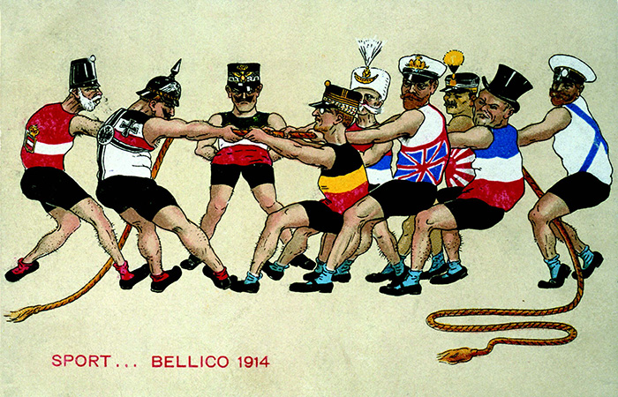

Slide 12
Activity 6 – Recall Quiz
Name the Moroccan city visited by Kaiser Wilhelm II in 1905.
In what year was the Algeciras Conference?
Where did Kaiser Wilhelm II send a gunboat in 1911?
Between which 2 cities did Kaiser Wilhelm want to build a railway?
When did Austria-Hungary annex Bosnia-Herzegovina?

Slide 14
Activity 6 – Recall Quiz
Which 4 countries made up the Balkan League?
Name the secret society formed in Serbia in 1911.
Which town in Bosnia did Archduke Franz Ferdinand and his wife visit in June 1914?
When did Russia mobilize in 1914?
What happened on 4th August 1914?

Slide 16
Activity 7 – Explaining
Why did Germany become involved in Morocco?
Give two reasons why the growth of Serbia threatened the stability of Europe.
What did Britain declare war on Germany in 1914? Give two reasons.

Slide 18
Activity 8 – Challenge
Explain how the Moroccan situation (1905-1911) strengthened relationships between Britain & France.
How important was Balkan nationalism in creating tension in Europe, 1912-1914?
To what extent was Germany to blame for starting the First World War?

