Slide 1
Edexcel IGCSE History P2: Breadth Study A1
The Origins & Course of WW1,
1905-1918

Slide 2
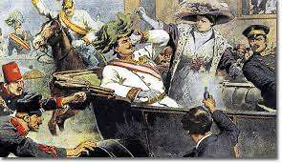
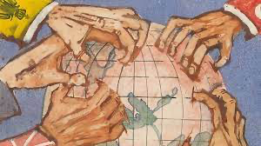
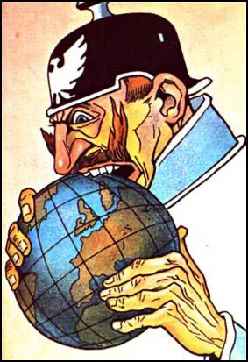
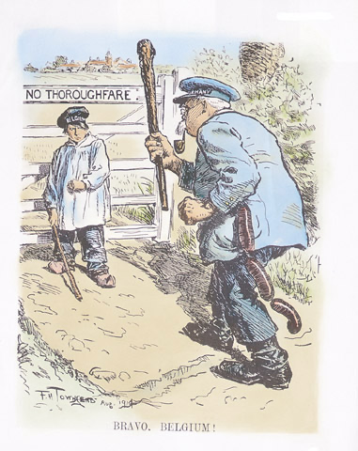
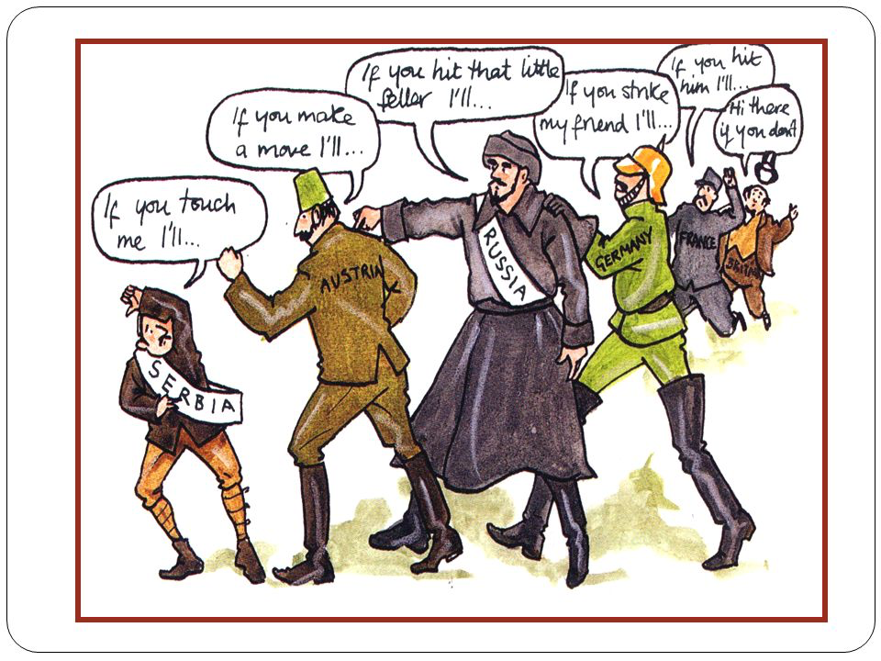

Slide 3
Edexcel IGCSE History P2: Breadth Study A1
The Origins & Course of WW1,
1905-1918
2.2 Crisis in the Balkans

Slide 4
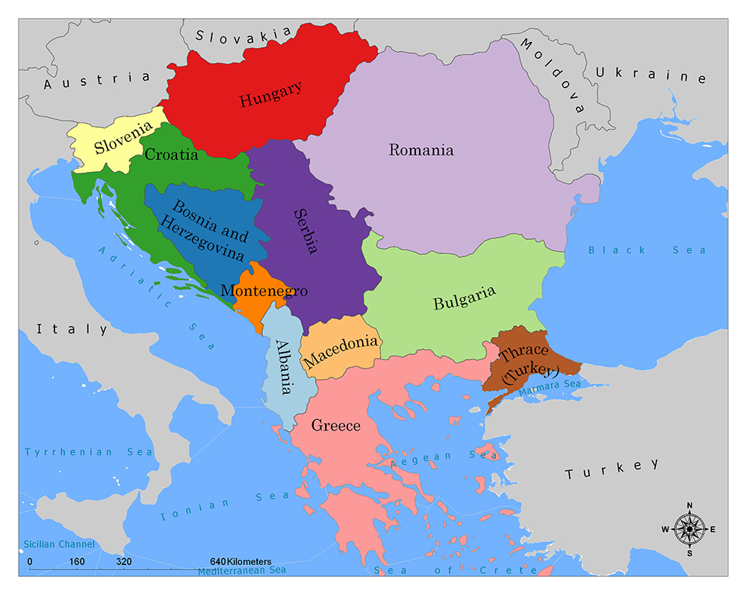
(b) Crisis in the Balkans
The Balkans had once been part of the mighty Ottoman Empire & ruled over by the Turkish Sultan. As the power of the Empire weakened, Turkey lost control of Slavs living in the Balkans. Rebellions erupted amid Slavs demanding independence. At the start of the 20th Century, the Balkans was a very unstable part of Eastern Europe. Great Powers that bordered the Balkans began to take an interest in events there and they hoped to take advantage of Turkey’s weakness to increase their own influence in the area.

Slide 5
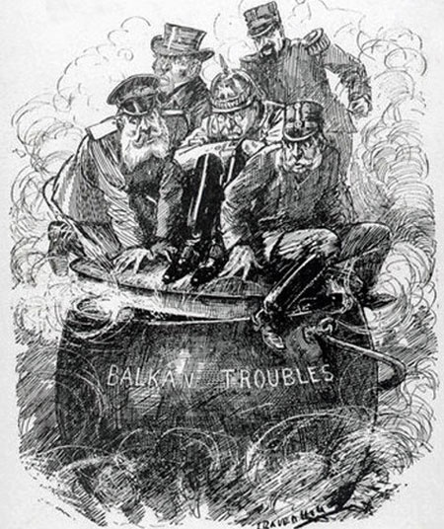
(b) Crisis in the Balkans
Politicians in 3 major powers in Europe were monitoring events in the Balkans:
AUSTRIA-HUNGARY was an empire made up of multiple nationalities + were already struggling to keep them united under the Emperor. They did not want Serbs under their control joining Serbia after seeing Slavs gain independence from Turkey. More land with a coastline on the Adriatic Seas would also help them expand their empire.
RUSSIA were the self-appointed protectors of the Serbs. Fellow Slavs, they shared language, culture + customs. Control over the Dardanelles would guarantee their Black Sea fleet access to the Med.

Slide 6
(b) Crisis in the Balkans
GERMANY was not interested in Balkan land for power; they were much more interested in its economic & industrial wealth. Extensive oil fields in Iraq could provide Germany with resources to power its quest for dominance and Kaiser Wilhelm aimed to build a railway from Baghdad to Berlin. Any direct oil transportation between the 2 capitals, of course, would have to cross the Balkans, so Germany could not afford to let other European powers gain influence over the area they needed to lay railway track upon.
ALL 3 NATIONS HAD SOMETHING TO GAIN + THEIR CHANCE TO TAKE IT CAME IN 1908.

Slide 7
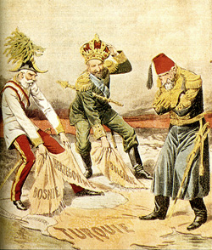
(b) Crisis in the Balkans
The Bosnian Crisis, 1908-09
Revolution in Turkey, 1908, led by ‘Young Turks’, forced Sultan Abdul Hamid to restore Turkey’s democratic constitution. During the chaos, Austrian Emperor Franz Joseph annexed the provinces of Bosnia & Herzegovina. The ripple effect began:
The King of Serbia claimed both provinces, full of Serbs, should belong to Serbia. He protested to Austria-Hungary.
Russia supported Serbia & protested too.
Germany staunchly supported Austria-Hungary.
Bulgarian ruler, Prince Ferdinand , crowned himself King and declared Bulgarian independence from Turkey.
NOBODY WISHED TO RISK A WAR OVER THE ISSUE.

Slide 8
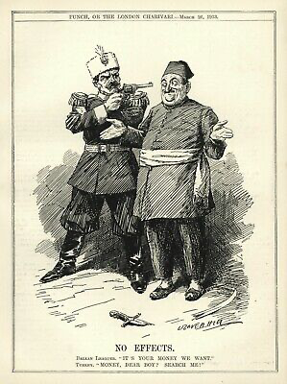
(b) Crisis in the Balkans
The Balkan Wars, 1912-13
The Kings of Bulgaria, Greece, Montenegro + Serbia joined together to form the Balkan League. Their main aim was to force Turkey out of Europe.
1st Balkan War (Oct 1912 – May 1913)
Short & bloody, the Turks surrendered after just 50 days of fighting. They could not compete against the combined forces of Bulgaria, Greece, Montenegro & Serbia. At the resulting peace conference in London, Turkey agreed to give up all European land to the 4 members of the Balkan League.

Slide 9
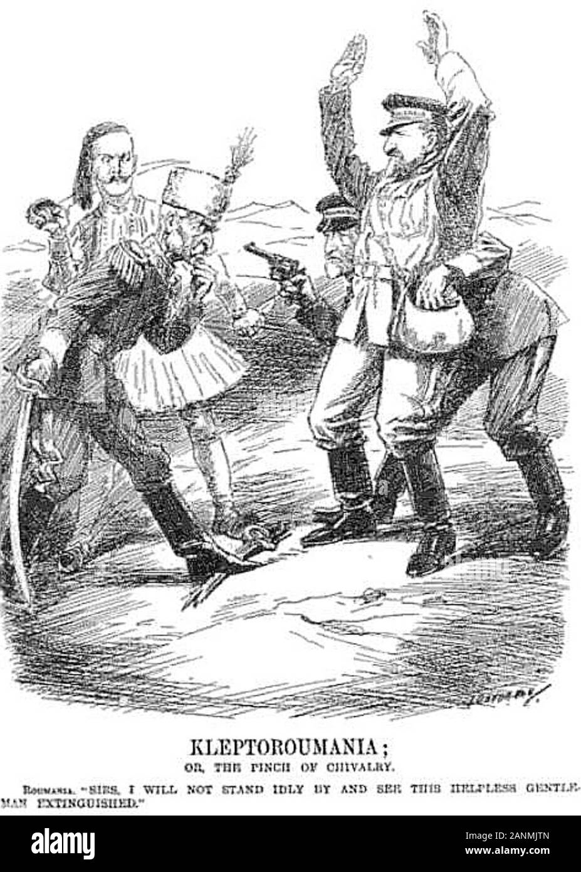
(b) Crisis in the Balkans
2nd Balkan War (Oct 1912 – May 1913)
Unsatisfied with the division of land between the Balkan League, King Ferdinand of Bulgaria ordered his troops to attack 2 League members – Serbia & Greece! They invaded Bulgaria, supported by an old enemy of Bulgaria – ROMANIA – igniting Turkey’s interest in their lost land, who also sent troops to attack Bulgaria. Fighting only ended when Bulgaria asked for an armistice – they eventually lost land gained in the 1st Balkan War to Serbia and, somehow, Turkey also regained land lost from the Balkan League.

Slide 10
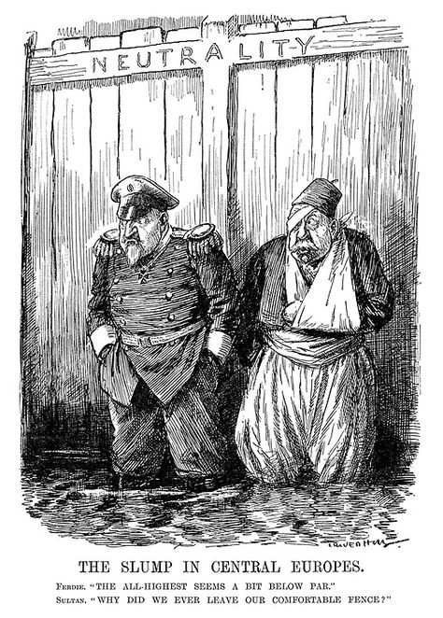
(b) Crisis in the Balkans
Results of the Balkan Wars, 1912-13
Serbia doubled in size + grew more aggressive
Serbs in Bosnia-Herzegovina wanted to join Serbia
Austria-Hungary feared a revolt in its Empire
Austria-Hungary was determined to control Serbia
Bulgaria was determined to take revenge on Serbia

Slide 11
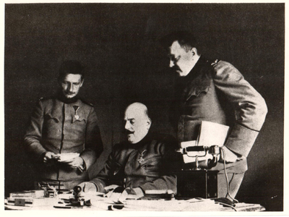
(b) Crisis in the Balkans
Balkan Nationalism
The Bosnian Crisis strengthened the growth of nationalism in the Balkans. It had been shared Slav identity that brought the Balkan League together. It was nationalism that made King Ferdinand demand more for Bulgaria after the 1st war, leading to the 2nd.
The Black Hand
On 22 May 1911, ten Serbian officers met in Belgrade to form “Unity or Death” – also known as the “Black Hand” after their symbol. Their leader was Col. Dragutin Dimitrievic, known as Apis; they soon had 2,500 members.

Slide 12
(b) Crisis in the Balkans
Aims of the ‘Black Hand’
Unite all Serbs in Bosnia under Serbian rule.
Propaganda campaigns to inspire Revolutionary Units.
Establish a network of terrorists to cross from Serbia into Bosnia.
In Bosnia, plant bombs, cut telegraph wires & carry out assassinations.
In 1914, the Balkans was a seething mix of hatred, resentment, suspicion and aggression. A powder-keg …… a spark?

Slide 13
Exam-Style Question
Describe two features
of the Balkan Wars
(1912-13). (6 marks)
Hint – Identify two clear features, don’t just say what they were – support!

