Slide 1
Edexcel IGCSE History P2: Breadth Study A1
The Origins & Course of WW1,
1905-1918

Slide 2
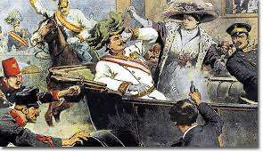
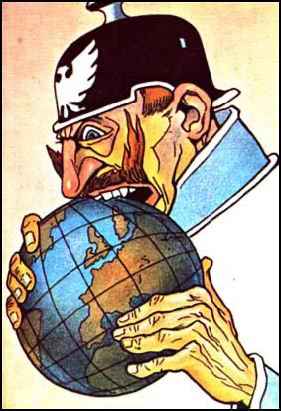
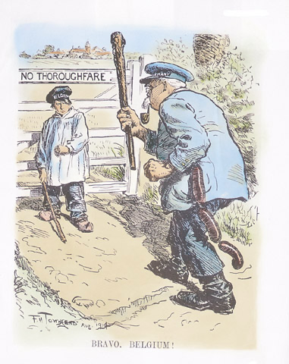
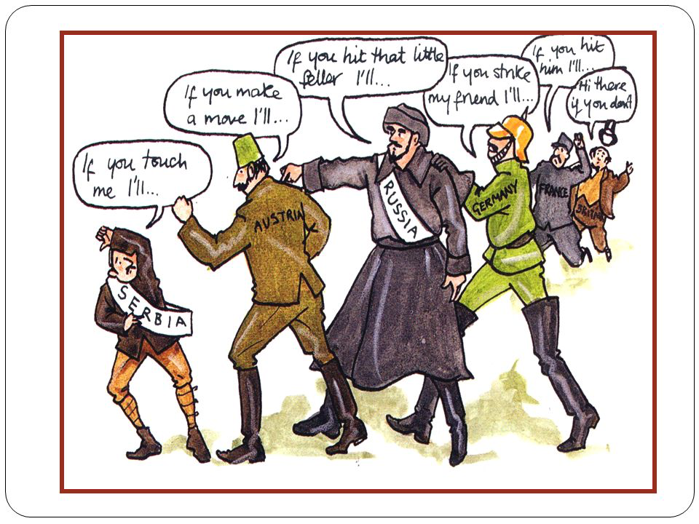

Slide 3
Edexcel IGCSE History P2: Breadth Study A1
The Origins & Course of WW1,
1905-1918
2.1 The Moroccan Crisis, 1905-1906 + 1911

Slide 4
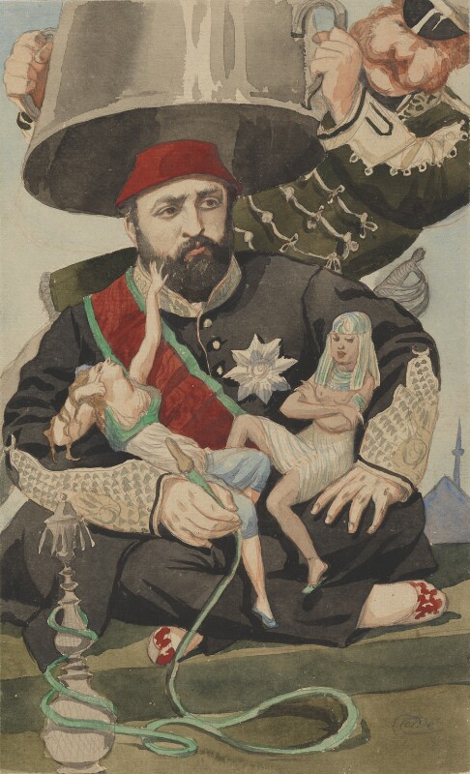
(a) The Moroccan Crisis, 1905-1906 + 1911
In 1902, Morocco was one of the few African states not occupied by a European power after “The Scramble for Africa”.
Sultan Abdul Aziz was facing challenges to his rule – the Berbers of the Atlas Mountains were fighting for their independence. By 1903, the Moroccan capital, FEZ, was under attack & Sultan Aziz had lost control of most of the country as Moroccans chose to support the rebel Berbers. In April 1904, France & Britain agreed France would have a mandate over Morocco in return for French interests in Egypt going to Britain. Nobody had consulted Germany, who really wanted an Empire, so the Kaiser was sure to have a strong opinion on this.

Slide 5
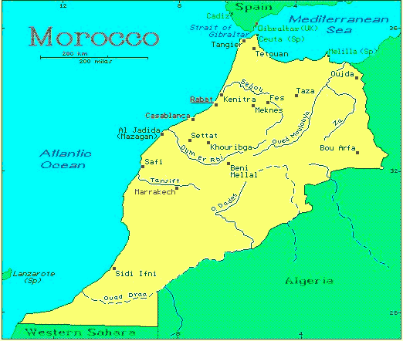
(a) The Moroccan Crisis, 1905-1906 + 1911
Indeed, Kaiser Wilhelm II publicly declared that all he was interested in was “equal economic rights in Morocco to those of other European countries.” German politicians went further than their leader; aiming to stem French power in the Med & North Africa, Sultan Abdul Aziz was assured of support and encouraged to resist France. The Germans did not really care about the Sultan, of course, but they were keener for Britain & France to see that Germany wanted “a place in the sun” to rule too.

Slide 6
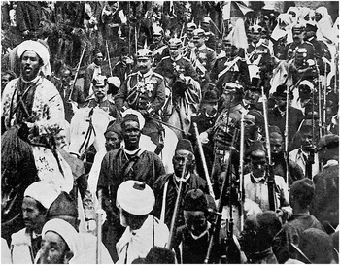
(a) The Moroccan Crisis, 1905-1906 + 1911
On 31 March 1905, the Kaiser landed at Tangier to demonstrate German interest in North Africa. He went straight to the German Embassy, met with Moroccan, German & French officials, assuring them that the independence of Morocco & Sultan Aziz had his full support. He also stated “Germany knows best how to protect independence”. When he left the building, he toured Tangier on a white horse, surrounded by officials & supporters – a dramatic display of support for Sultan Abdul Aziz.

Slide 7
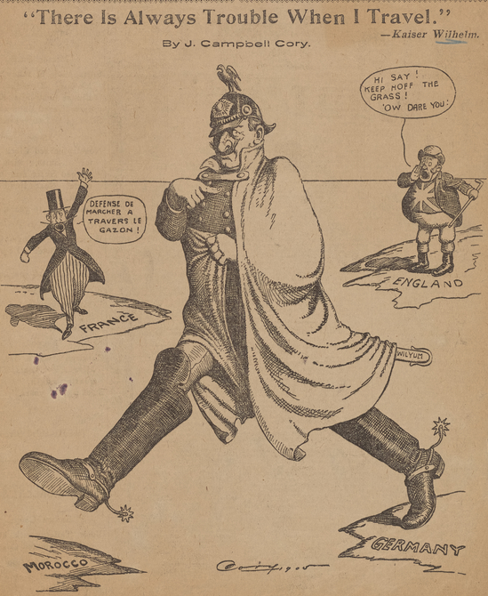
(a) The Moroccan Crisis, 1905-1906 + 1911
France & Britain were shocked:
The French press were furious – they had assumed aggreging French control over Morocco would be simple. While the French Government refused to risk war with Germany over the matter, all military leave for soldiers was cancelled … just in case.
The British Government did not hide their displeasure. They feared a German naval base in a Moroccan port threatening British dominance + the British Naval Base at Gibraltar.
A conference was held in 1906 to settle things.

Slide 8
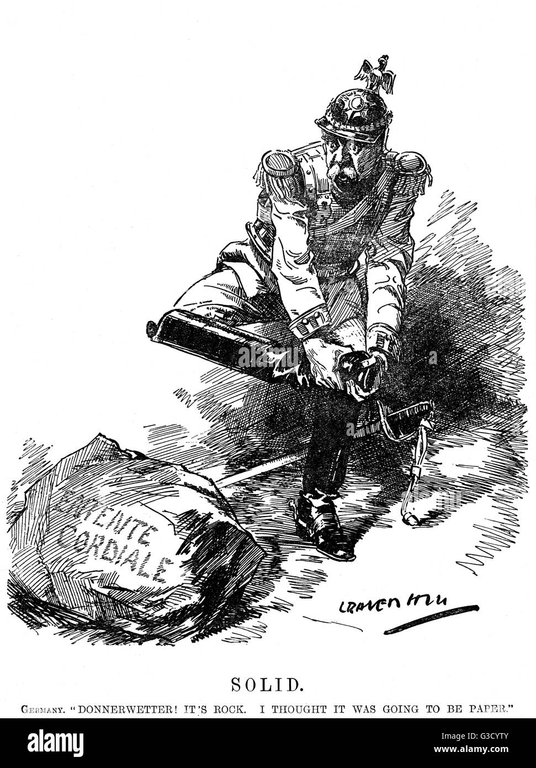
(a) The Moroccan Crisis, 1905-1906 + 1911
THE ALGECIRAS CONFERENCE lasted from 16th January to 7th April and was attended by 12 European countries + USA. The only country to support Germany was their old ally, Austria-Hungary. The final agreement was that FRANCE WOULD HAVE A CONTROLLING INTEREST IN MOROCCO, BUT EVERY NATION WAS FREE TO TRADE WITH MOROCCO. Furthermore, ACTION IN MOROCCO BY ANY COUNTRY HAD TO BE AGREED BY ALL THE SIGNATORIES TO THE FINAL AGREEMENT. It was a temporary solution – worsening tensions in Europe, as Britain had supported France to embarrass the Kaiser. Wilhelm II saw the Entente Cordiale was ‘solid’.

Slide 9
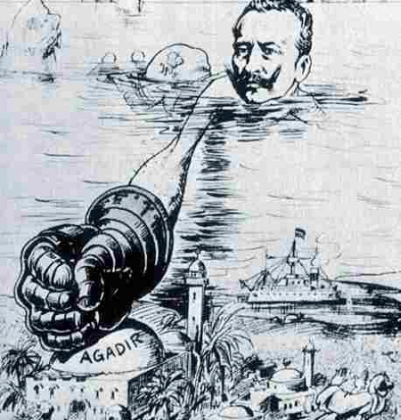
(a) The Moroccan Crisis, 1905-1906 + 1911
In March 1911, rebels rose up against the Sultan and surrounded the capital city, Fez. The Sultan appealed to France for help – in May 1911, French troops & Spanish troops arrived … to protect their nationals living there.
Germany, however, reacted very differently. They felt the French had deliberately encouraged a tribal revolt to justify occupying Morocco – in breach of the Algeciras Conference agreement. On 1st July 1911, the German gunboat SMS Panther arrived at the port of Agadir … to protect Germans in Morocco too.

Slide 10
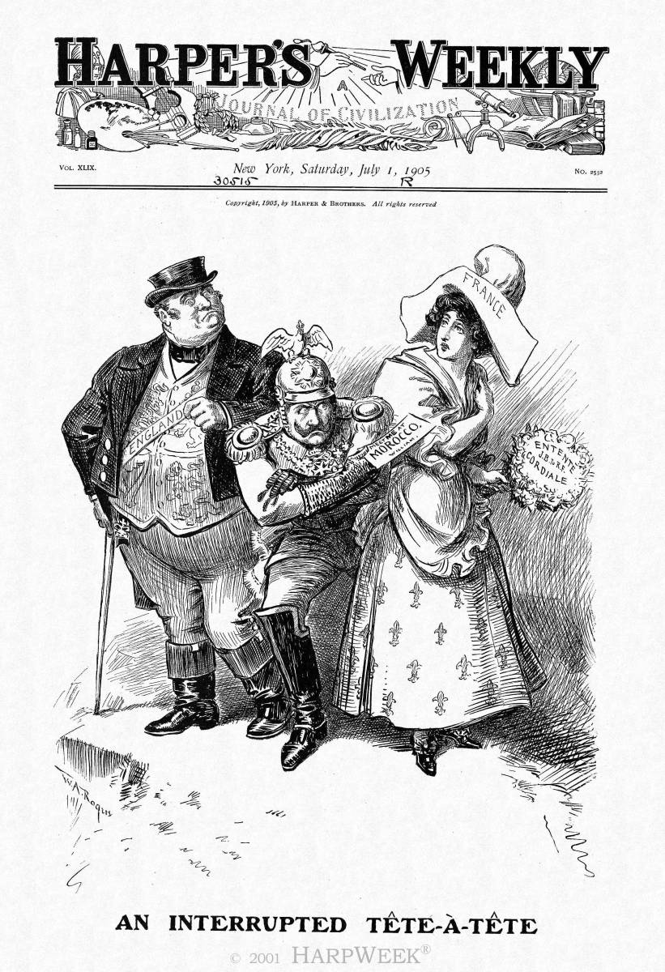
(a) The Moroccan Crisis, 1905-1906 + 1911
The French reaction to the “AGADIR INCIDENT” was to increase French troops in Morocco. British politicians tried to persuade France to avoid more tension, but the French were determined to assert their authority over Morocco. Britain HAD to support the French position, while still worried about British Naval dominance being threatened by a German military base in the Med. Just when tensions were about to tip over, an unexpected financial crisis in Germany took the wind from their sails & they signed the Treaty of Fez in November 1911 – France retained Morocco, in return for Germany being granted land in the Congo (a French colony).

Slide 11
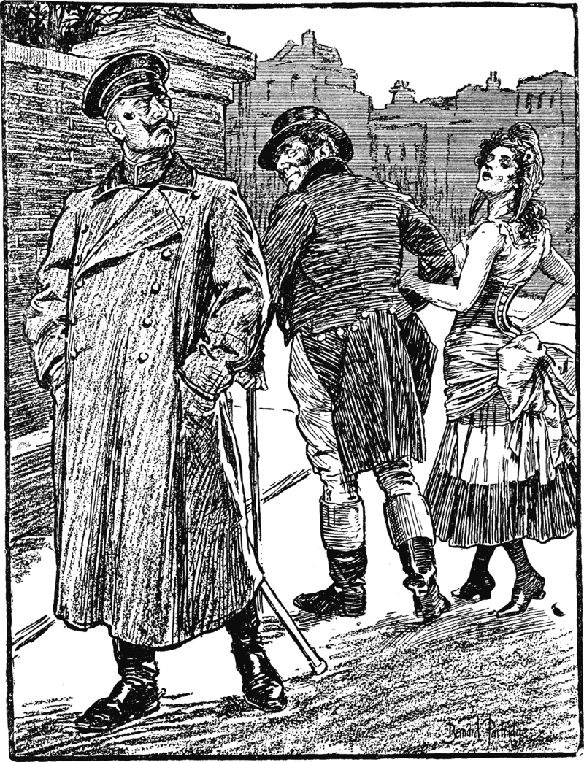
(a) The Moroccan Crisis, 1905-1906 + 1911
There were long-term effects once the Moroccan Crises were over:
British support for France strengthened the Entente Cordiale of 1904.
The division between the Entente powers and Germany increased; Germany utterly isolated.
Britain & France signed a Naval Agreement; Britain would protect France from German attack, while French fleet would protect British interests in the Mediterranean.

Slide 12
Exam-Style Question
Describe two features
of the second Moroccan Crisis (1911-12). (6 marks)
Hint – Identify two clear features, don’t just say what they were – support!

