Slide 1
Edexcel IGCSE History P2: Breadth Study A1
The Origins & Course of WW1,
1905-1918

Slide 2
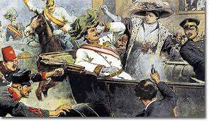
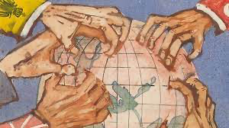
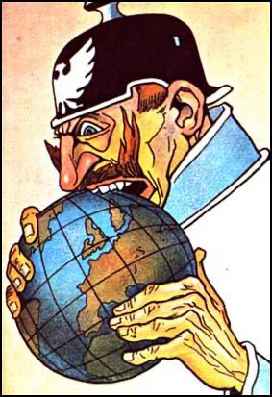
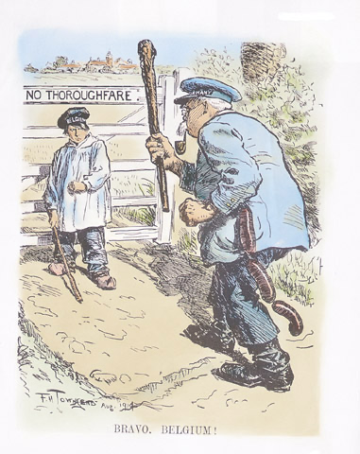
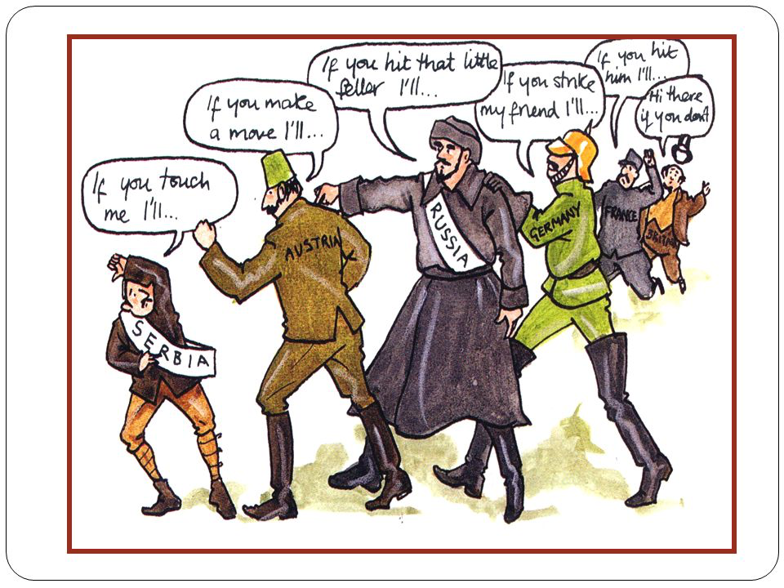

Slide 3
Edexcel IGCSE History P2: Breadth Study A1
The Origins & Course of WW1,
1905-1918
1.3 Military Rivalry: Planning for War?

Slide 4
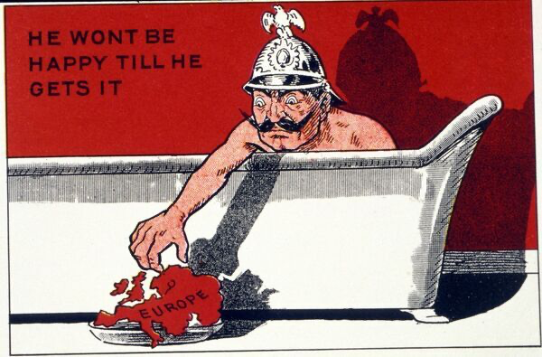
(c) Military Rivalry
Tensions increased in Europe over military matters. Germany was afraid of being surrounded by ever more hostile nations. British politicians believed that Germany was aiming at European, possibly World, domination. There was fear & suspicion on both sides of Europe, especially between Germany & Britain. Britain wanted to maintain position as the most powerful country in Europe, but Germany was pressing for change and wanted to challenge this very long established British supremacy.

Slide 5
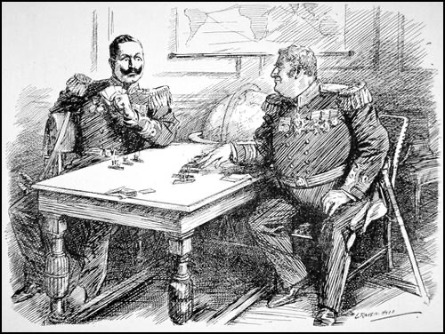
(c) Military Rivalry
Britain relied on its massive Navy to
Keep the sea routes open to the furthest points of its Empire.
Protect its economic interests
Protect the peoples of the Empire
PROTECT THE ISLAND NATION FROM ANY EUROPEAN AGGRESSION
Germany and the Kaiser knew, however, that if Germany wished to become a World Power with a large Empire, it had to challenge the mighty British Navy.

Slide 6
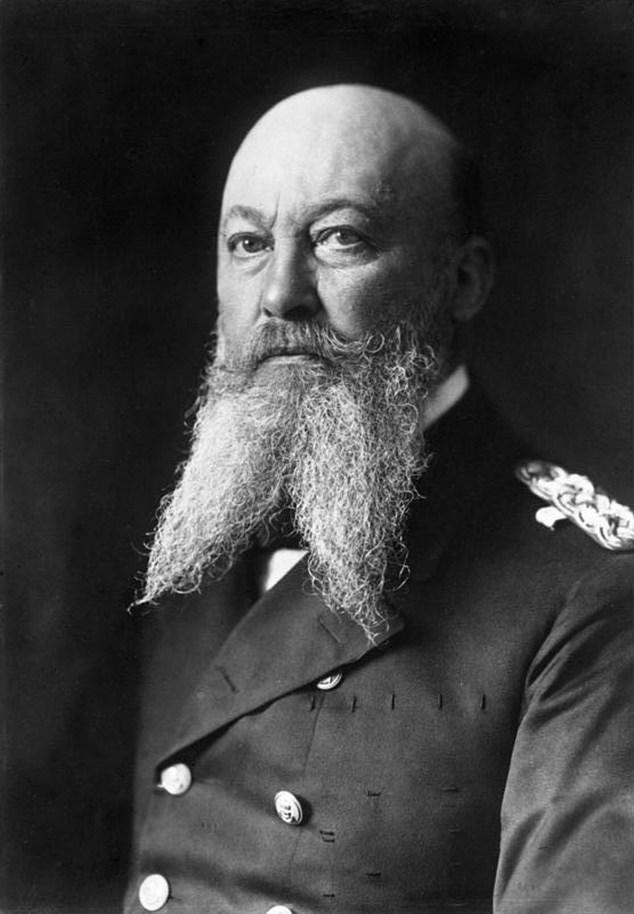
(c) Military Rivalry
In 1898 + 1900, Germany passed Navy Laws. 1st gave permission to build 16 battleships; 2nd increased 16 to 42 battleships. There were also 60 cruisers built too. By 1905, Admiral Tirpitz set up the Naval League to encourage German people to take an interest in their Navy – tours of ports & lectures about the fleet were organized far & wide.
The British response was to build the best ever battleship in 1906 – HMS Dreadnought. It was so advanced that its revolutionary design made all other battleships out-of-date.

Slide 7
Activity 2
German sailors feared
HMS Dreadnought so much
that they referred to their
own vessels as “5 Minute Ships”.
Find out why the German sailors did this.

Slide 8
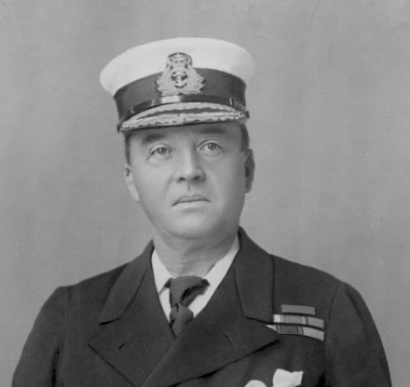
(c) Military Rivalry
Germany responded by building their own version of HMS Dreadnought, named RHEINLAND.
Britain’s naval chief, Admiral Fisher, immediately ordered the building of a “Super-Dreadnought” – HMS Neptune.
Hundreds of men were recruited as sailors to serve on these brand new battleships.
1906-1914 Britain, 29 Germany, 17

Slide 9
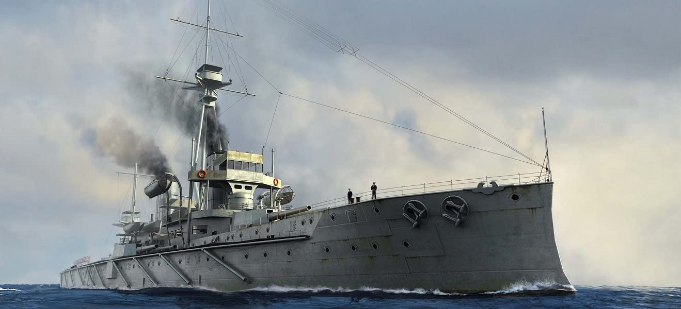

Slide 10
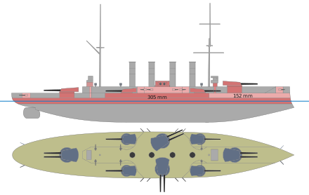
(c) Military Rivalry
What was so different about HMS Dreadnought?
More heavily armoured; 28cm thick on the sides & 35cm thick on the decks
Fired shells further than any other ship could
Designed to fight from a distance; blows up ships 32km away
Fast; Could carry 800 sailors & travel at 22 knots

Slide 11
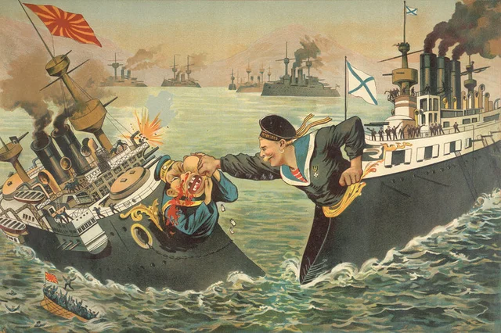
(c) Military Rivalry
The Arms Race was not just about ships & Navies. All European powers were building up their land forces & armaments:
Russia’s defeat in the Russo-Japanese War, 1905, led the Government to form a State Defence Council. The new Main Directorate of General Staff dealt with recruitment & training the new soldiers. Though huge, however, the Russian Army was badly equipped.
Austria-Hungary secretly started making massive cannons in the Skoda works.

Slide 12
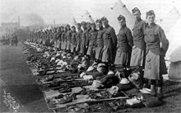
(c) Military Rivalry
Britain’s War Minister, Richard Haldane, formed a British Expeditionary Force of 144,000 soldiers, ready for deployment. This BEF could move immediately to support France if any war was declared. Haldane also set up a Territorial Army of Volunteers, to back up the regular Army, plus an Officer Training Corps in schools.
Germany & France drew up war plans, to work out how they’d fight their enemies if war began.

Slide 13
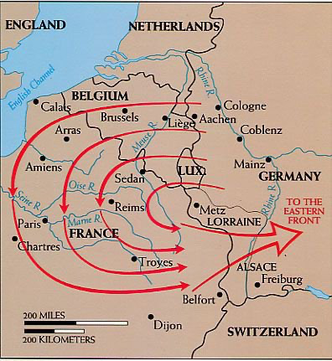
(c) Military Rivalry
THE SCHLIEFFEN PLAN was created in 1905 by Count Alfred von Schlieffen. It was obvious that Germany could not win a war fought on two fronts, with France in the West & Russia in the East, so the plan was to capitalize on the poor road & rail network in Russia. Estimating that it would take 6 weeks for Russia to mobilise, the German Army would attack & defeat France first and, with Paris captured in 6 weeks, the German Army would hurry Eastwards (via superior rail & road) to attack and defeat Russia.

Slide 14
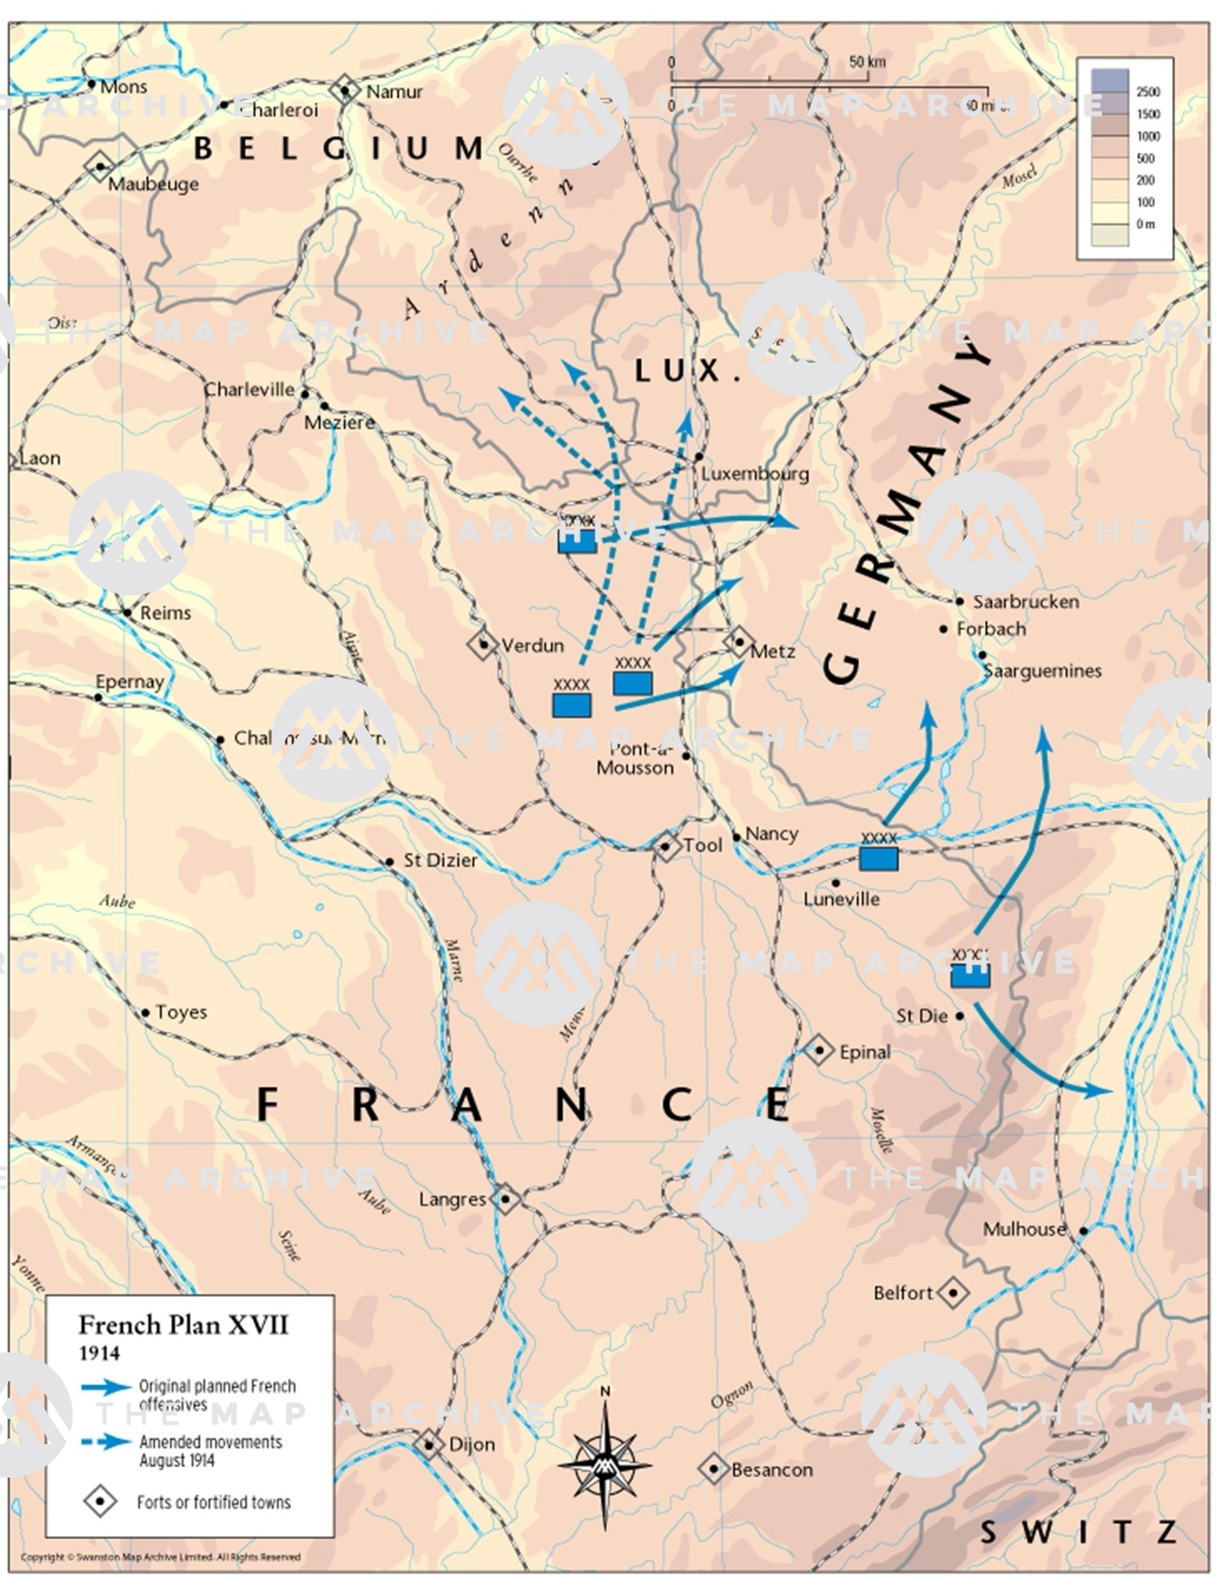
(c) Military Rivalry
PLAN 17 was created in 1913 by French Army chief, General Joffre. It was even simpler than the Schlieffen Plan – if war broke out, French troops would launch an all-out attack on Alsace-Lorraine. After securing these former French provinces, the French troops would then cross the River Rhine and advance on Berlin.
After years of planning for war, this very basic plan was the only strategy that the French had developed. Like the Schlieffen Plan, Plan 17 made no alternative arrangements if things didn’t go to plan.

Slide 15
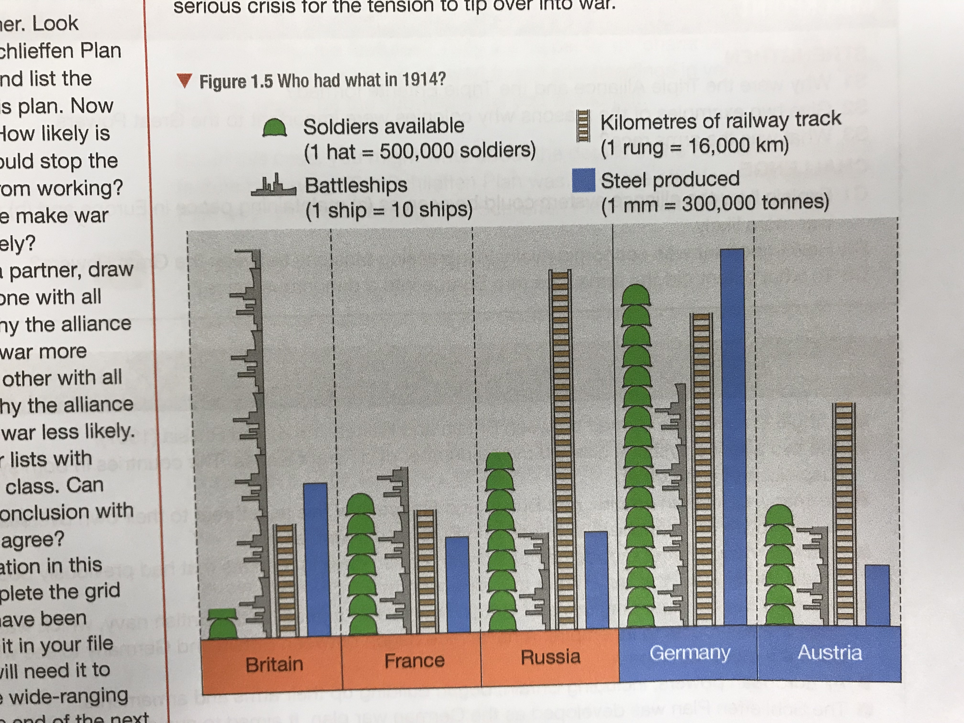

Slide 16
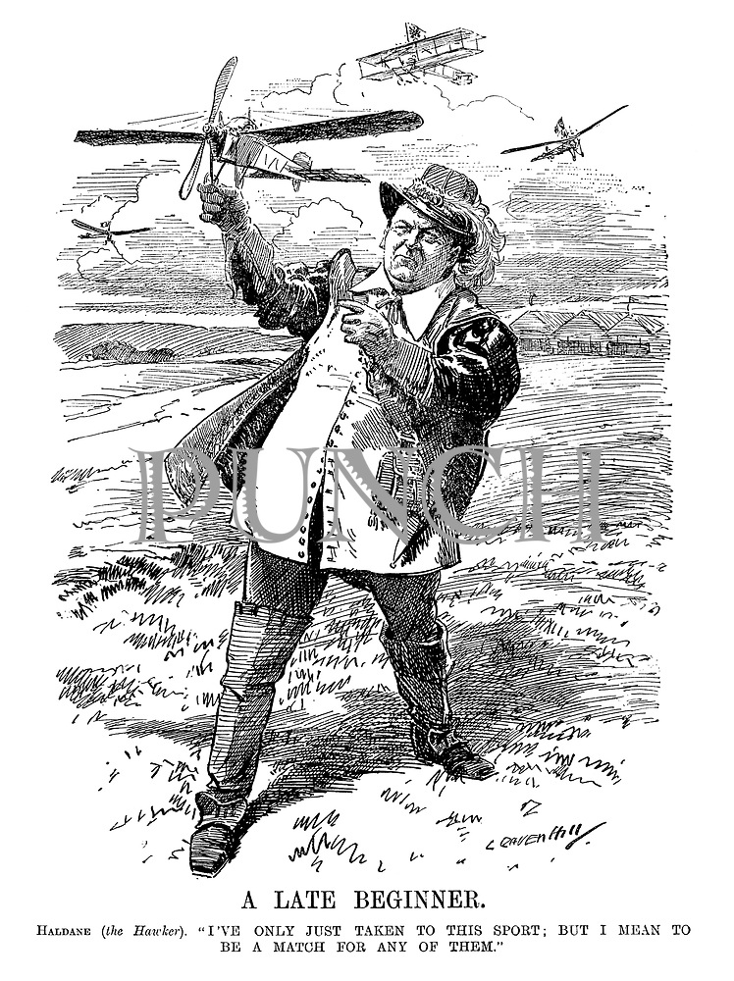
(c) Military Rivalry
The Arms Race made Europe a dangerous place, BUT IT DID NOT AUTOMATICALLY LEAD TO WAR.
In the 1890s, to actively prevent a war, a PERMANENT COURT OF ARBITRATION had been set up … but it was a voluntary court.
In Feb. 1912, Richard Haldane made a secret visit to Berlin – he hoped to persuade the Germans to accept a voluntary limit on arms. Haldane failed.
Tensions remained high between the Great Powers; a serious crisis could tip tension over into War.

Slide 17
Exam-Style Question
Describe two features of
the Naval Race. (6 marks)
Hint – Identify two clear features, don’t just say what they were – support!

Slide 19
Activity – Recall Quiz
In what year was the Triple Entente formed?
Who were the members of the Triple Entente?
Which 2 provinces did France really want to regain from Germany?
What was the name of the German Kaiser, the Russian Tsar & the British King?
Why did Germany want colonies?

Slide 21
Activity 3 – Recall Quiz
How big was the British Empire?
Why was the Navy important to Britain?
When was HMS Dreadnought launched and how did Germany respond to it?
What was the name of the German war plan created in 1905 and how did it work?
What was Plan 17?

Slide 23
Activity 4 – Explaining
Why were the Triple Alliance & the Triple Entente formed?
Give two examples of the reasons why colonies were important to the Great Powers.
What was the Arms Race?

Slide 25
Activity 5 – Challenge
Explain how the alliance system could be seen as (a) maintaining peace + (b) making an European war more likely.
How important was economic rivalry in increasing tensions between Great Powers?
To what extent did the Arms Race turn Europe into a dangerous place?

