Slide 1
Edexcel IGCSE History P2: Breadth Study A1
The Origins & Course of WW1,
1905-1918

Slide 2
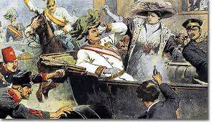
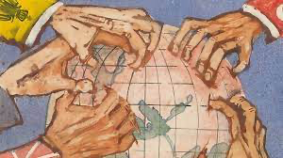
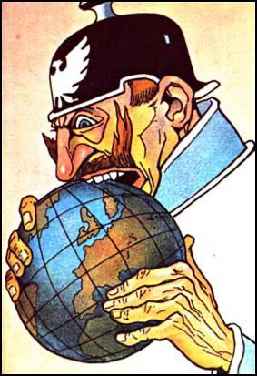
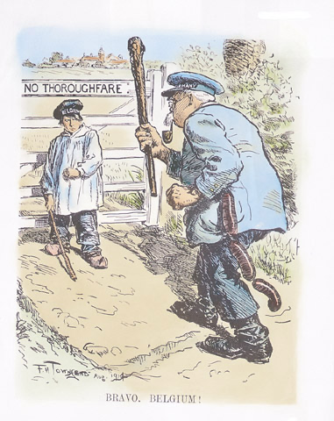
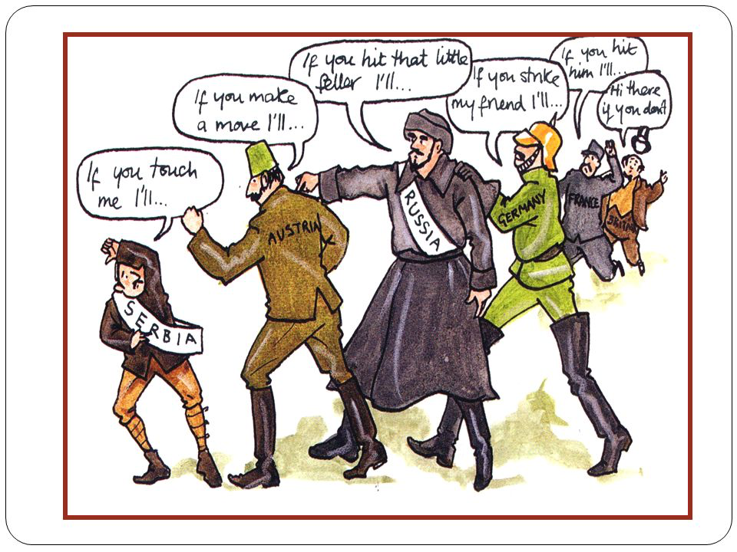

Slide 3
Edexcel IGCSE History P2: Breadth Study A1
The Origins & Course of WW1,
1905-1918
1.2 Empires & Economics

Slide 4
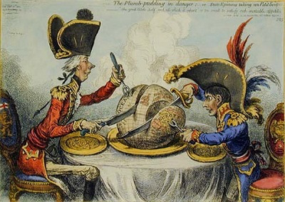
(b) Empires & Economics
The desire to acquire colonies, especially Germany’s desire, disturbed Britain & France. Populations were proud of their empires and were incredibly patriotic, which added to tensions in Europe.
Colonies provided raw materials and were ready-made markets for goods produced by the Europeans powers who governed them. Colonies, therefore, were linked to strength of European nations. The British & French often put pressure on their Governments if they felt their empires were under threat.

Slide 5
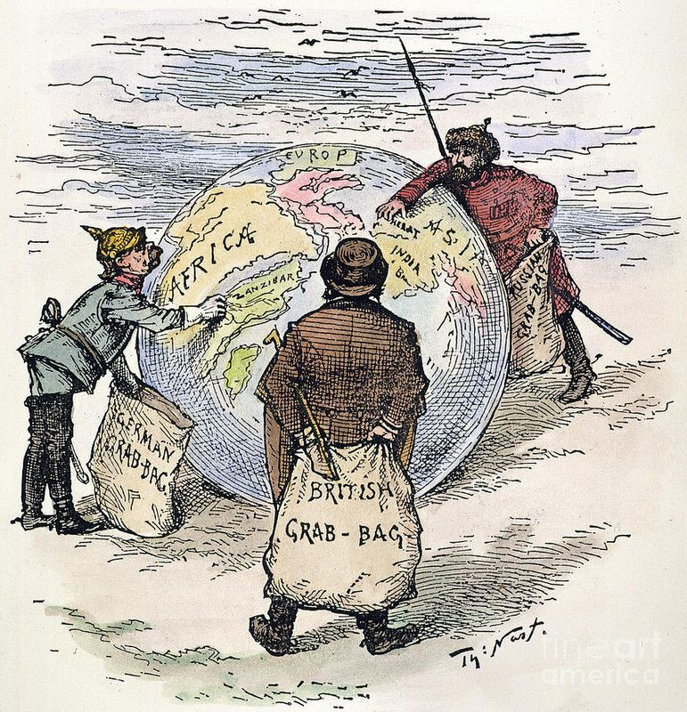
(b) Empires & Economics
All European nations were involved in trying to win colonies or supporting colonies. This led to Imperial Rivalry between the 6 ‘Great Powers’ to see who could amass the largest empire.
Russia & Austria-Hungary hoped to expand on mainland Europe.
Britain, France & Germany set their sights on expansion outside Europe.
These nations firmly believed they had a right to rule over others after invasion, take-over or by Treaty.

Slide 6
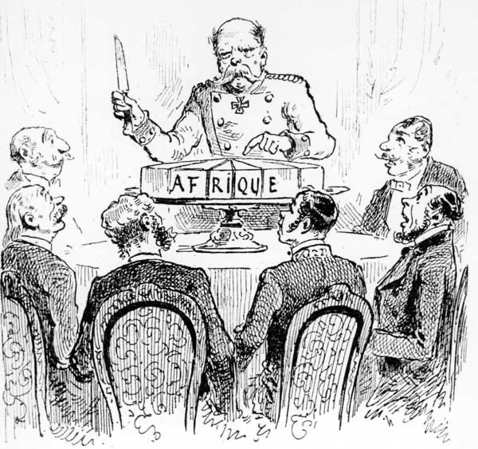
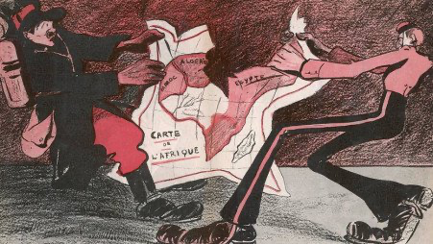
“THE SCRAMBLE
FOR AFRICA.”

Slide 7
Activity 2
In 1870, 10% of Africa
was under European control.
In 1914, 90% of Africa
was under European control.
Find out how this happened
in “THE SCRAMBLE FOR AFRICA”.

Slide 8
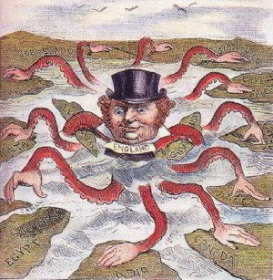
(b) Empires & Economics
In 1905, Great Britain was the most powerful country in the World – mostly due to its overseas empire. It took up nearly a quarter of the World’s surface and a quarter of the World’s population was under British control. Britain needed to monitor, maintain and manage its many colonies – especially the Jewel in the Crown – India. Raw cotton shipped from India & then Britain exported cotton cloth back to India. Merchant ships sailed the sea routes, protected by the Royal Navy. Any naval challenge to Britain was a threat to their Empire’s security. Any push for a colony was a threat to British dominance.

Slide 9
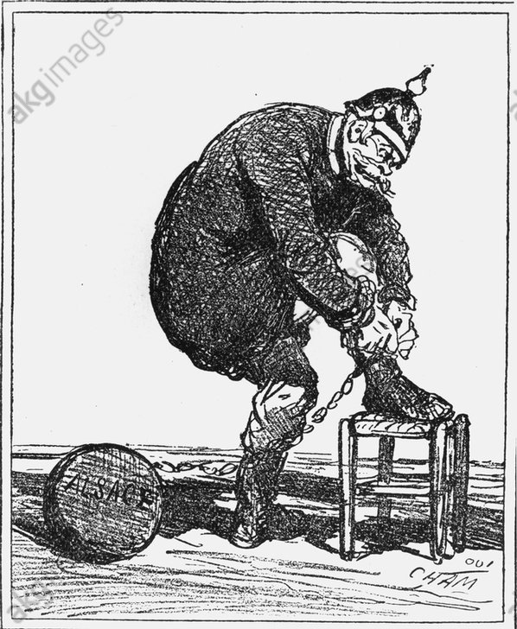
(b) Empires & Economics
The Republic of France had the second largest empire in the World, after Britain. Most of the French colonies were in West Africa, where they ruled without much opposition. In France’s Far East colonies, however, the French Army often fought with rebels demanding independence; putting a strain on the French economy. France was keen to keep all their colonies. After losing Alsace-Lorraine to Germany, France was determined to recover its reputation & prevent loss of any more land.

Slide 10
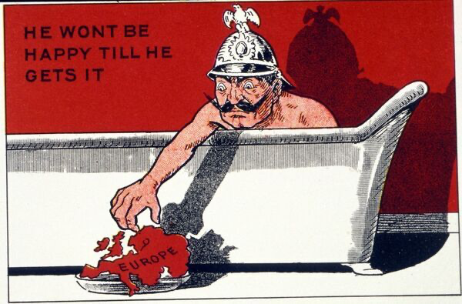
(b) Empires & Economics
Since Germany’s formation in 1871, German politicians expected the country to develop to be strong & powerful – mainly by acquiring colonies. A strong Navy was the key to gaining & holding on to such overseas territories. As the British Navy “Ruled the Waves”, however, this increased tension between the 2 Empires. Britain saw Germany as a threat to their established Empire, while Germany saw Britain as a block to becoming a World Power.

Slide 11
EUROPEAN POWERS + THEIR OVERSEAS COLONIES IN 1914
 | BRITAIN | FRANCE | RUSSIA | GERMANY | AUSTRIA-HUNGARY
POPULATION | 40.8 million | 39.6 million | 159 million | 65 million | 50 million
POPULATION OF COLONIES | 390 million | 58 million | 0 | 15 million | 0
NUMBER OF COLONIES | 56 | 29 | 0 | 10 | 0
SIZE OF COLONIES | 27 million Sq km | 11 million Sq km | 0 | 2.5 million | 0

Slide 12
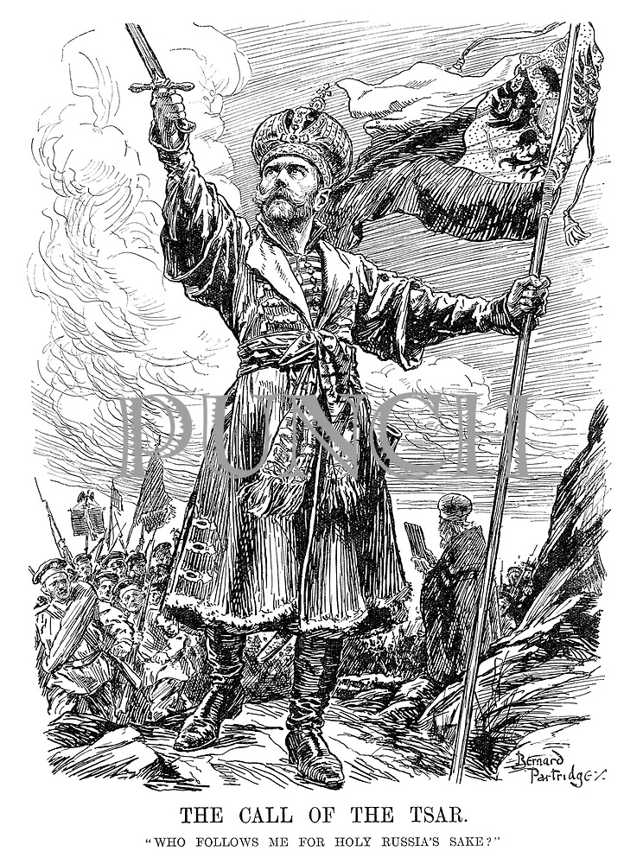
(b) Empires & Economics
Russia & Austria-Hungary had no overseas empires – they were happy without them. Russia wanted to expand within Europe, while Austria-Hungary wanted to control various nationalities within its borders:
Russia wanted to expand South-East into Manchuria for ice-free ports & wanted to expand into the Balkans for access to the Mediterranean Sea & the Atlantic.
Austria-Hungary contained 11 nationalities & struggled to hold them together. Czechs, made to use German, rioted & Serbs all seemed likely to break away to Serbia.

Slide 13
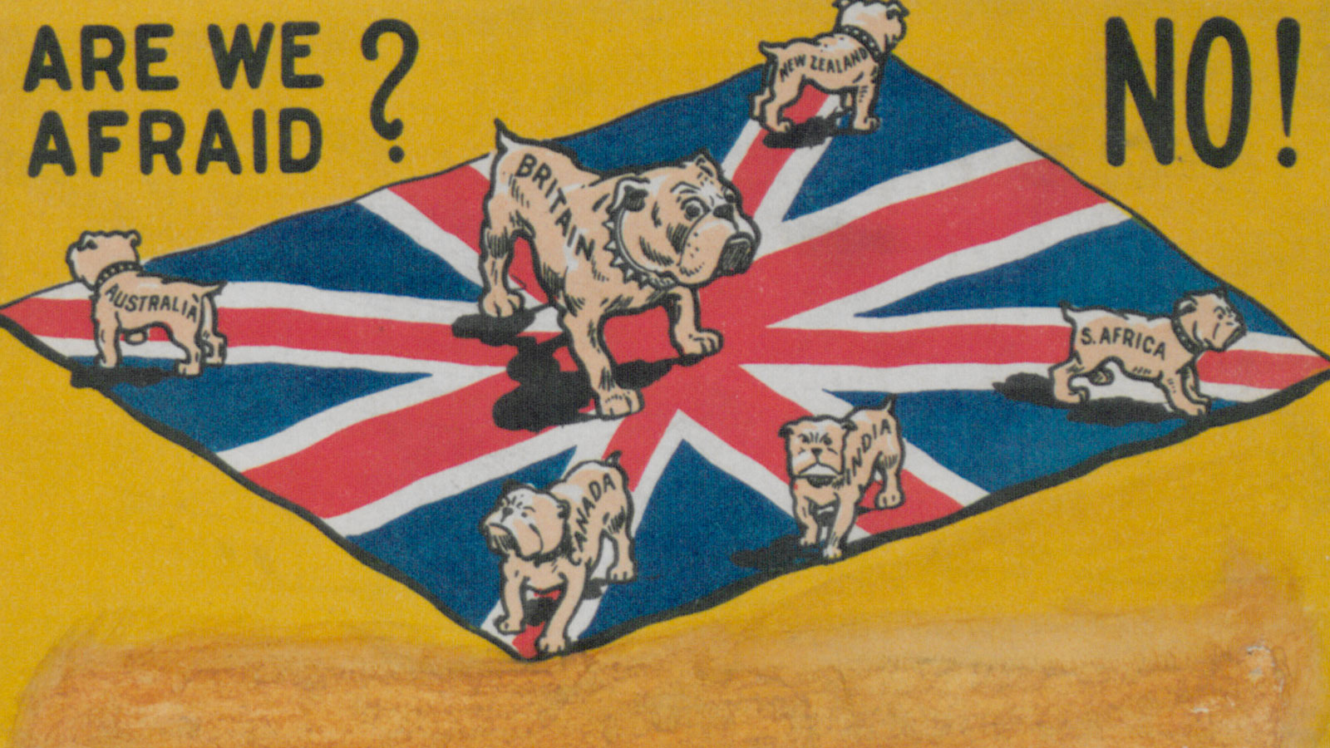
(b) Empires & Economics
Nationalism is closely linked to Empire & Imperialism. Loving one’s country is usually seen as a positive thing but, when nationalism becomes too strong & too extreme, it easily becomes aggressive. The slow, gradual build-up of nationalism across Europe in years running up to 1914 actually helped to prepare people for war and inspired young men to join up and fight.

Slide 14
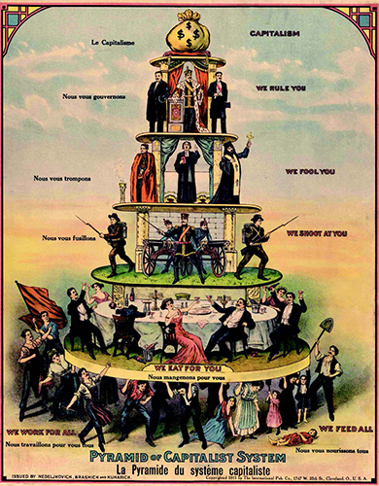
(b) Empires & Economics
Wealth really mattered in early 20th Century Europe – the more money a nation had, through buying & selling goods, the bigger Army & Navy it could have to protect itself.
A country that was rich in raw materials & had efficient industry & markets to sell goods to could become incredibly wealthy. This led to increasing economic rivalry in Europe as the 6 ‘Great Powers’ competed to have the major share in European economic activity. Rivalry soon became tension – war was looming.

Slide 15
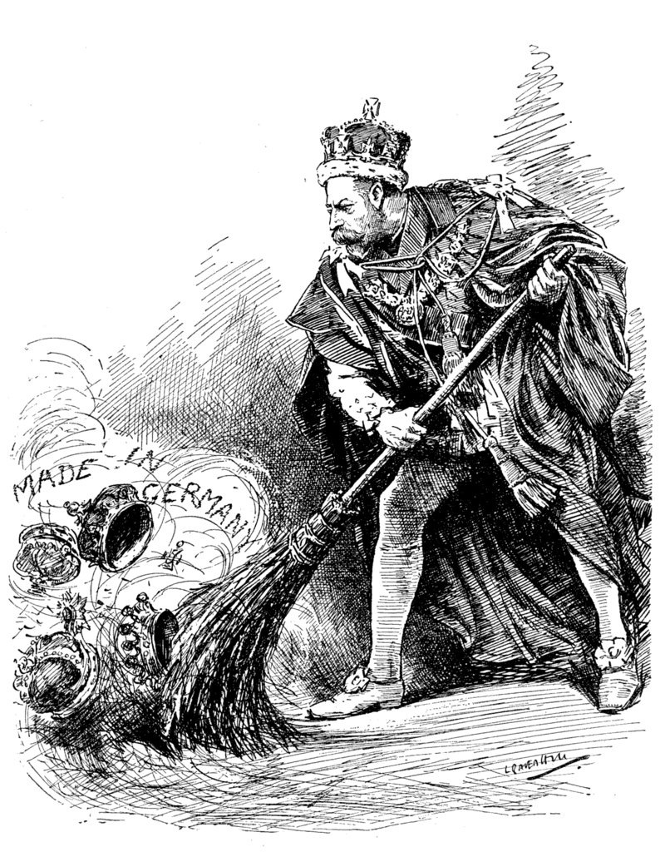
(b) Empires & Economics
BRITAIN v. GERMANY
After Britain was the first nation to industrialize, goods manufactured in Britain flooded European markets & the British Empire. Britain was clearly well-resourced with raw materials from its empire. As a result, Britain was the richest country in Europe in the 19th Century. After 1871, however, Germany caught up by modernizing manufacturing. By 1890, German goods were competing with British goods in every single market previously dominated by Britain. By 1914, Germany produced more iron, steel & coal (even cars!) than Britain & Germany was the strongest power economically.

Slide 16
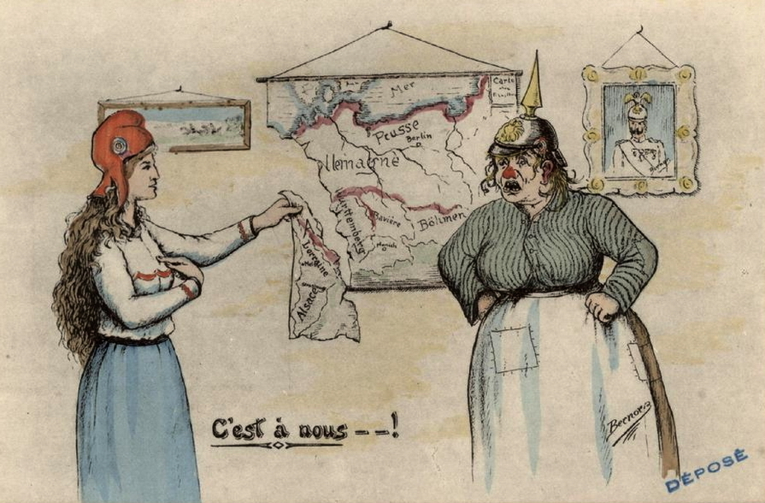
(b) Empires & Economics
FRANCE v. GERMANY
When France lost Alsace-Lorraine to Germany, it had to import coal from other countries. This hit the French economy and weakened it, because the loss of coal-rich Alsace-Lorraine left France without a ready-made resource. France investigated the possibility of mining for minerals in Morocco. Importing minerals from Morocco, however, would put France into competition with Germany in terms of agriculture & industry. Furthermore, Germany feared that France was trying to turn Morocco into a new French colony.

Slide 17
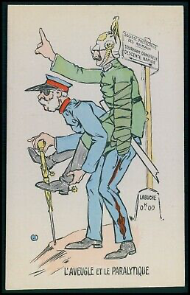
(b) Empires & Economics
RUSSIA v. GERMANY + AUSTRIA-HUNGARY
Germany & Austria-Hungary had well-established commercial markets in the Balkans. In 1888, Russia had begun to build a railway in the area. Germany & Austria-Hungary regarded this as a threat to their prosperity, because a railway would allow Russian goods to be transported around easier. Even though Russia had not yet fully industrialized, and was not producing much of anything to export, Germany & Austria-Hungary were worried about what the future held. Neither could afford to let Russia encroach into their markets and tension was building between all 3.

Slide 18
EUROPEAN POWERS + THEIR ECONOMIES IN 1914
 | BRITAIN | FRANCE | RUSSIA | GERMANY | AUSTRIA-HUNGARY
COAL PRODUCED | 292 million tonnes | 40 million tonnes | 36.2 million tonnes | 277 million tonnes | 47 million tonnes
STEEL PRODUCED | 11 million tonnes | 4.6 million tonnes | 3.6 million tonnes | 14 million tonnes | 5 million tonnes

