Slide 1
Edexcel IGCSE History P2: Breadth Study A1
The Origins & Course of WW1,
1905-1918

Slide 2
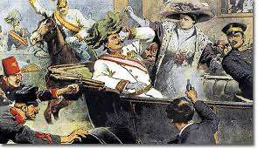
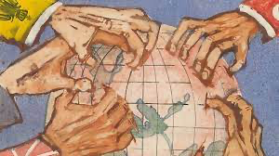
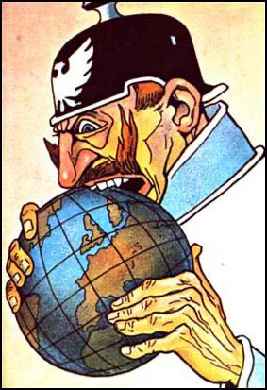
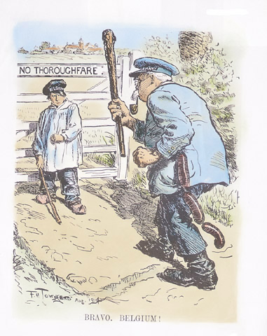
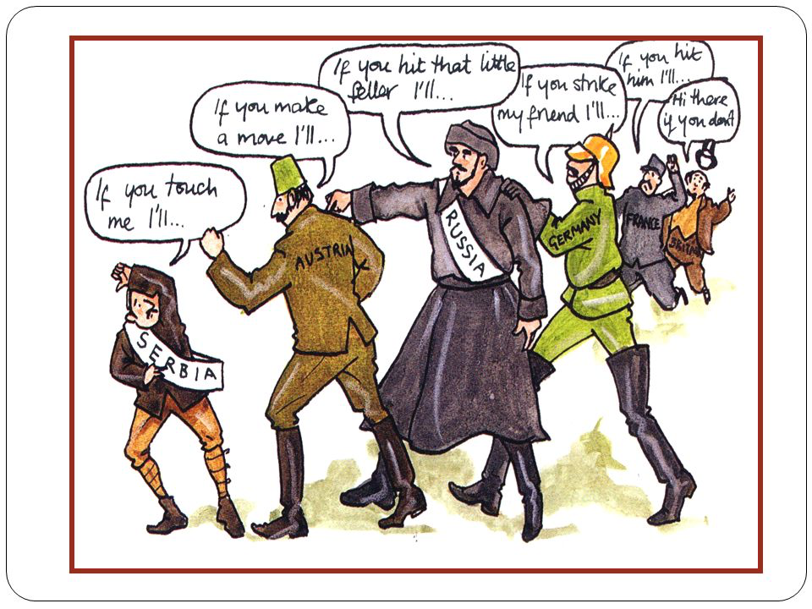

Slide 3
Edexcel IGCSE History P2: Breadth Study A1
The Origins & Course of WW1,
1905-1918
1.1 The Alliance System

Slide 4
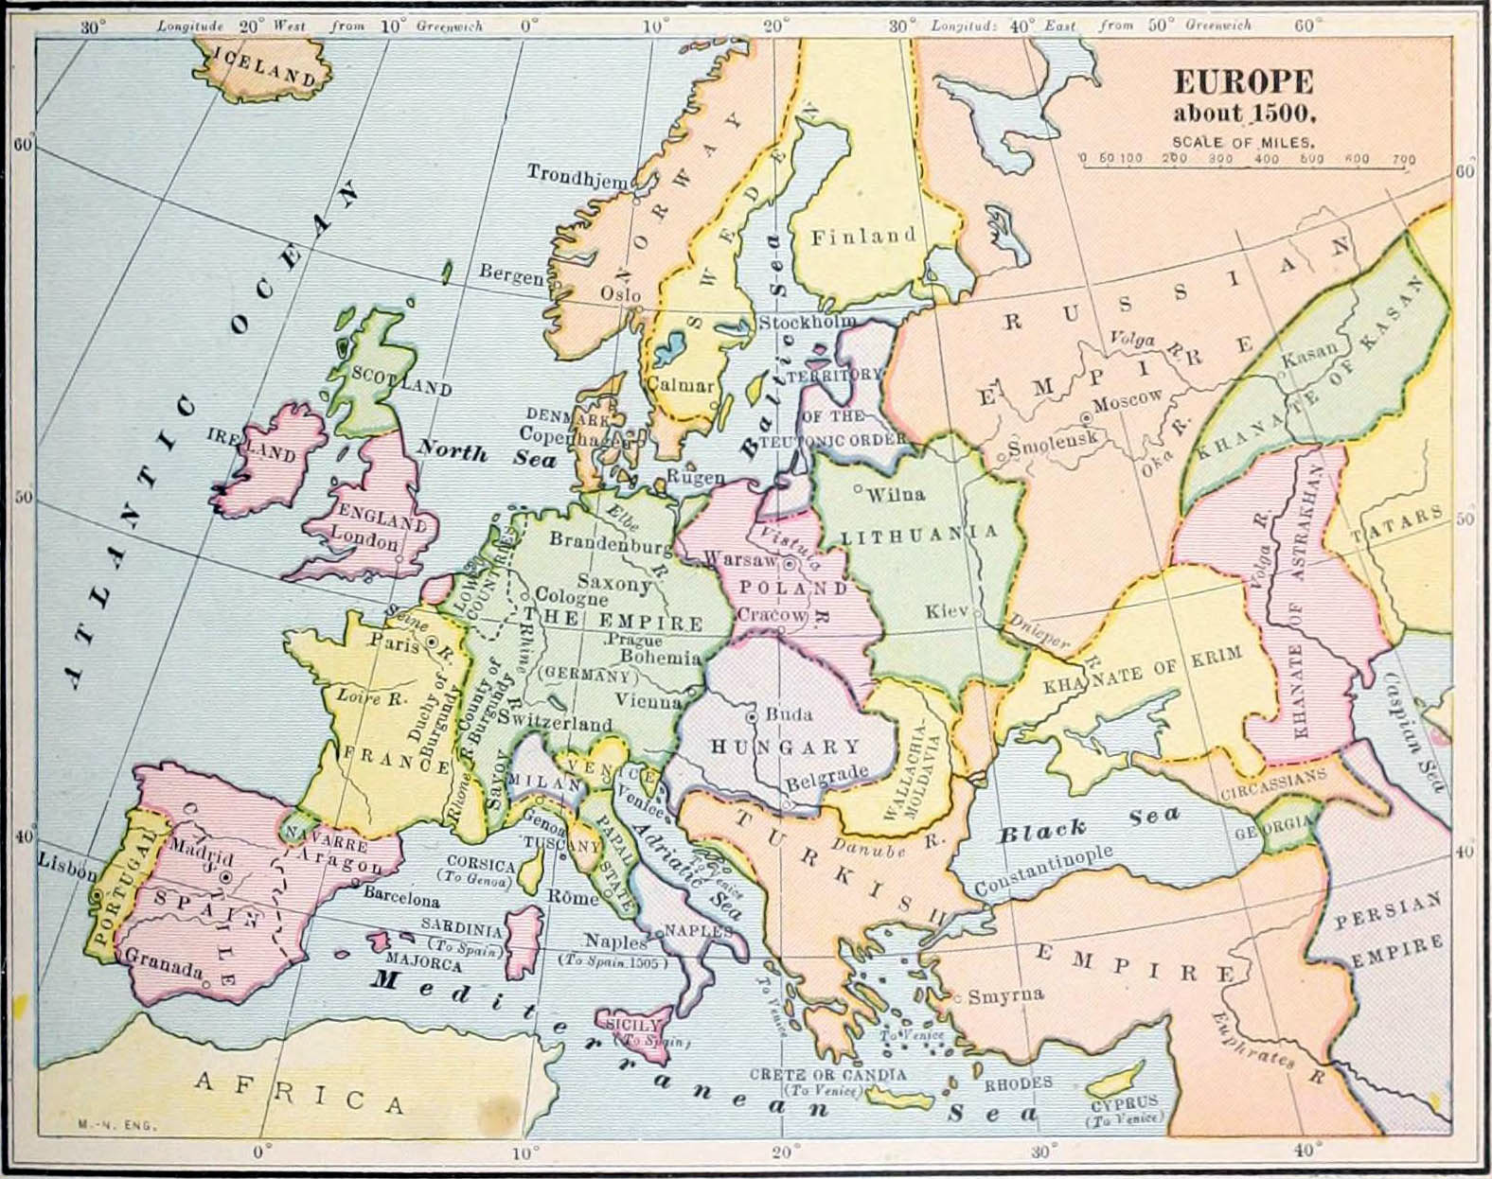
(a) The Alliance System
At the beginning of the 20th Century there were 6 ‘Great Powers’ in Europe:
Germany Austria-Hungary
Italy France
Russia Great Britain
Despite their differences, in aims & ambitions, they had things in common:
The desire to be safe from attack from other nations
The desire to increase their prosperity through trading in overseas markets

Slide 5
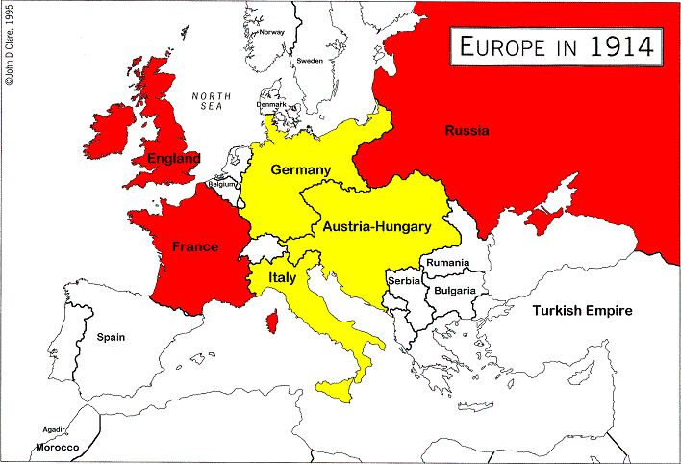
(a) The Alliance System
In trying to obtain security from attack & increase trading opportunities, the ‘Great Powers’ often found themselves competing; sometimes, inevitably, leading to wars. By the end of the 19th Century, the ‘Great Powers’ had begun to protect themselves by uniting into a system of alliances by 1905:
THE TRIPLE ALLIANCE; Germany, Italy & Austria-Hungary.
RUSSO-FRANCO ALLIANCE, Russia & France
THE ENTENTE CORDIALE, Britain & France
Tensions between these fierce rivals gradually deepened until war broke out in 1914.

Slide 6
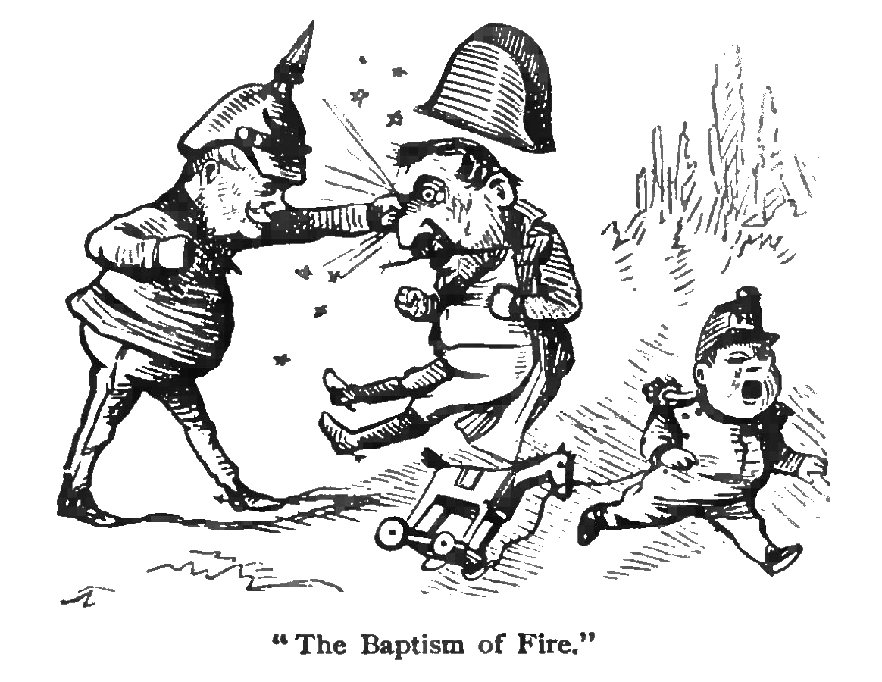
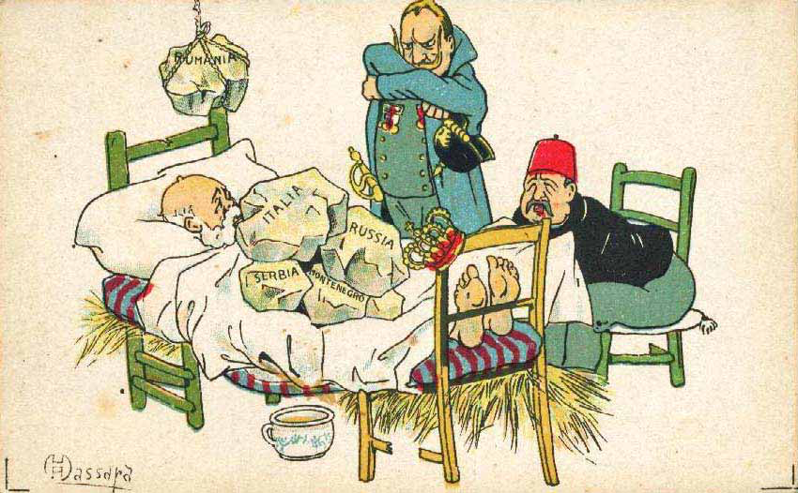
(a) The Alliance System
Pre-1905 tensions in Europe include:
GERMANY – They defeated France in the Franco-Prussian War & took industrial Alsace-Lorraine as part of the Peace. Germans feared France would strike any moment to seize back Alsace-Lorraine.
AUSTRIA-HUNGARY – They were a huge Empire in Central Europe, containing different nationalities; some expecting independence. It was up to the Austrian Emperor to keep his Empire together. He knew Serbs were supported by Russia, so the 2 huge Empires were mighty rivals.

Slide 7
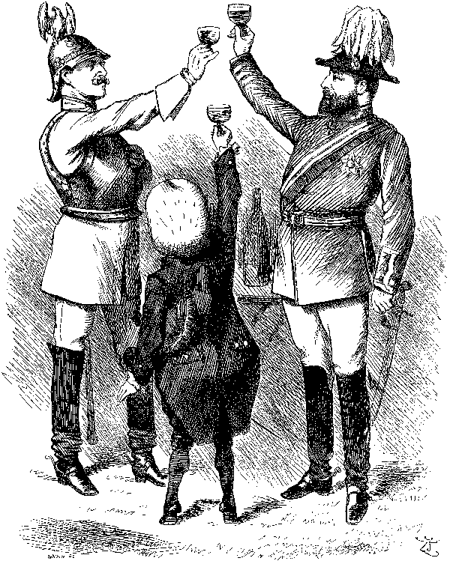
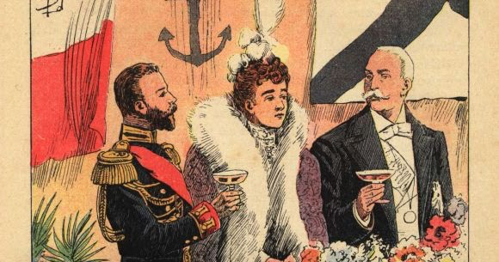
(a) The Alliance System
Pre-1905 tensions in Europe include:
ITALY – Like Germany, it was a relatively ‘new’ country so lacked industrial & military strength. Keen to ally with others, it joined the Triple Alliance and, thereby, was anti-Russian & anti-French.
FRANCE – They were primarily concerned with ensuring that Germany never attacked them again and to steal back Alsace-Lorraine. France allied with Russia, purely because it wanted some support against Germany and it was difficult to fight enemies on both fronts.

Slide 8
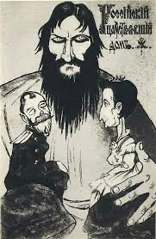
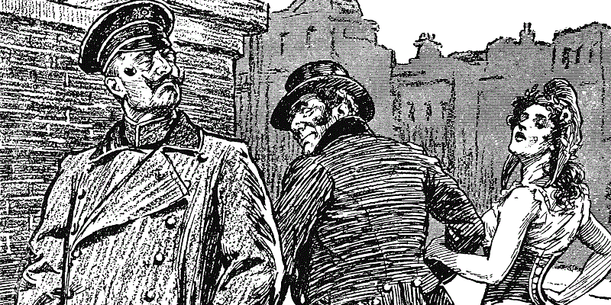
(a) The Alliance System
Pre-1905 tensions in Europe include:
RUSSIA – As largest of the 6 ‘Great Powers’, it was ironically the least developed. Their main fear was that Germany would try to expand into their territory & Austria-Hungary would take measures against Slavs in their Empire.
GREAT BRITAIN – They preferred to keep out of European politics in “Splendid Isolation”. The British Navy & Empire limited the need to form alliances but, as the 20th Century began, Germany’s Navy & Empire became a direct threat to British dominance. In 1904, Britain & France joined the Entente Cordiale.

Slide 9
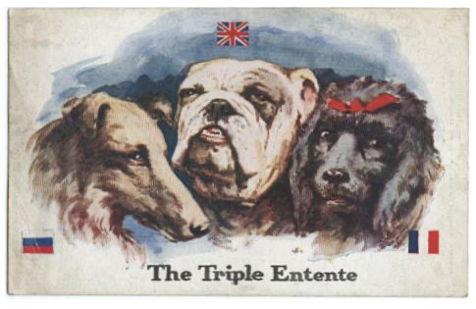
(a) The Alliance System
By 1905, Europe was beginning to divide into 2 separate groups whose rivalry was to lead to war in 1914.
What had changed to make things worse?
In 1907, Russia joined with Britain & France to make THE TRIPLE ETENTE. There was no formal agreement to support each other if one was attacked, but it was assumed that there was a moral obligation to support each other.

Slide 10
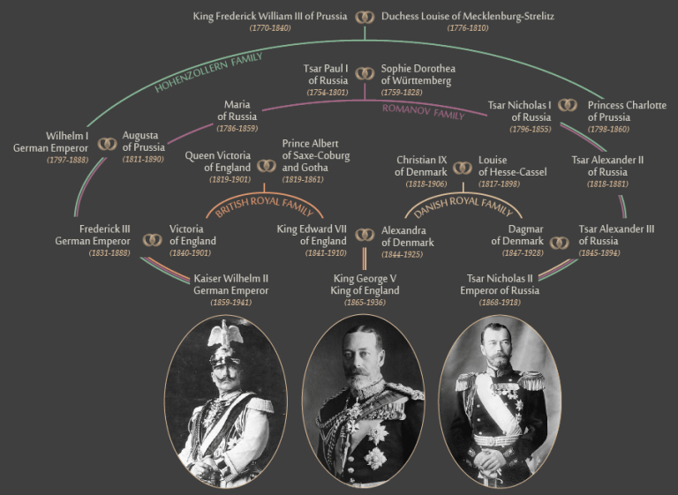

Slide 11
Activity 1
A. Who was King George V’s father?
B. Who was the Kaiser’s mother?
C. How are Answers A + B related?
D. What does that make the Kaiser + George V?
E. Who was Tsar Nicholas II’s mother’s sister?
F. Who was King George V’s mother?
G. What does that make the Tsar + George V?

Slide 12
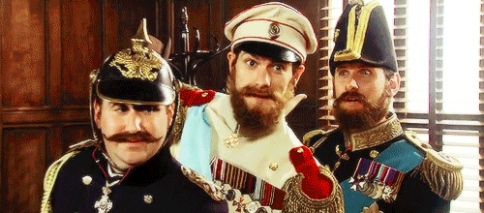
https://www.youtube.com/watch?v=oXmMT4sETu8

Slide 13
Exam-Style Question
Describe two features
of the alliance system
in 1905. (6 marks)
Hint – Identify two clear features, don’t just say who is on each side!

