Slide 1
Edexcel IGCSE History P1: Depth Study 3
Germany: Development of Dictatorship, 1918-1945

Slide 3
Edexcel IGCSE History P1: Depth Study 3
Germany: Development of Dictatorship, 1918-1945
5. Germany & the Occupied Territories
during WW2, 1939-1945

Slide 4
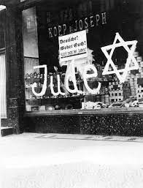
(a) Nazi Policies towards Jews
It is wrong to assume that Adolf Hitler skipped straight to killing Jews from the very start of Nazi Germany. The Nazi policy was more divisive than that – by slowly de-humanizing Jews through propaganda & laws against them in the 1930s, when the “Final Solution” came in 1942, most Germans did not oppose it as anti-semitism had become an accepted and acceptable part of Nazi ideology. Loyal Nazis, old & young, saw nothing wrong with the euphemistic “re-homing” the Jews in the East and removing them from German society.

Slide 5
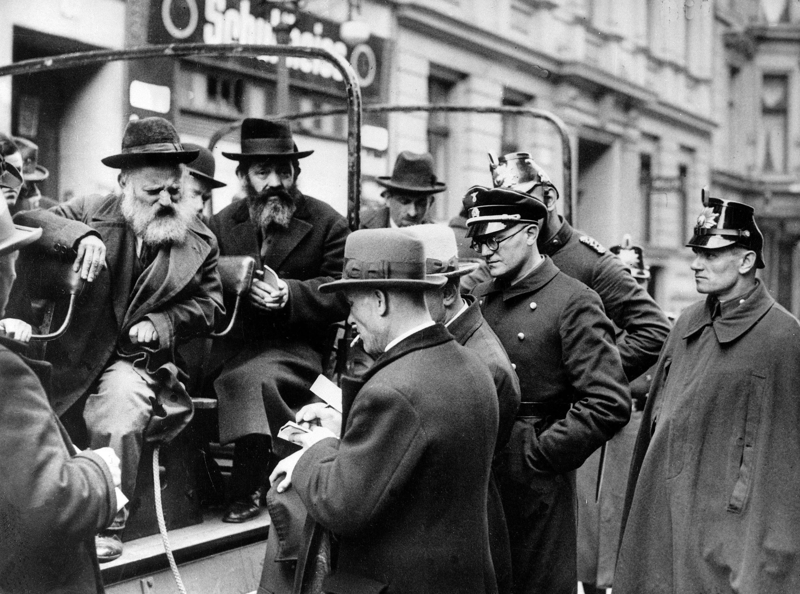
(a) Nazi Policies towards Jews
The persecution process was slow for the Jews and, at the start, Nazis hoped that Jews would simply flee Germany:
1933:Boycott of Jewish Businesses
1934: Jews banned from public places
1936: Nuremberg Laws forbidding marriage and removing citizenship
1938: KRISTALLNACHT
1939: Emigration speeded up
1940: GHETTOISATION
1941: Stars of David to be worn (6+)
1941: DEATH SQUADS

Slide 6
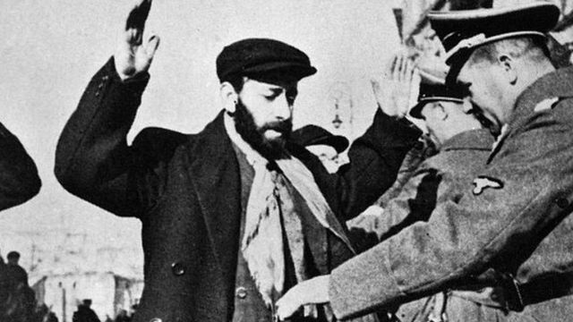
(a) Nazi Policies towards Jews
After the 1939 invasion of Poland, Germany’s policy of “Lebensraum” expansion of their borders only added more & more Jews. While Germany contained fewer than 200,000 Jews, Poland added over 3,000,000 Jews to the peoples that Germany controlled. Nazis could not adopt the same successful strategies they had used in their own country – like persecution to ensure mass emigration – so two alternative approaches had to be applied.

Slide 7
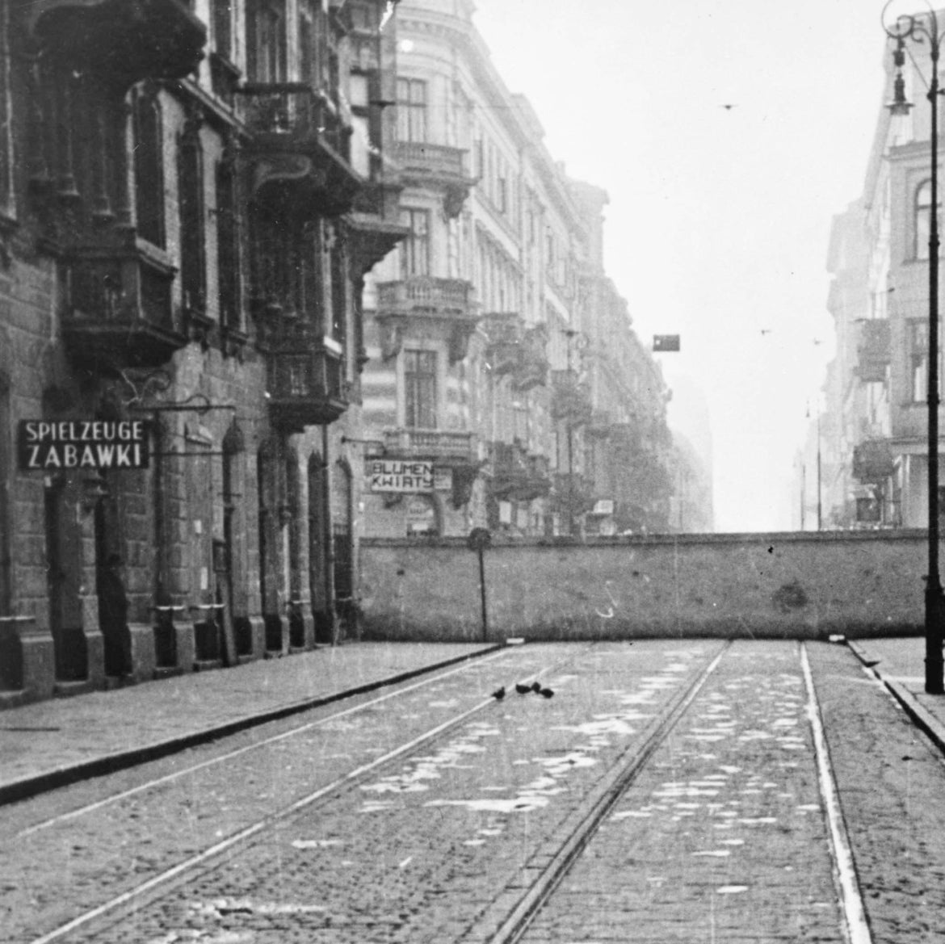
(a) Nazi Policies towards Jews
GHETTOISATION
In Polish cities, GHETTOS were set up and these walled-off areas saw Jews crammed into poor housing “Jewish Quarters”. All movement in and out of ghettos was tightly restricted, so food supplies soon ran out and starvation was quite common. Diseases like typhus and cholera, made worse by no medical supplies, were rife. The Warsaw Ghetto had a 3.5m wall, topped with barbed-wire & broken glass, built by a German Company but charged to the Jewish community of Warsaw. From Jan. 1941 to July 1942, almost 4,000 Jews died each month.

Slide 8
‘Realizing that the Germans intended to exterminate the Jews of Warsaw, Adam Czerniakow committed suicide. Before swallowing the tablet, he wrote two notes – one to the Jewish Council and the other to his wife. In he first, he said that the Germans had visited him that day and told him the expulsion order applied to children as well. They could not expect him to hand over helpless children for destruction. He had therefore decided to put an end to his life. He had asked his colleagues not to see this as an act of cowardice.’
An account of the chairman of Warsaw Jewish Council’s death, 1942
Are you surprised by this account? What does it tell you about ghettos?

Slide 10
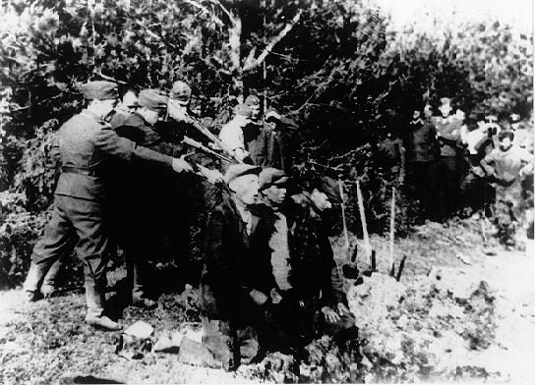
(a) Nazi Policies towards Jews
DEATH SQUADS
After the invasion of Russia in 1941, Germany easily taking western areas, even more thousands of Jews were under German control. Instead of establishing Soviet Ghettos, however, “Einsatzgruppen” tailed the German Army. These Death Squads rounded up Gypsies & Communists, but especially Jews – men, women & children – to be executed & thrown into mass graves in fields & forests. Einsatzgruppen had murdered more than 1.2 million Soviet civilians by 1943.

Slide 11
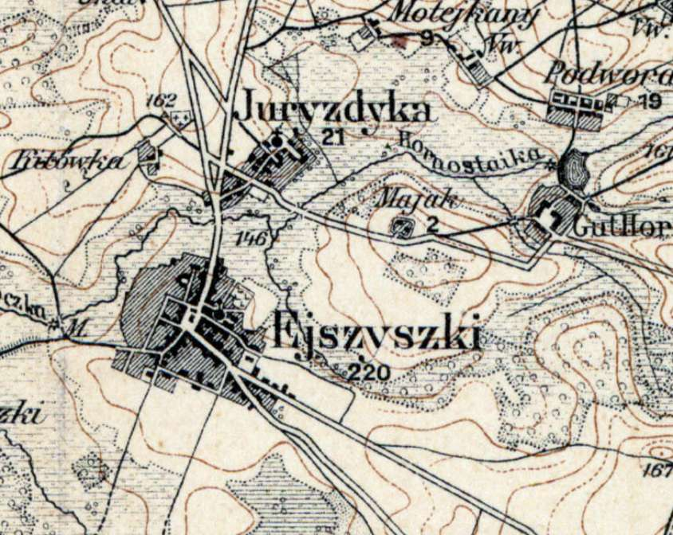
Activity 19
Find out what happened in Ejszyszki on 21 Sept. 1941.
What is the legacy of that day on the town of Ejszyszki today?

Slide 13
Exam-Style Question
Explain two effects on
Jews of the Nazi policy of
Jewish ghettos. (8 marks)
Hint – When explaining effects, you can include long-terms as well as short-term!

Slide 15
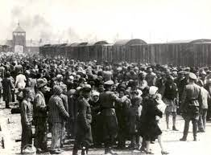
(a) Nazi Policies towards Jews
The “Final Solution” to the “Jewish Problem” was decided at the Wannsee Conference of Nazi leaders in Berlin in January 1942. Put simply, the “Final Solution” was to convert concentration camps in the East into death camps – to exterminate the Jews using gas chambers & cremate their remains in ovens. This mass murder, up to 6,000,000 Jews killed, became known as the Holocaust. In addition to the Jews, an additional 5,000,000 non-Jews (gypsies, homosexuals, priests + the disabled) were killed in camps like Auschwitz, Treblinka & Dachau.

Slide 16
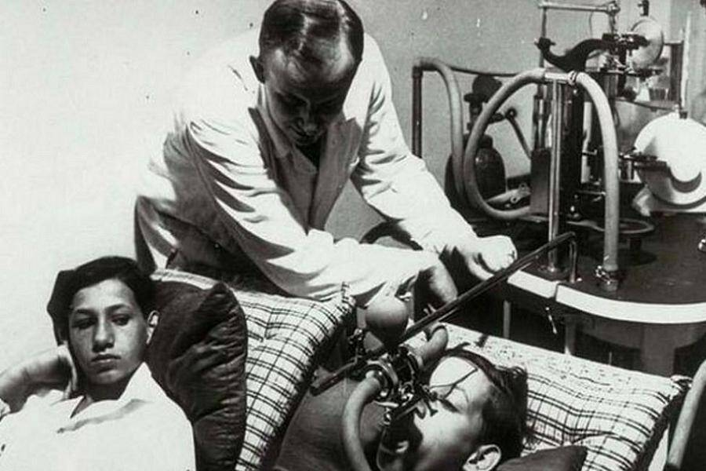
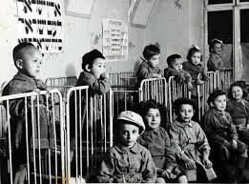
(a) Nazi Policies towards Jews
Before clearing the concentration camps, Nazis divided Jews into 2 groups:
1. FIT TO WORK – who were used like slaves to repair aerial bomb damage + often worked to death. Those deemed physically fit enough were also forced to take part in warped medical experiments under DR. JOSEF MENGELE; these were things like how long a human could take extreme cold and how a twin reacted if the other twin was infected with a deadly disease. Results had no medical value.
2. UNFIT TO WORK – who were killed.

Slide 18
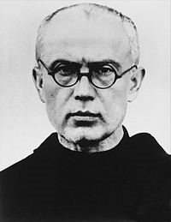
Activity 20
Find out where & when Polish Catholic Priest, Maximilian Kolbe, died.
Why was Maximilian Kolbe, was made a saint by the Pope in 1982?

Slide 20
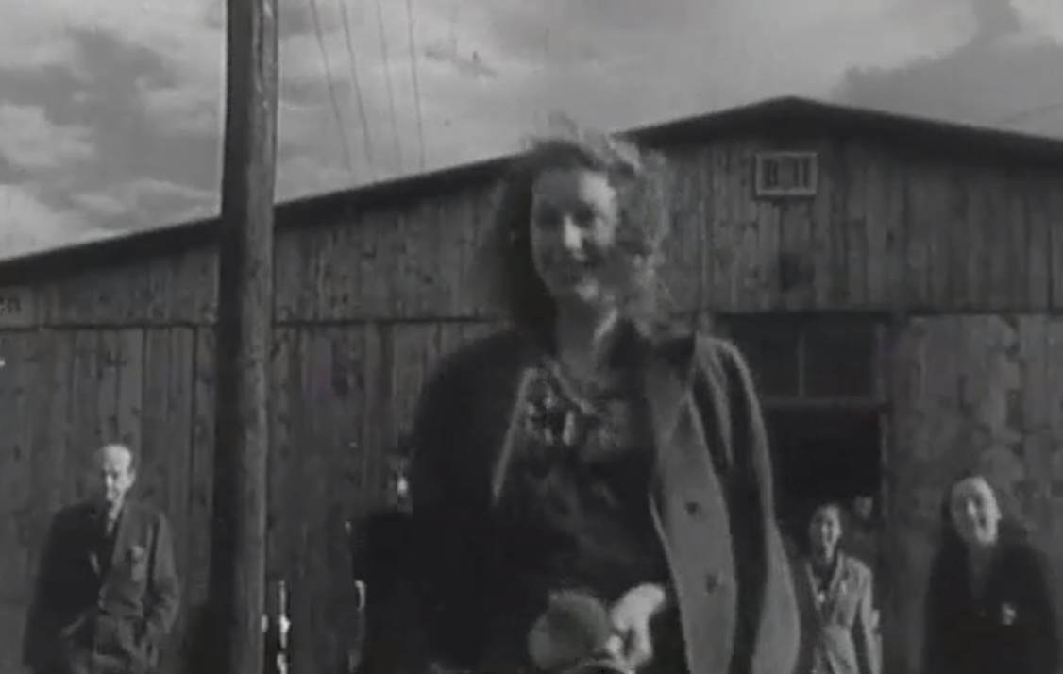
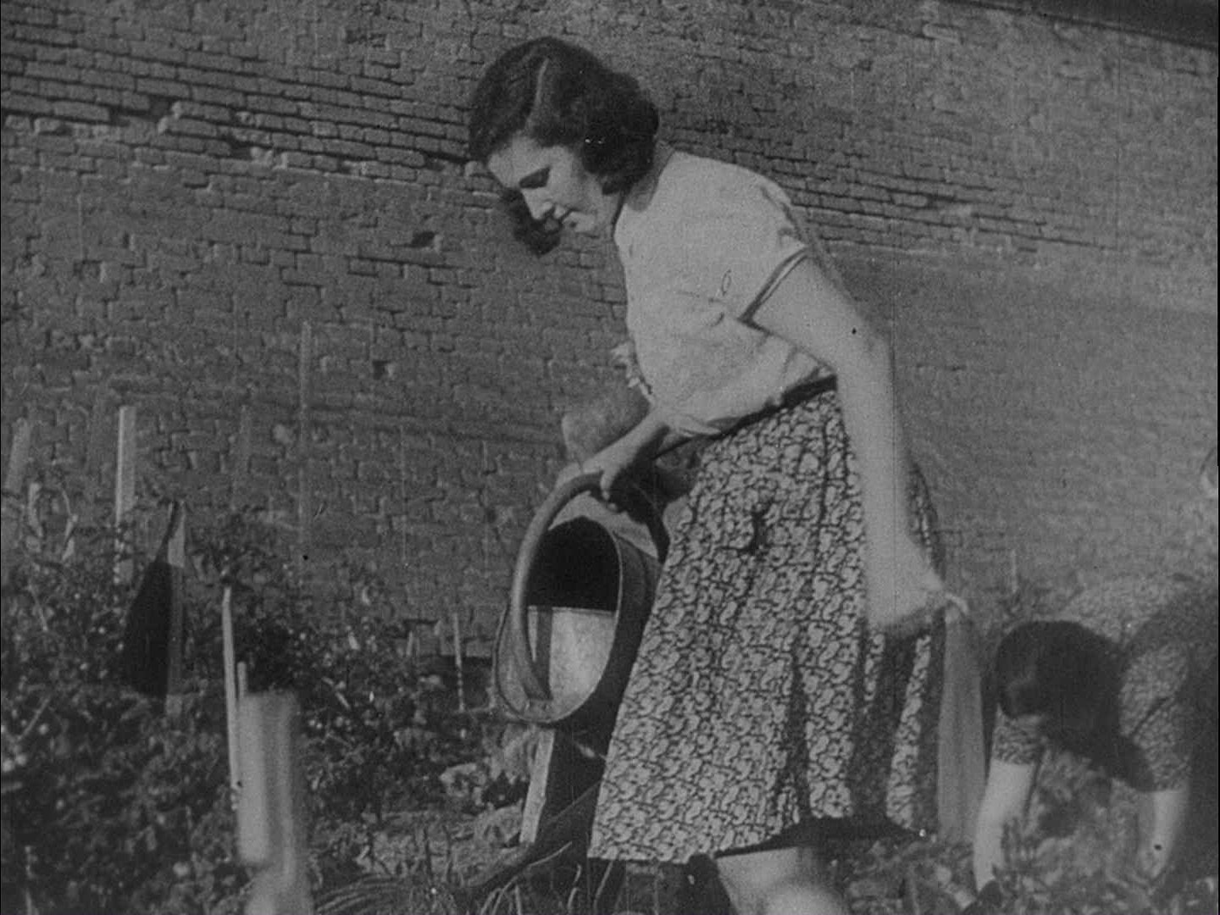
(a) Nazi Policies towards Jews
Propaganda was used extensively to hide the fact that the “Final Solution” was a genocide taking place. Ordinary Germans were under the false impression, from films shown of “resettlement in the East”, that Auschwitz & Treblinka were mere Labour Camps – providing good living conditions & treating Jews well within their walls. In April 1943, after Jews realized that they were not being “re-homed”, an uprising in the Warsaw Ghetto took place; Jews held out for a month, but the Nazis regained control by the end of May 1943 and 56,000 Jews were arrested, 7,000 shot + any remaining were sent to death camps.

Slide 21
‘In the summer of 1941, a decision was taken by senior Nazi leaders to seek a permanent and final solution to the Jewish question. It was to exterminate them in death camps … Death camps were built in Poland, far away from Germany, where Jews were to be worked to death … By the summer of 1943, Jews were being transported to these camps … On arrival at the camps, Jews were divided into two groups. Those who were fit were put to work. The others were sent to the gas chambers.’
An extract from a history of Germany, written in 2009
What impression does the author give about Nazi treatment of the Jews? (6m)

Slide 22
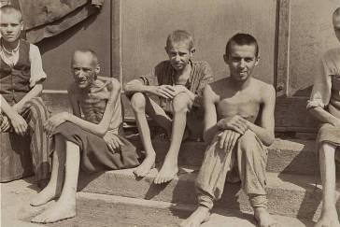
(a) Nazi Policies towards Jews
Once Adolf Hitler could see that Germany was losing the war, records & railways to Death Camps were hastily destroyed. Allied soldiers who liberated camps were stunned at what they saw in 1945. The reality of the Holocaust dawned, but has been debated ever since. Some deny it ever happened. RUDOLPH HOESS, Auschwitz Commandant, was hanged for war crimes in 1947.

Slide 23
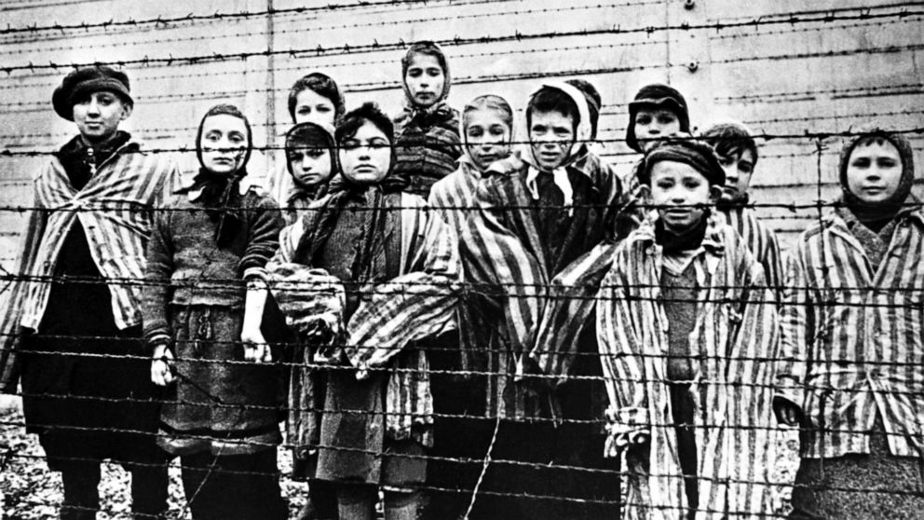

Slide 24
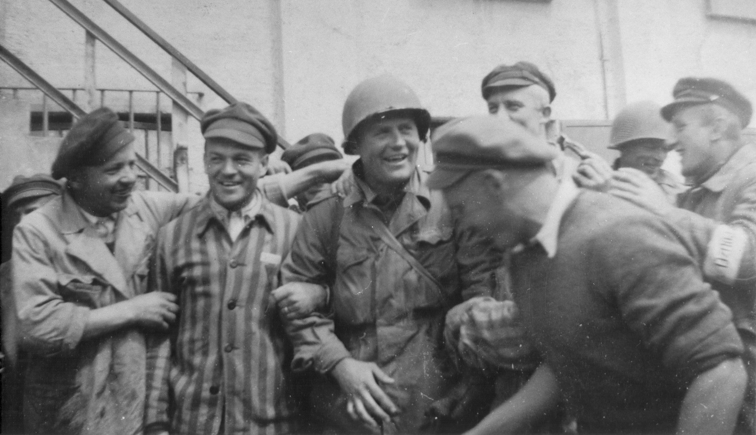

Slide 25
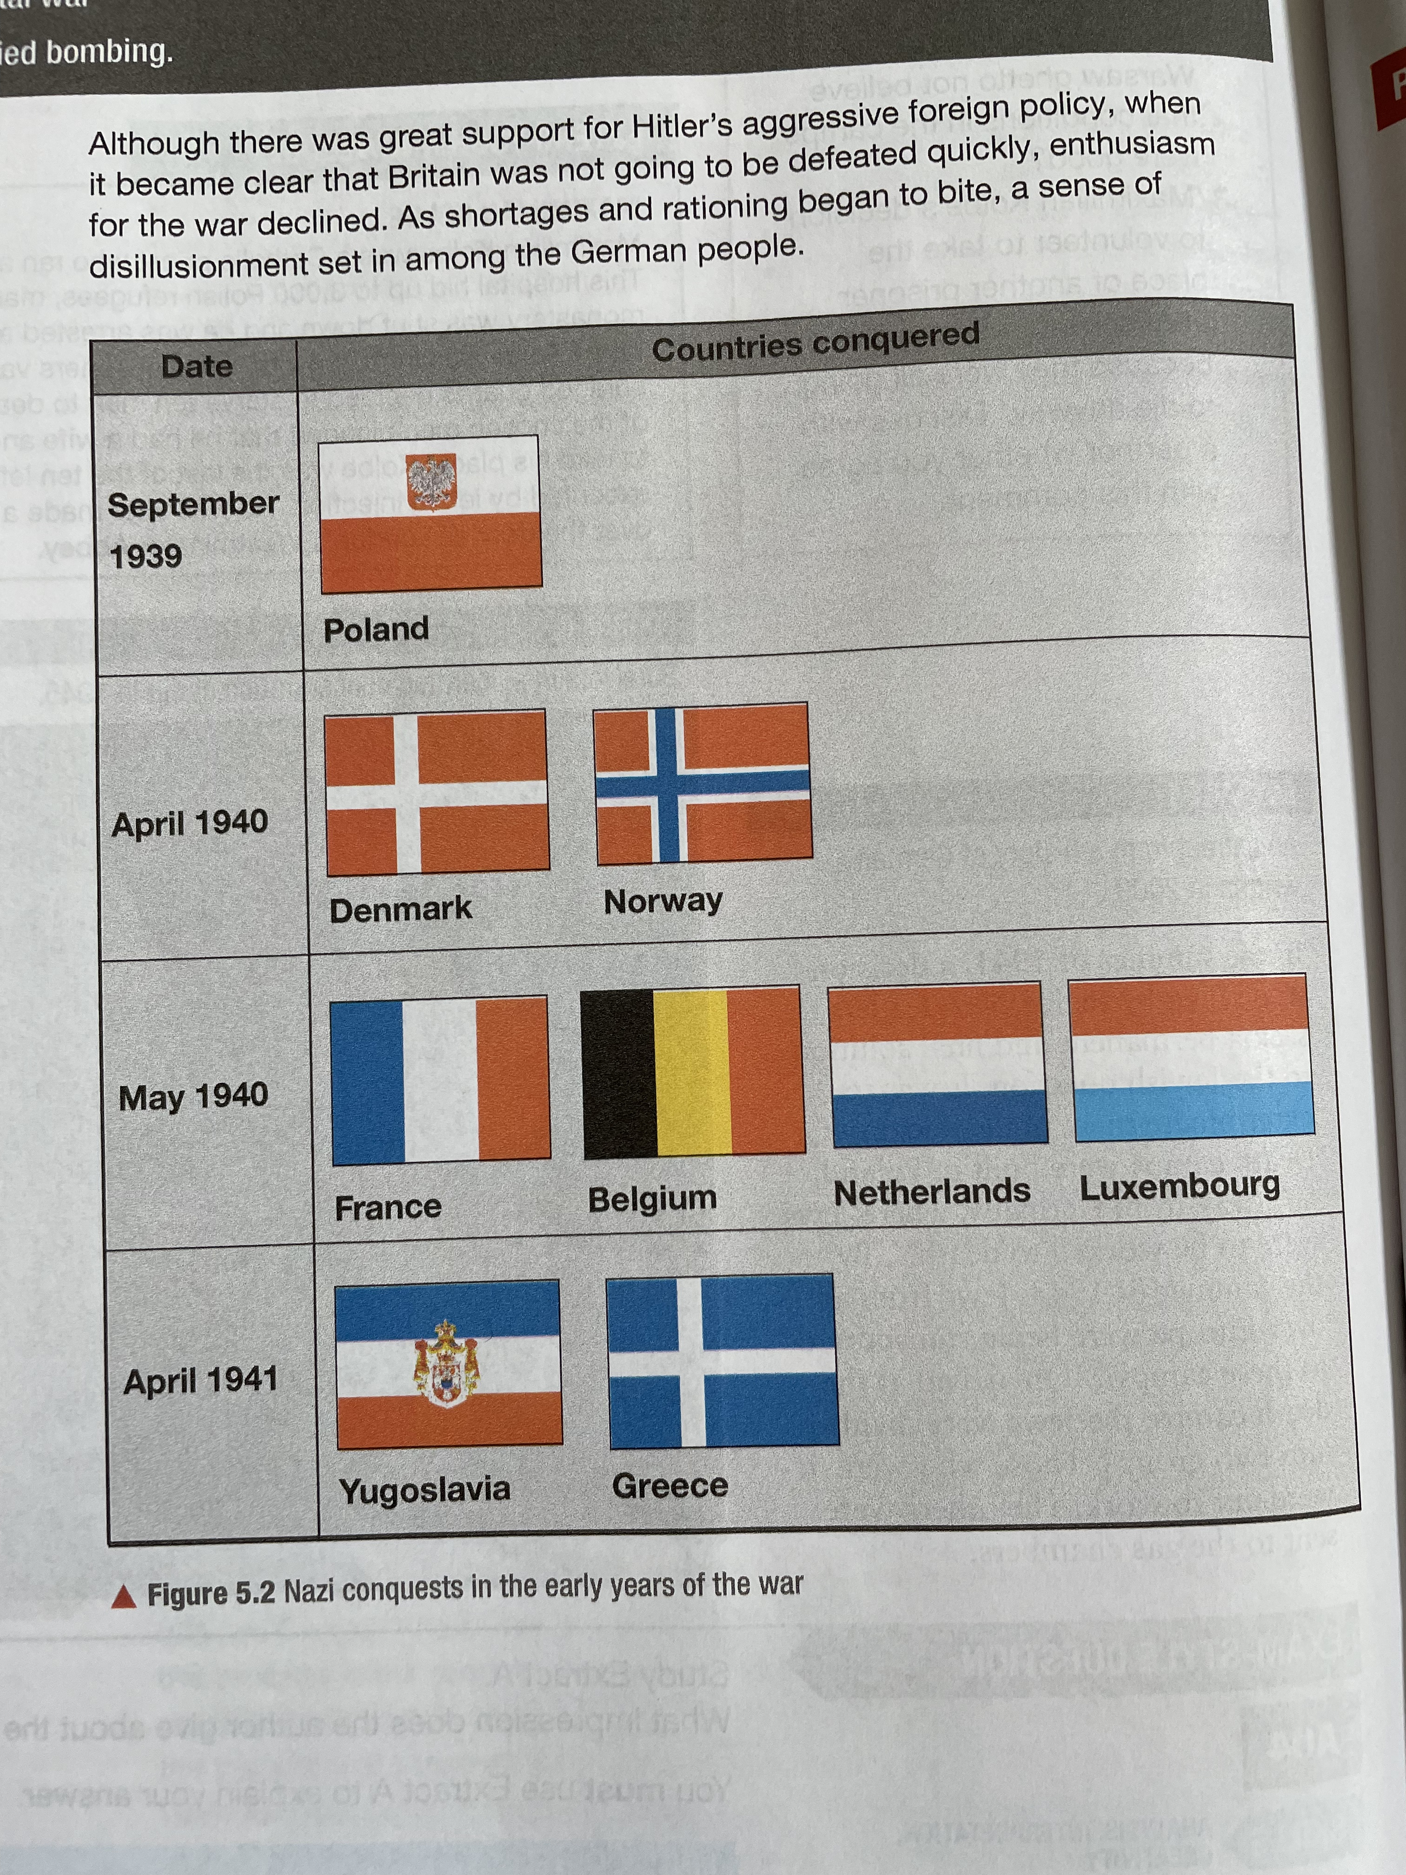
(b) The Home Front
From 1939 to 1941, the Nazi conquest of Europe via Hitler’s aggressive foreign policy went well. The Wermacht and the Luftwaffe co-ordinated in “Blitzkrieg” (Lightning) attacks that saw maximum force used for minimal engagement with the enemy – most quickly surrendered after the Army & Airforce attacked across the border. After Britain & Russia resisted, however, enthusiasm in Germany began to wane.

Slide 26
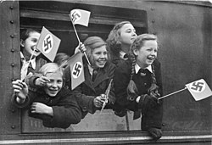
(b) The Home Front
Unlike the British evacuation of major cities, when Germans were told to evacuate children from Berlin MANY CHOSE NOT TO! Allied bombing from 1942 onwards changed German minds, however, so children were evacuated from cities to rural areas. About 2.5 million children were evacuated across Germany as the Nazi “Kinderlandverschikung” policy was put in place. Rather than move into the houses of individuals who had room, the German evacuees were placed into one of 9,000 camps supervised by Hitler Youth leaders and the Nazi Teachers Association.

Slide 27
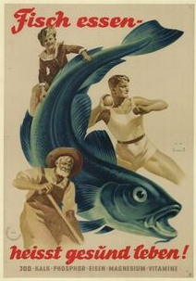
(b) The Home Front
Rationing for the German population began in August 1939:
BREAD & DAIRY
MEAT & SOAP
In November 1939, rationing included
CLOTHING
Despite this, however, the goods and products seized from the conquered countries meant that luxuries, like chocolate & furs, helped to keep morale high. Shortages of COAL & SHOES in the successive winters of 1939-40 + 1940-41 made the population totally disillusioned.

Slide 28
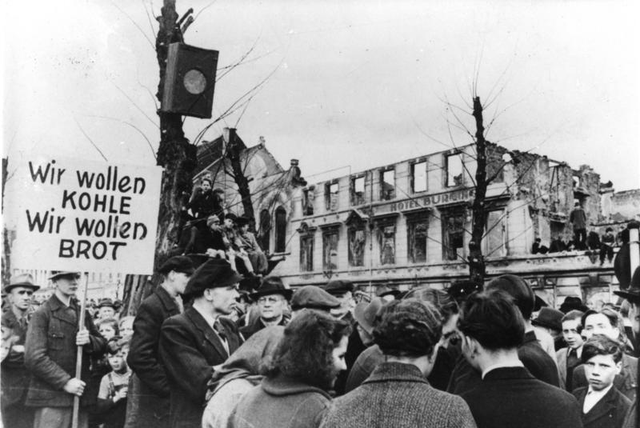
(b) The Home Front
In May 1942, drastic shortages forced the Nazis to cut rations even further:
BREAD: ½ loaf per person per day
MEAT: 40g per person per day
Goods were available on the “Black Market”, of course, but at vastly inflated prices that only the wealthiest Germans could afford.
Food shortages had to be coped with & many Germans learned to live with shortages, rationing & restrictions.
By 1945, many Germans were facing starvation and desperately hungry.

Slide 29
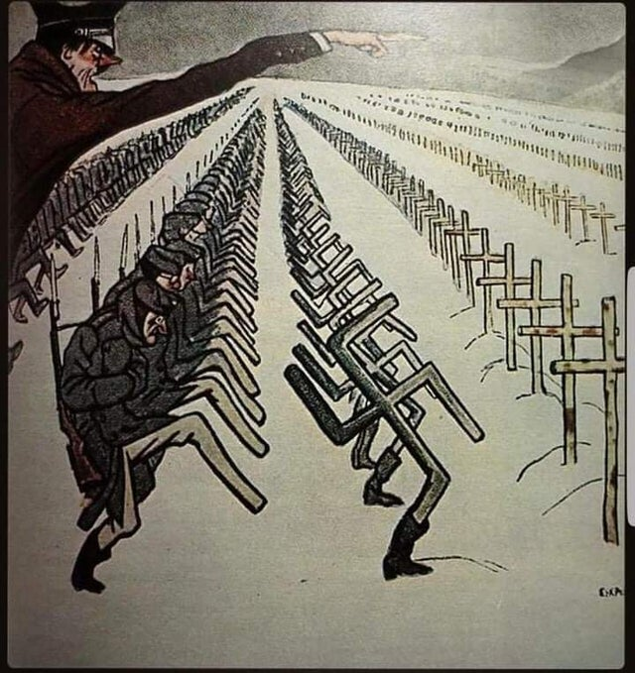
(b) The Home Front
Hitler’s worst gamble of WW2 was the launch of OPERATION BARBAROSSA in June 1941. At first, Hitler’s Wermacht advanced rapidly & were threatening Moscow, Leningrad & Kiev by early November 1941. In late November 1941, however, temperatures plummeted & the German advance slowed. Supplies & winter equipment were low, so the Germans were facing defeat. The Soviet “Scorched Earth” policy – destroying anything useful to the enemy – left the Germans trapped in a prolonged war of attrition that saw 2 million Germans die.

Slide 30
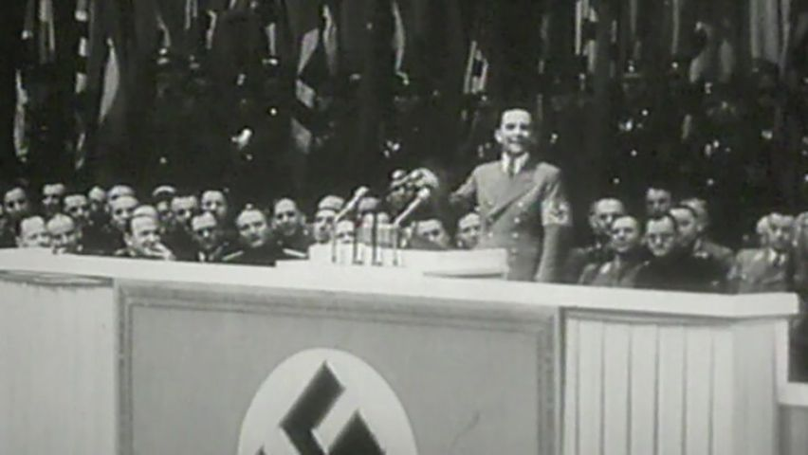
(b) The Home Front
The Nazis did not at all like to acknowledge the great strain that the failure of Operation Barbarossa put on Germany. In February 1943, Dr. Joseph Goebbels announced to the German people that a “TOTAL WAR” now existed – all of Germany’s resources had to be fully committed to fighting for victory & the German people had to support this idea that everybody & everything was focused on winning the war.

Slide 31
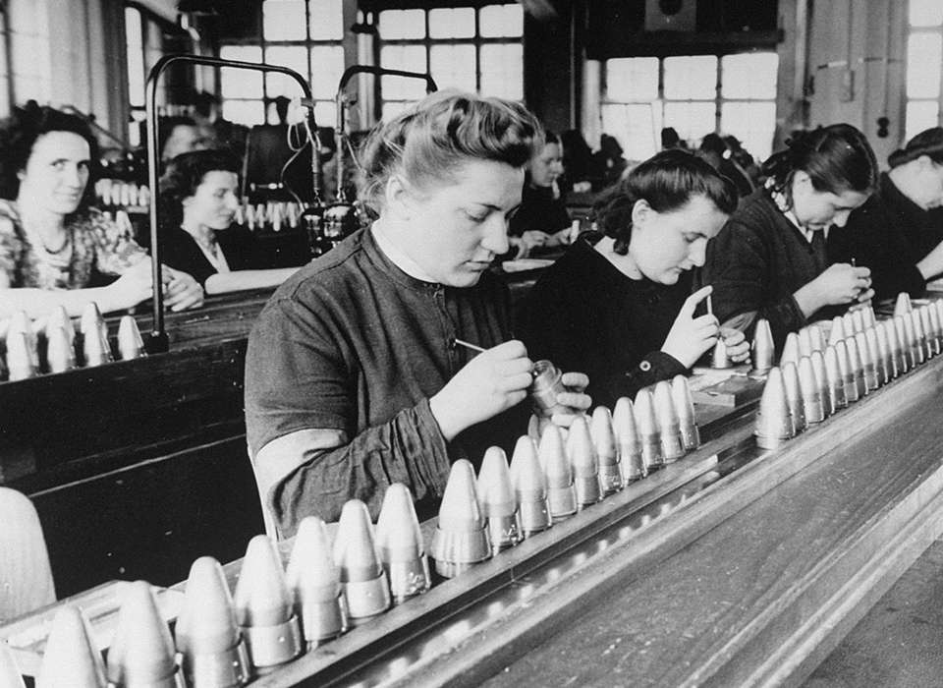
(b) The Home Front
Shortages of labour in German factories was the most pressing problem for the Nazis, so measures had to be taken:
1939-41: Workers from occupied nations were recruited as workers.
Oct. 1941: Hitler ordered that Russian prisoners of war be used as slave labour.
Jan. 1943: All men 16-65 and all women 17-45 had to register available for work.
Aug. 1944: Working hours increased to 60 hours per week & all holidays banned.
1944: Over 7 million prisoners of war working within German industry.

Slide 32
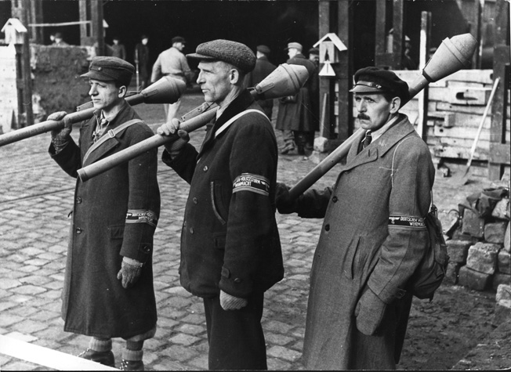
(b) The Home Front
From 1943-45, during the period of ‘TOTAL WAR’ or “Sportspalast”, the Nazis resorted to some desperate measures:
Sports teams & entertainments were shut down – though cinemas remained open for propaganda purposes.
Clothing taken from Jews were being used by soldiers on the front-lines, often under their uniforms in the East.
Postal services were reduced to save fuel.
A HOME-GUARD or “Volkssturm” was created to preotect from potential invasion. In the spring of 1945, boys as young as 12-years-old were being used in the Volkssturm.

Slide 33
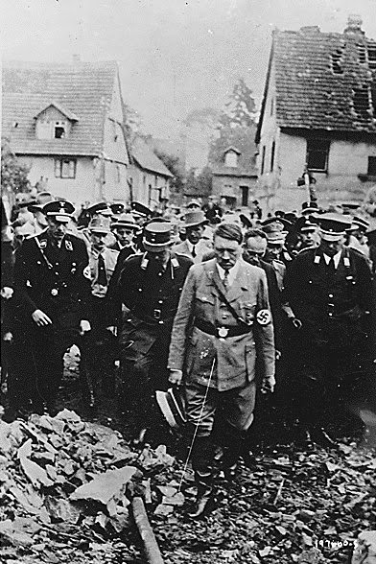
(b) The Home Front
After RAF bombing began on German cities in Aug. 1940, German production in factories was minimal. Military & industrial areas were targeted by RAF bombers up until 1942. After 1942, however, civilian areas were targeted to destroy the morale of the German people. During Mar-Jul. 1943, 43 German cities were bombed repeatedly and severely – raids on the city of Hamburg in the last week of July 1943 killed 42,600 civilians, wounded over 180,000 & over 1 million Hamburgers fled the city. Many modern historians highlight how the Hamburg bombings foreshadow the Allied bombing of Hiroshima and Nagasaki in Aug. 1945.

Slide 34
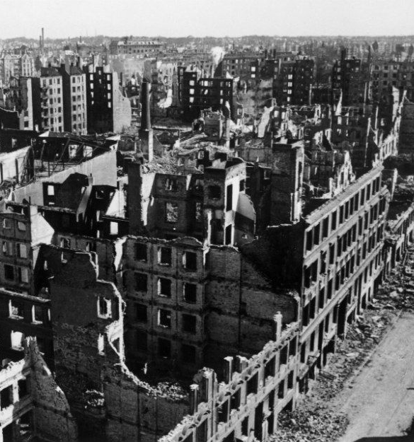
(b) The Home Front
The German Government were forced to try to reduce the impact of RAF bombing with stories of bravery, heroism and determination. Nazi welfare organizations provided food & drink for those effected and accommodation was found for those who lost their homes. Nazi propaganda went into over-drive, but there was no denying that RAF bombing had a negative impact on the morale of German people. Just as Britain had done during the Blitz, however, Germany carried on with life as normal – despite the difficulties – and turned up to work and maintained ordinary life as much as they could.

Slide 35
Activity 21
Over 600,000 Germans died as a result of Allied bombing – 76,000 of which were children – especially after fire-storms.
Why did the incendiary bombs used by the Allies lead to “healthy” Germans collapsing and dying on the streets of bombed cities?

Slide 37
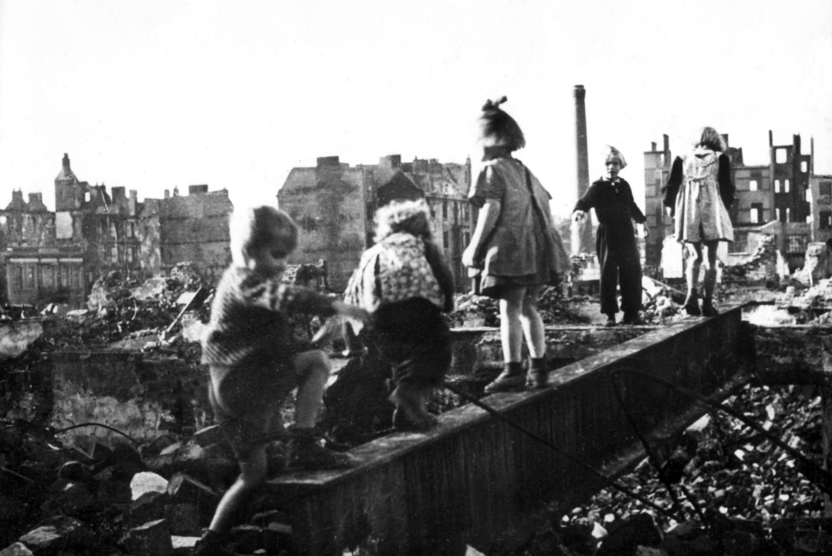
(b) The Home Front
After 1944, the Allied bombing of Germany focused on strategic targets – railways, bridges & autobahns. Despite this, a survey in 1944 suggested that German production of war materials was only reduced by 1%! RAF raids on the Ruhr Valley in 1944 were said to have reduced metal production by 40%, so it depended which part of Germany was being spoken about in statistics. The most successful element of strategic RAF bombing was in destroying transport links; in 1945, Allied troops in Munich found 100s of German tanks in a railway yard, all had been abandoned after RAF bombs had blown up railways lines needed to move them from Munich to where necessary.

Slide 38
Exam-Style Question
Explain two effects on the German people of Allied
bombing from 1943. (8 marks)
Hint – When explaining impact, do not just explain the bombings – focus on effects!

Slide 40
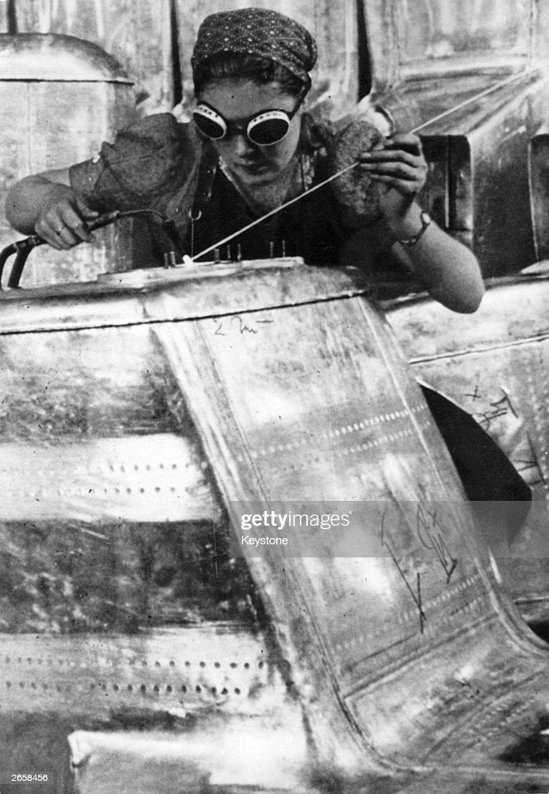
(b) The Home Front
One of the indicators of Nazi desperation during WW2 was the way the role of women changed. Despite the success of their policy to remove women from the work place in the 1930s – fewer women working in 1939 than in 1929 – the shortage of workers once war began was worse than ever. In June 1941, Goering ordered that “All women who had previously been in paid work and had no children should register for work.” This helped, but ’TOTAL WAR’ in 1943 meant a further revision of Nazi rules – “All women 17-45 had to register for work.” This added an extra 500,000 women to German industry, especially in war productions.

Slide 41
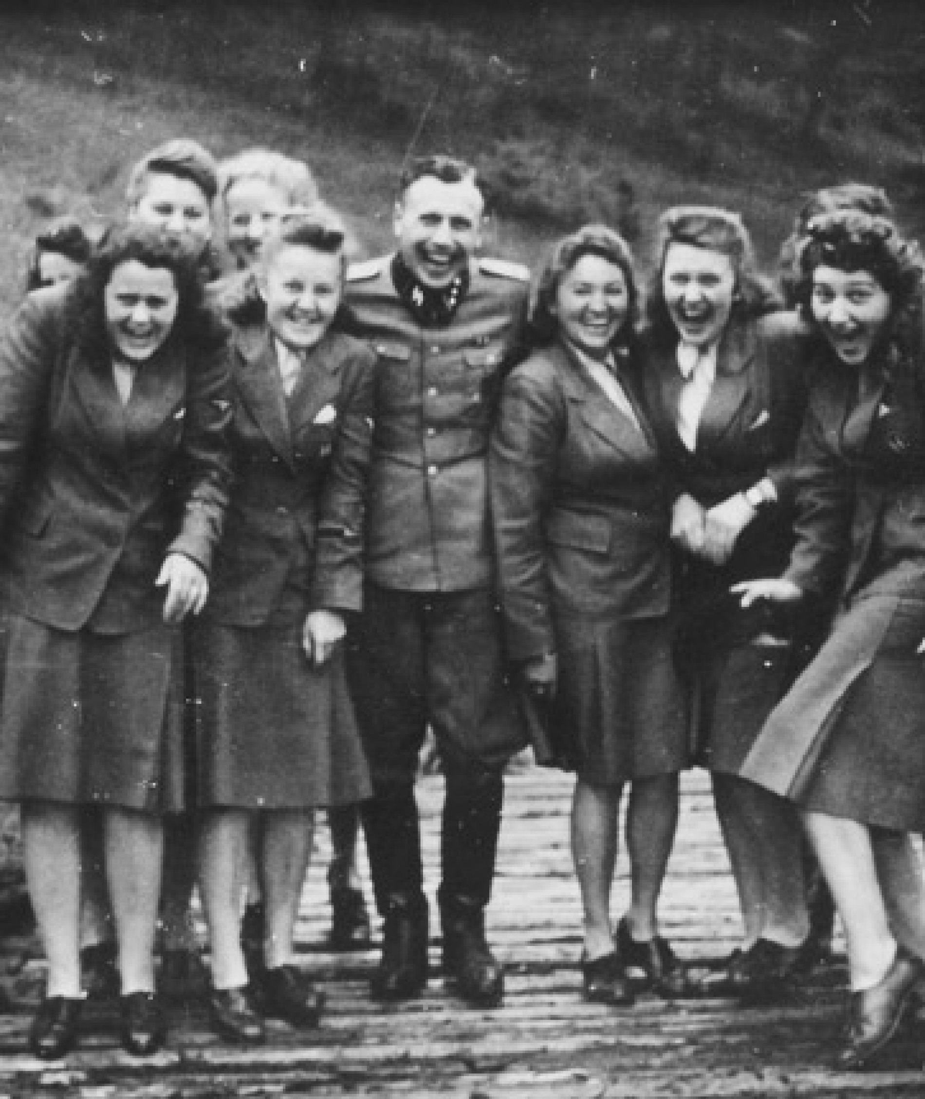
(b) The Home Front
In November 1943, Hitler refused a request to raise the age of registered working women from 45 to 50 … but sanctioned such action by 1945. Indeed, by the end of WW2, women made up 60% of the German Labour Force.
Furthermore, women played vital roles as AUXILLIARIES in the Armed Forces – operating searchlights for shooting down RAF bombers and even using the anti-aircraft guns to shoot RAF bombers themselves!

Slide 42
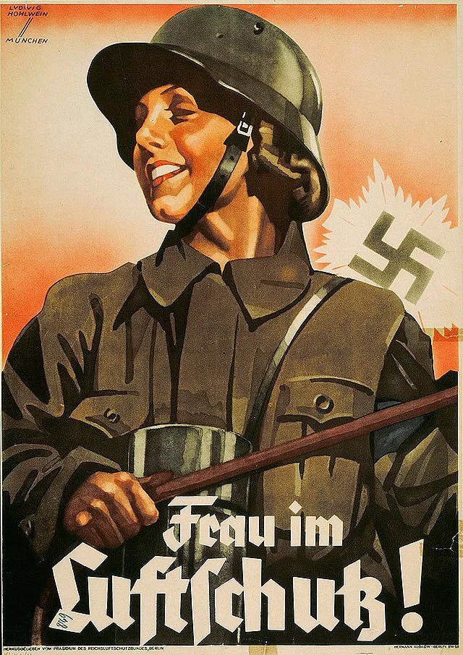
(b) The Home Front
The psychological impact on German women cannot be under-estimated. Living in constant fear that husbands & sons had been killed in fighting, whilst struggling to raise a family, plus being bombed by the RAF, and facing food shortages, must have been an awful experience. Many women died in RAF air-raids, others made homeless and others evacuated to safer areas. The biggest fear, however, was the Soviet Army closing in – Nazi propaganda had warned that the Red Army was brutal. Soviet soldiers did rape millions of German women in East Prussia & Berlin, plus 1,000s of women were murdered or simply committed suicide to avoid encountering the Russians.

Slide 43
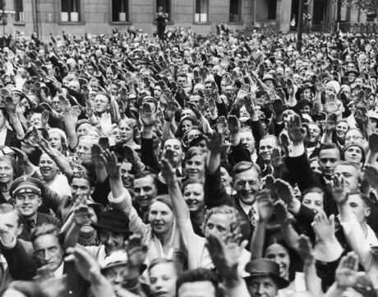
(c) Growth of Opposition to Hitler
During the 1930s, the Nazi state ensured that any opposition was dealt with severely – the Gestapo and the S.S. created sufficient fear to prevent protests & uprising occurring. With other political parties banned, trade unions banned, a censored media and Churches under control, ordinary life lacked any opposition. Children, too, had to accept “correct” Nazi ideals at school, in Nazi youth movements and outward conformity spread throughout Nazi Germany.

Slide 44
(c) Growth of Opposition to Hitler
Despite the Gestapo and the S.S. there was still some opposition to the Nazis at ground level & at underground level.
COMMUNISTS remained a key resistance group and over 100 “cells” were established across Germany – yet the Gestapo infiltrated these & the Communists never became a major threat.
CHURCHES produced individuals who opposed the Nazis (Roman Catholics criticized euthanasia & the Protestant Confessional Church criticized anti-semitism) but remained a low-level threat.
THE KREISAU CIRCLE was a group of nobility, lawyers & politicians opposed to Nazi policy crushing personal freedoms. Active 1942-43, the Gestapo broke up this minor threat quite easily.

Slide 45
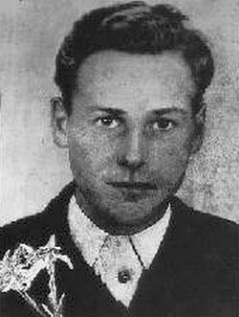
(c) Growth of Opposition to Hitler
Naturally rebellious, the German youth were harder to convince … so minor threats emerged:
SWING included middle-class youngsters who wished to listen to American & British “Swing” music; in defiance of Nazi “degenerate” views about black jazz music; Arrests & Concentration Camps sufficed to squash this opposition.
EDELWEISS PIRATES emerged from working-class Rhineland in 1937, but spread across Germany. They were an antidote to the Hitler Youth & beat members up. They left graffiti in German towns and acted like a teen resistance group: sheltering army deserters; stealing food in freight; derailing ammunition trains; supplied adult resistance with explosives. A plan to blow up Cologne Gestapo HQ in 1944, saw pirate Barthel Schink executed.

Slide 46
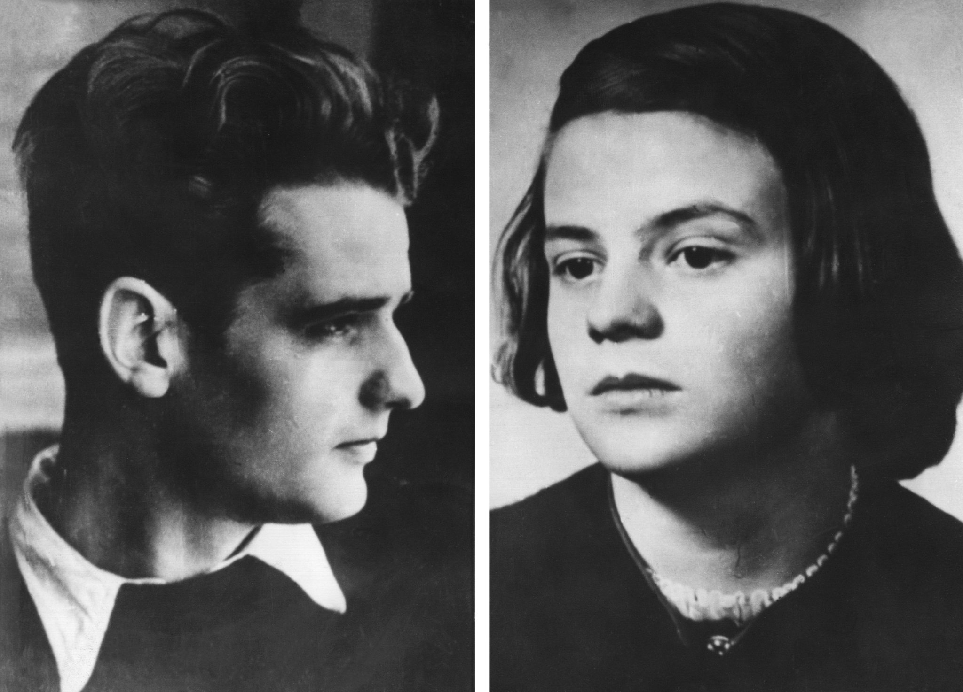
(c) Growth of Opposition to Hitler
Intellectual opposition to the Nazis was, perhaps, the greater threat to the regime than rebellious youths:
THE WHITE ROSE GROUP began at Munich University and was founded by Hans & Sophie Scholl. They opposed the Nazi treatment of Jews & Slavs and campaigned to end Germany’s involvement in WW2. During 1942-43, they published six critical leaflets & one contained the phrase “Hitler is leading Germany to inevitable defeat.” This type of treasonable quote, painted on the walls of Munich buildings too, was to cost the Scholls their lives. When Gestapo officers had reports that Sophie was seen distributing leaflets & Hans tried to swallow one from out of his pocket, they were arrested on 18th Feb. 1943. Both were executed by guillotine on 22 Feb. 1943. Hans Scholl yelled “Long live Freedom!” as the axe fell.

Slide 47
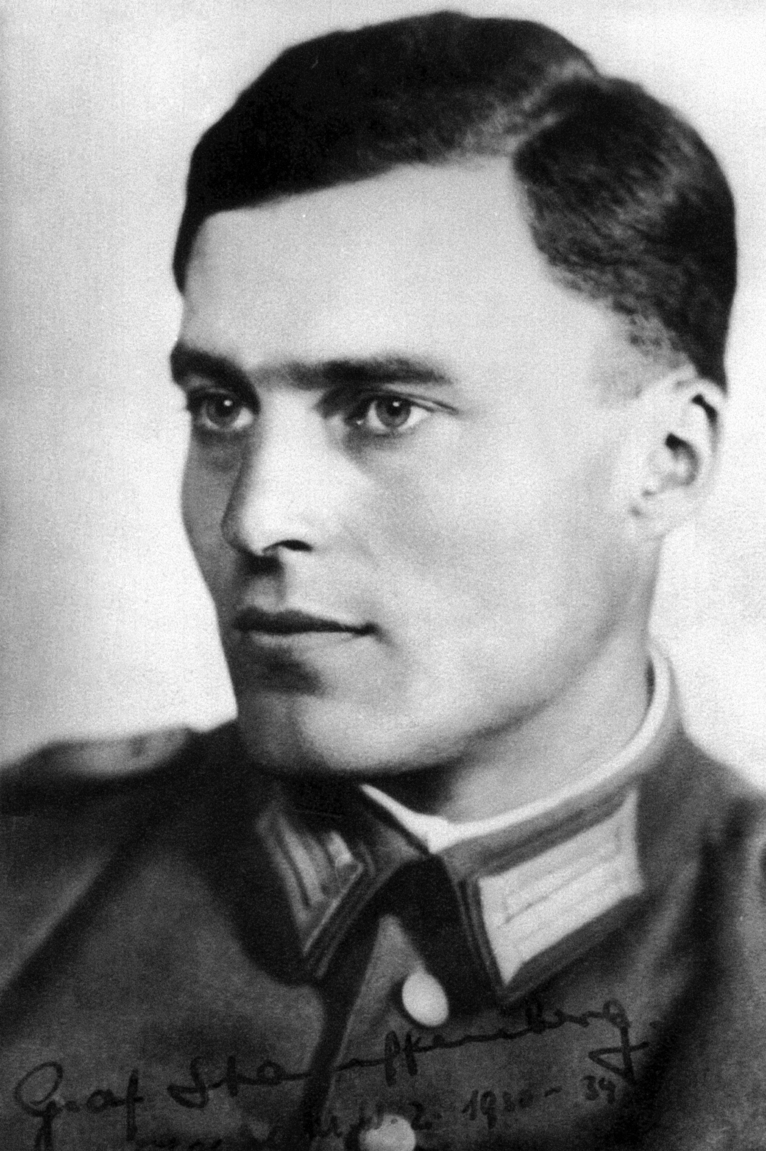
(c) Growth of Opposition to Hitler
What nobody expected was opposition to emerge from within the Nazi regime itself, esp. the Military:
THE JULY BOMB PLOT, 1944 was the result of a group of dissatisfied Nazis angry at failings in Russia, Hitler’s brutal methods & his anti-semitism. General Beck, Colonel von Stauffenberg & Dr. Goerdeler were to assassinate Hitler and replace him with Goerdeler. On 20th July 1944, von Stauffenberg took a briefcase with a bomb in it to a Nazi military meeting, arranged a call to remove him, then left the bomb to kill the Fuhrer. Unfortunately, an aide at the meeting moved the briefcase under a a table so, when it exploded, 4 men were killed but the table-top shielded Hitler. A few splinters were the worst that Hitler endured.

Slide 48
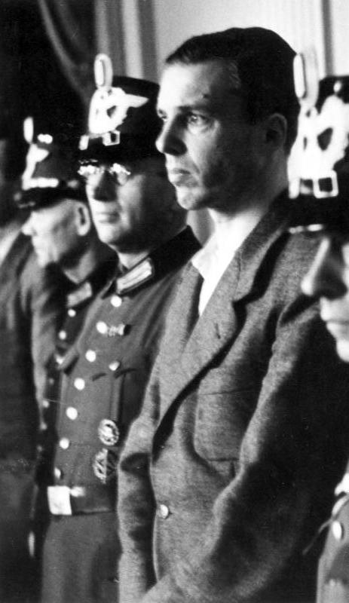
(c) Growth of Opposition to Hitler
The repercussions of the July Bomb Plot, 1944 were very severe:
BECK was given a revolver to shoot himself with; he only wounded himself, so had to be shot by the S.S.
GOERDELER was arrested & hanged by the S.S.
VON STAUFFENBERG was arrested & shot by an S.S. firing-squad.
6,000 plotters of 7,000 rounded by by Himmler’s S.S. were executed.
VON STAUFFENBERG’S BROTHER, BERTHOLD was hanged using piano-wire & the execution was filmed for Hitler to re-watch at his leisure.

Slide 49
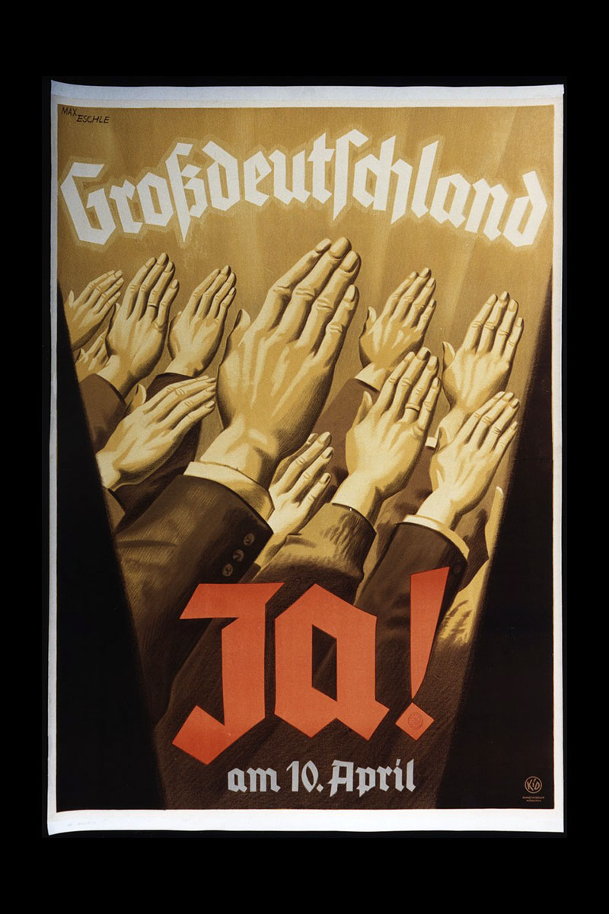
(c) Growth of Opposition to Hitler
In the final analysis, it is difficult to judge how much opposition the Nazis faced 1933-1945. Propaganda muddies the necessary clarity, as it suggested that all of Germany loved the regime. There were certainly no major attempts to overthrow Hitler 1933-1943 … although there were plenty of private grumblings & griping and a certain amount of opposition from oppressed groups. In all, there were 11 attempts on Hitler’s life … but their failure only strengthened his belief that he was the chosen ‘Fuhrer’ meant to lead Germany. Daily undermining of the Nazis (not saluting, jokes, absenteeism, not reporting suspicions) was the extent of opposition pre-1944 – the July Bomb Plot was the most serious pocket of opposition, but wiped out before 1945.

Slide 50
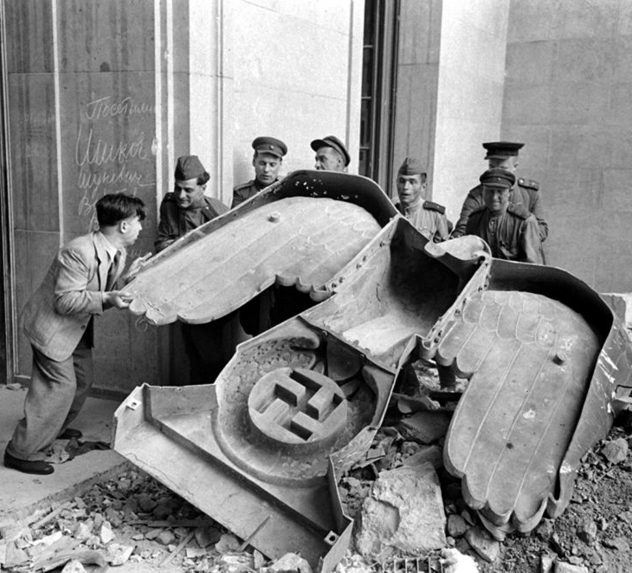
(d) Hitler’s Death & the End of the Third Reich
By the start of 1945, Germany was close to defeat in WW2. Allied forces were closing in from the West and the Red Army was advancing from the East. RAF bombing of German cities intensified, too, making matters worse. Indeed, more soldiers died in Jan-May 1945 than in the entirety of 1942 and 1943 together! Refugees fled the Red Army as they advanced on Berlin and it has been estimated that up to 1 million German civilians died from hunger, disease and the cold as the war came to an end.

Slide 51
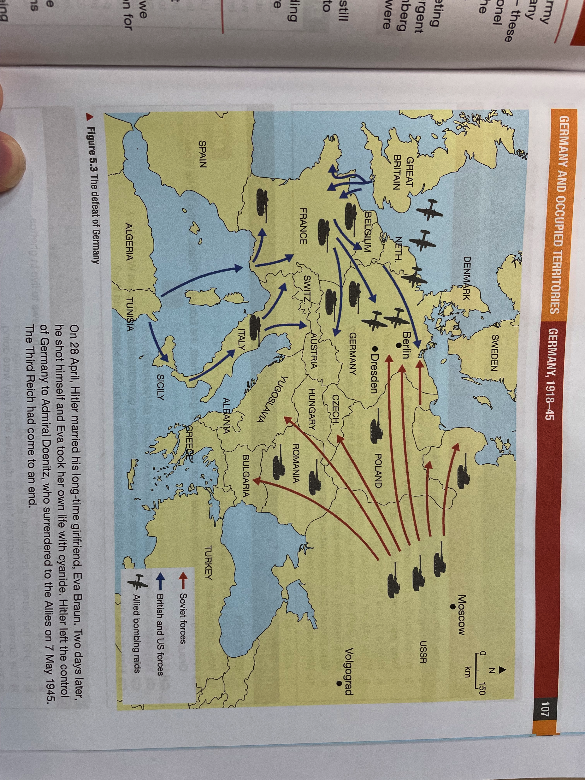

Slide 52
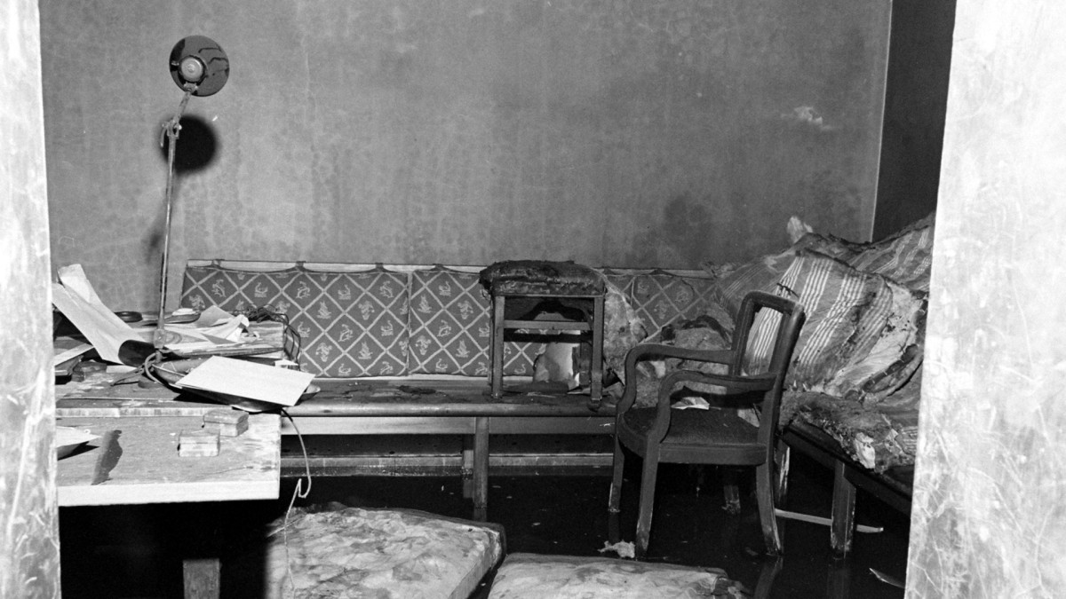
(d) Hitler’s Death & the End of the Third Reich
In his bunker under Berlin, as the sound of the Red Army tanks could be heard overhead, Adolf Hitler married Eva Braun on 28 Apr. 1945.
Two days later, on 30 Apr. 1945, the pair committed suicide with cyanide (tested on Hitler’s German-Shepherd, Blondie, & her pups) & revolvers.
Hitler’s final orders were to place all Germany under the control of ADMIRAL KARL DOENITZ and he surrendered to the Allies on 7 May 1945. The Third Reich ended on 8 May 1945 – V.E. Day.

Slide 53
Activity 22 – Recall Quiz
How many Jews were left in Germany in 1941?
How many Jews are said to have died in the Holocaust?
Which country conquered by Germany, had 3 million Jews?
What was ‘Operation Barbarossa’?
How long was the working week in Germany by late 1944?

Slide 55
Activity 22 – Recall Quiz
What was the Volkssturm?
Which German town was bombed 7 times in the Summer of 1943?
What happened to Sophie & Hans Scholl?
Who planted the bomb that was supposed to kill Hitler in the July Bomb Plot 1944?
What was the Third Reich?

Slide 57
Activity 23 – Explaining
Why did the Nazis introduce the Final Solution?
Why did the Allies bomb German cities?
Which organization was the greater threat to the Nazi Government – the Edelweiss Pirates or the White Rose?

Slide 59
Activity 24 – Challenge
Why didn’t the German people stop the persecution of the Jews?
Why did so few Germans show opposition to the Nazi Government in WW2?
How far did the lives of women in Germany change during WW2?

