Slide 1
Edexcel IGCSE History P1: Depth Study 3
Germany: Development of Dictatorship, 1918-1945

Slide 3
(f) Nazi Methods to Win Support
Propaganda was the way that Nazis increased their support 1929-1933. They used mass rallies, posters in prominent places & bright banners so that the Nazis appeared to be everywhere. The newly appointed Head of Propaganda, Josef Goebbels, understood how mass media could manipulate audiences to increase Nazi support – messages had to be simple and repeated frequently, so that they seeped into consciousness. By 1930, the Nazi Party owned 120 daily or weekly newspapers read by most of the German population. Furthermore, the speeches of Goebbels & Hitler were being broadcast by radio, so the Nazi message was becoming increasingly inescapable for local, regional, national & presidential elections.

Slide 4
(f) Nazi Methods to Win Support
As unemployment had hit all classes, Hitler & the Nazis tried to appeal to all sections of society. Their message was that the Weimar Government had caused the economic crisis & weak coalitions had no solutions – only the Nazis could unite all of Germany at this time of crisis. On top of the usual rhetoric about “November Criminals” & Versailles, Hitler offered another scapegoat – the Jews:
involved with both Communism & Capitalism, first in the Bolshevik Revolution & then evil greed
caused unemployment
conspired in Germany’s defeat in WW1
preparing to seize all private property & wealth

Slide 5
(f) Nazi Methods to Win Support
During the presidential Election of March 1932, Hitler stood against Hindenburg. Josef Goebbels perfected his propaganda techniques during the campaign – organizing rallies all over Germany. Moreover, the Nazis utilised modern technology; Hitler flew from city to city by aeroplane (up to 5 per day) and his speeches were put on film, radio & records. This ensured Hitler was recognized as a national political figure of great importance.
Hindenburg failed to secure the necessary 51% in the first round, but was elected in a second round. His 19.3 million votes beat Hitler’s 13.4 million votes, but Goebbels presented the defeat as a victory because Hitler’s percentages were so huge.

Slide 6
(f) Nazi Methods to Win Support
Like all political parties, the Nazis needed financial backers to conduct their campaigning. As well as appealing to the poorest people in German society, big businesses backed Hitler’s economic programme of July 1932. Industrialists like Thyssen, Krupp & Bosch were so scared of Communism & the growth of trade unionism, they felt investing vast sums in the Nazi Party would protect them from the ‘Red Threat’. Alongside this backing from big business, the Nazis developed closer links with Germany’s Nationalist Party (DNVP) & Alfred Hugenburg – a national newspaper tycoon, who allowed Goebbels to publish many articles attacking Chancellor Bruning. Such support allowed the Nazis to remain at the forefront of German minds in 1932.

Slide 7
(f) Nazi Methods to Win Support
As the awe-inspiring leader of the Nazi Party, Adolf Hitler could be all things to all people:
Superhuman Saviour
War hero
Ordinary Man-on-the-Street
This ‘Cult of Personality’ was created so that his entire existence was given over to Germany & he had no distractions to stop him achieving his goal – the easy to understand philosophy of making Germany the strongest nation in the World. A great orator, able to convince a crowd to share his vision, Hitler’s most effective characteristic was what other German politicians lacked – charisma.

Slide 9
Exam-Style Question
Explain two effects on
the German people of
Hitler’s methods to win their
support in 1932. (8 marks)
Hint – When explaining effects, be sure to include information about HOW public feelings changed.

Slide 11
(g) The Role of the SA
The ‘Sturmabteilung’ were used to protect Nazi Party members making speeches & used to disrupt meetings of opposition parties. In speeches, Hitler claimed Parliamentary Democracy simply didn’t work & only the strong government of the Nazis could save Germany. Ernst Rohm was re-appointed as SA leader in Jan. 1931 & membership increased from 70,000 to 170,000 by Jan. 1932. Clashes with Communists showed that the SA were ready to stamp out a Bolshevik revolution & expected appreciation from the electorate; SA were stationed at polling stations to remind people to be grateful (or to intimidate them).

Slide 13
(h) Events of 1932 to Jan.1933 – the Role of von Papen, von Schleicher & von Hindenburg
After the 1932 Presidential election, Hitler was leader of the second largest party in the Reichstag. When a general election was called for 31st July 1932, the Nazis were optimistic on improving their number of seats from the 106 of Sept. 1930. Violence erupted across Germany and about 100 people were killed & 1125 wounded at political clashes. More people voted than had ever done so & the Nazis became the largest party in the Reichstag, but without a majority of 51%.

Slide 14
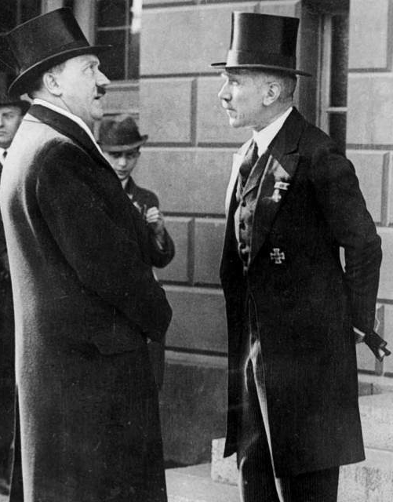
(h) Events of 1932 to Jan.1933 – the Role of von Papen, von Schleicher & von Hindenburg
Despite the Nazis being the largest party in the Reichstag, it was Centre Party Chancellor Franz von Papen who remained in charge of Germany. He began to scheme with President Hindenburg, knowing that the President refused to contemplate Hitler ever being made Chancellor. So, when Hitler demanded the post of Chancellor in Aug. 1932, Hindenburg replied he “could not answer before God, his conscience & the Fatherland if he handed over the entire power of the government to a single party & one which was so intolerant towards those with different views.” Hitler was furious.

Slide 15
(h) Events of 1932 to Jan.1933 – the Role of von Papen, von Schleicher & von Hindenburg
It was impossible to govern Germany well without a Reichstag majority and, given Hitler’s demands to be made Chancellor, the Nazis were unlikely to agree to any coalition. In Sept. 1932, in the hope that Nazi momentum was waning & the Centre Party could absorb lost Nazi votes, Franz von Paper called another election. He was correct that the Nazi votes would not be as high as it had been, but he had never expected the Nazis to remain the largest party in the Reichstag.

Slide 16
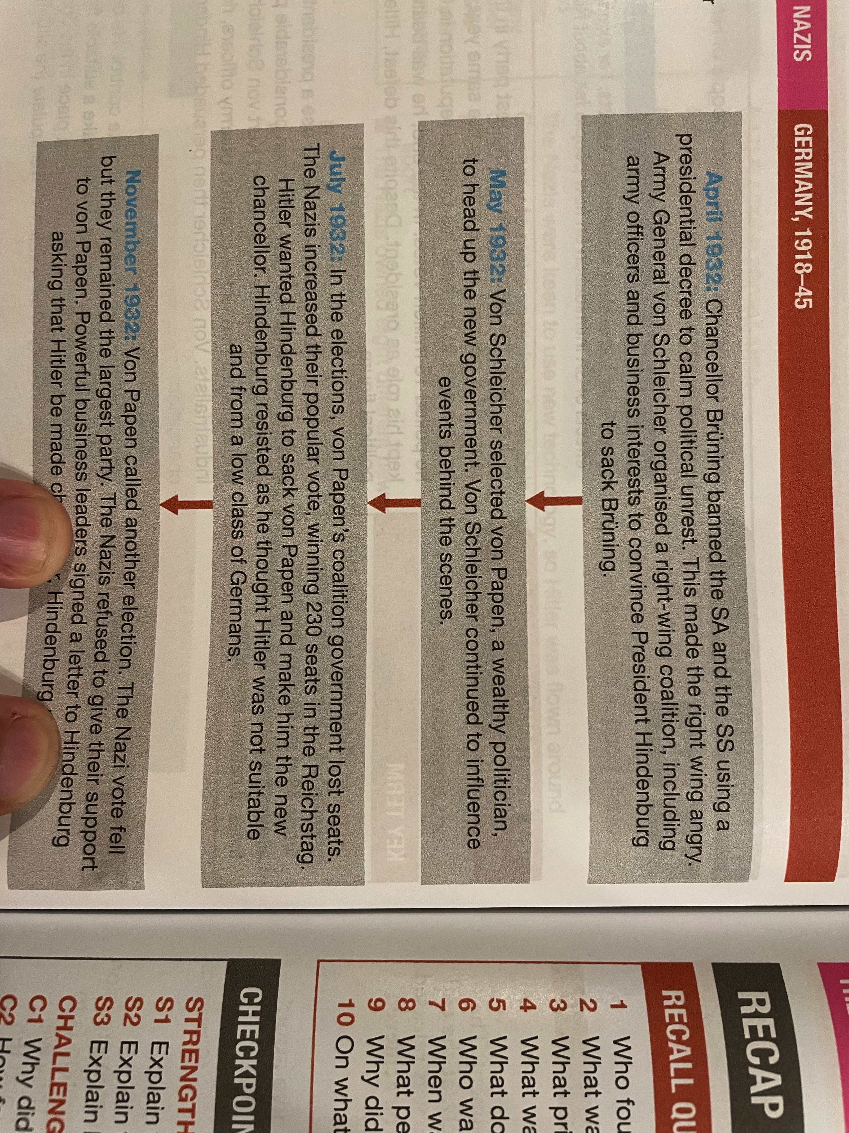

Slide 17
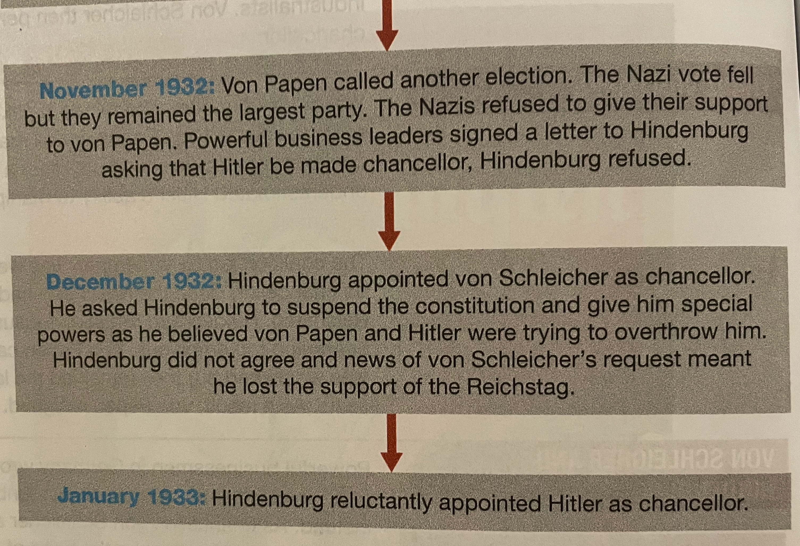

Slide 18
(h) Events of 1932 to Jan.1933 – the Role of von Papen, von Schleicher & von Hindenburg
While von Papen couldn’t secure a Reichstag majority, Hitler demanded to be Chancellor. When von Papen suggested abolishing the Weimar Constitution, Kurt von Schleicher, Minister of Defence, persuaded Hindenburg that a civil war would break out. Von Papen resigned in Nov. 1932, so Hindenburg made von Schleicher Chancellor; still not Hitler. Von Schleicher assured the President that he could attain a Reichstag majority via a ‘Querfront’ (Cross-front) of Left & Right parties. Von Papen was furious.

Slide 19
(h) Events of 1932 to Jan.1933 – the Role of von Papen, von Schleicher & von Hindenburg
At the start of January 1933, von Papen met with Hitler to propose a mutually beneficial deal:
Hitler be Chancellor
Von Papen be Vice-Chancellor
The Army, major landowners & Industrialists were behind this deal, as they were convinced that von Schleicher was going to cause a Communist takeover. Von Papen spoke to President Hindenburg & argued that stability could be achieved via this coalition, plus von Papen reckoned he would “make Hitler squeak”. On 30th January 1933, Hindenburg appointed Hitler Chancellor. The ‘Legal Revolution’ had succeeded.

Slide 21
Exam-Style Question
‘The main reason for Nazi support in the 1932 general election was powerful groups underestimated Adolf Hitler’s ambition.’ How far do you agree?
You may use the following in your answer:
The November 1932 election result
The fears of industrialists
You must also use information of your own. (16 marks)

Slide 23
Activity 9 – Recall Quiz
Who founded the German Worker’s Party in 1919?
What was Hitler’s job at the end of WW1?
What prison was Adolf Hitler sent to, after the failed Munich Putsch in 1923?
What was the name of the book Hitler wrote while in prison? Who did he dictate the book to?
What were the SA nicknamed? Who was the original leader of the SA? Who replaced him in 1926?

Slide 25
Activity 9 – Recall Quiz
What does the term ‘Lebensraum’ mean?
When was Bruning Chancellor of Germany?
What percentage of the vote did Hitler win in July 1932?
Why did Paul von Hindenburg dislike Adolf Hitler? Which 2 men wanted to “use” Hitler?
On what date did Adolf Hitler become the new Chancellor? What was the “Legal Revolution”?

Slide 27
Activity 10 – Explaining
Explain three ways in which the Great Depression affected people in Germany.
Explain three ways in which the Nazis used propaganda messages in their election campaigns.
Explain how the role of the SA grew.

Slide 29
Activity 11 – Challenge
Why did industrialists give their support to Hitler as Chancellor?
How far did the Nazis change their tactics to gain power after 1924?
In what ways did the Weimar’s weaknesses provide opportunities for Adolf Hitler?

