Slide 1
Edexcel IGCSE History P1: Depth Study 3
Germany: Development of Dictatorship, 1918-1945

Slide 3
Edexcel IGCSE History P1: Depth Study 3
Germany: Development of Dictatorship, 1918-1945
3. The Rise of Hitler & the Nazis to January 1933

Slide 4
(a) Hitler & the German Workers’ Party
Adolf Hitler was born in Austria-Hungary in 1889. He was shaped by 3 events as he grew up:
Alois Hitler, his father, died in 1903.
Klara Hitler, his mother, died in 1907.
His application to the Academy of Fine Arts in Vienna was rejected in 1907 & again in 1908.
In 1913, Hitler fled to Germany and, upon the outbreak of WW1 in August in 1914, he volunteered for the German Army. He was a brave soldier & won the Iron Cross 2nd Class in 1914, fought at the Battle of the Somme in 1916 & won the Iron Cross 1st class in 1918. He ended the war a mere ‘Gefreite’ (Lance-Corporal) stuck in hospital after being temporarily blinded by gas.

Slide 5
(a) Hitler & the German Workers’ Party
In response to the Spartacist Urprising in Jauary 1919, Anton Drexler founded the German Workers’ Party (Deutsche Arbeiter Partei, DAP) in Bavaria. It was very Right-Wing & nationalistic, but also quite Socialist too (restricting Company profits, building a classless society) with a strong belief in the ‘Volkisch’ – a pure German people. By the Summer of 1919, the DAP was still small, just 50 members, but it attracted the attention of the political department of the Army; keen to crush any organisations promoting Socialist ideas. At the end of WW1, Hitler remained in the Army as an intelligence informer based in Munich. In Sept. 1919, Hitler attended a DAP meeting to report on it; but, when Hitler made a speech against one of the speakers, Drexler recruited Hitler.

Slide 6
‘In spite of their very well prepared and thoroughly organized propaganda, their successes remain very minor. This party isn’t going anywhere. Today, it is a splinter group that can’t exert any real influence on the great mass of the population.’
From a confidential Interior Ministry report on the Nazis in the 1920s.
What impression does the extract give about the impact of the Nazis in 1920s Germany? (6m)

Slide 8
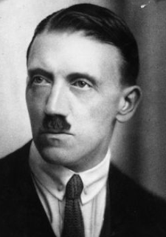
(a) Hitler & the German Workers’ Party
In Mein Kampf, published in 1924, Hitler wrote that he joined the DAP after Drexler had been impressed with his first speech. Recent historical research, however, has suggested that Hitler’s Army superiors told him to join the party for intelligence reasons. Nevertheless, Hitler’s journey from Party member to Party leader within 2 years had begun and, within 14 years, he would be leader of Germany itself. Hitler’s enthusiasm for DAP ideology & his flare for public speaking soon saw him made responsible for recruitment & propaganda. The standard themes of Hitler’s DAP speeches were ‘Dolchstoss’, disgust at the Treaty of Versailles, deriding the ‘November Criminals’ & destruction of Germany by Jews + Communists.

Slide 9
(b) Changes to the Party (1920-1922)
In Feb. 1920, Hitler & Drexler wrote their political manifesto – the 25 Point Programme:
No.1 Union of all Germans form a Greater Germany
No.2 Scrapping the Treaty of the Versailles
No.4 Citizenship for those of German blood only
No.7 Foreign Nationals to be deported if it became impossible to feed the entire population.
No.8 All non-Germans who entered after 1914 to leave
No.13 Nationalisation of all businesses & corporations
No.14 Government Profit-sharing in major industries
No. 23 Editors of newspapers to be Germans only
No.25 Creation of a strong central Government Reich

Slide 10
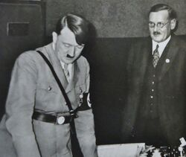
(b) Changes to the Party (1920-1922)
With the publication of the 25 Point Programme, in Feb. 1920, the DAP became the NSDAP as ‘National Socialist’ was added to the Party’s name. Party membership grew rapidly throughout 1920 & Hitler was largely responsible for this – his oratory skills attracted hundreds to NSDAP meetings, who then joined the “Nazi” Party. Increased membership meant they could afford to publish its own Nazi newspaper – the ‘Volkischer Beobachter’ (People’s Observer). Hitler’s influence on the party was so great, he became Nazi leader in July 1921. His new leadership style was based on ‘Fuhrerprinzip’ (Leadership Principle) where he had absolute power & authority and was answerable to no one.

Slide 12
(b) Changes to the Party (1920-1922)
Hitler made key changes to the Party as leader:
Swastika (‘der Hakenkreuz’) adopted as the party emblem, symbolizing the struggle for racial purity
Speeches focused on the purity of Aryan Germans & the responsibility of Jews for all of Germany’s problems
Raised arm salute used among Party members
Protection Squads for Nazi speakers developed into the SA (Sturmabteilung) in 1921 led by Ernst Rohm.
Uniforms for the SA – leading to ‘Brownshirts’ nickname
SA used to disrupt SDP & Communist Party meetings
Through maximum publicity, Hitler’s Nazi Party grew from 1100 in June 1920 to 55,000 in November 1923.

Slide 13
(c) Causes, Events & Results of the Munich Putsch
The long-term causes of the Nov. 1923 Putsch were:
Germany hated the harsh Treaty of Versailles, 1919
Friedrich Ebert’s SDP Government & “November Criminals” were also hated, 1919-1923
Growth of Nazi Party support, 1921-1923
Benito Mussolini seizing power in Italy in 1922
The short-term causes of the Putsch were:
German humiliation after French invasion of Ruhr
Ebert’s ‘passive resistance’ causing hyperinflation
Hitler had General Ludendorff & was confident the Bavarian politician von Kahr would support him

Slide 15
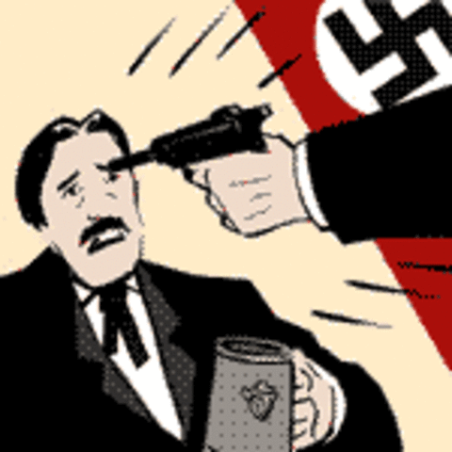
(c) Causes, Events & Results of the Munich Putsch
On the evening of 8th November 1923, Hitler & 600 Nazis seized the Burgerbrau Keller (a Munich Beerhall) where von Kahr, von Seisser & von Lossow were at a political meeting. Hitler held them at gunpoint to extract promises of support for his planned takeover. After the promises were made, however, Hitler allowed the 3 leaders to leave the Beerhall. The next day, 9th Nov. 1923, von Seisser & von Lossow broke their promise & organized the German Army & Police to resist the Nazi march through Munich. With only 2,000 rifles, the Nazis were no match for the well-armed police; 4 policemen were killed, 16 Nazis died & Hermann Goering was shot in the thigh. Hitler escaped, but was arrested on 11th Nov. 1923 & the Nazi Party was banned the same day.

Slide 16
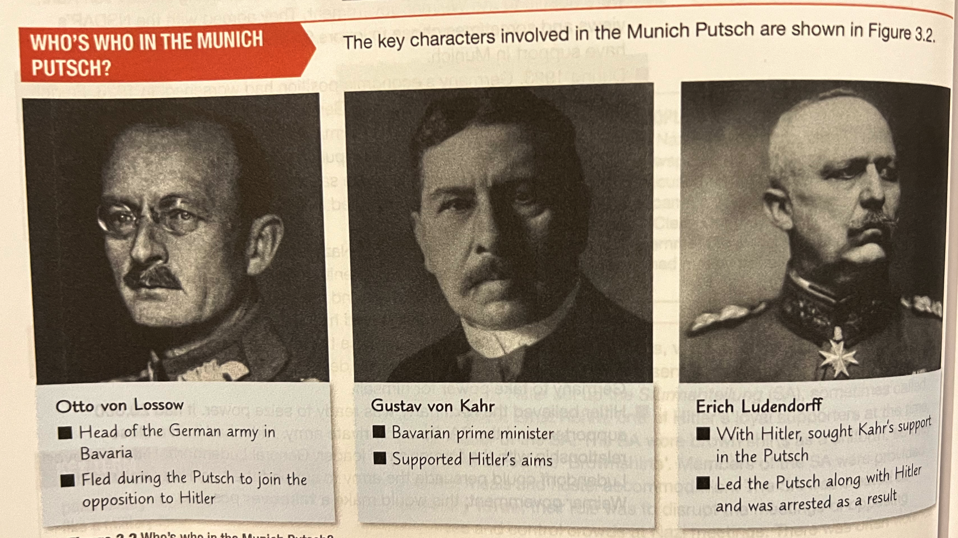

Slide 18
(c) Causes, Events & Results of the Munich Putsch
In February 1924, Hitler & Ludendorff were tried for treason. The trial lasted a month, but provided Hitler with national publicity & introduced him to the German people via the extensive press coverage. Judges, who were sympathetic to the Nazi cause, allowed Hitler to deny treason & launch into long speeches mocking the “November Criminals”, the Treaty of Versailles & Jewish Bolshevists damaging Germany’s chance to be great again. On 1st April 1924, Hitler was found guilty of treason. He was given the minimum sentence of 5 yrs, but only served 9 months in Landsberg Prison.

Slide 19
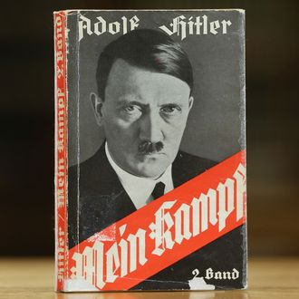
(c) Causes, Events & Results of the Munich Putsch
During his 9 months imprisonment, Hitler dictated his autobiography to Rudolf Hess. Called ‘Mein Kampf’ (My Struggle) the book contained his political ideology and, after publicity Hitler gained as a “martyr” during his trial, ‘Mein Kampf’ became a bestseller when published in 1925.
More importantly, whilst imprisoned, Hitler reflected on the failed Putsch & came to the conclusion that the German people had no appetite for violent uprisings so soon after WW1. He told a fellow Landsberg inmate “Instead of working to achieve power by armed conspiracy, we shall have to hold our noses & enter the Reichstag”. To the Nazis, democracy stunk but a new path to power of ‘Legal Revolution’ was set – democracy to end democracy.

Slide 21
‘Hitler … proved singularly ineffective. Nothing had been properly planned … He remained shut up in the Beer Hall … unable to make up his mind whether or not to risk a demonstration. It was Ludendorff who decided for him and, at noon the next day, led out Hitler & the other Nazi leaders at the head of a column of several thousand men, which … marched to the centre of the city. While Ludendorff marched on and pushed through the police cordon, Hitler – after being pulled to the ground and dislocating his arm, scrambled to his feet and fled.’
From a history book on Weimar Germany written in 1992.
What impression does the extract give Hitler’s leadership of the Munich Putsch, 1923? (6m)

Slide 23
Exam-Style Question
‘The most important reason for the failure of the Munich Putsch was Hitler’s poor leadership.’
How far do you agree?
You may use the following in your answer:
Hitler’s poor leadership
The German Army
You must also use information of your own. (16 marks)

Slide 25
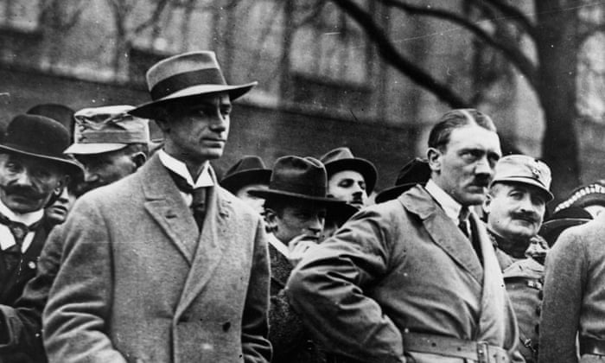
(d) Reorganisation of the Party (1924-1928)
While Hitler was in prison, the fortunes of the Nazi Party declined. Replacement leader, Alfred Rosenburg, lacked Hitler’s leadership skills & the party split into rival groups. After his release, Hitler gradually regained control & re-launched the Nazi Party in Feb 1925:
25 Point Programme was accepted as cornerstone of Nazi Party Policy.
New Nazi Party branches, called a ‘Gaue’, were to be founded & led by a ‘Gauleiter’.
Only Hitler’s closest associates would help run the Nazi Party.
Schutzstaffel (SS) set up as Hitler’s own bodyguard.
‘Hitler Jugend’ (Hitler Youth) was also established.

Slide 26
‘Instead of working to achieve power by armed coup, we shall have to hold our noses and enter the Reichstag against the opposition deputies. If out-voting them takes longer than out-shooting them, at least the results will be guaranteed by their own constitution.’
From a speech by Adolf Hitler to Nazi Party members, 1925.
What do you think meant by “hold our noses” in this 1925 speech?

Slide 28
(d) Reorganisation of the Party (1924-1928)
At the Bamberg Nazi Party Conference in 1926, Hitler moved to strengthen his position as leader by dealing with personal rivals:
Gregor Strasser was appointed Nazi Party Propaganda leader .
Josef Goebbels was made ‘Gauleiter’ of Berlin.
Ernst Rohm was removed as SA leader & replaced by Ernst von Saloman.
The reorganization paid dividends, as Nazi Party membership rose from 27,000 in 1925 to 100,000 by 1928. Yet, the Nazi Party’s 32 seats in the 1924 Reichstag was reduced to just 12 seats in 1928. 1929, however, was to be the year things changed.

Slide 29
‘Support for the Nazi Party had grown due to the country’s problems of hyperinflation and the French invasion of the Ruhr. By 1928, Nazism appeared to be a dying cause. Now that Germany’s outlook was suddenly bright, the Nazi Party was rapidly withering away. Once scarcely heard of Hitler or the Nazis, except as a joke.’
An American journalist recalls his time in Germany in 1928.
What does this source confirm about the impact of the Nazi Party in Germany, 1924-1929?

Slide 31
(e) Impact of the Great Depression
In Oct. 1929, after 5 years of economic prosperity under Gustav Stresemann, the US Stock Market collapsed & the Wall St. Crash began a worldwide economic depression. Stresemann, who claimed “Germany was dancing on a volcano”, also died & robbed Germany of the only man who could have steered the country through the troubled times. The USA recalled its loans to Germany, German international trade contracted, German exports fell rapidly & unemployment rose equally rapidly. By January 1932, over 6 million Germans were unemployed & 4/10 workers were without a job. German voters wanted a political party that offered a simple solution to their economic woes.

Slide 33
(e) Impact of the Great Depression
In March 1930, another weak Chancellor, Heinrich Bruning, replaced the equally weak Chancellor Hermann Muller. Without a majority, Bruning relied on President Paul von Hindenburg & Article 48 to pass measures to deal with increasing economic issues. Indeed, use of Article 48 saw Presidential decrees increase from 5 in 1930 to 66 in 1932. Desperate to win a majority, Bruning called a general election in September 1930 – but it was the Nazis who made a breakthrough, increasing their seats to 107, so they were the second largest party in the Reichstag. Bruning’s failure to solve Germany’s problems saw him nicknamed the “Hunger Chancellor” and, his only mild success, was the suspension of Reparations in 1931. When Bruning resigned in May 1932, the Nazi support was still swelling.

Slide 34
‘He deliberately deepened the economic crisis, as he hoped it would allow Germany to recover more quickly … He broke the spirit of the constitution. This contributed to the final destruction of the Weimar Republic and produced an atmosphere of hopelessness.’
A modern historian sums up Bruning’s policies as Chancellor.
What impression does the extract create about the impact of Bruning as Chancellor? (6m)

Slide 36
Exam-Style Question
‘The Wall St. Crash was to blame for the economic & social problems in Germany 1929-32.’
How far do you agree?
You may use the following in your answer:
The Wall Street Crash
Bruning’s policies
You must also use information of your own. (16 marks)

