Slide 1
Edexcel IGCSE History P1: Depth Study 3
Germany: Development of Dictatorship, 1918-1945

Slide 3
Edexcel IGCSE History P1: Depth Study 3
Germany: Development of Dictatorship, 1918-1945
2. The Recovery of Germany, 1924-1929

Slide 4
(a) The Work of Stresemann
Born in Berlin in 1878, Gustav Stresemann was a Reichstag Deputy by the age of 28 in 1906. He was appointed leader of the People’s Party in 1917 and, after just 4 months as Chancellor, was then appointed as the Weimar Foreign Minister in 1923 – a post he held until 1929.
Most importantly, from August 1923, Stresemann served as Ebert’s Chancellor and significantly improved Germany’s economic, international & political prospects. He persuaded workers in the Ruhr to call off their ‘passive resistance’ & strikes; he resolved the hyperinflation situation with a new currency; he achieved Germany entry into the League of Nations; he faced no uprisings at all.

Slide 6
(b) Rentenmark, Dawes Plan, Young Plan & Recovery
In Nov. 1923, Stresemann ordered the incineration of old Deutschmarks & introduced a new temporary currency – the Rentenmark. It was issued in limited amounts & based on property values, not gold. This restored economic confidence in Germany & financial stability returned. In 1924, the Rentenmark was converted into the Reichmark – a stable currency, based on gold.
The main points of the Dawes Plan, Sept. 1924, were:
Reparations begin at 1 billion marks
Ruhr to be evacuated by Allied troops
USA to provide loans to Germany for recovery

Slide 7
(b) Rentenmark, Dawes Plan, Young Plan & Recovery
The main points of the Young Plan, June 1929, were:
Reparations to be reduced to $8 billion.
Length of payment extended to 59 years at $473million a year.
Stresemann’s success in securing economic recovery was criticized as being based on US loans alone. Dawes came with 800 million marks and, by Young, US banks & US companies had given Germany loans of nearly $3000 million.

Slide 8
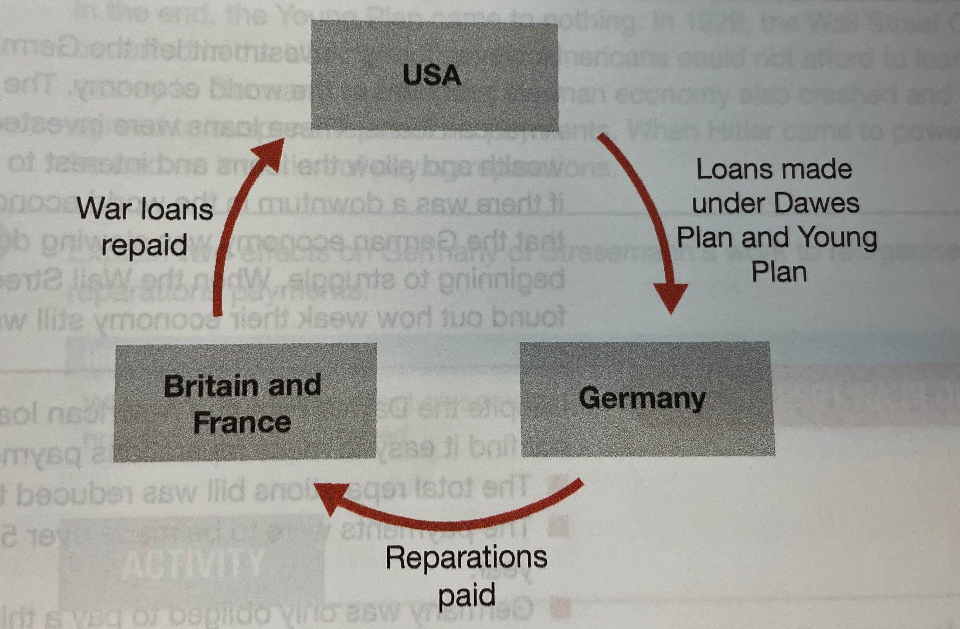

Slide 9
Exam-Style Question
Explain two effects on
Germany of Stresemann’s
reorganization of reparations payments. (8 marks)
Hint – When explaining effects, be sure to include information about HOW things changed.

Slide 11
‘In my opinion there are 3 great tasks that confront German foreign policy in the immediate future: 1. The solution of the reparations problems in a way that is tolerable for Germany. 2. The protection of those ten to twelve million Germans who now live under foreign control. 3. The readjustment of our eastern frontiers; the recovery of Danzig, the Polish corridor and a correction of the frontier in Upper Silesia.’
From a letter written Gustav Stresemann in 1925.

Slide 12
(c) Successes Abroad – Locarno, League & Kellogg-Briand
Stresemann knew improving relations with Britain & France would be key to restoring Germany’s prestige & reducing reparations. For France to feel secure, thus more likely to cooperate with changes to Versailles, Gustav Stresemann signed the Locarno Treaties (Dec. 1925) with Britain, France, Belgium & Italy; agreeing to preserve the original Versailles borders enforced on Germany in 1919.
As reward for agreeing to Versailles borders, Germany was given a permanent seat on the Council of the League of Nations in Sept. 1926. Germany was a ‘Great Power’ again & trading resumed across Europe for German Industry.

Slide 13
“The great majority of the German people stands firm for such a peace as this. Relying on this will to peace, we set our signature to this treaty. It is to introduce a new era of cooperation among the nations. It is to close the 7 years that followed the War, by a time of real peace, upheld by the will of responsible and far-seeing statesmen, who have shown us the way to such development, and will be supported by their peoples, who know that only in this fashion can prosperity increase. May later generations have cause to bless this day as the beginning of a new era.”
Gustav Stresemann speech after signing the Locarno Pact in 1925.
What can historians learn about the Locarno Pact from this source?

Slide 15
(c) Successes Abroad – Locarno, League & Kellogg-Briand
In 1928, Germany signed the Kellogg-Briand Pact alongside 64 other nations. It stated that all signatories would keep their Army for self-defence only & international disputes would be solved ‘by peaceful means’. This was the crowning glory for Stresemann’s beneficial foreign policy for Germany:
France withdrew from the Ruhr in 1925
The Allies allowed the Dawes Plan, 1924
Allied troops withdrew from the west bank of the Rhine in 1927 (5 years early)
The Allies allowed the Young Plan, 1929

Slide 16
Stresemann’s Strategy | Drawbacks
Use diplomacy to improve relations | Germany was getting stronger, but not really genuine power
Reorganise Germany’s reparations payments | Nationalists saw relations with former enemies as weakness
Build a stronger Germany | Nationalist wanted Germany to refuse to pay altogether
Increase loyalty to the new Weimar Republic | Germany was vulnerable, as it relied on loans from the USA
Build an economic recovery | Support for the regime was still only limited at best
Match up the correct strategy with the correct drawback.

Slide 17
Stresemann’s Strategy | Drawbacks
Use diplomacy to improve relations | Germany was getting stronger, but not really genuine power
Reorganise Germany’s reparations payments | Nationalists saw relations with former enemies as weakness
Build a stronger Germany | Nationalist wanted Germany to refuse to pay altogether
Increase loyalty to the new Weimar Republic | Germany was vulnerable, as it relied on loans from the USA
Build an economic recovery | Support for the regime was still only limited at best
Match up the correct strategy with the correct drawback.

Slide 18
‘As the economy improved, so social conditions stabilized and political violence died down. Between 1924 and 1929, no major political figures were assassinated. The Weimar Government had been in power long enough for many people to accept it – as long as things continued to improve. Support for extremists (left & right wing) reduced … Coalitions were still the norm, although they changed less often; 1924-1929, there were just 6 different coalitions. Stresemann’s influence was vital to this. However, none of the weaknesses of the constitution had been resolved. And, in 1929, Stresemann died.’
From a history textbook for schools, published in 2015.
What impression does the extract give of Stresemann’s impact on German politics? (6m)

Slide 20
Exam-Style Question
‘The foreign policy of Gustav Stresemann was the main reason why Germany recovered.’
How far do you agree?
You may use the following in your answer:
The foreign policy of Stresemann
The Dawes Plan, 1924
You must also use information of your own. (16 marks)

Slide 22
Activity 6 – Recall Quiz
What name was given to the 1923 government led by Gustav Stresemann?
How many months did Stresemann hold the position of chancellor, before becoming Foreign Minister?
What was the name of the new currency introduced in November 1923?
What was the Reichsbank?
How much money was lent to Germany by the USA under the Dawes Plan, 1924?

Slide 24
Activity 6 – Recall Quiz
Which period is known as the ‘Locarno Honeymoon’?
What was the League of Nations?
Who was Kellogg? Who was Briand?
In 1928, how many countries signed the Kellogg-Briand Pact?
In what year did Gustav Stresemann die?

Slide 26
Activity 7 – Explaining
Describe the measures taken by Stresemann to stabilize the German economy.
Summarise the terms of the Locarno Treaty, 1925.
List three points included in the Kellogg-Briand Pact, 1928.

Slide 28
Activity 8 – Challenge
Why did Stresemann argue Germany needed to accept the Treaty of Versailles?
Explain the key differences between the Dawes Plan, 1924 and the Young Plan, 1929.
What do you think people meant when they described the years 1925-1929 as the ‘Locarno Honeymoon’?

