Slide 1
Edexcel IGCSE History P1: Depth Study 3
Germany: Development of Dictatorship, 1918-1945

Slide 3
Edexcel IGCSE History P1: Depth Study 3
Germany: Development of Dictatorship, 1918-1945
1. Establishment of Weimar Republic & Early Problems

Slide 4
(a) Abdication of Kaiser & German Revolution, 1918-1945
On 9th November 1918, Kaiser Wilhelm II abdicated the German throne & fled to Holland. Germany instantly became a Republic and, 2 days later, the Armistice was signed to officially end WW1. This should have meant peace for Germany, but a period of chaos & violence began. The 5 years up to 1923 saw a failed Communist Revolution, brutal political assassinations, two Putsches (armed uprisings) and an economic inflation crisis. Above all, Germany had to accept the Treaty of Versailles and many citizens blamed their post-war problems on the very bad decisions taken by the “November Criminals” – the politicians of the new Weimar Republic, led by Chancellor Friedrich Ebert.

Slide 5
(a) Abdication of Kaiser & German Revolution, 1918-1945
On 11th November 1918, Friedrich Ebert was declared Chancellor of the Weimar Republic. Ebert was the leader of the Social Democratic Party (SDP) and his first act as Chancellor was controversial; he accepted the Armistice, based upon US President Wilson’s 14 Points for Peace. Ebert then announced Germany would hold democratic elections on 19th Jan. 1919. Many Germans thought that the end of WW1 was a betrayal of the German Wermacht – who were not defeated by the Allies, but forced to surrender by the new Weimar Government. Chancellor Ebert and the “November Criminals” had caused Germany suffer a ‘Dolchstoss’ – the German people had been ‘stabbed in the back’.

Slide 6
Activity 1
THE GERMAN WHO SIGNED AT VERSAILLES
Find out what happened to Matthias Erzberger (Ebert’s representative in Paris) whilst out walking on a holiday
in the Black Forest, Germany, in 1921.
Find out what happened next.

Slide 7
FRIEDRICH EBERT’S APPROACH TO GOVERNMENT
Ebert reassured industrial leaders that the new Government would not oversee nationalization (he did want to take state control over any private industries)
Ebert kept the state running, by keeping civil servants from the previous Government and by telling them to work with the new workers’ councils and soldiers’ councils
Ebert promised trade unions that his new Government would reduce working hours to 8 hours per day

Slide 8
Activity 2
THE GERMANS WHO WERE UNHAPPY
Why did the following groups
oppose the Weimar Republic:
(a) Senior Army figures & Judges?
(b) Supporters of the Kaiser?
(c) Communists & Russian sympathisers

Slide 9
(b) Strengths & Weaknesses of the Republic & its Constitution
After elections for the Constituent Assembly, Berlin was declared far too dangerous for members to meet. The more peaceful surroundings of the town of Weimar was chosen as the meeting place, hence the name Weimar was given to the new Republic. The Assembly members had 2 key tasks:
Draw up a new Constitution for Germany
Formulate a Peace Treaty with the Allies
Ebert was chosen as the new President and Philipp Scheidemann was made Chancellor. These SDP leaders had to form a coalition with the Zentrum Catholics & the DDP. Proportional representation & lots of parties made weak coalitions a Weimar issue.

Slide 10
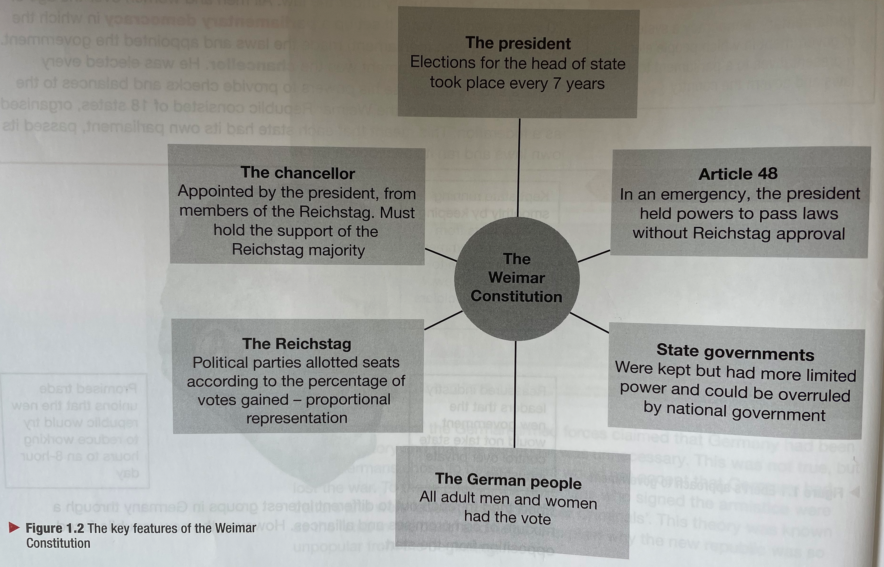

Slide 11
(b) Strengths & Weaknesses of the Republic & its Constitution
The Weimar Constitution was finalized in August 1919. Key articles included:
Art. 1 The German Reich is a Republic. Political authority derives from the people
Art. 22 Proportional Representation
Art. 23 The Reichstag is elected for 4 years
Art. 41 The Reich President is chosen by the electorate for 7 years
Art. 48 If public order & safety is endangered, the Reich President may take necessary measures to restore public order & safety.
Art. 54 The Reich Chancellor & Reich Ministers require the confidence of the Reichstag. They must resign if the Reichstag withdraws its confidence in them.

Slide 12
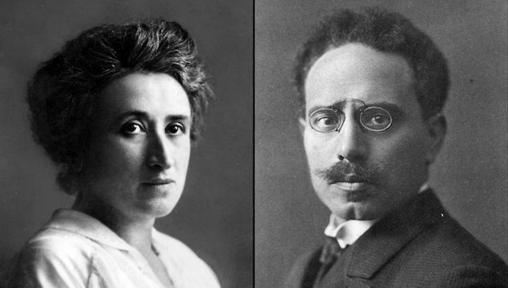
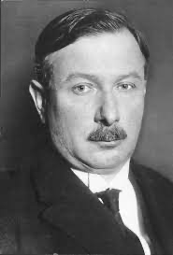
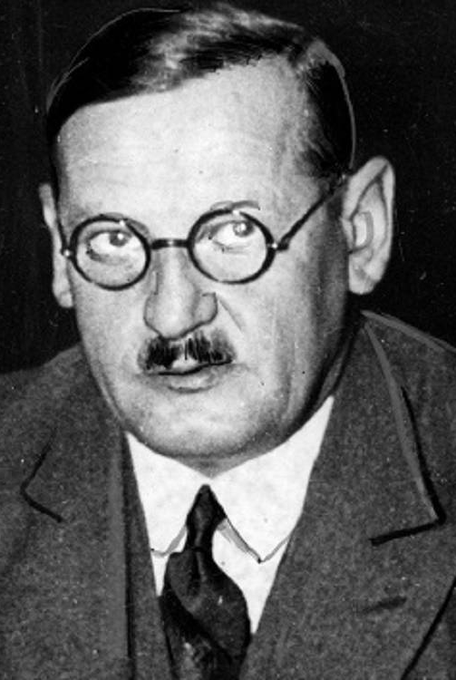
Luxemburg & Liebknecht
Wirth
Drexler

Slide 13
(b) Strengths & Weaknesses of the Republic & its Constitution
But Chancellor Scheidemann & President Ebert created a flawed Constitution:
Proportional Representation – awarding seats on the votes gained produced weak coalitions, limiting political stability as no party could win a Reichstag majority.
Democratic ‘Self-Destruction’ – Article 48 allowed the President to rule by decree, without consulting the Reichstag.
Army Criticism – the Wermacht wanted the return of the Kaiser & their old status.
Judiciary Criticism – Judges & Senior Civil Servants hated Weimar liberal politics.

Slide 14
Chancellors
of Germany
1919-1923
CHANCELLOR OF GERMANY | DAYS IN OFFICE
Ebert | 96
Scheidemann | 127
Bauer | 279
Muller | 86
Fehrenbach | 313
Wirth | 1 year 118 days
Cuno | 1 year 202 days
Why so many
in 4 years?
Why so few long-term Chancellors?
Why so unstable?

Slide 15
‘The new constitution had several built-in weaknesses. Between 1919 and 1933, there was not even a single election when one party won more than half the votes cast in elections for the Reichstag. As a result, the system of proportional representation meant that no party won more than half the seats. Consequently, whichever party formed the government was forced to rely on other, less successful, parties to form squabbling and weak coalitions. When faced with having to deal with any serious political problems, the coalitions fell apart because the different parties had different views.’
From a recent 21st Century book on the history of Germany
What impression does this extract give about the impact
of proportional representation on Germany? (6 marks)

Slide 16
(c) Reactions to the Treaty of Versailles
After the Armistice was signed 11th Nov. 1918, the Peace Treaty of Versailles wasn’t signed until 28th June 1919. The Germans expected it to be based on US President Wilson’s 14 Points, but French Prime Minister Clemenceau & British Prime Minister Lloyd-George wanted revenge for the war widows & many lives lost. Wilson’s Points about Self-Determination & Freedom of the Seas upset Lloyd-George, who defended the British Empire & the British Navy. Wilson’s idealism upset Clemenceau, who was furious French Industry had been reversed by 200 yrs & demanded compensation for damage done 1914-18 while US joined WW1 in 1917.

Slide 17
(c) Reactions to the Treaty of Versailles
As the Treaty of Versailles was conceived as part of the Paris Peace Conference, Clemenceau took a leading role in ensuring the terms were harsh.
Blame – Article 231 (War Guilt Clause) meant Germany had to take full responsibility for starting WW1 … even though they joined fourth.
Reparations – Finally fixed at £6.6 billion, meant Germany would be bankrupt up until 1989.
Armed Forces – Army limited to 100,000 men & no tanks; Navy limited to 6 battleships & no submarines; Airforce banned completely.
Territory Losses – Empire confiscated; 13% land lost; 10% population lost; Rhineland demilitarized.

Slide 19
(c) Reactions to the Treaty of Versailles
On top of the harsh terms of the Treaty, the final insult was Germany being denied entry to the new League of Nations (the only Point of Peace that US President Wilson got accepted; the other 13 failed). Germany was an international ‘pariah’ and most Germans saw the Treaty as shaming & humiliating; branding it a “Diktat” and, when Ebert was blamed for accepting it, Ebert called it a “Gewaltfrieden” (‘enforced peace’). On 19th June 1919, Chancellor Scheidemann resigned in disgust & the German cabinet rejected the Treaty, but the Allies warned the “November Criminals” that refusal to accept the terms would see a renewal of hostilities. Yet the “Dolchtoss” myth had already taken hold.

Slide 20
‘Much more important than the fairness or unfairness of the treaty was its impact on the new German Republic. How far is it true that the Versailles Treaty wrecked German democracy? Much more serious was the political demoralization which the treaty caused within Germany itself. The real damage was the disillusionment of more moderate men who might otherwise have supported the new republic.’
From a recent 21st Century book on the history of Germany
What impression does the author of this extract give about
the impact of the Treaty of Versailles on Germany? (6 marks)

Slide 21
Exam-Style Question
Describe two effects on
Germany of the Treaty of Versailles. (6 marks)
Hint – Identify two clear, separate effects; ECONOMIC & PSYCHOLOGICAL IMPACT.

Slide 22
(d) Challenges from Left & Right – Spartacist & Kapp
After the Boshevik Revolution, October 1917, established Communism in Russia, many German socialists hoped that Germany would have a similar Revolution. Ebert’s SDP was not Left-wing enough for the Communists, so fear of Revolution grew. Ebert even made a deal with the new Wermacht leader, Wilhelm Groener, that the Weimar Government would be protected by the Army against attempted coups. Even though the Army had criticized the new Weimar Constitution and its democracy, the “November Criminals” were better than Bolsheviks in military eyes. So, during demonstrations in December 1918, the Communist Spartacist League clashed with the Army and a total of 16 Spartacists died.

Slide 23
(d) Challenges from Left & Right – Spartacist & Kapp
On 6th Jan 1919, the Spartacists attempted to overthrow Ebert. Karl Liebknecht & Rosa Luxemburg led the Spartacist Uprising to try to create a Communist state. Ebert used the Reichswehr (regular army) & Berlin Freikorps (WW1 veterans) to put down the Uprising. Within days, the Communists had been crushed – Liebknecht & Luxemburg were captured, killed and dumped in a canal. Ebert did not condemn the violent killings in public, giving the impression that he approved.

Slide 24
(d) Challenges from Left & Right – Spartacist & Kapp
At the start of March 1920, Ebert announced at that the regular army was to be reduced in size and the Freikorps disbanded. Despite their role in stopping the Spartacist Uprising, Ebert wished to comply with the Treaty of Versailles. The leader of the Berlin Freikorps, Hermann Ehrhardt, refused to comply & planned a Freikorps attempt to overthrow Ebert. Planned with the Berlin politician, Wolfgang Kapp, the Kapp Putsch was intended to seize Berlin and form a Monarchist Government with Kapp as the Chancellor. Berlin Reichswehr commander, General Walther von Luttwitz, also supported this Right-wing coup. Hans von Seeckt, Commander-in-Chief of the Reichswehr, assured success when he said “The Reichswehr does not fire on the Reichswehr”.

Slide 25
(d) Challenges from Left & Right – Spartacists & Kapp
On 13th March 1920, Kapp seized Berlin and the Weimar Government fled to Dresden. Ebert called on the people of Berlin not to support the Kapp Putsch & urged workers to go on strike. Natural enemies of Right-wingers, Trade Unionists & Civil Servants supported the Weimar Government and the general strike saw the Kapp Putsch collapse. Despite more than 400 Reichswehr officers being involved in the Putsch, nobody was punished. Ebert clearly seemed to be treating the Left & Right rebels very differently.

Slide 26
(d) Challenges from Left & Right – Spartacists & Kapp
While Ebert survived all the violence, 2 Weimar Ministers were assassinated: Matthias Erzberger, leader of the Centre Party & signatory to Versailles, in 1921; Walther Rathenau, Ebert’s SDP Foreign Minister, in 1922.
The period 1919-1922 saw a total of 376 political murders in Weimar Germany. 354 political murders were committed by the Right-wingers and 0 were punished.
By contrast, 22 political murders committed by Left-wingers saw 10 people sentenced to death.

Slide 27
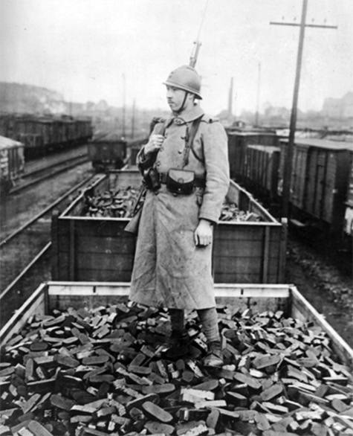
(e) French Occupation of the Ruhr
Germany experienced inflation during WW1 and had borrowed heavily to finance the war effort. When the reparations figure was finalized in 1921 (£6.6 billion at £100 million per year) Ebert argued Germany couldn’t pay. The loss of wealth-generating industrial areas & the loss of taxable population made it worse. Inflation got worse and, after Ebert began to print more & more money to pay France & Belgium reparations, the value of German currency began to plummet. After paying no reparations at all to the Allies in 1922, French troops legitimately entered the Ruhr to seize resources to the value of reparations owed.

Slide 28
(e) French Occupation of the Ruhr
After the invasion on 9th January 1923, rather than respond to demands for reparations with payment, Ebert ordered a policy of ‘passive resistance’. This meant that workers in the Ruhr industries were not mining coal & ore, nor felling trees, for the French troops to seize in lieu of payment. ‘Passive resistance’ also meant there was less income from the Ruhr, so Germany’s inflation problems doubled. Worse still, striking German workers in the Ruhr carried out industrial sabotage and the situation spiraled into violence. 130 German civilians were shot dead by French troops and, as the occupation of the Ruhr continued into 1924, it proved to be a complete disaster for Ebert’s Government.

Slide 29
DATE | EVENT | GERMAN MARKS = US DOLLARS
1914 | Outbreak of WW1 | 4
1919 | German Government prints money to pay Treaty of Versailles reparations | 19
1921 | German Economy suffers – more money printed by Government | 65
1922 | German Government printed more money | 493
Jan. 1923 | Ruhr Invasion – money printed to pay strikers | 17,972
Nov. 1923 | German income lost – so even more money printed | 4.2 billion

Slide 30
(f) Causes & Effects of Hyperinflation
In January 1923, after Ebert printed more & more money, German inflation became hyperinflation. Hyperinflation meant that the value of the German currency dropped while prices shot up. Peoples’ savings in banks were worthless and a monthly pension payment couldn’t buy a coffee. An egg that had once cost ¼ mark in 1918 cost 500 marks in Jan. 1923; 30 million marks by Sept. 1923; and 4 billion marks by Oct. 1923. A loaf of bread also cost 200 billion marks in Nov. 1923. Ebert’s mismanagement of the Ruhr invasion, in an attempt to preserve the German economy, ironically resulted in hyperinflation & humiliation. Ebert was ultimately saved by his new Chancellor.

Slide 31
DATE | COST OF A LOAF OF BREAD
December 1918 | 0.54
December 1921 | 0.39
December 1922 | 163.5
January 1923 | 250
March 1923 | 463
June 1923 | 1,465
July 1923 | 3,465
August 1923 | 69,000
September 1923 | 1,512,000
October 1923 | 1,743,000,000
November 1923 | 201,000,000,000

Slide 32
Effects of Hyperinflation on Germany
SHOP | Nov. 1922 |  | Jan. 1923 |  | Nov. 1923
String
Rulers
Paper
Highlighters
Pencils
Mini Whiteboards
Red Pens
Board Pens
Key Tags
Felt Pens

Slide 33
Exam-Style Question
‘The most important cause of
the hyperinflation crisis was the
French occupation of the Ruhr.’
How far do you agree?
You may include in your answer:
the French occupation of the Ruhr
reparations
You must also include information of your own (16 marks)

Slide 34
Activity 3 – Recall Quiz
Which countries were the Allies in WW1?
On what date did Kaiser Wilhelm II abdicate?
Who was elected as the first President of the new Weimar Republic?
When was the Treaty of Versailles signed?
Who were the leaders of the Spartacists?

Slide 36
Activity 3 – Recall Quiz
Which industrial region was invaded by the French & the Belgians in January 1923?
What name is given to the peaceful opposition that was the German response to the French invasion?
Who paid the strike pay for German workers?
What is Hyperinflation?
Identify one benefit & one problem of hyperinflation.

Slide 38
Activity 4 – Explaining
How did the ‘stab in the back’ myth develop in Germany?
The German Government caused hyperinflation by printing money. Why didn’t they stop printing extra money?
Identify three effects of the hyperinflation crisis in January, 1923.

Slide 40
Activity 5 – Challenge
How far was proportional representation a problem for the new Weimar Republic?
Why were the German people hopeful that the peace settlement of 1919 would be reasonable?
Why were groups like the Freikorps so opposed to the Treaty of Versailles?

