Slide 1
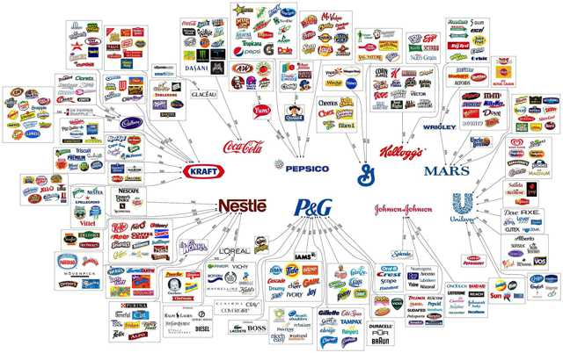
Economies of Scale
To understand how Economies of Scale are achieved and why Diseconomies of Scale set in.

Slide 2
Why do these firms enjoy economies of scale?

Slide 4
Choose one of the following firms (or your own)and explain how it benefits from the 6 forms of internal Economies of Scale. Does it benefit from any of the 4 External Economies of Scale? Write up your findings in a brief presentation with evidence and data to support your answer.

Slide 5
LEGO “Most companies die of indigestion not starvation?” Jørgen Vig Knudstorp
http://www.dailymail.co.uk/home/moslive/article-1234465/When-Lego-lost-head--toy-story-got-happy-ending.html
Read the following article and identify some of the Economies of Scale enjoyed by Lego and the Diseconomies it suffered during the early 2000’s

