Slide 1
Aggregate Demand and Aggregate Supply

Slide 2
In this section we consider the following topics in detail:
Aggregate demand
Aggregate supply
Equilibrium
The Keynesian multiplier
As economists we want to be able to model what is happening in an economy - particularly in the macroeconomy. This enables us to analyse what causes changes in the economy at the macro level and to develop appropriate policies to achieve our macro goals.

Slide 3
In managing a country's economy, governments are usually aiming to:
Maintain high levels of employment or full employment
Maintain price stability - low and consistent levels of inflation
Maintain a satisfactory balance of payments
Maintain high levels of economic growth
There will always be trade-offs between these macroeconomic goals, because it can be difficult to maintain all of them at once; governments will, as a result, face decisions on acceptable levels for each target.

Slide 4
In trying to understand the various macroeconomic problems a country might face, and the policies that its government may adopt in response, it is useful to look at one of the most common theoretical frameworks for analysing the macroeconomy; those of aggregate demand and supply.
These are similar to the concepts of demand and supply
Agregate means 'the sum of', so we are now looking at total demand and supply in the whole economy, instead of demand and supply of goods and services in individual markets.

Slide 5
Difference between Micro and Macro

Slide 6
Aggregate Demand – Why is the curve downward sloping? What makes up Aggregate Demand?
The wealth effect
The interest rate effect
The international trade effect

Slide 7
The Aggregate Demand Curve

Slide 8
General Price Level During the Business Cycle
General Price Level?
General Price Level?
General Price Level?
General Price Level?
General Price Level?
General Price Level?
General Price Level?
General Price Level?

Slide 9
Expansion
Prices are rising at a rate of 2% on all your wealth, depreciate your wealth by 2%
The rate of interest increases from 5% to 10% as more money is demanded (from financial institutions) for both consumers and firms to carry out the same amount of purchases and transactions
As prices continue being more expensive in our economy Exports drop by 30% and imports rise by 30%

Slide 10
Peak
Prices are rising at a rate of 5% on all your wealth, depreciate your wealth by 5%
The rate of interest continues to increases from 10% to 15% as more money is demanded (from financial institutions) for both consumers and firms to carry out the same amount of purchases and transactions
As prices become more expensive in our economy Exports drop by a further 20% and imports rise by 20%

Slide 11
Contraction
Prices are rising at a rate of 1% on all your wealth, depreciate your wealth by 1%
The rate of interest decreases from 7% to 3% as less money is demanded (from financial institutions) by both consumers and firms to carry out the same amount of purchases and transactions
As prices become more expensive in our economy Exports drop by 30% and imports rise by 30%

Slide 12
Trough
Prices are deflating at a rate of 2% on all your wealth, appreciate your wealth by 2%
The rate of interest decreases from 3% to 1% as less money is demanded (from financial institutions) by both consumers and firms to carry out the same amount of purchases and transactions
As prices become cheaper in our economy Exports rise by 30% and imports drop by 30%

Slide 13
Shifts in Aggregate Demand
A rightward shift means that aggregate demand increases
A leftward shift means that aggregate demand decreases

Slide 14
Aggregate Supply
Whereas the AD curve is accepted by all economists the…
Aggregate Supply is a hotly debated topic among economists:
Most of the disagreements focus on the shape of the aggregate supply curve
We will study 3 Aggregate Supply curves in this topic

Slide 15
Aggregate Supply in the Short Term

Slide 16
Neo-Classical long-run Aggregate Supply

Slide 17
Keynesian long-run aggregate supply

Slide 18
Movements and shifts in the SRAS

Slide 19
The Long Run Aggregate Supply Curves LRAS
Intro:
Today we will analyze the ‘Neo-classical’ Long Run Aggregate Supply Curve (LRAS).
Remember the definition of the short run and the long run in macroeconomics?
We will look at the monetarist/neo-classical view of the LRAS curve.
We will consider why they believe it works like it does.
Why does it Matter or WALT?
Firstly the shape of the LRAS curve is a source of massive controversy between different schools of economics
Governments and Politicians place huge importance on these schools of economics in their handling of the economy and the 5 Macro-economic objectives

Slide 20
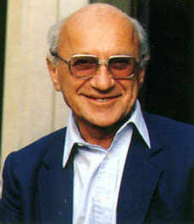
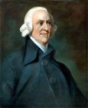
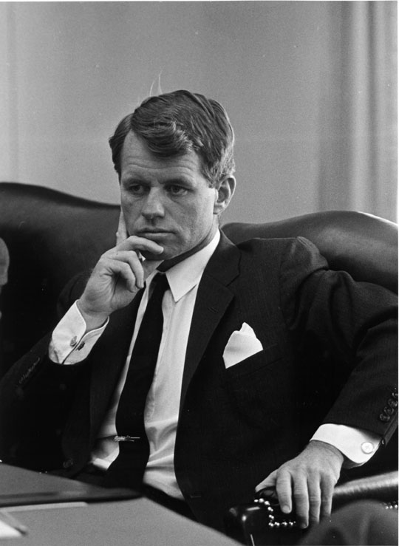
facebook
Wall
Photos
Flair
Boxes
John F. Kennedy
Logout
Milton Friedman staring as myself in the movie ‘Free to Choose’, no autographs pls x x x
Wall
Info
Photos
Boxes
Write something…
Share
View photos of Milton (8654)
Send Milton a message
Milton Friedman just got awarded the Nobel Prize award in Economic Science lmao xo
October 14, 1976
Poke message
Milton Friedman just blocked John Maynard Keynes :@
October 1, 1963
Friedrich Hayek likes this
Information
Education:
Rutgers University
University of Chicago
Birthday:
July 31, 1912
Political:
Democrat
Hometown:
Brooklyn NY.
Interests and views:
Explaining the principles of the Free Market
There is a close and stable link between inflation and the money supply
Rejects the use of fiscal policy as a took of demand management
Decimalization of drugs and prostitution
Favorite books
Capitalism and Freedom, A Monetary History of the United States, Free to Choose, Bright Promises, Dismal Performance, Tyranny of the Status Quo, Two Lucky People
Dislikes
Government spending
Friends
Adam
Frank
Marilyn
Bobby
Jackie
Robert

Slide 21
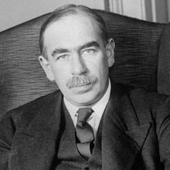
facebook
Wall
Photos
Flair
Boxes
John F. Kennedy
Logout
John Maynard Keynes
Wall
Info
Photos
Boxes
Write something…
Beginning to dislike; M.F and F.H. Like if you know who I’m talking about ;)
Share
View photos of JMK (905)
Send JMK a message
John Maynard Keynes just published a book ‘The General Theory of Employment
July 7, 1936
Poke message
Fredriech Hayak tagged John in a photo
July 1, 1933
Information
Networks:
Kings College
University of Cambridge
Eton College
Birthday:
June 5, 1883
Political:
Liberal
Hometown:
Cambridge, United Kingdom.
Keynesian economics is a theory of total spending in the economy (called aggregate demand) and its effects on output and inflation. Although the term has been used to describe many things over the years, six principal tenets seem central to Keynesianism. Everybody should buy their way out of recession!
Friends
Otto
Frank
Marilyn
Bobby
Jackie
Robert

Slide 22
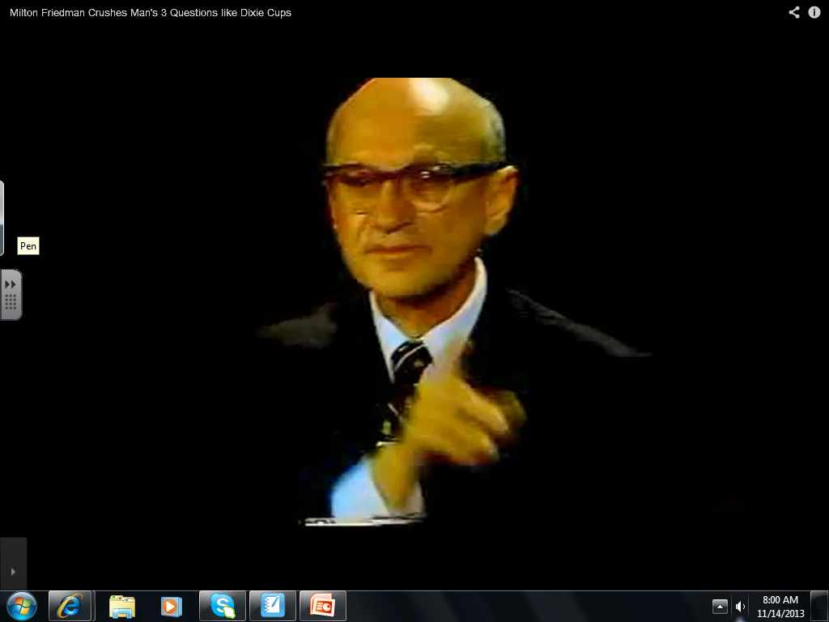
The Monetarist View - Government Spending, the reallocation of resources general levels of taxation and price levels

Slide 23
Keynesianism
“In the long term we are all Dead “ A quote attributed to John Maynard Keynes
Labour prices are ‘sticky’, this means that the neo-classical/monetarist view is false..
Think about why labour prices are sticky?
Are goods and services in the product markets also sticky?
Government intervention can and should be used to stimulate and create Aggregate Demand in the economy

Slide 24
The Keynesian Model

Slide 26
Section 1
There is still spare capacity in all parts of the Resources markets

Slide 27
Section 2
The capacity is being used in all parts of the Resources markets

Slide 28
Section 3
All FOP’s are employed and therefore any further increases in the components of AD or Injections into the circular flow will only increase the PL and cause inflation

Slide 29
Shifts in the Aggregate Supply Curve over the Long Term
Aggregate supply changes
Many economists argue that the LRAS curve is vertical, which means that any increase in AD will lead to an increase in prices. They feel that a time lag exists between the level of demand increasing and the supply sector of the economy being able to expand to meet this. They argue that only through increases in LRAS will such rises in AD be met without inflationary pressures.
Supply-side policies may enable the economy to expand in a non-inflationary way, as shown in Figure 1 below.

Slide 30
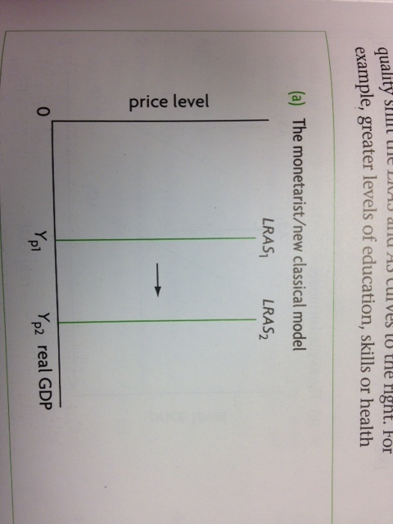
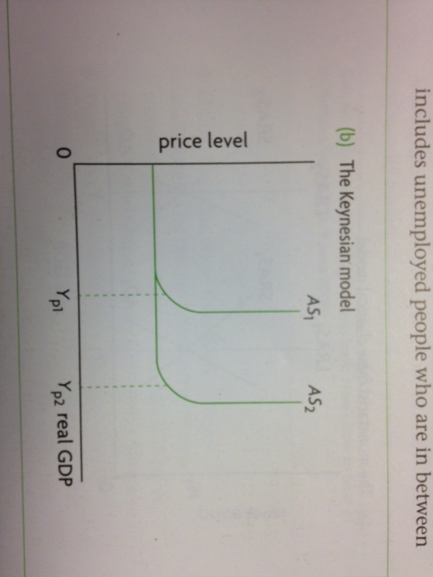
So far we have considered the LRAS and Keynesian AS curves as fixed. Yet over time, these curves can shift to the left or right…

Slide 31
Each of the curves represent a particular level of potential output, which is the total quantity of goods and services produced by an economy when there is ‘full employment’ of resources

Slide 32
An increase in potential output signifies economic growth over the long-term; a decrease signifies negative growth or fall in real output

Slide 33
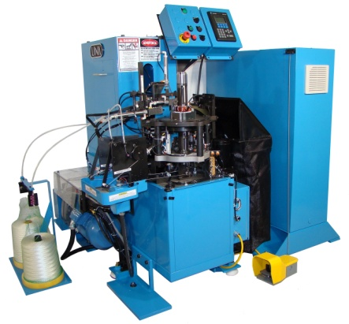
So what are the factors that change aggregate supply over the long term…?
Increase in the quantities of the factors of production

Slide 34
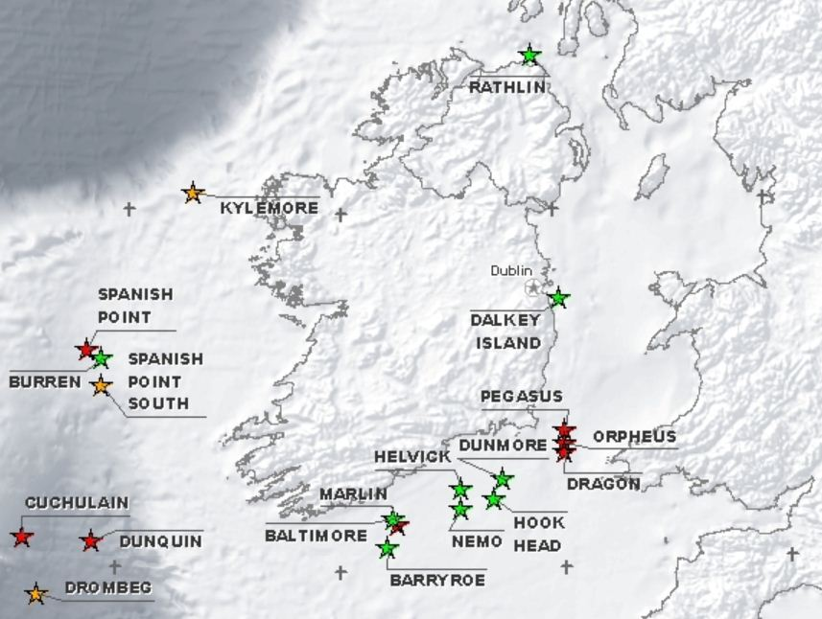
Migration from Romania
Current Irish Oil Exploration

Slide 35
Improvements in the quality of the factors of production
Education and training
More efficient extraction methods for minerals
Investment in more technology

Slide 36
Improvements in technology

Slide 37
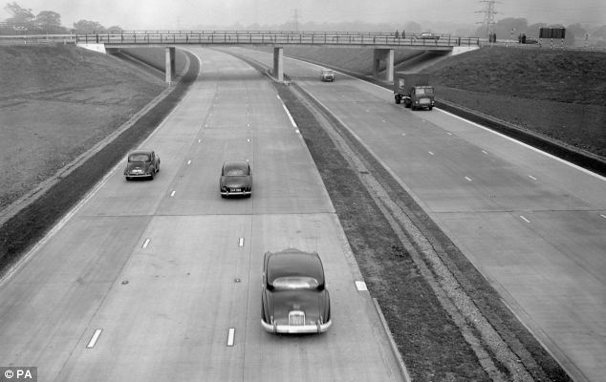
Increases in efficiency

Slide 38
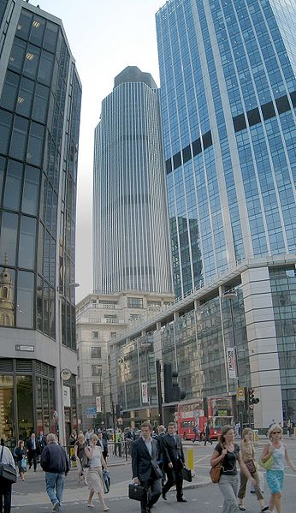
Institutional changes
Government changes to the law
De-regulation of financial markets
Eg. The 1980’s ‘Big Bang’ or the deregulation of the financial services industry that occurred in the City of London.

Slide 39
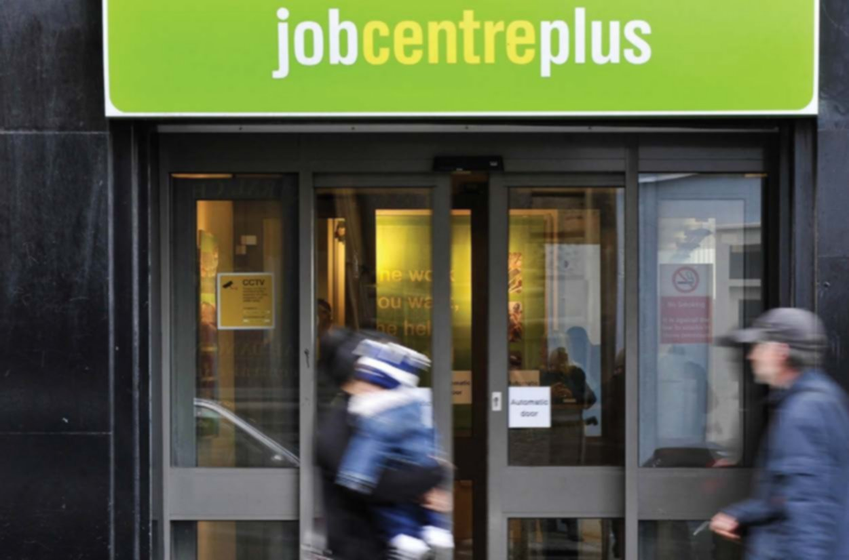
Reductions in the natural rate of unemployment

Slide 40
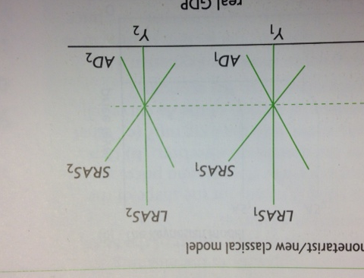
Long term growth versus short term economic fluctuations

Slide 41
Long term growth versus short term economic fluctuations
All the factors above, affecting the LRAS and Keynesian AS curve, usually need an extended period of time, I.e. the long term
Over long periods of time most economies experience positive growth

Slide 42
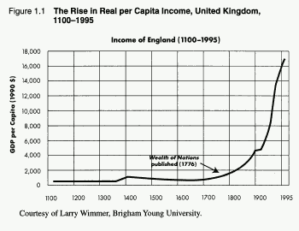
Long term growth versus short term economic fluctuations
Over long periods of time most economies experience positive growth

Slide 45
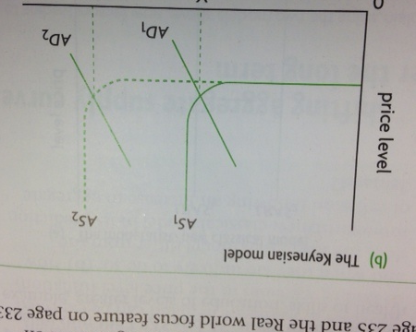

Slide 46
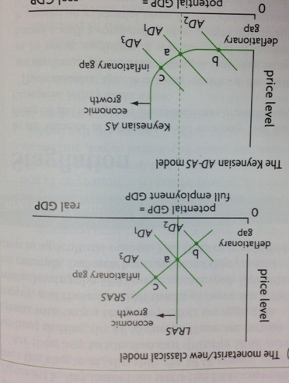

Slide 48
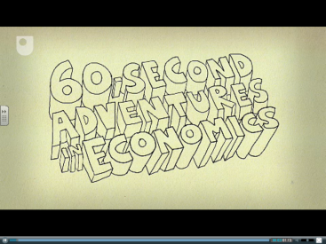
TOK
Why are there different approaches to the cause of and solutions to ‘Boom and Bust’ Economics?
Watch these two different clips and make a list of the Normative and Positive claims that are made by Neo-classical Economists (such as Hayek) and Keynesian Economists (E.G. those that follow the ideas of JM Keynes)

Slide 49
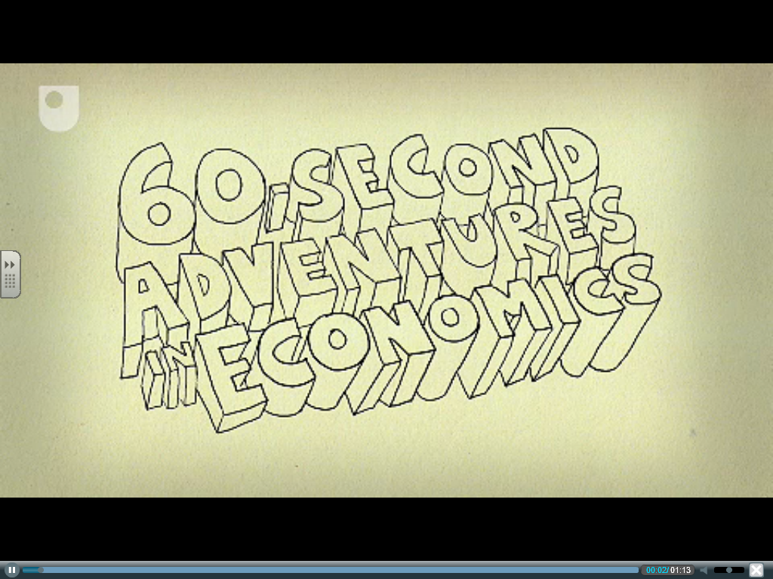

Slide 50
Keynes V Hayek

Slide 51
TOK Questions to Answer
1.) Do you agree with Solow that it is very likely that personal judgments influence economists choices between alternative theories (the choice of analytical framework) Give examples..
2.) Is the effective use of the scientific method influenced by economists’ personal beliefs and ideologies?
3.) Do the social sciences, and economics in particular, differ from the natural sciences by having political beliefs and ideologies influence thinking?
4.) What kind of political beliefs and ideologies do you think are linked with (a) monetarist/neo-classical perspective, and (b) the Keynesian perspective?

Slide 52
Battle of the Century
Now that you understand the radically different approaches to analysing the macroeconomy. It is time to create your own viral video!
In groups of no more than 3 (one less than 4 and 1 more than 2)
Create a video that explains in detail the underlying differences

Slide 53
Here are ideas that should be included…
Biographical information about Keynes and Hayek, use the money matters documentary information
Analyse the assumptions and implications of both economic models
Explain the consequences for policy makers of these two radically different approaches

Slide 54
Form
Use of analogy
Humor (YES THERE ARE SUCH THINGS AS ECONOMIC JOKES)
We have LEGO, one group can complete a stop motion animation, you will need to know how to do this YOURSELVES and have the software
Should be 3-4 minutes long
Contain Economic Diagrams

Slide 55
Macroeconomic objectives - introduction
In this section, we consider the following sub-topics in detail:
Low unemployment
Low and stable rate of inflation
Economic growth
Equity in the distribution of income
Government macroeconomic policy aims to achieve a number of macroeconomic objectives.
The major objectives usually targeted by all governments include maintaining or creating:
low levels of unemployment or perhaps full employment
price stability - low and stable rates of inflation
a satisfactory balance of payments
high levels of economic growth
a satisfactory distribution of income

Slide 56
http://www.youtube.com/watch?v=CNvKmlvacNk&feature=related

Slide 57
Macroeconomic Objectives 1: Low Unemployment, Low and Stable Rates of Inflation
1.) Define the term ‘Unemployment’?
http://datacatalog.worldbank.org/
Describe the data you have plotted focusing on short term patterns, long term trends, and relationships between variables.
Repeat the exercise for two other countries from different continents.
Identify similarities and differences between the three sets of unemployment data.
Analyse the factors that might account for the similarities and differences you have identified. (You may want to revisit this answer once you have completed this section).

Slide 59
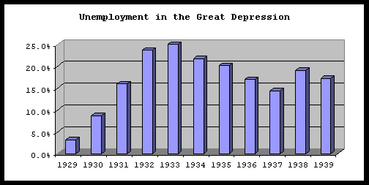
The Depression Era USA

Slide 60
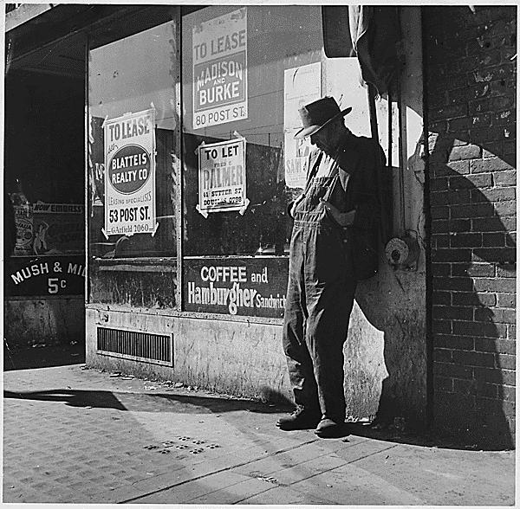

Slide 61
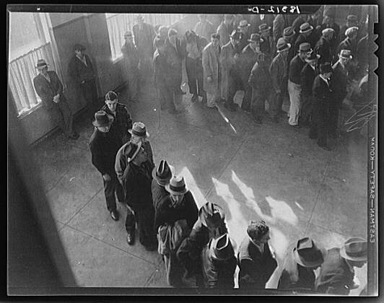

Slide 62
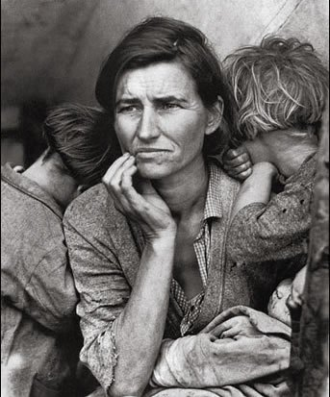

Slide 63
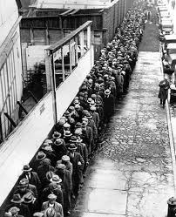

Slide 64
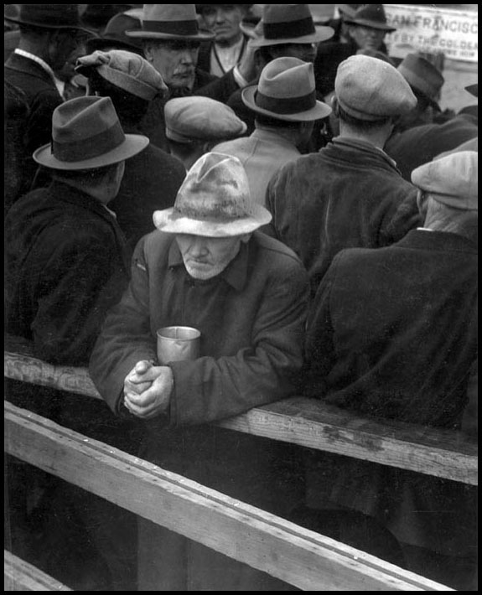

Slide 65
Unemployment
To understand and define the different types of unemployment
Discuss possible personal and social consequences of unemployment, including increased crime rates, increased stress levels, increased indebtedness, homelessness and family breakdown.
Describe, using examples, the meaning of frictional, structural, seasonal and cyclical (demand-deficient) unemployment.

Slide 66
Low Unemployment
There will always be trade-offs between different macroeconomic objectives as it can be difficult to satisfy all of them at once.
So governments will face decisions on acceptable levels for each target.
The trade-off is particularly apparent, between reducing unemployment and achieving stable price levels.

Slide 67
Governments perceive high unemployment as a waste of resources; the economy is operating within its production possibility boundary and as a result could potentially produce a more goods and services.
However, the government is aware that stimulating an economy to lower unemployment can cause inflation, which is undesirable because it makes a country less competitive and is destabilising.

Slide 68
We often tend to look at unemployment and inflation together because if one target is hit, the other may be missed.
If economic growth is healthy, this may help keep unemployment low, but it may also add to inflationary pressures.
If the government 'cools' the economy to reduce inflation using fiscal and/or monetary policy, increased unemployment may be the result.

Slide 69
What are the causes of Unemployment?
The causes can be categorized as:
Structural unemployment:
Changes in demand for particular labour skills
Changes in the Geographical location of jobs
Labour Market Rigidities
Frictional Unemployment
Seasonal Unemployment
Cyclical (demand deficient Unemployment)

Slide 70
Structural Unemployment
Changes in demand for particular labour skills, examples include:
Welsh Valleys after the end of coal mining
London Docklands following containerisation
Textile workers following closure of Textile Mills

Slide 71
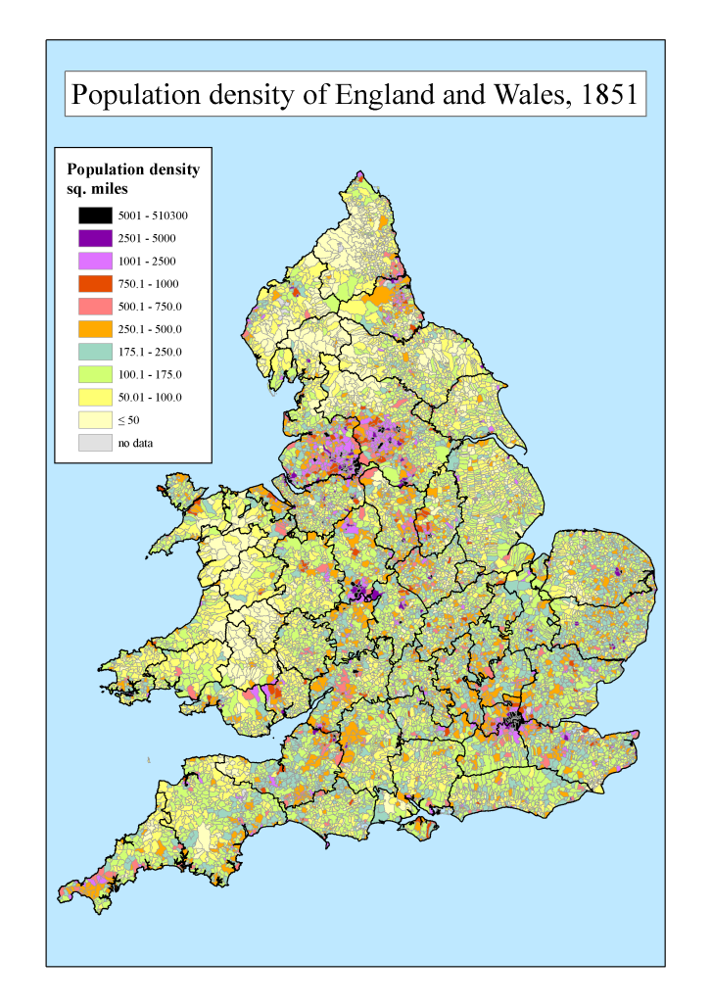
Changes in the Geographical location of jobs:
Some regions may be particularly badly affected by unemployment when an industry relocates, for example to a foreign country:
Ship building on the Clyde in Scotland
Steel Production in Sheffield

Slide 72
Labour Market Rigidities Due to:
Minimum wage legislation
Labour Union Activities
Employment Protection Laws
Generous Unemployment Benefits

Slide 73
Calculating Unemployment
Lesson Objective: To understand some of the problems of calculating unemployment from the official statistics
The labour force is defined as the number of people who are employed (working) plus the number of people of working age who are unemployed (not working but seeking work)
The labour force is actually a fraction of the total population of a country, because it excludes children, retired persons, adult students, all people who cannot work because of illness or disability
Unemployment is usually measured as a number or as a percentage
Unemployment rate is expressed as a percentage
Unemployment rate = number of unemployed/ Labour Force X 100

Slide 74
Example - HL
The labour force of the Armania Republic in 2011 was 2.95 Million
Of which 182,900 individuals were without a job but actively seeking one.
Calculate the unemployment rate

Slide 75
Difficulties in Measuring Unemployment
The unemployment rate is one of the most widely reported measures of economic activity, used extensively as an indicator of economic performance
Official Statistics often underestimate true unemployment because of hidden unemployment

Slide 76
Hidden Unemployment
Discouraged Workers, those that wanted employment but have given up
Unemployment figures do not make a distinction between full time and part-time jobs
Unemployment figures make no distinction between the type of work done
Does not include people on retraining programs who previously lost their jobs
Early retirement
Further official statistics do not include people working in the underground economy

Slide 77
Disadvantages of the national unemployment rate
Region
Gender
Ethnic group
Age
Occupation and educational attainment

Slide 78
HW Questions
1.) Explain why unemployment figures are not usually accurate.
Hidden Unemployment, including:
Discouraged workers
No distinction between full time and part time workers
Type of work done, in other words underemployment of a skill
Does not include people on retraining programs
The underground economy (if you like ‘hidden employment’)
2.) Identify some of the economic and social consequences of unemployment.
Economic consequences:
A loss of real output (real GDP)
A loss of income for employed workers
A loss of tax revenue for the government
Costs to the government of lost tax revenue
Costs to the government of unemployment benefit
Costs of dealing with the social problems
More unethical distribution of wealth
Unemployed find it harder to find work in the future

Slide 79
Personal and social consequences
Personal problems
Greater social problems

Slide 80
Cyclical (demand-deficient) unemployment
Occurs during the downturns of the business cycle
Arises from low or declining aggregate demand (AD)
As Real GDP falls due to a fall in AD, unemployment increases because firms lay off workers.
In the upturn of the business cycle, as Real GDP increases, the recessionary gap becomes smaller and cyclical unemployment falls
When the economy produces real GDP at the level of potential output, there is no longer any cyclical unemployment

Slide 81
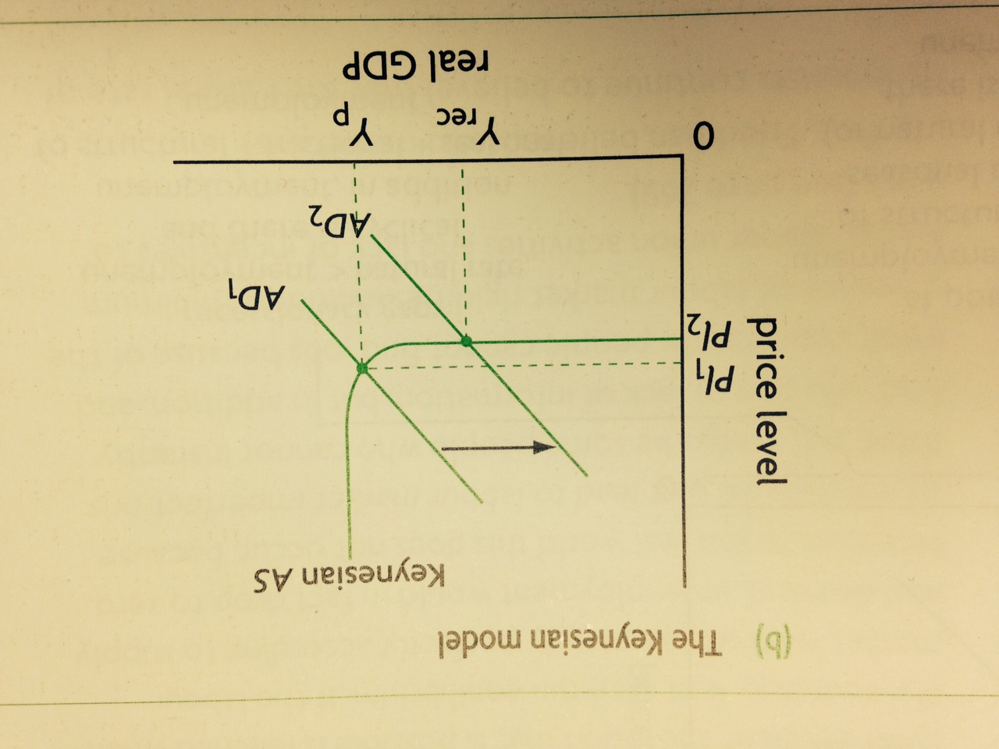
The Keynesian Model

Slide 82
The Neo-classical/Monetarist

Slide 83
The Four Types of unemployment in relation to the AD-AS model

Slide 84
Solutions to unemployment…
Barely touched upon up to now…
Something for a later date
However we can make this quick point now:
Frictional, seasonal and structural unemployment are essentially problems of the supply of labour (inadequate skills within the labour force, skills mismatches,
Cyclical unemployment is a problem of demand (that means to say a lack of demand in the economy).
Needless to say two very different sets of solutions are required to deal with the two types of unemployment.

