Slide 1
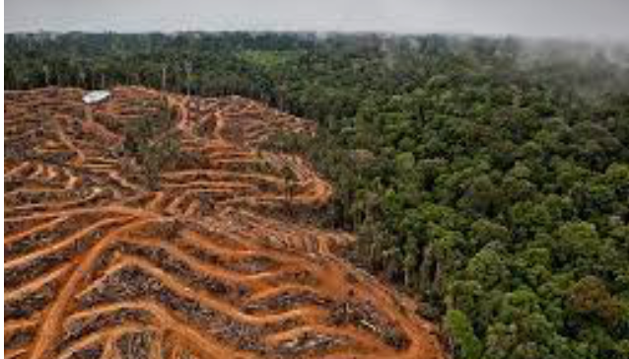
Economic Development and Climate change
What: The impact of global economic development on the Global Commons, including rainforest removal, biodiversity loss and ocean pollution. Why: To investigate the concept of the Global Commons. To recognise the main areas of concern. ​

Slide 2
Starter
Decide where you stand on the decision line in relation to the statement. Be prepared to justify!
Yes
Maybe
“All development in the Rainforest should be stopped”
No
Yes!
Maybe?
No!
Why is it the best way?
What are the most influential reasons?
What should we worry most about?
What is making you unsure?
What would it take for you to make a decision?
What are both sides of the argument?
Why not?
What is a better way?
Which negatives particularly outweigh the positives?
What are the advantages of development in the tropical rainforest?
What are the disadvantages of development in the tropical rainforest?
What are the conditions like in the tropical rainforest?
What examples can you use to illustrate the advantages and disadvantages?
How can you decide?

Slide 3
Organise the following into ‘goods’ and ‘services’
They give us a wide range of natural resources we can harvest, collect or capture to sell and to make money from.
Water and nutrient cycling
Building materials (timber)
Medicines
Air purification (absorbing CO₂)
Protection against soil erosion
Energy from HEP
Employment opportunities
Fish and shellfish
Building materials (timber)
Wildlife habitats
Native food crops (fruit & nuts)
Wild meat and fish
Biodiversity
Water

Slide 4
GOODS
SERVICES
Energy from HEP
Air purification (absorbing CO₂)
Biodiversity
Medicines
Protection against soil erosion
Wild meat and fish
Employment opportunities
Building materials (timber)
Fish and shellfish
Water and nutrient cycling
Wildlife habitats
Native food crops (fruit & nuts)
Water

Slide 5
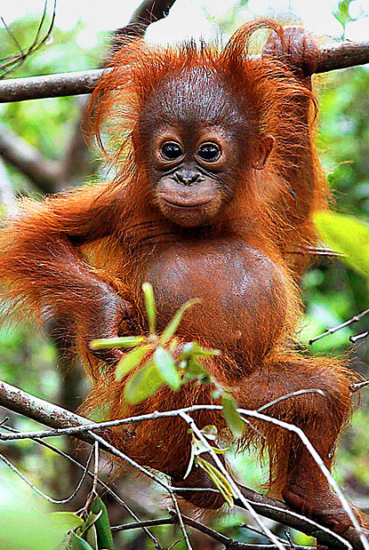
How are all of these things linked?

Slide 6
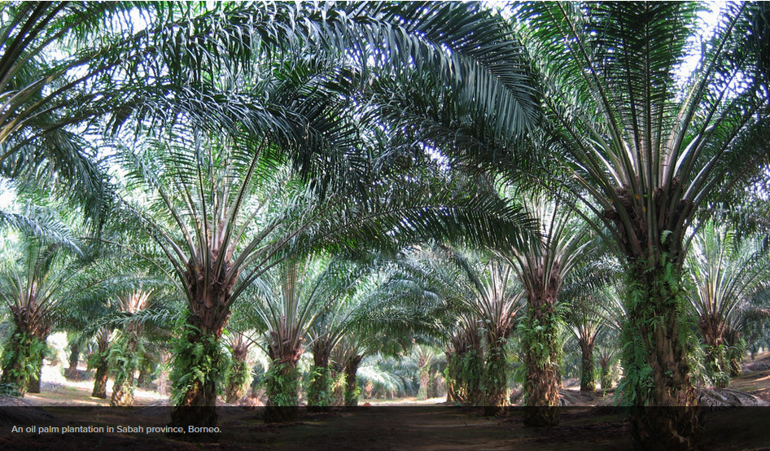
Palm Oil

Slide 7
CASE STUDY - PALM OIL IN Borneo
https://www.youtube.com/watch?v=0o6WHN4NDTk

Slide 8
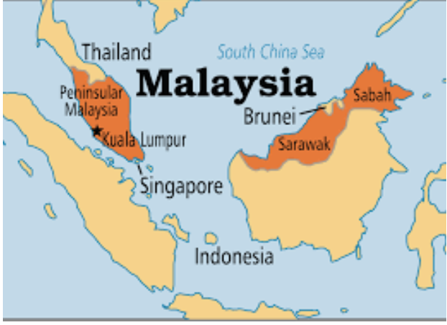
It is a country in South East Asia
The natural vegetation in Malaysia is tropical rainforest
67% of Malaysia's land is covered by rainforest

Slide 11
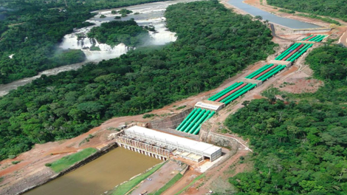
Other reasons for deforestation in Borneo
Population pressures
Road building
Mining
HEP
Logging

Slide 12
Impacts of deforestation on the Malaysian rainforest

Slide 13
Reducing the costs
Pressure groups People who come together with the aim of influencing others, or the government about a particular issue.
Research what pressure groups, like Greenpeace are doing to try and protect the environment

Slide 14
